Slide 1
CRMA: Collision Resistant Multiple Access
Lili Qiu
University of Texas at Austin
Joint work with
Tianji Li, Mi Kyung Han, Apurv Bhartia,
Eric Rozner, Yin Zhang, Brad Zarikoff
ACM MobiCom 2011

Slide 2
Motivation
Traditional MAC protocols avoid collisions
FDMA, TDMA, FTDMA, CSMA, …
Avoid collisions ➔ large overhead
FDMA: unoccupied channel and guard band
TDMA: global coordination and centralized scheduling
CSMA: carrier sense overhead, hidden terminals, exposed terminals
1500-byte frame: 29% for 802.11a (54Mbps) and 72% for 802.11n (600Mbps)
TCP ACK: 77% overhead for 802.11a and 83% overhead for 802.11n
…

Slide 3
Collision Avoidance ➔ Collision Resistance
Let collisions happen naturally and decode collisions
Notes:
1) The goal of this work is to go from collision avoidance to collision resistance.
2) Instead of trying to avoid collisions, we let collisions happen naturally.
3) Whenever a collision occurs, instead of treating them as useless transmission, we try to decode collisions.

Slide 4
Our Contributions
New encoding/decoding to allow multiple signals transmitted on the same channel
Collision resistant medium access protocol (CRMA) based on the encoding/decoding
Evaluation to show CRMA is a promising direction for spectrum sharing

Slide 5
CRMA: An Illustrating Example
S1
R1
Channel 1
Channel 2
R2
S2
Randomly pick a channel?
- 50% collisions!
Coordinate to avoid using the same channel?
Large overhead specially for lots of dynamic flows
Notes:
Consider two flows: one from node A to node B and the other from node C to node D. There are two channels.
How should these two flows transmit?
If we let them independently pick a channel to transmit, they will collide 50% of time. Or we have to pay for the coordination/carrier sense overhead to make sure they don’t transmit on the same channel at the same time.
Can we do better?

Slide 6
CRMA: An Illustrating Example
Frame 1
S1
R1
Channel 1
Frame 2
Channel 2
S2
R2
Frame 1
Frame 2
$$R\left(1\right)=h\left(1,1\right)×c\left(1,1\right)×x1+h\left(1,2\right)×c\left(1,2\right)×x2$$
$$R\left(2\right)=h\left(2,1\right)×c\left(2,1\right)×x1+h\left(2,1\right)×c\left(2,2\right)×x2$$
Notes:
In CRMA, we let each flow randomly pick a few channels to transmit. In this case, both flows transmit on the two channels.
The signals transmitted on the same channel naturally add up in the air.
What the receiver received on the channel 1 is the sum of the signal transmitted by the first flow scaled by its channel coefficient and its code and the signal transmitted by the second flow scaled by its channel coefficient and its code.
Similarly on channel 2.
If receiver knows about the code and channel coefficient, it can construct a simple linear system R=Ax, where x denotes the unknown signal. It can solve for the unknown signals based on the two constraints it gets from the received signals.

Slide 7

CRMA: An Illustrating Example
Frame 1
S1
R1
Channel 1
Frame 2
Channel 2
S2
R2
Frame 1
Frame 2
$$R=Ax$$

Slide 8
CRMA: Research Questions
Frame 1
A
B
Channel 1
Frame 2
Channel 2
Frame 1
C
D
Frame 2
$$R\left(1\right)=h\left(1,1\right)×c\left(1,1\right)×x1+h\left(1,2\right)×c\left(1,1\right)×x2$$
$$R\left(2\right)=h\left(2,1\right)×c\left(2,1\right)×x1+h\left(2,1\right)×c\left(2,2\right)×x2$$

Slide 9
CRMA: Research Questions
Frame 1
A
B
Channel 1
Frame 2
Channel 2
Frame 1
C
D
Frame 2
$$R\left(1\right)=h\left(1,1\right)×c\left(1,1\right)×x1+h\left(1,2\right)×c\left(1,1\right)×x2$$
$$R\left(2\right)=h\left(2,1\right)×c\left(2,1\right)×x1+h\left(2,1\right)×c\left(2,2\right)×x2$$
What is the code c?
How do the sender and receiver agree on the code?

Slide 10
CRMA: Research Questions
Frame 1
A
B
Channel 1
Frame 2
Channel 2
Frame 1
C
D
Frame 2
$$R\left(1\right)=h\left(1,1\right)×c\left(1,1\right)×x1+h\left(1,2\right)×c\left(1,1\right)×x2$$
$$R\left(2\right)=h\left(2,1\right)×c\left(2,1\right)×x1+h\left(2,1\right)×c\left(2,2\right)×x2$$
- What is the code c?
How do the sender and receiver agree on the code?
How to decode transmissions?
How to handle decoding failures?
How to decode misaligned collisions?
How to limit # transmissions in a collision?
How to enhance spectrum utilization?

Slide 11
CRMA
What is the code c?
How do the sender and receiver agree on the code?
How to decode transmissions?
How to handle decoding failures?
How to decode misaligned collisions?
How to limit # transmissions in a collision?
How to enhance spectrum utilization?
Notes:
I will describe CRMA by answering each of these questions in turn.

Slide 12
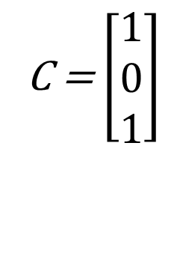
Code Selection
We use a binary code for simplicity
C(i,f)=1 if transmitter i uses channel f, otherwise 0
Channel 1
Channel 2
Channel 3
C = $\left[\begin{aligned}1 \\ 0 \\ 1\end{aligned}\right]$

Slide 13
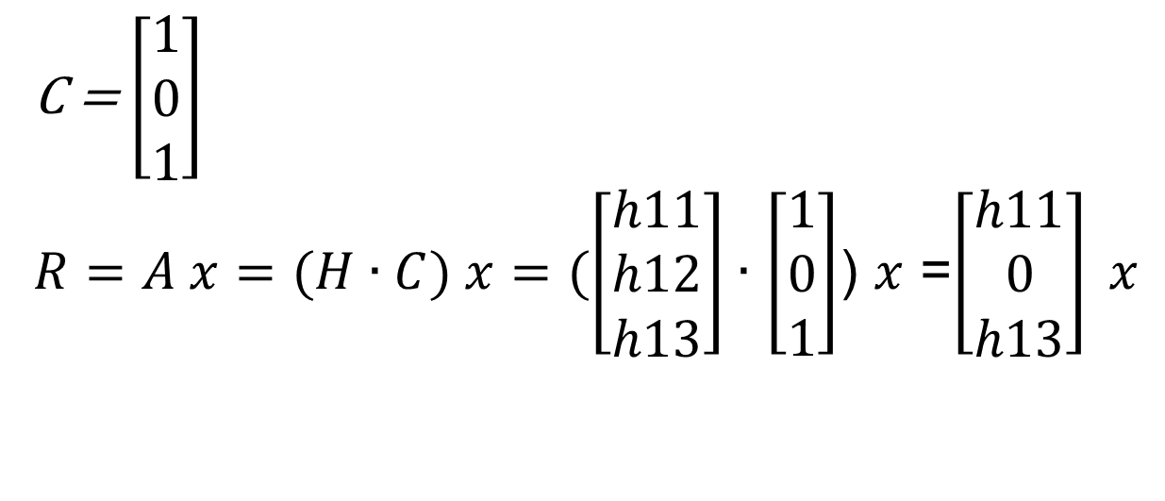
Code Selection
We use a binary code for simplicity
C(i,f)=1 if transmitter i uses channel f, otherwise 0
Channel 1
Channel 2
Channel 3
C = $\left[\begin{aligned}1 \\ 0 \\ 1\end{aligned}\right]$
$R=A x=(H∙C) x=(\left[\begin{aligned}h11 \\ h12 \\ h13\end{aligned}\right]∙$ $\left[\begin{aligned}1 \\ 0 \\ 1\end{aligned}\right]$) $x$ =$\left[\begin{aligned}h11 \\ 0 \\ h13\end{aligned}\right] x$

Slide 14
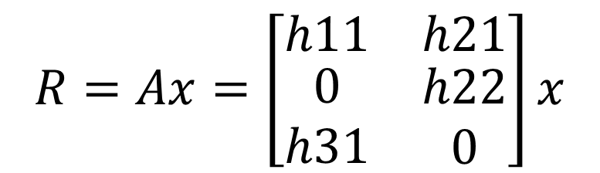
Code Selection
We use a binary code
c(i,f)=1 if transmitter i uses channel f, otherwise 0
Channel 1
Channel 2
Channel 3
$$R=Ax=\left[\begin{matrix}h11 & h21 \\ \begin{aligned}0 \\ h31\end{aligned} & \begin{aligned}h22 \\ 0\end{aligned}\end{matrix}\right]x$$

Slide 15
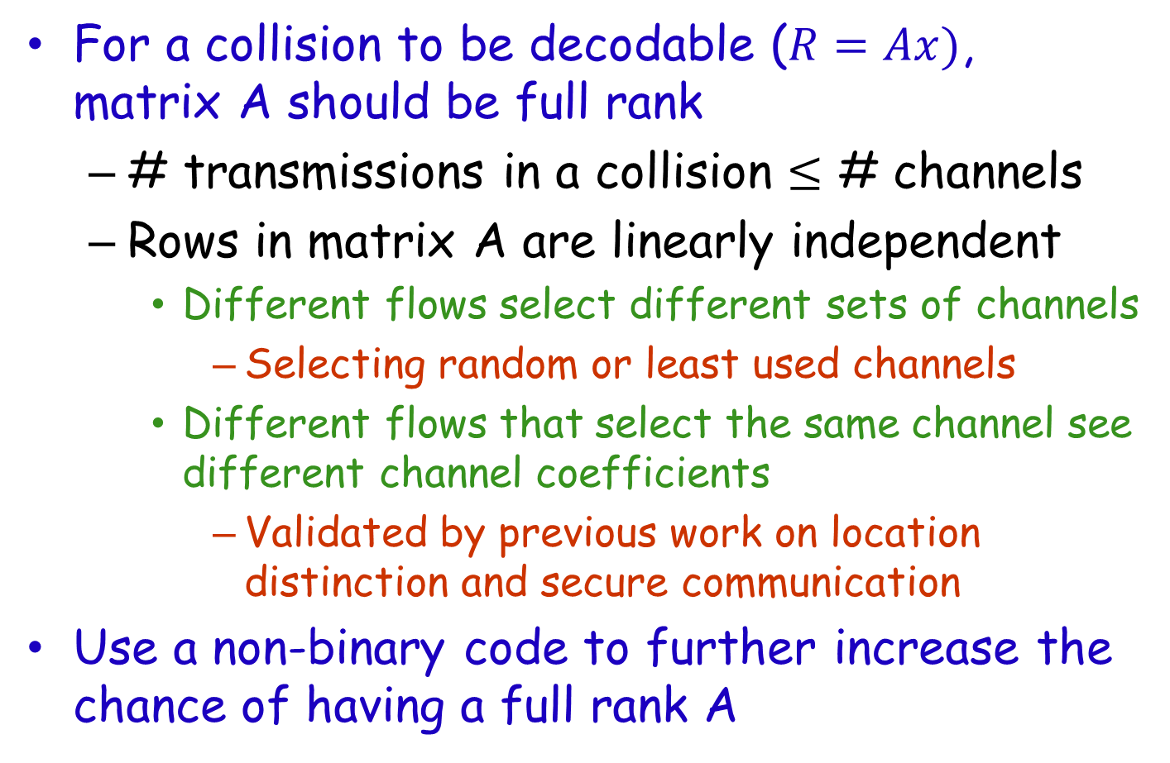
Code Selection (Cont.)
For a collision to be decodable ($R=Ax)$, matrix A should be full rank
# transmissions in a collision $≤$ # channels
Rows in matrix A are linearly independent
Different flows select different sets of channels
Selecting random or least used channels
Different flows that select the same channel see different channel coefficients
Validated by previous work on location distinction and secure communication
Use a non-binary code to further increase the chance of having a full rank A

Slide 16
CRMA
What is the code c?
How do the sender and receiver agree on the code?
How to decode transmissions?
How to handle decoding failures?
How to decode misaligned collisions?
How to limit # transmissions in a collision?
How to enhance spectrum utilization?

Slide 17
Code Establishment
Using control channel
The sender and receiver negotiate the code on a separate control channel
In band notification
Each frame has two PN sequences to denote sender and receiver IDs
A receiver correlates the received signal
with its ID to determine if the frame is destined to itself
with senders’ IDs to determine who send traffic
Correlation is close to 0 except when perfectly aligned with the IDs ⬅ works under collisions!
In-band processing but no need for control channel

Slide 18
CRMA
What is the code c?
How do the sender and receiver agree on the code?
How to decode transmissions?
How to handle decoding failures?
How to decode misaligned collisions?
How to limit # transmissions in a collision?
How to enhance spectrum utilization?

Slide 19
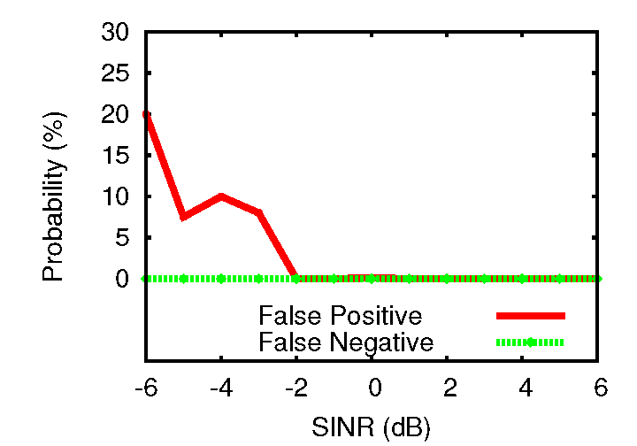
Decoding Transmissions
Detect frame arrival and departure
Correlate the received signal with the preamble and postamble
Correlation is close to 0 except when perfectly aligned with preamble or postamble
Accurate preamble detection (e.g., false positive and false negative ratios are 0 when SINR=-2).

Slide 20
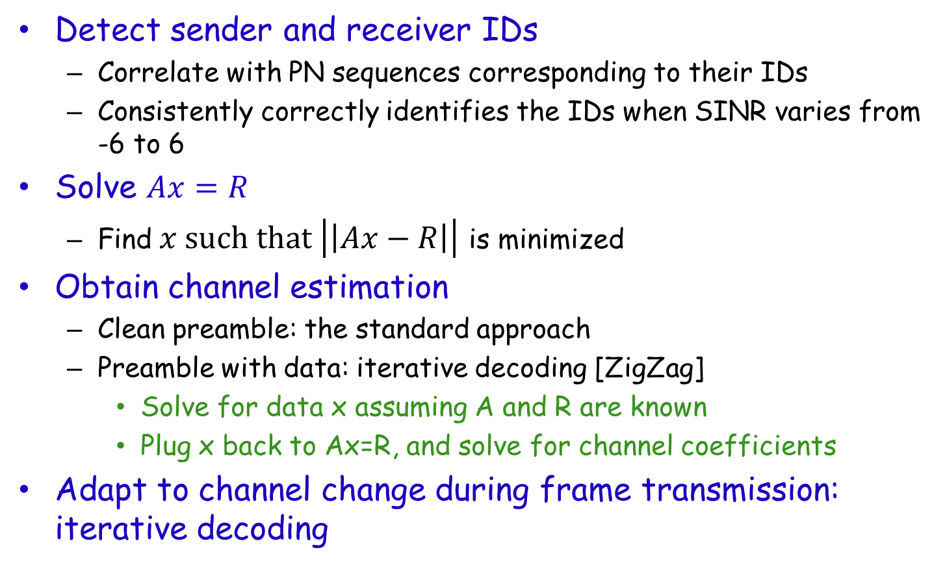
Decoding Transmissions (Cont.)
Detect sender and receiver IDs
Correlate with PN sequences corresponding to their IDs
Consistently correctly identifies the IDs when SINR varies from -6 to 6
Solve $Ax=R$
Find$x such that \left|\left|Ax−R\right|\right|$ is minimized
Obtain channel estimation
Clean preamble: the standard approach
Preamble with data: iterative decoding [ZigZag]
Solve for data x assuming A and R are known
Plug x back to Ax=R, and solve for channel coefficients
Adapt to channel change during frame transmission: iterative decoding
Notes:
Iterative decoding allows us to not only update channel estimates using preamble but also track the channel change in the middle of a frame transmission

Slide 21
Handling Decoding Failures
Use ACKs and retransmissions to enhance reliability
ACKs are sent in the same way as data frames
Receiver sends an ACK on the same set of selected channels
Sender decodes the ACK by solving a linear system (as decoding data frame)

Slide 22
Problem of Misaligned Collisions
FFT window
Symbol 1
Symbol 2

Slide 23
Handling Misaligned Collisions
Cyclic prefix (CP) allows collided symbols fall in the same FFT window
FTT window
Symbol _{i-1}
CP_{i}
Symbol _{i-1}
CP_{i+1}
Symbol _{i+1}
CP_{i-1}
CP_{i-1}
Symbol _{i-1}
CP_{i}
Symbol _{i-1}
CP_{i+1}
Symbol _{i+1}
offset

Slide 24
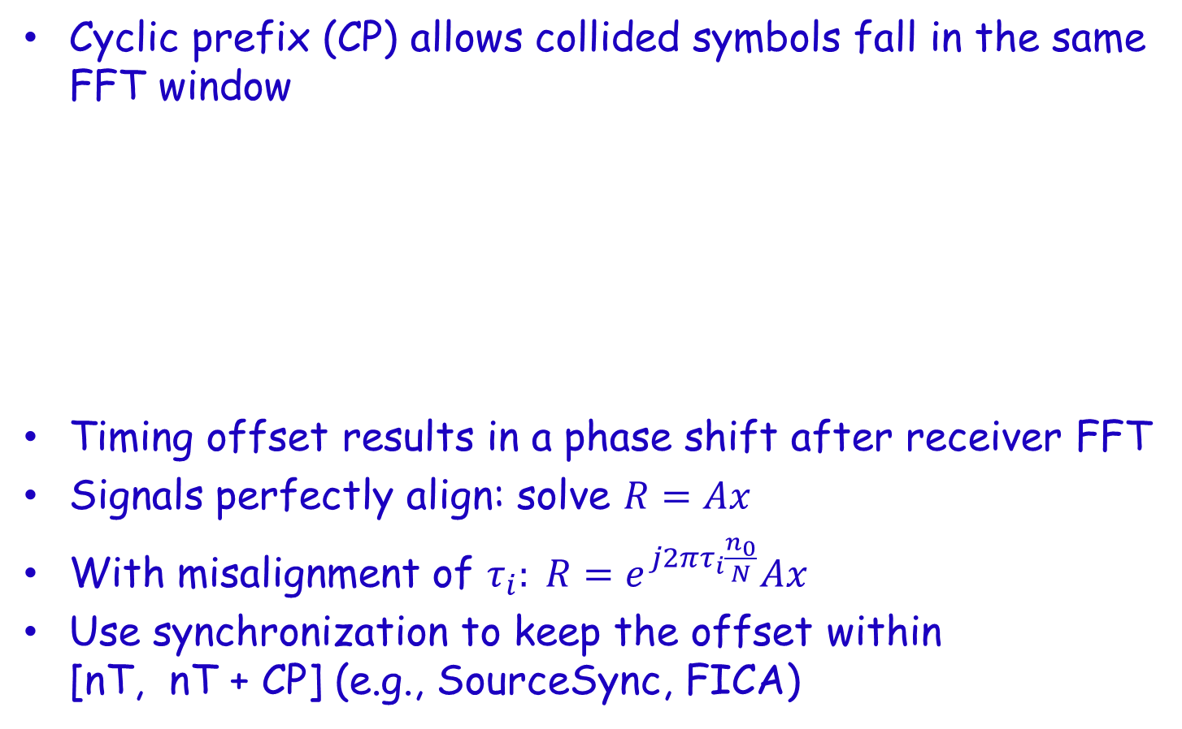
Handling Misaligned Collisions
Cyclic prefix (CP) allows collided symbols fall in the same FFT window
Timing offset results in a phase shift after receiver FFT
Signals perfectly align: solve $R=Ax$
With misalignment of $τ_{i}: R=e^{j2πτ_{i}\frac{n_{0}}{N}}Ax$
Use synchronization to keep the offset within [nT, nT + CP] (e.g., SourceSync, FICA)
same
FTT window
CP_{i-1}
Symbol _{i-1}
CP_{i}
Symbol _{i-1}
CP_{i+1}
Symbol _{i+1}
CP_{i-1}
Symbol _{i-1}
CP_{i}
Symbol _{i-1}
CP_{i+1}
Symbol _{i+1}
offset

Slide 25
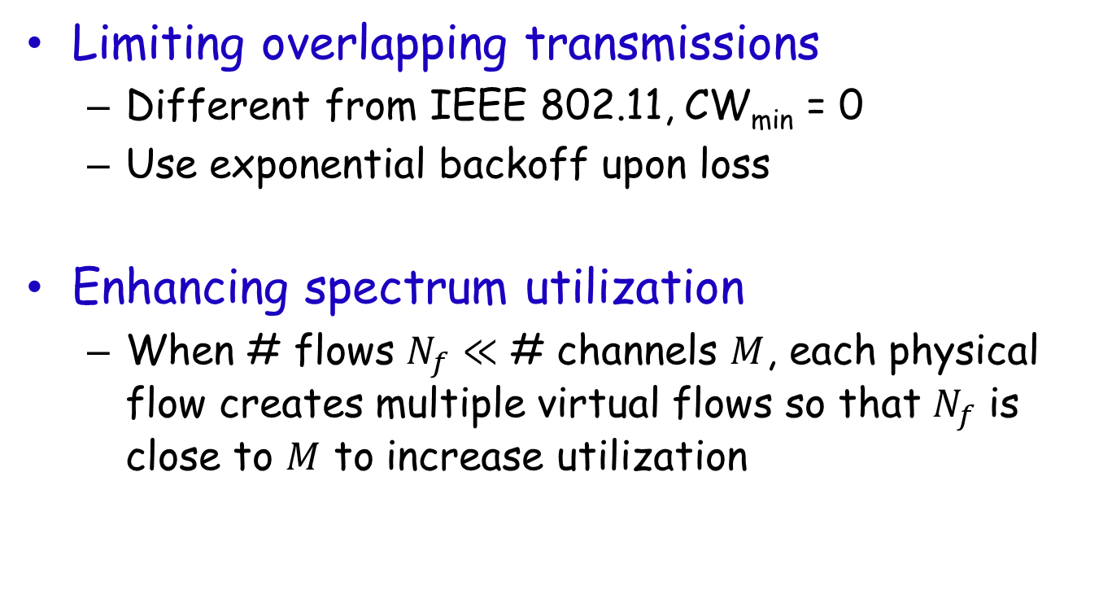
Other Design Components
Limiting overlapping transmissions
Different from IEEE 802.11, CW_{min} = 0
Use exponential backoff upon loss
Enhancing spectrum utilization
When # flows $N_{f}≪$ # channels $M$, each physical flow creates multiple virtual flows so that $N_{f}$ is close to $M$ to increase utilization

Slide 26
Evaluation Methodology
Testbed experiments show feasibility
Implement CRMA on top of the default OFDM implementation in USRP
5 GHz, BPSK, 200 subcarriers, each 1.95KHz
Qualnet simulations evaluate efficiency
Compare CRMA w/ and wo/ virtual flows, CSMA/CA (one/multiple channels), WiFi (one channel), random access
1000-byte frames, 16 QAM, 20MHz total spectrum divided into 10 channels
700 MHz for long distance, and 5 GHz for short distance networks

Slide 27
Testbed Experiments (Cont.)
Delivery rate of 1000-byte frames
SINR (dB) | High SINR | Low SINR
0 | 25% | 25%
1 | 98% | 95%
3 | 98% | 95%
5 | 100% | 98%
7 | 99% | 0.09%
High decoding rate when 1 ≤ SINR ≤ 5, and degrades as SINR approaches 0 or too high.
The latter could be improved by partial packet recovery.
Notes:
This table shows delivery rate of 1000-byte frames.
As we can see, CRMA can decode packets from both high and low SNR senders.
The decoding rate is close to 100% when SNR is between 1 and 5.
The decoding rate is lower when the SNR is close to zero due to possible signal cancellation.
When SINR is larger than 7 dB, the capture effect dominates. In such cases, the stronger signals have high decoding rates, but the weaker signals have low decoding rates. Existing collision decoding schemes experience similar degradation in this case. We can use partial packet recovery to extract correct symbols from partially correct frames to improve performance.
Other collision decoding techniques experience similar degradation as SINR approaches 0 or too high. We can improve the decoding rate by partial packet recovery.

Slide 28
Testbed Experiments (Cont.)
CRMA accurately decodes collisions up to 140 sample offsets.

Slide 29
Qualnet Simulation: Varying # flows in long distance networks
CRMA-VF > CRMA > other schemes.

Slide 30
Qualnet Simulation: Varying # flows in short distance networks
CRMA-VF > CRMA > other schemes.

Slide 31
Qualnet Simulation: Varying data rate
CRMA significantly out-performs the other schemes
and its benefit increases with data rate.

Slide 32
Related Work
Decoding collisions
Successive interference cancellation, ZigZag, analog network coding, …
CRMA: a MAC protocol based on ability to decode collisions
CDMA
Synchronous CDMA: requires tight synchronization
Asynchronous CDMA: suffers Multiple Access Interference (MAI)
Channel assignment and channel hopping
Try to avoid collisions
CRMA: a new perspective on spectrum sharing
Notes:
Our work benefits significant from the following related work.

Slide 33
Conclusion
CRMA: a new direction for spectrum sharing
A new encoding and decoding scheme
A new MAC protocol based on it
Experimental evaluation to show it can achieve high efficiency without fine-grained coordination
Future work
Robust to channel estimation errors
Effectively support high data rate
More graceful degradation as # transmissions exceeds # channels

Slide 34
Thank you!
34

