Slide 1

Harnessing Frequency Diversity in Wi-Fi Networks
Apurv Bhartia
Yi-Chao Chen
Swati Rallapalli
Lili Qiu
The University of Texas at Austin
MobiCom 2011, Las Vegas, NV

Slide 2

Existing Wi-Fi Protocols
Entire channel as a uniform unit
All symbols are equal
Significant frequency diversity exists
Not all symbols are equal
Header vs. payload symbols
Data symbols vs. FEC symbols (Systematic FEC)
Subject vs. Background symbols

Slide 3
SNR in a 20MHz Channel
SNR (dB)
Channel Subcarriers
  Frequency selective fading, narrow-band interference

Slide 4
Wireless is Moving To Wider Channels
802.11n | Up to 40 MHz
802.11ac | Up to 160 MHz
Whitespaces | 100s of MHz
Ultra Wideband | 100s of MHz to GHz
Frequency diversity increases with wider channels!

Slide 5
Contributions
Analyze the frequency diversity in real Wi-Fi links
Propose approaches to exploit frequency diversity
  Map symbols to subcarriers according to CSI
  Leverage CSI to improve FEC decoding
  Use MAC-layer FEC to maximize throughput
Joint Optimization
  Unifying our three techniques
  Combine with rate adaptation
  Perform simulation and testbed experiments

Slide 6
Talk Outline
Trace Analysis
Approach
Smart Mapping
Improving FEC Decoding
MAC-layer FEC
Unified Approach
Combine with Rate Adaptation
Results

Slide 7
Trace Collection
Intel Wi-Fi Link 5300 IEEE a/b/g/n
5 senders, 3 receivers; with 3 antennas each
5GHz channel 36, 20MHz channel width
1000-byte packet size, MCS 0, TX power: 15 dBm
Traces collected on 6th floor of office building

Slide 8
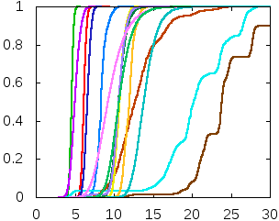
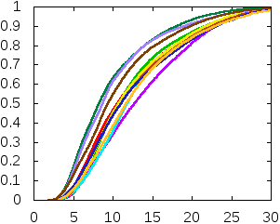

Frequency Diversity Does Exist…
> 10dB difference
> 8dB difference
Fraction of Packets
Fraction of Packets
$$\max{(SNR_{sub})−\min{(SNR_{sub})}}$$
$$\max{(SNR_{sub})−\min{(SNR_{sub})}}$$
Static Channel
Mobile Channel
Degree of frequency diversity varies across links

Slide 9
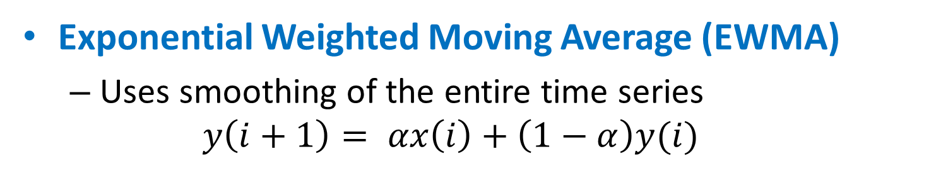
Prediction using EWMA
Exponential Weighted Moving Average (EWMA)
  Uses smoothing of the entire time series
  $$y\left(i+1\right)= αx\left(i\right)+\left(1−α\right)y(i)$$
Prediction Error
Prediction Error
Static Traces
Mobility Traces
Single value for ‘α’ does not work for both!

Slide 10
Prediction Using Holt-Winters
Holt-Winters Algorithm
  Decomposes time series into 1) baseline and 2) linear
  Uses EWMA for both
Prediction Error
Prediction Error
Static Traces
Mobility Traces
Holt-Winters prediction works well!

Slide 11
Talk Outline
Trace Analysis
Approach
Smart Mapping
Improving FEC Decoding
MAC-layer FEC
Unified Approach
Combine with Rate Adaptation
Results

Slide 12
A Quick OFDM Primer
PHY layer Data Frame
20 MHz Channel, 52 subcarriers
Transmit data by spreading over multiple subcarriers
  Each subcarrier independently decodes the symbol
Robustness to multipath fading
Used in digital radio, TV broadcast, 802.11 a/g/n, UWB, WiMax, LTE …

Slide 13
Standard Interleaving
Arranges bits in a non-contiguous way
  Improves performance of FEC codes
  Standard 2-step permutation process
Avoid long runs of low reliability bits but assumes
  all subcarriers are equal
  all bits are equal

Slide 14
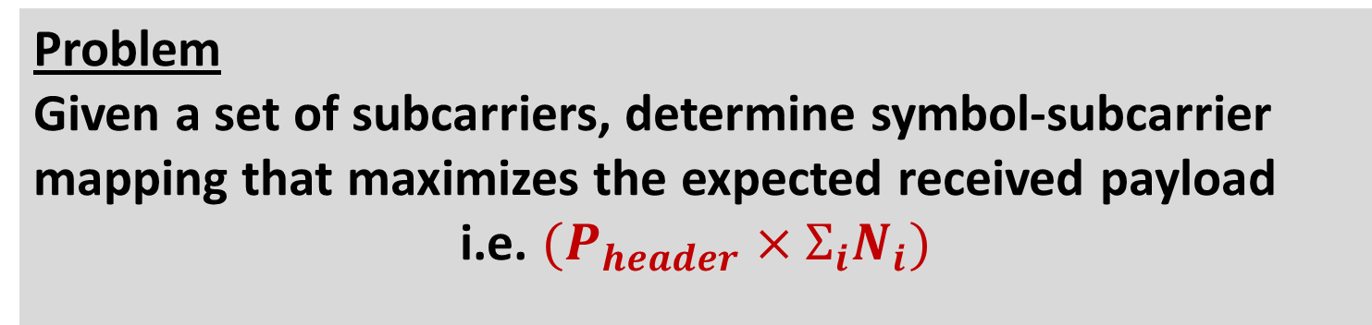

Smart Symbol Interleaving (1)
Map important symbols to reliable subcarriers
  Mapping should maximize throughput
Problem
Given a set of subcarriers, determine symbol-subcarrier mapping that maximizes the expected received payload
i.e. $(P_{header}×Σ_{i}N_{i})$
correctly received data bits in FEC group $i_{}$
Non-linear utility function
  Optimal solution is challenging
  We develop several heuristics …

Slide 15
Smart Symbol Interleaving (2)
Header
Payload
Subcarriers sorted by SNR
Header
Payload
Smart Header
Data
FEC
Data
FEC
Smart Data
Header(Data)
Payload(Data)
Header(FEC)
Payload(FEC)
Data
FEC
Data
FEC
Header
Smart Header/Data
Payload
Subcarriers ordered by SNR

Slide 16
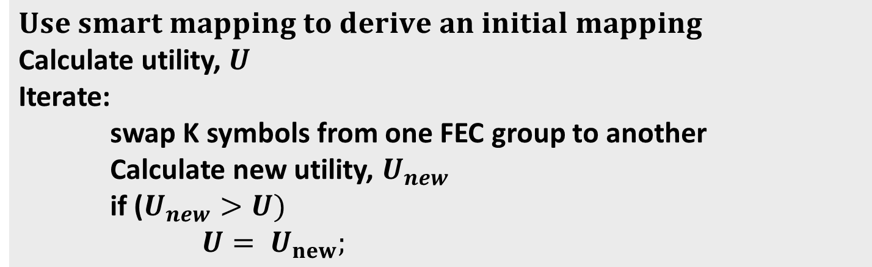
Smart Symbol Interleaving (3): Iterative Enhancement
Improves performance of heuristic solutions
$$Use smart mapping to derive an initial mapping$$
Calculate utility, $U$
Iterate:
swap K symbols from one FEC group to another
Calculate new utility, $U_{new}$
if ($U_{new}>U)$
${U= U}_{new};$
Swap between best and worst FEC groups

Slide 17
Leveraging CSI for FEC Decoding
Recover partial PHY-layer FEC groups
  Use subcarrier SNR to extract symbols whose SNR > threshold
Increase FEC group recovery
  LDPC decoder assumes uniform BER
  Accurate knowledge of BER across subcarriers increases FEC group recovery in LDPC
  BER estimated using CSI can significantly help LDPC!

Slide 18
MAC-Layer FEC
Due to frequency diversity, single PHY-layer data rate might not work for all subcarriers
  Per subcarrier modulation and PHY-layer FEC? [FARA]
  May map symbols within a FEC group to same/adjacent subcarriers bursty losses
  Significant signaling and processing overhead
  Not available in commodity hardware
  Benefits of MAC-layer FEC
  Protection based on symbol importance
  More fine-grained than PHY-layer FEC
  Easily deployable on commodity hardware

Slide 19
Problem and Challenges
Maximize throughput by selectively adding MAC FEC
Data Symbols
MAC-layer FEC
Redundancy Symbols
PHY-layer Frame
FEC Group
Challenge: Search space becomes larger!
  How much MAC FEC to add?
  How to split MAC FEC to differentially protect PHY-layer symbols?
  What FEC group size to use at the MAC layer?

Slide 20
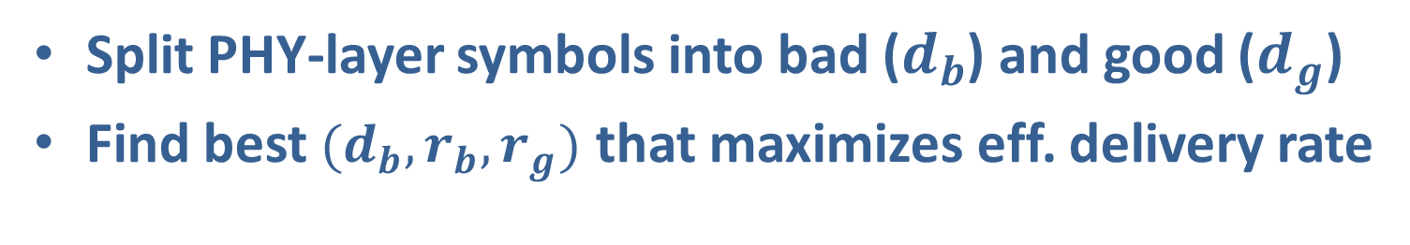


MAC-layer FEC: Algorithm
Split PHY-layer symbols into bad ($d_{b}$) and good ($d_{g}$)
Find best $(d_{b}, r_{b}, r_{g})$ that maximizes eff. delivery rate
$foreach PHY layer FEC group$
$foreach (d_{b}, r_{b}, r_{g})$
$utility= {N_{delivered}}/{N_{tx}}$
$if {utility> utility}_{max}$
${utility}_{max}=utility$
$configuration=(d_{b}, r_{b}, r_{g})$
r_{b}
r_{g}
MAC-FEC
PHY-data
d_{b}
d_{g}
d
$N_{tx}:$ Total # of symbols transmitted (including MAC FEC)
$N_{delivered}:$ Estimated # of symbols successfully received

Slide 21
Talk Outline
Trace Analysis
Approach
Smart Mapping
Improving FEC Decoding
MAC-layer FEC
Unified Approach
Combine with Rate Adaptation
Results

Slide 22
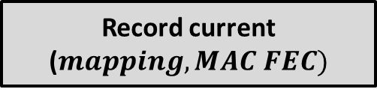
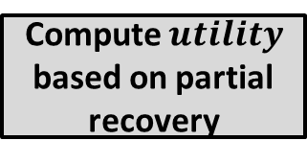
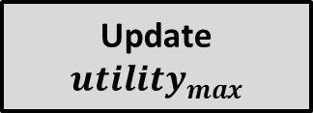

Unified Approach
Perform Smart Mapping
Optimize MAC-layer FEC
Compute $utility$ based on partial recovery
$$utility> utility_{max}$$
Record current ($mapping, MAC FEC)$
Update $utility_{max}$

Slide 23
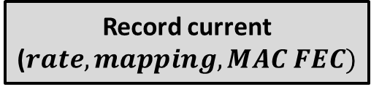
Unified Approach + Rate Adaptation
Perform Smart Mapping
Optimize MAC-layer FEC
Compute $utility$ based on partial recovery
For each Rate
$$utility> utility_{max}$$
Record current ($rate, mapping, MAC FEC)$
Update $utility_{max}$

Slide 24
Talk Outline
Trace Analysis
Approach
Smart Mapping
Improving FEC Decoding
MAC-layer FEC
Unified Approach
Combine with Rate Adaptation
Results

Slide 25
Simulation Methodology
Extensive trace-driven simulation
CSI traces collected using Intel Wi-Fi 5300 a/b/g/n
~20,000 packets for both static and mobile traces
Throughput as the performance metric
Evaluate fixed and auto-rate selection mechanism

Slide 26
Symbol Mapping (Static Traces)
Throughput (Mbps)
Smart Symbol Mapping
Smart mapping schemes give 63% to 4.1x increase

Slide 27
CSI-based Hints (Static Traces)
Throughput (Mbps)
CSI-based Hints enabled
CSI-based hints give 126% to 13x increase!

Slide 28
MAC FEC and Joint Optimization
7% to 207%
15% to 549%
1.6x to 6.6x
Throughput (Mbps)
MAC FEC improves performance significantly
  Joint Optimization gives 1.6x to 6.6x benefit

Slide 29
Combining with Rate Adaptation
Throughput (Mbps)
Smart Symbol Mapping
Jointly optimized scheme outperforms the standard

Slide 30
Combining with Rate Adaptation
Throughput (Mbps)
CSI-based Hints enabled
CSI-based hints + Smart iterative benefits significantly
  - 40% to 134% over the default auto-rate scheme

Slide 31
Mobile Traces
Throughput (Mbps)
Throughput (Mbps)
Smart Symbol Mapping
CSI-based Hints enabled
Benefits of CSI hints extend under mobile scenarios
  - Smart Iterative gives 68% to 96% benefit

Slide 32
Testbed Methodology
USRP1 based experiments
Low channel width of 800KHz (artifact of USRP1)
  Inject narrowband interference to ‘recreate’ frequency diversity
Vary interference across different runs
Each run consists of 1000 packets, 1000 bytes each
Use the OFDM implementation in GNU Radio 3.2.2
  192 subcarriers in the 2.49 GHz range
  Implement different interleaving schemes and MAC-layer FEC

Slide 33
Testbed Results (1)
Throughput (Kbps)
Symbol Mapping Schemes
Smart mapping out-performs the standard by 42-173%
Benefits of CSI-based hints are also clearly visible

Slide 34
Testbed Results (2)
Throughput (Kbps)
MAC-layer FEC
MAC-layer FEC improves performance significantly
  - Standard mapping improves by 1.4x to 3.3x

Slide 35
Testbed Results (3)
Throughput (Kbps)
Joint Optimization
Combined approach outperforms default by 33-147%

Slide 36
Related Work
Frequency-aware rate adaptation [Rahul09, Halperin10]
  We propose other techniques like symbol mapping, CSI as hints
Frequency diversity in retransmissions [Li10]
  Our technique applies to any transmissions
Frequency Diversity
Extensively studied [Bicket05, Holland01, Sadeghi02, Wong06, etc.]
  Our work can be complementary to these!
BER-based rate adaptation [Vutukuru09, Chen10]
  Assume SNR is uniform within the frame
Rate Adaptation
Fragment-based CRC [Ganti06][Han10], error estimating codes[Chen10]
PHY-layer hints [Jamieson07], multiple radios [Miu05, Woo07]
  Easily deployable on commodity hardware
Partial Packet Recovery

Slide 37
Conclusion and Future Work
CSI exhibits strong frequency diversity
Develop complementary techniques to harness such diversity, and then jointly optimize them
Significant performance benefits are possible
CSI is fine-grained and more challenging to predict
  More robust optimization needed to predict
  Prediction holds the key to performance under mobility

Slide 38
Questions
apurvb@cs.utexas.edu

