Slide 1
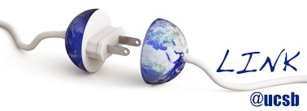

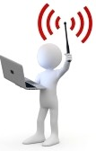
I Am the Antenna: Accurate Outdoor AP Location using Smartphones
Zengbin Zhang, Xia Zhou, Weile Zhang*, Yuanyang Zhang
Gang Wang, Ben Y. Zhao, Haitao Zheng
Department of Computer Science,
University of California, Santa Barbara, USA
*School of Electronic and Information Engineering,
Xian Jiaotong University, China

Slide 2
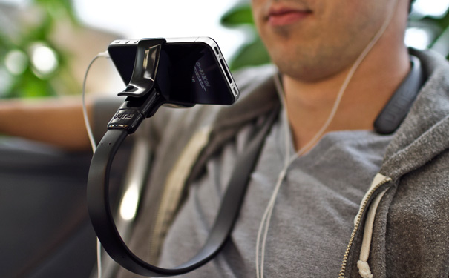
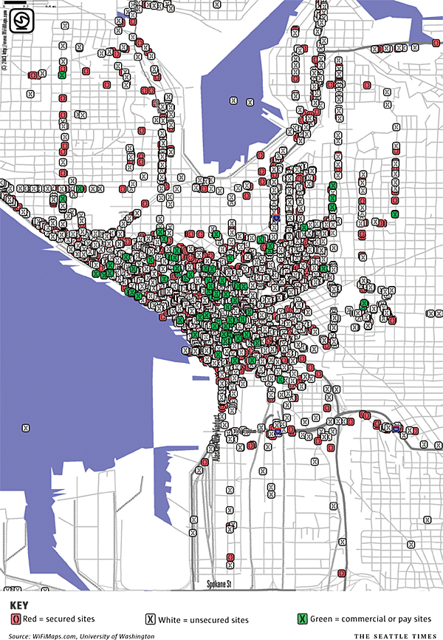
Ubiquitous Broadband Access
WiFi network is growing rapidly
Cisco: WiFi traffic will surpass wired IP traffic in 2015
High density
We need well tuned and managed WiFi networks!

Slide 3

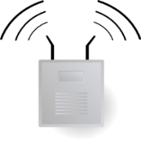
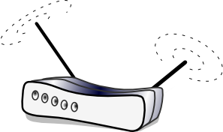

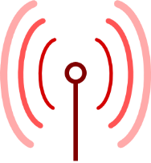
AP Location: A Critical Function
Better network planning
Finding rogue APs
Neighboring AP

Slide 4
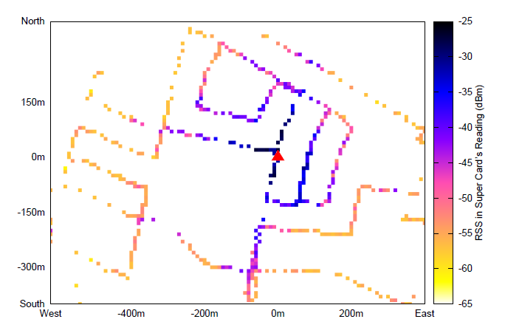
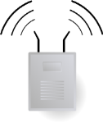



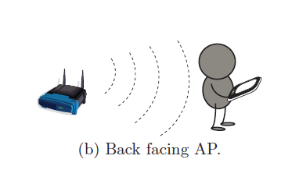
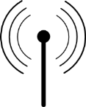

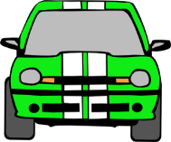


Conventional AP Location Methods
Directional Antenna
Signal Map
RSS Gradient
20%+ Violations
Distance
RSS Gradient
Fast, very accurate (10˚)
Expensive (hundreds to thousands of dollars)
Simple method, easy to perform
Very time consuming
Low measurement overhead
Low accuracy (often error > 45˚)
Do we have a better method to quickly and accurately locate the AP?

Slide 5
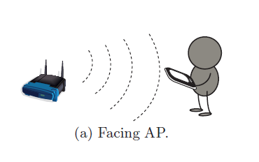
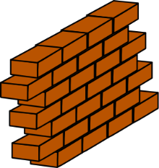

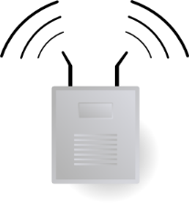


Insight: The Body Blocking Effect
Can we use this to detect AP location?
No…Effect is not clear enough
Our observation
User facing the AP
User’s back facing the AP

Slide 6
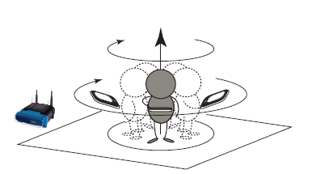
Rotation based Measurement
Facing AP
Back facing AP
The difference is significant
User’s body is much larger than the phone
User is close to the phone
13dB
We can emulate a directional antenna just by
Rotating with Smartphones

Slide 7
Generality of the Effect
Devices
Motorola Droid, HTC G1(Android)
LG Fathom(WM 6.5)
iPhone4 (iOS)
Protocols
802.11 b/g
802.11n (MIMO)
Postures and body shapes of the user
7 users in our lab
Different phone orientations
Environments
Outdoor LOS/Non-LOS
Different distances to AP
RSS(dBm)
Back facing AP
User Orientation
iPhone 4
RSS(dBm)
Back facing AP
User Orientation

Slide 8
Outline
Motivation
Accurate AP Location
Evaluation
Conclusion

Slide 9
User Rotation based AP Location
AP direction
Walk for x m
RSS profile
Borealis’ Design
Requirements
Accurate
Directional Analysis
Low
Energy Consumption

Slide 10

Directional Analysis Is Non-Trivial
user’s back facing AP?
Min RSS direction?
Using Min RSS direction would cause large errors
ERROR=40˚
Actual direction
For 35% cases,
Error > 45˚

Slide 11
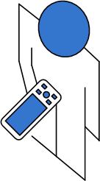


Our Directional Analysis Model
Signal degradation occurs at a range of directions
Ideal RSS Profile
RSS
blocking
sector
RSS could vary inside the sector, so Min RSS is not accurate
Around 90˚

Slide 12
Locating the Blocking Sector
Find the sector with the largest RSS degradation
Sliding window
Sin: average RSS inside
the sliding sector
Sout: average RSS outside
the sliding sector
degradation = Sout - Sin
Sliding Sector
Degradation
Detected direction

Slide 13
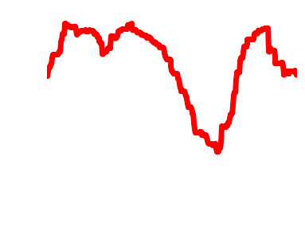
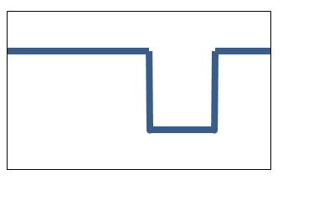
Navigation
How does a user navigate using directional hints?
Strawman design: periodic
Refine AP direction every 20m
However, nothing is perfect
Temporal/spatial variation
Our adaptive method
Measurement confidence
The similarity of measured RSS and ideal RSS profile
If confidence is high
Walk further between measurements
Detected direction
Actual direction

Slide 14

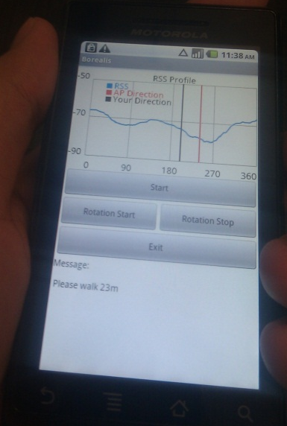
Implementation
Application layer
Leveraging WiFi scan to read RSS
Default scan is very slow
Scanning all channels each time
OS layer
Modified WiFi driver
Scanning the interested channel only
Accelerate the process: 10 seconds per rotation (10 times faster)
Save power: WiFi’s energy consumption is 14 times less

Slide 15
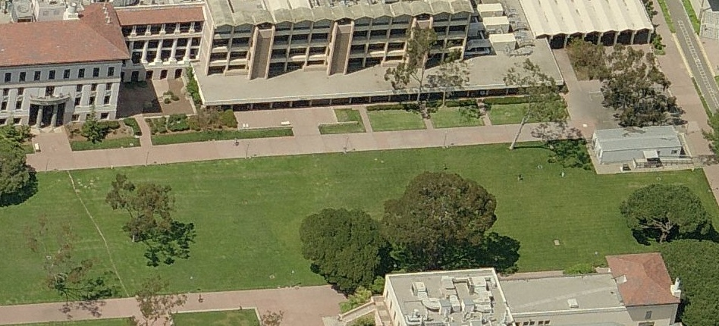
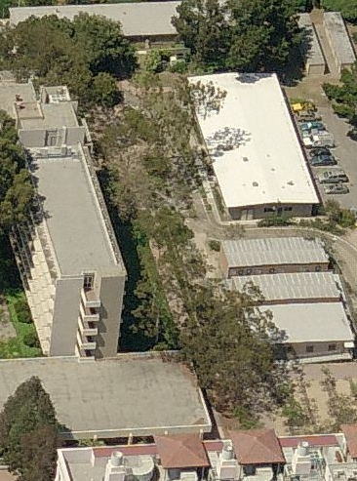
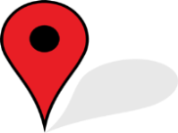
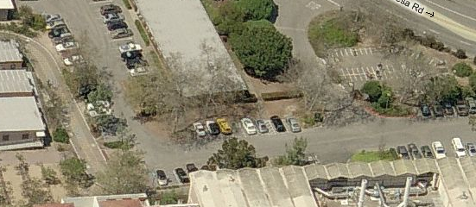
Testing Scenarios
Simple Line of Sight (Simple LOS)
Non Line of Sight (NLOS)
Complex Line of Sight (Complex LOS)

Slide 16
Accuracy of Directional Analysis
We compared Borealis to
Offline Analysis: clustering-based ML method
Optimized by training set, can be upper bound of directional analysis
GUIDE: RSS gradient based
Min RSS: minimum RSS direction based
Error < 30˚ for 80%+ cases in Simple LOS
Error < 65˚ for 80%+ cases in NLOS

Slide 17
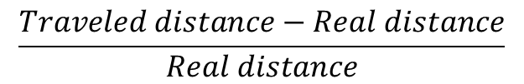
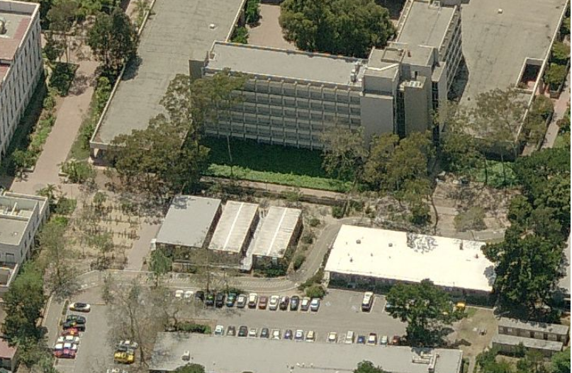

Navigation Efficiency
Navigation Overhead:
Defined as the normalized extra distance a user needs to travel
134%
107%
Navigation Overhead
74%
48%
37%
18%
NLOS Examples

Slide 18
Locating Indoor APs?
Most APs are mounted inside buildings
We mounted the AP on a table in our lab
Try to locate it outside in Complex LOS/NLOS environment
Borealis is fully capable of finding Indoor APs

Slide 19
Conclusion
AP location is an important function
Very beneficial in AP deployment and management
Borealis: an efficient and accurate solution for WiFi AP location
Leveraging the body blocking effect on smartphones
Feasible even in complex environments
Body blocking effect is general
i.e. works on GNU Radios in 900MHz/1900MHz/5GHz
Borealis can be applied to locate other types of transmitters

Slide 20
Thank you!
Questions?

