Slide 1
E-MiLi: Energy-Minimizing Idle Listening in Wireless Networks
Xinyu Zhang, Kang G. Shin
University of Michigan – Ann Arbor

Slide 2
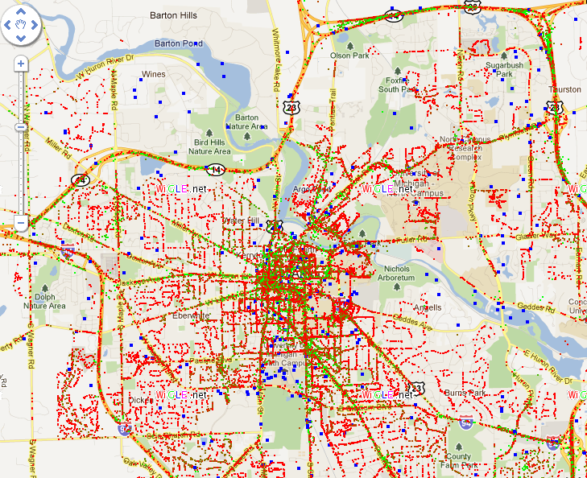



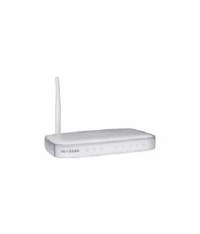




WiFi for mobile devices
WiFi: popular means of wireless Internet connection
WiFi hotspots in Ann Arbor
WiFi: a main energy consumer in mobile devices
14x
higher than GSM on cellphone
Even in idle mode (w/o packet tx/rx)

Slide 3
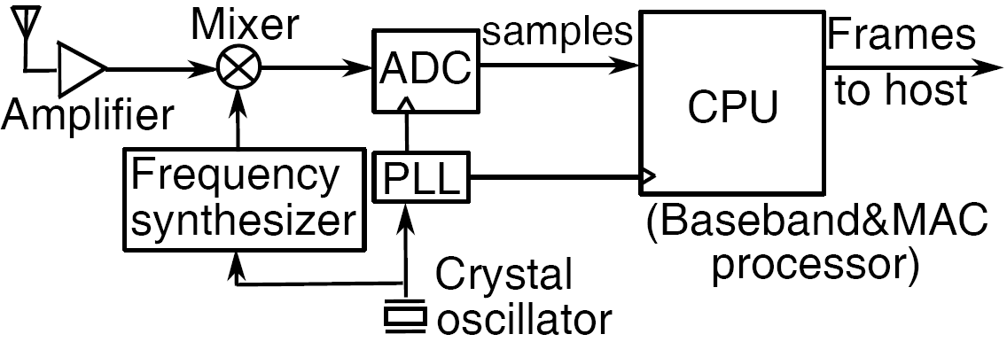
Cost of idle listening (IL)
Most of time is spent in IL!
Due to the nature of WiFi CSMA
IL dominates WiFi’s energy consumption!
IL power is comparable to TX/RX
Known for WiFi devices
Why?
All components are active during IL
Analog components
Digital components

Slide 4


Existing solution
Sleep scheduling (802.11 PSM and its variants)
Beacon
ACK
Beacon
AP
Data pkt
……
……
ACK
Client
PS-Poll
……
Carrier sensing, contention, queuing
Sleeping
Sleep scheduling reduces unnecessary waiting (IL) time
Client wakes up and performs CSMA only when needed
Is sleep scheduling effective?

Slide 5
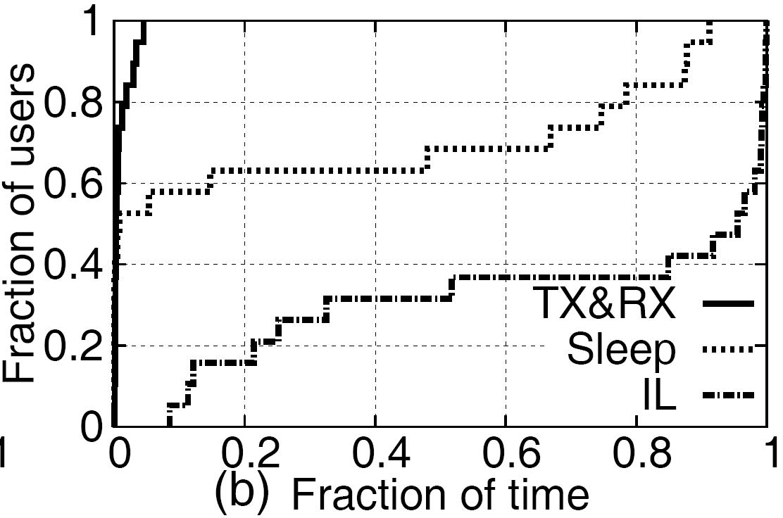
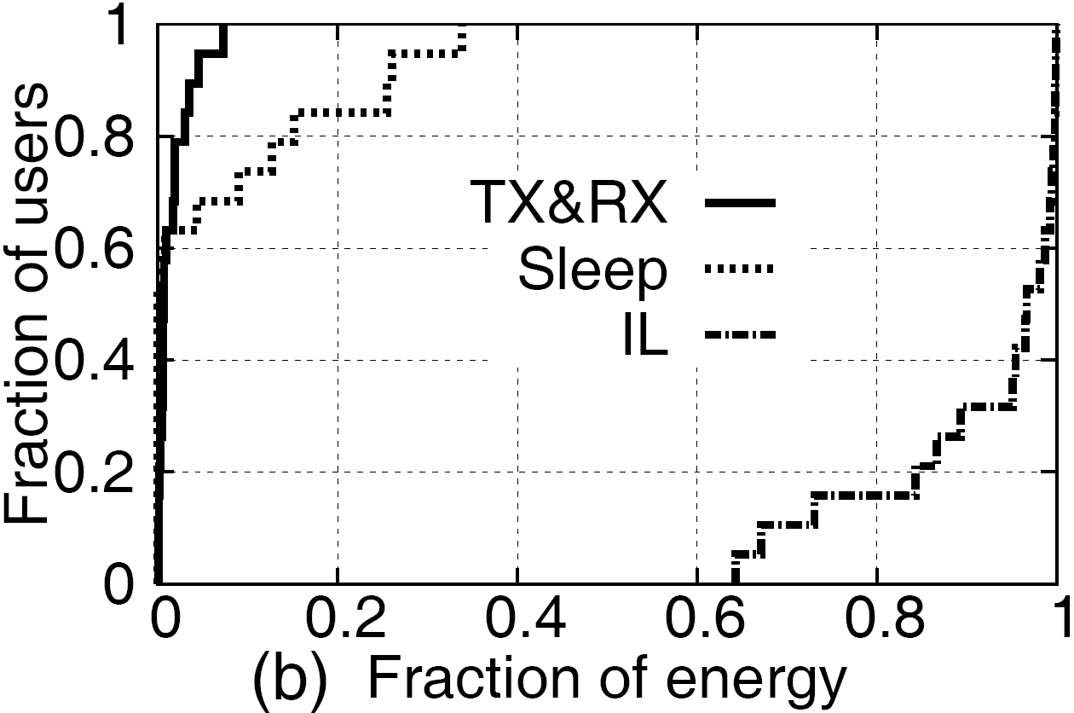
Effectiveness of WiFi sleep scheduling
Approach
Analysis of real-world WiFi packet traces
CDF of the fraction of time and energy spent in IL
80+% of energy spent in IL for most users!

Slide 6
Why is sleep scheduling not enough?
Contention time (carrier sensing & backoff)
Even if the client knows there’s a packet to send or receive, it needs to WAIT for a channel access opportunity
Queueing delay
Even if the client knows there’s a packet buffered at AP, it needs to WAIT for its turn to receive
Energy cost is shared among clients => the more clients, the more energy is wasted in IL for each client

Slide 7
E-MiLi: Energy-Minimizing idle Listening
Main observations:
IL energy = Time × Power
Sleep scheduler
E-MiLi
Rationale: Power Clock-rate
Key idea:
WiFi
E-MiLi
Constant clock-rate
Adapting clock-rate
IL
Packet
……
IL
Packet
……
Clock ticks

Slide 8
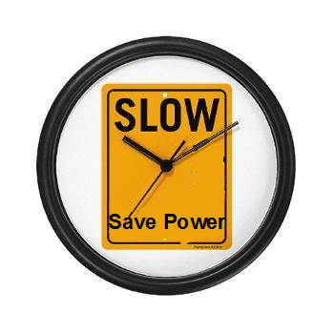
Power savings by downclocking
WiFi
USRP
Power (W)
Power (W)
47.5% saving
36.3% saving
Clock rate
Clock rate

Slide 9
Key challenge: receiving packets at low clock-rate
The fundamental limit:
Nyquist-Shannon sampling theorem: to decode a packet, we need
Receiver’s sampling clock-rate ≥ 2 × signal bandwidth
Equivalently,
receiver’s sampling clock-rate ≥ transmitter clock-rate
Challenge:
Packets cannot be decoded if the receiver is downclocked

Slide 10
Separate packet detection from its decoding
E-MiLi
……
IL
802.11 pkt
……
Clock ticks
Downclock during IL
Decode pkt at full sampling-rate
Downclock during IL
Detect pkt at low sampling-rate
Packet detection is not limited by Nyquist-Shannon theorem
Customize preamble to enable sampling-rate invariant detection (SRID)

Slide 11
Sampling-Rate Invariant Detection (SRID)
How do we ensure the packet can still be detected, when the receiver operates at low clock-rate?
M-Preamble Design
802.11 preamble and data
M-preamble
M-preamble: duplicated versions of a random sequence
Use self-correlation between duplicates for detection
Duplicates remain similar even after down-sampling
Resilient to change of sampling rate

Slide 12
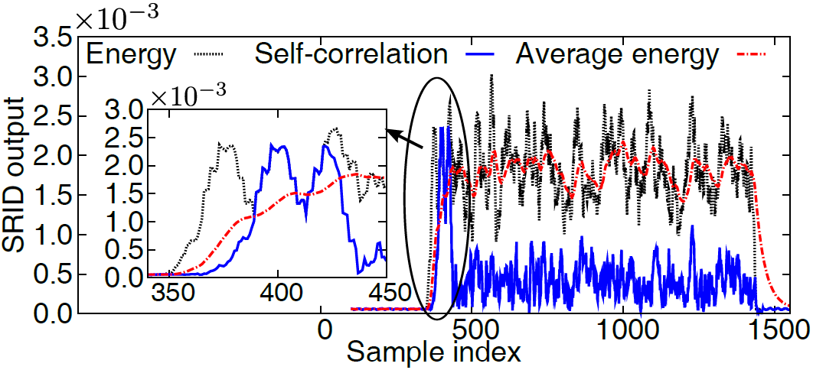
Sampling-Rate Invariant Detection (SRID), cont’d
M-Preamble Design, cont’d
Basic rules:
Self-correlation Energy
Avg Energy
> minimum detectable SNR
Noise floor
Enhanced rule:
# of sampling points satisfying basic rule
M-preamble length

Slide 13
PHY-layer address filtering
Problem: false triggering
Packets intended for one client may trigger all other clients
Waste of energy
Solution: PHY-layer addressing
Use sequence separation as node address
Node 0:
802.11 packet
Node 1:
802.11 packet
Sequence separation

Slide 14
Addressing overhead
Problem:
Preamble length number of addresses
Solution: Minimum-cost address sharing
Allow multiple nodes to share the same address
Address allocated according to channel usage:
Clients with heavy channel usage share address less with others
Formulated as an integer program and solved via approximation

Slide 15
Switching overhead
Delay caused by clock-rate switching
outage event
……
packet
packet
Clock ticks
full-clock
down-clock
switching period (9.5~151 )
Problem: how to prevent outage event?
Solution: Opportunistic Downclocking (ODoc)
Downclock the radio only if the next packet arrival is unlikely to fall in the switching time
How do we know if this is true?

Slide 16
Opportunistic downclocking (ODoc)
Separate deterministic packet arrivals
e.g., RTS CTS DATA ACK
Predict outage caused by non-deterministic packet arrivals
History-based prediction
History=1: outage occurs
0
1
0
0
History=0: otherwise
history size
Next=1 if history contains 1
Next arrival

Slide 17
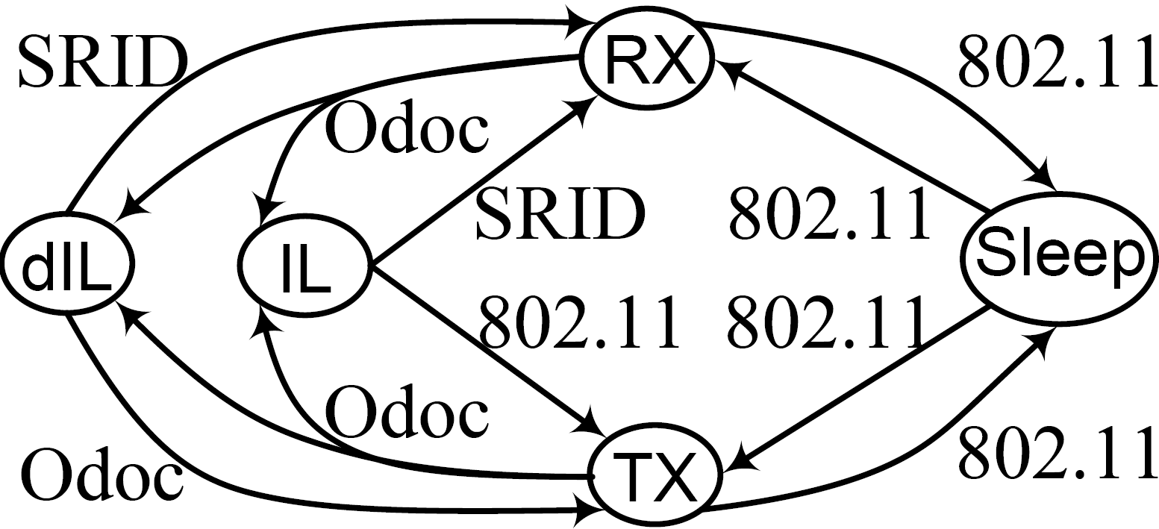
Integrating E-MiLi with sleep scheduling protocols
State machine
dIL
Add a new state dIL (downclocked IL)
TX
Sleep
and RX
Sleep managed by sleep scheduling
SRID manages carrier sensing and packet detection
ODoc determines whether and when to transit to IL or dIL

Slide 18
Evaluation
Packet detection
Software radio based experiments
Energy consumption
Packet traces from real-world WiFi networks
Simulation for different traffic patterns
Using ns-2

Slide 19
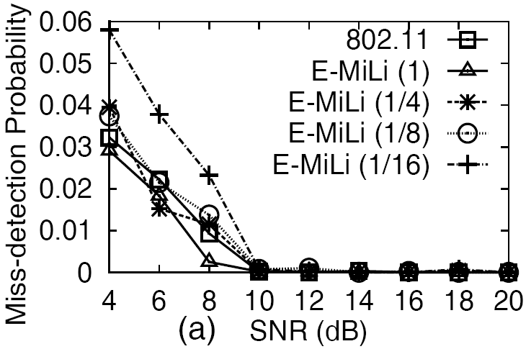
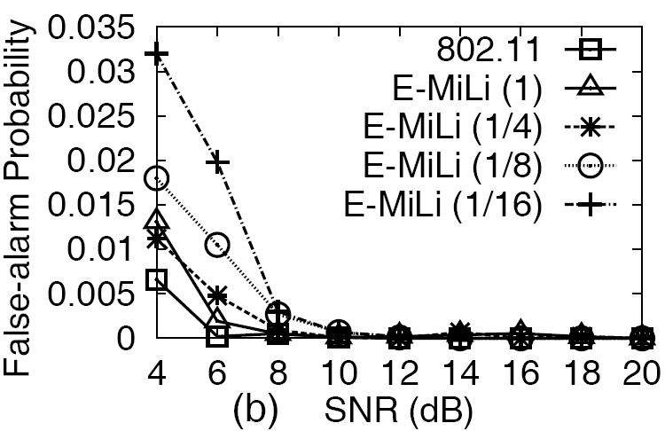
Packet detection performance
Single link
USRP nodes; varying SNR and clock-rates

Slide 20
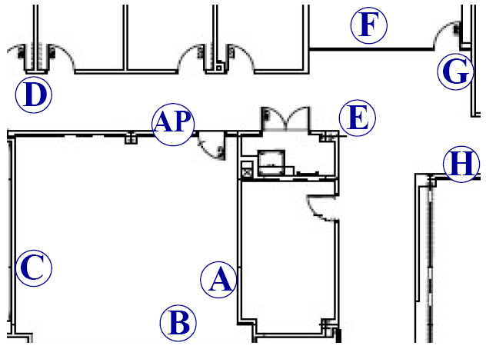
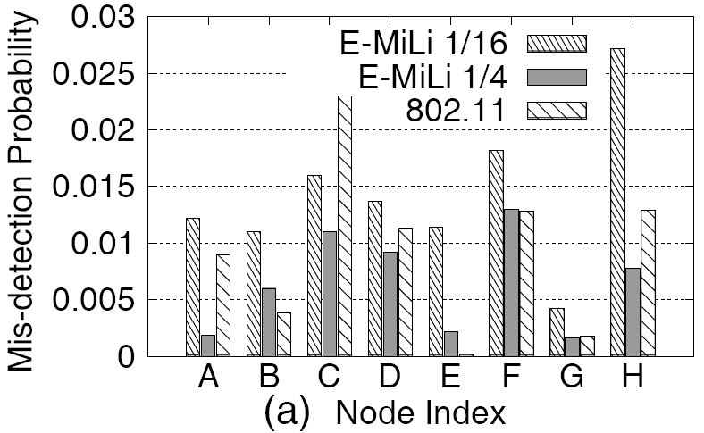
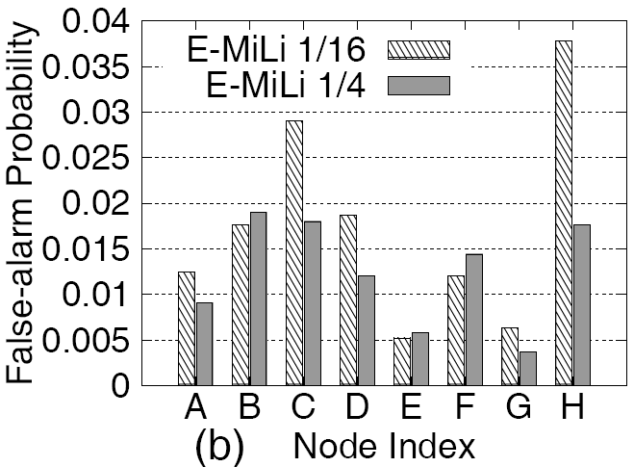
Multiple links
Lab/office environment
All nodes are static except D
Detection performance

Slide 21
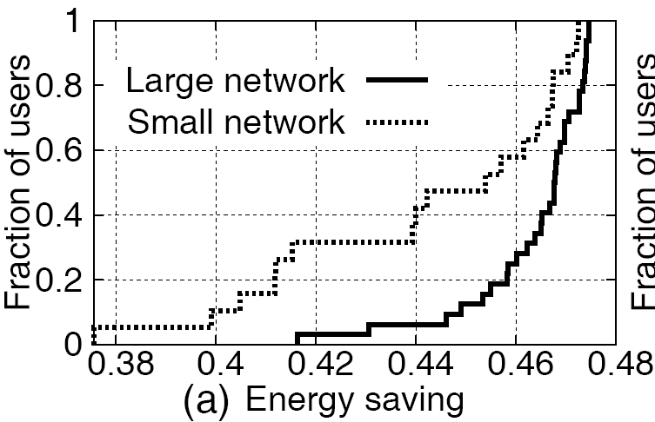
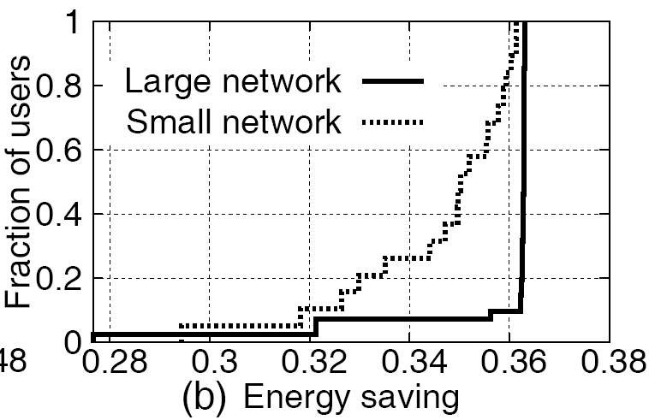
Energy savings
Trace-based simulation
Based on WiFi power profile
Based on USRP power profile
(Max downclocking factor 4)
(Max downclocking factor 8)

Slide 22
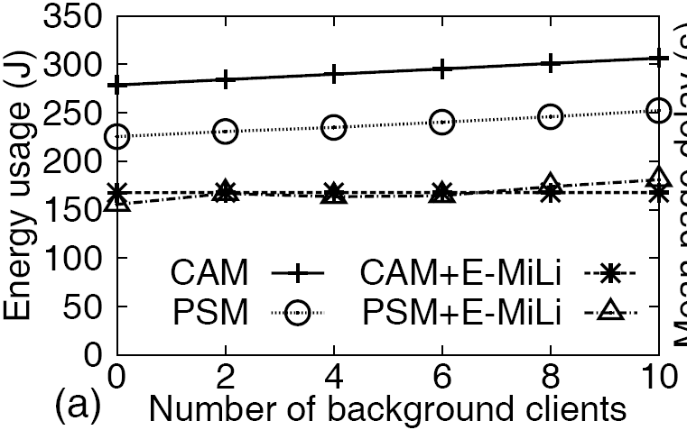
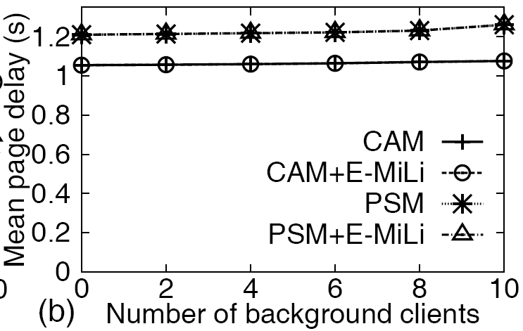
Simulation of synthetic traffic
Implementation in ns-2
MAC layer: ODoc
Switching delay: 151 (worst case)
SNR: 8dB (pessimistic)
Performance of a 5-minute Web browsing session

Slide 23
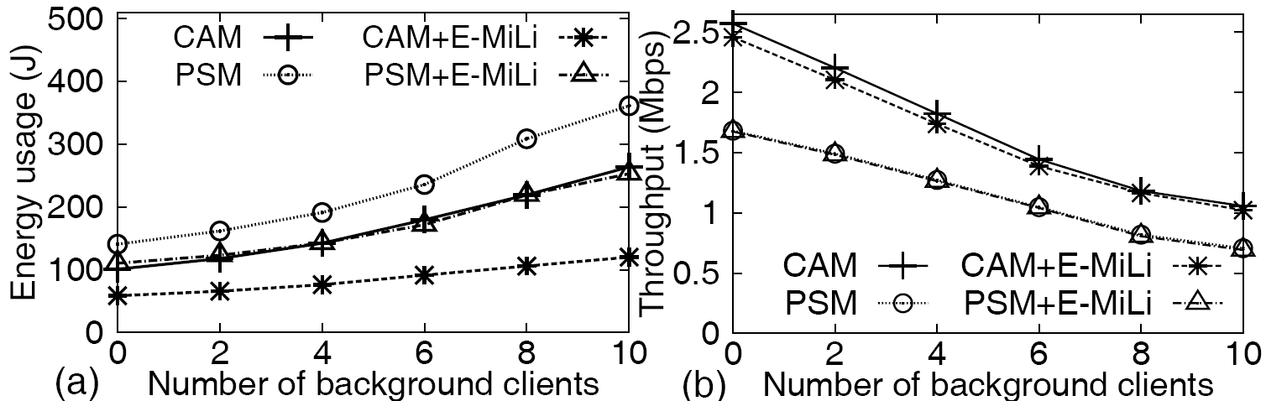
Performance when downloading a 20MB file using FTP

Slide 24
Conclusion
Idle Listening (IL) dominates WiFi energy consumption
E-MiLi: reducing IL power by adaptive clock-rate
Separate packet detection from packet reception
SRID: detecting packets at low clock-rate
ODoc: integrating with MAC-layer sleep scheduler
Future work
Incorporating voltage scaling
Application to other carrier sensing networks (e.g., ZigBee)

Slide 25
Thank you!

