Slide 1

Enhance & Explore:
LCA
an Adaptive Algorithm to Maximize
the Utility of Wireless Networks
Adel Aziz
joint work with
Julien Herzen, Ruben Merz, Seva Shneer, and Patrick Thiran
September 21st 2011
CH-1015 Lausanne
adel.aziz@epfl.ch
http://people.epfl.ch/adel.aziz

Slide 2
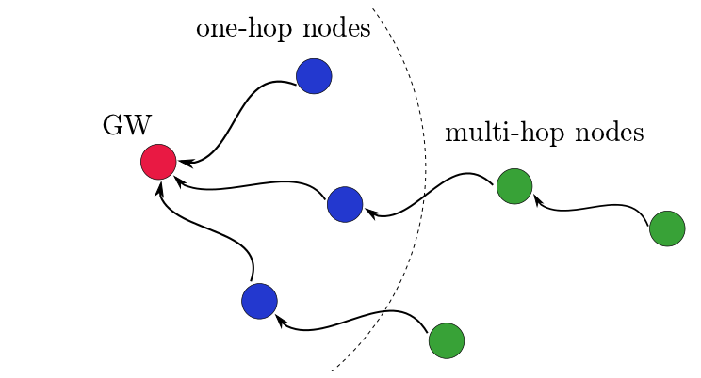
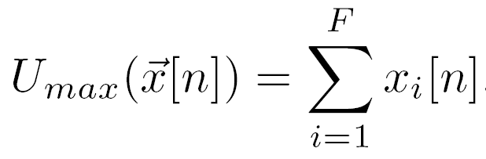
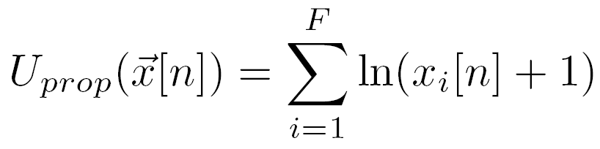


Problem Statement
Objective
Maximize given utility function
Challenges vs. related work
Work on existing MAC
No network-wide message passing
Wireless capacity is unknown a priori
(Max-Weight based ^{[1]})
(IFA ^{[2]})
(GAP ^{[3]})
^{[1]} Proutière et al., CISS, 2008
^{[2]} Gambiroza et al., MobiCom, 2004
^{[3]} Mancuso et al., Infocom, 2010
1/14

Slide 3
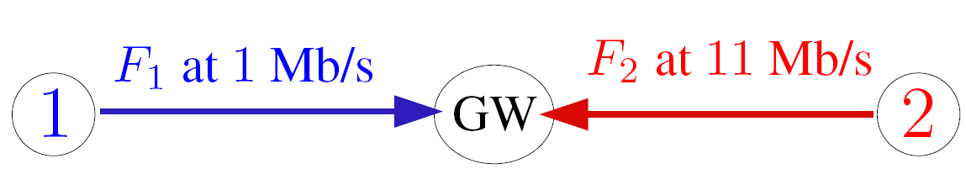
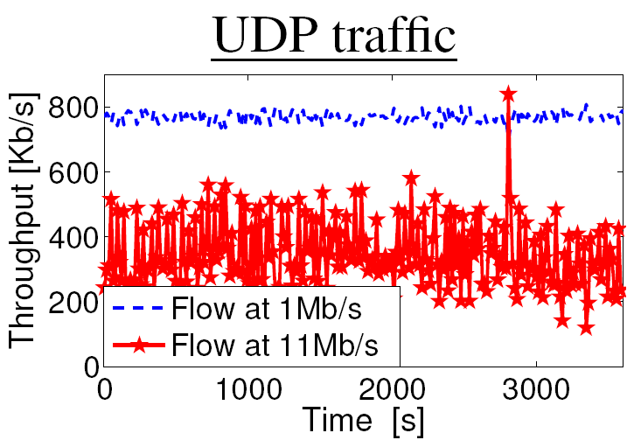
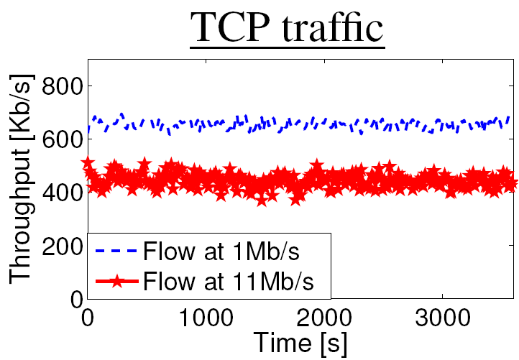
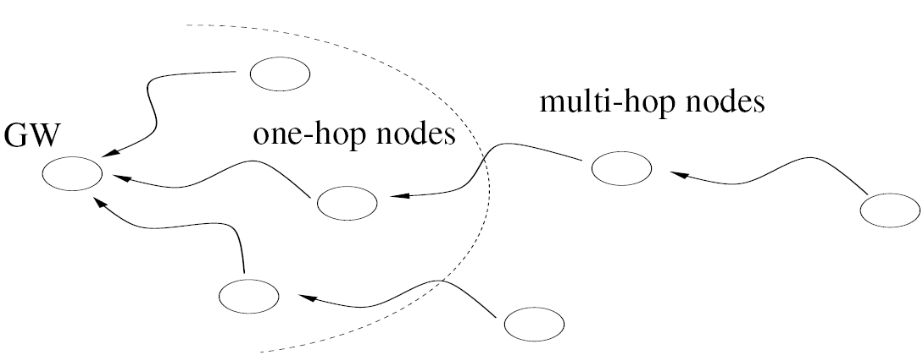
Motivation
WLAN Setting
Inter-flow problem
Optimally allocate resources
Multi-Hop Setting
Intra-flow problem
Avoid congestion
^{[3]}
^{[3]} Heusse et al., Infocom, 2003
2/14

Slide 4
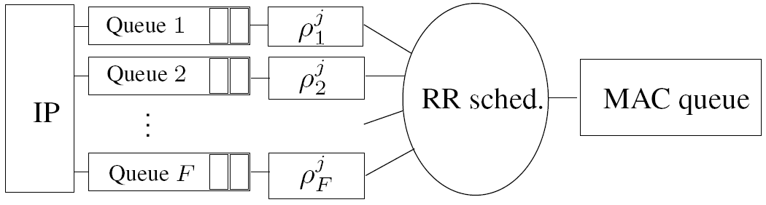


Network Abstraction
Flow = <IP src; IP dst>
No scaling problem
Architecture of node j
Information to set at node j at time slot n
Rate allocation vector:
Information to monitor at GW at time slot n
Measured throughput:
3/14

Slide 5


Network Abstraction
x₂
X*
x₁
Useful information at time slot n
Measured throughput:
Capacity region: (unknown a priori)
Rate allocation vector:
Last stable allocation:
Utility function:
Level set:
4/14

Slide 6
‘Enhance & Explore’ in WLAN
Starts from IEEE 802.11 allocation
Throughput vector: x[0] = ρ[0] {rate allocation}
Level set of utility μ[0]: L(x[0], μ[0])
Remember allocation: r[0] = x[0]
Enhance phase: (Find the next targeted level set)
If (x[n-1] = ρ[n-1] )
μ[n] = full-size gradient ascent
Else
μ[n] = halved-size gradient ascent
Explore phase: (Find the next allocation)
Pick point ρ[n] randomly
If (x[n] = ρ[n] )
Remember new allocation: r[n] = x[n]
Go to Enhance phase
Else
Repeat Explore phase at most N times, then move to Enhance
μ[4]
μ[1]
μ[2]
μ[3]
μ[0]
Truncated Gaussian pdf
Example: N = 2
5/14

Slide 7



Optimality Theorem
Theorem for E&E
Utility of never decreases through time
converges to an allocation of maximal utility
Converges for any initial rate allocation
Assumptions for the proof
Fixed capacity region
Coordinate-convex capacity region
Much weaker than convexity!
Future work
Study speed of convergence
6/14

Slide 8
Complete Solution: E&E + EZ
GW
E&E decides the per-flow rate allocation
One-hop nodes
E&E rate-limits one-hop nodes
Multi-hop nodes
EZ-flow^{[1]} rate-limits multi-hop nodes
^{[1]} Aziz et al., CoNEXT 2009
7/14

Slide 9
Practical Implementation
Based on Click^{[1]} with MultiflowDispatcher^{[2]}
Creation of 5 new elements
MFQueue
MFLeakyBucket
EEscheduler
EEadapter
EZFlow
Evaluation with
Asus routers
Ns-3
^{[1]} Kohler et al., Transactions on Computer Systems, 2000
^{[2]} Schiöberg et al., SyClick, 2009
8/14

Slide 10
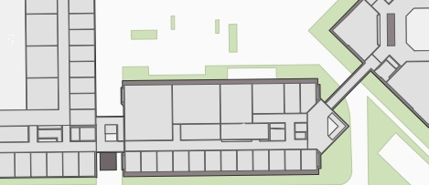
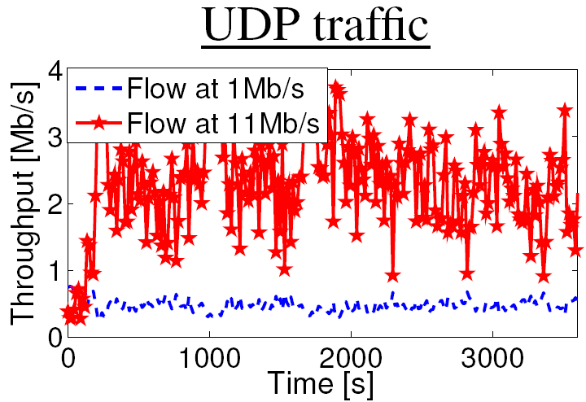
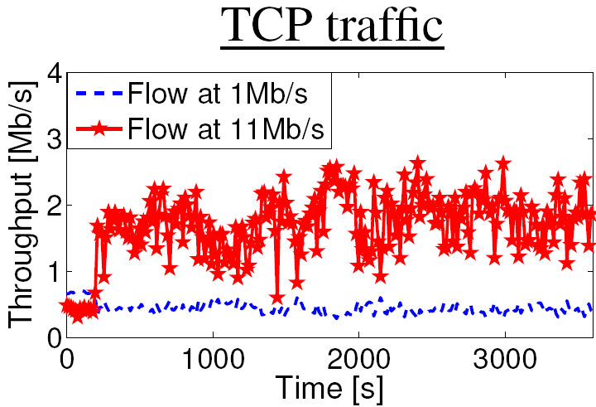
Experimental Results in WLAN
Deployment map:
Without E&E:
With E&E:
(proportional fairness)
9/14

Slide 11

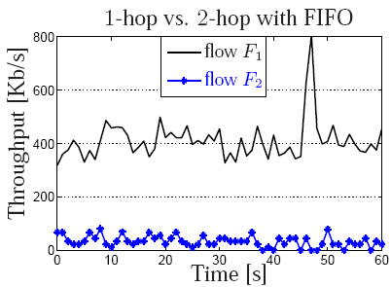
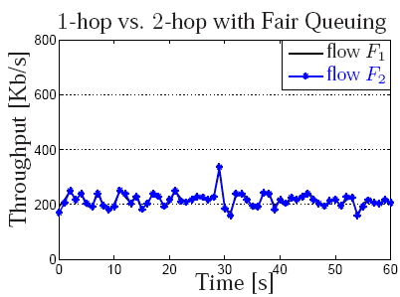
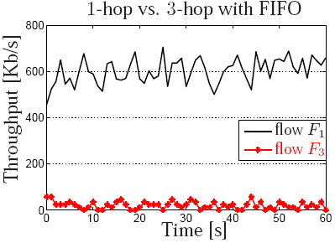
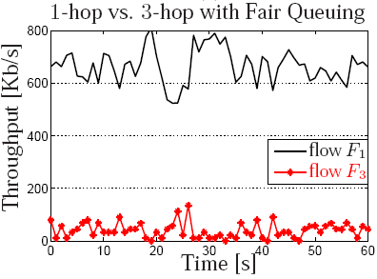
Starvation in Mesh Networks
Inter-flow fairness
Appropriate queuing is needed (Fair Queuing ^{[1]})
… but it is not enough
^{[1]} Demers et al., Sigcomm’89
10/14

Slide 12
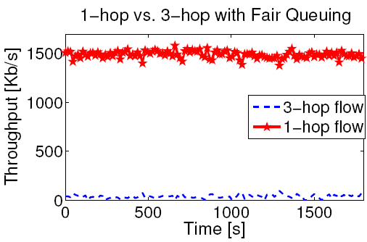
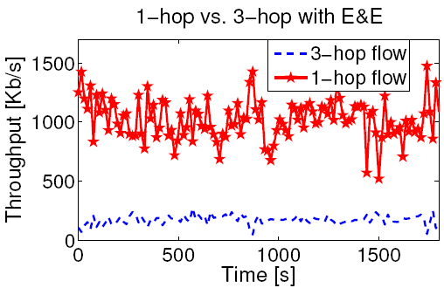
Practical Results in Mesh Networks
Deployment map:
Without E&E:
With E&E:
(proportional fairness)
1-hop flow
3-hop flow
1-hop flow
3-hop flow
11/14

Slide 13
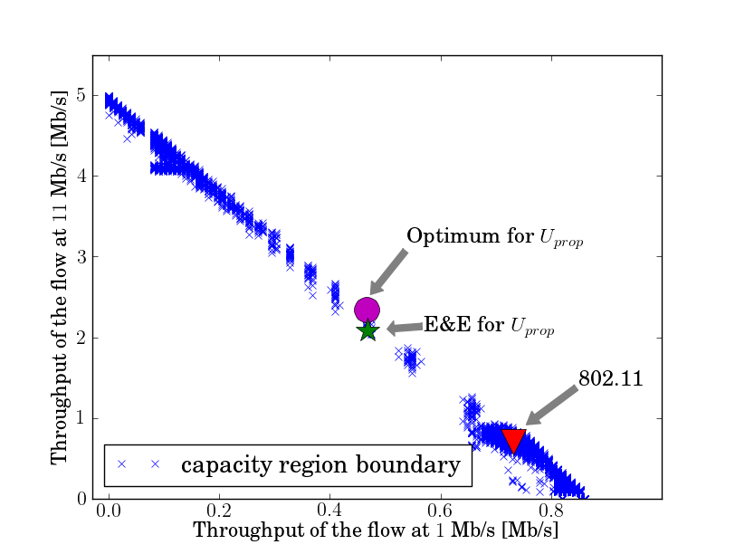
Simulation Results in WLAN
Ns-3 simulator
Re-use of same Click elements
More controlled environment
Possible estimation of capacity
Computation of optimum
12/14

Slide 14
Future Work
Include downstream traffic
Study and improve the speed of convergence
Analyze new distributions for the Explore phase
Study the interaction with rate adaptation
13/14

Slide 15
Conclusion
Wireless networks suffer from
Intra-flow problem (e.g., congestion)
Inter-flow problem (e.g., unfairness)
Time-variability
Difficulty/impossibility characterizing the capacity region
Need adaptive algorithms to maximize a desired utility
E&E solves the inter-flow problem in WLAN
Combining E&E and EZ-Flow in mesh networks
Solves both the inter-flow and intra-flow problem
Avoids network-wide message passing
Does not modify networking stack
14/14

