Slide 1
XPRESS: A Cross-Layer Backpressure Architecture for Wireless Multi-Hop Networks
Rafael Laufer, Theodoros Salonidis, Henrik Lundgren, Pascal Le Guyadec

Slide 2
Motivation
Wireless multi-hop networks operate below capacity
Poor coordination across layers
Poor coordination among transmitting nodes
How to achieve the network capacity?
Backpressure scheduling & routing
Select optimal link set for transmission

Slide 3
Backpressure Scheduling & Routing
Compute the weight of link as
Select links to maximize
Transmit chosen flows on the selected links
6
2
3
3
5
A
B
2
6
1
4
3
5
C
D
4
7
7
8
1

Slide 4
Backpressure Challenges
Practical challenges
Time slots: TDMA MAC in multi-hop networks
Link sets: Knowledge of non-interfering links
Protocol overhead: Queue backlogs known at each slot
Computation overhead: Exhaustive search over links sets
Link scheduling: Backpressure schedules links, not nodes
Hardware constraints: Memory limitations at wireless cards
Backpressure so far a theoretical concept
Backpressure-inspired solutions use priorization over 802.11
No real system implementing backpressure to date

Slide 5
Our Contributions
Design and implementation of XPRESS
First throughput-optimal backpressure system
Backpressure challenges addressed
Time slots: multi-hop TDMA MAC & time synchronization
Link sets: RSS-based interference estimation
Protocol overhead: Multi-slot framing and speculation
Computation overhead: Binary interference → MWIS
Link scheduling: Individual link queues at the MAC
Hardware constraints: Network/MAC queue coordination

Slide 6


XPRESS Overview
Mesh access point (MAP)
Sends queue lengths
Executes the schedule
Cross-layer protocol stack
Mesh controller (MC)
Receives flow queue lengths
Computes schedule
Disseminates schedule
Internet
MC
GW
MAP
CS
DS
…
…
…
…
Frame k

Slide 7
Backpressure Scheduler
Challenge: compute optimal schedule per slot
Knowledge of queue backlogs at each slot
Speculative scheduling: estimate queue backlogs
Challenge: schedule computation takes time
During frame , compute the schedule for frame
MC
Estimate
Estimate
Compute
Compute
Execution of
Execution of
CS
DS
CS
DS
MAP
Frame
Frame

Slide 8
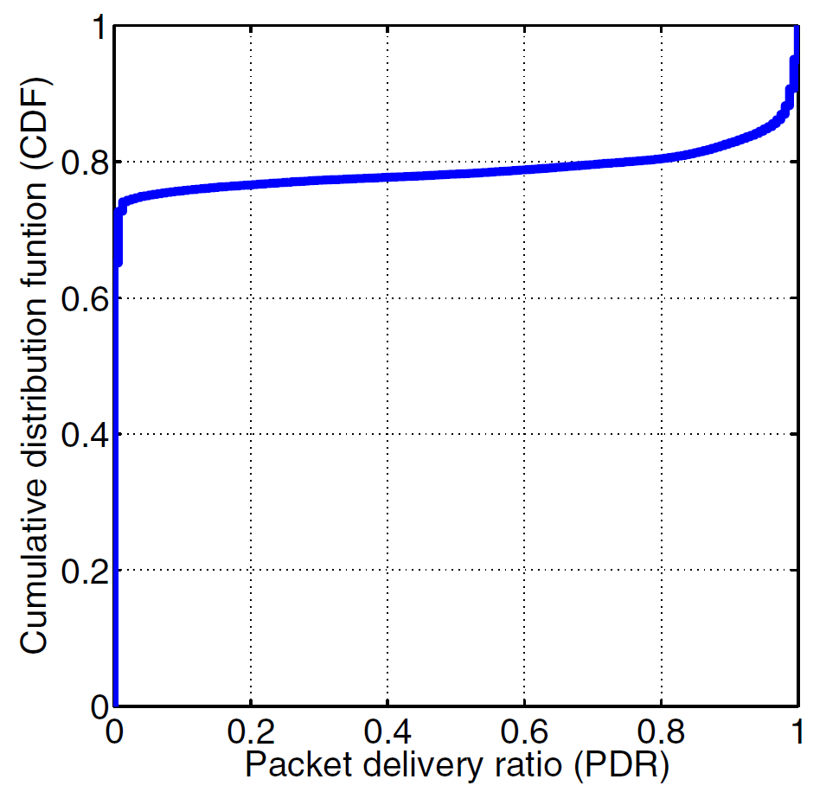
Optimal Schedule Computation
For each slot, exhaustive search over all link sets
Find link set which maximizes the sum of weights
Binary interference in TDMA MAC over 802.11 PHY
Links have either low or high PDR
Maximum weighted independent set (MWIS)
MWIS computation takes 100 µs for our testbed
→ Conflict graph

Slide 9
Interference Estimation
Knowledge of interference to build conflict graph
Naive approach: measure each link set at all rates
Measurement complexity
RSS measurements taken on each TDMA frame
Control packets used to measure RSS
Link RSS used to compute SIR → threshold per PHY rate
Measurement complexity reduced to
RSS limited only to decoded packets
PDR measurements also taken on each TDMA frame
Detection of hidden interferers

Slide 10



XPRESS Cross-Layer Protocol Stack
Flow Schedule
Link Schedule
Flow
Classifier
Link
Classifier
PreQ
FlowQ
LinkQ
A₁
Time
.
.
.
A_{n}
Congestion Control
Packet
Scheduler
Slot t+1
Packet
Scheduler
Per-Flow
Queues
Forward
Per-Link
Queues
Congestion control ensures flow rates
are within the capacity region
Flow queues at the kernel address the limited memory in the firmware
Flow scheduler enforces schedule
and avoids overflows at the firmware
Link queues required for link scheduling
Link scheduler enforces schedule, respecting TDMA slot boundaries
Local
User
Kernel
Firmware
Wireless

Slide 11
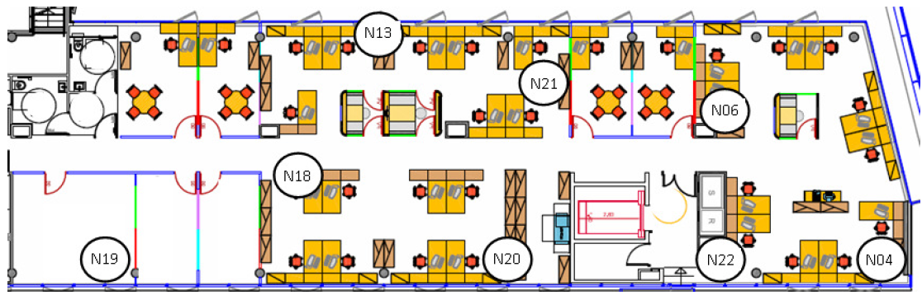
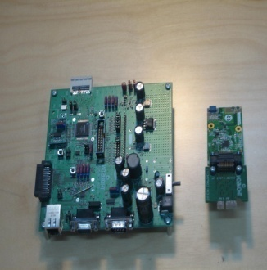
802.11a Indoor Testbed
MAP node
1.6 GHz CPU, 512 MB RAM
Linux OS / BP kernel module
802.11 Technicolor card (5 GHz)
Customized firmware (TDMA/link scheduling)
Mesh controller
2.7 GHz CPU, 16 GB RAM

Slide 12
Multi-Hop: Multi-Path Topology
Ability of XPRESS to exploit multiple paths
One flow between extreme nodes
XPRESS allowed to use every link available
802.11 uses the shortest ETX path

Slide 13
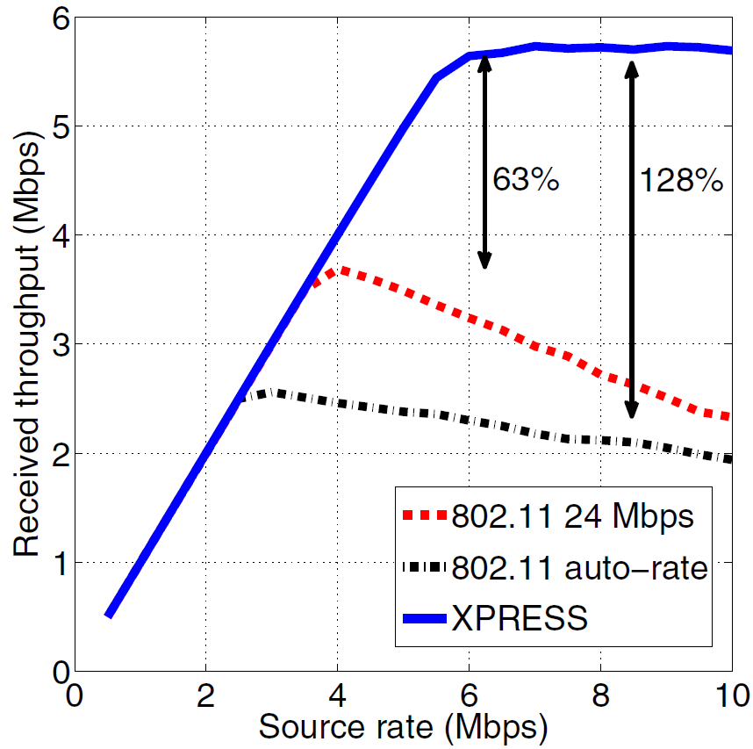
Multi-Hop: Multi-Path Topology
Coordination & path diversity → higher network throughput

Slide 14
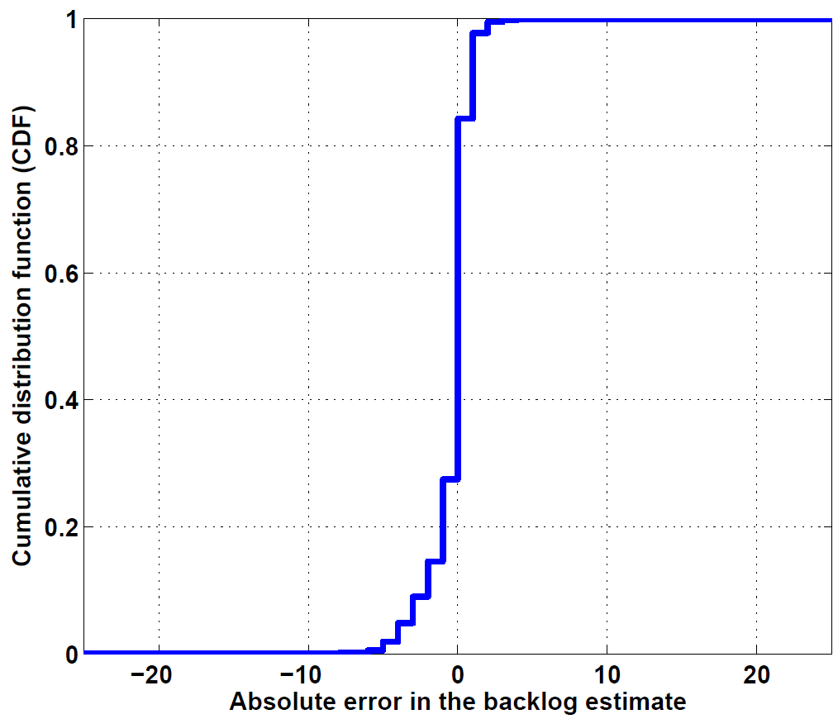
Queue Backlog Estimation Error
Accurate predictions → XPRESS reaches network capacity

Slide 15
Overhead: Computation
MWIS computation for optimal schedules
In theory, MWIS is NP-hard
In practice, polynomial with the number of links

Slide 16
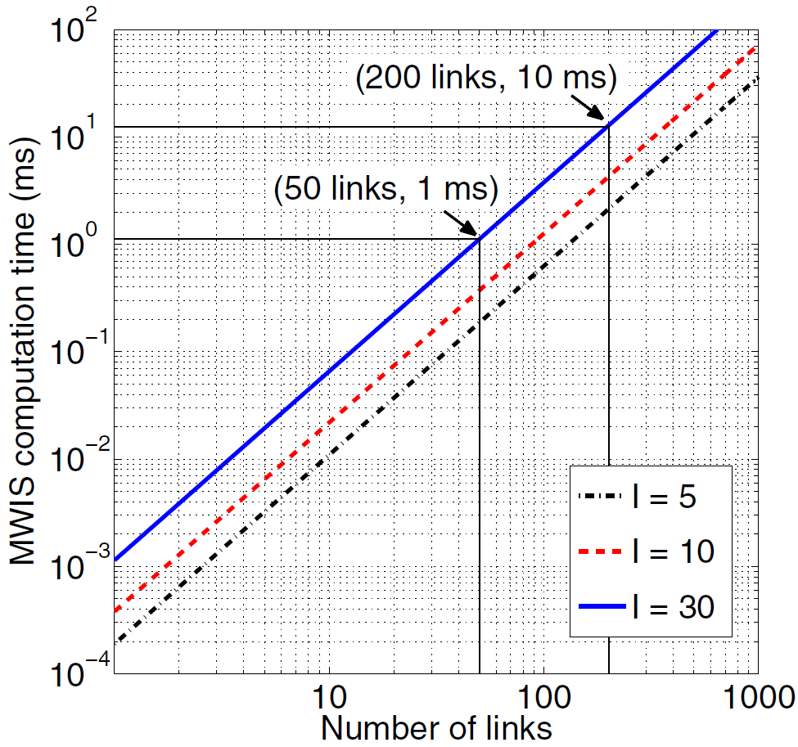
Overhead: Computation
MWIS computation is feasible for practical network sizes

Slide 17
Overhead: Protocol
Each frame
Queue backlogs sent from the MAPs to the MC
Computed schedule sent from the MC to MAPs
Time to exchange this on the control subframe

Slide 18
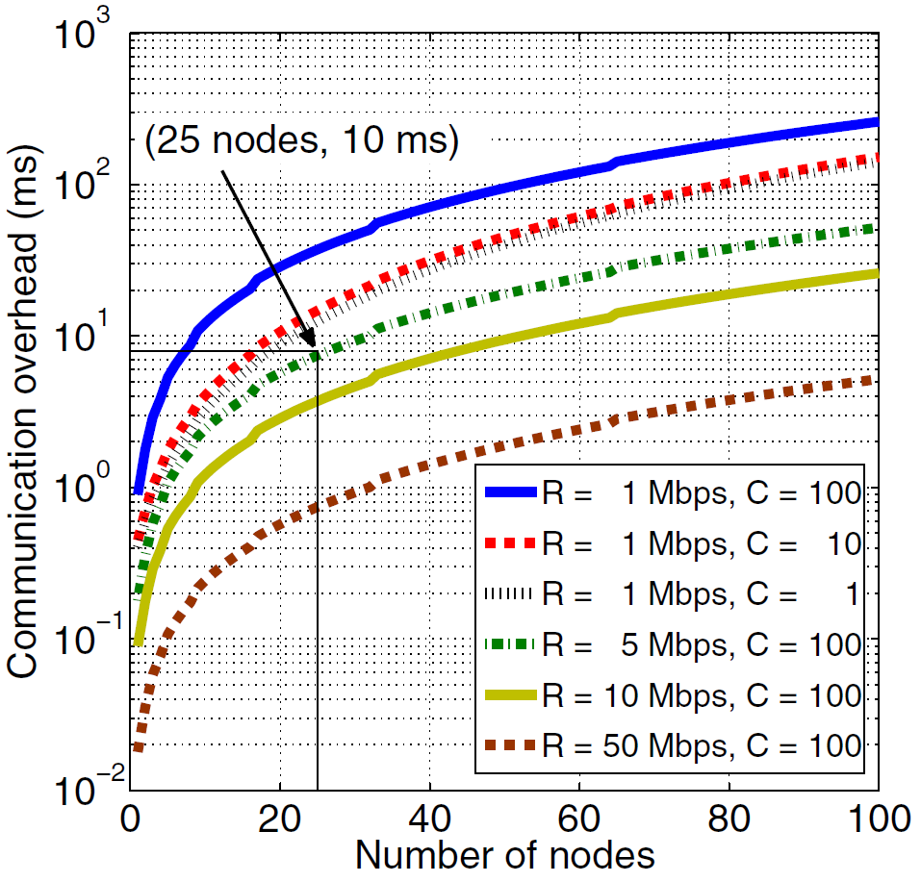
Overhead: Protocol
(50 nodes, 10 ms)
Control exchange feasible for practical network sizes

Slide 19
Conclusions
Design and implementation of XPRESS
Cross-layer backpressure architecture
First throughput-optimal backpressure scheduling
XPRESS integrates backpressure with TDMA MAC
XPRESS achieves the network capacity
High throughput gains in practice
Feasible for practical network sizes

Slide 20
XPRESS: A Cross-Layer Backpressure Architecture for Wireless Multi-Hop Networks
Rafael Laufer, Theodoros Salonidis, Henrik Lundgren, Pascal Le Guyadec

