Slide 1




REfactor-ing Content Overhearing to Improve Wireless Performance
ab
ab
1d
abc
abc
Shan-Hsiang Shen
Aaron Gember
Ashok Anand
Aditya Akella

Slide 2
Improve Wireless Performance
abc
abc
Focus on throughput
Leverage wireless overhearing
Notes:
Goal is to improve wireless performance
Focus on improving wireless network throughput
Achieving suitable throughput can be difficult when node density is high or link quality is poor
One way to achieve better throughput is to leverage wireless overhearing

Slide 3
Leveraging Overheard Packets
Reduced transmissions => more capacity
Several techniques
  RTS-id: suppress transmissions [Afanasyev ‘08]
  ExOR: better forwarding [Biswas ‘05]
  COPE: network coding [Katti ‘08]
Do not leverage duplication across transfers
Notes:
Wireless overhearing takes advantage of the fact that wireless is a broadcast medium
If packets are overheard, then they can be leveraged to reduce number of network transmissions => makes more capacity available for sending new data
There are several ways in which overhead packets can be used to reduce transmissions
RTS-id prevents an already received packet from being re-sent by responding to a request-to-send with an indication that transmission is not necessary
ExOR performs opportunistic routing, having the node closest to the destination which received the packet forward the packet, avoiding unnecessary intermediate transmissions
COPE, codes multiple packets together and sends them in a single transmission; a client is able to extract its packet by reversing the coding using overheard packets
These approaches do offer throughput improvements, but they miss some opportunities because they do not look for duplication across transfers
Even though the transmissions of individual packets are reduced, the same content may still be sent multiple times

Slide 4
Content-Based Overhearing
Ditto [Dogar ‘08]
Request
C1
A
AB
ABC
C
C
B
B
A
A
MANY MISSED
OPPORTUNITIES
Gateway
Request
C
C2
B
A
A
AB
ABC
A
AB
ABC
4
Does not remove sub-packet redundancy
Only works for some applications
Notes:
To be able to take advantage of this duplication across transfers, more recent overhearing approaches argue for a content-centric design
A content-centric approach doesn’t just look at individual packets, but looks at the content within those packets
If some particular data was already overhead, then packet transmissions need not contain that data
This object pull transport layer approach to content-overhearing misses several opportunities to improve throughput
Cannot remove smaller chunks of redundancy – others have shown that significant redundancy exists at the sub-packet granularity, with chunks as small as 64 bytes
Ditto can only provide benefits to applications which map well to retrieving data in pre-named object chunks – could transfer a static file with this approach, but cannot transfer dynamic generated data or data for applications which have small messages
“We posit that the transport layer is the wrong choice for content overhearing because it misses too many opportunities.”

Slide 5
We REfactor content overhearing
Application
Transport
Network
Link
Physical
Content overhearing at the network layer
Identify sub-packet redundancy
Notes:
In this work, we REfactor content overhearing to address these limitations and provide additional throughput benefits
We push content overhearing lower down the stack to the network layer
By looking for duplicates at the network layer, we can suppress duplicate data transmissions both within and across applications and are not limited by the types of data an application transmits
We look for redundancy at a much smaller granularity than Ditto – at the sub-packet granularity
Rather than needing to overhear several packets worth of data, we only need to have overheard a single packet payload to be able to suppress transmission of some duplicate data
By removing redundancy as small as 32 bytes from packet payloads, we reduce the size of individual transmissions
This means packets are transmitted faster, making air time available for other transmissions
Smaller packets also means packets are less likely to be lost due to errors, avoiding the need for retransmissions
Both of these outcomes means we can achieve a higher effective data throughput in the wireless network
Additionally, the way we remove redundancy enables our system to provide benefits in a wide range of wireless scenarios – infrastructure based networks, mobile ad hoc networks, mesh networks with opportunistic routing, and wireless networks which apply network coding

Slide 6
Outline
Benefits of REfactor approach
How REfactor works
Challenges & design innovations
Additional scenarios
Evaluation results

Slide 7
Benefits of REfactor Approach
Operates at finer granularity
  Ditto only works in 8-32KB object chunks
  Object chunks require overhearing several packets
  (not possible at 75% of nodes 50% of the time)
Savings from redundancy as small as 64 bytes
Leverages any overhearing, even a single packet
Notes:
First, REfactor operators at a finer granularity
Ditto works at coarse granularity, with object chunks 8-32KB in size
Benefits can only be realized if an entire object chunk is redundant
Prior studies on per-packet redundancy by Anand et al. have shown that about 70% of redundant chunks are less than 150 bytes in size
REfactor is able to realize airtime savings from these small-sized pieces of redundant data because it works at a sub-packet granularity
Throughput improvements can be realized by removing redundancy as small as 64 bytes
Not only do larger chunks miss these small pieces of redundancy, but they also require overhearing several packets
An object chunk 8KB in size means a node needs to overhear about 6 packets in order to be able to cache the entire object chunk and get some benefit from it
The authors of Ditto find that overhearing all the packets for an object chunk isn’t possible at ¾ of the nodes over half the time
- Without the entire object chunk, it is not possible to realize any savings
- Because REfactor operators at a sub-packet granularity, a node only needs to receive one packet to be able to realize savings later on
Overhearing is leveraged better because even a single overheard packet can provide benefits

Slide 8
Benefits of REfactor Approach
Operates at the network layer
  Transport-layer approach ties data to
  application or object chunk
  Transport approach requires payload reassembly
Redundancy elimination (RE) across all flows
Per-packet processing exceeding 600Mbps
Notes:
Second, benefits in REfactor arise from the fact that it operates at the network layer
Content-based overhearing approaches that work at the transport layer, such as Ditto, tie data to a specific application or object chunk
Redundancy can only be removed between flows for the same application or, in the case of Ditto, when the same object is requested
By pushing content-based overhearing to the network layer we can leverage redundancy elimination (RE) techniques to remove redundancy across all flows regardless of which application or object the data is associated with
For example, if two users access different pages on CNN, Ditto will treat the pages as two different objects and not remove any redundancy; however, redundancy elimination at the network layer will look for bytes that the same between the two pages and remove this redundancy
Redundancy elimination at the network can also still remove redundancy if an entire object chunk is duplicated
Operating at the transport layer also makes it necessary to reassemble payloads to be able to cache entire objects
Reassembly requires extra processing time and memory
By operating at the network layer, REfactor does not need to reassemble payloads and works on a per-packet basis
Our implementation can process packets at a rate exceeding 600Mbps, so even as wireless speeds continue to grow, REfactor can still be leveraged

Slide 9
Benefits of REfactor Approach
Operates in more scenarios
  Ditto design limits applicability
Improvements in several wireless scenarios
Notes:
The scenarios in which benefits can be achieved are also a benefit of the REfactor approach
Ditto’s design really limits it to providing savings in mesh networks
If you have a single AP in infrastructure mode, then there are no intermediate nodes to overhear and cache chunks, so you can’t realize any savings on the single wireless hop
REfactor, however, can realize savings even over a single wireless hop
It provides improvements in several wireless scenarios – mesh networks, infrastructure based networks, mobile ad hoc networks, and more esoteric situations like network coding – talk about later

Slide 10

REfactor Overview
 | Chunk | Reception Prob.
1
2
3
4
 | Chunk | Reception Prob.
1 | AB
2
3 | EF
4
AP
 | Chunk | Reception Prob.
1 | AB | C1=1; C2=0.8
2
3 | EF | C1=1; C2=0.8
4
C1
A B E F
C1
A B E F
Redundancy
Elimination
(RE) [Spring ’00]
AP does not know which
clients overheard
 | Chunk
1
2
3
4
 | Chunk
1 | AB
2
3 | EF
4
 | Chunk
1
2
3
4
 | Chunk
1 | AB
2
3 | EF
4
C1
C2

Slide 11
REfactor Overview
Data:
ABGH
 | Chunk | Reception Prob.
1 | AB | C1=1; C2=0.8
2
3 | EF | C1=1; C2=0.8
4
 | Chunk | Reception Prob.
1 | AB | C1=1; C2=0.8
2
3 | EF | C1=1; C2=0.8
4
AP
 | Chunk | Reception Prob.
1 | AB | C1=1; C2=0.8
2
3 | EF | C1=1; C2=0.8
4 | GH | C1=0.7; C2=1
C2
A B G H
C2
1
G H
Only have estimate of
whether client has chunk
 | Chunk
1 | AB
2
3 | EF
4
 | Chunk
1 | AB
2
3 | EF
4
 | Chunk
1 | AB
2
3 | EF
4
C2
A B G H
C1
C2

Slide 12
REfactor Overview
Data:
GHCD
 | Chunk | Reception Prob.
1 | AB | C1=1; C2=0.8
2
3 | EF | C1=1; C2=0.8
4 | GH | C1=0.7; C2=1
 | Chunk | Reception Prob.
1 | AB | C1=1; C2=0.8
2 | CD | C1=1; C2=0.5
3 | EF | C1=1; C2=0.8
4 | GH | C1=0.7; C2=1
AP
 | Chunk | Reception Prob.
1 | AB | C1=1; C2=0.8
2 | CD | C1=1;C2=0.5
3 | EF | C1=1; C2=0.8
4 | GH | C1=0.7; C2=1
C1
4 = GH
C1
G H C D
C1
4
C D
Need to be able to handle
cache misses
AP
4
 | Chunk
1 | AB
2
3 | EF
4
 | Chunk
1 | AB
2
3 | EF
4
 | Chunk
1 | AB
2
3 | EF
4 | GH
 | Chunk
1 | AB
2
3 | EF
4
C1
G H C D
C1
C2

Slide 13
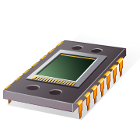

Challenges
Overhearing is probabilistic
  Lack tight cache synchronization
Resource constrained nodes
  Need to limit cache size and processing overhead
Notes:
Most of the issues I pointed out during the overview fall under the challenge of dealing with the fact that overhearing is probabilistic
When we send a packet to a client, chunks from that packet are added to its cache, but with overhearing, we do not know what other additional clients received the packet
We lack tight synchronization between client and AP caches – the AP and each client may each have different chunks in their cache
Second, wireless nodes tend to be resource constrained

Slide 14
Caching
Two issues:
  How do we store chunks?
  How do we refer to them in shim headers?
Hash table with pointers to log of chunks
Identify with SHA-1 hash
Consistent across caches
Large hash is expensive

Slide 15
Caching
Self-addressing chunks
  20-bit hash used as index into cache
Consistent across caches
Efficient use of memory
Need to properly handle cache collisions

Slide 16
Removing Redundancy
Traditional RE has tight synchronization
and can remove all identified redundancy
  Not the case with wireless overhearing
Reception probability vector
  Does client cache contain chunk?
Model-Driven RE
  What is the benefit from removing a
  redundant chunk?

Slide 17

Reception Probability Vectors
Destination client (d) definitely has chunk
Overhearing client (o) may have chunk
  Compare r_{d} and r_{o}
r_{d}
r_{o}
o
d
Rate used to send
to destination (d)
Last rate used to send
to overhearing client (o)

Slide 18
Model-Driven RE
Reduced
packet size
air time
savings
higher
goodput
Cache miss => extra transmissions
=>
=>
Expected benefit =
[transmission time savings]
– [cache miss cost]

Slide 19
Network Coding Scenario
COPE [Katti ’08]
C4
C4
C D G H
C D G H
C3
C3
A B E F
A B E F
+ REfactor
C1
C2
Relay
C4
2
G H
C3
1
E F
C3 & C4
C3 & C4
A B E F
C D G H
 | Chunk
1 | AB
2
3
 | Chunk
1 | AB
2
3
 | Chunk
1
2 | CD
3
 | Chunk
1
2 | CD
3
C3
C4

Slide 20
Evaluation
Implemented in Click
Single AP with two clients
  C1: perfect overhearing; high rate
  C2: varied overhearing; varied rate
Traces derived from real-world traffic
  49% inter-client redundancy
C1
Near
Middle
Far
C2

Slide 21

Testbed Results
Total Data Transferred
Goodput =
Total Transmission Time
C2’s Distance From AP | REfactor Goodput | No RE Goodput | Percentage Improvement
3m (near) | 4.0 Mbps | 3.4 Mbps | 20%
6m (middle) | 3.0 Mbps | 2.6 Mbps | 14%
10m (far) | 1.3 Mbps | 1.2 Mbps | 6%

Slide 22
Simulation Results
Notes:
Look at 4 different scenarios
Perfect overhearing which is upper bound on performance
REfactor
Greedy RE
No RE which is lower bound on performance
With high overhearing, the goodput with REfactor is 18% better than no RE
With low overhearing, the goodput is only about 1% better; however, REfactor does not cause goodput to drop below No RE
Now compare Greedy RE to REfactor
With high overhearing, Greedy RE is the same as REfactor
With low overhearing, Greedy RE is 9% worse than REfactor; furthermore, it is also about 9% worse than No RE – highlights the importance of model driven approach

Slide 23
Conclusion
Up to 20% improvement in wireless goodput
Fine-grained at network layer
  Enables better leveraging of overhearing
  Savings with any type of application
Improvements in several wireless scenarios
agember@cs.wisc.edu

Slide 24
Evaluating REfactor + Network Coding
Click simulation with
REfactor + COPE [Katti ‘06]
C3 & C4 Overhearing Percentage | Percent better than just COPE
90% | 14%
50% | 10%
10% | 3%

Slide 25
SHA-1 vs. Self-addressed Chunks
Minimum chunk size | REfactor |  | SHA Hash Based
 | Redundancy Detected | Effective RE | Redundancy Detected | Effective RE
32 | 0.31 | 0.27 | 0.41 | 0.22
64 | 0.28 | 0.26 | 0.38 | 0.29
128 | 0.23 | 0.22 | 0.31 | 0.27

Slide 26
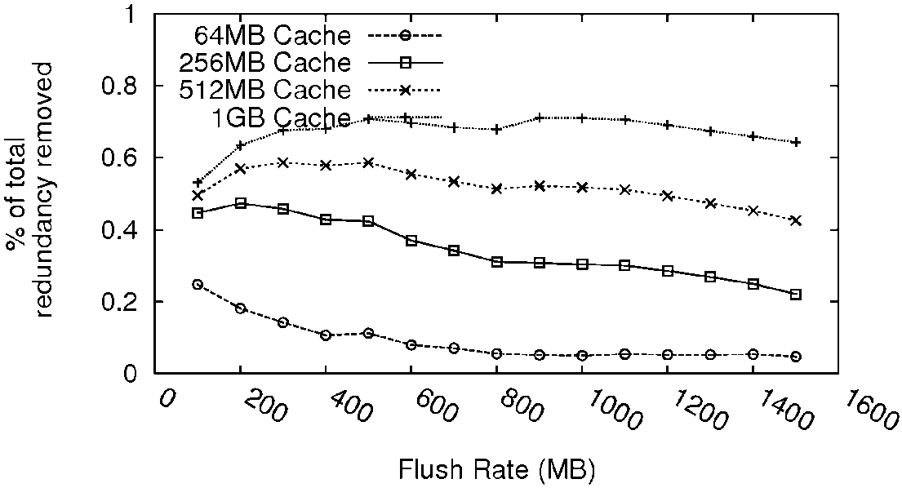
Memory vs. Unique Chunks Tradeoff
Require 2^{n} * m bytes of memory
to store 2^{n} chunks of maximize size m

Slide 27
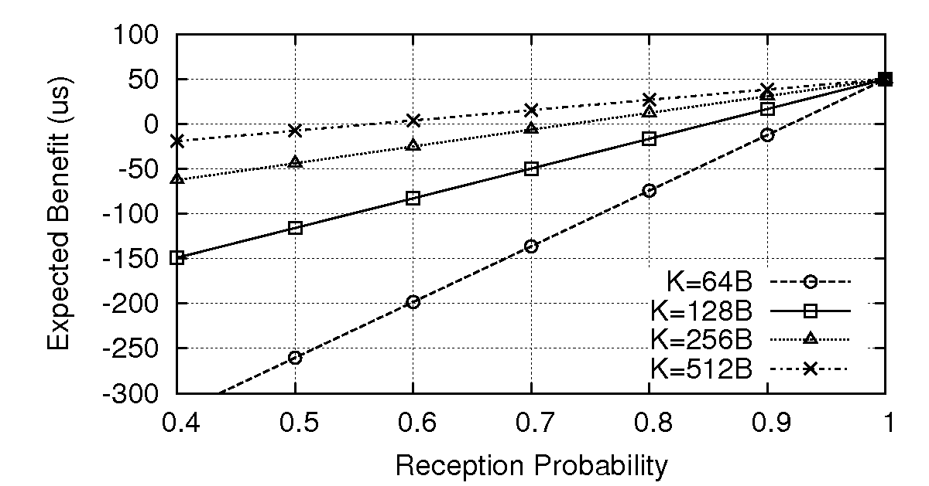
Model-Driven RE
Use model to decide on removal of 64B chunk

Slide 28
Simulation Results - Airtime

Slide 29
Multi-AP Scenario
 | Chunk
1
2
3
 | Chunk
1 | AB
2
3 | EF
 | Chunk
1
2
3
AP1
AP2
 | Chunk
1 | AB
2 | CD
3
To: C2
To: C2
ABCD
To: C1
1
CD
To: C1
ABEF
ABEF
 | Chunk
1
2
3
 | Chunk
1 | AB
2
3 | EF
 | Chunk
1
2
3
 | Chunk
1 | AB
2
3 | EF
 | Chunk
1 | AB
2
3 | EF
To: C1
ABCD
C1
C2

Slide 30
Ad-hoc Mesh Scenario
 | Chunk
1
2
3
 | Chunk
1 | AB
2
3 | EF
 | Chunk
1 | AB
2 | CD
3 | EF
 | Chunk
1 | AB
2 | CD
3 | EF
R2
To: C1
4
CD
 | Chunk
1
2
3
 | Chunk
1 | AB
2
3 | EF
 | Chunk
1 | AB
2
3 | EF
 | Chunk
1
2
3
 | Chunk
1 | AB
2
3 | EF
 | Chunk
1 | AB
2 | CD
3 | EF
To: C1
ABCD
To: C1
ABCD
To: C2
To: C2
ABEF
ABEF
C1
C2
 | Chunk
1
2
3
 | Chunk
1 | AB
2
3 | EF
R1

