Slide 1
SmartVNC: An Effective Remote Computing Solution for Smartphones
Cheng-Lin Tsao, Sandeep Kakumanu, and Raghupathy Sivakumar
Georgia Institute of Technology
ACM MobiCom ‘11
Las Vegas, NV, USA, Sept. 20, 2011

Slide 2
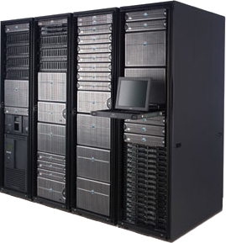
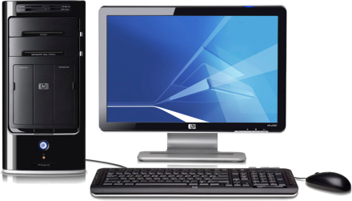
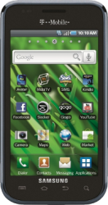
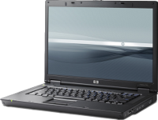
Remote Computing from Smartphones
Smartphones: mobile phones w/ advanced capabilities
Overtook PCs in global shipments in 2010 [source: CNN, Feb 2011]
Remote computing from smartphones
Allowing users to access a remote PC, ex. VNC and RDP
Accessing applications and data in a PC when being away from it
Accessing a PC instance in VDI (Virtual Desktop Infrastructure)
Remote IT support for troubleshooting
Availability and popularity of remote computing clients
AndroidVNC, TeamViewer, etc: 2.5M+ downloads in Android
Knowledge workers spend 35% of time at their desks. [source: Harvard Business Review, Sept 2011]
VDI server
Internet
Files & data
User
IT technician
Local PC
Applications
Remote PC
Smartphone
Notes:
http://money.cnn.com/2011/02/09/technology/smartphones_eclipse_pcs/index.htm
Q4 2010: PC = 92.1M, smartphone = 100.9M
Harvard Business Review, Sept 2011. 44 surveys with 7312 knowledge workers in 18 organizations. Employees spend 35% of time at desk.

Slide 3
User Experience Today
Demo of remote computing from a smartphone
Client: AndroidVNC in Samsung Galaxy S Android phone
Server and PC application: MS Windows and Intuit QuickBooks
Task: generating a sales report and exporting it into csv format
Real-user experiments
22 users, 9 applications, 54 tasks of 3 complexity levels
Metric: opinion score (1=poorest, 5=best)
Poorer user experience with remote
computing from smartphones
Consistent observation with Linux,
iPhone, and/or RDP
More serious degradation from higher
task complexity when using smartphones

Slide 4
Understanding User Experience
Task effort: number operations required for a task
Mouse clicks & keystrokes in PCs; touch actions in smartphones
Task effort inflation from smartphones
Causes: the zooming, panning, keyboard, and error problems
TaskEffort^{RCS} = TaskEffort^{PC} × Inflation
Correlation between task effort and opinion score
Lower correlation in PCs and higher correlation in smartphones

Slide 5
Core Construct: Aggregation
Reducing task effort by aggregating repetitive sequences of operations in user activity
Q2. How do we efficiently harness the redundancy?
Q2. How do we efficiently harness the redundancy?
Macros: a recorded sequence of instructions
Application macros [Mickens ‘10, Leshed ‘08, Hupp ‘07, Bolin ’05, Excel]
Raw macros [Chang ‘04 , AutoHotkey]
Q1. Does redundancy exist in user activity?
Q1. Does redundancy exist in user activity?
Tracing user activity
Activity monitor tool
10 volunteer users
Recording all operations in all applications
Average period:12.5 days
Analyzing activity redundancy
Average redundancy: 34.32%
Yes
Operation Aggregation
Q3. How do we design and realize a system for smartphone users?

Slide 6
SmartVNC
Overview
Creating robust, general, and extensible macros to aggregate operations on the PC
Invoking macros easily in remote computing from the smartphone
Generic design elements for any PC platform, smartphone platform, and remote computing protocol
Goals
Application macros
(ex. Excel)
Raw macros
(ex. AutoHotKey)
Application agnostic
X
O
Robust
O
X
Extensible
X
X
Task effort reducing
X
X
Easy adoption
X
X

Slide 7
Application-Agnostic Smart-Macros
Smart-macros: a sequence of operations with addressable GUI element information
Key design
Tapping into a GUI accessibility framework (ex. Microsoft UI Automation) for robustness and generality
Details
Extracting the GUI element handle for each operation
FromPoint() for mouse clicks and FocusedElement() for keystrokes
Retrieving an identifier as (name, auto_id, ctrl_type)
Smart-macros
Effort reducing frontend
Parameterization
Offline recommendation
Raw macros
Application agnostic
Not robust
Smart-macros
Application agnostic
Robust
Application macros
Application specific
Robust
mouse clicks
keystrokes
operating system
event
GUI element
function call
software component
User

Slide 8
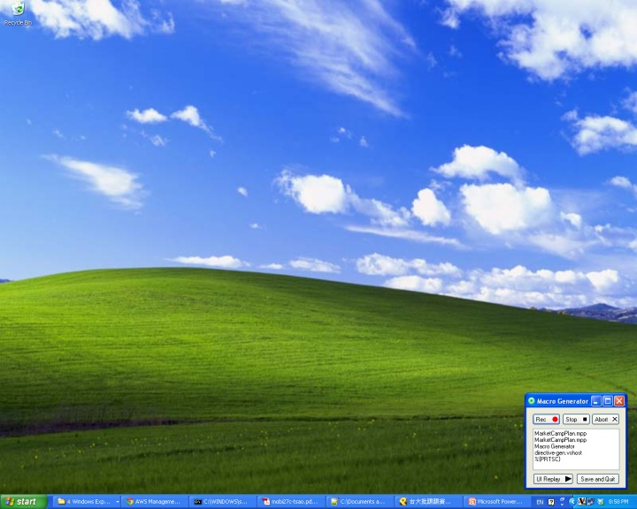
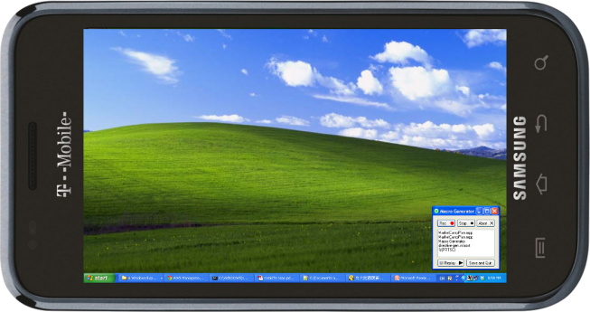
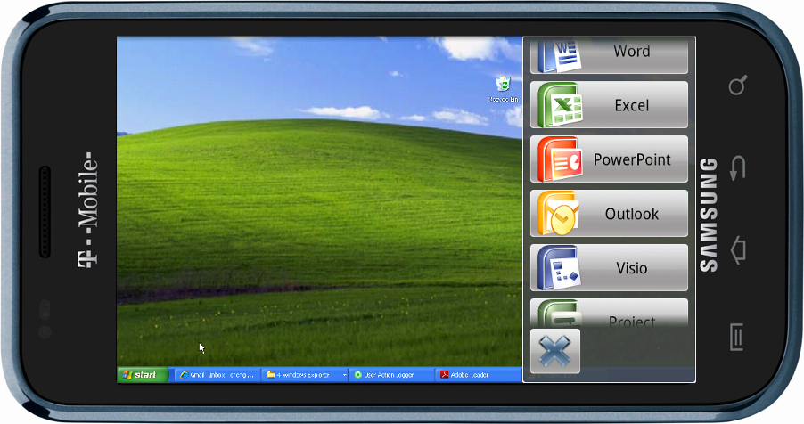
Task Effort Reducing Front-end
Easy and non-intrusive access to macros from
smartphones
Key design
Tailored interface in reducing task effort from smartphones with seamless integration into the remote computing client
Details
Collapsible overlay on the remote computing client
Showing macro playback progress via remote computing
Task effort reduction
Grouping macros by applications
Automatic application opening
Automatic zooming and panning the
front-end view to the focused GUI element
Fast playback that minimizes time on task
Smart-macros
Effort reducing frontend
Parameterization
Offline recommendation
Scrollable application/macro menu
Remote computing
Hide overlay panel
Overlay panel

Slide 9
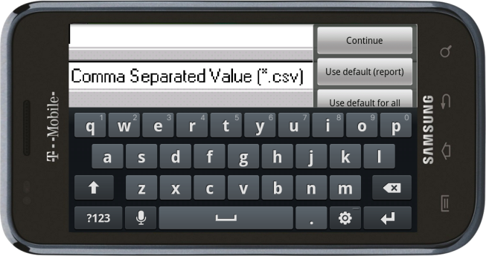
Parameterization and Extensibility
Accommodating variations and extensions in
macro replay
Parameterization: replacing certain operations
Extensibility: interrupting playback to add/remove operations
Key design
Identifying parameter operations that only change the state of the associated GUI element
Details
Automatically categorizing operations by
the control type
Allowing the user to manually specify parameter operations
Providing choices for parameter operations in runtime
Allowing the user to pause playback and/or add raw input
Smart-macros
Effort reducing frontend
Parameterization
Offline recommendation

Slide 10
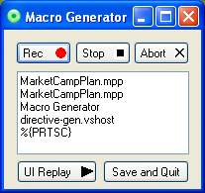
System and Prototype
Two-end enhancement on top of remote computing
Prototyping Testbed
SmartVNC server
Dell desktop (2.8 GHz/3GB/19” screen/WinXP SP3)
Coexisting with unmodified RealVNC server
SmartVNC client
Samsung Galaxy S (1GHz/512MB/4” screen/Android 2.1)
Integrated with AndroidVNC
Access network
Local Wi-Fi 802.11g (54Mbps)
Demo: exporting a sales report with
QuickBooks using SmartVNC
SmartVNC
Server
SmartVNC
Client
Macro Recording
store
Macro
Repository
retrieve
Macro Presentation
Macro Recommendation
Macro Replaying
replay
handle parameter
Remote Computing Server
screen output
Remote Computing Client
control input
Internet
User

Slide 11
Performance Evaluation Methodology
Metrics
Macroscopic: time on task and task effort
Microscopic: subjective feedback and system overhead
Experimental methodology
22 volunteers
Students of ages between 20 and 30
54 tasks of 3 complexity levels (easy, medium, and hard)
9 PC applications: Word, Excel, PowerPoint, Outlook, Quicken, IE, Visio, Project, and SharePoint
Real-user experiments
Using (after practicing) PC, mobile VNC, and SmartVNC
Pre-recorded macros for SmartVNC
Trace-based experiments
Evaluating achievable time/effort reduction in generic tasks

Slide 12
Performance (1/2)
Macroscopic performance
Mobile VNC inflates task effort by 3.32x to 4.55x (average 3.73x).
SmartVNC reduces task effort from smartphones by 83% to 86%.
SmartVNC requires less tax effort than PC in certain tasks (average 0.61x).
Time on task is similar to task effort.
Subjective opinion
Lots of users have poor experience with mobile VNC.
Almost all users give good or best opinion to SmartVNC.
Task effort reduction improves UX.
Error bar: 90% confidence interval
Poorest
Best

Slide 13
Performance (2/2)
Overhead analysis
Server (measured w/ MS perfmon)
CPU: higher usage due to fast playback
Memory: unoptimized code but sustainable
Client (measured w/ SystemPanel)
CPU: lower usage w/ less interaction
Memory: efficient integration
Trace-based evaluation
Split operations in the collected traces
Repetitive or non-repetitive
Calculating total effort in smartphones
Repetitive: reduced effort (0.61x)
Non-repetitive: inflated effort (3.73x)
Average reduction from VNC: 37.71%

Slide 14
Summary
Poor user experience and high task effort in remote computing from smartphones
Propose SmartVNC to reduce effort with operation aggregation
Application-agnostic smart-macros
Task effort reducing front-end
Parameterization and extensibility
Offline macro recommendation
Prototype and evaluate SmartVNC in testbed
Significant performance improvement in task effort, time to task, and subjective opinion score
Minimal system overheads at the client

Slide 15
Thank you!
Questions and Comments?

