Slide 1

SoftCast⁺
Scalable Robust Mobile Video
Szymon Jakubczak and Dina Katabi

Slide 2
Demos
Compare our SoftCast and MPEG4/H.264
Mobility demo: receiver moves away from source
http://people.csail.mit.edu/szym/softcast/single.swf?config=data/football/b130_h.xml
Same mobility demo but with 10x more compression
http://people.csail.mit.edu/szym/softcast/single.swf?config=data/football/b016_h.xml
Packet loss demo
http://people.csail.mit.edu/szym/softcast/multi.swf?config=data/msr/er.xml&zoom=1.0

Slide 3
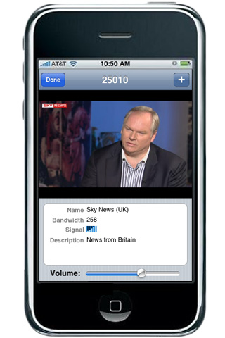
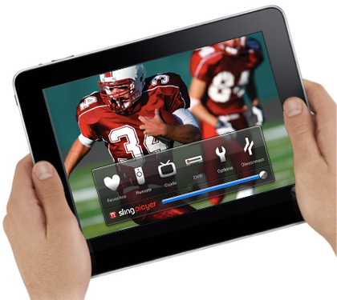
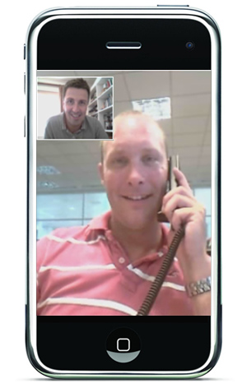
Mobile video is the future …
All TV programs to your handheld device
Live broadcast of sports and concerts
Mobile video calls

Slide 4
Cisco Visual Networking Index predicts
the incoming 5 years will show
66x increase in mobile traffic
mainly mobile video
Can WiFi, WiMax, or LTE deal with such growth?
Notes:
Can existing technology support

Slide 5
Today’s Wireless Video Is Unscalable

Slide 6


Today’s Wireless Video Is Unscalable
Different receivers have different channel qualities
1 Mb/s
6 Mb/s
In current wireless, sender has to pick one bitrate
Today, sender transmits one video per receiver
→ Unscalable
Broadcast one stream to all receiver
→ Reduce all to the performance of worst receiver

Slide 7
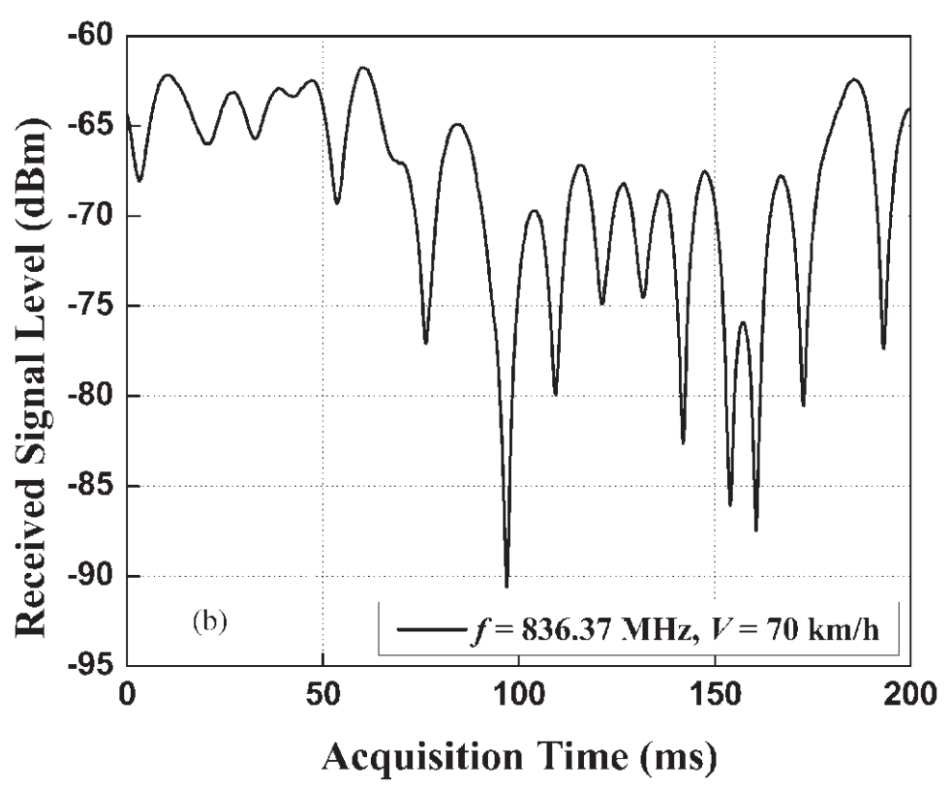
Mobility Makes Things Worse
Causes fast unpredictable variations in channel quality
Received Signal Level [dBm]
200ms
Time [ms]
Current wireless can’t transmit one video that works at all channel qualities
Mobile video experiences glitches and stalls

Slide 8
Problem
Today’s WiMax, WiFi, …
Cannot transmit one video stream that satisfies all channel qualities

Slide 9
Performance Cliff

Slide 10
Performance Cliff
Critical quality
Channel is better than critical point → Video doesn’t improve
Channel is worse than critical point → Video is unwatchable

Slide 11
Performance Cliff
Critical quality
Channel is better than critical point → Video doesn’t improve
Channel is worse than critical point → Video is unwatchable

Slide 12
Performance Cliff
H.264; BPSK ½ rate
Channel is better than critical point → Video doesn’t improve
Channel is worse than critical point → Video is unwatchable

Slide 13
Performance Cliff
H.264; BPSK ¾ rate
Channel is better than critical point → Video doesn’t improve
Channel is worse than critical point → Video is unwatchable

Slide 14
Performance Cliff
H.264; QPSK ½ rate
Channel is better than critical point → Video doesn’t improve
Channel is worse than critical point → Video is unwatchable

Slide 15
Performance Cliff
H.264; 16QAM ½ rate
Channel is better than critical point → Video doesn’t improve
Channel is worse than critical point → Video is unwatchable

Slide 16
Performance Cliff
H.264; 16QAM ¾ rate
Channel is better than critical point → Video doesn’t improve
Channel is worse than critical point → Video is unwatchable

Slide 17
Performance Cliff
H.264; 16QAM ¾ rate
H.264; 16QAM ½ rate
H.264; QPSK ¾ rate
H.264; QPSK ½ rate
H.264; BPSK ¾ rate
H.264; BPSK ½ rate
Channel is better than critical point → Video doesn’t improve
Channel is worse than critical point → Video is unwatchable

Slide 18
Ideally: One-Video for All Channel Qualities
H.264; 16QAM ½ rate
Ideal
H.264; QPSK ¾ rate
H.264; QPSK ½ rate
H.264; BPSK ¾ rate
H.264; BPSK ½ rate
Large Bandwidth Saving
No glitches or stalls with mobility
Transmitter broadcasts one video
Each receiver decodes a video quality commensurate with its channel quality
Notes:
How can we obtian this ideal?
To undertand this we first need to understand why existing video suffers form cliff effect

Slide 19
Why Does Today’s Video Suffer a Cliff?
Pixels
Video Codec
(Compression)
Bits
PHY Code
(Error Protection)
Compression and error protection convert real-valued pixels to bits
Bits destroy the numerical properties of original pixels
  11110 and 11111 could refer to pixels as different as 5 and 149
If all bit errors can be corrected ➔all pixels are correct
Even one residual bit error ➔arbitrary errors in pixels
Notes:
so *why* cannot the current design *provide* smooth video degradation?
The reason is that it has completely sacrificed smooth degradation for efficiency,
that is, it tries very hard to compress and error-protect the stream but in the process gives up on smooth degradation.
Current compression and error protection convert real-valued pixels to sequences of bits.
These bits, have _no numerical relation, _whatsoever_, to the original pixel values.
For example, two sequences that differ in only one bit, like 11110 and 111111,
could refer to pixel values as different as 5 and 149.
You end up with a system where
- if you can correct *all* bit errors, then all the pixels are *correct*…
however, even *one* residual bit error leads to _arbitrary_ errors in pixel values
-- and *sharp* degradation in video quality.

Slide 20
Analog TV Did not Suffer a Cliff
It did not convert pixels to bits
Real-Valued Pixels
2, 153, …
α
Transmitted Values
2α, 153α, …
Transmitted values are linearly related to pixels
Small perturbation in pixel values
Small perturbation on channel
But Analog TV was not efficient:
No compression
No error protection
Notes:
But we_had_ a system that provided smooth video degradation: analog TV
(pause)
Analog TV, did *not* convert pixels to *bits*.
Instead, it simply transmitted a scaled version of the *pixels*.
It was LINEAR.
-- so naturally, when the channel perturbed the transmitted signal,
it caused a _proportional_ perturbation in the pixel values, and hence *smooth* degradation.
But the *problem* with analog TV is that it is not *efficient*,
because it has no compression nor error protection coding.

Slide 21
SoftCast ⁺
SoftCast combines the best of both worlds
Is as efficient as digital video
Has no cliff effect, like analog video

Slide 22
SoftCast ⁺

Slide 23
SoftCast ⁺
Pixels
Bits
Joint code to compress and protect from error
PHY Code
(Error Protection)
Video Codec
(Compression)
Signal samples
Linear
Small perturbation in pixel values
Small perturbation on channel
No Cliff Effect
Need to compress and protect from errors, while staying linear!

Slide 24
Existing compression is not linear
Challenge 1

Slide 25
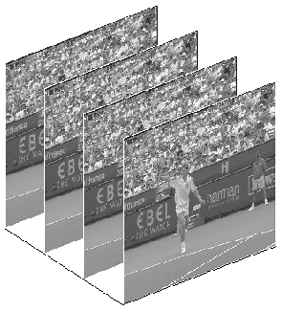
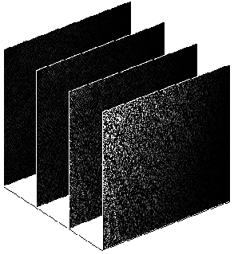
Compress by dropping 3D frequencies
Solution 1
Black Regions are Zeros
3D DCT
Pixel values change slowly in space and time
In the frequency domain, most temporal and spatial frequencies are zeros
SoftCast+ transforms to freq. domain using 3D-DCT
Notes:
First, how does SoftCast compress? -> In an image, pixels change *gradually*, which means the *frequency* of change is small;
so if we *change* image representation to the _frequency_ domain, we find that most of the *high* frequencies are _zero_.
SoftCast compression *exploits* this fact, and has the following *two* steps:
-> first, it converts each frame to the frequency domain using DCT (DCT is a *well known* transform, if you haven’t *heard* of it before, just *think* of it as the Fourier transform)
->So here’s a frame. SoftCast computes DCT on all pixels in the frame. By applying DCT on the frame as a whole, we get a representation that looks -> like this. ( ) The level of gray in *this* image corresponds to the magnitude of each frequency. So all of the values in the black areas are zeros.
We don’t need to transmit the zeros, we just need to tell the decoder where they are, because it can just insert the zeros back.
So now in the second step, -> SoftCast ignores all the zero frequencies, and transmits only the non-zero frequencies. ( ) -> Since a *large* fraction of the frequencies is zeros…, by discarding them, we can achieve high *compression* rate, without losing *information*.

Slide 26
Compress by dropping 3D frequencies
Solution 1
Black Regions are Zeros
3D DCT
Compression: Send only non-zero frequencies
More aggressive compression: Send only frequencies above a threshold value

Slide 27
Compress by dropping 3D frequencies
Solution 1
Black Regions are Zeros
3D DCT
3D DCT compresses within and across frames
Compression: Send only non-zero frequencies
More aggressive compression: Send only frequencies above a threshold value
DCT is a linear operator ➔ Linear Compression

Slide 28
Challenge 2
Existing error protection codes operate on bits not reals
Notes:
Now that we have _compressed_ the video, how do we *protect it* from *channel* noise?
Conventional error protection codes are designed to operate on *bit sequences*, so they are not *suitable* for SoftCast.
-> In order to provide error protection to _real_ values, SoftCast uses *magnitude scaling*.

Slide 29
Solution 2
Protect transmitted values using magnitude-scaling
25.1
25
±0.1
24.9
Before Tx Scale up
After Rx Scale down
Channel Noise
±0.1
/10
x10
2.51
2.5
2.49
±0.01
Compressed value
Transmitted
Received
Decoded
Scaling the transmitted values up, scales down the error by the same factor
Notes:
Let’s see how this works using an example.
-> Suppose we want to transmit a codeword that has a value of 2.5.
-> Say, we scale the codeword up 10x before transmission,
-> in this case, we’re going to transmit 25.
-> the channel adds noise to the transmitted value,
for example suppose the noise is +- 0.1
-> the receiver then receives a value between 24.9 and 25.1
-> when the receiver scales this value back down, the error is reduced to just 0.01
=> Thus, scaling the codeword *up*, scales the effective noise on the channel _down_ by the same factor.
(emo) Ok! Let’s just scale *everything* *all the way up*!!

Slide 30
How much to scale up?
Scaled-up values are larger ➔ take more power to transmit
But hardware has limited power
Formulate it as an optimization that finds the scaling factors that minimize received video errors
Idea: Scale DCT frequencies based on their information content, i.e., their variance
Theorem
Let λ_{i} be the variance of a set of frequencies i
The linear encoder that minimizes video errors scales the values x_{i} in the set i as follows:
y_{i} = g_{i} x_{i} where g_{i} ~ λ_{i}^{-1/4}
Magnitude Scaling is Linear
→ Linear Error Protection

Slide 31
How Does the PHY Transmit?
Recall: Channel transmits pairs of real values (I and Q)
Traditional PHY maps bits to reals (I,Q) using modulation
…0011001
QAM modulation
I
Q
SoftCast PHY sends the real-valued codewords as I and Q
y_{[1]}
I
y_{[3]}y_{[1]}
…y_{[5]}y_{[4]}y_{[3]}y_{[2]}y_{[1]}
…y_{[5]}y_{[4]}y_{[3]}
…y_{[5]}
y_{[2]}
Q
y_{[4]}y_{[2]}
SoftCast+ achieves its goal of ensuring that the transmitted signal is linearly related to the pixels
Notes:
So now, how do we _transmit_ these compressed and error-protected *codewords*?
At a high level, recall that the wireless channel transmits *pairs of real values*, that are referred to as the I and Q samples.
The current PHY has to map the *bits* to these real-valued I and Q.
The process that performs this mapping is called Quadrature Amplitude Modulation or QAM
In contrast, SoftCast’s codewords are *already* real-valued. Thus the job of the PHY is much simpler: -> it can directly transmit pairs of SoftCast codewords as the I and Q samples
For example, if the incoming codewords are y1, y2, y3, and so on,
then we can take the first pair y1 and y2 and transmit them as the first pair of I/Q samples,
then take the next pair y3,y4 and transmit them as the next pair of I/Q, and so on.
As you can see, by maintaining the real-valued representation, => SoftCast achieves its goal of ensuring that the transmitted signal is linearly related to the pixels.

Slide 32
Performance
Notes:
Let’s see how SoftCast performs.

Slide 33
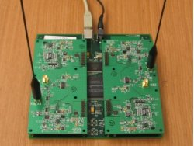
Implementation
USRP2 Hardware
GNURadio software
Carrier Freq: 2.4 GHz
OFDM-Based Physical Layer

Slide 34
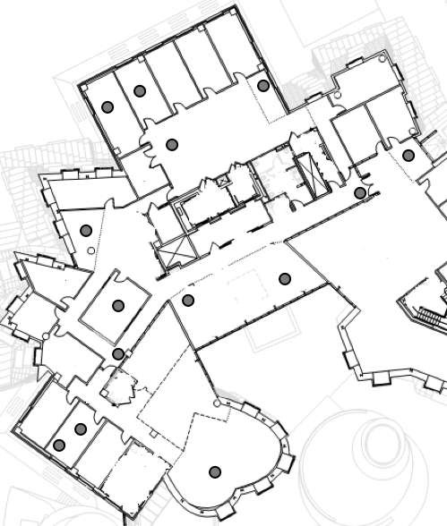
Testbed
In each run, we pick a transmitter at random and let the other nodes be receivers

Slide 35
Compared Schemes
SoftCast ⁺
H.264/MPEG4 over 802.11-like OFDM physical layer
Layered video (i.e., SCV) over Hierarchical Modulation

Slide 36
Video Quality as Function of Channel Quality

Slide 37
Video Quality as Function of Channel Quality
H.264; BPSK ½ rate

Slide 38
Video Quality as Function of Channel Quality
H.264; BPSK ¾ rate

Slide 39
Video Quality as Function of Channel Quality
H.264; QPSK ½ rate

Slide 40
Video Quality as Function of Channel Quality
H.264; 16QAM ¾ rate
H.264; 16QAM ½ rate
H.264; QPSK ¾ rate
H.264; QPSK ½ rate
H.264; BPSK ¾ rate
H.264; BPSK ½ rate
Current approach cannot deliver a single video that works well for all channel qualities

Slide 41
Video Quality as Function of Channel Quality
+
H.264; 16QAM ¾ rate
SoftCast
H.264; 16QAM ½ rate
H.264; QPSK ¾ rate
H.264; QPSK ½ rate
H.264; BPSK ¾ rate
H.264; BPSK ½ rate
SoftCast⁺ delivers one-video that satisfies all channels qualities

Slide 42
Video Quality as Function of Channel Quality
+
SoftCast
2-layer video

Slide 43
Video Quality as Function of Channel Quality
+
SoftCast
2-layer video
3-layer video
Alternatives, simply replace one cliff with a few smaller cliffs

Slide 44
Mobility Demo
SoftCast⁺ is beneficial even with a single mobile receiver
http://people.csail.mit.edu/szym/softcast/single.swf?config=data/tennis.xml&chart=0

Slide 45
Related Work
Rate distortion theory
Past work on joint source channel coding
Analog and hybrid systems
  But has compression & error protection over real values

Slide 46
Conclusion
SoftCast⁺ : one video to satisfy all channel qualities
Key idea: Linear JSCC over the reals
Is implemented and evaluated in a wireless testbed
Increases scalability and robustness to mobility

