Slide 1
SociableSense: Exploring the Trade-offs of Adaptive Sampling and Computation Offloading for Social Sensing
Kiran K. Rachuri^{δ} Cecilia Mascolo^{δ}
Mirco Musolesi^{ψ} Peter J. Rentfrow†
^{δ} Computer Laboratory, University of Cambridge
^{ψ}School of Computer Science, University of Birmingham
†Faculty of Politics, Psychology, Sociology and International Studies, University of Cambridge

Slide 2



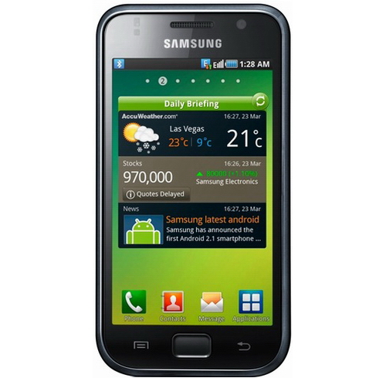
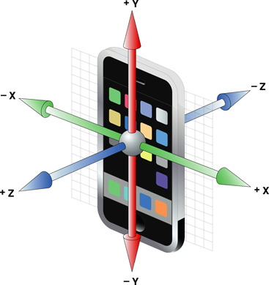



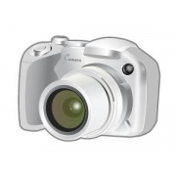
Mobile Phone Sensing
Sensors in a mobile phone
Accelerometer
Ambient light
Bluetooth
Camera
GPS
Magnetometer
Microphone
Proximity

Slide 3
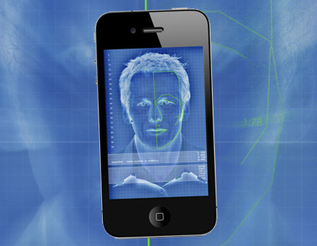
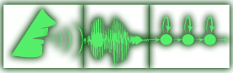
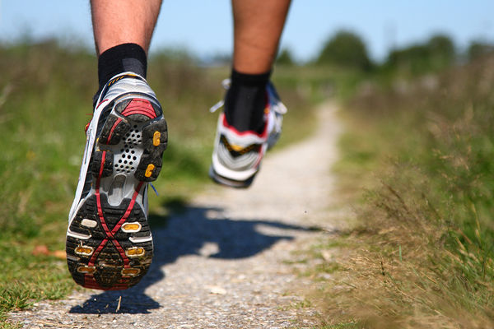
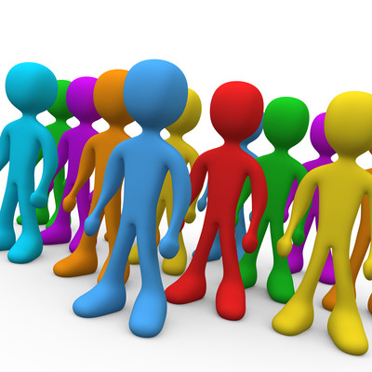
Applications
Camera – Face Recognition
Microphone – Speaker Recognition
Accelerometer – Activity Recognition
Bluetooth – Colocation Detection

Slide 4
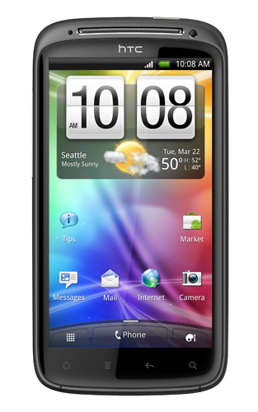
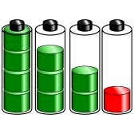

Challenges
Continuous sensor sampling
Limited energy
Accuracy-energy trade-offs
Where to perform the computations
Locally on the phone
Remotely in the cloud

Slide 5
Contributions
Mobile Phone
CASE STUDY Social Application
Computation Distribution
Remote Classifiers
Alerts Module
Adaptive Sensor Sampling
Accelerometer
Bluetooth
Mic

Slide 6

Sensor Sampling
Events
Time →
Sleep
Sense
Sleep
Sense
Sleep
Events
Time →
Sleep
Sense
Sleep
Sense
Sleep

Slide 7
Event Classification
E.g. microphone sensor records ‘silence data’
E.g. microphone sensor records ‘audible data’
uninteresting
interesting
missable
unmissable

Slide 8
Learning based Sensor Sampling
Reinforcement learning
Linear reward inaction algorithm
Defined in terms of:
Actions
Probability of taking these Actions
Success and failure of taking these Actions
Action: Sensing from a sensor
Success: Sensing action results in an interesting event
Failure: Sensing action results in an uninteresting event

Slide 9
Sensor Sampling Adaptation
Adapts to the context by adjusting the probability
Increases the probability when an interesting event is detected
Decreases the probability when an uninteresting event is detected
Success:
Failure:
= Probability of taking an action

Slide 10
Computation Distribution
Where to perform the computations:
Locally on the phone
Remotely in the cloud
Decision considering the dimensions:
Energy consumption
Latency
Data sent over the network

Slide 11
Computation Distribution
Each subtask can be computed locally or remotely. Total combinations in which this task can be executed:
E.g. T = {t1, t2}
Configuration | Task 1 | Task 2
C1 | Local | Local
C2 | Local | Remote
C3 | Remote | Local
C4 | Remote | Remote

Slide 12
Utility Functions
Utility for each configuration:
Weights (w) defined by experiment designers
Utility value for energy:

Slide 13
Computation Distribution - Adaptation
Adaptation of weights to changing mobile phone resources:
battery
data sent over the network
<rules>
<condition expr="battery_left > 80
and data_sent < 50MB">
<weight metric="energy">33.3</weight>
<weight metric="latency">33.3</weight>
<weight metric="data">33.3</weight>
</condition>
<condition expr="battery_left < 20">
<weight metric="energy">60</weight>
<weight metric="latency">20</weight>
<weight metric="data">20</weight>
</condition>
</rules>

Slide 14

EVALUATION
Micro-benchmarks
Social psychology study

Slide 15
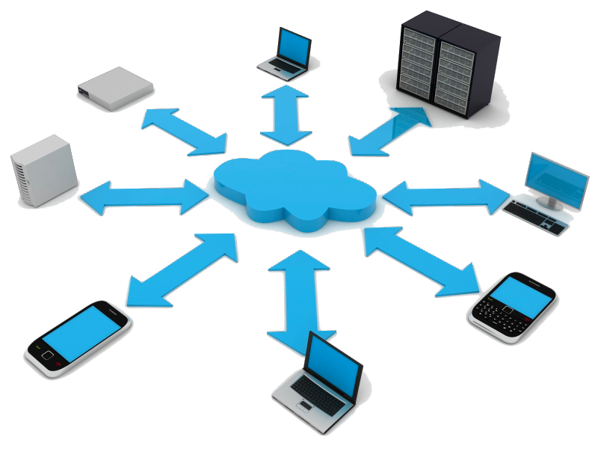
Computation Distribution Benchmarks
Speaker Identification: two tasks
Task 1: converts the recorded audio sample to parametric form
Task 2: compares the parametric file with preloaded speaker models to identify speaker

Slide 16
Computation Distribution for Speaker Identification
Configuration | Task 1 | Task 2
C1 | Local | Local
C2 | Local | Remote
C3 | Remote | Local
C4 | Remote | Remote
Name | We | Wl | Wd
S1 | 1 | 0 | 0
S2 | 0 | 1 | 0
S3 | 0 | 0 | 1
S4 | 0.33 | 0.33 | 0.33

Slide 17
Computation Distribution for Speaker Identification
Configuration | Task 1 | Task 2
C1 | Local | Local
C2 | Local | Remote
C3 | Remote | Local
C4 | Remote | Remote
Name | We | Wl | Wd
S1 | 1 | 0 | 0
S2 | 0 | 1 | 0
S3 | 0 | 0 | 1
S4 | 0.33 | 0.33 | 0.33

Slide 18
Computation Distribution for Speaker Identification
Configuration | Task 1 | Task 2
C1 | Local | Local
C2 | Local | Remote
C3 | Remote | Local
C4 | Remote | Remote
Name | We | Wl | Wd
S1 | 1 | 0 | 0
S2 | 0 | 1 | 0
S3 | 0 | 0 | 1
S4 | 0.33 | 0.33 | 0.33

Slide 19
CASE STUDY
Social psychology application
Uses the services of sensor sampling and computation distribution components

Slide 20
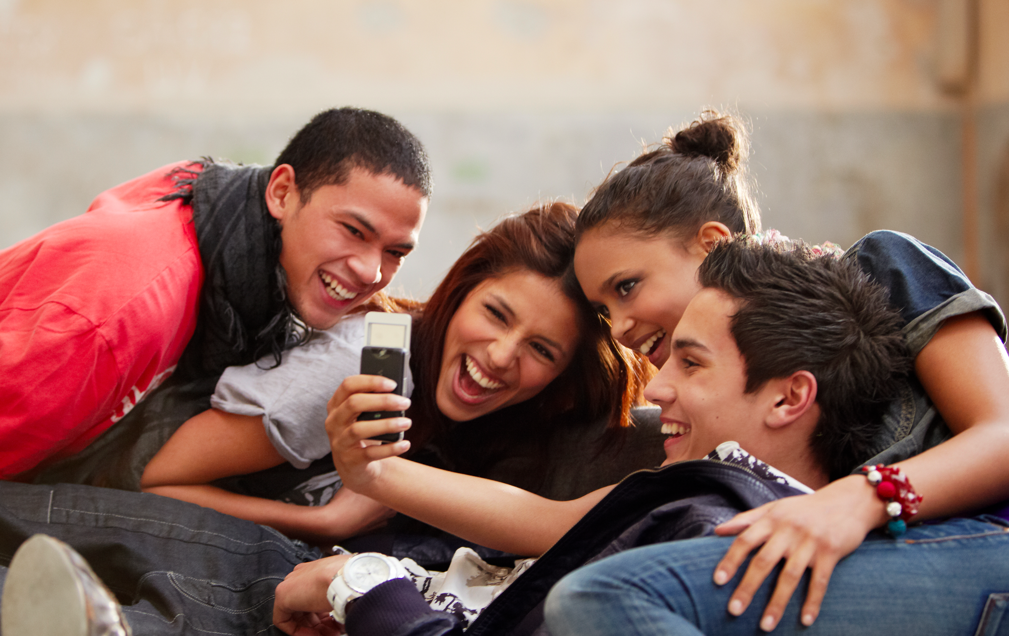
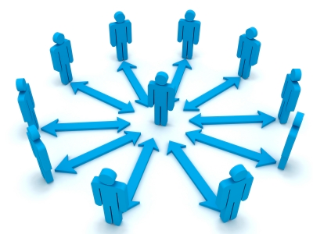
Social Application
Sociability: strength of user’s connection to his/her group
We use the network constraint to evaluate sociability.
Two dimensions for measuring sociability
Colocation
Interaction

Slide 21
Network Constraint - Examples
B
0.4
C
B
C
1.0
0.4
0.4
0.5
A
0.5
1.0
0.5
1.0
0.2
0.2
A
D
0.5
E
0.2
Network constraint of
A : 0.5
B : 1.25
C : 1.25
Network constraint of
C : 0.69
A : 0.83
B : 0.83
D : 1.13
E : 1.32

Slide 22

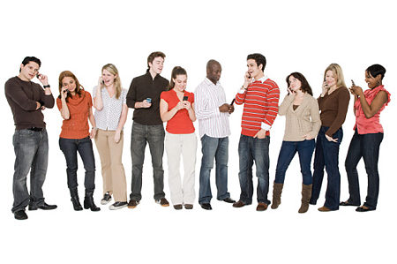
Social Psychology Study
Two working weeks with 10 users
Two phases
Phase 1: feedback mechanisms disabled
Phase 2: feedback mechanisms enabled
Five main locations:
3 : work locations
2 : sociable locations

Slide 23
Social Study Results

Slide 24
Social Study Results

Slide 25
Summary
Mobile phones for social sensing
SociableSense
Adaptive sensor sampling
Computation distribution
Social application
Benchmarks
Deployment

Slide 26

Thank you Kiran K. Rachuri Computer Laboratory University of Cambridge Email: kkr27@cam.ac.uk

