Slide 1
AutoMAC : Rateless Wireless Concurrent Medium Access
Aditya Gudipati, Stephanie Pereira, Sachin Katti
Stanford University

Slide 2
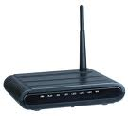

Conventional Schemes :
Avoid Interference at all costs !
Alice
Bob

Slide 3
Conventional Schemes :
Avoid Interference at all costs !
Interference Avoidance
  RTS/CTS
  CSMA with exponential backoff
Interference handling
  ZigZag
CTS
Alice
CTS
Alice
CTS
Alice
RTS
RTS
Alice
Bob

Slide 4
Our Approach :
Encourage and Exploit Interference !
Alice
Bob
Alice Decoder
Bob Decoder
Subtract

Slide 5
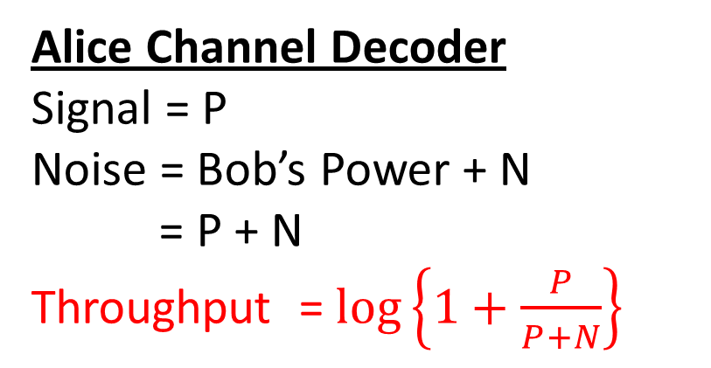
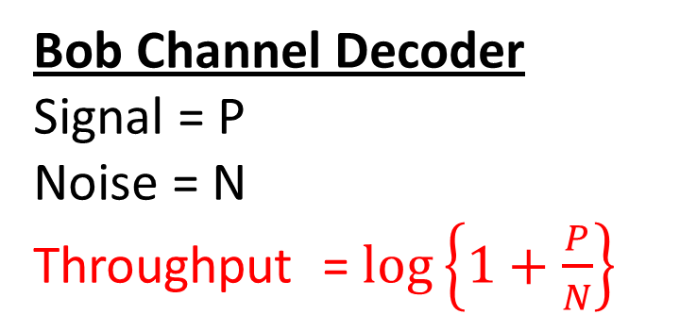
Our Approach :
Encourage and Exploit Interference !
Alice Decoder
Bob Decoder
Subtract
Received Power from Alice at AP = P
Received Power from Bob at AP = P
Alice Channel Decoder
Signal = P
Noise = Bob’s Power + N
= P + N
Throughput = $\log\left\{1+\frac{P}{P+N}\right\}$
Bob Channel Decoder
Signal = P
Noise = N
Throughput = $\log\left\{1+\frac{P}{N}\right\}$

Slide 6
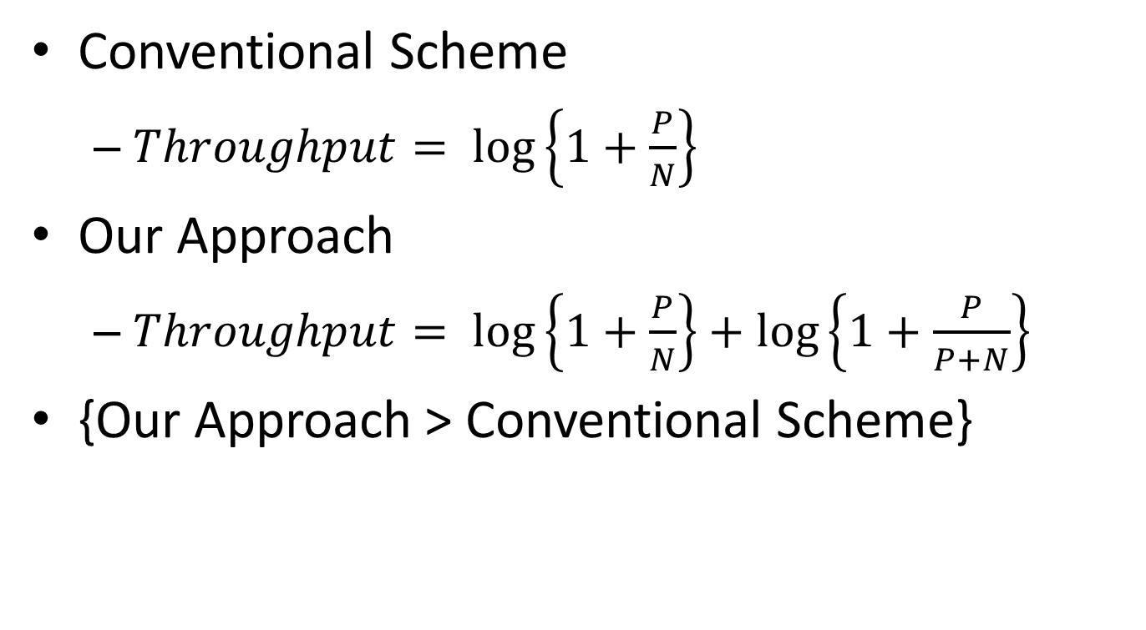
Our Approach vs Conventional Scheme
Conventional Scheme
  $Throughput= \log\left\{1+\frac{P}{N}\right\}$
Our Approach
  $Throughput= \log\left\{1+\frac{P}{N}\right\}+\log\left\{1+\frac{P}{P+N}\right\}$
{Our Approach > Conventional Scheme}

Slide 7
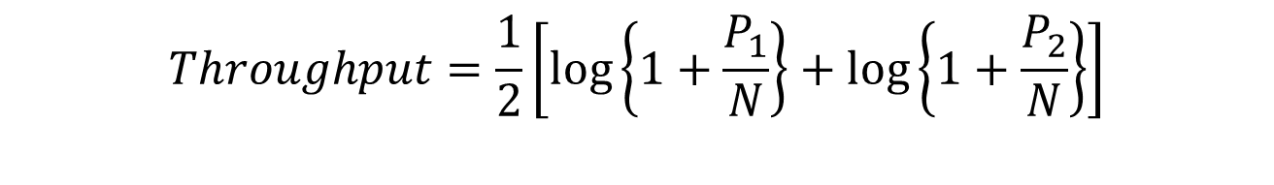
Even on Downlink, Conventional Schemes avoid Interference
P₂ > P₁
P₁
P₂
Alice
Bob
$$Throughput=\frac{1}{2}\left[\log\left\{1+\frac{P_{1}}{N}\right\}+\log\left\{1+\frac{P_{2}}{N}\right\}\right]$$

Slide 8
Our Approach on Downlink also
Exploits Interference !
P₂ > P₁
P₁
P₂
Alice
Bob

Slide 9
Our Approach on Downlink also exploits Interference !
Received Power from AP at Alice = P₁
Received Power from AP at Bob = P₂
P₂ > P₁
ALICE
Alice Decoder
BOB
Alice Decoder
Bob Decoder
Subtract

Slide 10
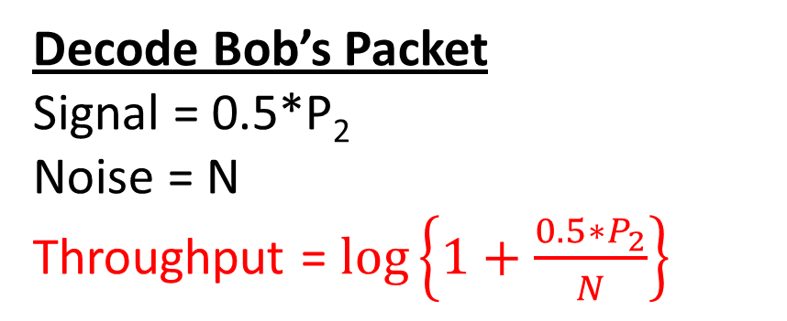
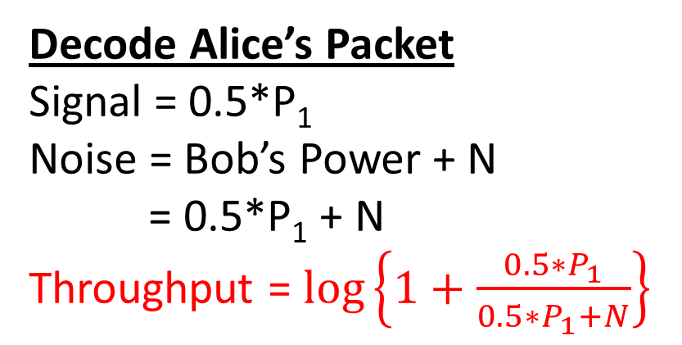
Our Approach on Downlink also exploits Interference !
Received Power from AP at Alice = P₁
Received Power from AP at Bob = P₂
P₂ > P₁
Alice Decoder
Alice Decoder
Bob Decoder
Subtract
ALICE
BOB
Decode Alice’s Packet
Signal = 0.5*P₁
Noise = Bob’s Power + N
= 0.5*P₁ + N
Throughput = $\log\left\{1+\frac{0.5∗P_{1}}{0.5∗P_{1}+N}\right\}$
Decode Bob’s Packet
Signal = 0.5*P₂
Noise = N
Throughput = $\log\left\{1+\frac{0.5∗P_{2}}{N}\right\}$

Slide 11
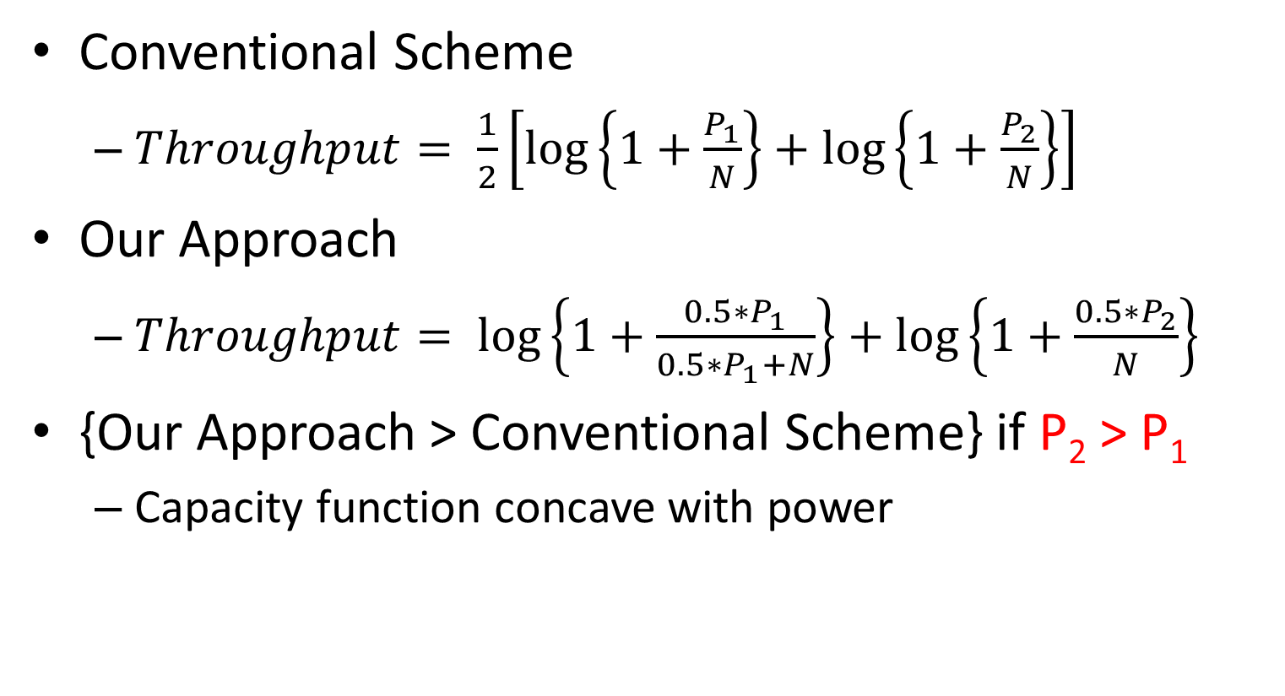
Our Approach vs Conventional Scheme
Conventional Scheme
  $Throughput= \frac{1}{2}\left[\log\left\{1+\frac{P_{1}}{N}\right\}+\log\left\{1+\frac{P_{2}}{N}\right\}\right]$
Our Approach
  $Throughput= \log\left\{1+\frac{0.5∗P_{1}}{0.5∗P_{1}+N}\right\}+\log\left\{1+\frac{0.5∗P_{2}}{N}\right\}$
{Our Approach > Conventional Scheme} if P₂ > P₁
  Capacity function concave with power

Slide 12
AutoMAC Contributions
Practical system for exploiting interference
Rateless encoding scheme
  Upto 3 successful concurrent transmissions
Novel MAC protocol
  Leverage gains due to Interference
Implemented on USRP2s and evaluated
  60% gain on Uplink
  35% gain on Downlink

Slide 13
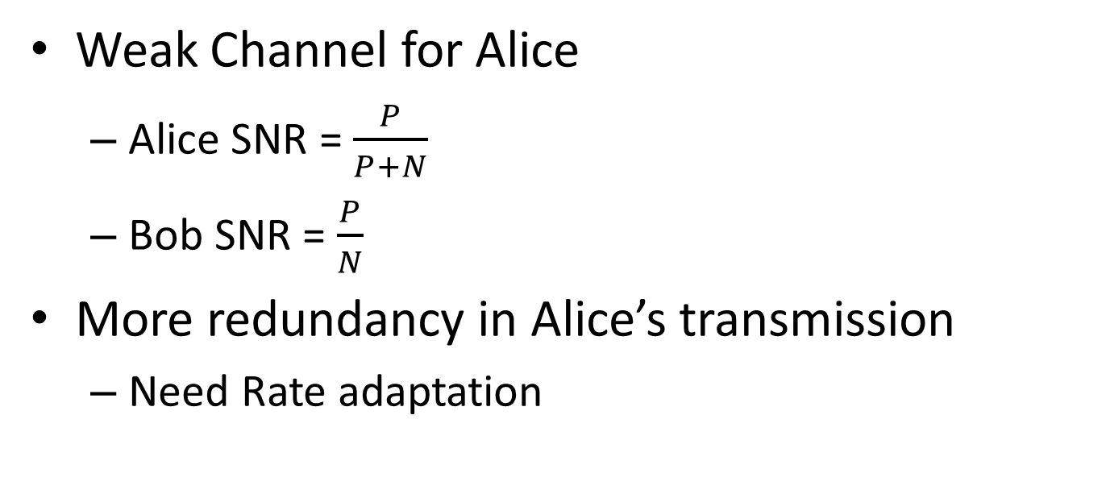
Challenge 1 : Rate Adaptation
Alice Decoder
Bob Decoder
Subtract
Weak Channel for Alice
  Alice SNR = $\frac{P}{P+N}$
  Bob SNR = $\frac{P}{N}$
More redundancy in Alice’s transmission
  Need Rate adaptation

Slide 14
Challenge 1 : Rate Adaptation
Increasing Rates

Slide 15
Challenge 1 : Rate Adaptation
Increasing Rates

Slide 16
Challenge 1 : Rate Adaptation
Alice Decoder
Bob Decoder
Subtract
Alice needs to adapt its rate
Alice needs to figure out
  Own SNR at the AP
  Who is interfering?
  How strong is the Interference ?
Can we avoid this ?

Slide 17
Solution 1 : Rateless Codes
Orthogonal to choice of rateless code
Strider [Sigcomm’11]
  Encoder generates stream of transmissions
  Receiver ACKs once decoded
  SNR determines # transmissions
  # transmissions determines rate

Slide 18
Solution 1 : Rateless Codes

Slide 19
Challenge 2 : Wasted Transmissions
Alice Decoder
Bob Decoder
Subtract
Weak Channel for Alice
  More transmissions needed for Alice Decoder
Strong Channel for Bob
  Fewer transmissions needed for Bob Decoder
Bob can’t be decoded before Alice !
  Wastage

Slide 20
Challenge 2 : Wasted Transmissions
Alice Decoder needs 6 tx
Bob Decoder needs 3 tx
Alice Decoder
Bob Decoder
Subtract
A₁ + B₁
A₁ + B₁
A₁ + B₁
A₁ + B₁
A₁ + B₁
A₁ + B₁
A₁
Noisy B₁
Noisy B₁
Noisy B₁
Noisy B₁
Noisy B₁
Noisy B₁
3 transmissions wasted !!
B₁

Slide 21
Solution 2 : Speculative ACKing
Alice Decoder needs 6 tx
Bob Decoder needs 3 tx
Alice Decoder
Bob Decoder
Subtract
ACK
A₁ + B₁
A₁ + B₁
A₁ + B₁
A₁ + B₂
A₁ + B₂
A₁ + B₂
A₁
Noisy B₁
Noisy B₁
Noisy B₁
Noisy B₂
Noisy B₂
Noisy B₂
B₁
No wastage !!
B₂

Slide 22
MAC Protocol
AP driven MAC
  Frequency Domain Backoff [Sen et al Mobicom’11]
Contention Ad
Bob
Alice
Charlie
David

Slide 23
MAC Protocol
AP driven MAC
  Frequency Domain Backoff [Sen et al Mobicom’11]
1-Alice
2 - Bob
Bob
Alice
Freq
Charlie
David

Slide 24
MAC Protocol
AP driven MAC
  Frequency Domain Backoff [Sen et al Mobicom’11]
Pre
Pre
Data
Bob
Alice
Pre
Data
Pre
Data
Charlie
David

Slide 25
Evaluation
Implement PHY layer on USRP2s
  GNURadio platform with RawOFDM
  OFDM with 64 subcarriers
  External Clock to Synchronize USRP2s (Jackson)
Upto 3 successful concurrent transmissions
Compared to omniscient rate adaptation
  30% gain on Uplink , 35% gain on Downlink

Slide 26
Uplink CDF
30% median
throughput gain

Slide 27
Downlink CDF
35% median
throughput gain

Slide 28
Downlink gains depend on
Relative SNRs

Slide 29
Interference Cancellation isn’t Perfect !

Slide 30
Simulations
Simulate MAC layer
  Dense Network (8 contending nodes)
  Fully Loaded
60% uplink gain over 802.11 MAC
  Improved PHY layer
  Efficient channel utilization at MAC layer

Slide 31
Conclusion
Exploit interference instead of avoiding it
Novel PHY & MAC protocol
  Rateless encoding scheme enables SIC
  AP driven MAC coordinates interferers
Implemented on USRP2s and evaluated
Future Work
  Other applications of SIC , eg. MIMO systems

