Slide 1

MARVEL: Multiple Antenna based Relative Vehicle Localizer
Dong Li+, Tarun Bansal+, Zhixue Lu+, Prasun Sinha
Computer Science and Engineering Department
The Ohio State University
{lido, bansal, luz, prasun}@cse.ohio-state.edu
+Co-primary authors

Slide 2
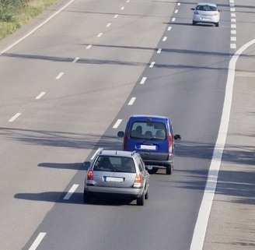
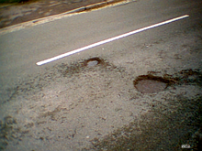

Why important to know lanes?
Hard Brakes, Sudden Deceleration and Potholes
  Inform rear vehicles in the same lane
Blind spots
  Visualization and Driver alert
Notes:
@Tarun: Do you have data about how much accident is caused by potholes?
35,000 annual fatalities(USA); 130,000 (India); 68,000 (China)

Slide 3
Contents
Objective
System Design
Experiments
Aggregation and Simulations
Conclusion & future work

Slide 4

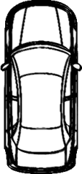
Objective
To design a system, that estimates the relative location of given two vehicles.
V₁
V₂
Direction of Travel
Notes:
Specifically, given two vehicles V₁ and V₂ , we seek to determine if V₁ is in front, back, left lane, same lane or in right lane with respect to V₂’s lane.

Slide 5
Vehicular Localization Techniques
GPS
  Experiment: 46% accuracy
  Low accuracy in urban canyons and tunnels.
Radar, Camera
  Already deployed by Lexus, BMW etc.
  Can only detect neighboring vehicles
Our Solution: Radio on vehicle’s body
Notes:
Width of lane recommended by AASHTO
Lane width : ~3.6 meters
. ( error will be >54% in our test)

Slide 6
Challenges
Currently deployed technologies do not work well
  GPS – Low accuracy
  Camera – Light/weather conditions, Localizes only vehicles in sight
  Radar – Localizes only vehicles in sight
Robust to noise/obstacles
  Different light/weather conditions
  Parked vehicles may affect localization accuracy

Slide 7
Contents
Motivation & Objective
System Design
Experiments
Aggregation and Simulations
Conclusion & future work

Slide 8
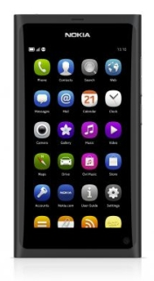
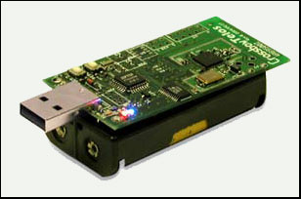
Devices Used
Smartphone
  48% Americans have smartphones [Nielsen 2012]
  Monitors turn/ lane change events
  Discovers neighboring vehicles
  Controls activity of radios
  Computes relative locations
Radio
  Send/Receive beacons
  Report RSSI to smartphone
Nielsen 2012: http://blog.nielsen.com/nielsenwire/?p=30950
Notes:
http://blog.nielsen.com/nielsenwire/?p=30950

Slide 9
How Radios Work
Two radios: distinguish Left, Same, and Right lane

Slide 10
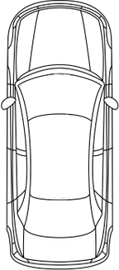

How Radios Work
Radio
Link L1
Link L1
Link L1
Link L2
Link L2
Link L2
Same Lane
Front car in left lane
Front car in right lane
Notes:
Say this is illustration with 2 radios.

Slide 11
How Radios Work
Two radios: distinguish Left, Same, and Right lane
Four radios
  Distinguish front and back
  Add robustness

Slide 12
How the System Works
Monitor Phase:
Monitor accelerometer &
Look for new vehicles
Beacon Phase:
Direct wireless radios to send/recv beacons
Analyze Phase:
Determine
Relative location and share locations

Slide 13
Monitor Phase
Discover vehicles in neighborhood
  Smartphone sends/receives discover beacons
Detect lane change and turn events:
  Using accelerometer
  Cancel out noise by taking an average of last 0.5s
  Maintain max and min values within last 3s.
Acc_{y}
Acc
y
m/s²
2
t
0
-2
Notes:
We propose to use accelerometers to detect lane-change events. Most smart phones are equipped with 3-Axis accelerometers.
Accelerometers are used to measure the proper acceleration (force) it receives along certain direction. In the driving scenario, whenever a lane-change event happens, the accelerometer mounted on the vehicle will receive forces (with some specific pattern, i.e., a wave shape) along the width of the vehicle.
In our Experiment, one smart phone was mounted on the dashboard of the vehicle. The smart phone gives 100 3D(XYZ) readings per second.
Those readings are re-oriented to the vehicle (X'Y'Z'), so that we can calculate the acceleration along the width of the vehicle (Y'). Please refer to P. Mohan EMNETS 2008
To cancel out the noise and inaccuracy of the accelerometer, we compute the value of a reading at any point by taking an average of readings received in the previous 0.5 second
We maintain two values: the max and min readings within the last 3 seconds. Whenever the difference of those two values exceed some threshold, a lane-change event was reported.

Slide 14
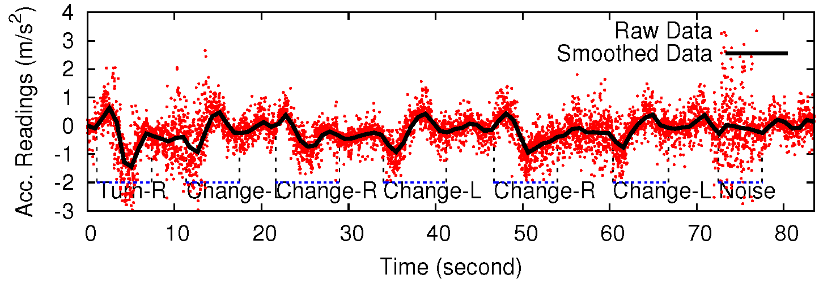
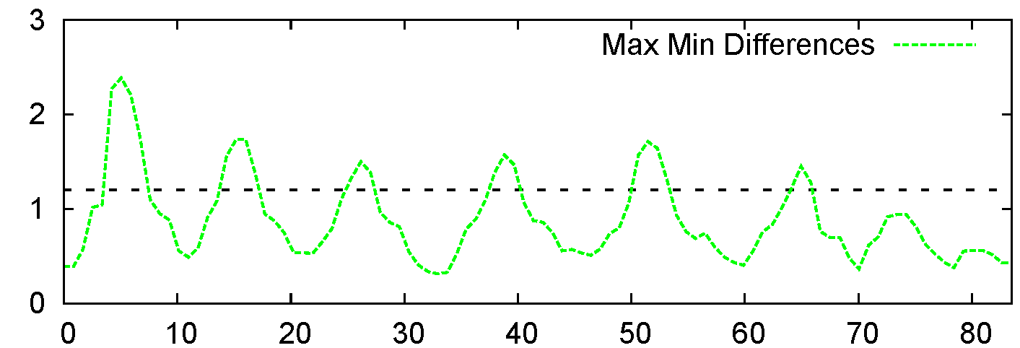
Monitor Phase
  Trigger if the Max-Min diff. exceeds the threshold
Max-Min difference
Time (second)
Notes:
Red dots are the raw readings along the width of the vehicle (Y').
Black Line is the smoothed shape by taking an average within the last 0.5s. Noise are well cancelled.
--replot the figure
Blue Lines are the ground truth. (6 lane-change events and 1 noise event)
Green line shows the corresponding max-min difference at any give time.
The threshold for green line is 1.08 in this graph to filter out the noise.
The conclusion of this slides is that :

Slide 15
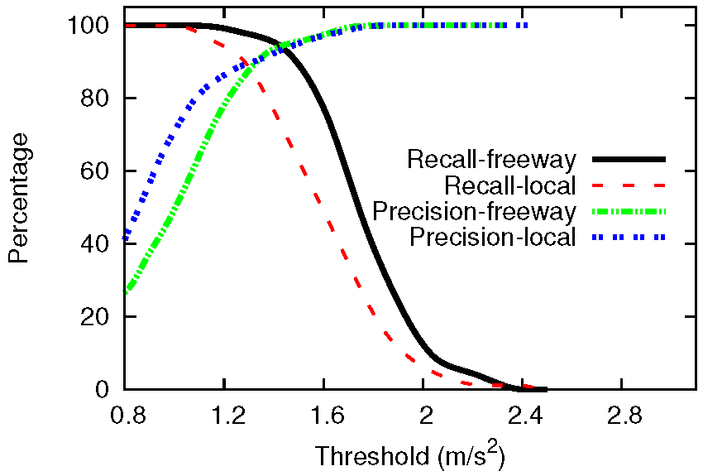
Monitor Phase
1.08 m/s²
Precision: Fraction of detected change/turn events that are true.
Recall: Fraction of change/turn events that are detected.
Notes:
Red dots are the raw readings along the width of the vehicle (Y').
Black Line is the smoothed shape by taking an average within the last 0.5s. Noise are well cancelled.
--replot the figure
Blue Lines are the ground truth. (6 lane-change events and 1 noise event)
Green line shows the corresponding max-min difference at any give time.
The threshold for green line is 1.08 in this graph to filter out the noise.
The conclusion of this slides is that :

Slide 16
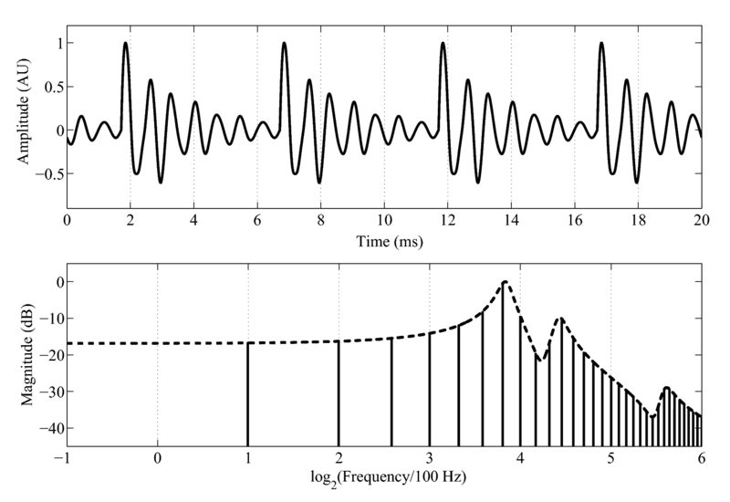

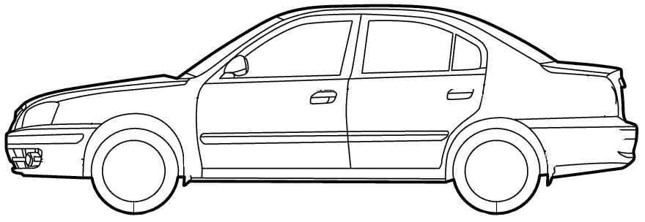


How the System Works
Monitor Phase:
Smartphones discover each other
Analyze Phase:
Report RSSI
Find relative lanes
Beacon Phase:
Schedule a transmission
Share results
Send Beacons
Notes:
This page describes the ideal process of discovering cars and figuring out lanes

Slide 17
Contents
Motivation & Objective
System Design
Experiments
Aggregation and Simulations
Conclusion & future work

Slide 18
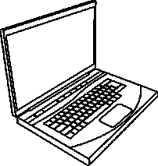

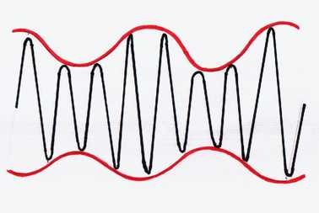
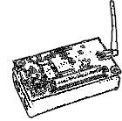

Experiment Settings
Zigbee
Notes:
In practice, phone has 802.11 protocol, radios has zigbee protocol, we have to use a laptop to bridge them.
In our experiment, we use a laptop connected with a zigbee mote, to talk with the radios. The laptop talk with the phone using WiFi. (at this moment, in our real experiment, the phone is doing nothing, the laptop did the phone’s job for the sake of implementation simplicity).
Phone, laptop with a zigbee is inside the car. Other four radios are outside the car.

Slide 19

Data Processing
Dataset A
Train with
SVM
Model
50%
Train
{RSSI, Label}
50%
Test
Dataset B
Accuracy
label$∈\{Six Positions\}$
Model trained with SVM classifier in RapidMiner
Train and test using different datasets when cross validation.
Notes:
Need to find a metric to compare how good each position is. We use the classification accuracy of a model generated by the data collected for a position.
Here we use SVM (Support Vector Machine) as the classification algorithm
RapidMinder is a useful tool for data mining task

Slide 20
Radios installation: How many and where?
99.8%
94.7%
Other radio configurations tried in driving tests
  Varying number of radios: 2/3/4
  Radios inside/outside vehicle’s body
  Symmetric/ Asymmetric placement of radios
Notes:
We derived 21 different configurations, from the two configuration.

Slide 21
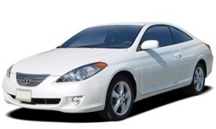
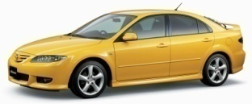
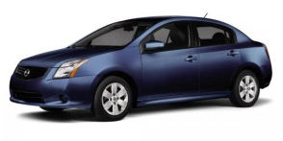
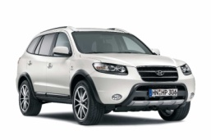
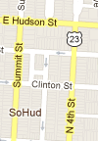
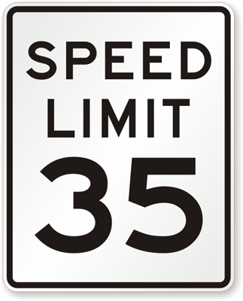
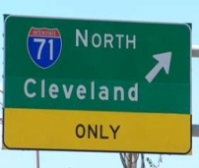
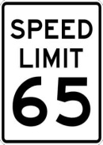
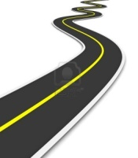
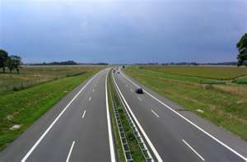
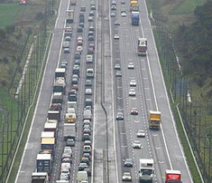
Driving Experiments
Cars: Sedan, SUV, Coupe
Roads: Local & Freeway
Light Traffic
& Heavy Traffic
>800 miles
Notes:
Four cars are used : two sedans, one coupe, and one suv
Two road types: local drive with speed limit 35mph, freeway with speed limit 65mph
Did test on light traffic condition and heavy traffic condition.

Slide 22
Experiment Results: Road Types
Training Dataset
Test
Dataset
Accuracy
Local Drive
Freeway
97.3%
Freeway
Local Drive
99.4%
Local roads & freeways have similar path loss pattern
Notes:
This is on light traffic
Local → Freeway >97.33% : training on local driving data set, testing on freeway.
Freeway→ Local >99.39% :training on freeway, testing on local driving data.

Slide 23
Experiment Results: Traffic Conditions
Training
Dataset
Test Dataset
Accuracy
Light traffic
Heavy traffic
25.2%
Heavy traffic
Light traffic
38.7%
Mix light traffic
Mix light traffic
97.2%
and
heavy traffic
and heavy traffic
Light traffic pattern ≠ Heavy traffic pattern
Must train if traffic conditions are significantly different
No need to provide traffic condition as an input to the classifier
Notes:
Note that in the mixing data, different types of data is equally distributed.

Slide 24
Experiment Results: Vehicle Bodies
Training Dataset
Test Dataset
Accuracy
Two Sedans
Coupe & SUV
88.3%
Coupe
& SUV
Two
Sedans
92.7%
Mix c
ar types
Mix car types
99.8%
The bodies of the tested cars have similar path loss pattern
Important to train on different car bodies
No need to provide car body as an input to the classifier
Notes:
Here Mix means Mix(Two Sedans, Coupe & SUV), too long to write.
Car body is not a so important feature, but this feature can improve the classification accuracy.
This indicates we may do not need to train for different car body cases.
The accuracy of mix-mix is very high, that’s because Train and test both use Sedan is high, Tran and test both use Coupe and SUV is also high.
88.32% and 92.73% is the result when we using one car type as training set, and another car type as testing set.

Slide 25
Contents
Motivation & Objective
System Design
Experiments
Aggregation and Simulations
Conclusion & future work

Slide 26
Information Aggregation
Right
Right
Right
Right
Aggregation: Left-Same-Right relation OR Front-Back relation
Improves localization accuracy
Challenges:
  Distributed
  Rapidly changing set of neighbors
  SVM classifier can be incorrect

Slide 27
Left-Same-Right Aggregation: Lane Coordinate System
Lane Coordinate System (CreateTime, CreatorId)
Every vehicle has a lane number (or coordinate) in its coordinate system
Join coordinate system with the earliest CreateTime
Same coordinate system ↔ Lane numbers comparable
Lane 1
(Created at 8:00AM, Blue car)
Lane 3
Lane 1
(Created at 9:00AM, Red car)
(Created at 8:00AM, Blue car)
Notes:
The animation shows a car in 9:00Am coordinate finds a new car in 8:00am coordinate system.

Slide 28



Left-Same-Right Aggregation: Algorithm
Find neighboring vehicles in the earliest coordinate system
Determine relative location with these vehicles
Determine lane number that maximizes overall confidence
SAME, 2
LEFT
SAME, 3
LEFT, 3
Lane number is 2

Slide 29
Front-Back Aggregation
Red in Front
of Green
Reduce local neighborhood information to a graph
Cycle → Inconsistent information
Algorithm to remove all cycles
  Eliminates cycles while maximizing the confidence
Blue in
Front of red
Green in
Front of Blue
  Edge from rear vehicle to vehicle in front

Slide 30
Simulation
Trace-driven simulations using ns-3 and SUMO
  SUMO: A simulator for VANETs which given a road network, generates a pre-determined number of routes for vehicles
Extracted position of each vehicle at each instance from SUMO
In ns-3, the trace of RSSI readings from driving experiments were plugged

Slide 31
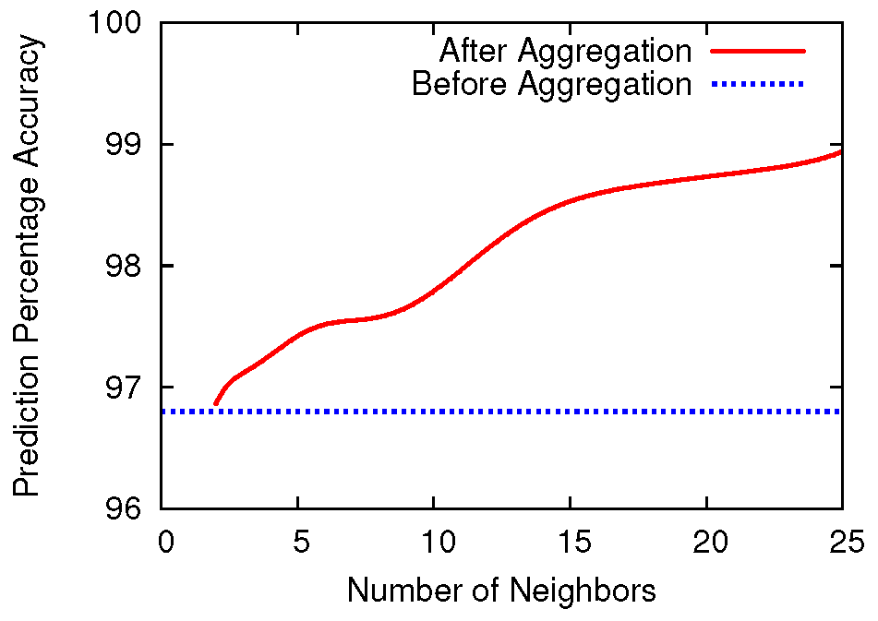
Simulation Results
Increase in prediction accuracy is not significant

Slide 32
Incremental Deployment
MARVEL can provide incremental benefit to vehicles that are equipped with 4 radios.
Dedicated Short Range inter-vehicle Communication (DSRC)
  All vehicles expected to be equipped with at least one antenna.
Experiment Result
  Accuracy of relative localization between a vehicle with one antenna and a vehicle with 4 antenna: 64%
Simulation Result: When 50% vehicles have single antenna, 50% have four antenna, with aggregation:
  Accuracy of 4 antenna vehicle with one antenna vehicle: 87.1%
  Incentive for drivers to install 4 radios due to increased accuracy

Slide 33
Conclusions
Relative lane localization using radios
  High accuracy observed through experiments and simulations
  Aggregating information improves accuracy
Pros: Independent of light/weather conditions
Cons: Need both vehicles to install radios for higher accuracy

Slide 34
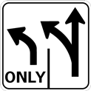
Discussion & Future Work
Determining absolute lane location
  Lane-level navigation alerts
Work with cameras, radars to improve accuracy
“Live training” possible using aggregation

Slide 35
Thank you

