Slide 1


We Can Hear You with Wi-Fi !
Guanhua Wang
Yongpan Zou, Zimu Zhou, Kaishun Wu, Lionel M. Ni
Hong Kong University of Science and Technology
Notes:
Good afternoon everyone.
Today, I will present the paper: We Can Hear You with Wi-Fi. This work is done by Guanhua Wang, with the help of Yongpan Zou, Zimu Zhou, Kaishun Wu and Lionel Ni.
The authors are from the Hong Kong University of Science and Technology, CSE department.

Slide 2

Advanced Research in ISM band
Localization
Notes:
Recent research has pushed the limit of ISM band radiometric detection to a new level, including localization

Slide 3
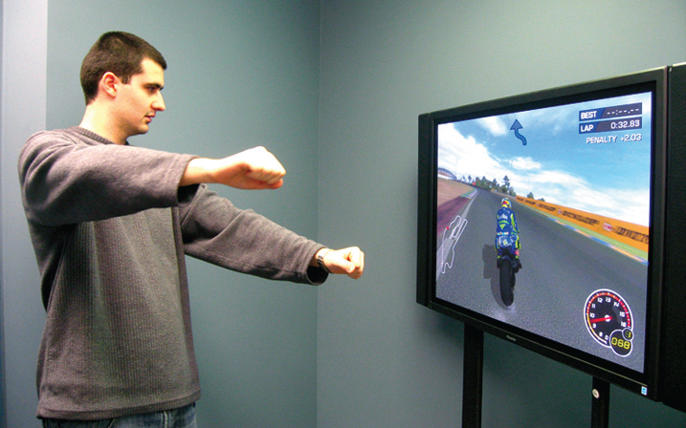
Advanced Research in ISM band
Gesture Recognition
Notes:
Gesture Recognition

Slide 4
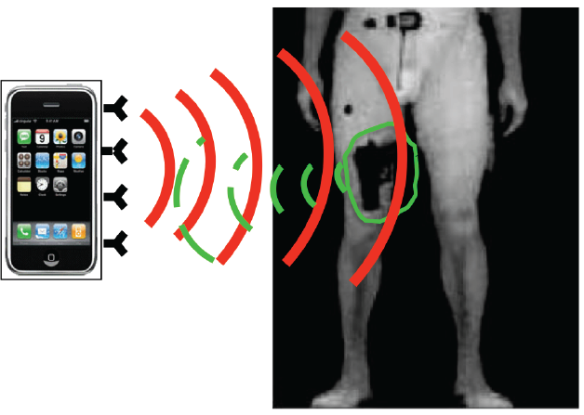
Advanced Research in ISM band
Object Detection
Full Duplex Backscatter. In hotnets 2013
Notes:
And even Object Detection.

Slide 5

Advanced Research in ISM band
Localization
Gesture recognition
Object Classification
They enable Wi-Fi to “SEE” target objects.
Notes:
By detecting and analyzing signal reflection, they enable Wi-Fi to “SEE” the target objects.

Slide 6



Can we enable Wi-Fi signals to HEAR talks?
Notes:
In this paper, we ask the following question: Can we enable Wi-Fi signals to HEAR talks ?

Slide 7

Can we enable Wi-Fi signals to HEAR talks?
Notes:
We present WiHear.

Slide 8
What is WiHear?
Notes:
So what is WiHear?

Slide 9

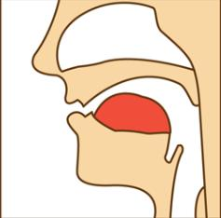

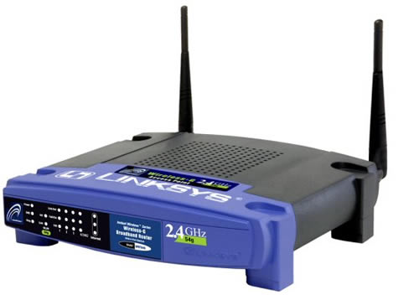
“Hearing” human talks with Wi-Fi signals
Hello
Non-invasive and device-free
Notes:
The key insight of WiHear is to sense and recognize the radiometric impact of mouth movement on WiFi signals.
WiHear exploits the radiometric characteristics of mouth movements to analyze micro-motion in a non-invasive and device-free manner.

Slide 10


Hearing through walls and doors
I am upset.
Understanding complicated human behavior (e.g. mood)
Notes:
Since WiFi signals do not require line of sight, WiHear can “hear” people talks through walls and doors within the radio range.
In addition, WiHear can“hear” and “understand” your speaking, which can get more complicated information from human talks than traditional gesture based interaction interface like Xbox Kinect (e.g. one wants to express upset, it is unlikely to be delivered by simple body gestures, but can be conveyed by speaking).

Slide 11

Hearing multiple people simultaneously
MIMO Technology
Easy to be implemented in commercial Wi-Fi products
Notes:
By using MIMO technology, WiHear can be extended to hear multiple human talking simultaneously.
In addition, since we do not need to make any changes on commercial wi-fi signals, WiHear can be easily implemented in commercial WiFi infrastructure like access points and mobile devices.

Slide 12
How does WiHear work?
Notes:
So how does wihear work?

Slide 13
WiHear Framework
Vows and consonants
Filtering
Classification & Error Correction
Remove
Noise
Partial Multipath Removal
Feature Extraction
MIMO Beamforming
Profile
Building
Wavelet Transform
Segmentation
Mouth Motion Profiling
Learning-based
Lip Reading
Notes:
This slide gives a general view of how WiHear works. The basic prototype consists of a transmitter and a receiver.
First, the transmitter focuses radio beam on the target’s mouth to reduce irrelevant multipath effects.
Then, WiHear receiver analysis signal reflection by mouth motions in two steps:
1. Wavelet-based Mouth Motion Profiling: WiHear analysis received signals by filtering out-band interference and partially eliminating multipath. It then constructs mouth motion profiles via discrete wavelet packet decomposition.
2. Learning-based Lip Reading: Once WiHear extracts mouth motion profiles, it applies machine learning to recognize pronunciations, and translates them via classification and context-based error correction.
In the rest of this talk, we will describe each part in details. First we focus on mouth motion profiling process.

Slide 14
Mouth Motion Profiling
Locating on Mouth
Filtering Out-Band Interference
Partial Multipath Removal
Mouth Motion Profile Construction
Discrete Wavelet Packet Decomposition
Notes:
The details of Mouth Motion profiling consists of five steps: namely, Locating on Mouth, Filtering Out-Band Interference, Partial Multipath Removal, Mouth Motion Profile Construction and Discrete Wavelet Packet Decomposition.

Slide 15
Mouth Motion Profiling
Locating on Mouth
Filtering Out-Band Interference
Partial Multipath Removal
Mouth Motion Profile Construction
Discrete Wavelet Packet Decomposition
Notes:
First, let’s look at the process of locating radio beam on mouth.

Slide 16
Locating on Mouth
T1
T2
T3
T3
Notes:
We exploit MIMO beamforming techniques or directional antennas to let radio beam locate and focus on the mouth, thus both introducing less irrelevant multipath propagation and magnifying signal changes induced by mouth motions. It works as follows:
The transmitter sweeps its beam for multiple rounds while the user repeats a predefined gesture (e.g. pronouncing [æ] once per second). Meanwhile, the receiver searches for the time when the gesture pattern is most notable during each round of sweeping.
The receiver sends the selected time stamp back to the transmitter and the transmitter then adjusts and fixes its beam accordingly.
As in this example, after the transmitter sweeping the beam for several rounds, the receiver sends back time slot 3 to the transmitter.

Slide 17
Mouth Motion Profiling
Locating on Mouth
Filtering Out-Band Interference
Partial Multipath Removal
Mouth Motion Profile Construction
Discrete Wavelet Packet Decomposition
Notes:
After the beam locating process, we need to remove the radio information of irrelevant frequency components

Slide 18
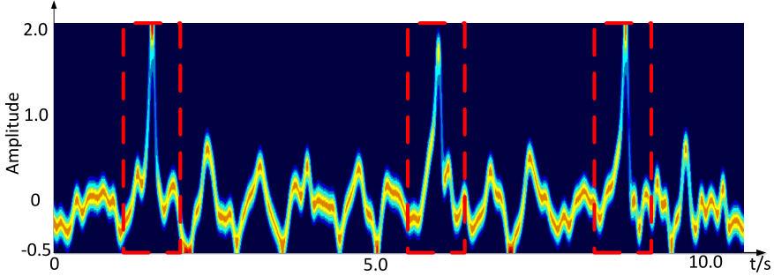
Filtering Out-Band Interference
Signal changes caused by mouth motion: 2-5 Hz
Adopt a 3-order Butterworth IIR band-pass filter
Cancel the DC component
Cancel wink issue (<1 Hz)
Cancel high frequency interference
The impact of wink (as denoted in the dashed red box).
Notes:
Signal changes caused by mouth motion in the temporal domain are often within 2-5 Hz.
Therefore, we apply band-pass filtering on the received samples to eliminate out-band interference.
It can Cancel the DC component, the wink issue (<1 Hz), and also the high frequency interference.

Slide 19
Mouth Motion Profiling
Locating on Mouth
Filtering Out-Band Interference
Partial Multipath Removal
Mouth Motion Profile Construction
Discrete Wavelet Packet Decomposition
Notes:
After filtering out-band interference, we apply our proposed “partial multipath removal” procedure.

Slide 20
Partial Multipath Removal
Mouth movement: Non-rigid
Covert CSI (Channel State Information) from frequency domain to time domain via IFFT
Multipath removal threshold: >500 ns
Convert processed CSI (with multipath < 500ns) back to frequency domain via FFT
The multipath threshold value can be adjusted to achieve better performance
Notes:
Unlike previous works in gesture recognition, where multipath reflections are eliminated thoroughly, WiHear performs partial multipath removal.
The rationale is that mouth motions are non-rigid compared with arm or leg movements. It is common for the tongue, lips, and jaws to move in different patterns.
Therefore, we need to remove reflections with long delays (often due to reflections from surroundings), and retain those within a delay threshold (corresponding to non-rigid movements of the mouth).
The procedure detail is to remove multipath effects over 500ns via IFFT and FFT. Further, in order to achieve better performance, the multipath threshold value can be dynamically adjusted in different application scenarios.

Slide 21
Mouth Motion Profiling
Locating on Mouth
Filtering Out-Band Interference
Partial Multipath Removal
Mouth Motion Profile Construction
Discrete Wavelet Packet Decomposition
Notes:
To reduce computational complexity with keeping the temporal spectral characteristics, we explore to select a single representative value for each time slot.
For more details, please take the paper as reference.

Slide 22
Mouth Motion Profiling
Locating on Mouth
Filtering Out-Band Interference
Partial Multipath Removal
Mouth Motion Profile Construction
Discrete Wavelet Packet Decomposition
Notes:
Then WiHear performs discrete wavelet packet decomposition on the obtained Mouth Motion Profiles as input for the learning based lip reading.

Slide 23
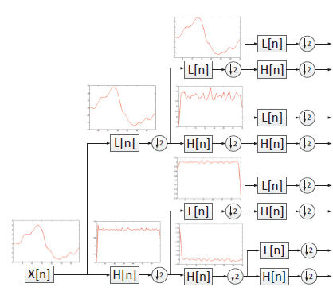
Discrete Wavelet Packet Decomposition
A Symlet wavelet filter of order 4 is selected
Notes:
Based on our experimental performance, a Symlet wavelet filter of order 4 is selected.

Slide 24
WiHear Framework
Vows and consonants
Filtering
Classification & Error Correction
Remove
Noise
Partial Multipath Removal
Feature Extraction
MIMO Beamforming
Profile
Building
Wavelet Transform
Segmentation
Mouth Motion Profiling
Learning-based
Lip Reading
Notes:
This slide gives a general view of how WiHear works. The basic prototype consists of a transmitter and a receiver.
First, the transmitter focuses radio beam on the target’s mouth to reduce irrelevant multipath effects.
Then, WiHear receiver analysis signal reflection by mouth motions in two steps:
1. Wavelet-based Mouth Motion Profiling: WiHear analysis received signals by filtering out-band interference and partially eliminating multipath. It then constructs mouth motion profiles via discrete wavelet packet decomposition.
2. Learning-based Lip Reading: Once WiHear extracts mouth motion profiles, it applies machine learning to recognize pronunciations, and translates them via classification and context-based error correction.
In the rest of this talk, we will describe each part in details. First we focus on mouth motion profiling process.

Slide 25
Lip Reading
Segmentation
Feature Extraction
Classification
Context-based Error Correction
Notes:
Next, we come into second part lip reading. It includes segmentation, feature extraction, classification and context-based error correction.

Slide 26
Lip Reading
Segmentation
Feature Extraction
Classification
Context-based Error Correction
Notes:
The first component is the segmentation of collected signals.

Slide 27
Segmentation
Inter word segmentation
Silent interval between words
Inner word segmentation
Words are divided into phonetic events
Notes:
We have two options. Inner word segmentation and inter word segmentation.
For inner word segmentation, we divide the words into phonetic events. And then directly match these phonetic events with training samples.
For inter word segmentation, we leverage silent interval between words to do the segmentation.

Slide 28
Lip Reading
Segmentation
Feature Extraction
Classification
Context-based Error Correction
Notes:
Next is feature extraction.

Slide 29
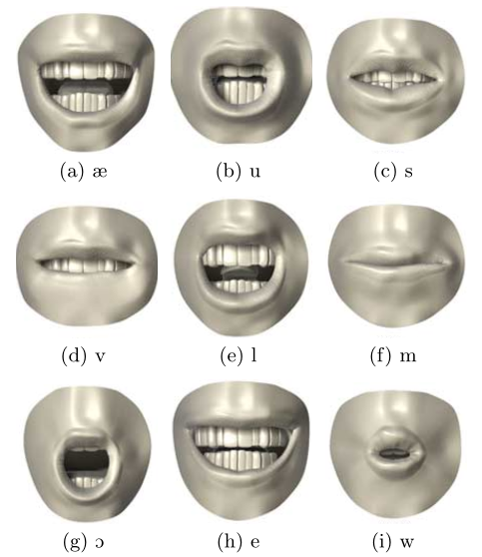
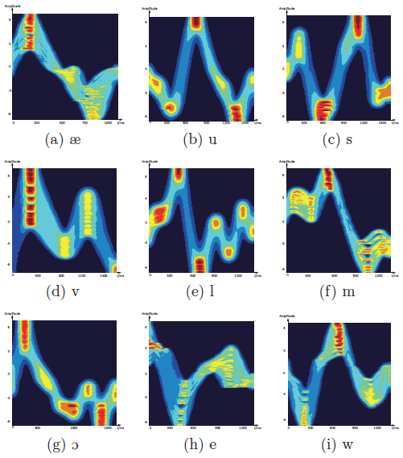
Feature Extraction
Multi-Cluster/Class Feature Selection (MCFS) scheme
Notes:
We apply a sophisticate scheme MCFS to extract signal features of each pronunciation.
The figure shows 9 examples of selected feature and corresponding mouth movements.

Slide 30
Lip Reading
Segmentation
Feature Extraction
Classification
Context-based Error Correction
Notes:
For a specific individual, his speed and rhythm of speaking each word share similar patterns.
We can thus directly compare the similarity of the current signals and previously sampled ones by generalized least squares.

Slide 31
Lip Reading
Segmentation
Feature Extraction
Classification
Context-based Error Correction
Notes:
since the pronunciations spoken are correlated, we can leverage context-aware approaches widely used in automatic speech recognition to improve recognition accuracy.

Slide 32
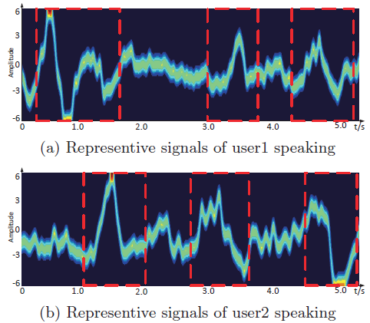
Extending To Multiple Targets
MIMO: Spatial diversity via multiple Rx antennas
ZigZag decoding: a single Rx antenna
Notes:
To support debate or discussion, we need to extend WiHear to track multiple talks simultaneously. A natural approach is to leverage MIMO technology. That is to use spatial diversity via multiple rx antennas. WiHear can also achieve hearing multiple people even with single antenna via zigzag decoding.
Zigzag decoding: The key insight is that, for most of the circumstances, multiple people do not begin pronouncing each word exactly at the time.
As shown in the Figure, After segmentation and classification, we can see each word as encompassed in the dashed red box. As is shown, three words from user1 have different starting and ending time compared with those of user2. Take the first word of the two users as an example, we can first recognize the beginning part of user1 speaking word1, and then use the predicted ending part of user1’s word1 to cancel in the combined signals of user1 and user2’s word1. Thus we use one antenna to simultaneously decode two users’ words.

Slide 33
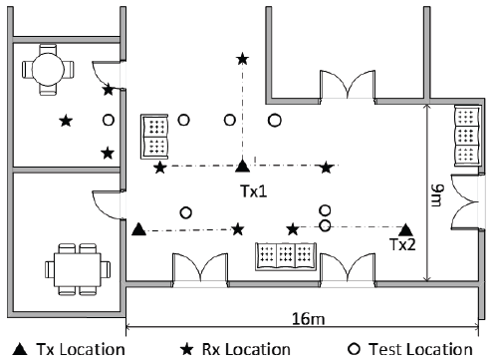
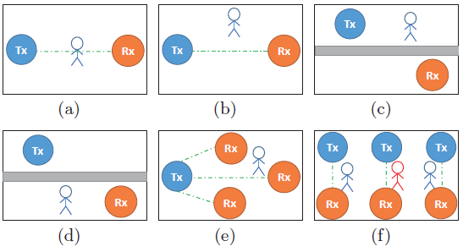
Implementation
Floor plan of the testing environment.
Experimental scenarios layouts. (a) line of sight; (b) non-line-of-sight; (c) through wall Tx side; (d) through wall Rx side; (e) multiple Rx; (f) multiple link pairs.
Notes:
We tested WiHear in a typical office environment and run our experiments with 4 people (1 female and 3 males). And we conduct experiments on both USRP N210 and commercial Wi-Fi products.
We extensively evaluate WiHear’s performance in the six scenarios. (a) line of sight; (b) non-line-of-sight; (c) through wall Tx side; (d) through wall Rx side; (e) multiple Rx; (f) multiple link pairs.

Slide 34
Vocabulary
Syllables:
[æ], [e], [i], [u], [s], [l], [m], [h], [v], [ɔ], [w], [b], [j], [ ʃ ].
Words:
see, good, how, are, you, fine, look, open, is, the, door, thank, boy, any, show, dog, bird, cat, zoo, yes, meet, some, watch, horse, sing, play, dance, lady, ride, today, like, he, she.
Notes:
The vocabulary that WiHear can currently recognized is listed here, which includes 14 syllables and 33 words.

Slide 35
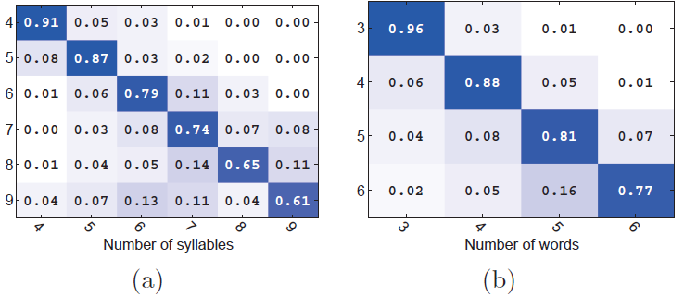
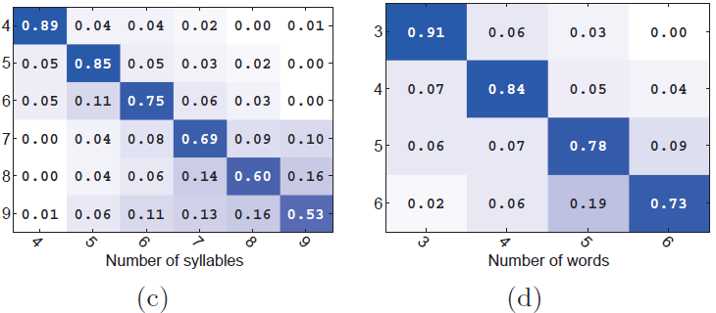
Automatic Segmentation Accuracy
Automatic segmentation accuracy for
Inner-word segmentation on commercial devices
(b) Inter-word segmentation on commercial devices
(c) Inner-word segmentation on USRP
(d) Inter-word segmentation on USRP
Notes:
Fig.9 shows the inner-word and inter-word segmentation accuracy. We mainly focus on LOS and NLOS scenarios.
The correct rate of inter-word segmentation is higher than that of inner-word segmentation. The main reason is that for inner-word segmentation, we directly use the waveform of each vowel or consonant to match the test waveform. Since different segmentation will lead to different combinations of vowels and consonants, even some of the combinations do not exist. In contrast, inter-word segmentation is relatively easy since it has a silent interval between two adjacent words.
Furhter, we find the overall segmentation performance of commercial devices is a little bit better than USRPs.

Slide 36
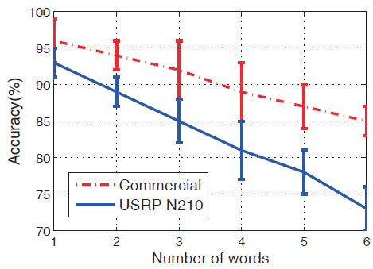
Classification Accuracy
Notes:
This figure depicts the recognition accuracy on both USRP N210s and commercial Wi-Fi infrastructure in LOS and NLOS.
The accuracy performance of commercial Wi-Fi infrastructure system achieves 91% on average with no more than 6-word sentences. In addition, with multiple receivers deployed, WiHear can achieve 91% on average with fewer than 10-word sentences.
Since overall commercial Wi-Fi devices perform better than USRP N210, we mainly focus on commercial Wi-Fi devices in the following evaluations.

Slide 37
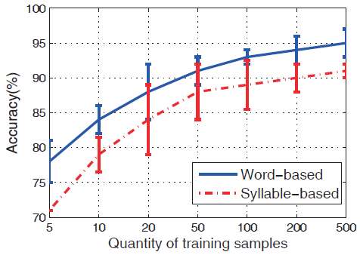
Training Overhead
Notes:
As a whole, we can see that for each word or syllable, the accuracy of word-based is higher than syllable-based scheme. Given this result, empirically we choose the quantity of training sample ranging from 50 to 100, which has good recognition accuracy with acceptable training overhead.

Slide 38
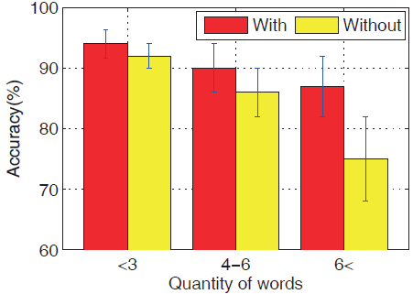
Impact of Context-based Error Correction
Notes:
Here we evaluate the importance of context-based error correction in LOS and NLOS scenarios.
As we can see that without context-based error correction, the performance drops dramatically. Especially in the scenario of more than 6 words, context-based error correction achieves 13% performance gain than without it. This is because the longer the sentence, the more context information can be exploited for error correction.

Slide 39
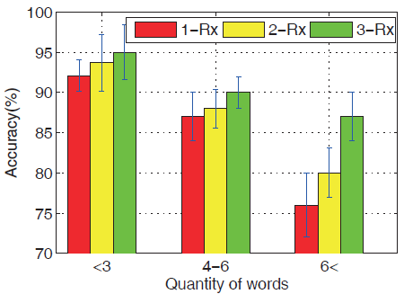
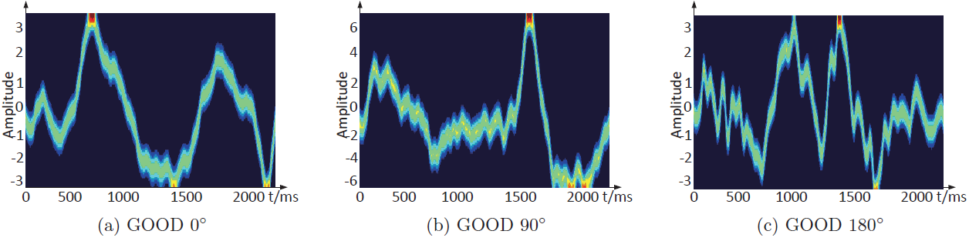
Performance with Multiple Receivers
Example of different views for pronouncing words
Notes:
The figure below shows the same person pronouncing the word “GOOD” has different radiometric impacts on the received signals from different perspectives (from the angles of 0, 90 and 180).
As shown in the upper side figure, with multiple (3 in our case) dimensional training data, WiHear can achieve 87% accuracy even when the user speaks
more than 6 words. It ensures the overall accuracy to be 91% in all three words’ group scenarios. Given this, if it is needed for high accuracy of Wi-Fi hearing, we recommend to deploy more receivers from different views.

Slide 40
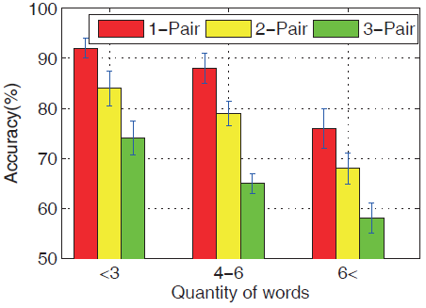
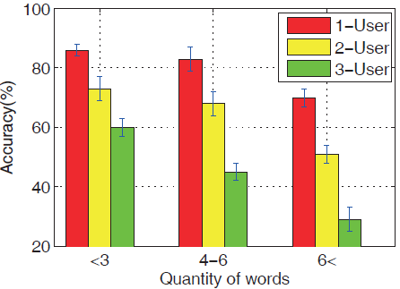
Performance for Multiple Targets
Performance of multiple users with multiple link pairs.
Performance of zigzag decoding for multiple users.
Notes:
The left side figure shows to use multiple link pair for hearing multiple targets. Compared with a single target, the overall performance decreases with the number of targets increasing. Further, the performance drops dramatically when each user speaks more than 6 words.
For zigzag decoding on the right side, the performance drops more severely than that of multiple link pairs. The worst case (i.e. 3 users, 6<words) only achieves less than 30% recognition accuracy. Thus we recommend to use ZigZag cancelation scheme with no more than 2 users who speak fewer than 6 words.

Slide 41
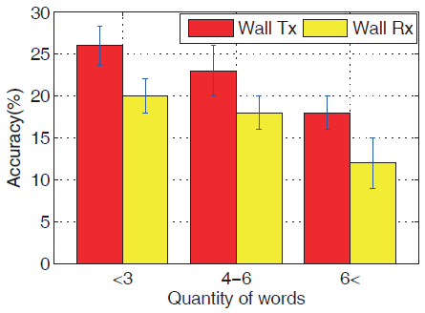
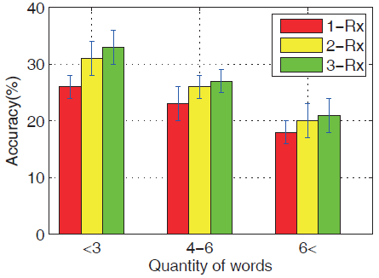
Through Wall Performance
Performance of two through wall scenarios.
Performance of through wall with multiple Rx.
Notes:
As shown in the left figure, although recognition accuracy is pretty low (around 18% on average), compared with the probability of random guess (i.e. 1/33=3%), the recognition accuracy is acceptable.
Performance with target on the Tx side is better.
As depicted in right side figure, With trained samples from different views, multiple receivers can enhance through wall performance.

Slide 42
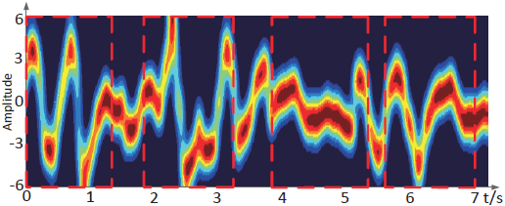
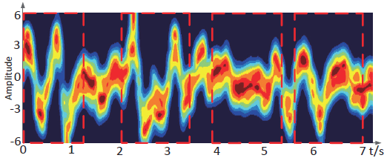
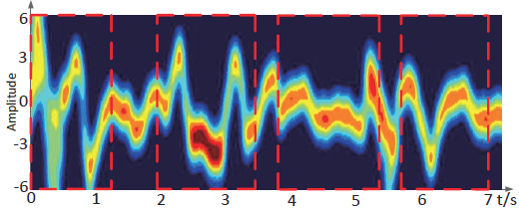
Resistance to Environmental Dynamics
Waveform of a 4-word sentence without interference of ISM band signals or irrelevant human motions
Impact of irrelevant human movements interference
Impact of ISM band interference
Notes:
Here we evaluate WiHear’s Resistance to Environmental Dynamics.
We let one user repeatedly speak a 4-word sentence. For each of the following 3 cases, we collect the radio sequences of speaking the repeated 4-word sentence for 30 times and draw the combined waveform.
For the first case, we remain the surroundings stable. As shown in the upper side figure, we can easily recognize 4 words that user speaks.
For the second case, we let three men randomly stroll in the room but always keep 3 m away from the WiHear’s link pair. As shown in the middle, the words
can still be correctly detected even though the waveform is loose compared with the first case.
For the third case, we use a mobile phone to communicate with an AP (e.g. surfing online) and keep them 3 m away from WiHear’s link pair. As shown in the bottom, the generated waveform fluctuates a little compared with the first case, but still recognizable.

Slide 43
Conclusion
WiHear is the 1st prototype in the world, trying to use Wi-Fi signal to sense and recognize human talks.
WiHear takes the 1st step to bridge communication between human speaking and wireless signals.
WiHear introduces a new way so that machine can sense more complicated human behaviors (e.g. mood).

Slide 44
Thank you for your listening !

Slide 45

Questions ?
WiHear
Guanhua Wang
gwangab@cse.ust.hk
We Can Hear You With Wi-Fi !

