Slide 1



Use it Free: Instantly Knowing Your Phone Attitude
Pengfei Zhou*, Mo Li
Nanyang Technological University
Guobin (Jacky) Shen
Microsoft Research

Slide 2
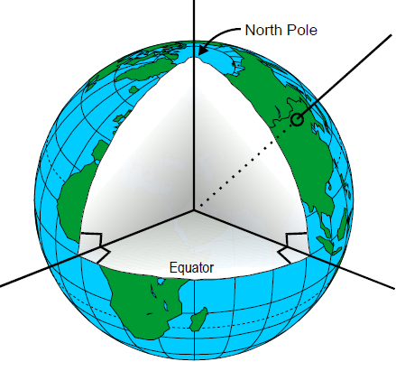
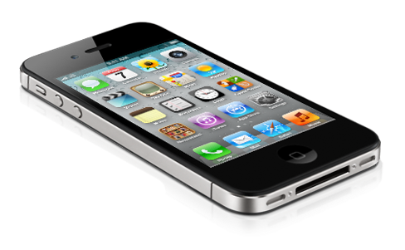
What is phone attitude?
Z_{e}
3D orientation of the phone with respect to the Geo-frame
Z
Y
Yaw
X
Roll
Y_{e}
X_{e}
Pitch
Body-frame
Geo-frame

Slide 3
What is phone attitude?
Z_{e}
Relative difference of the two frames
Euler Angles
Rotation Matrix R
3 degrees of freedom
Y_{e}
X_{e}
Geo-frame

Slide 4
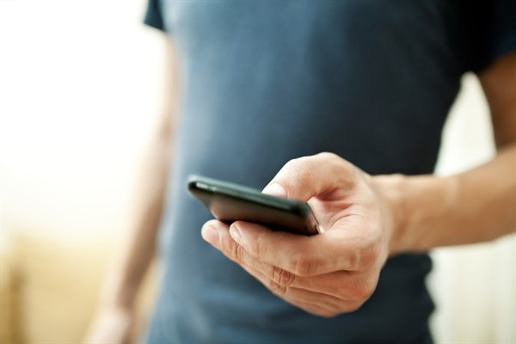
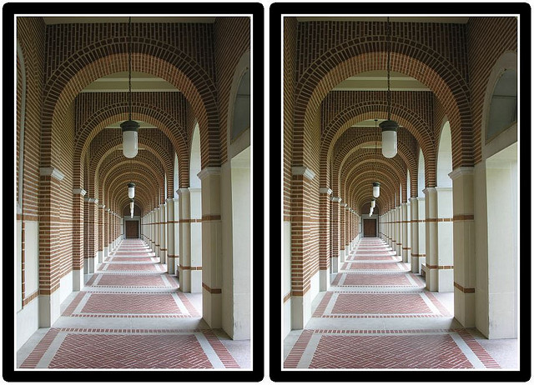
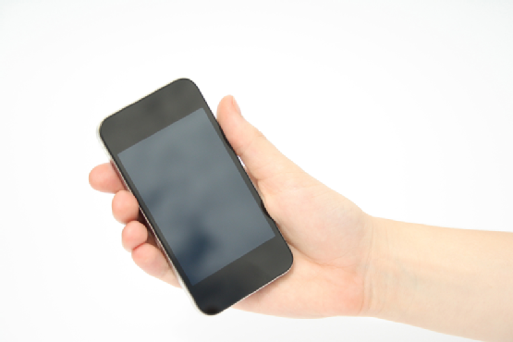
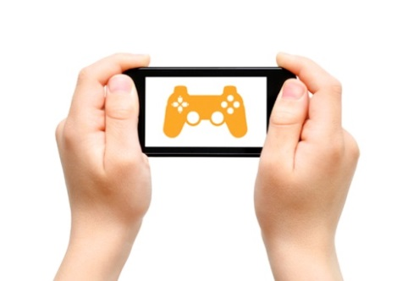
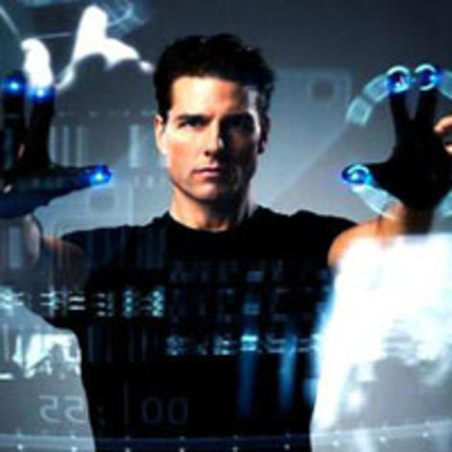
Why phone attitude is important?
Dead-reckoning based localization
3-D photography
Mobile gaming
Fine-grained gesture recognition

Slide 5
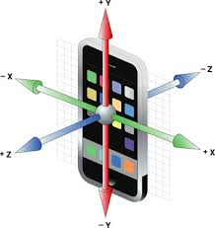
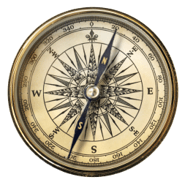
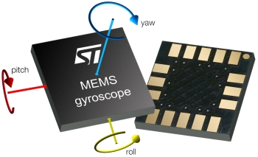
How to derive it?
Inertial Measurement Unit (IMU) sensors
MEMS Gyroscope
Accelerometer
Compass
Android APIs
  getRotationMatrix() : accelerometer + compass
  getRotationMatrixFromVector(): gyro + accelerometer + compass

Slide 6
MEMS gyroscope
Widely blamed for its poor accuracy
Papers / Apps | Error / Statements
UnLoc @ MobiSys’12 | “Error accumulates over time”, 20 meters within 3 mins
Walkie-Markie @ NSDI’13 | “Rapid error accumulation as distance increases”
Sensing Vehicle Dynamics@ MobiSys’13 | “Gyro sensor readings can be noisy and unreliable”
Characterization study @ TCMS | Temperature and humidity affects MEMS gyroscope
Gyrophone @ USENIX Security’14 | “Susceptible to ambient acoustic noises”
Sensor Box @ Android | 65°within 3 mins
Seene @ iPhone | 30°within 3 mins

Slide 7
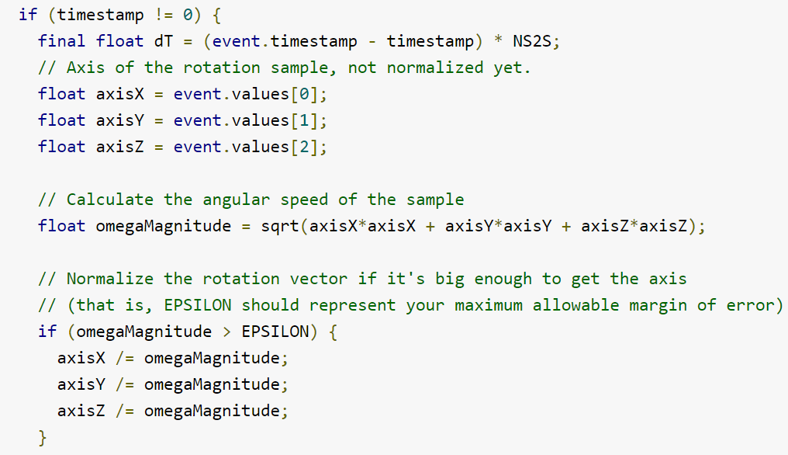
Why poor accuracy of gyro?
Low-end MEMS gyroscope sensor ($20 ~ $100)
Insufficient understanding on the sensor nature

Slide 8
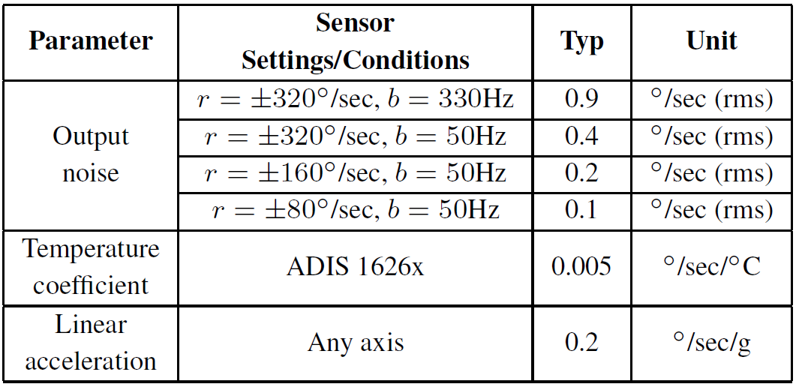
Why poor accuracy of gyro?
What are the major factors influencing the performance of smartphone gyroscopes?

Slide 9
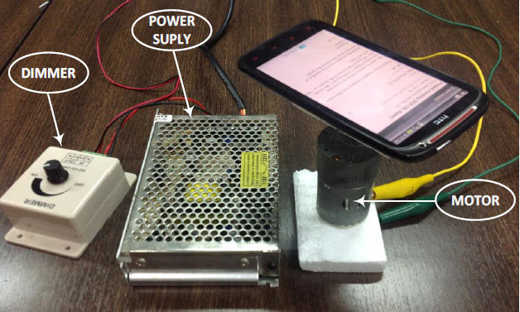
Gyroscope experiment
Factors investigated
  Temperature
  Phone motion
  Tracking time
Experiment devices
  HTC Sensation XE mobile phone
  Motor, dimmer, and a power supply
-- single point compensation has already been done

Slide 10
Impact of phone motion
Phone motion
Rotational
Translational
Angular velocities
Linear accelerations

Slide 11
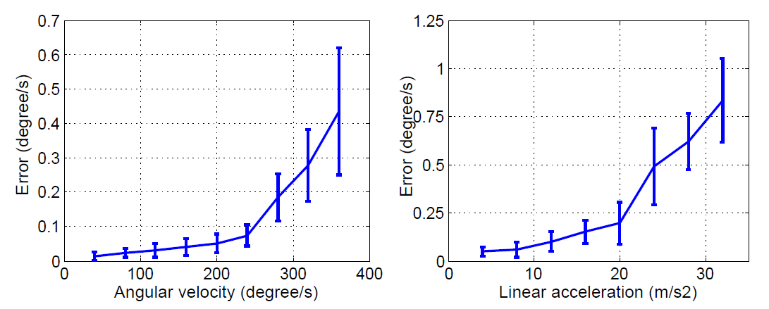
Impact of rotational motion
Low-frequency motion v.s. out-of-range motion
Rotational
Angular velocities

Slide 12
Impact of translational motion
Low-frequency motion v.s. out-of-range motion
Translational
Linear accelerations

Slide 13
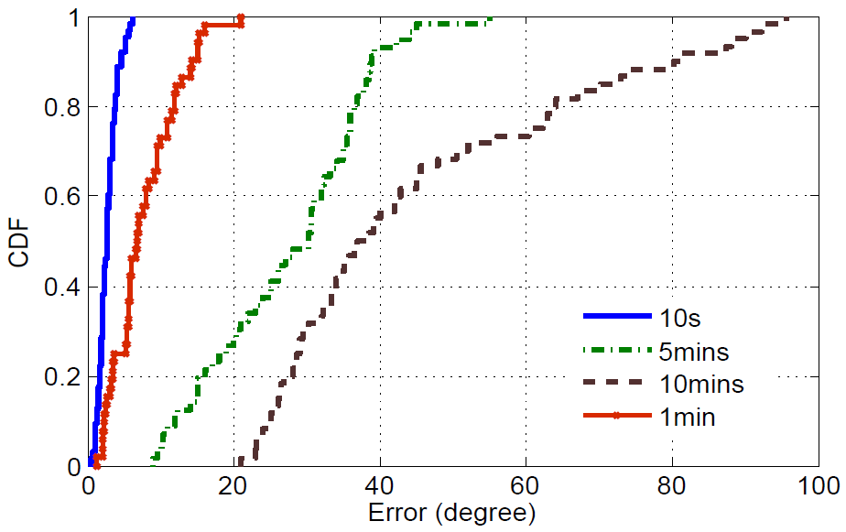
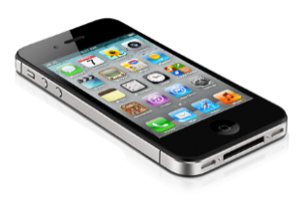
Impact of tracking time
Cumulative error
  the error of attitude estimation after a certain period of usage
3°
30°
Random usage
6°
39°

Slide 14
Gyroscope performance summary

Slide 15
Gyroscope performance summary
Error is almost linearly proportional to the tracking time and mobile phone motion (linear acceleration & angular velocity).
The error of gyroscope can be tracked based on the real time phone motion and tracking time
If working within short time period and safe condition range, gyroscope is accurate. The out-of-range motion significantly pollutes the consequent estimation results!

Slide 16
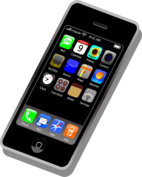

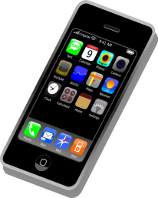
An alternative for attitude estimation
Combination: estimate the phone attitude instantly.
  Another 3 degrees of freedom: independent of gyroscope estimation
Z_{e}
Y
Y_{e}
α
X_{e}

Slide 17
An alternative for attitude estimation
Gravity extraction using low pass filters (e.g., Butterworth Filter in Android)
  The extraction is accurate when phone motion is low but complicated during high-frequency motion
Earth north estimation based on the earth magnetic field signal.
  The estimation is accurate outdoors but complicated indoors

Slide 18
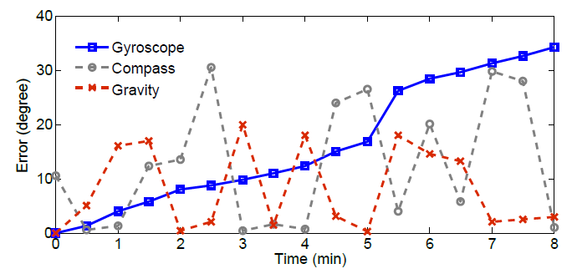
Different nature of the IMU sensors
Sensing redundancy

Slide 19
Different nature of the IMU sensors
Sensing redundancy
Gyroscope based Attitude Tracking
Accelerometer & Compass based Calibration

Slide 20
Attitude tracking and calibration
Real-time Attitude
Gyroscope Tracking
Calibration
Gyroscope
Accelerometer
Compass
Indoor/outdoor

Slide 21
Is that all?
Attitude tracking and calibration
Problem: Calibration opportunities could be too few

Slide 22
Opportunistic calibration
What does the MEMS gyroscope measure?
  Angular velocity: the attitude change of the mobile phone
Gyroscope is accurate within a short time period (e.g., 2 secs)
The measure of the attitude change is accurate
We can compare the change of gravity estimation and earth north estimation with that of gyroscope
Similar trend indicates a positive calibration opportunity

Slide 23
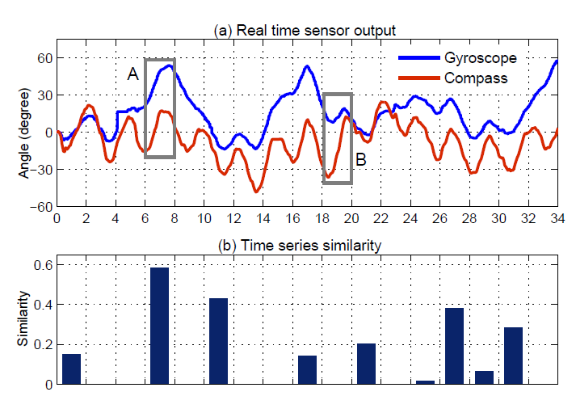
Opportunistic calibration

Slide 24
Evaluation

Slide 25
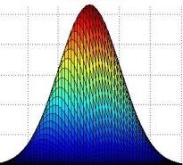

Previous work
Kalman-based algorithms
e₂
m(k)
s(k)
e₁
s(k-1)
p(k)

Slide 26
Evaluation settings
Mobile Phones
  HTC Sensation XE, Samsung Galaxy S2 i9100, and LG Google Nexus 4
Scenarios: walking in hand & in pocket
Comparison
  Basic A³
  A³
  Android API
  x-AHRS
Popular apps investigation

Slide 27
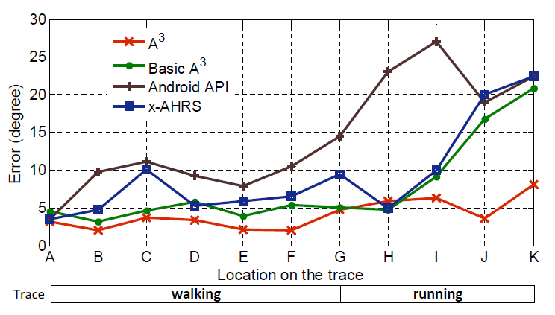
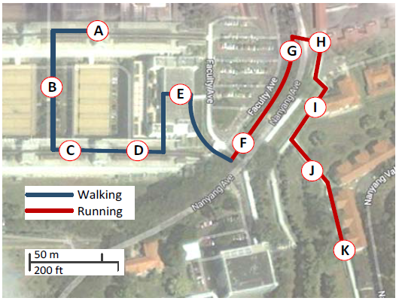
An instant trace

Slide 28
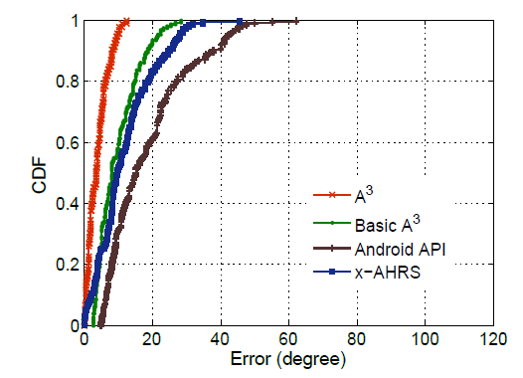
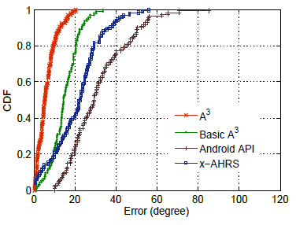
Performance in different scenarios
Walking in hand
Walking in pocket

Slide 29
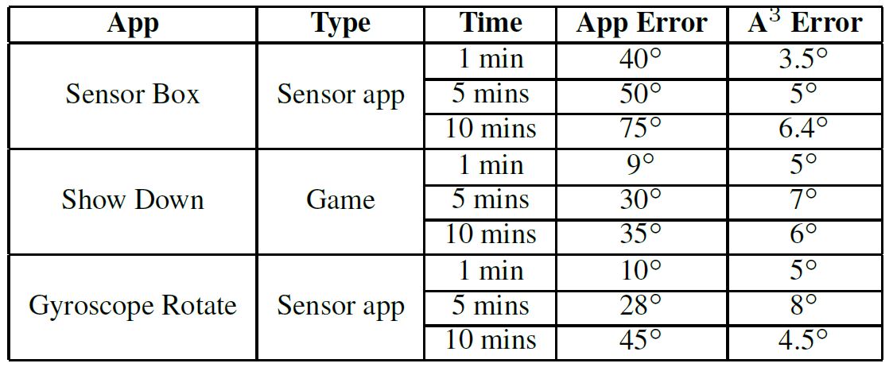
In popular apps

Slide 30
Conclusion
Detailed studies to understand the basic performance of mobile phone IMU sensors and their sensitivity to environments
A novel phone attitude estimation method which fully exploits the sensing redundancy of gyro, accelerometer and compass
A novel opportunistic calibration technique which looks at the trend of the estimation instead of the absolute value

Slide 31
Thank you & questions.
Pengfei Zhou
http://pdcc.ntu.edu.sg/wands/pfzhou/

Slide 32
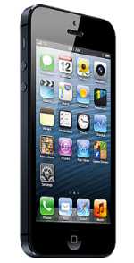
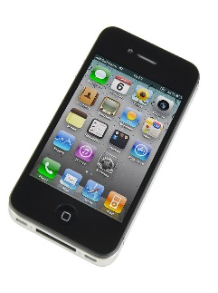
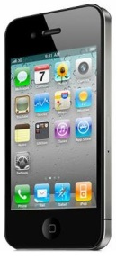
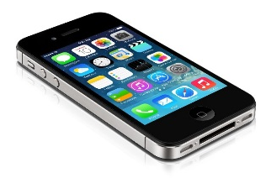








Gyroscope
Integration time slots for angular velocities
$$ω_{1}$$
$$ω_{2}$$
$$ω_{3}$$
$$ω_{4}$$
……
……
$$t_{1}$$
$$t_{2}$$
$$t_{3}$$
$$t_{4}$$

Slide 33
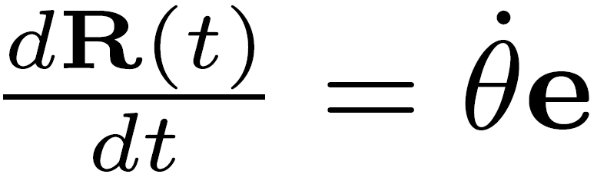
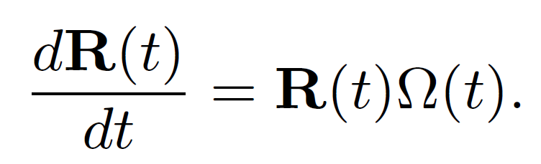
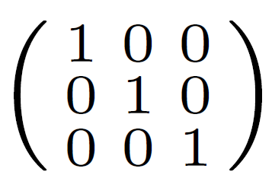
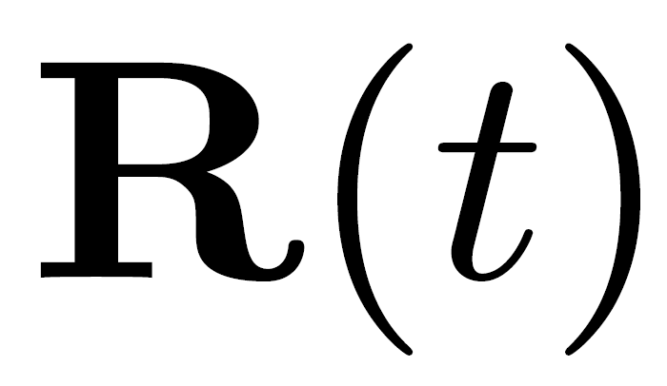

Euler Angle/Axis method
3-axis angular velocity integration
  Find a equation for the rotation speed in the geo-frame based on differential.
rotation matrix

Slide 34
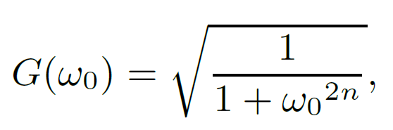
Gravity extraction using accelerometer
Using low pass filters to extract gravity (e.g., Butterworth Filter in Android)
Performance gain G(w₀) depends on the phone motion

Slide 35
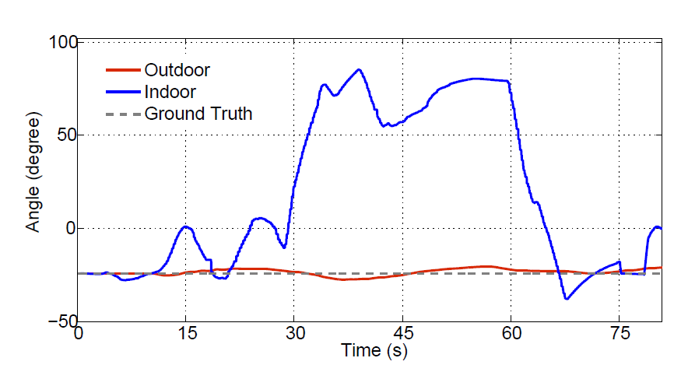
Earth north estimation using compass
Earth north estimation based on the earth magnetic field signal.
Estimation is accurate outdoors but complicated indoors

Slide 36


How to find good calibration opportunities?
What are good calibration opportunities?
  When the gravity extraction and earth north estimation are more accurate than the gyroscope estimation.
Quality of the gyroscope estimation result.
Quality of the combination of gravity and compass.

Slide 37
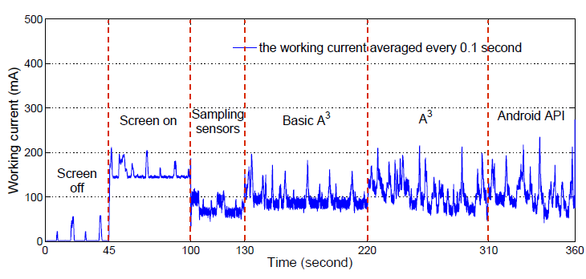
Power consumption

