Slide 1

DAISY
Data Analysis and Information SecuritY Lab
E-eyes: Device-free Location-oriented Activity Identification Using Fine-grained WiFi Signatures
Presenter: Yan Wang
Yan Wang†, Jian Liu†, Yingying Chen†,
Marco Gruteser‡, Jie Yang#, Hongbo Liu*
†Dept. of ECE, Stevens Institute of Technology
‡ WINLAB, Rutgers University
# Dept. of CS, Florida State University
* Indiana University-Purdue University Indianapolis
MobiCom 2014
Maui, Hawaii
Sept. 7th – 11th 2014
Notes:
1

Slide 2
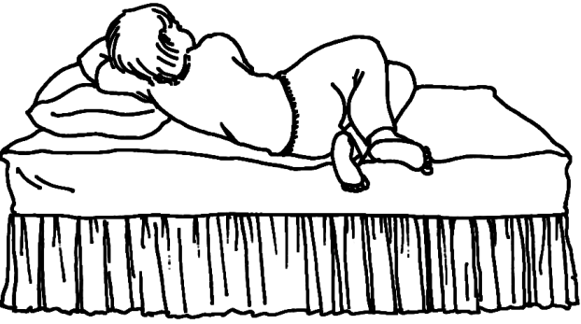
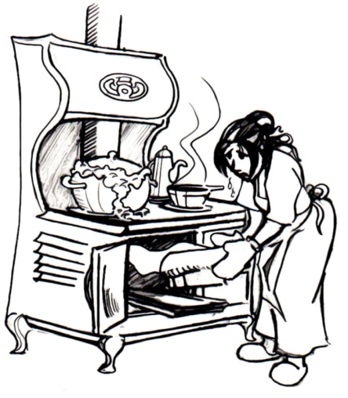

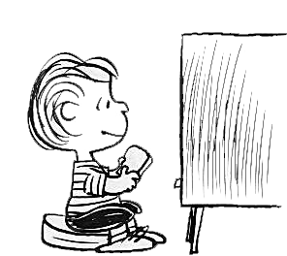
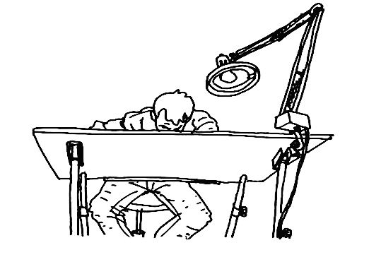
Motivation and Applications

Slide 3
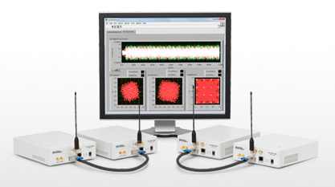
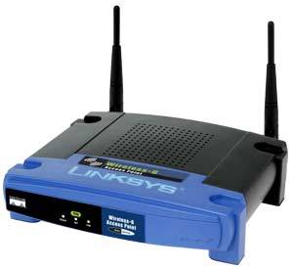
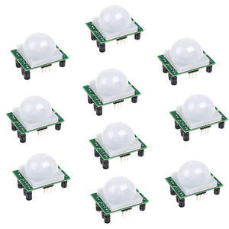
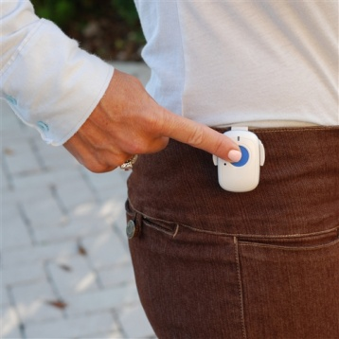
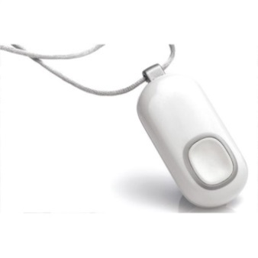
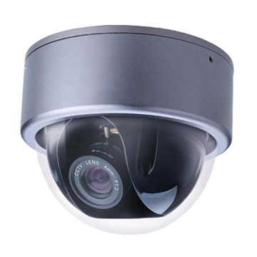
Our Goal: Low-Cost Fine-Grained Activity Identification
Coarse-grained
Localization using
off-the-shelf WiFi
Device-free passive localization
Nonintrusive
Intrusive
Granularity of the solutions
RSS-based approach
Localization/classification
using specialized devices
Localization
WiSee, WiTrack
RTI
Fine-grained
Our E-eyes
Activity sensors
Attached sensors
Optimal solution
Non-attached sensors
Low cost
Scalability / Infrastructural cost
High cost

Slide 4


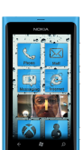


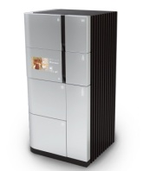

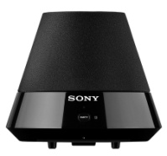
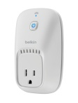
Intuition and Basic Idea
CSI Amplitude
Increasing availability of WiFi signals in home environments
WiFi provides fine-grained channel state information (CSI)
Use CSI to capture changes of multipath environment

Slide 5


Uniqueness of CSI Comparing to RSS
CSI Amplitude
RSS amplitude

Slide 6
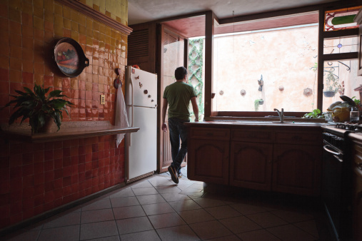
E-eyes System Challenges
Profile uniqueness and Robustness
Generality to different types of activities
Assisting the profile generation and updating

Slide 7
System Overview
Access Point Signal Time Series
Data Pre-processing
Increase robustness to real environments
Activity Identification
Assisting the profile generation and updating
Coarse Activity Determination
Generality to different Activities
Walking Activity Tracking using MD-DTW
In-place Activity Identification using EMD
Walking activity
In-place activity
Profile Construction and Updating
Construction
Data Fusion
Crossing Links
None Profile Based
Adaptive Updating
Profile matching
Known Activity
Unknown Activity
User Feedback

Slide 8
Coarse Activity Determination
Subcarrier 1
Subcarrier p
Subcarrier P
CSI Amplitude
CSI Amplitude
CSI Amplitude
CSI Amplitude
…
In-place activity
Walking activity
…
Time
Time
Time
…
…
Time
Walking activity
  Large moving variance due to significant body movements and location changes
In-place activity
  Small moving variance due to smaller body movements

Slide 9
Characteristics of CSI Measurements from Walking Activity
Trajectory 1
Trajectory 2
CSI pattern is dominated by walking activities’ path
Doorway profile can facilitate walking activity tracking

Slide 10
Walking Activity Tracking
CSI measurements
Subcarrier 1
Subcarrier p
Subcarrier P
CSI Amplitude
CSI Amplitude
CSI Amplitude
…
…
Walking Activity
Classifier
Time
Time
Time
Multi-Dimensional Dynamic Time Warping Distance Derivation
Activity Profiles
CSI Amplitude
Subcarrier 1
CSI Amplitude
Subcarrier p
CSI Amplitude
Subcarrier P
…
…
DTW distance
Time
Time
Time

Slide 11


Characteristics of CSI Measurements from In-Place Activity
Different in-place activities cause different distributions of CSI
Different rounds of same in-place activities result in similar distributions of CSI

Slide 12
In-Place Activity Identification
CSI measurements
CSI Amplitude
In-place Activity
Classifier
Distribution of CSI Amplitudes Extraction
Time
Subcarrier Earth Mover’s Distance Derivation
Activity Profiles
Distribution
EMD distance

Slide 13
Non-profiling Clustering
Activity Identification
Profile Construction and Updating
Constructing profiles
Non-profiling Clustering
Adaptive Updating
Unknown Activity
User Feedback
Semi-supervised approach to cluster daily activities and update CSI profiles
Construct CSI profiles when our system starts

Slide 14
Questions
How robust is the system in typical indoor environments?
Can two different activities be distinguished at the same location?
Is WiFi traffic in home environment feasible to identify activities?

Slide 15
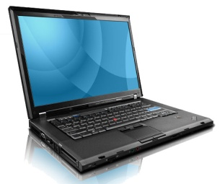
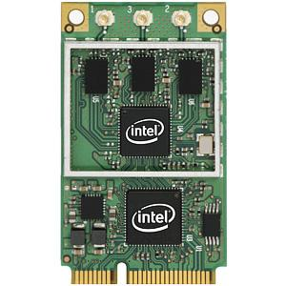
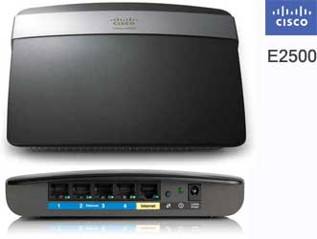
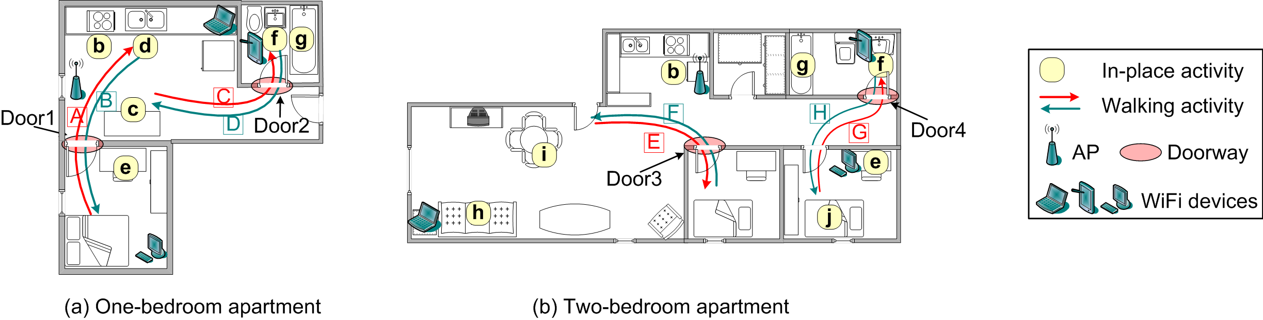
Experimental Setup
WiFi devices
  Intel 5300 NIC + Thinkpad T500 and T 51
  Cisco E2500
Scenarios
  Small apartment with one bedroom
  Large apartment with two beddoms

Slide 16
Questions
How robust is the system in typical indoor environments?
Can different activities be distinguished at the same location?
Is WiFi traffic in home environment feasible to identify activities?
Notes:
How robust is your system in typical indoor environments with multipath effects?

Slide 17
Performance of In-place Activity Identification in Two Different Apartments
1-bedroom apartment
2-bedroom apartment
TPR
TPR
1-bedroom apartment
2-bedroom apartment
Activity types
Activity types
FNR
FNR
False positive rate: less than 5%
Activity types
Activity types

Slide 18
Performance of Walking Activity Tracking and Doorway Identification
1-bedroom apt. | A | B | C | D | Unknown | Door | Door1 | Door2 | Door3
A | 1 | 0 | 0 | 0 | 0 | Door1 | 1 | 0 | 0
B | 0 | 1 | 0 | 0 | 0
C | 0 | 0 | 0.95 | 0.05 | 0 | Door2 | 0 | 0.975 | 0.025
D | 0 | 0 | 0 | 1 | 0
O | 0 | 0 | 0.1 | 0 | 0.9 | None | 0 | 0 | 1
2-bedroom apt. | E | F | G | H | Unknown | Door | Door1 | Door2 | Door3
E | 1 | 0 | 0 | 0 | 0 | Door3 | 1 | 0 | 0
F | 0.15 | 0.85 | 0 | 0 | 0
G | 0 | 0 | 0.9 | 0.1 | 0 | Door4 | 0 | 0.875 | 0.125
H | 0 | 0 | 0 | 1 | 0
O | 0.05 | 0 | 0.1 | 0 | 0.9t | None | 0 | 0 | 1

Slide 19
Questions
How robust is the system in typical indoor environments?
Can different activities be distinguished at the same location?
Is WiFi traffic in home environment feasible to identify activities?

Slide 20
Performance of Identifying Different Activities at the Same Location
Four in-place activities
  Sleeping on the bed
  Sitting on the bed
  Receiving calls nearby the sink
  Washing dishes nearby the sink

Slide 21
Questions
How robust is the system in typical indoor environments?
Can different activities be distinguished at the same location?
Is WiFi traffic in home environment feasible to identify activities?

Slide 22
Performance of Different Packet Rate
Packet transmission rate (PTR): 5 pkts/s - 20 pkts/s

Slide 23
Conclusion
Show that the channel state information (CSI) from off-the-shelf 802.11n devices can be utilized to identify and distinguish in-place activities inside a home
Develop a monitoring framework that can run on a single WiFi AP and use the associated profile matching algorithms to compare amplitude profiles against those from known activities
Explore dynamic profile construction to accommodate the movement or replacement of wireless devices and day-to-day profile calibration
Extensive experiments in two apartments of different size demonstrates the generality of our approach

Slide 24


Yan Wang
ywang48@stevens.edu

