Slide 1


A Vehicle-based Measurement Framework for Enhancing Whitespace Spectrum Databases
Tan Zhang, Ning Leng, Suman Banerjee
University of Wisconsin Madison

Slide 2




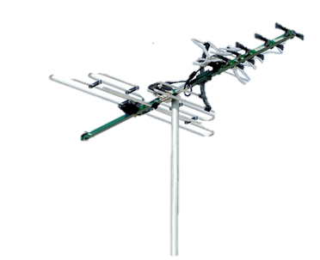

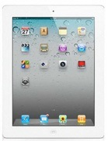






New Opportunity in TV Whitespaces
Vacant TV Channels
FCC OPENS TELEVISION WHITESPACES FOR UNLICENSED USE
November, 2008
TV Whitespaces

Slide 3

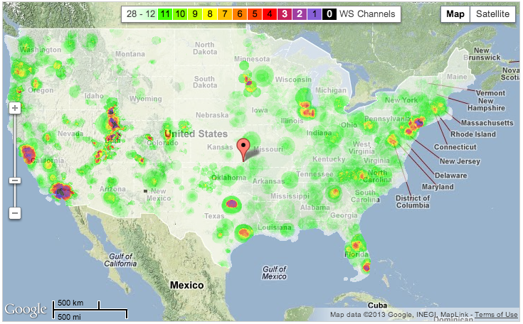
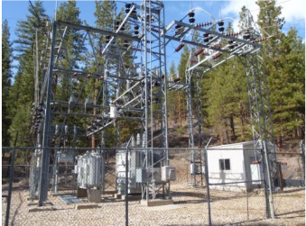
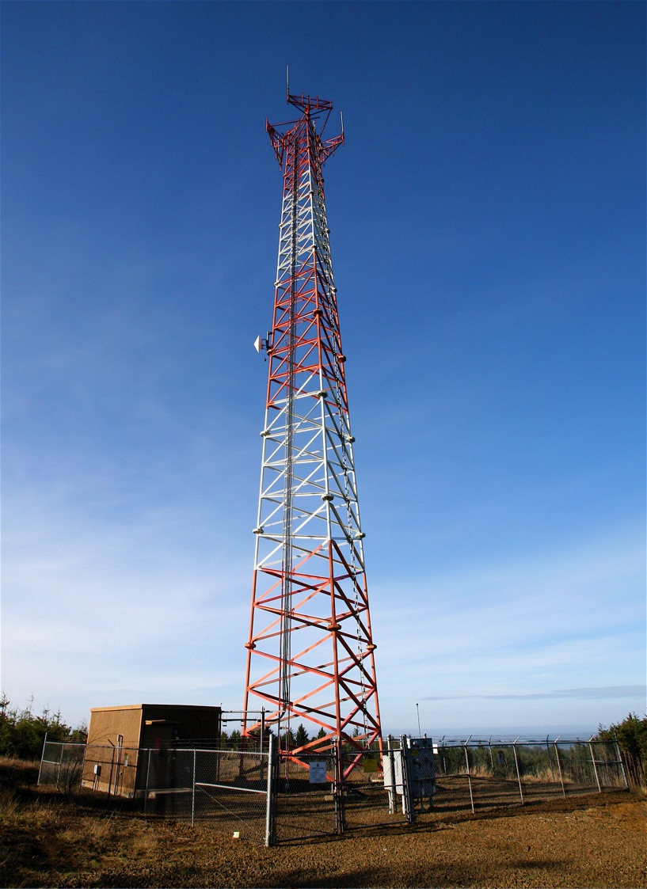
Advantages of TV Whitespaces
Good Propagation Range
in Lower Frequency
Large Spectrum Resource
after TV Broadcast Transition
60 – 180MHz!
Plumas-Sierra, CA
Logan, OH
Claudville, VA
Rural
Broadband
Smart Grid
Oriental Pearl TV Tower
Shanghai, China
TV Whitespace Availability
Google Spectrum Database

Slide 4

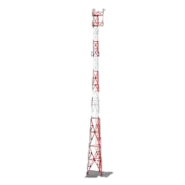



Whitespace Spectrum Database
Vacant
Spectrum Database
TV Whitespaces
TV Coverage
Primary
Users
MIC Protection
Contour
4

Slide 5
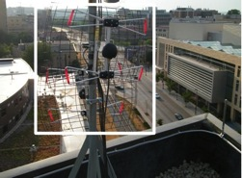

Error in Determining Whitespaces
Single Location
Measurement
Spectrum Wastage
Spectrum Database
Channel | 29 | 43
Database
Measurement
TV Whitespaces
TV Coverage
Primary
Users
MIC Protection
Contour
5

Slide 6

Unable to Predict Channel Quality
Spectrum Database
TV
Bad
Broadcast
Leakage
Channel | 1 | 3
Database
Good
Co-channel Interference
1
2
3
TV Whitespaces
Unlicensed
Microphone
TV Whitespaces
6

Slide 7
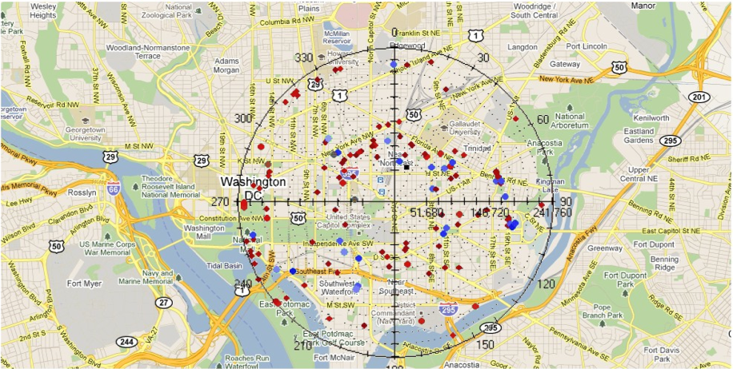
Localizing TV-band Devices
Spectrum Database
Use wide-area measurements to augment databases
7

Slide 8


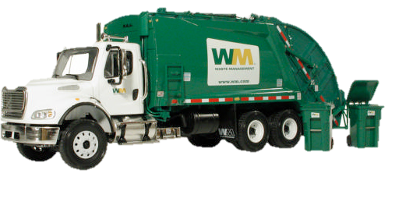
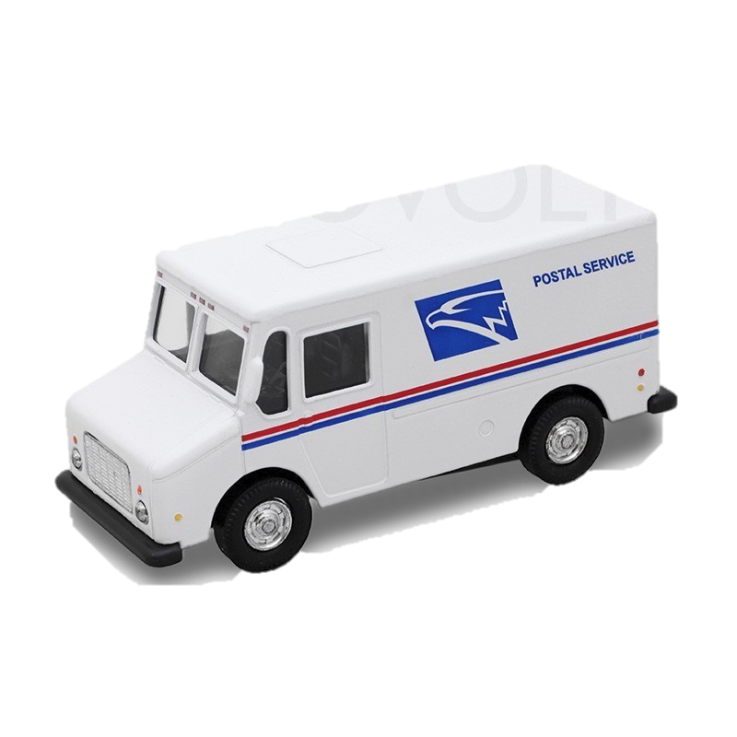
Wardriving on Public Vehicles
Spectrum Sensor
V-Scope = Vehicle + Sensor
Study the limitations of spectrum databases
Augment databases with measurements
Collect 1,000,000 measurements
over 150 square km at Madison, WI
Predict whitespace spectrum
Estimate channel quality
Localize primary and secondary devices

Slide 9
Outline
Database limitations
Opportunistic wardriving framework- V-Scope
  Primary detection algorithm
  Propagation model refinement
  Broadcast leakage prediction
  Localization algorithm
Evaluation
Conclusion

Slide 10
Outline
Database limitations
Opportunistic wardriving framework- V-Scope
  Primary detection algorithm
  Propagation model refinement
  Broadcast leakage prediction
  Localization algorithm
Evaluation
Conclusion

Slide 11
Accuracy of Commercial Databases
Study a commercial-grade database from SpectrumBridge, Inc.
Device | Under Protection
TV | 0.1%
Microphone | 0.02%
Databases are efficient in protecting primary users

Slide 12
Accuracy of Commercial Databases
Large Waste of Whitespace Spectrum
42% Wasted Area
Spectrum Waste in Protecting TV

Slide 13

Variation in Channel Quality
Measure noise power in whitespace channels
Calculate the difference between the best channel
and worst channel at each location
Broadcast
Leakage
Co-channel
Interference
120 Mbps Lower Data Rate
8dB median difference

Slide 14
Outline
Database limitations
Opportunistic wardriving framework- V-Scope
  Primary detection algorithm
  Propagation model refinement
  Broadcast leakage prediction
  Localization algorithm
Evaluation
Conclusion

Slide 15

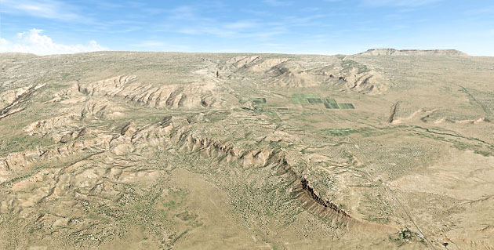



V-Scope Overview
Location | Measurement
1 | TV
2 | Whitespace
3 | Whitespace
Adjusted Parameter
Database
Whitespace
Device
TV Tower
TV
TV
Whitespace
Whitespace

Slide 16

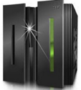
V-Scope Architecture
Loc | Signal | Power | Database
1 | TV | -60 dBm | Occupied
Path Loss
2 TV -70 dBm
Occupied
Loc2, Occupied
Distance
V-Scope Server
Database
Loc2, TV, -70dBm
Whitespace
Device
Leakage
Source
TV
Tower
Loc1
Loc2
Loc3
Loc4

Slide 17

Challenge in Detecting Primary Signals
FCC requires to detect primary signal up to -114dBm
Detect primary signals based on features
Strong Signals (-60dBm)
Weak Signals (-114dBm)
Pilot
TV
Where are the features?
Tone
MIC
32768 FFTs
over 6MHz

Slide 18
Intuition of Zoom-in Capture
Capture at a narrower band to reduce noise floor
FFT bins
Reduce noise floor by 4x
5MHz
20MHz

Slide 19
Zoom-in Feature Detection
Capture at a narrower band to reduce noise floor
Zoom-in
Pilot Frequency
TV
Pilot
12dB lower
noise floor
Use feature power to estimate total power
Peak Frequency
MIC

Slide 20
Accuracy of Primary Detection
Experiment setup
  Collect trace in 30 UHF channels
  Capture primary signals from -40dBm to -120dBm
Detected Groundtruth | Digital | Analog | MIC
Digital | 94.9% | 0.7% | 4.4%
Analog | 0.5% | 97.4% | 2.1%
MIC | 1.2% | 0.7% | 98.1%

Slide 21
Model Refinement
Improve any propagation model by fitting its parameters with measurements
Linear Regression
TV Tower
Standard

Slide 22

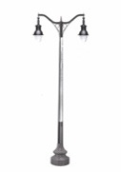

Region Specific Model
TV Tower

Slide 23
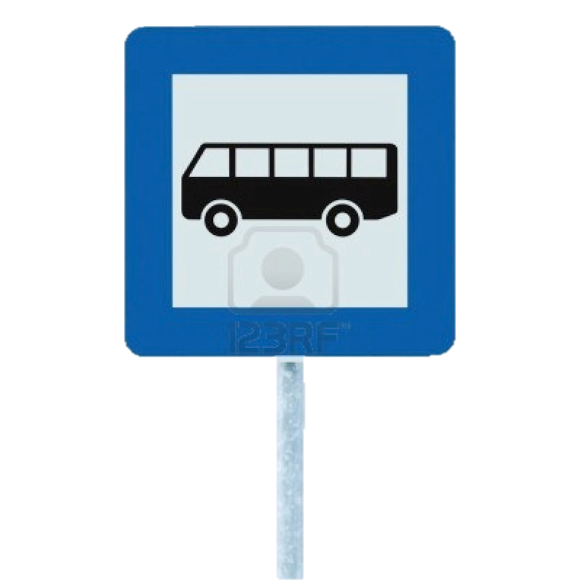

Weighted Regression Fitting
Lower squared sum causes under-fitting
Large error at locations with
fewer measurements
4
5
8
7
1
2
3
6

Slide 24
Predicting Leakage of TV Broadcast
A constant power offset between in-band signal and leakage signal at any location
Estimate for each TV broadcast with measurements
Add to TV power to estimate leakage power

Slide 25

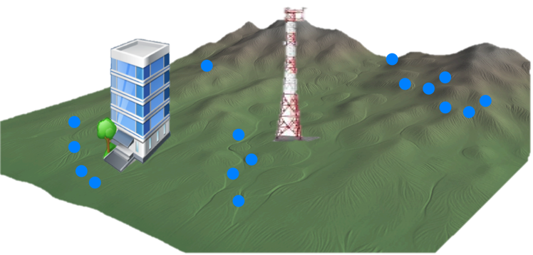
Localizing TV-band Devices
Select sectors with good propagation trend
Fit for each sector
Environmental variation perturbs path loss trend
( )
( )
Vehicular measurements for
3.8W whitespace transmitter

Slide 26
Outline
Database limitations
Opportunistic wardriving framework- V-Scope
  Primary detection algorithm
  Propagation model refinement
  Broadcast leakage prediction
  Localization algorithm
Evaluation
Conclusion

Slide 27
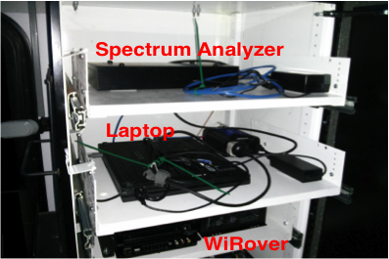
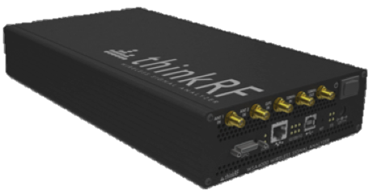
Evaluation
Experiment setup
  Deployed on a metro bus at Madison, WI
  Collected over 1 million measurements around 150 square-km area
ThinkRF WSA4000
Cabinet inside bus

Slide 28
Predicting TV Whitespace Spectrum
Use 80% measurements to fit different models
Predict TV signal strength at the rest of measurements
Use -114dBm threshold to determine TV whitespaces
4x Reduction
Prediction | Under Protection
Commercial Database | 0.1%
V-Scope | 0.037%

Slide 29
Selecting Suitable Whitespace Channels
Sum the predicted power of unlicensed devices and broadcast leakage in each whitespace channel
Select suitable channels with power below a threshold
Count number of mis-selected channels at each location
Correctly select all the channels for
72 - 83% locations
15-30Mbps lower PHY rate for 5dB higher power
3 – 4 channels
mis-selected for
50% locations

Slide 30
Localizing Unlicensed Devices
Localize 100mW TV-band devices in 5 different buildings
Collect vehicular measurements over 2 square km area
Use a GPS device to determine ground truth locations
Sector-based approach reduces error by 2 – 3x
27m
16m

Slide 31
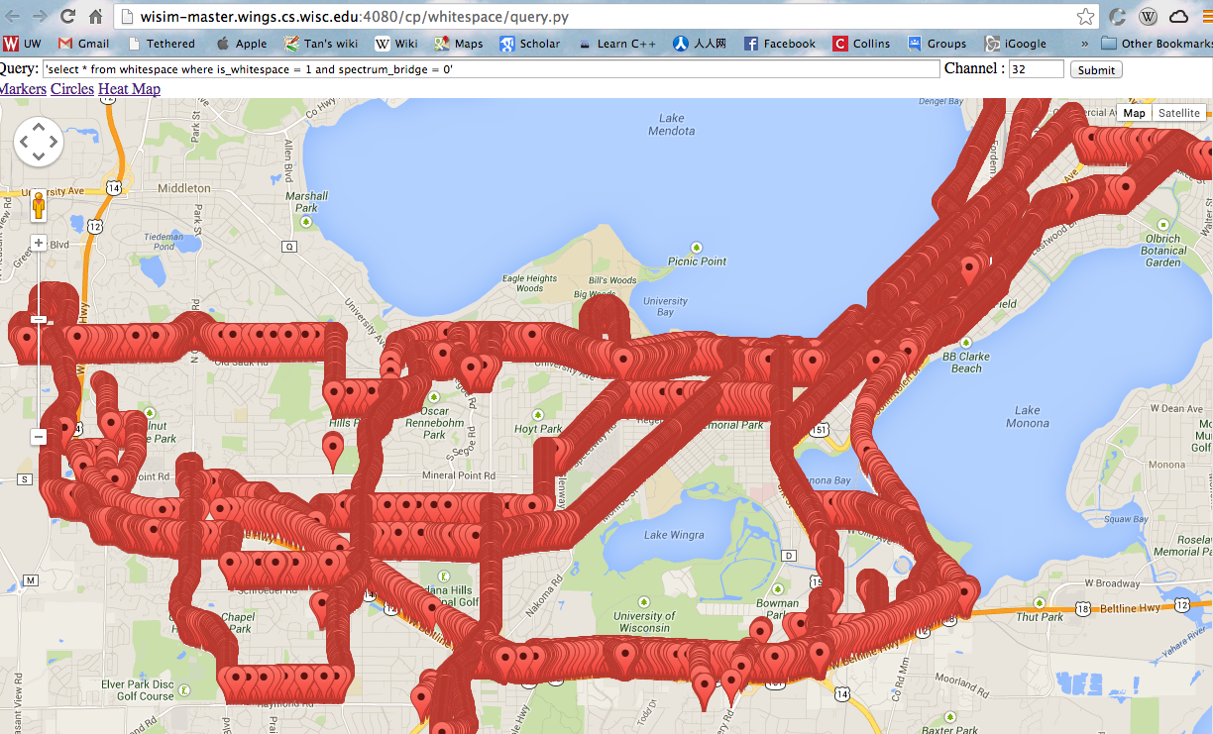
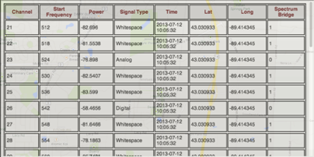
Web Front-end
http://research.cs.wisc.edu/wings/projects/vscope/
SQL Query

Slide 32
Conclusion
Deployed a system on public transit buses to collect spectrum measurements.
Existing databases have limitations in managing TV whitespaces.
  Cause under-utilization of whitespace spectrum
  Unable to predict the quality of whitespace channels
  Do not attempt to validate the location of TV-band devices
Designed measurement-refined models to augment databases
  Predict TV whitespace spectrum
  Estimate the quality of whitespace channels
  Localize primary and secondary devices

Slide 33
Thanks for your attention!
Questions?

Slide 34
Backup Slides

Slide 35
Variation in Channel Quality
Measure noise power in whitespace channels
Calculate variation in channel noise between the best channel and worst channel at each location
Unlicensed Microphone
TV
Leakage
Noise
Broadcast
Leakage
Co-channel
Interference
120 Mbps Drop
in PHY Rate
8dB median difference
Channel 26
Channel 27
Channel 28

Slide 36
Feature based Power Estimation
Use feature power to estimate total power
Fixed power relationship
ATSC:
10 – 15dBm Lower
1000 measurements for each TV strength
Audio tones carry > 95%
total power

Slide 37
Weighted Regression Fitting
Use weighted regression to compensate measurement density variation
Measurement | Weight | Measurement | Weight
1 | 16 | 5 | 1
2 | 16 | 6 | 1
3 | 16 | 7 | 1
4 | 16 | 8 | 1
4
5
7
1
2
3
6
8

Slide 38
Performance of Different Model Fitting
Accuracy in predicting path loss
  Measurements collected in a 100m road segment
Measurement
Weighted regression improves accuracy at sparse measurements
50dB
Error

Slide 39
Localizing TV-band Devices
Collect vehicular measurements for a 3.8W whitespace transmitter over 3 square km area
Choose subsets of measurements under different power
thresholds for localization
Use a GPS device to determine ground-truth location
Algorithm | System
Single-deterministic | EZ, RADAR
Single- probability | WifiNet, Horus
Sector- deterministic | V-Scope
Sector- probability | V-Scope
Locate within 80m using weak measurements < -75dBm
27m
Reduces error by 1.2 – 3.5x

