Slide 1



Enhancing Reliability to Boost the Throughput over Screen-Camera Links
Anran Wang, Shuai Ma, Chunming Hu, Jinpeng Huai,
Chunyi Peng, Guobin Shen

Slide 2
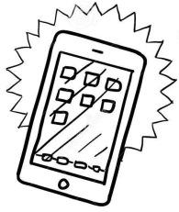

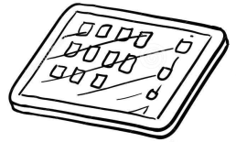
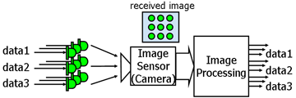
VLC over Screen-Camera Links
High availability of camera-equipped smart devices
Tablets
Smartphones
Laptops
Visible light communications (VLC)
Yet another promising transmission channel

Slide 3

Pros and Cons
VLC over screen-camera links are highly competent for one-time short-range wireless communications.
Compared with Radio Frequency (RF) techniques
Highly available: A smartphone has a screen and camera
Direct and secure: No need to do authentication process
Infrastructure-less: No dependency on WiFi or cellular networks
When you are here!

Slide 4

Pros and Cons
VLC over screen-camera links is challenging.
Smartphone limitations and user behavior uncertainty seriously hinder the transmission quality.

Slide 5
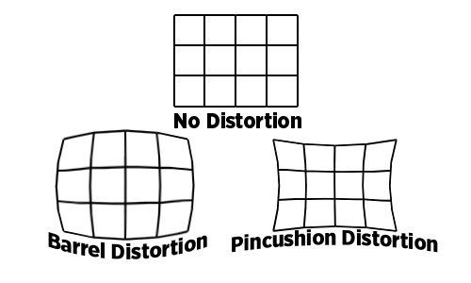
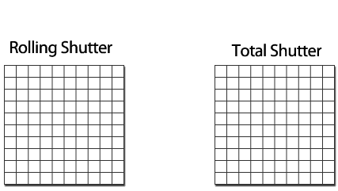
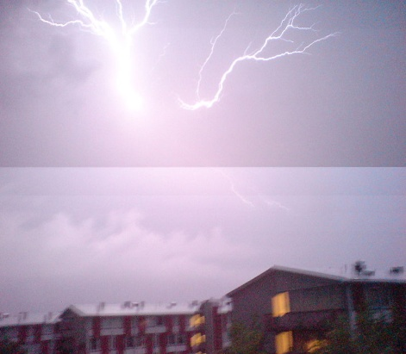

Smartphone Limitations
Lens distortions
Rolling shutter
Low border performance
(vignetting)
Color issues:
Color inaccuracies,
Different color processing mechanisms
Limited resources
Limited computing ability
Low battery capacity
…
Notes:
Lighting conditions changed between the exposure of the top and bottom parts of the photo.

Slide 6
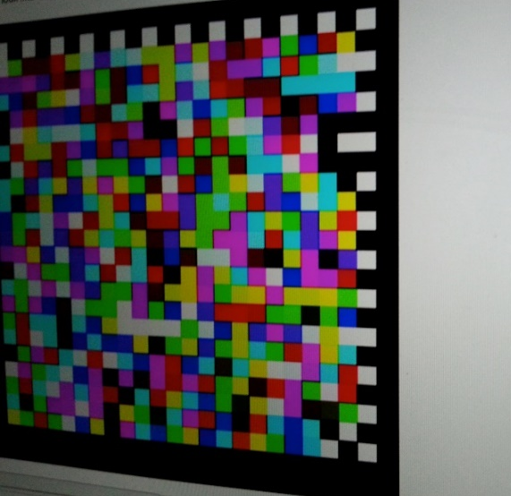

User Behavior Uncertainty
Users behave differently when shooting pictures
Unsuitable capture positions
Trembles
Distorted or incomplete pictures
Several sequential blurred pictures

Slide 7
Challenges and Its Solution
Challenges
The locality problem: For an image with uniform features, the close places in its captured image have similar features, while places far from each other present different features.
The partial unavailability problem: Unrecognizable parts of a frame caused by e.g., unsuitable shooting positions or temporally sequential frames loss caused by e.g., trembles.
One-way communication
No feedback available during data transmission
Retransmitting data is expensive
Solution
Reliability (correctness, integrity and ordering)
Enhancing reliability to boost the throughput

Slide 8
Design Principles and Architecture

Slide 9
Principles: High-Speed Reliable Transmission
Speed and reliability are two sides of a coin
Enhancing reliability with a reasonable overhead
Address the locality and partial unavailability problems
A packet-frame-block tri-level structure
Split each frame to independent “blocks” and aggregate sequential frames into independent “packets”
Different error correction techniques for three layers
Work with the limited computing resources
Adopt light-weight solutions

Slide 10
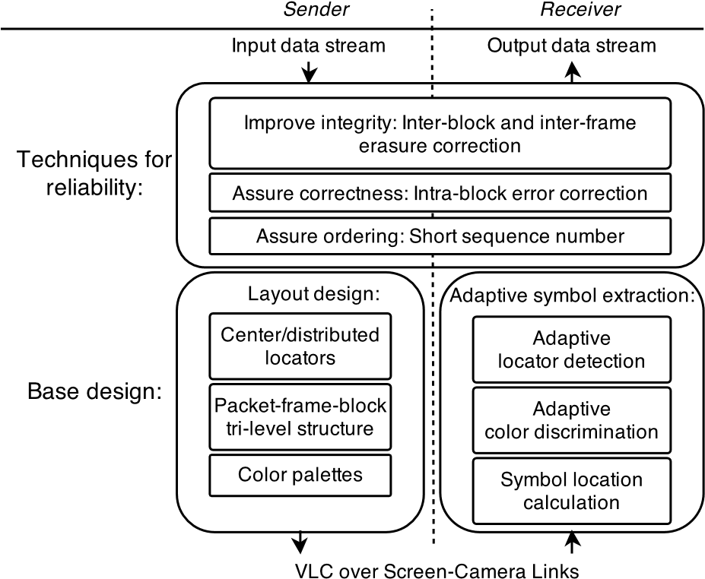
RDCode Architecture

Slide 11
RDCode Design
Techniques for reliability
Layout design
Symbol extraction

Slide 12
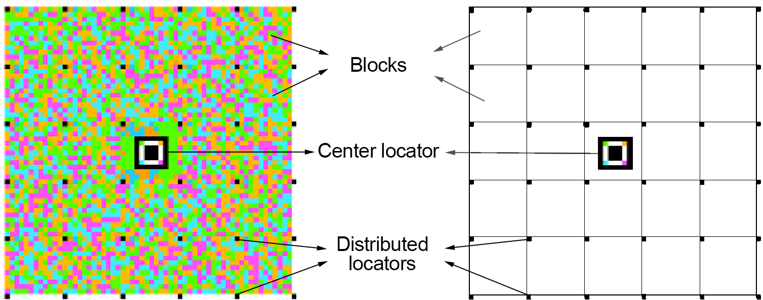
Layout Design
Symbols:
p X p square of pixels in the same color
Blocks
h X h square of symbols
Frames
m X n rectangle of blocks
Packets
A sequence of a fixed number of frames
Center locators :
locate the center of a frame
Distributed locators:
locate the other blocks
Color Palettes:
in each block
Reasonable transmission overhead
Around 4~5% symbols in a frame
Notes:
In one frame, 563/14275 symbols are functional (1404/14256 for COBRA design).

Slide 13
Symbol Extraction
Goals:
Robust for distortions and color inaccuracies
The available portion of a frame remains decodable
Low computational overhead
The symbol extraction Procedure
Step 1 (only do once): Locating center locator
Mean-Shift algorithm
Step 2: Locating distributed locators
Firstly, the four distributed locators around the center locator
Then, the other distributed locators
Step 3: Locate symbols and data extraction

Slide 14
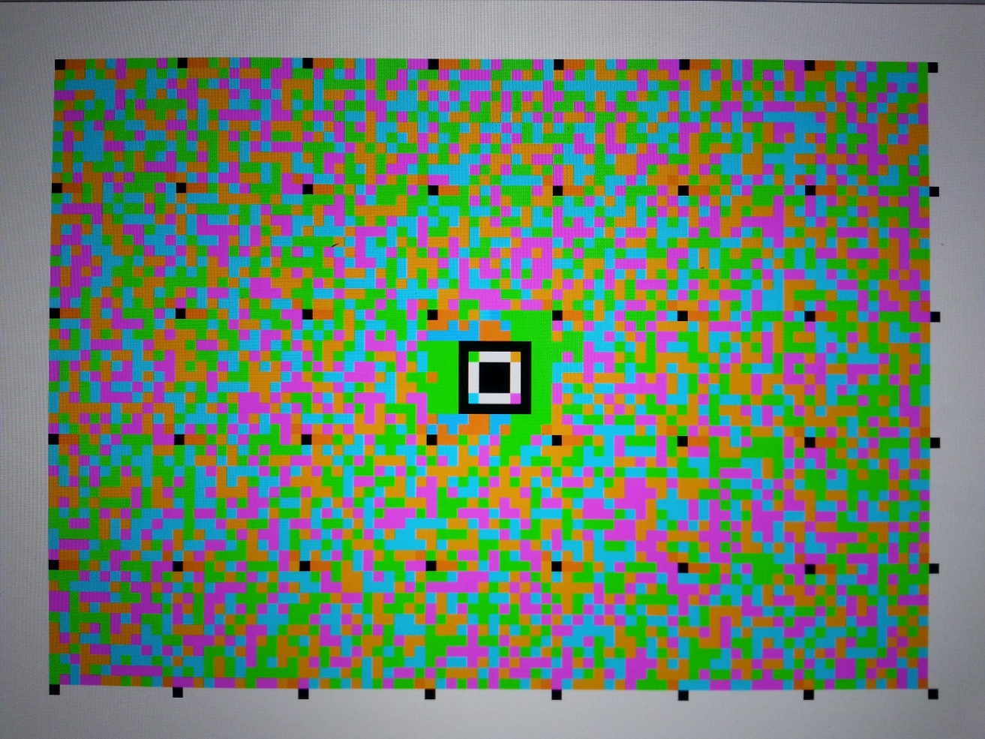
Symbol Extraction
Step 1: Locating center locator using the Mean-Shift Algorithm

Slide 15

Symbol Extraction
Step 2: Locating the four distributed locators for the block where the center locator is located

Slide 16
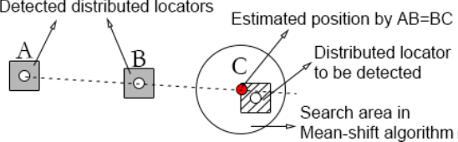
Symbol Extraction
Step 2: Locating the other distributed locators

Slide 17
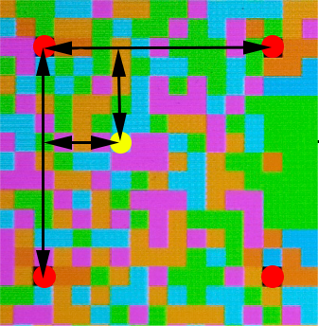
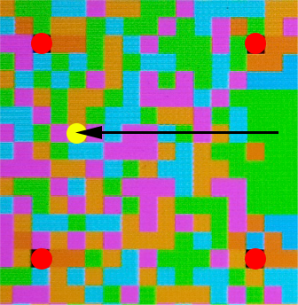
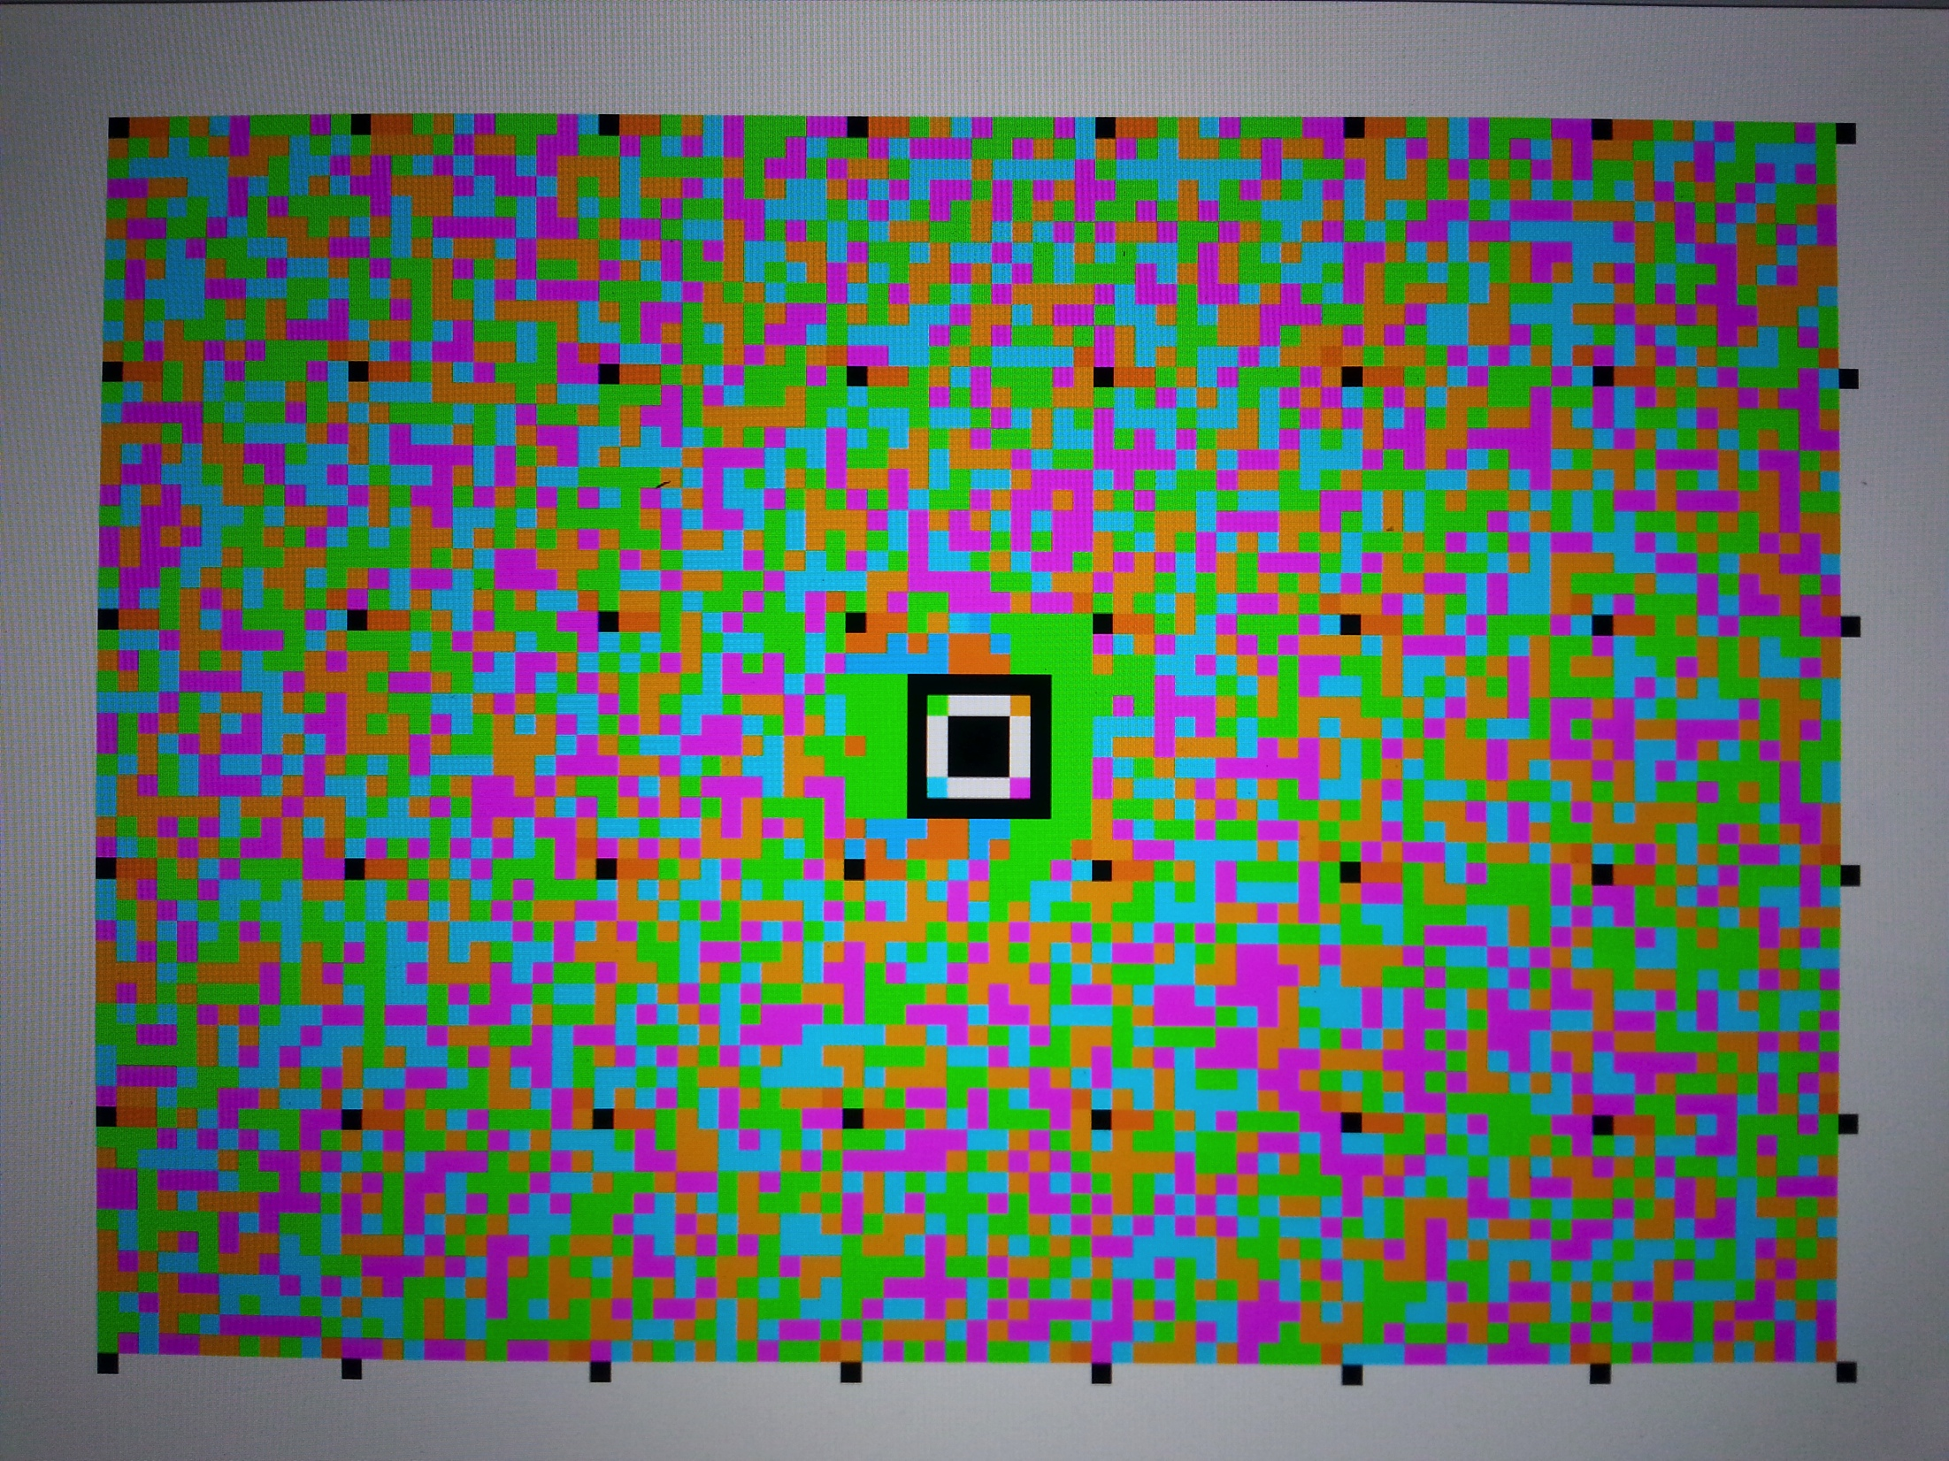
Symbol Extraction
Step 3.1: Locating data symbols
Step 3.2: extracting data using the color palette
The color palette

Slide 18
RDCode Techniques for Reliability
Techniques for reliability
Layout design
Symbol extraction

Slide 19
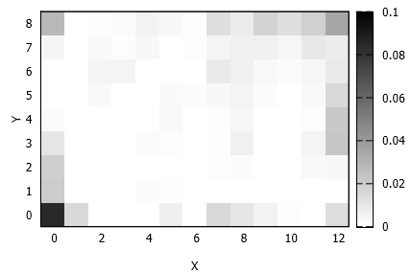
Error Correction Techniques
(1) Block-level error correction
Tolerate symbol errors in blocks caused by noises
Reed-Solomon codes with different code rates
To adapt the uneven error distribution
Bit-error-rate of each block within one captured frame

Slide 20
Error Correction Techniques
(2) Frame-level erasure correction
A small number of blocks are dedicated for parity-check
Recover lost blocks using successfully decoded blocks in a frame caused by partial unavailability or too much noise
(3) Packet-level erasure correction
A small number of frames are dedicated for parity-check
Recover lost frames in a packet caused by trembles or too fast sender refresh rate

Slide 21
Data Ordering
Different blocks in one captured image may belong to distinct frames from the sender.
A total sequence number for each frame is encoded in the center block, a short relative sequence number is encoded in every block
Full sequence number in the center block: 00101101
Short relative sequence number: 00
→ Full sequence number: 00101100

Slide 22
RDCode Implementation
On the Android platform, Scala language, about 4k LOC
Using YUV Color space for efficiency
Both online and offline encoder and decoder
Multi-thread enabled (4 threads available)
A simple optimization for file transmission:
Instead of looping the packets, code the packets
Even loops: first half, first half XOR second half
Odd loops: second half, first half XOR second half
✔
1 | 2 | 3 | 4 | 5 | 6 | 1 | 2 | 3 | 4 | 5 | 6
✔
1 | 2 | 3 | 1+4 | 2+5 | 3+6 | 4 | 5 | 6 | 1+4 | 2+5 | 3+6

Slide 23
RDCode Evaluation

Slide 24
Evaluation
Effectiveness & Efficiency
Bandwidth (bps)
bit-error-rate (%)
Throughput (KB/s) :
successfully decoded bytes per unit time excluding the redundant data
Goodput (KB/s)
transmission speed per unit time for an entire file transfer
Decoding time (s/frame)
Experimental settings:
Indoor environment
Except those tests for trembles and capture positions, sender and receiver are kept still
Devices: Nexus 7, Nexus 4 and Galaxy S3
50% sender luminance
Using offline encoder and decoder

Slide 25
Evaluation – Transmission Speed
Setting |  | Base design |  | After error correction |  | File transmission
 |  | Bandwidth | Bit-error-rate | Maximum Throughput | Successfully decoded | Goodput | Average loops
RDCode | 156*108@10FPS, p = 4,n − k = 6,q = 2 | 324kbps | 1.1% | 21.8KB/s | 99.2% | 17.0KB/s | 1.28
COBRA | 100*60@10FPS, RS(255,191) | 120kbps | 4.5% | 8.8KB/s | 89.4% | 2.1KB/s | 4.13
 | 100*60@7FPS, RS(255,191) | 84kbps | 2.1% | 6.1KB/s | 94.6% | 3.0KB/s | 2.03
 | 100*60@7FPS, RS(255,127) |  |  | 4.1KB/s | 98.8% | 2.6KB/s | 1.60
System performance. Sender: Nexus 7. Receiver: Nexus 4

Slide 26
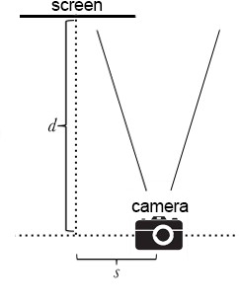
Evaluation – Capture Position
100
80
Sucessfully decoded (%)
p=0 d=24cm
60
d=21cm
d=18cm
40
d=15cm
p=5 d=24cm
20
d=21cm
d=18cm
d=15cm
0
0
2
4
6
8
s (cm)
Sender: Nexus 7. Receiver: Nexus 4

Slide 27
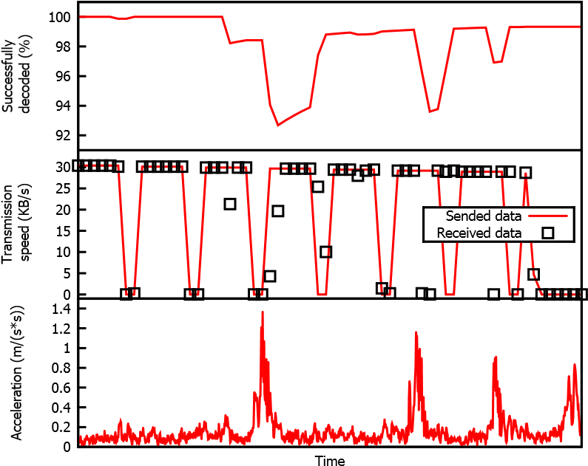
Evaluation – Trembles
Sender: Nexus 7.
Receiver: Nexus 4

Slide 28
Conclusions
RDCode is a robust barcode system :
using VLC over screen-camera links, and
enhancing reliability to boost the throughput
Based design: A novel tri-level barcode layout with adaptive symbol extraction methods
Techniques for reliability: different error correction approaches at different layers
The experiment study shows that RDCode reaches better transmission reliability and speed

Slide 29
Thanks
Please go to the demo session:
Anran Wang, Shuai Ma, Chunming Hu, Jinpeng Huai, Chunyi Peng, and Guobin Shen,
A Robust Barcode System for Data Transmissions over Screen-Camera Links. In MobiCom 2014.

Slide 30
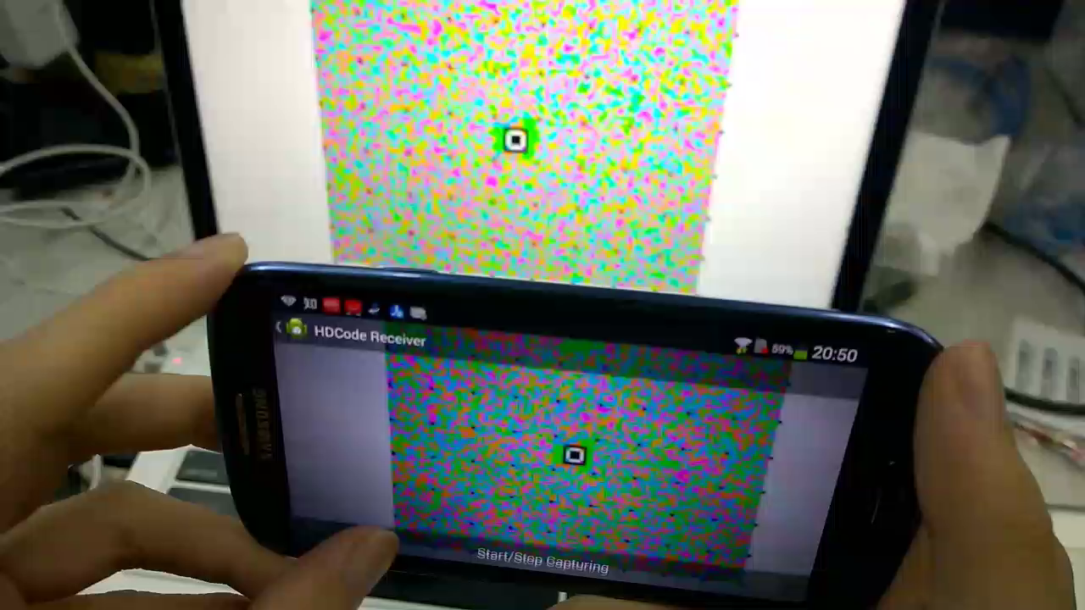
Implementation

