Slide 1



Strata: Layered Coding for Scalable Visual Communication
Wenjun Hu Jingshu Mao Zihui Huang Yiqing Xue
Junfeng She Kaigui Bian Guobin (Jacky) Shen

Slide 2
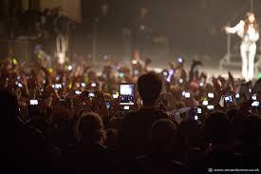
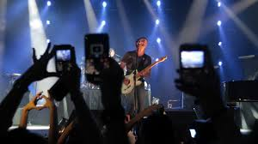
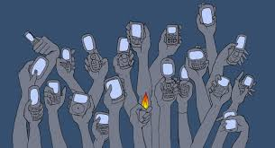
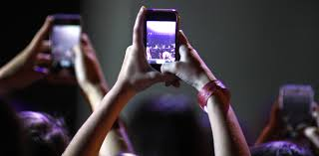
You may have seen these…

Slide 3
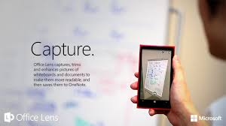
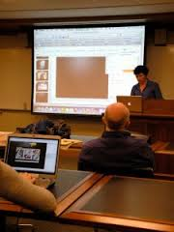

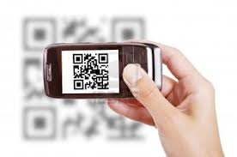
Smartphone cameras as “receivers”

Slide 4
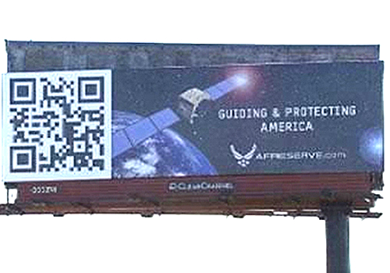
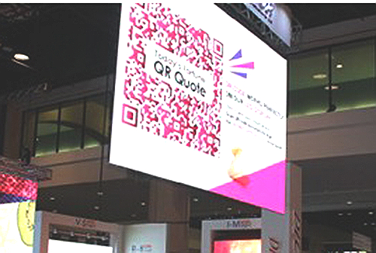
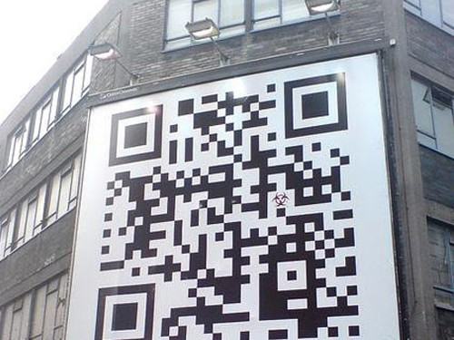
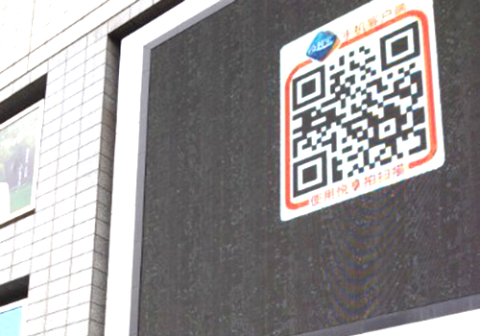
… everywhere

Slide 5

Existing codes: All or nothing
Camera view
Minimum resolution needed

Slide 6
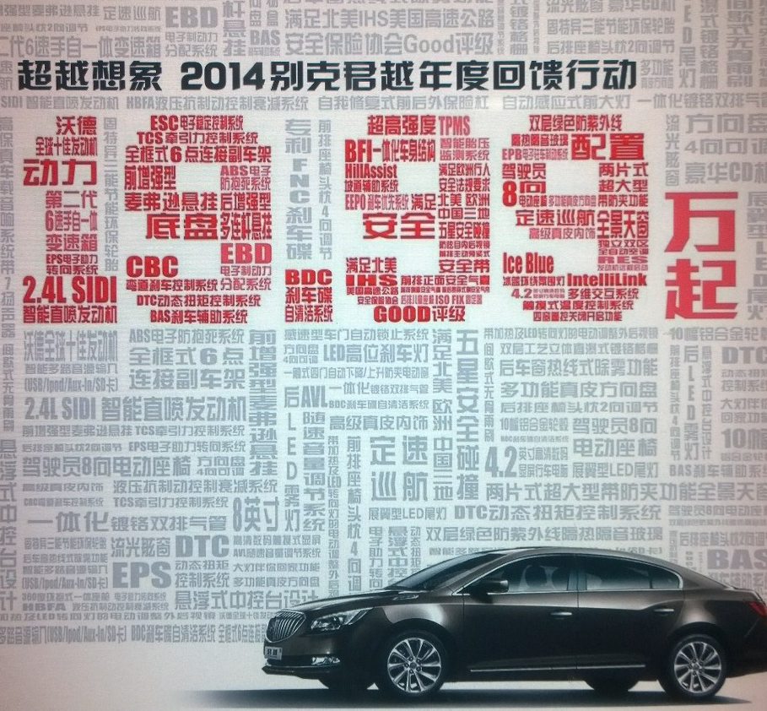
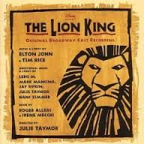
Multi-resolution information display

Slide 7
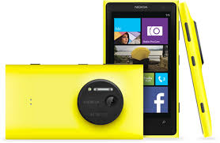
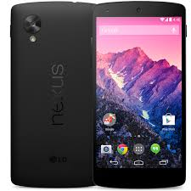
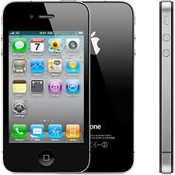
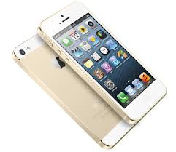
Diverse camera hardware
Lumia 1020 ~38MP, 30fps
Nexus 5
8MP, 30fps
iPhone 4
5MP, 30fps
iPhone 5s
8MP, 120fps

Slide 8
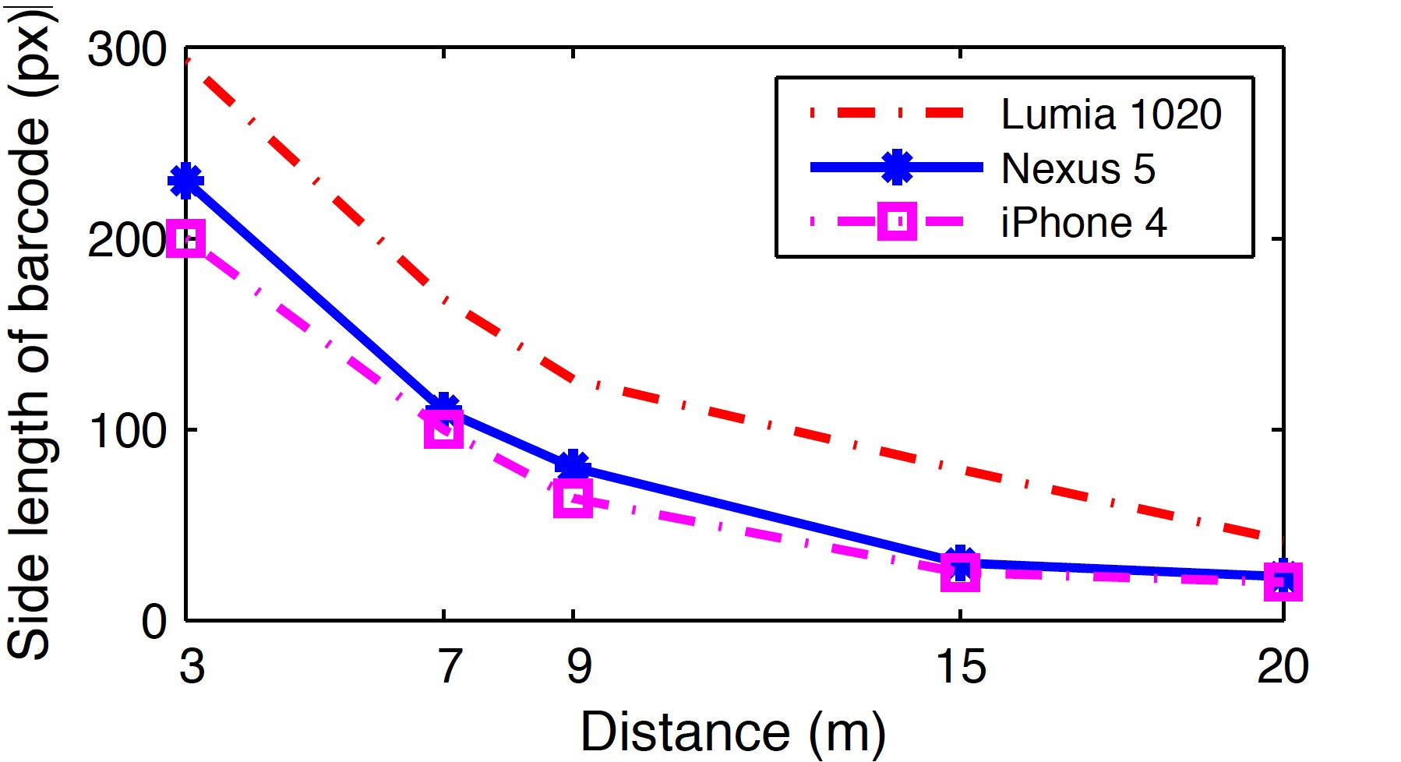
Capture distance vs resolution
Capture resolution < display resolution
Undersampling
Not supported by existing codes!

Slide 9
Our goal
Multi-resolution encoding and decoding
  Analogous to HM and SVC for scalable channel/source coding
Decoding performance scales with receiver capability and channel condition

Slide 10
In the rest of the talk…
Undersampled channel
Strata design
Strata performance
Focus on spatial, analogous for temporal
  See paper for temporal mixing, code design, and performance results

Slide 11
Undersampled channel

Slide 12

Spatial undersampling
Original image
Captured at 28m , enlarged

Slide 13
Spatial undersampling
In theory, linear mixing of pixel colors
In practice, messier…
  (Auto-)Focus, exposure, contrast
  Noise at block edges
  …

Slide 14
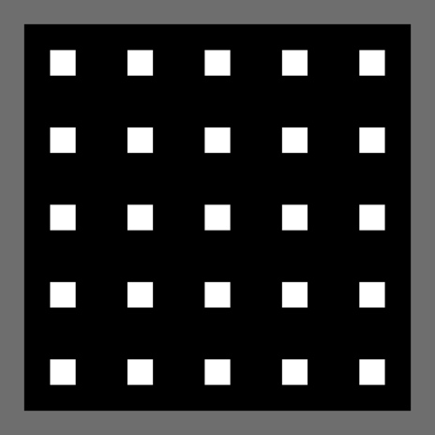
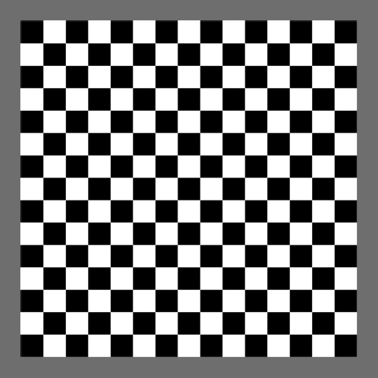

Color mixing experiment
Patterns of alternating squares

Slide 15
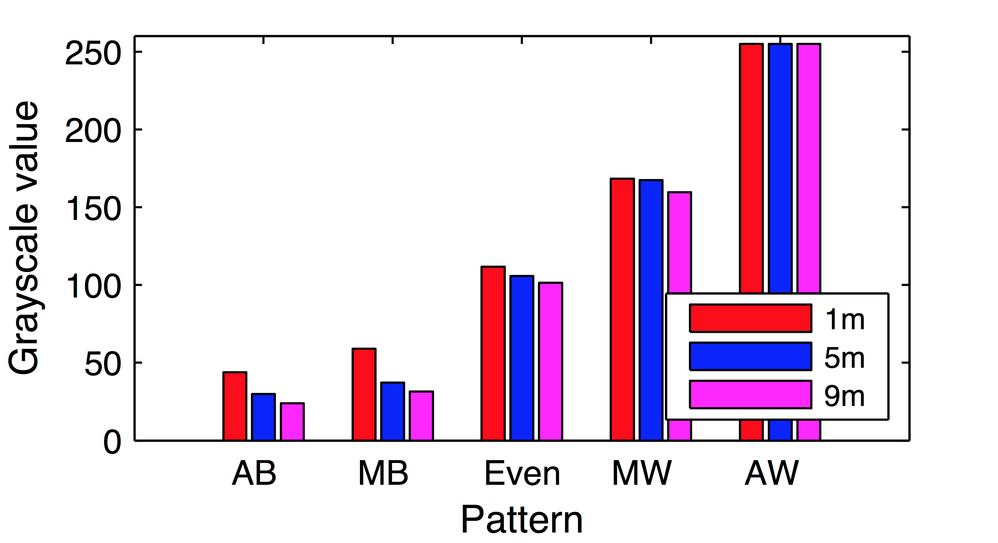
Color mixing results

Slide 16
Color mixing results
For the same distance, close to linear color mixing

Slide 17
Color mixing results
Darker when further away White is better preserved

Slide 18
Color mixing results
Less grayscale difference
if minimal contrast

Slide 19
Strata Design

Slide 20
Toy example
2 layers
  Black overall
  Also small blocks
Small white blocks
are interference

Slide 21
A simple SNR (like) model
Signal = # of small blocks of the intended color
Noise = # of small blocks of other colors
  Both noise and interference
This actually reflects color mixing weights for monochrome codes

Slide 22
A simple SNR (like) model
If SNR > 1, the overall block carries at least 1 bit of information
  Its color can be determined
Key: Control noise/interference
  “Reserve” the color of some blocks

Slide 23
Basic design
2-layer structure, with reserved block
Base layer block
Enhancement layer block
Reserved block
Ensures black majority
Contiguous to mitigate issues in color mixing

Slide 24
Harnessing additional bits
Bits from reserved block shape
2 bits from 4 different positions

Slide 25
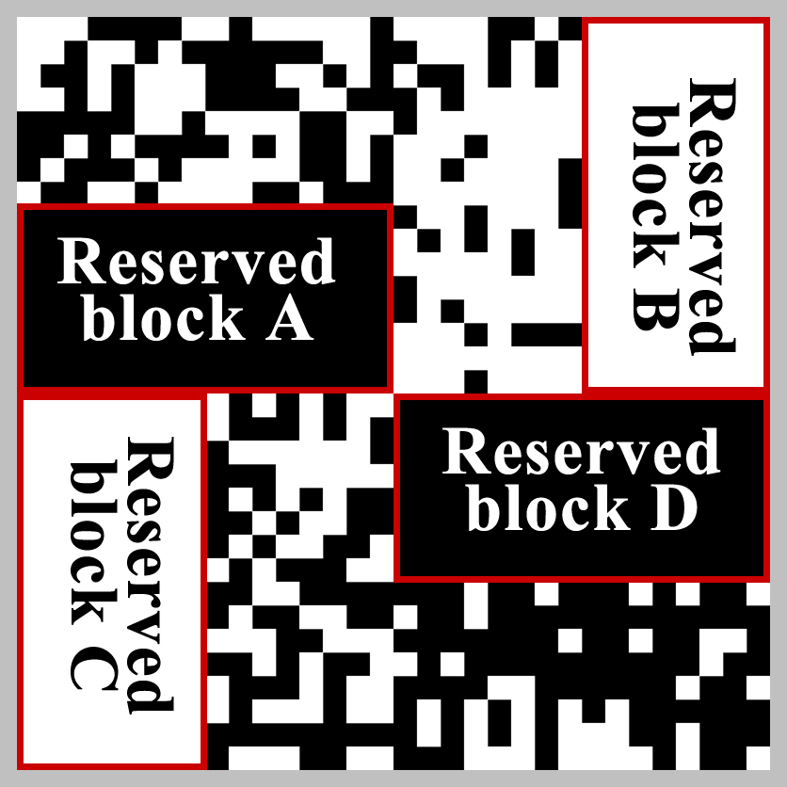
Example 2-layer code
Base layer block
Enhancement layer block

Slide 26
Recursively adding layers
Divide each enhancement block further
Follow the same rule otherwise
Base layer
(2nd layer) block
Reserved block
(In)Dependency between layers:
structural, but not the information encoded
Enhancement layer (3rd layer) block

Slide 27
Harnessing more bits
Adding smaller (third-layer) blocks in the reserved block

Slide 28
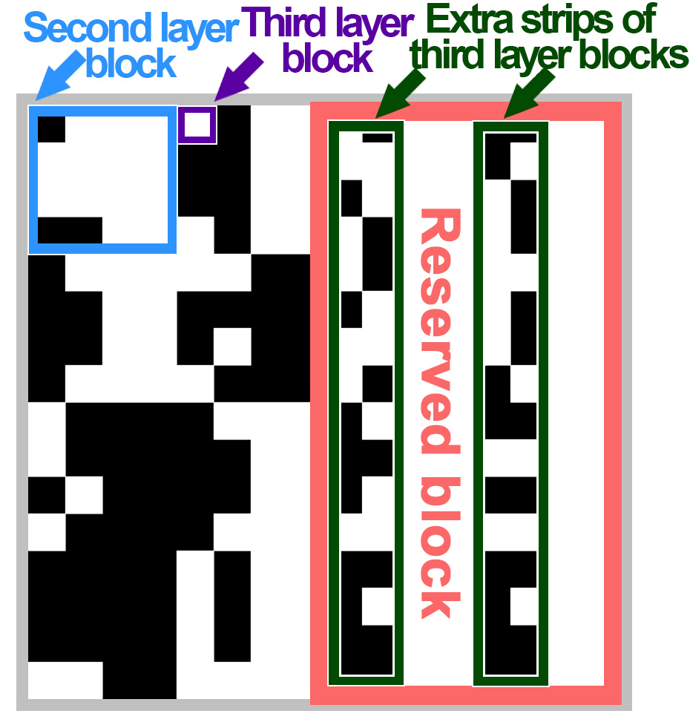
Harnessing more bits
Doubles the
third-layer capacity
Can further add
fourth-layer blocks

Slide 29
Choice of parameters
Reserved block size
  Efficiency vs accuracy tradeoff
  Need ½ when not knowing input statistics
“Branching factor”
  Control of granularity
  16 offers a good tradeoff
Details in the paper

Slide 30
Decoding

Slide 31
Decoding
Divide into blocks
  Start with Layer 1
Determine per-block colors
  11 blacks, 5 whites
Majority gives overall block color (black)

Slide 32
Decoding
Continue with finer blocks
Stop if can’t divide further

Slide 33
Strata performance

Slide 34

Example Strata image
20cm x 20cm on screen, no error correction

Slide 35
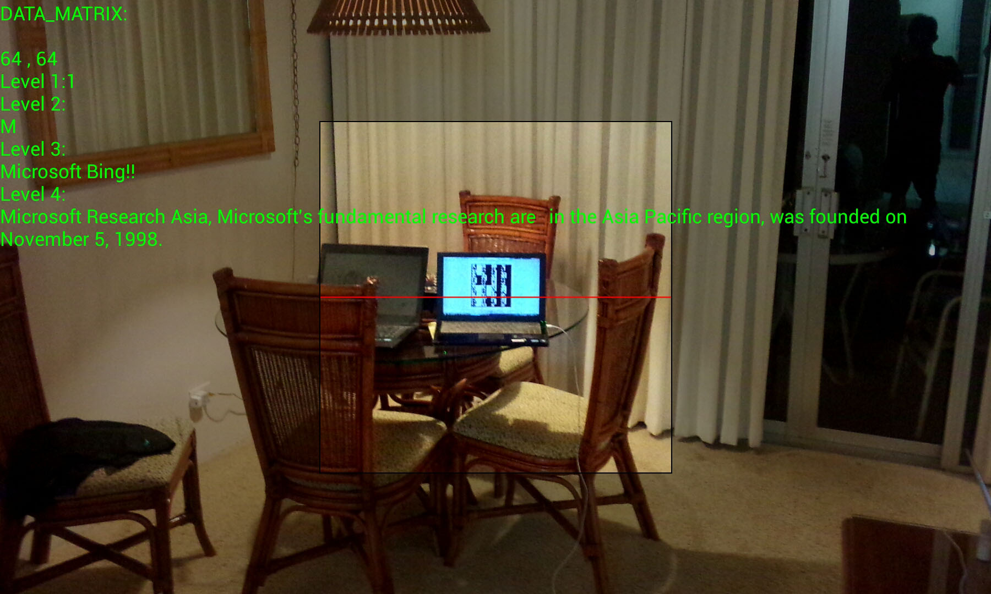
Decoder implementation
Online Android app & Offline version
Multi-level decoded info
Strata test display

Slide 36
Performance metric
Goal recap:
The amount of information decoded
scales with capture resolution/rate
Metric: decodable bit/layer count

Slide 37
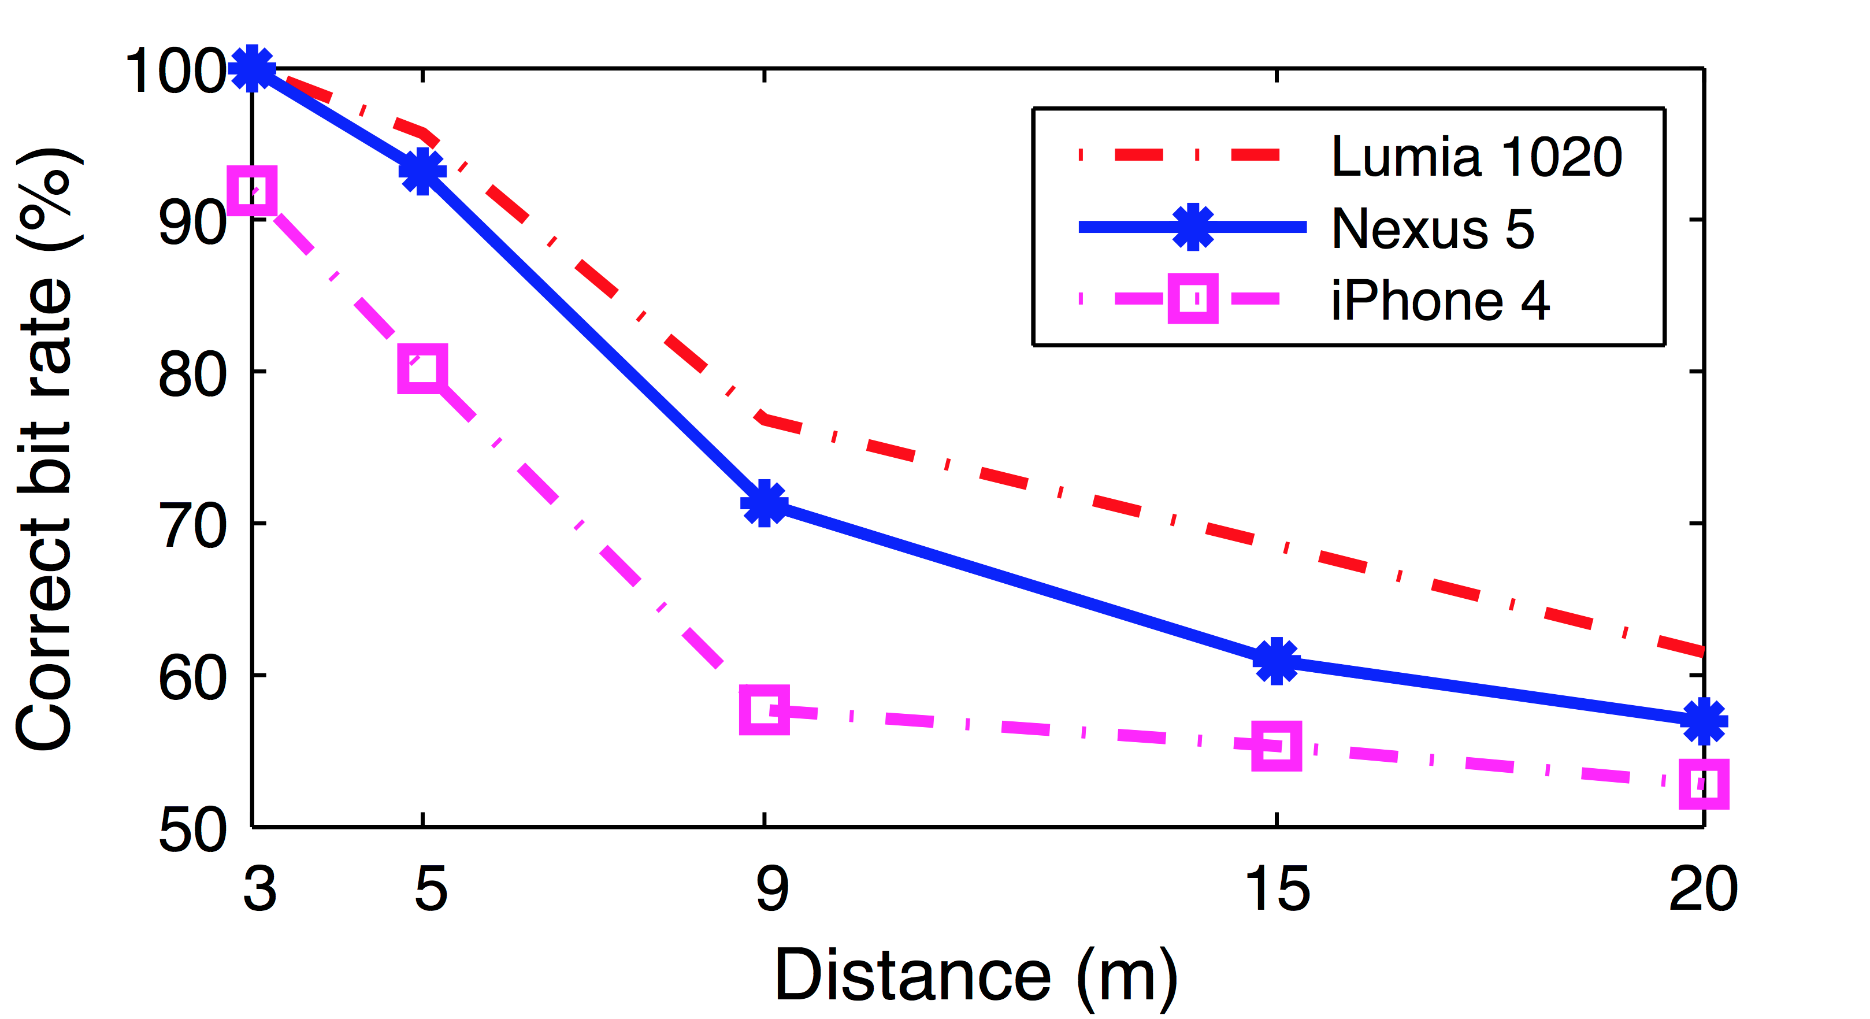
Performance (spatial)

Slide 38
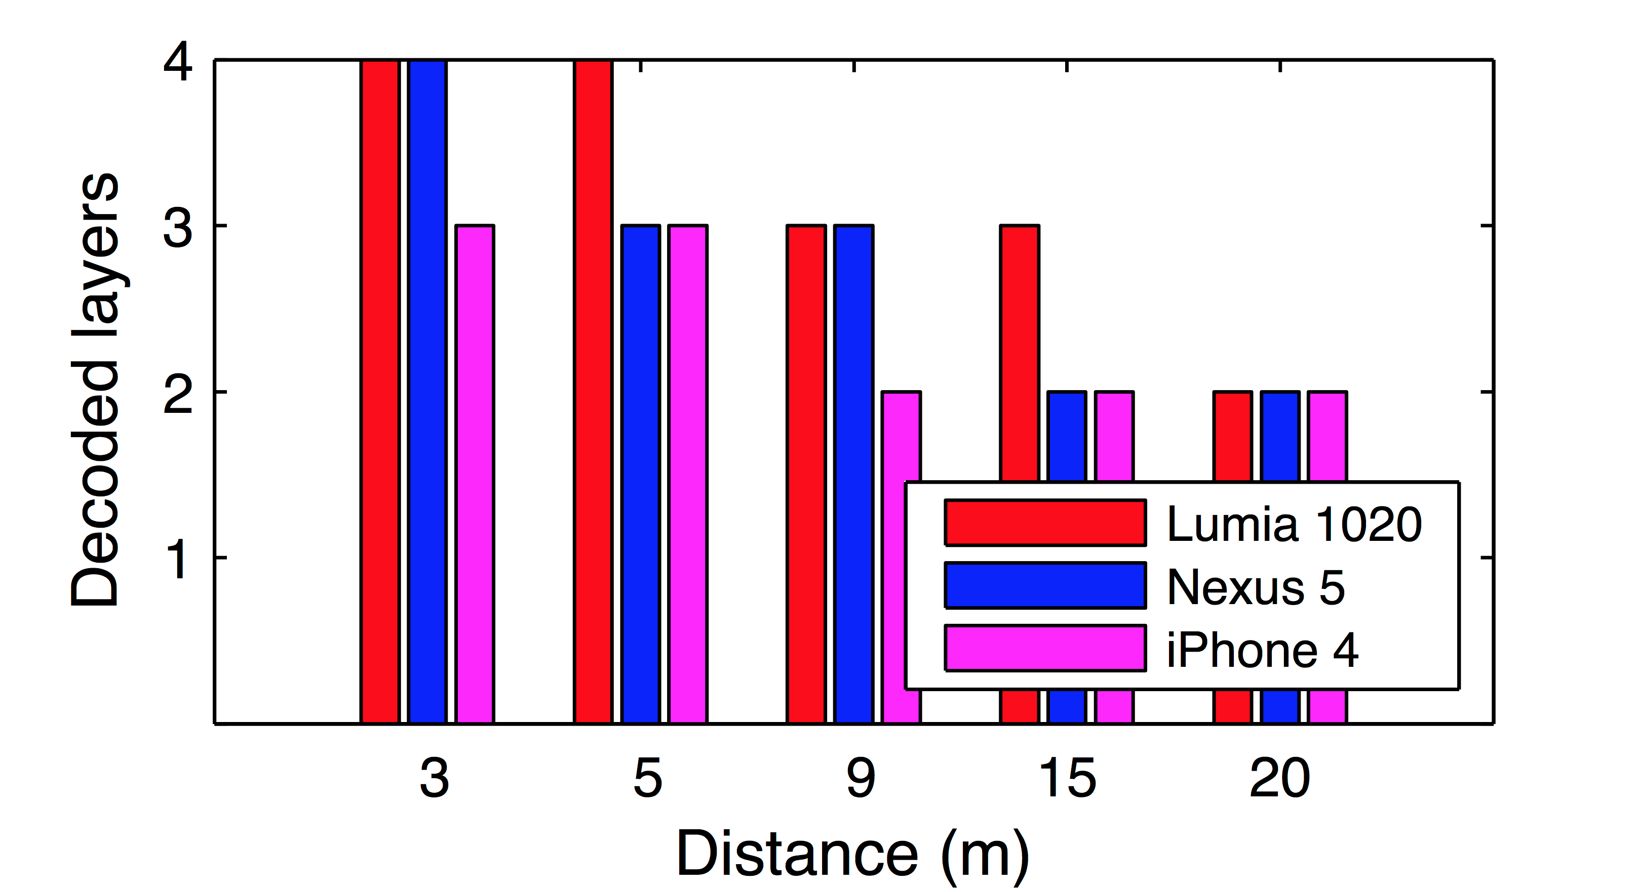
Performance (spatial)
Better camera resolution or shorter distance
More decodable information

Slide 39
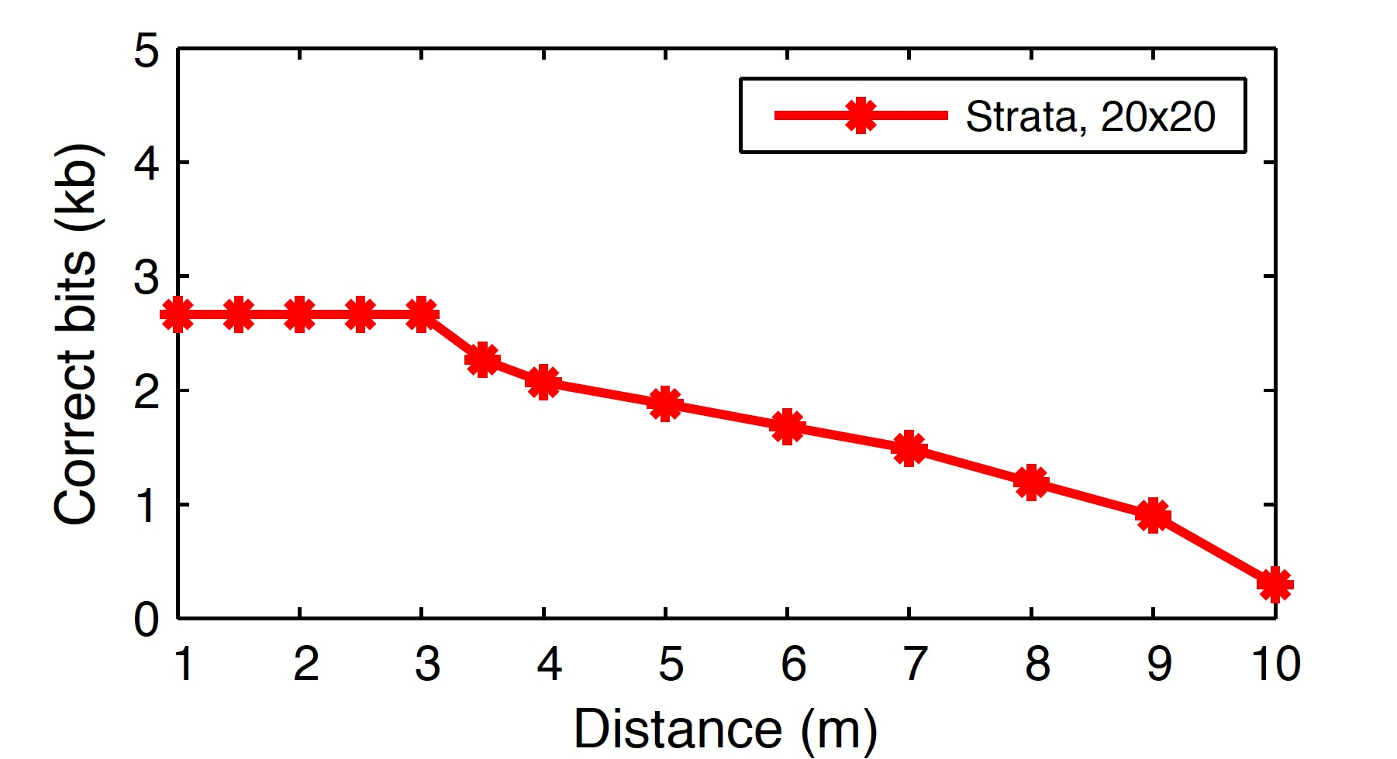
Strata vs Single-layer code

Slide 40
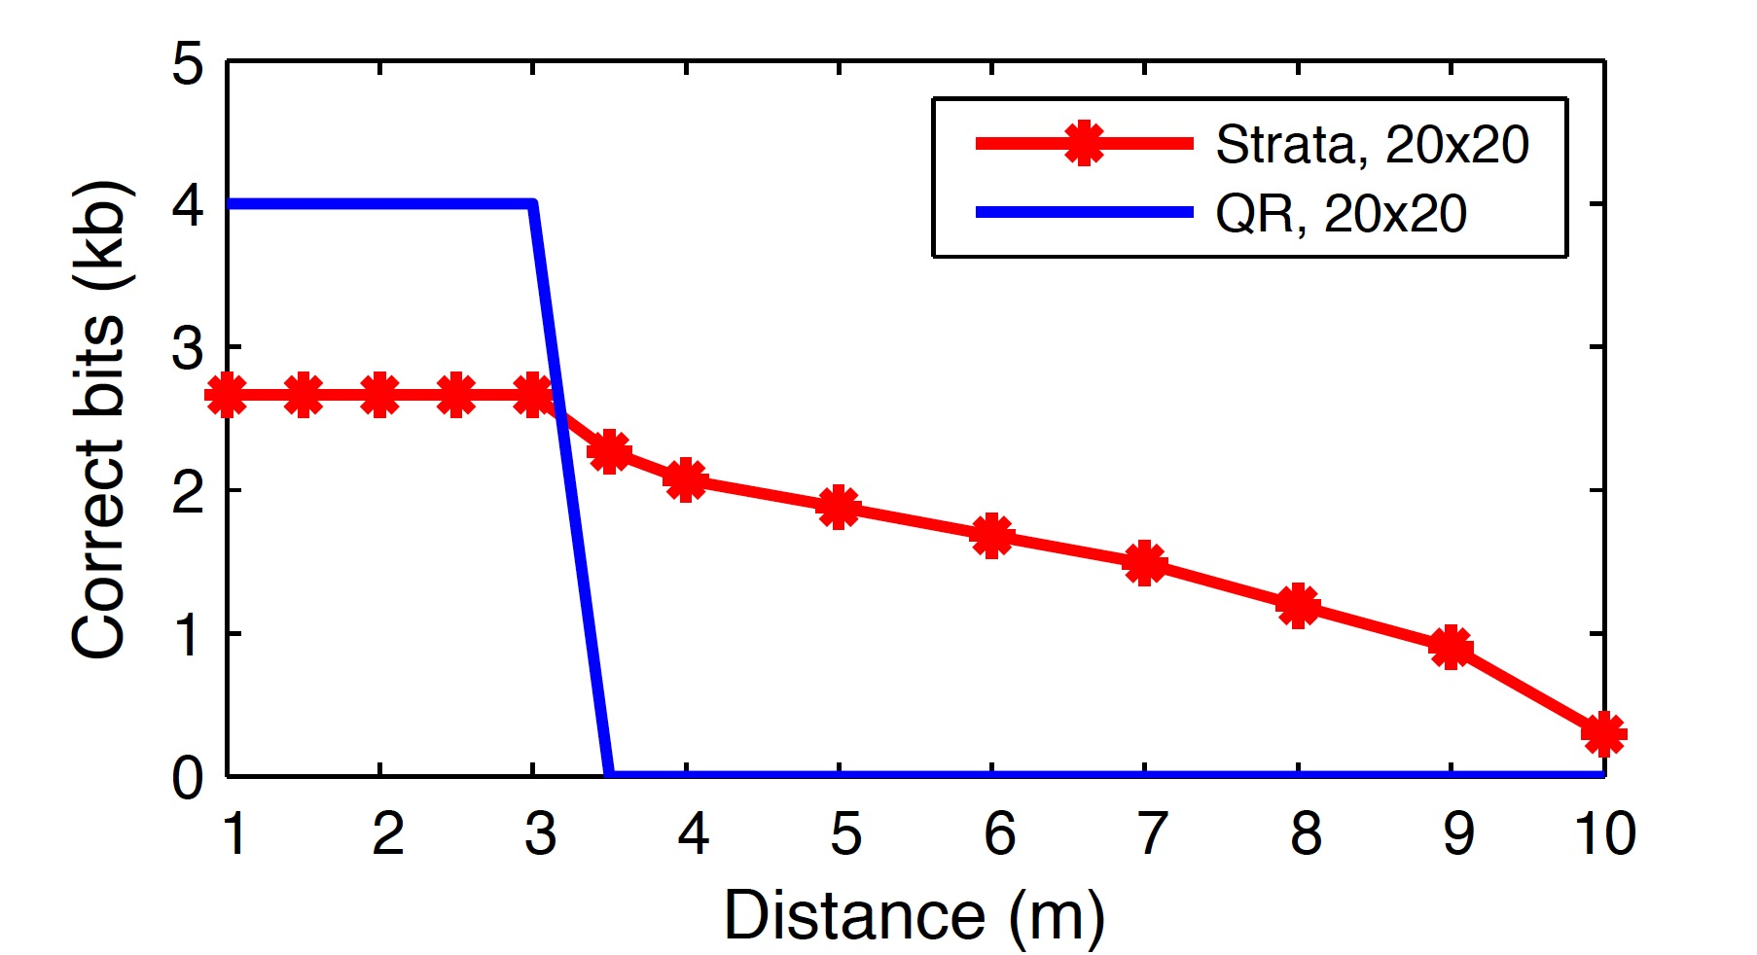
Strata vs Single-layer code

Slide 41
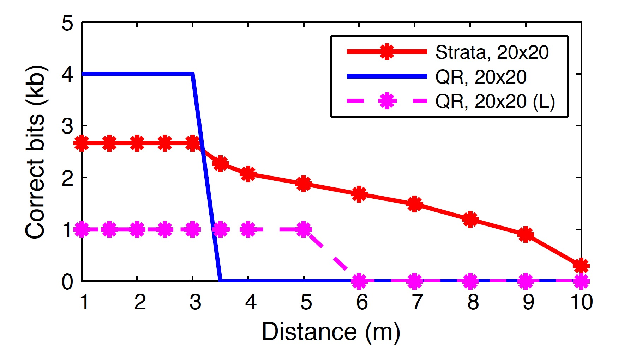
Strata vs Single-layer code
Strata balances capacity and supported distance

Slide 42
Other comparison results
Strata vs frequency domain encoding
Strata vs multi-level grayscales
Strata vs group of codes
Details in the paper

Slide 43
Related work
Temporal barcode design (inter-frame)
  Unsynchronized 4D Barcodes
Spatial barcode design (per-frame layout)
  PixNet, COBRA
Visual tags
Hierarchical coding on LED arrays
Other work on visible light communications
  E.g., Visual MIMO

Slide 44
Conclusion
Diverse screen/surface-camera channels
  Hardware diversity
  Capture conditions vary
Strata: Layered coding for scalability
  The amount of information decoded scales with diverse channel conditions

Slide 45
Thank you!
Questions?

