Slide 1


Enfold: Downclocking OFDM in WiFi
Feng Lu, Patrick Ling, Geoffrey M. Voelker, and Alex C. Snoeren
UC San Diego

Slide 2
WiFi Power Matters
Researchers report active WiFi radio can consume up to 70% of a smartphone’s energy [Rozner et al. MobiSys 2010]
Smartphone activities are network centric
80-90% data activities over WiFi [Report: Mobidia Tech and Informa 2013]
But commercial WiFi chipsets have efficient sleep: 700mW (active) to 10mW (sleep)
[Manweiler et al. MobiSys 2011]

Slide 3





Can’t Sleep the Day Away
Power saving mode (PSM) on WiFi: move to sleep state when not actively used
Challenges of WiFi energy savings on smartphones
real-time/chatty apps
developer may abuse WiFi sleep policy (constantly awake)
Many variants proposed by the research community for better power saving mechanisms and policies

Slide 4
Downclocking WiFi Communication
Trade good SNR for energy savings
We proposed SloMo in NSDI 2013
Downclocked DSSS WiFi transceiver design (1/2 Mbps)
5x clock rate reduction
Fully backwards compatible

Slide 5
When There is Sparsity
Leveraging information sparsity/redundancy in a variety of application scenarios
WiFi: downclocked packet detection [Zhang et al. MobiCom 2011], SloMo downclocked Tx/Rx [Lu et al. NSDI 2013]
Outside WiFi: spectrum sensing [Polo et al. ICASSP 2009], GPS synchronization [Hassanieh et al. MobiCom 2012], etc

Slide 6
OFDM Signaling is Dense
WiFi (802.1a/g/n/ac) is shifting towards OFDM
OFDM signals are extremely dense, and there is no sparsity in the encoding scheme
Open question as whether it is possible to receive and decode OFDM signals with reduced clock rates
Downclocked OFDM?

Slide 7
Enfold: Downclocked OFDM Receiver
SloMo
[NSDI 2013]
E-MiLi
[MobiCom 2012]
Enfold
Backwards
Compatible
Standards
Compliant
WiFi Spec
Change
AP→Enfold: standard WiFi OFDM signal
Enfold→AP: downclocked DSSS transmission (from SloMo)

Slide 8
10,000 Foot View of OFDM
D₁
R₁
1
1
D₂
R₂
2
2
3
3
Data
Bits
4
4
Decoded
Bits
IFFT
Time Domain
Signal
FFT
61
61
62
62
D₆₄
63
63
R₆₄
64
64
sender
receiver

Slide 9


Nyquist Likes It Fast
Sampling at the correct rate (2f) yields actual signal
Sampling too slowly yields aliases
“High frequency” signal becomes indistinguishable from “low frequency” signal

Slide 10
Aliasing Viewed on Frequency Domain
Aliasing effect: addition in frequency domain
Multiple frequency domain responses are aliased into a single value
In general, impossible to recover the original data (think about multiple unknowns but less equations)

Slide 11
Downclocked OFDM Signaling (50%)
Aliasing effect in OFDM → addition of data encoded on subcarriers in a structured manner
100%: 64 samples
50%: 32 samples
+
1
16
17
32
33
48
49
64
1
2
31
32
frequency domain subcarrier responses
2 unknowns 1 equation

Slide 12
Downclocked OFDM Signaling (25%)
+
100% : 64 samples
+
Finite values for the unknowns?
Possible to recover each unknown given one equation!!
x + y = z, x: [1, 3], y: [2, 5] → z: [3, 6, 5, 8]
z = 6 → x = 1, y = 5
1
16
17
32
33
48
49
64
+
25%: 16 samples
frequency domain subcarrier responses
1
16
4 unknowns 1 equation
Aliasing effect in OFDM → addition of data encoded on subcarriers

Slide 13
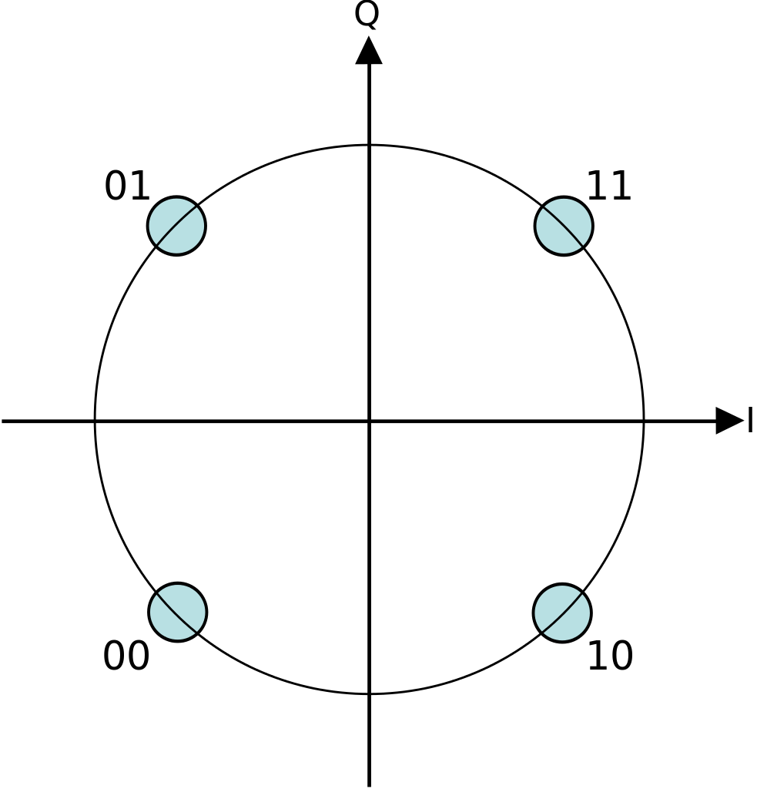
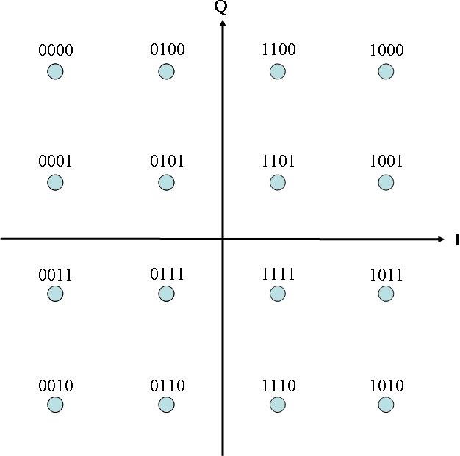
Quadrature Amplitude Modulation (QAM)
QAM: encode data bits by changing the amplitude of the two carrier waveforms: Real (I) and Imaginary (Q)
Q
actual response
I
2-QAM: 1 bit
4-QAM: 2 bits
16-QAM: 4 bits

Slide 14
Harnessing Aliasing Effect (I)
2-QAM per subcarrier → 2 possibilities for data coded on subcarrier
50% downclocking (2 unknowns 1 equation): 4 possible values for each frequency response
00
10
2-QAM→4-QAM
01
11

Slide 15
Harnessing Aliasing Effect (II)
25% downclocking (4 unknowns 1 equation): 16 possible values
Aliasing transforms original QAM into a more dense, but still decodable, QAM
16-QAM
100%: n-QAM
50%: n²-QAM
25%: n⁴-QAM

Slide 16
WiFi Reception Pipeline
channel samples
Timing Synchronization
Frequency Synchronization
Channel Estimation
data bits
Bits Decoding
FFT
Phase Compensation

Slide 17
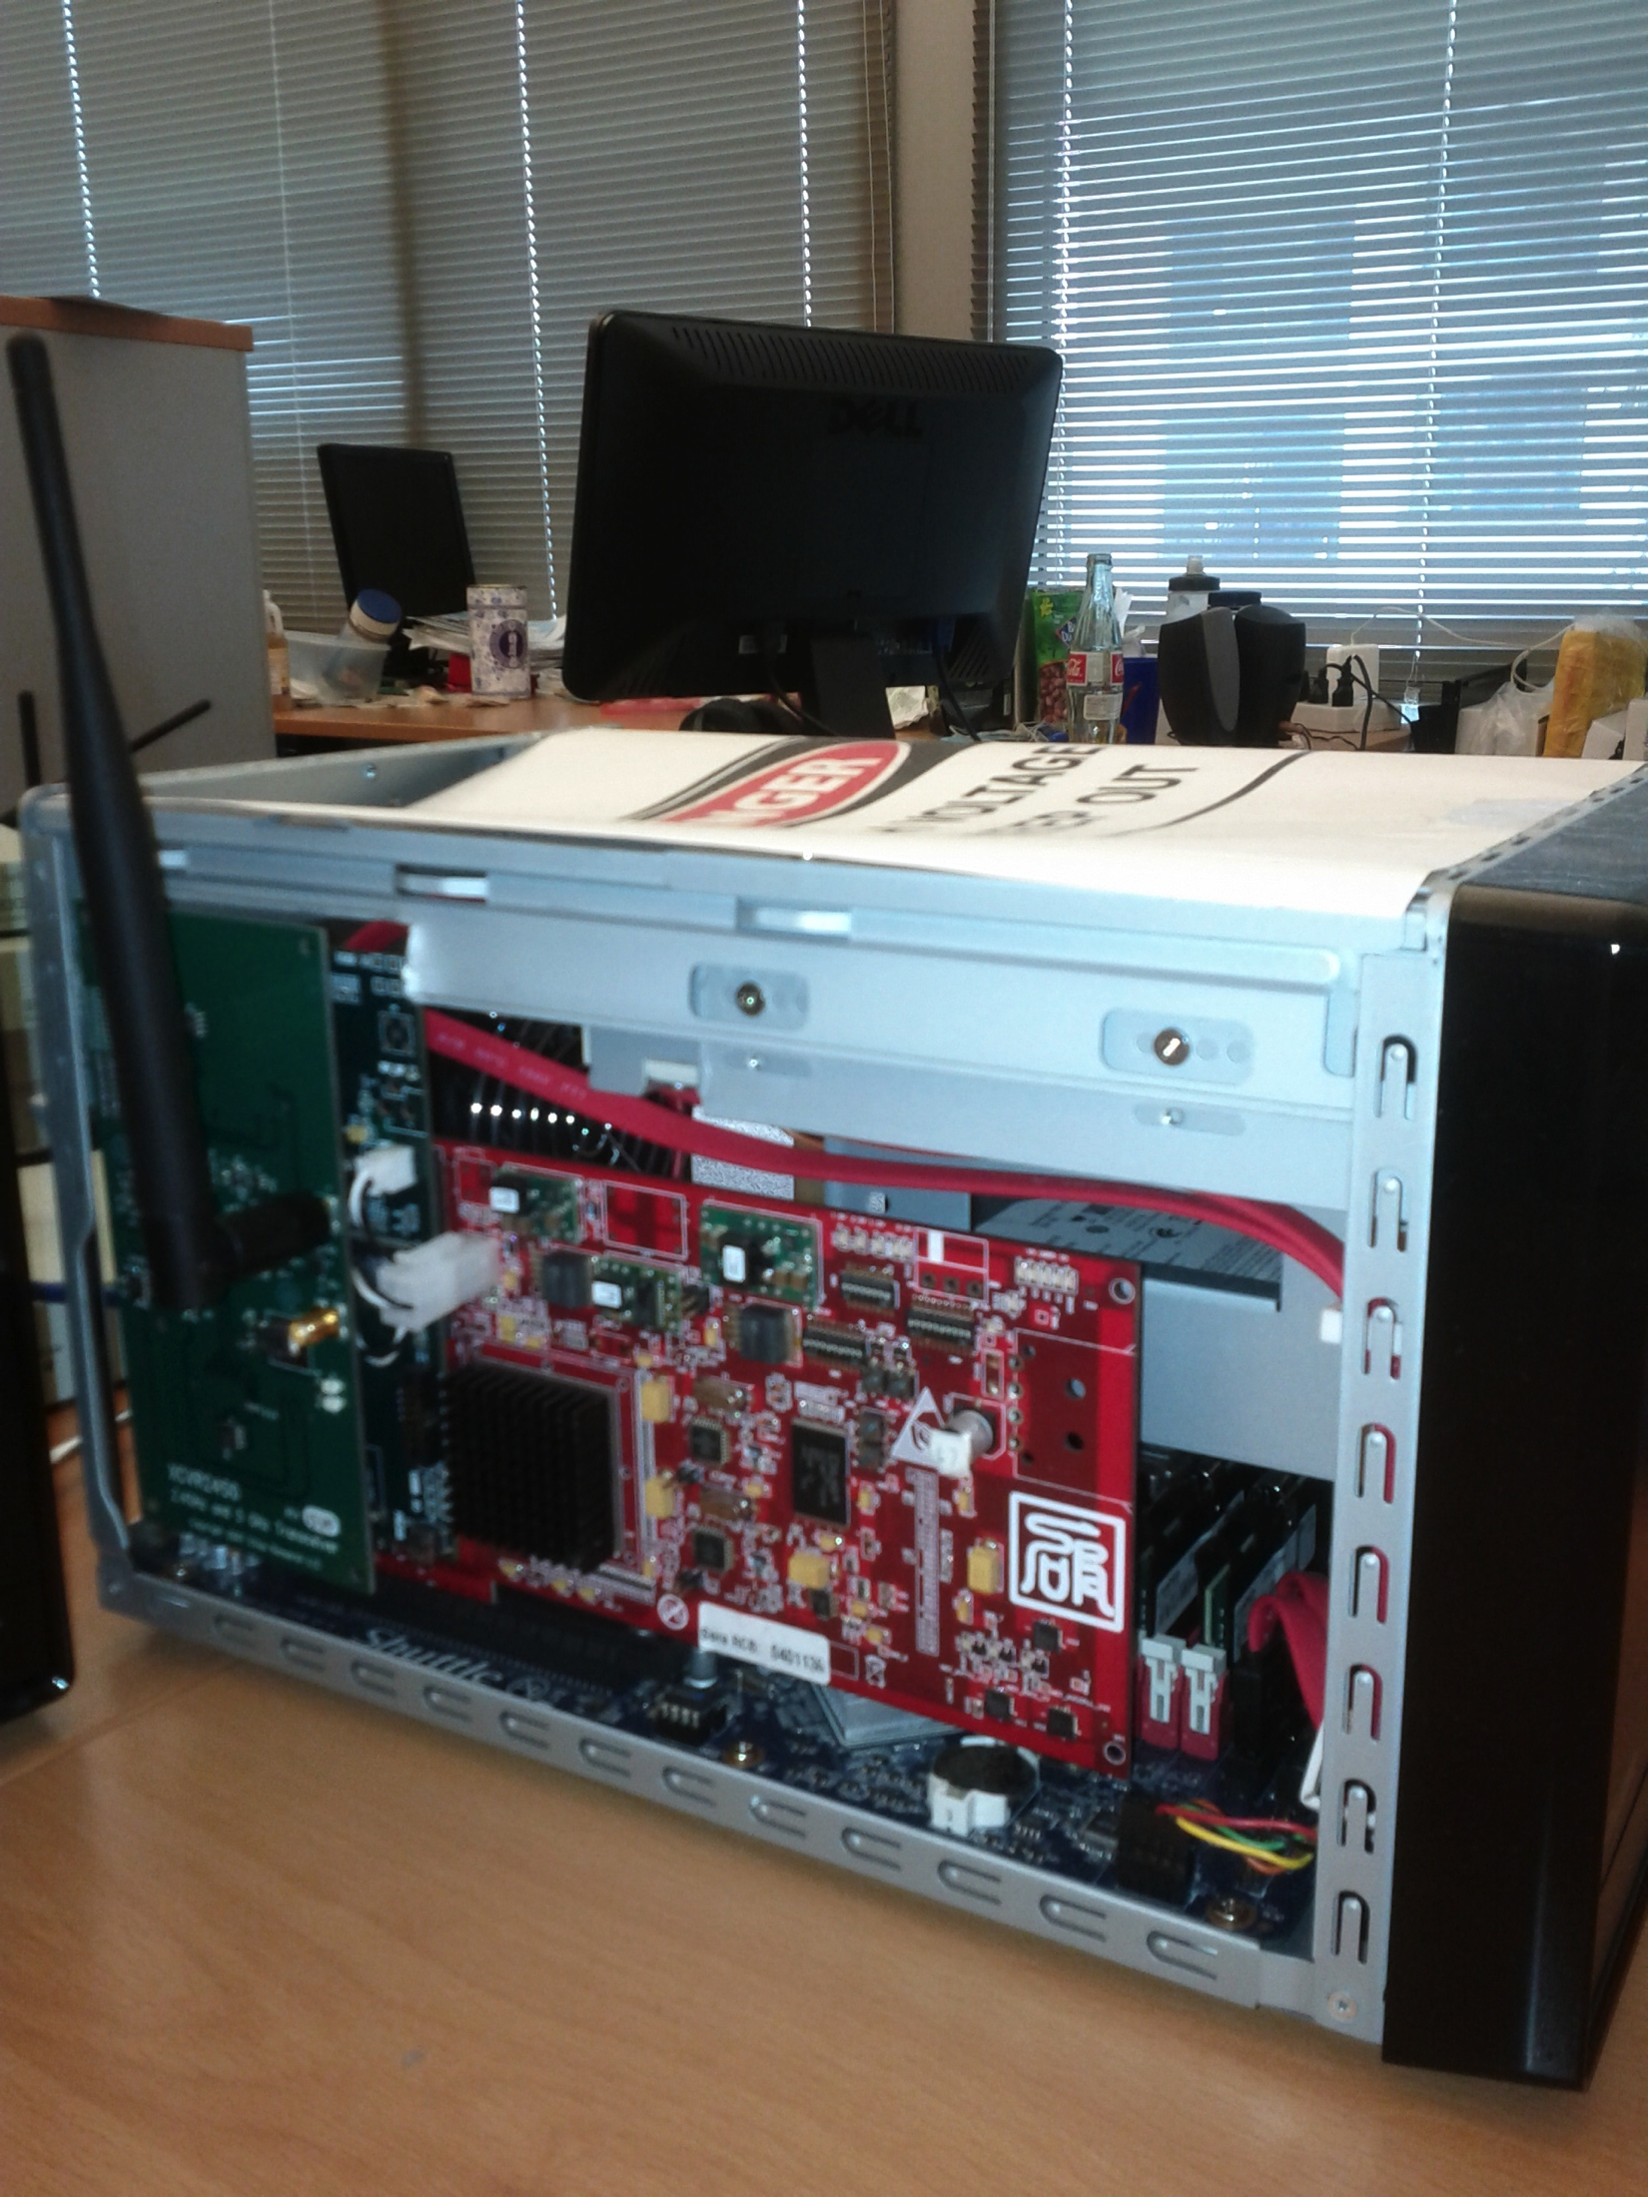
Enfold Implementation
Implemented on Microsoft SORA platform
Standards-compliant design
Evaluated 6 Mbps 2-QAM 802.11a/g frame reception
Downclocked DSSS transmission (SloMo) for ACKs

Slide 18
Packet Reception Rate vs SNR (100-Bytes)
Baseline: standard WiFi implementation (@100% clock rate) 3 SNRs: 30/25/20dB.
Well below typical SNR (40dB or more) [Pang et al. MobiSys 2009]

Slide 19
Packet Reception Rate vs SNR (1000-Byes)
Baseline: standard WiFi implementation (@100% clock rate) 3 SNRs: 30/25/20dB.
Well below typical SNR (40dB or more) [Pang et al. MobiSys 2009]

Slide 20






Apps WiFi Energy Evaluation
Trace based energy evaluation
power model based on real measurements [Manweiler et al. MobiSys 2011]
Conservative: max 35% saving
12 popular smartphone apps
each app > 5 M downloads
Collect ~200s of real WiFi packet traces
video

Slide 21
Energy Saving with Enfold
Enfold Energy Savings:
Low data-rate apps: 25% to 34%
Bandwidth hungry apps: 10% to 20%

Slide 22

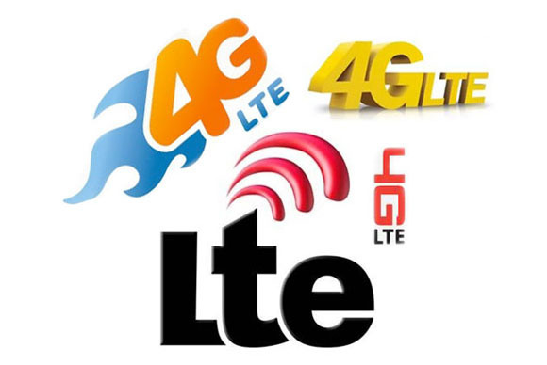

Conclusion
Downclocked OFDM WiFi reception is both practical and beneficial for smartphones
up to 34% energy reduction at 25% clock rate
Tradeoff SNR (throughput) for energy savings using lower data rates while remain downclocked
a great tradeoff for many popular smartphone apps
Policy impact: introduce a downclocked state into existing WiFi rate selection and power management framework
Applicable in other domains using OFDM

Slide 23
Thank you!

