Slide 1



BBN: Throughput Scaling in Dense Enterprise WLANs with Blind Beamforming and Nulling
Wenjie Zhou (Co-Primary Author), Tarun Bansal (Co-Primary Author),
Prasun Sinha and Kannan Srinivasan
The Ohio State University
Notes:
Add group logo

Slide 2

Changes in Uplink Traffic
Traditionally, WLAN traffic:
downlink heavy
less attention to uplink traffic
Recently, uplink traffic increased rapidly :
mobile applications
Cloud Computing
Online Gaming
Code Offloading
VoIP,
Video Chat
Sensor Data Upload

Slide 3
Can we scale the uplink throughput with the number of clients?

Slide 4




Network MIMO
Exchange raw samples
AP₁
AP₂
AP₃
C₁
C₂
C₃
Huge bandwidth consumption

Slide 5
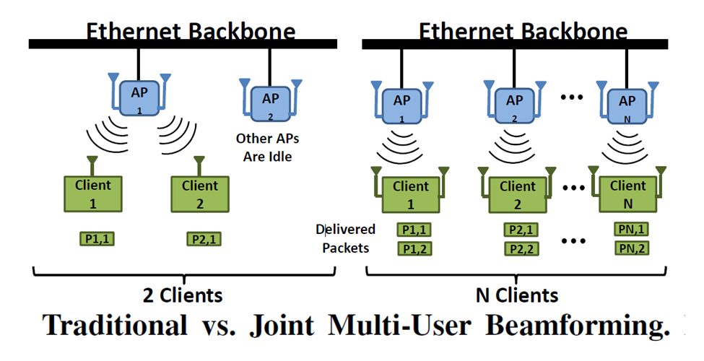
MegaMIMO¹
Does not apply to uplink :
Clients do not share a backbone network
[1] Rahul, H., Kumar, S., and Katabi, D. MegaMIMO: Scaling Wireless Capacity with User Demand. In Proc. of ACM SIGCOMM 2012.

Slide 6
Interference Alignment¹
C₁
AP₁
C₂
AP₂
C₃
AP₃
4 packet, 3 slots
Enough time slots, everyone gets half the cake
Exponential slots of transmissions, not suitable for mobile clients
Heavy coordination between clients
[1] Cadambe, V. R., and Jafar, S. A. Interference Alignment and the Degrees of Freedom for the K User Interference Channel. IEEE Transactions on Information Theory (2008).

Slide 7
Existing interference alignment and beamforming techniques are not suitable to mobile uplink traffic.
How can we bring the benefits of beamforming to
uplink traffic?

Slide 8
AP Density in Enterprise WLANs
(140,0.5)
BBN leverages the high density of access points
Notes:
CDF of number of APs observed (Measurements conducted at Ohio State University campus)

Slide 9


Omniscient TDMA
Single Collision Domain
Time Slot: 1
Time Slot: 2
Time Slot: 3
AP₁
AP₂
Switch
AP₃
AP₄
x₁
x₂
x₃
C₁
C₂
C₃
Three Packets received in Three Slots
Only one AP is in use

Slide 10
Blind Beamforming and Nulling Single Collision Domain
Time Slot: 1
h⁽¹⁾₁₁x₁ + h⁽¹⁾₂₁x₂ + h⁽¹⁾₃₁x₃
h⁽¹⁾₁₂x₁ + h⁽¹⁾₂₂x₂ + h⁽¹⁾₃₂x₃
AP₁
AP₂
h⁽¹⁾₁₃x₁ + h⁽¹⁾₂₃x₂ + h⁽¹⁾₃₃x₃
h⁽¹⁾₁₄x₁ + h⁽¹⁾₂₄x₂ + h⁽¹⁾₃₄x₃
Switch
AP₃
AP₄
h⁽¹⁾₁₃
h⁽¹⁾₂₃
h⁽¹⁾₃₃
x₁
x₂
x₃
C₁
C₂
C₃

Slide 11
Blind Beamforming and Nulling Single Collision Domain
Receives:
a₁₁x₁ + s₁h⁽¹⁾₂₁x₂ + s₁h⁽¹⁾₃₁x₃
Receives:
a₁₂x₁ + a₂₂x₂ + a₃₂x₃
Time Slot: 2
AP₁
AP₂
Switch
AP₃
AP₄
Transmits:
(h⁽¹⁾₁₃x₁ + h⁽¹⁾₂₃x₂ + h⁽¹⁾₃₃x₃)
Transmits:
v₄ (h⁽¹⁾₁₄x₁ + h⁽¹⁾₂₄x₂ + h⁽¹⁾₃₄x₃)
v₃

Slide 12

Blind Beamforming and Nulling Single Collision Domain
Slot 1: h⁽¹⁾₁₁x₁ + h⁽¹⁾₂₁x₂ + h⁽¹⁾₃₁x₃
Slot 1: h⁽¹⁾₁₂x₁ + h⁽¹⁾₂₂x₂ + h⁽¹⁾₃₂x₃
Slot 2: a₁₁x₁ + s₁h⁽¹⁾₂₁x₂ + s₁h⁽¹⁾₃₁x₃
Slot 2: a₁₁x₁ + s₁h⁽¹⁾₂₁x₂ + s₁h⁽¹⁾₃₁x₃
Slot 2: a₁₂x₁ + a₂₂x₂ + a₃₂x₃
(s₁h⁽¹⁾₁₁-a₁₁)x₁
AP₁
AP₂
Switch
AP₃
AP₄
Three Packets received in Two Slots

Slide 13
Number of APs Required
In a network with APs, APs in BBN can receive N uplink packets in two slots
3 clients, 4 APs
4 clients, 7 APs
10 clients, 46 APs

Slide 14
Throughput Improvement
Previous Example Topology
APs in BBN receive three packets in two slots: an improvement of 50%
General Topology
Uplink throughput in BBN scales with the number of clients (N/2 packets per slot).
Half of the cake as in Interference Alignment
Always two slots
No coordination between clients

Slide 15
BBN Highlights
Leverages the high density of access points
All computation and design complexity shifted to APs
APs only need to exchange decoded packets over the backbone instead of raw samples

Slide 16
Further Optimizations to Improve SNR
x₁
x₂, x₃
Receivers
AP₂
AP₁
Transmitters
AP₄
Switch
AP₃
C₁
C₂
C₃
Which subset of APs act as transmitters and which subset as receivers?
Which AP decodes which packet?
BBN Approach: x_{i} is decoded at the AP_{j} where it is expected to have highest SNR

Slide 17
Challenge 1/4: Synchronization of APs
To perform accurate beamforming, APs need to be tightly synchronized with each other
Solution:
SourceSync (Rahul et al., SIGCOMM 2010): synchronizes APs within a single collision domain
Vidyut (Yenamandra et al., SIGCOMM 2014): uses power line to synchronize APs in the same building

Slide 18
Challenge 2/4 : MultiCollision Domain
Not all APs may be able to hear each other directly
Solution: Make smaller groups where all APs in a single group can hear each other.

Slide 19

Distributed System
Group Head
Group Head
Within a group, all APs can hear each other
When one group is communicating, neighboring groups remain silent

Slide 20
Challenge 3/4 : Inconsistency in the AP density
Number of APs may be less than
Solution: Appropriate MAC layer algorithm that restricts the number of participating clients

Slide 21
MAC Timeline
Keep Silent – Allow neighboring groups to transmit
Uplink
Uplink
Downlink
Uplink
Time Slot 1
Time Slot 2
.......
.......
.......
Time
Poll
Approve A, B and C
Compute pre-coding vectors
in the background
Notification Period

Slide 22

Challenge 4/4 : Robustness
Nulling is not always perfect.
Can’t Subtract x₁
Decoding Error
x₁, x₂ , x₃
x₁
AP₁
AP₂
Switch
AP₄
AP₅
x₁
x₂
x₃
C₁
C₂
C₃

Slide 23
Challenge 4/4 : Robustness
What if we have extra APs
x₁
x₁, x₂ , x₃
x₁
AP₁
AP₂
AP₅
Switch
AP₃
AP₄
AP₆
AP₇
x₁
x₂
x₃
C₁
C₂
C₃

Slide 24
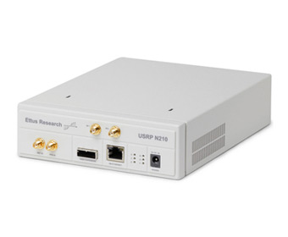
Experiments
Intended Signal = x₁
Interference from x₂, x₃
x₂, x₃
AP₁
AP₂
USRP N210
Switch
AP₃
AP₄
x₁
x₂
x₃
C₁
C₂
C₂

Slide 25
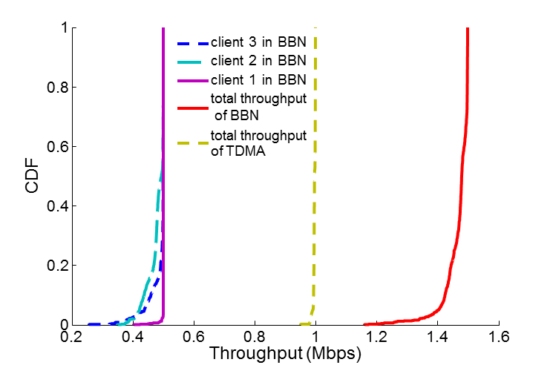
Throughput
1.48X
BBN provides 1.48x throughput compared to TDMA
Notes:
Decoding dependency

Slide 26
Trace-Driven Simulation
Over multiple collision domains (divided into groups)
Field Size: 500m X 500m
Number of clients: 1000
Vary the number of APs
Residual interference distribution from experiment
Other algorithms simulated
Omniscient TDMA
IEEE 802.11

Slide 27
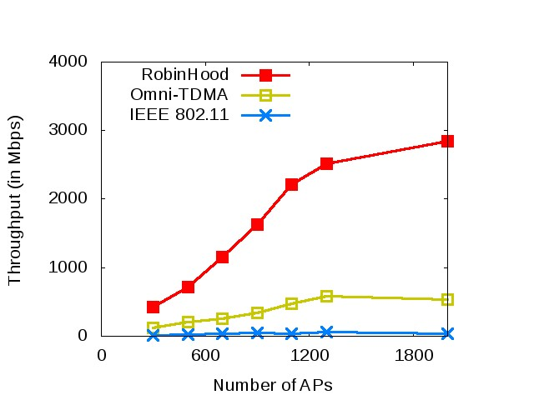
Throughput
BBN
2000 APs
4.6X throughput gain
~76 APs near each client

Slide 28
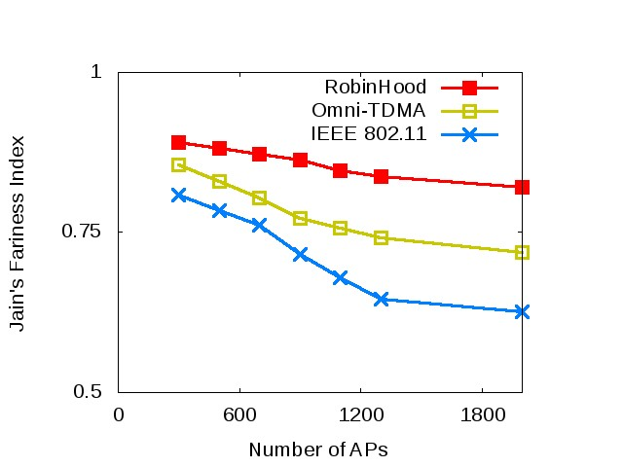
Fairness
BBN
BBN achieves higher fairness
Beamforming increased SINR of clients that are far away

Slide 29
Summary and Future Work
BBN leverages the high density of APs to scale the uplink throughput for single antenna systems
Throughput scales linearly with the number of clients
All computational and design complexity shifted to APs
Future Work
Coexist with legacy network
Data rate selection
Thank you

