Slide 1
  A Practical Traffic Management for
  Integrated LTE-WiFi Networks
Speaker: Rajesh Mahindra
NEC Labs America
Hari Viswanathan, Karthik Sundaresan, and Mustafa Arslan

Slide 2
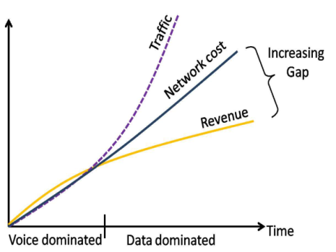
Key Trends
Data traffic exploding on cellular networks
  Rise in video streaming, social networking
Revenue per byte is decreasing
Mobile operators embracing WiFi as a key technology to enhance LTE experience
  Cheap to deploy – unlicensed
  Easy (fast) to deploy – unplanned
  Critical to manage flows across
  APs-Basestations to maximize QoE and resource utilization

Slide 3
Operator-based WiFi deployments
Absence of network-wide traffic management
  Devices always connect to WiFi when available (static policy)
  Past focus has been authentication methods over WiFi

Slide 4

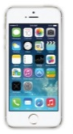
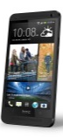


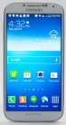

Today: Devices always connect to WiFi

Slide 5
Operator-based WiFi deployments
Absence of network-wide traffic management
  Devices always connect to WiFi when available (static policy)
  Past focus has been authentication methods over WiFi
Absence of tight data-plane integration
  3GPP based deployments have high CAPEX
    Requires backhauling WiFi traffic through mobile core
    Increased investment in infrastructure

Slide 6


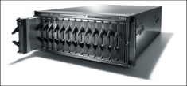
Today: Resistance to Tight Integration of LTE and WiFi
ePDG
3GPP standard WiFi Gateway
MME
Increased backhaul
costs
INTERNET
Serving-gateway
PDN-gateway
LTE Core-Network

Slide 7
Operator-based WiFi deployments
Absence of network-wide traffic management
  Devices always connect to WiFi when available (static policy)
  Past focus has been authentication methods over WiFi
Absence of tight data-plane integration
  3GPP based deployments have high CAPEX
    Requires backhauling WiFi traffic through mobile core
    Increased investment in infrastructure
  Inability to perform dynamic network selection
Result
  Diminishes the potential effectiveness of WiFi
  Degrades the user Quality of Experience (QoE)

Slide 8
Opportunity
State of the Art: Client-side solutions
Qualcomm’s CnE, Interdigital SAM
  Static policies (application level) enforced locally on each client
  QoE requirements provided by the application on the client
  Client-side decision making -> inefficient use of network resources
Operator agnostic mobile service (MOTA), in Mobicom 2011
    Requires frequent network state information from each base station
    Incompatible with standards -> difficult to deploy
    Individual decisions by client -> sub-optimal
      Inability for Mobile Operators to perform effective network-wide traffic management!

Slide 9
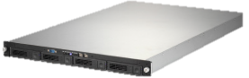

Our Idea: A Traffic Management Solution
Traffic Manager
Network Interface Assignment
Switching Service
Maps user flows to appropriate network(LTE/WiFi)
Centralized management -> Efficient use of network resources
Reduces backhaul costs -> Facilitates dynamic traffic mgmt
Operates for each LTE cell -> Scalable
Standards agnostic -> Easily Deployable
WiFi Gateway
PDN-gateway
Serving-gateway
LTE Core-Network
MME

Slide 10
Components
Network Interface Assignment Algorithm (NIA)
  Goal: Dynamically maps user traffic flows to appropriate LTE basestation or WiFi AP
Interface switching service (ISS)
  Goal: Switch current user flows from WiFi AP to LTE or vice versa based on decisions from NIA

Slide 11
Component 1: NIA

Slide 12
Problem Formulation
Consider an LTE cell and multiple WiFi APs in its coverage area
Assign basestation/ AP to each flow
  Maximize sum of users flows’ QoE
QoE captured using “utility”
  Weighted PF provides differential QoE
Pricing function supports 2 models
  Based on data usage
  Based on price/byte
Weight
Throughput
Network Pricing

Slide 13


Throughput Models
LTE basestation performs weighted PF
WiFi AP performs throughput based fairness
Algorithm does not depend on specific scheduler
  WiFi APs may perform weighted PF

Slide 14

Problem depiction
4Mbps
2Mbps
8Mbps
3Mbps
1Mbps
5Mbps

Slide 15
Problem depiction
3Mbps
2Mbps
5Mbps
4Mbps
2Mbps
6Mbps

Slide 16

Problem depiction
3Mbps
3Mbps
7Mbps
5Mbps
3Mbps
7Mbps

Slide 17
Network Interface Assignment (NIA)
Problem is NP-Hard
  Including the simplest topology of an LTE cell and a WiFi AP
NIA is a two-step greedy heuristic
  Considers each AP-basestation in isolation
  Fixes assignment for AP that maximized incremental utility
  Iterate till all hotspots are covered
  Complexity is O(K²S²), where K = # clients, S = # APs

Slide 18


NIA Example
Trigger - arrival/departure of clients or periodic
Step 1: In each WiFi hotspot, partition clients into two sets,
LTE and WiFi, so that sum of utilities is maximized

Slide 19
NIA Example
Step 2: Finalize interface assignment for clients in the WiFi hotspot with the highest incremental utility

Slide 20
NIA Example – Iterate
Repeat 1&2 with the new initial condition until all hotspots are covered
Done!

Slide 21
Component 2: Interface Switching Service

Slide 22

Design Considerations
Mid-session network switching capability facilitates dynamic traffic mgmt
Leverage HTTP characteristics
  HTTP traffic (esp video and browsing) dominates (>90% of internet)
  Session content(s) are downloaded using multiple HTTP requests
    Video streaming use HTTP-PD (Progressive Download) or DASH (Dynamic Adaptive Streaming over HTTP): A HTTP-GET request/chunk
    Browsing: A HTTP-GET request/object
VIDEO
Multi-resolution
video
VIDEO
VIDEO
Clients
DASH Server
HTTP
HTTP GET
TCP

Slide 23


Interface Switching Service (ISS)
Internet
Interface to NIA
ISS Controller
Control
Traffic
Switch to WiFi
HTTP based
Video streaming/
Browsing
LTE
WiFi
LTE
HTTP Proxy
HTTP-GET
Switch
Interface
Mobile Device
Application /
Browser
Control Logic
Other types of traffic can leverage existing 3GPP standards for seamless interface switching

Slide 24
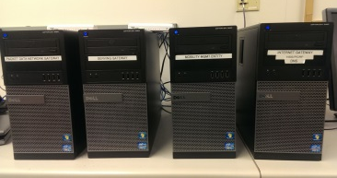
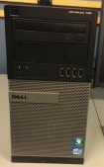
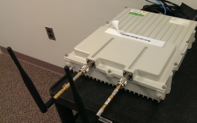
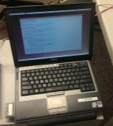
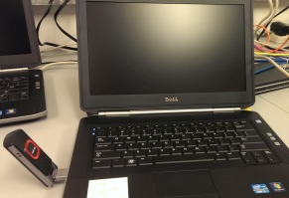
Prototype
ATOM
Squid HTTP Proxy
NIA Algorithm
Squid HTTP Proxy
ISS Control
OpenEPC
LTE Core
WiFi Gateway
Dlink
WiFi AP
NEC LTE Basestation
Shrpx HTTP Proxy
ISS Control
Linux Laptop
(Client)
HTTP
requests
Chrome Browser

Slide 25
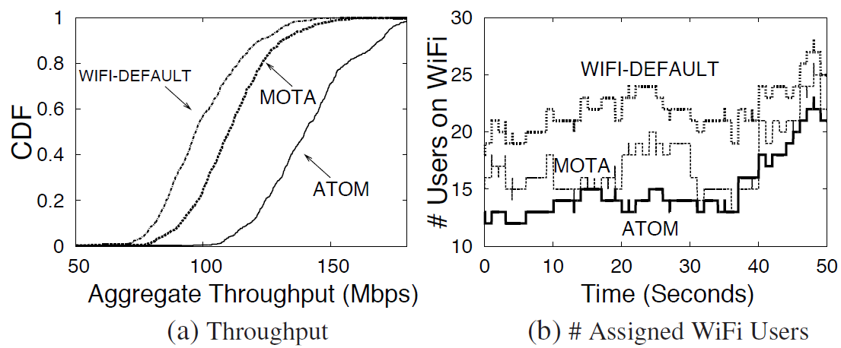
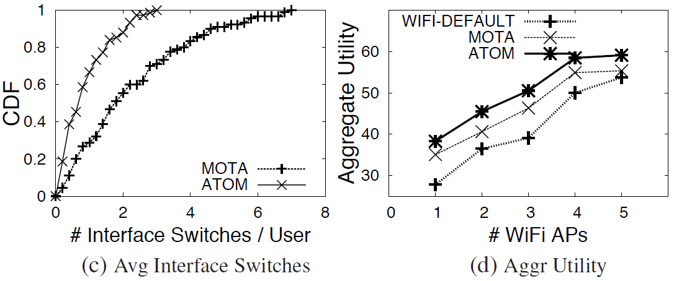
Experiment 1: Large-scale evaluation
Topology: 1 LTE basestation and 3 WiFi APs
Result: ATOM performs better than client-side solutions

Slide 26
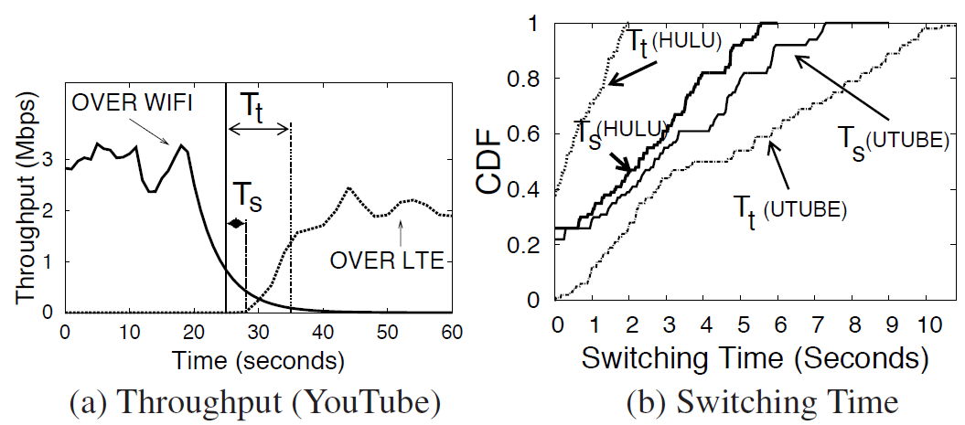
Experiment 2: Benchmarking the ISS
Measured the time taken for flows to switch using ISS:
  HTTP based video streaming flows
  Hulu (uses HTTP-DASH) v/s Youtube(uses HTTP-PD)
Insight: Switching time improves with DASH streaming
  DASH flows use smaller chunk sizes to ensure adaptive-ness to changing network conditions

Slide 27
Summary
Operators have to look towards exploiting multiple access technologies to increase capacity
  WiFi offers the cheapest alternate to cellular
Our Contributions: a traffic management solution that assigns user flows to LTE basestation/WiFi APs
  Low complexity, scalable algorithm for flow assignment
  Network-based solution more effective than client-side solutions
  HTTP based switching provides dynamic flow assignment at lower costs

Slide 28


