Slide 1

Accurate Indoor Localization with Zero Startup Cost
Swarun Kumar
Stephanie Gil, Dina Katabi and Daniela Rus
Notes:
Hi. I am Swarun Kumar from MIT and I am going to talk to you today about accurate indoor localization with zero startup cost.
This is joint work with my colleagues Stephanie, Dina and Daniela.

Slide 2
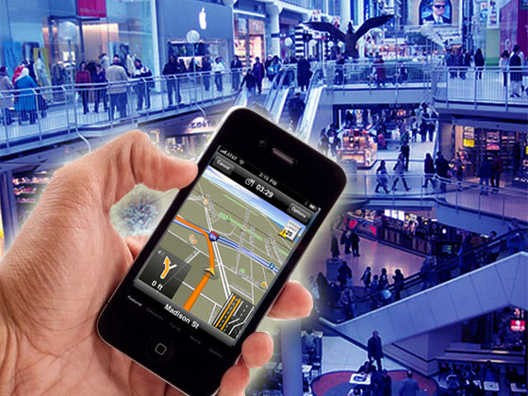
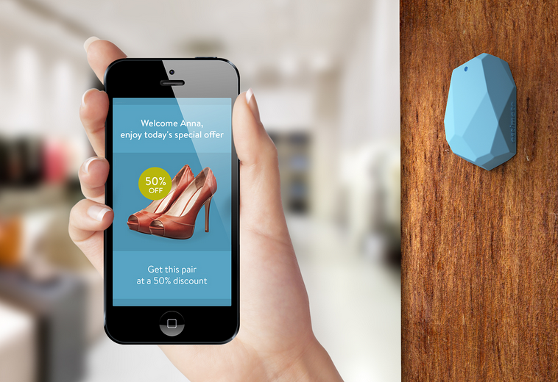
What if we had Ubiquitous Indoor Positioning Today?
Indoor Navigation
Context-Awareness
Notes:
Imagine if we had ubiquitous indoor positioning with your mobile device today…
This means you can walk into a mall you’ve never visited before and be able to navigate your way around with your mobile device, just like you do outdoors with GPS today.
Or you can be alerted to the best offers around you when you visit a nearby Macy’s…

Slide 3
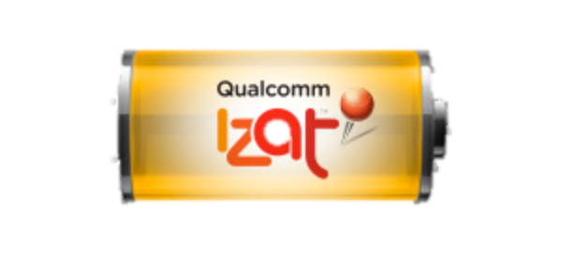



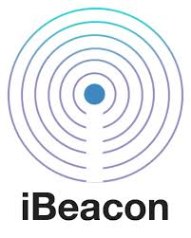



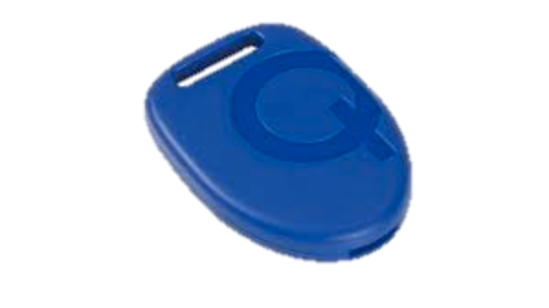
What if we had Ubiquitous Indoor Positioning Today?
Businesses
Researchers
[RADAR’00], [Cricket’04], [Lease’04], [Horus’05], [PlaceLab’05], [Beepbeep’07], [SrndSense’09], [EZ’10], [Compac’10],[BatPhone’11], [Wigem’11], [Zee ‘12], [Will’12],[Centaur’12], [Unloc’12], [PinLoc’12], [FootSlm’12], [ArrayTrack’13], [Guoguo’13] , [PinPoint’13],...
Notes:
But this is not a new dream..
Researchers and businesses have been working for over a decade to achieve the vision of ubiquitous indoor positioning. So much so that we have two sessions in Mobicom about it.

Slide 4
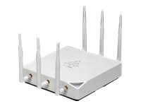
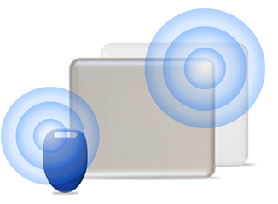
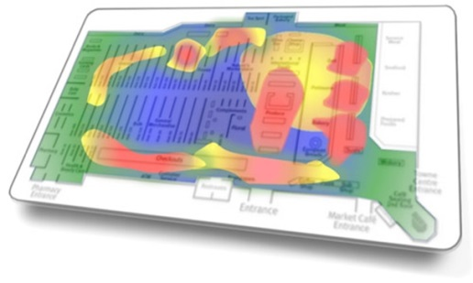
The Pain Point
The Deployment Nightmare
Change Infrastructure
Build Signal Maps
Can’t account for
moving people, furniture
Can’t ask every building to do this!
MIT spends $3M annually
to deploy/maintain APs
Notes:
But what’s really the pain point? Why is it that after all these years, I, as a user not seeing hardly any building today, where I can localize myself indoors?
It’s not that we don’t have high accuracy… state-of-the art papers have shown an accuracy of even tens of cm.
It’s just that these systems are just terribly terribly hard to deploy… Today, if say MIT wants to deploy accurate indoor localization, it’s stuck between a rock and a hard place.
It either has to go around changing its entire infrastructure.. Like buying bluetooth beacons or large Wi-Fi antenna arrays.
Of course these systems have a high accuracy up to tens of centimeters. But this expensive proposition. Consider for example that MIT shells nearly 3 million dollars just to maintain its current wireless infrastructure, which don’t even localize in the first place.
The second alternative is just as bad.. You have to get either regular users or building managers to populate a database of signal maps measuring the wireless signal in multiple points in every room of every building… But of course this approach, can’t account for changes in the environment, like moving people or displaced furniture and this greatly impacts the problem.
But here’s the bigger problem… Even if some building owners are willing to make these deployment investments, we can’t convince every building out there to do the same.
So is the dream of indoor localization wherever you go over?

Slide 5
So far, we’ve waited for a localization deployment…
Notes:
But notice something.. So far we’ve been waiting for businesses, or building managers to deploy some form of localization service…

Slide 6
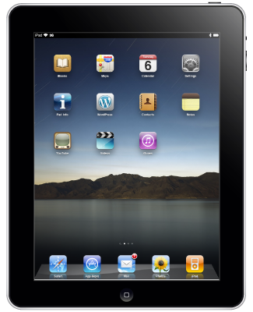
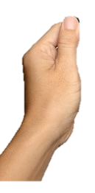
Let’s take matters into our own hands…
Standalone
Localization System
Carry localization with us, wherever we go!
Notes:
But why don’t we take matters into our own hands?
Why don’t we instead build a localization system that can run completely standalone in our mobile devices today.
If we can do this, we don’t need to wait for anybody..
We can just carry the indoor localization with us, no matter where we go!

Slide 7
Ubicarse
Novel algorithm: Endow mobile devices with power of advanced infrastructure
Accurate: Tens of cm on commercial tablet.
Opens up Applications: Transforms cheap mobile camera to a geo-tagging depth camera
Notes:
In the rest of this talk, I will present Ubicarse which does precisely that.
Ubicarse is a novel localization algorithm that runs on your purely on your cheap mobile device to give it the power of advanced infrastructure.
This leads to an advanced localization accuracy of tens of cm, in an actual implementation on a commercial tablet.
And we demonstrate that such accuracy enables new applications, like transforming your cheap mobile camera into a geo-tagging depth camera.

Slide 8
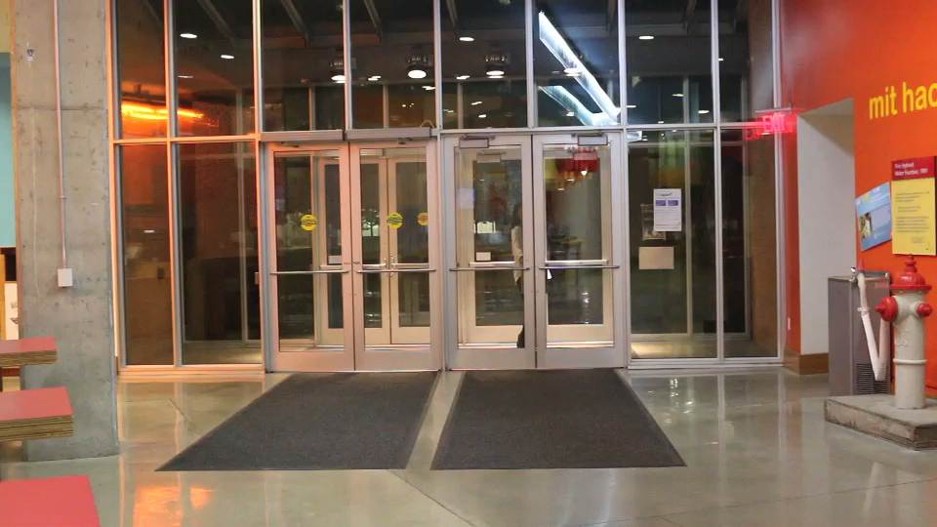
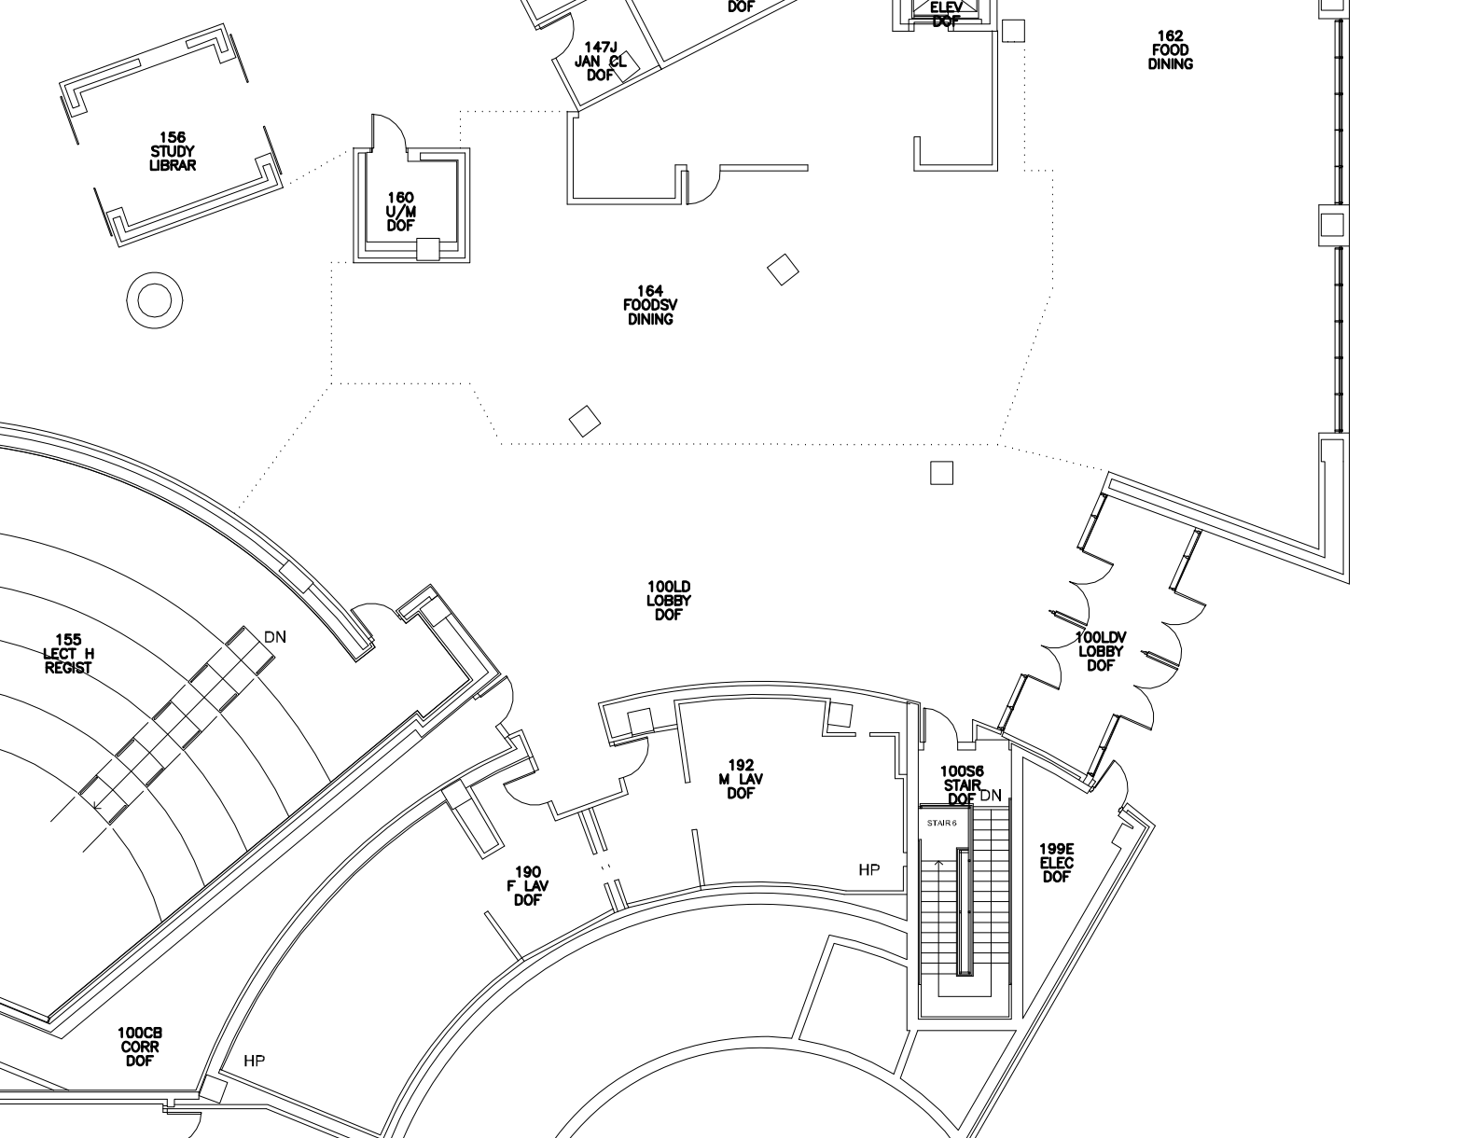

Our Solution
Ubicarse
28cm
Notes:
Essentially Ubicarse is an indoor positioning software for your mobile device.
With Ubicarse, my colleague Stephanie here can walk into a new building that she never visited before, with no specialized infrastructure of prior calibration, and find her location with just a twist of her tablet.
And Ubicarse achieves a localization accuracy of tens of cm

Slide 9
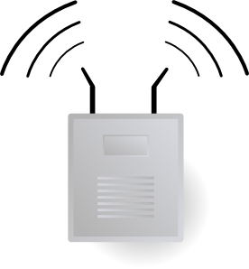
How does Ubicarse work?
Pos₂
Pos₁
Ubicarse Software
Notes:
So how does Ubicarse work?
Essentially, Ubicarse is a standalone piece of software running purely on your mobile device. It uses off-the-shelf hardware like WiFi cards and motion sensors, found in most mobile devices today.
It finds your location relative to the regular Wi-Fi access points around you, that don’t need to be modified in any way.
The only piece of information that Ubicarse needs is like any localization system, is some global reference, the global positions of the access points, … which can be measured in a matter of hours.. even in a large mall or hotel.

Slide 10
How do we build an accurate standalone localization software?
Notes:
So let’s see how we can build such a standalone piece of localization software for our mobile devices that is also accurate.
So when we first looked at this problem… we noticed that a lot of past work on highly accurate localization uses antenna arrays…

Slide 11
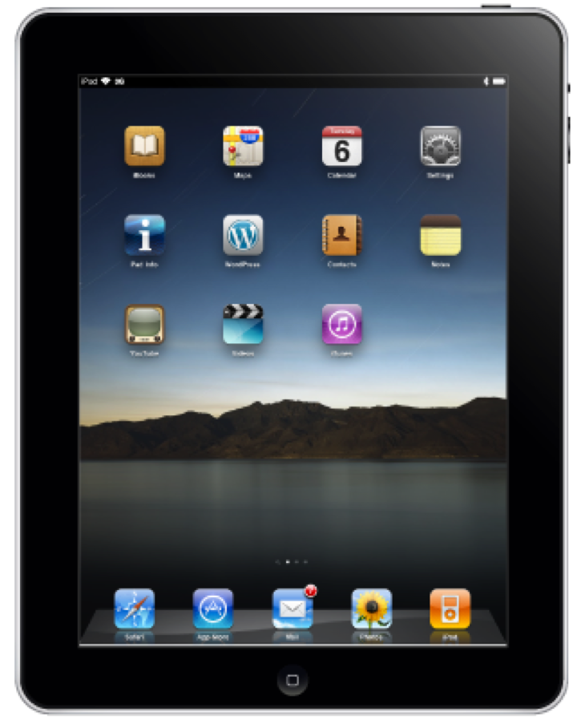
If we had many antennas on our device…
Such a device does not exist!
Notes:
This is because antenna arrays can listen to ping packets from nearby access points to find the actual angle alpha from which the signal arrives…
It can repeat this process for other access points in the vicinity and intersect these lines to find its location accurately.
Of course, today’s tablets and smartphones have two or at most three antennas.
So devices have the such a large number of antennas are impractical and simply don’t exist!

Slide 12
Synthetic Aperture Radar (SAR)
Move device to emulate “antenna array”
Form virtual arrays in the air and localize!
Notes:
Here’s a solution that require does not require many antennas…. A technique called SAR or Synthetic Aperture Radar.
The key idea behind SAR is simple…. Let’s say I move it can collect the snapshots of the signal
It can the process these snapshots to emulate a large multi antenna antenna array.
And SAR allows you to move your device not just along a line but also rotate it about a circle forming a circular antenna array..
And this is great because you can now localize by form large virtual antenna arrays in the air just by rotating your device in place.

Slide 13
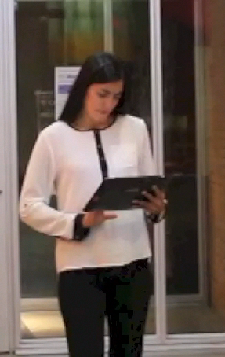
Let’s try this out!
Ask users to rotate tablet
Process signals as circular array
Notes:
So let’s actually try this out!
We went ahead and made Stephanie twist her tablet multiple times and processed her signal measurements as a circular antenna array…
And plotted a CDF of the error in her location.
And we were shocked to find a median error of 6 m and a worst case as high as 18 m…
And that’s surprising because SAR should theoretically give us accuracy of few tens of centimeters…
So what’s going on here?

Slide 14
Let’s try this out!
4-18m
But in theory, SAR has an accuracy of a few tens of cm!
Notes:
And we were shocked to find an error ranging from 4 m to as high as 18 m…
And that’s surprising because SAR should theoretically give us accuracy of few tens of centimeters…
So what’s going on here?

Slide 15
Key SAR Requirement: Move device along precisely known trajectories
Why not use the Accelerometer?
“Notoriously terrible at measuring accurate trajectories [Niessner’14]”
Notes:
It turns out that this stems from a key SAR requirement..
It requires you to move your device along precisely known trajectories correct to a few mm like a perfect line or circle..
One might ask why don’t we just use the accelerometers on your device to precisely measure the trajectories?
Unfortunately these accelerometers are notoriously terrible at measuring the kind of extremely accurate trajectories that SAR needs.

Slide 16
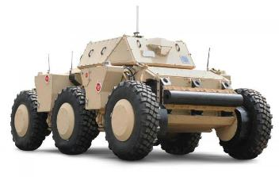
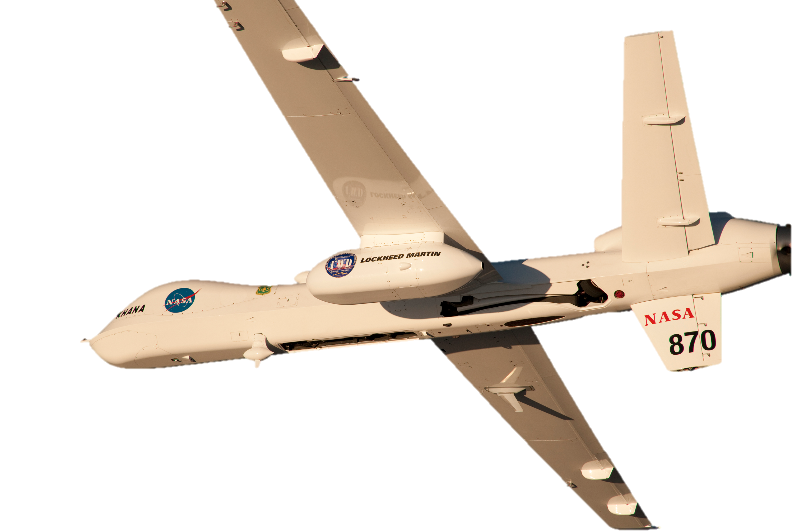
Easy for SAR-based Radar Systems
Notes:
In contrast, precise trajectories are easy to ensure in the world of radar systems, where SAR has traditionally been used..
Here, SAR antennas are usually mounted on aircraft or robots. .
Of course, these robots are designed to move these antennas along extremely accurate trajectories like perfect lines or circles at a constant speed..

Slide 17
If humans rotate their device…
Notes:
But of course, that’s not what we want… We want regular human beings like Stephanie to be able to twist the tablet…
And when we look at the trajectory of her antenna… its definitely not going to be a perfect circle. It’s going to be a messy irregular shape. So is there no way we can perform SAR?

Slide 18
Ubicarse: A New Form of SAR
First formulation of SAR on arbitrary, unknown trajectories
Your Location
Ubicarse
“transform”
Notes:
// Potential problem place
Here’s an idea.. What if I tell you that that no matter how arbitrarily you twist your device, we can somehow transform your movement into a perfect trajectory..
If we do this… we can then process this trajectory as circular array and find your exact location..
In fact, this is exactly Ubicarse’s key contribution. It’s a new form of SAR that can transform messy and unknown twists into perfectly circular paths.
And it provides the first such formulation of SAR that works such arbitrary and unknown trajectories.

Slide 19
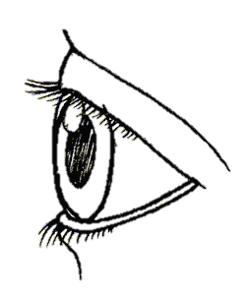
Our Solution: Uses the relative trajectories between two antennas
Antennas
Notes:
The key idea behind Ubicarse is simple: Instead of trying to measure the trajectory of one antenna on your device, we use relative trajectories between two antennas…
Let me explain what I mean by this.. And I’ll be dealing in 2 dimensions, for simplicity, though our solution easily extends to 3-D..
Our idea leverages the MIMO capability of today’s mobile devices… That is, most recent mobile devices contain at least two Wi-Fi antennas shown as colored circles here…
Of course, as the user twists the device, this still means that instead of one… we now get two paths, one for each antenna.
Notice that both these paths look messy… so looking at two antennas hasn’t really helped us.

Slide 20
Our Solution: Uses the relative trajectories between two antennas
z
Notes:
The key idea behind Ubicarse is simple: Instead of trying to measure the trajectory of one antenna on your device, we use relative trajectories between two antennas…
Let me explain what I mean by this.. And I’ll be dealing in 2 dimensions, for simplicity, though our solution easily extends to 3-D..
Our idea leverages the MIMO capability of today’s mobile devices… That is, most recent mobile devices contain at least two antennas shown as colored circles here…
Of course, as the user twists the device, this still means that instead of one… we now get two paths, one for each antenna.
Notice that both these paths look messy… so looking at two antennas hasn’t really helped us.

Slide 21
Our Solution: Uses the relative trajectories between two antennas
Notes:
The key idea behind Ubicarse is simple: Instead of trying to measure the trajectory of one antenna on your device, we use relative trajectories between two antennas…
Let me explain what I mean by this.. And I’ll be dealing in 2 dimensions, for simplicity, though our solution easily extends to 3-D..
Our idea leverages the MIMO capability of today’s mobile devices… That is, most recent mobile devices contain at least two antennas shown as colored circles here…
Of course, as the user twists the device, this still means that instead of one… we now get two paths, one for each antenna.
Notice that both these paths look messy… so looking at two antennas hasn’t really helped us.

Slide 22
Our Solution: Uses the relative trajectories between two antennas
Notes:
The key idea behind Ubicarse is simple: Instead of trying to measure the trajectory of one antenna on your device, we use relative trajectories between two antennas…
Let me explain what I mean by this.. And I’ll be dealing in 2 dimensions, for simplicity, though our solution easily extends to 3-D..
Our idea leverages the MIMO capability of today’s mobile devices… That is, most recent mobile devices contain at least two antennas shown as colored circles here…
Of course, as the user twists the device, this still means that instead of one… we now get two paths, one for each antenna.
Notice that both these paths look messy… so looking at two antennas hasn’t really helped us.

Slide 23
Our Solution: Uses the relative trajectories between two antennas
y
Antenna-1’s Frame
x
Notes:
But so far, we’ve been seeing these paths from the outside… that is the global frame of reference of the world.

Slide 24
Our Solution: Uses the relative trajectories between two antennas
Antenna-1’s Frame
y
x
Notes:
But why don’t we now shift our frame of reference to that of the first red colored antenna. Meaning that we’re looking at the world as if we’re sitting on top of antenna-1.
So in this frame of reference, as the device moves… antenna-1 is always going to remain at the origin.

Slide 25
Our Solution: Uses the relative trajectories between two antennas
Antenna-1’s Frame
y
r
x
Notes:
But of course… let’s now look at the blue antenna-2. Notice that since both antenna-1 and antenna-2 are attached to the same device… they are always going to be separated by a constant distance d.

Slide 26
Our Solution: Uses the relative trajectories between two antennas
Global Frame
Antenna-1’s Frame
y
r
x
y
x
Notes:
This is why even when though the trajectories of the two antennas in the global frame looked slighty different…
At any point in time, the distance between the two antennas always remained the same value r.

Slide 27
Our Solution: Uses the relative trajectories between two antennas
We know exact shape of the relative trajectories between antennas
We must know where antenna-2 is at each snapshot
Global Frame
Antenna-1’s Frame
y
r
θ(t)
x
y
Perfect Circular
Antenna Array!
x
Notes:
So this means that in antenna-1’s frame, antenna-2 will always move only in a circle whose radius is d.
This is great because we now transformed this irregular trajectory into the familiar perfect circular trajectory…
In other words, we now know the shape of the relative trajectories between the two antennas perfectly… its just a circle of radius r.
But remember that SAR snapshots the wireless signals at multiple points in this trajectory.
As a result, SAR needs to know not just the shape of the trajectory but also where antenna-2 is on that trajectory at any point In time.
In other words, we need the orientation of the device theta(t) at each snapshot.

Slide 28
Orientation
θ(t)
x
Notes:
Notice here that this orientation theta(t) of your device depends closely on where it thinks its x-axis is.

Slide 29
Orientation
θ'(t)
x
Notes:
So if your x-axis is off by a few degrees, so is your orientation.

Slide 30
Measure Orientation Using Gyroscope
Gyroscopes suffer from orientation drift
t = 0s
t = 1s
t = 2s
x
x
x
2°
4°
0°
)
)
Static
Static
Static
Device’s x-axis drifts by 2°/s
Changes over tens of sec → Estimate in real-time
Notes:
Of course the most straightforward way to measure orientation is to read it off of the device’s gyroscope.
But while gyroscopes are more reliable than accelerometers. They suffer from a form of error called orientation drift.
Let me tell you what this means..
Let’s say we have a device that is completely static, with its x-axis pointing towards 0 degrees at time t = 0. Since the device is static, its x-axis should always point to zero.
But in practice, this is not what happens, after a time t = 1 second.. Its perceived x-axis drifts.. And it drifts by a value of 2 degrees..
And after 2 seconds.. It now thinks its x-axis is at 4 degrees.
In other words, the device’s x-axis drifts by 2 degrees/second…
You might wonder hey.. What happens at t = 20s, and t = 200s, is the drift going to always be 2 degree/s..
Unfortunately, this is not the case. The drift can change fairly quickly over tens of seconds. So we need to estimate the drift in real-time.

Slide 31
Measure Orientation Using Gyroscope
Gyroscopes suffer from orientation drift
t = 0s
t = 1s
t = 2s
x
x
x
2°
4°
0°
)
)
)
α
)
)
α
α
x
x
3°
1°
)
Ubicarse
SAR
)
α+1°
α+3°
Notes:
So let me explain we how Ubicarse does this at a very high level… essentially it uses the fact the access point remains at a fixed location.. on some wall.
Which means we can use the direction alpha to the AP as a reference that is constant over time. And remember that SAR can help us estimate this direction…
So here’s what we do… let’s say perform SAR from t = 0 to t = 1… During this time.. The x-axis is going to drift.. And would drift by 1 degree on average.
So if we perform SAR.. we’ll get an incorrect value of the AP’s direction that’s about alpha + 1 degree…
And similarly, if we perform SAR from t = 1 to 2… the x-axis would have now drifted to about 3 degrees on average.
So SAR now tells us that the AP is at alpha + 3 degrees, which is also incorrect.

Slide 32
Measure Orientation Using Gyroscope
Compensate for this 2°/s drift and get correct orientation θ(t)
Subtracting the two gives us…
Drift = 2°/s
x
x
3°
1°
)
Ubicarse
SAR
)
α+1°
α+3°
Notes:
But notice that by subtracting these two incorrect AP directions.. We can obtain the precise drift in orientation.. 2 degrees.
We can then compensate for this drift to obtain the correct orientations.. And later on, we can now feed the corrected orientation into SAR once again to get the correct value of alpha.

Slide 33
Relative Trajectory of Two Antennas
Known Position =
Orientation θ(t)
Known Shape = Circle of radius r
r
θ(t)
We prove SAR works with relative trajectories
Notes:
So putting it all together… we now fully understand the relative trajectory of our antenna-2 relative to antenna-1.
Not only do we know that it’s a circle of radius r,
But we can track the exact relative position of antenna-2 using the orientation theta(t) at any time…
So all that’s left is to prove that SAR indeed works with these relative trajectories.

Slide 34
Lemma (Informal): SAR on relative trajectories of 2 antennas is equivalent to a circular SAR array
The Ubicarse Lemma
Proof by Reduction (In paper)
Reduce …. Relative Trajectories → Circle
“Relative Signals” → Signals on Circle
Relative SAR on 2 antennas → Circular SAR
Reduction holds in: non-line-of-sight, 3-D
Notes:
Indeed our paper proves the following lemma which I’ve restated here informally… Applying SAR using the relative trajectories of the two antennas on your device is essentially equivalent to SAR emulating an actual circular antenna array.
We have a formal proof by reduction for this in the paper. Of course I wont go into the details in this talk, but at a very high level, the proof works as follows.
Specifically, we show that just as we can reduce relative trajectories between 2 antennas into a perfect circular trajectory.
We can derive relative signal snapshots between 2 antennas which reduce to the signals you would obtain from that perfect circle.
As a result, we can mathematically show that complex relative SAR on two MIMO antennas, reduces to a simple circular SAR like formulation.
And even better, we prove that this reduction continues to hold in more general settings, including non-line-of-sight and 3-D.

Slide 35
Experimental Results
Notes:
So now that I’ve explained how Ubicarse works, let me show you how it performs in practice.

Slide 36

Implementation
HP-Split x2 Tablet
Intel 5300 Wi-Fi card, Yei Tech Motion Sensor
Notes:
We implemented Ubicarse on a Linux based HP split x2 tablet equipped with an intel 5300 wifi card and a yei technology motion sensor.
And we used the visual sfm stereo-vision tool kit to perform geo-tagging.

Slide 37

Evaluation
Large MIT Library – 5 Access Points
Baseline: Angle-of-Arrival using 2-Antenna Array
Notes:
We conducted our evaluation in a large MIT library with five surrounding access points.
We compare Ubicarse with a baseline that uses the two antennas on the tablet as a 2-antenna array, which like Ubicarse, does not require special infrastructure or signal maps.

Slide 38
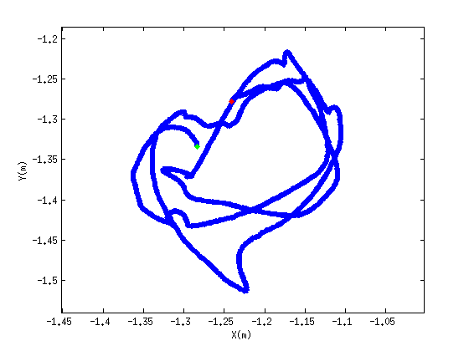
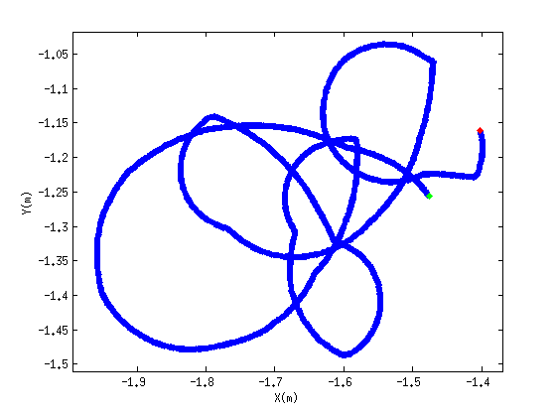
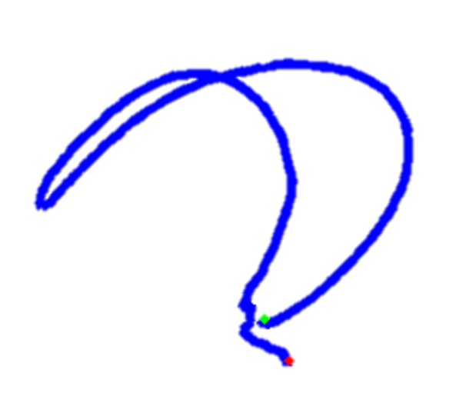
Several Device Trajectories
Circular Twisting
To-And-Fro Twist
~0.3m
>0.3m
Notes:
We then ask our user to move the device along different types of trajectories, like circular twists and a simple two and fro twist…

Slide 39
Accuracy in Device Location
25 cm
CDF
Error in Dimension (m)
Notes:
We measured the accuracy of both Ubicarse and baseline in each of x, y, and z dimension across experiments and plot the CDF.
We observe that Ubicarse has a median accuracy of 25 cm per dimension, while the baseline has an error of several meters.

Slide 40
Transform cheap mobile camera into geo-tagging depth camera
Notes:
Finally, let me show you how this accuracy enables a new application.
Transforming a cheap mobile camera into a geo-tagging depth camera.

Slide 41



Localizing Objects of Interest around You
To: Bob
Found interesting book
@ (21.39, 35.13)
Notes:
Specifically, often you want to localize not just yourself but also objects in the environment… For example, I want to tag the location my favorite book in the library I think may interest my friend.
This would need me to find its location accurately, so that my friend can come in later and find it easily.

Slide 42
Integrate Ubicarse with Stereo-Vision
Take multiple pictures and infer depth.
Need to know location of camera
Ubicarse gets location of camera
Accurate Geo-tagging Depth Camera!
Notes:
So our approach to do this is to integrate Ubicarse with stereo-vision algorithms.
These vision algorithms ask you to take multiple pictures from your camera from different perspectives to judge the depth of an object.
To do this accurately, you need to know the precise locations of the cameras themselves.
But this can be found very precisely using Ubicarse’s localization algorithm.
So by integrating the two we’ve now transformed a cheap mobile camera into a geo-tagging depth camera.

Slide 43
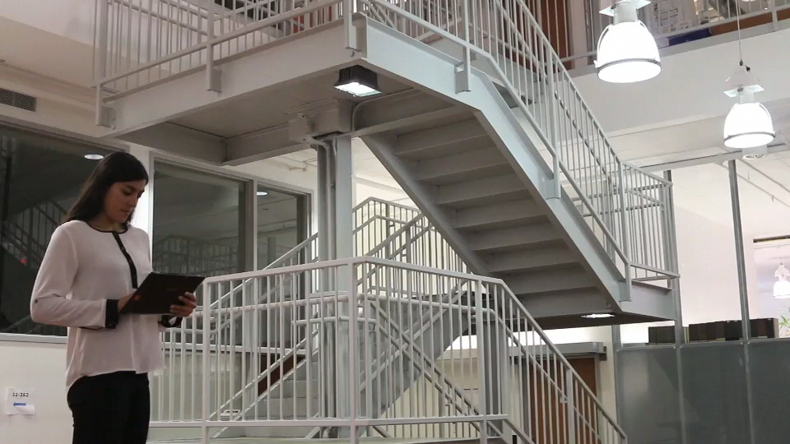

Object Geo-tagging
To: Facilities
Reporting Broken Lamp
@ (30.56, 21.23)
Notes:
So the next time, you are working on your tablet and find a broken lamp above you,… all you need to do is to twist your tablet and take a couple pictures from two different perspectives, and you can then report the precise location of this lamp to facilities.

Slide 44
Evaluation of Object GeoTagging
Integrate Ubicarse with VSFM toolkit
Localize books in the library
Notes:
Finally, we measured the accuracy in geo-tagging a book of interest in the library.
We integrate ubicarse with the vsfm vision toolkit.
We then use it to localize books in our library testbed.

Slide 45
Accuracy in Geo-Tagging
17 cm
CDF
Error in Dimension (m)
Notes:
We then measured the median accuracy of object geotagging across experiments, which was 17 cm on average. Notice that this accuracy is even higher than vanilla device localization because blending stereo-vision into Ubicarse further enhances our accuracy.
Compare this with geo-tagging using the device’s location itself, which can lead you astray by about 2m.

Slide 46
Conclusion
Indoor Localization system for your mobile device with an accuracy of tens of cm
Does not require special infrastructure or signal maps
Accurately search and geo-tag objects
Notes:
To conclude, I presented Ubicarse an accurate indoor localization system for your mobile device.
Ubicarse does not require specialized infrastructure or prior calibration.
And ubicarse can be used to tag everyday indoor objects of interest around us, much as we do with outdoor places today.

