Slide 1
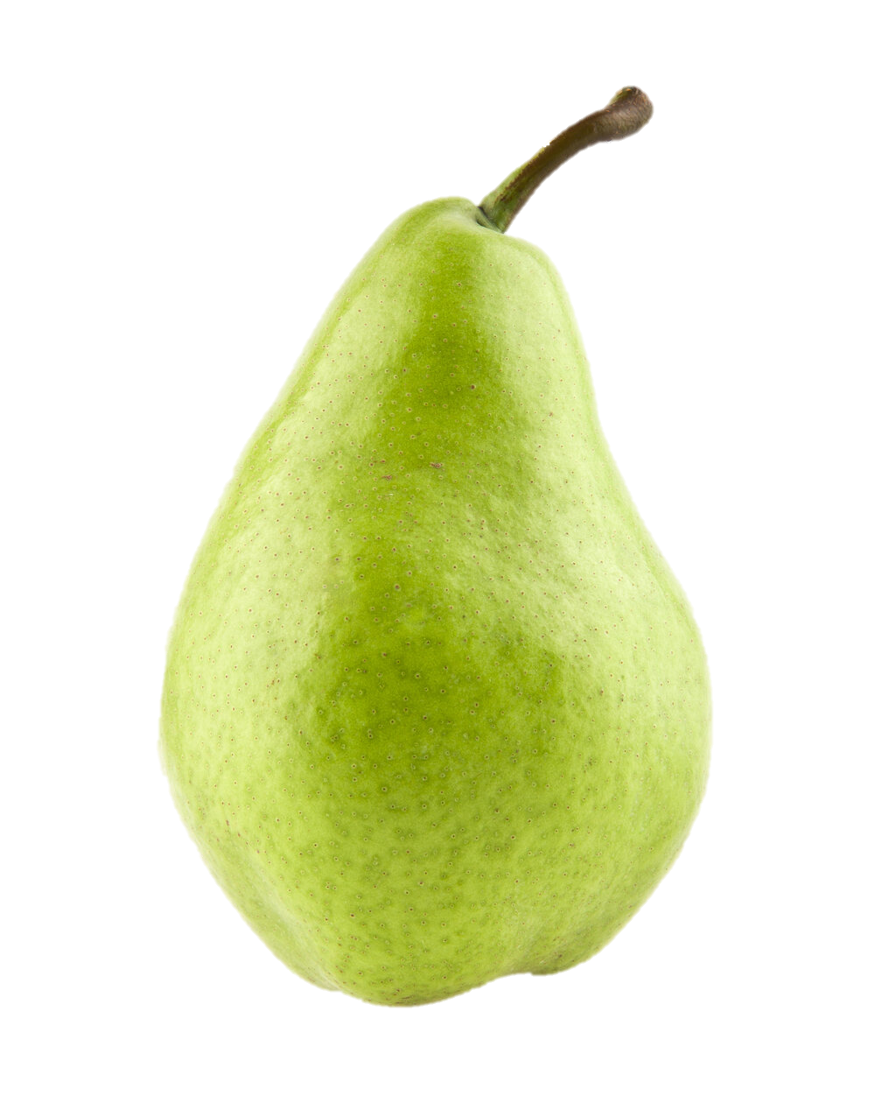





AgriTera: Accurate Non-Invasive Fruit Ripeness Sensing via Sub-Terahertz Wireless Signals
Sayed Saad Afzal
Atsutse Kludze, Subhajit Karmakar,
Ranveer Chandra, Yasaman Ghasempour
Notes:
Hello everyone! I am Sayed Saad Afzal from MIT Media Lab. I am very excited to be here today to tell you about our research on inferring fruit quality from sub-THz wireless signals. This is joint work with my colleagues from Princeton and Microsoft: Atsutse, Subhajit, Ranveer and Yasaman.

Slide 2
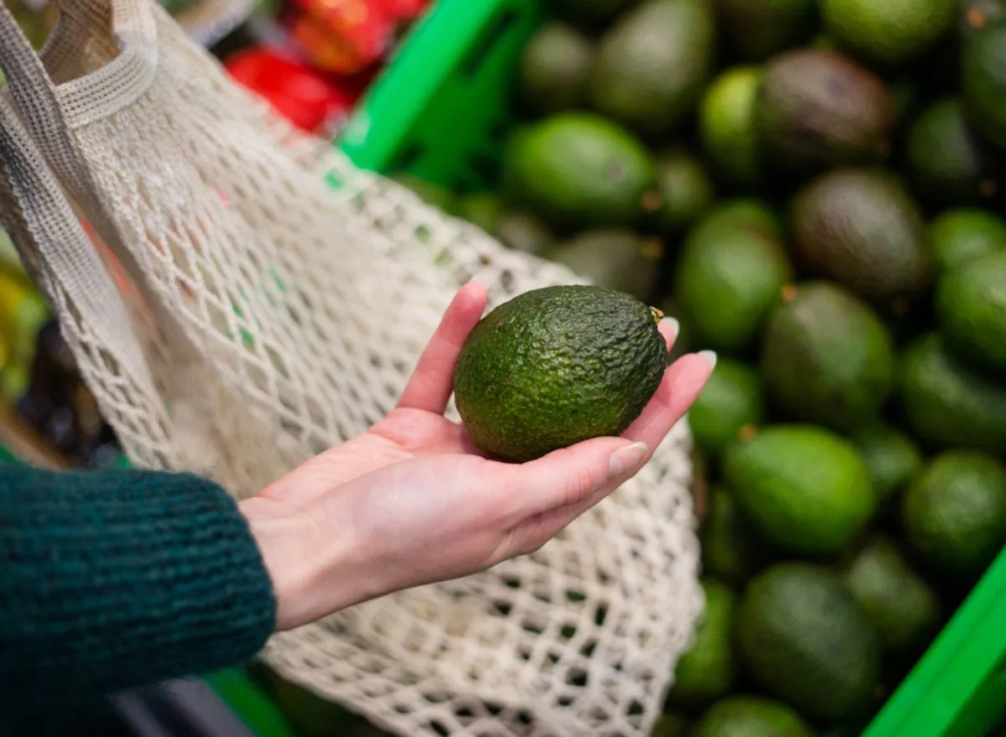
Can we detect the ripeness of fruit beneath its peel non-invasively?
Is it ripe?
Does it feel firm?
Has it rotten?
Nearly 50% of the fruits and vegetables produced worldwide are wasted each year
Notes:
This project is motivated by a simple question: [0.5s] Can we detect the ripeness of fruit beneath its peel non-invasively.
[click] We’ve all experienced situations where we picked up a fruit item in the super-market and started wondering. [click] Is it ripe? Does it feel firm? Has it rotten?
We might try to infer about the ripeness by pressing different sides of the fruit to check for firmness or looking at the color of the peel, but we still can’t know for sure if the fruit is rotten from the inside.
In fact, according to the united nation, due to these unreliable methods nearly half [click] the fruits produced worldwide are wasted each year. In the united states alone, 30% of all food worth $48.3 billion goes to waste each year. A large amount of it perishes during transportation or distribution or the fruits might get wasted in the supermarket because they fail to meet the retailers standard for color and appearance. So it is crucial to devise a non-invasive, accurate and scalable fruit quality sensing mechanism.
As we thought more about this problem, we started asking asking ourselves: What does it even mean for a fruit to be ripe, can we just qualitatively guess the ripeness stage of any fruit or can we go a step further and quantify it? Let me explain what I mean …

Slide 3
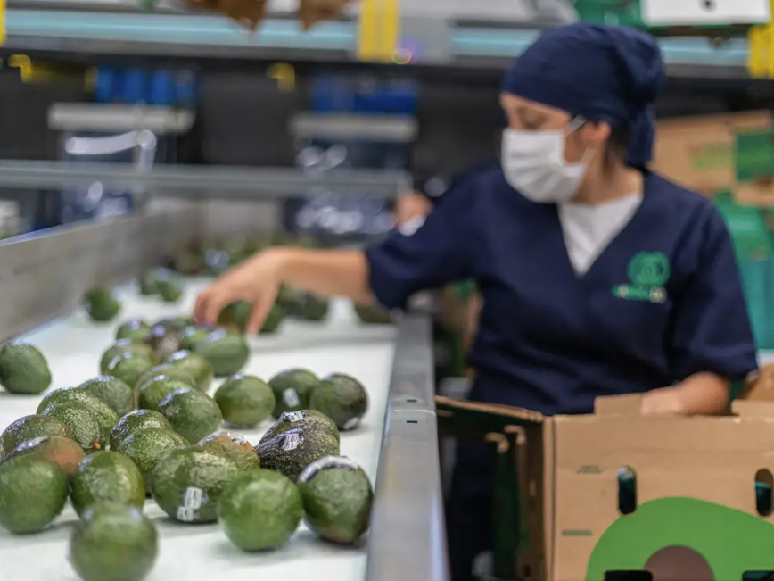
Can we detect the ripeness of fruit beneath its peel non-invasively?
Is it ripe?
Does it feel firm?
Has it rotten?
Nearly 50% of the fruits and vegetables produced worldwide are wasted each year
Notes:
This project is motivated by a simple question: [0.5s] Can we detect the ripeness of fruit beneath its peel non-invasively.
[click] People in the fruit industry and us have all experienced situations where we picked up a fruit item and started wondering. [click] Is it ripe? Does it feel firm? Has it rotten?
We might try inefficient ways to infer about the ripeness by pressing different sides of the fruit to check for firmness or looking at the color of the peel, but we still can’t know for sure if the fruit is rotten from the inside.
In fact, according to the united nation, due to these unreliable methods nearly half [click] the fruits produced worldwide are wasted each year. In the united states alone, 30% of all food worth $48.3 billion goes to waste each year. A large amount of it perishes during transportation or distribution or the fruits might get wasted in the supermarket because they fail to meet the retailers standard for color and appearance. So it is crucial to devise a non-invasive, accurate and scalable fruit quality sensing mechanism.
As we thought more about this problem, we started asking asking ourselves: What does it even mean for a fruit to be ripe, can we just qualitatively guess the ripeness stage of any fruit or can we go a step further and quantify it? Let me explain what I mean …

Slide 4
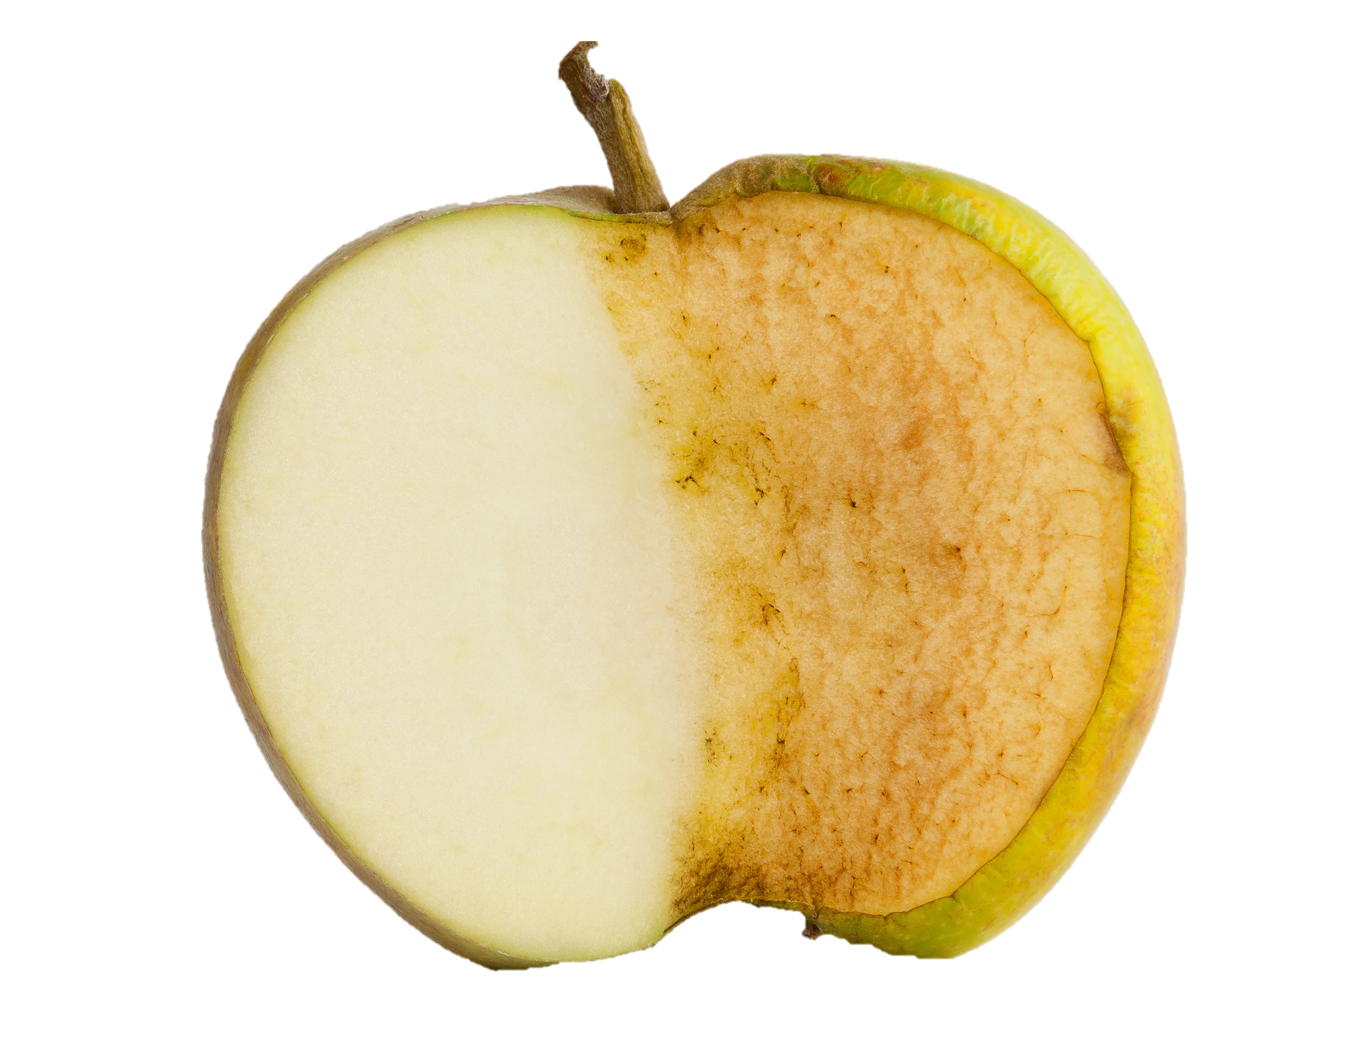
Quantifying fruit ripeness
Brix
Dry Matter
Time
Time
Starch
Unripe
Notes:
Lets consider an unripe apple [click], when fruits are unripe their pulp is typically composed of starch [click], however as they do through different maturity stages, two properties of the fruit change over time, Brix [click] and Dry-Matter [click] . Brix is taken as a measure of sugar or sweetness of fruits or fruit juices, while dry matter refers to the solid component of the fruit without water, it mainly accounts for various components including carbohydrates, oils, protiens, fiber, lipids etc. As the fruit ripens, both Brix and Dry-Matter increase [click] gradually over time.

Slide 5
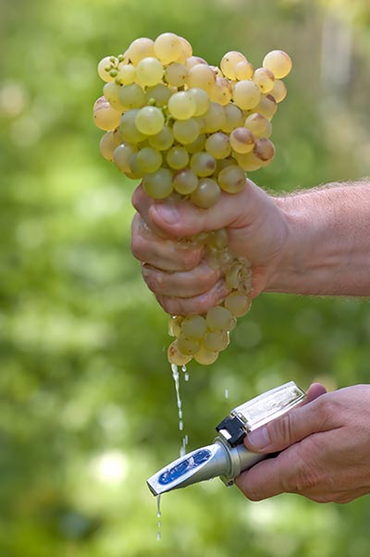
Quantifying fruit ripeness
Brix
Dry Matter
Time
Time
Sugar
Ripe
Notes:
As it continues to ripen [click] both Brix and Dry-matter continue to rise until they reach a saturation point [click]. This is the point where all the starch has been converted to sugar [click]. This is also the point where the fruit is fully ripe so by measuring the Dry Matter or Brix of various fruits, one can accurately estimate the maturity stage and ripeness of various fruits. Typically people rely on brix meters [click] that require juice from the fruit or they need to rely on other destructive methods to obtain dry matter values so the natural question is that …

Slide 6
How can we measure Brix and Dry-Matter non-invasively and without contact?
Notes:
How can we measure Brix and Dry-Matter non-invasively? Let me explain the basic principle …

Slide 7
Approach:
Approach : Exploit the sub-THz band to determine Ripeness Metrics
THz Transmitter
THz Receiver
Notes:
The key idea is to utilize the sub-THz band to determine the ripeness metrics. Let us say we want to test the ripeness of a pear [click], we have a THz transmitter [click] that emits a pulse and a receiver [click] that receives a reflection from the fruit. When we transmit a EM sub-THz pulse [click] , it travels to the fruit and penetrates the peel. The multi-layer medium of the fruit pulp has a certain permittivity and permeability profile so the transmitted pulse interacts with the material of the pulp …

Slide 8
Approach:
Approach : Exploit the sub-THz band to determine Ripeness Metrics
THz Transmitter
THz Receiver
Notes:
… where some of it aborbed by the pulp and some if is reflected back to the THz Reciever [click]. The physiological changes in the fruit during its ripening cycle impacts its refractive index and these changes …

Slide 9
Approach:
Approach : Exploit the sub-THz band to determine Ripeness Metrics
THz Transmitter
Changes in refractive-index
leave a footprint in the sub-THz band
Notes:
… in the refractive-index leave a fruit print in the sub-THz band which can be processed offline to determine the ripeness of various fruits.
A natural question at this point is why are we using sub-THz bands, why not used other frequency bands from the electromagnetic spectrum?

Slide 10
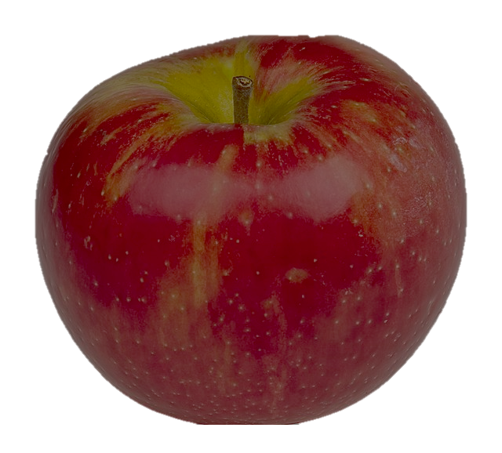
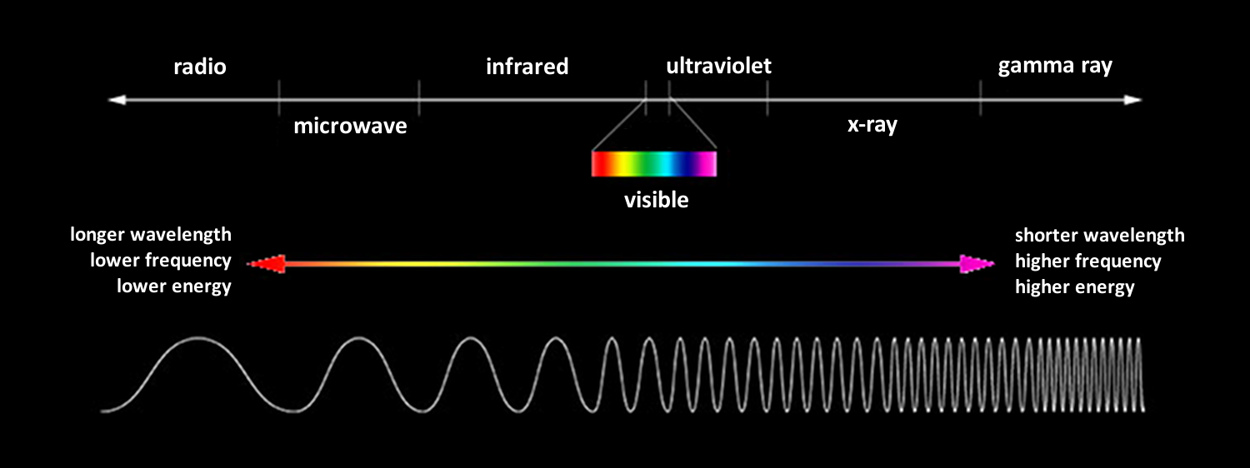
Approach:
Why Sub-THz bands?
Wi-Fii
mmWave
sub-THz
NIR
Visible
Notes:
Let us consider the first scenario where we use WiFi signals [click] Since WiFi signals easily penetrate through any object, the signal would easily pass through the fruit and will experience severe multipath before reaching the receiver, the same signal might also pass through other fruits which might result in additional errors while estimating ripeness metrics. [next slide] If we move to slightly higher frequencies in the mmWave, band

Slide 11
Approach:
Why Sub-THz bands?
Wi-Fii
mmWave
sub-THz
NIR
Visible
Notes:
the signal [click] does not pass through the fruit and the reflected signal can capture physiological changes beneath the peel but since the mmWave band is only a few 10s of GHz, it lacks the required resolution for accurate prediction of ripeness metrics. [next slide] , now it we move all the way close to near infrared band ….

Slide 12
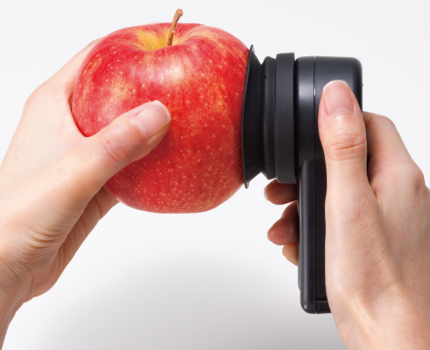
Approach:
Why Sub-THz bands?
Wi-Fii
mmWave
sub-THz
NIR
Visible
Notes:
We have the desired resolution but to ensure that the transmitted pulse penetrates the peel, the transmitter and receiver need to be in contact [click] with the fruit which is not practical for many cases. [next slide], and if we were to use visible light …

Slide 13
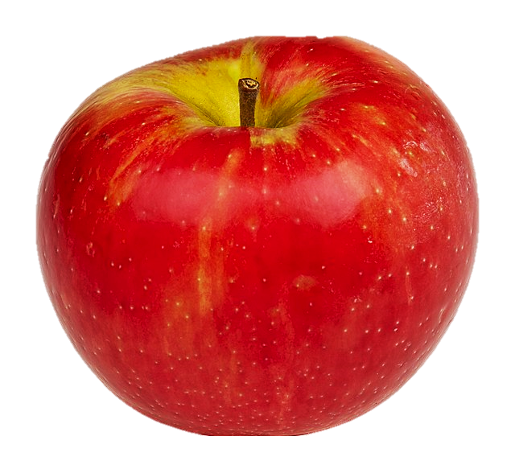
Approach:
Why Sub-THz bands?
Wi-Fii
mmWave
sub-THz
NIR
Visible
Notes:
e.g cameras to detect ripeness metrics [click] then we can only obtain surface level information since light cannot penetrate below the peel and we can only infer ripeness by looking at color changes which is suboptimal since many fruit such as green apples don’t even show considerable changes in color during ripening. In contrast, sub-THz are an ideal choice since they can not only penetrate the peel and have the desired resolution but they are also highly sensitive to changes in water and sugar content which are the key elements that determine ripeness[next slide]

Slide 14
AgriTera
Estimates fruit ripeness metrics such as Brix and Dry-Matter without contact
Works accurately with different types of fruits with different structures, surface properties, peel thickness and pulp types.
Implemented and evaluated in practical environments with
an average NRMSE error of 0.55%
Notes:
We present AgriTera.
[click] A fruit quality sensing system that can estimate fruit ripeness metrics such as Brix and Dry-Matter without contact
[click] AgriTera works accurately with types of fruits with different structures, surface properties, peel thickness and pulp types
[click] The system was implemented and evaluated in practical environments with an average normalized RMSE error of 0.55%
Now that we have discussed the main contributions of AgriTera, let us go back to the key idea underlying how it works.

Slide 15
Approach:
Key Idea : Exploit the sub-THz band to determine Ripeness Metrics
THz Transmitter
THz Receiver
Notes:
Recall from earlier that the key idea is to utilize the sub-THz band to determine the ripeness metrics

Slide 16



Parameters impacting Reflected Power
THz Transmitter
$$P_{r}(θ_{i}, f)= \sum_{k}{P_{i,k} R_{k}(θ_{i}, f)}$$
1
Reflectance
THz Receiver
$${90}^{o}$$
$$θ_{i}$$
Notes:
However it is not as simple as a lot of parameters will impact the reflected power. Infact the reflected power can be given by the following expression [click] where k denotes the index of different fruit layer, Pi and Pr denote the incident and reflected power, theta_i and f are the incident angle and frequency and R is the reflectance. Note how the power reflected from the peel is a function of the incident angle theta_i [click]. If I were to plot the reflectance as a function of the incident angle [click], I would get the following plot, this plot suggest that the ideal thing to do is to keep increasing the incident angle to obtain a better footprint in the sub-THz band but is that true? [2 secs]

Slide 17
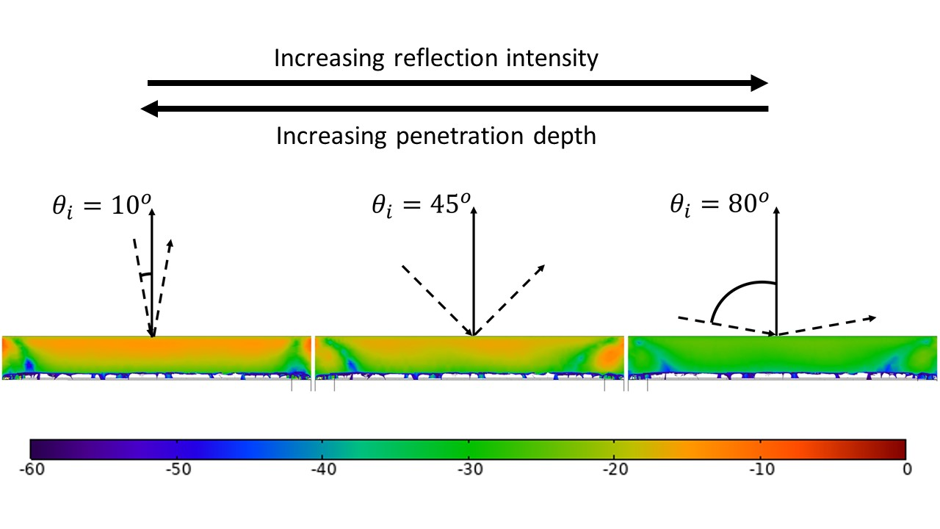




Parameters impacting Reflected Power
Increasing reflected Power
Increasing Penetration Depth
AgriTera relies on an incident angle of ${45}^{o}$ to ensure maximum penetration beneath the peel and maximum reflection
$${10}^{o}$$
$${45}^{o}$$
$${80}^{o}$$
Notes:
It turns out there is a tradeoff between the reflected power and the amount of signal that penetrates the peel. We performed a simulation in COMSOL to verify this. [click] This shows a heatmap of the incident power that penetrates through the peel, bright yellow indicates higher pentration. If we transmit at an incidence angle of 10 degrees, we observe that a lot of the signal penetrates the peel, however, if we were to increase the angle [click] [click], the amount of signal that passes through decreases significantly, so while increasing the incident improves the reflected power [click], decreasing the incident angle improves the penetration [click].
As a result. [click] AgriTera relies on an incident angle of 45 degrees to ensure maximum penetration beneath the peel and maximum reflection. Although this allows ArgiTera to achieve a strong received signal that contains the footprint of ripeness metrics in the sub-THz band. What is still unclear though is how can we map …

Slide 18
How can we map sub-THz spectra to Brix and Dry-Matter?
Notes:
Sub-THz spectra to Brix and Dry Matter? How do I know which frequencies contain information and which of them contain noise? Let me explain the basic principle …

Slide 19



Approach: Chemometric Analysis for Extracting Ripeness Metrics
$$X(f)$$
$<X\left(f\right), P>$
$$Frequency Subspace$$
N Measurements
N Projections
Notes:
The key idea is to use chemometric analysis for extracting ripeness metrics. Let us say you know the ground truth Brix/DM for N fruits of the same type and you obtain the N sub-THz spectrums [click], now we can can project all of these spectrums on a vector P [click] that lies in the frequency sub-space [click]. This might seem very similar to PCA where we search for a vector P, that maximizes the variance of the the N measurements, however in ArgiTera, we take this measurments …

Slide 20







Approach: Chemometric Analysis for Extracting Ripeness Metrics
R
$$X(f)$$
$<X\left(f\right), P>$
$<X\left(f\right), P>$
$$Latent Space$$
$$Y_{Brix/DM}$$
$$β(f)=PR$$
$${\tilde{Y}}_{Brix/DM}= {\tilde{X}\left(f\right)}^{T}β(f)$$
Notes:
And correlate them [click] with the true values of Brix and Dry-Matter [click]. AgriTera then searches for P that maximizes the correlation coefficient R [click] [click]. In this way AgriTera looks for relevant information in the spectrum (X(f)) that is highly correlated with Brix or Dry Matter. This gives us a model “beta” [click], and since this is constant, when I have a new sample [click], I can map the spectrum from the reflection of fruit surface, to the value of its ripness metrics i.e Brix and DM.

Slide 21
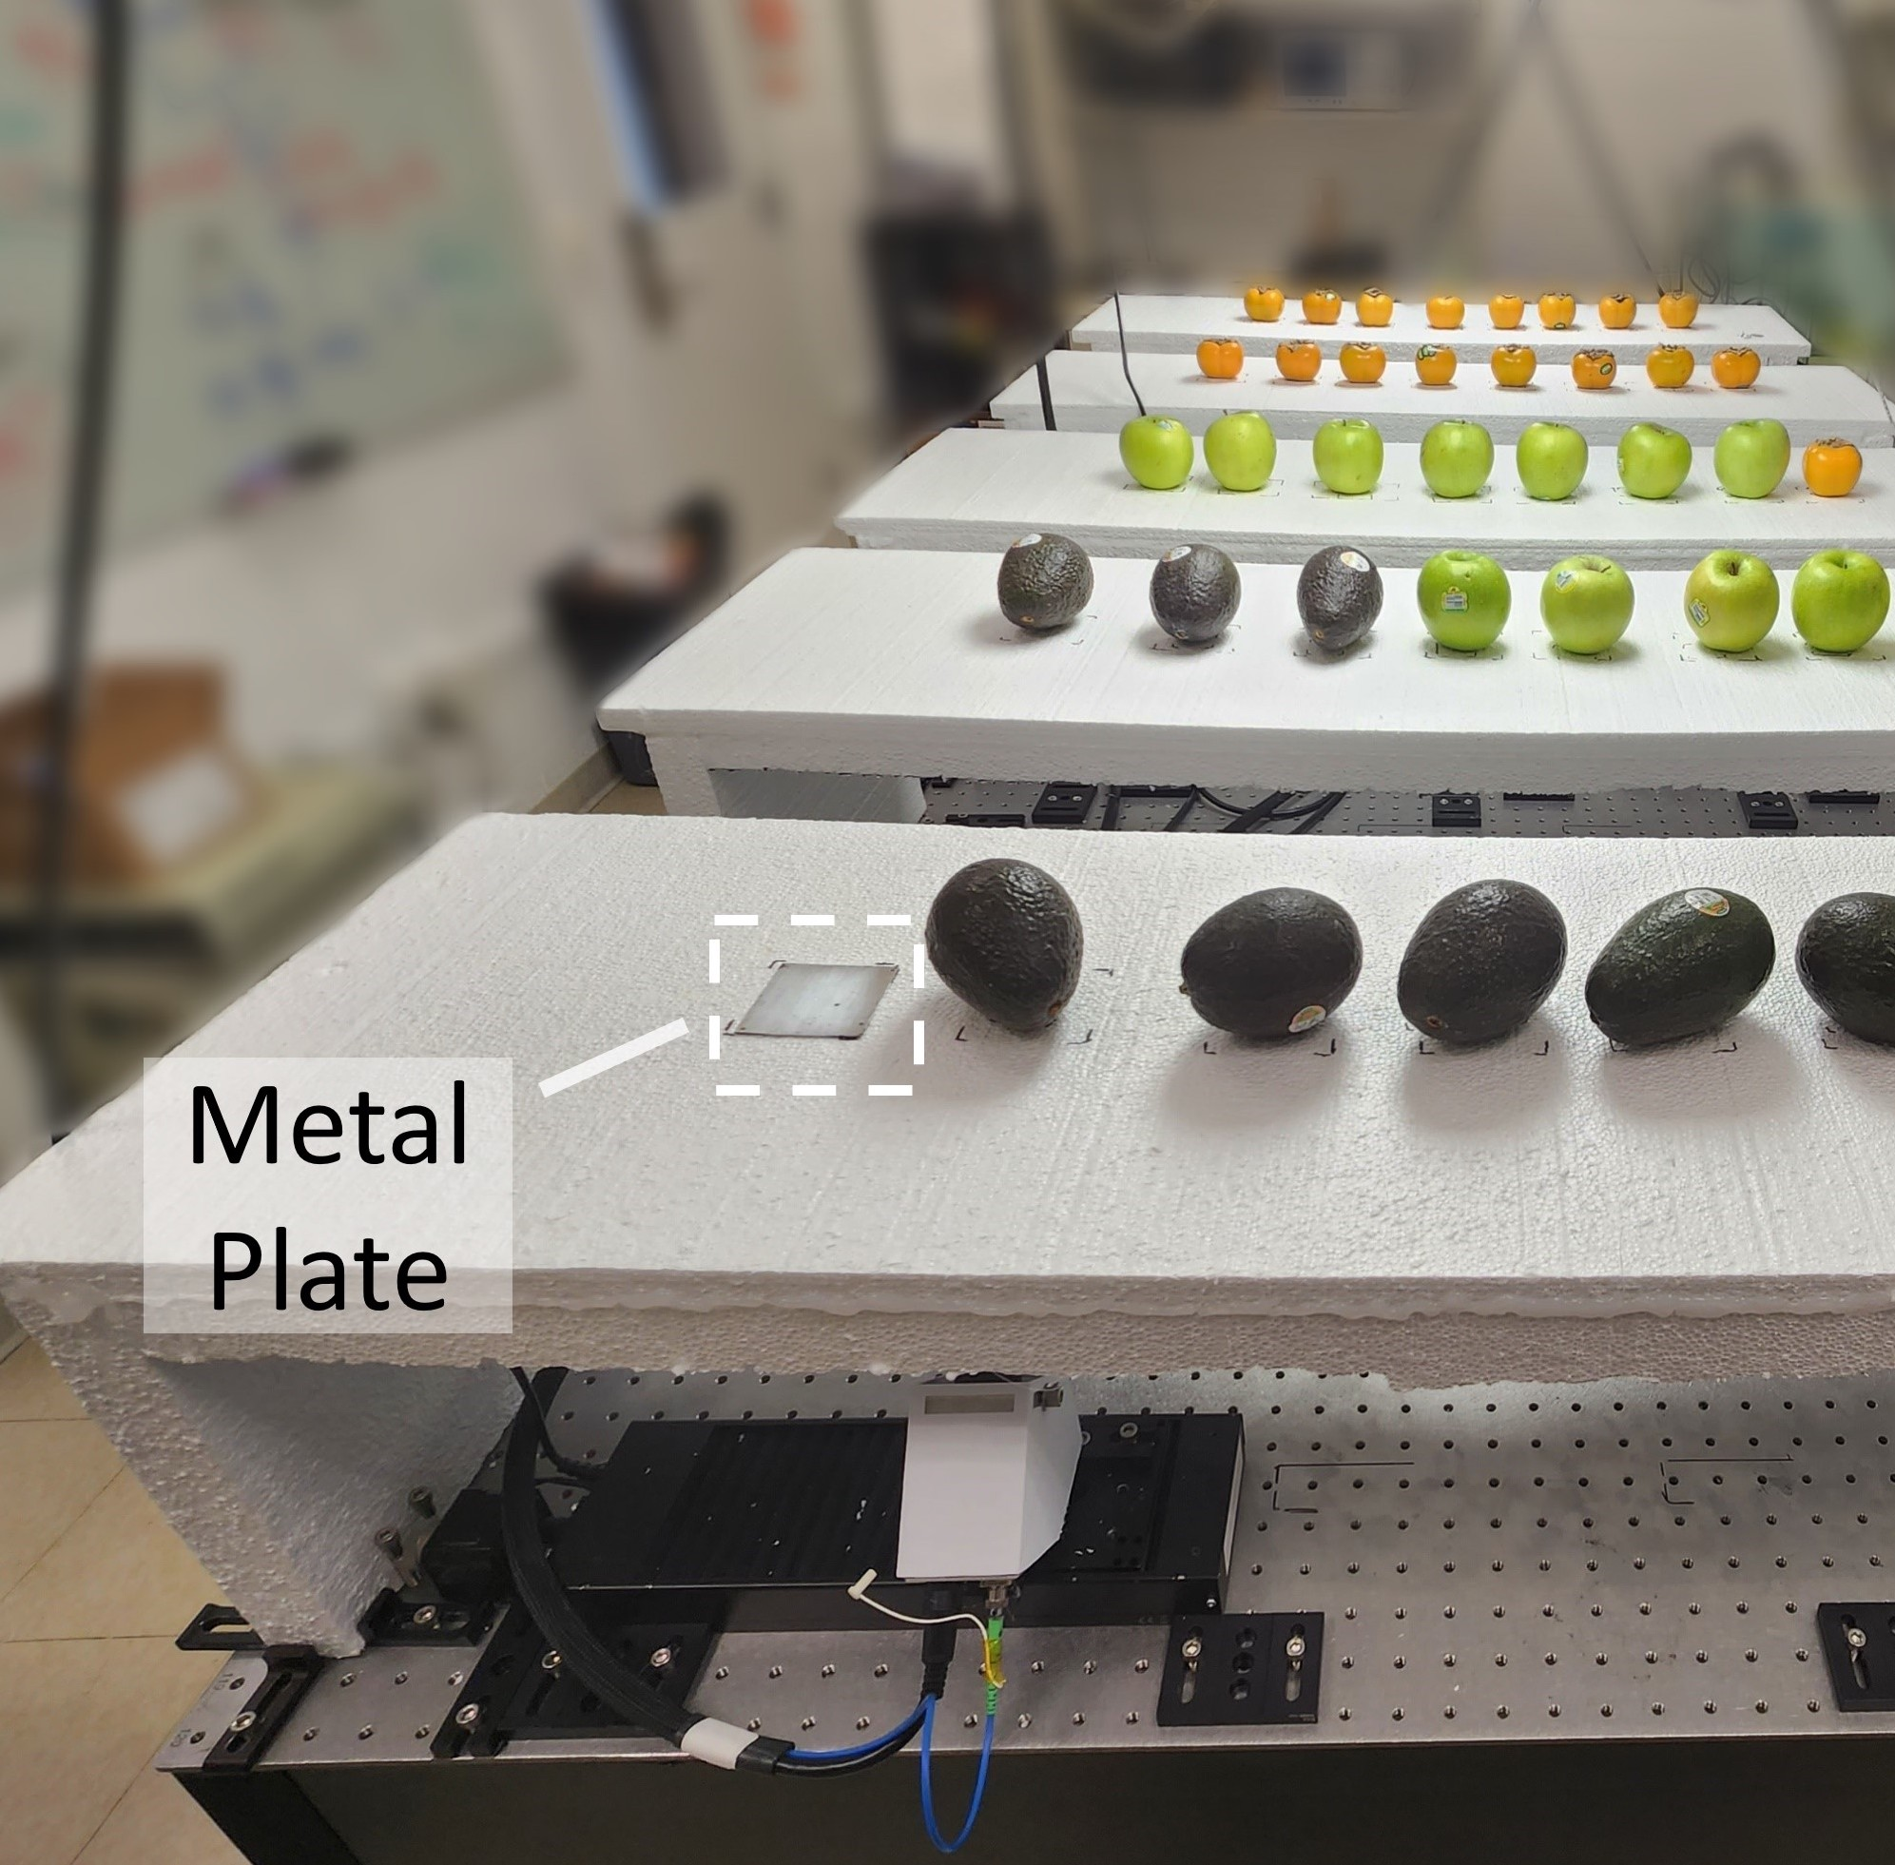
Implementation
Notes:
We evaluated AgriTera with three different fruit types [click] i.e persimmon, avocado and apples. The fruits are choses because they have different surface properties, peel thickness and pulp types. We collected over 200 measurements to test the performance of AgriTera. Furthermore, [click] we used a small metal plate to obtain a reference signal. This signal is used to perfrom a one-time calibration step via normalization to get rid of non-linearities.

Slide 22
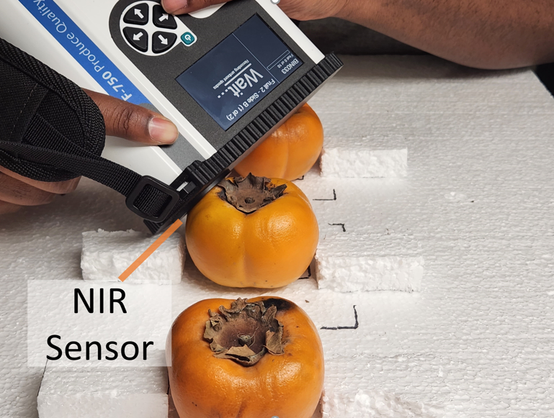
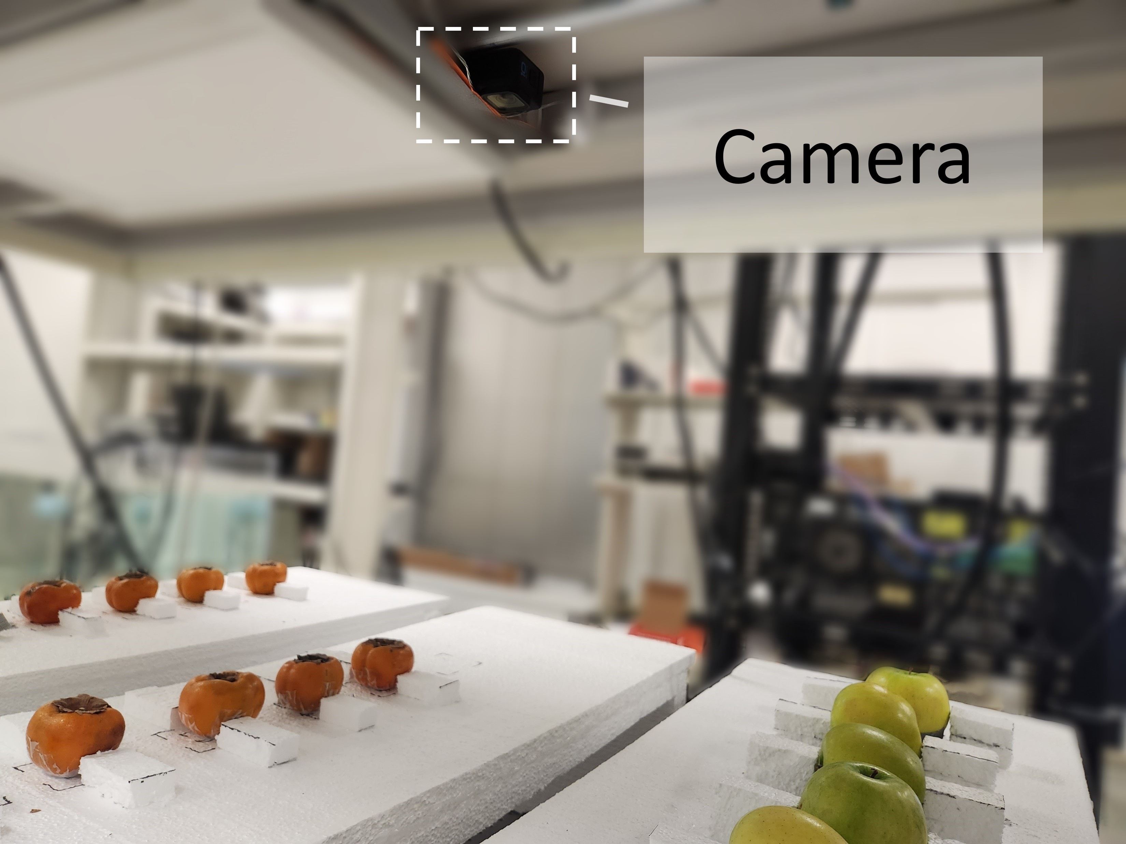
Implementation
Ground Truth
Baseline
Notes:
Additionally to obtain ground truth measurements [click], we used a NIR fruit quality sensing device and a camera [click] x2 (lag) to use as our baseline. Let me show you our results

Slide 23
Implementation
Ground Truth
Baseline
Notes:
Additionally to obtain ground truth measurements [click], we used a NIR fruit quality sensing device and a camera [click] to use as our baseline.
Since the NIR device was only limited to providing with only Brix values for Persimon, and only Dry Matter values for Avacdo, we only evaluate the performance of AgriTera with these metrics, however for Green apples we evaluate AgriTera for both Brix and Dry Matter

Slide 24
Fruit Specific Spectral Footprint
Notes:
Let us first look at how the model “beta” is a function of different fruit types and different bands. [click] Here I am plotting the Normalized value of beta as a function of different frequencies and different fruits. [click] The label on the left denotes the fruit type and the ripeness metric being considered. We use a threshold of 0.25 to determine if a frequency contributes to the model. Here are the plots [click]The red and blue plot the 25th and 75th percentile respectively while the yellow represents the median. Notice how the model coefficients trend for Green Apple Brix and Dry Matter in the bottom two plots are correlated, this demonstrates that the Brix and Dry Matter are correlated. Second the contribution of different frequencies [click] (the red shaded regions) depend on the fruit type so the same model cannot be applied universally to all fruits. Third the result shows that a wide range of frequencies have high sensitivity to changes in Brix or Dry Matter, which suggests that a wideband wireless transmission is crucial for accurate estimation of fruit ripening

Slide 25
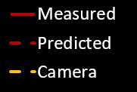
AgriTera Ripeness Prediction during Ripening Cycle
Notes:
We also evaluated the performance of AgriTera in estimating the Brix and Dry Matter values, [click] Here I plot the Brix and Dry Matter as a function of time for different fruits. The solid red line represents the actual value for the Brix and Dry Matter, while the dotted red line denotes the predicted values. The yellow dashed line represents the camera baseline where we evaluate the SSIM values of images over fruits taken over several days. A large drop in the SSIM indicates that there are visible color changes on the fruit surface. As we can see from the results, except for Avocado, the camera baseline fails to show considerable changes, while the fruit is undergoing different maturity stages. We can also see that the AgriTera can accurately evaluate the Brix and Dry Matter values.

Slide 26
Identifying Post Ripe Stage
Brix
Dry Matter
Time
Time
Over-Ripe / Rotten
Notes:
Now that we understand how AgriTera can determine whether a fruit has reached peak ripeness by evaluating the Brix and Dry-Matter, the next question is that can AgriTera also identify when the fruit is rotten [click]

Slide 27
Identifying Post Ripe Stage
Rotten
Stage
Reflected Energy
(Normalized)
Brix/DM
Time
Time
AgriTera can infer about the post ripe / rotten stage by observing the trend in the decay of the Reflected Energy
Over-Ripe / Rotten
Notes:
Since Brix/DM saturates over time, it is hard to tell if the fruit is rotting, so AgriTera looks at the normalized reflected energy [click] to determine if a fruit is rotting. The reflected energy will continue to decays as the fruit continues to loose moisture and becomes more transparent to the sub-Thz pulse [click]. If the fruit is already past the saturation point, AgriTera can use a threshold [click] to determine if a fruit has gone bad [click]. To summarize, [click] AgriTera can infer about the post-ripe/rotten state by observing the trend in the decay of the Reflected Energy.

Slide 28
Testing Post-Ripe Inferences
Notes:
We also evaluated the ability of AgriTera to estimate the maturity stage of fruits beyond their peak ripeness point. To test this I am plotting the normalized power of the reflected signal as a function of time [click]. As we can see from this plot, both green apple and persimmon continue to show a decay in the normalized reflected power even after their Brix and DM values have saturated. Avacados show a slight different behavior: the reflection increases in the begening due to accumulation of oil in the pulp, however over time the power decreases due to the breakdown of the cell wall, causing the avacodo skin to soften and the moisture from the fruit to escape which makes it more transparent to the subTHz pulse.

Slide 29
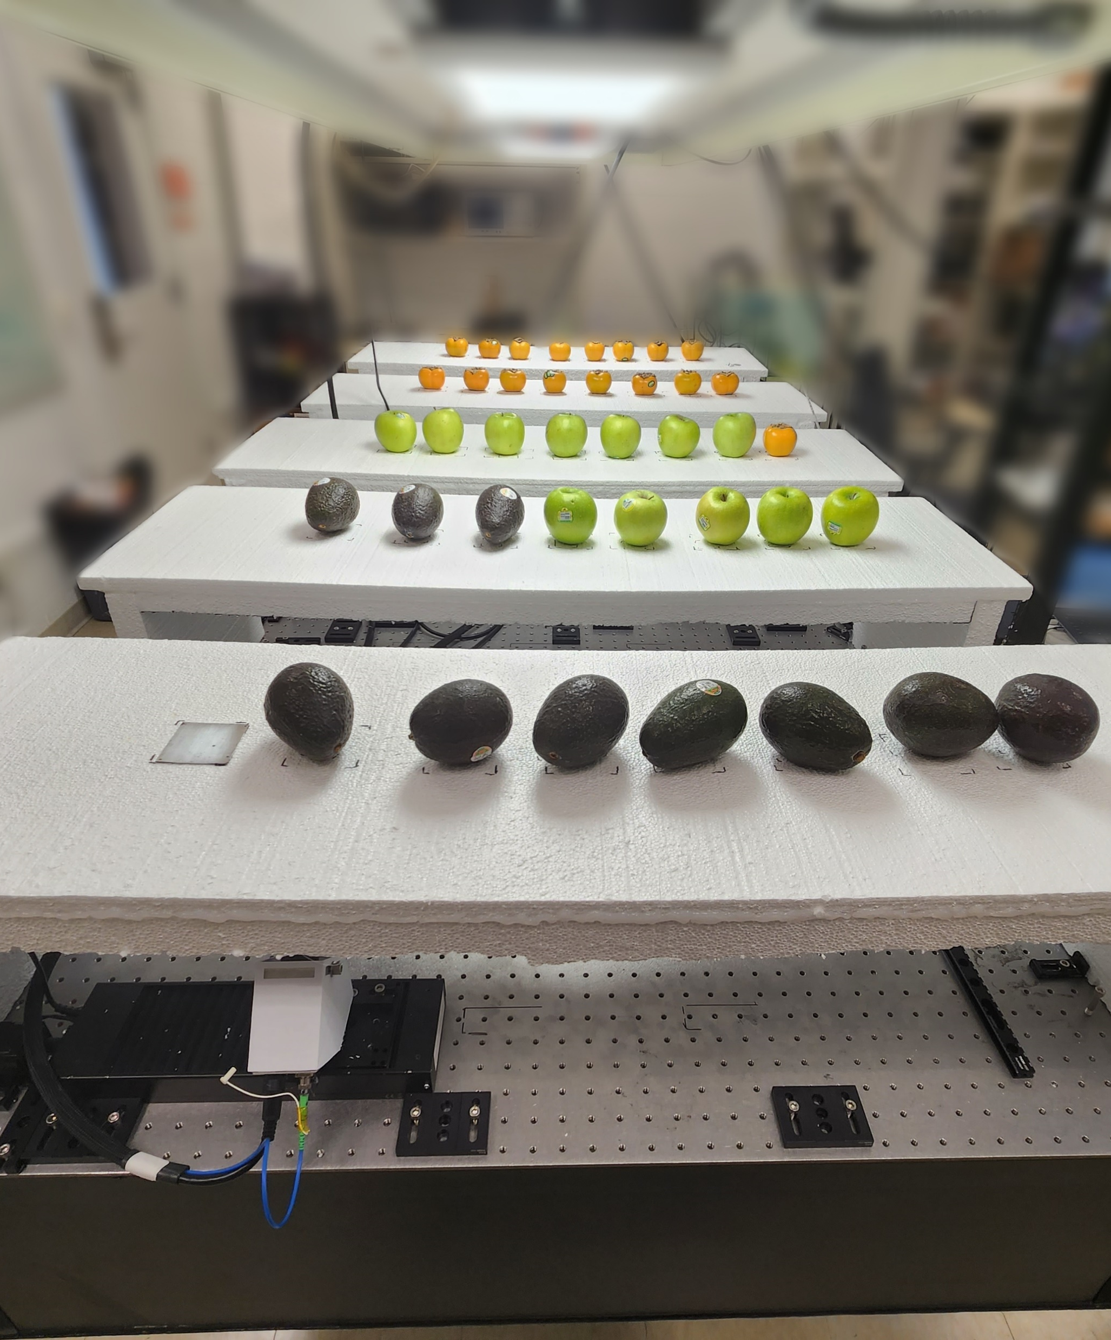
Conclusion
Agri-Tera utilizes the sub-THz band to infer about ripeness metrics of fruits
It can accurately determine Dry Matter/ Brix for a variety of different types of fruits
Future work: Enabling a mobile system for fruit sensing using AgriTera factors (e.g., container material)
Notes:
To conclude,
[click]AgriTera is a system that utilizes sub-THz band to infer about ripeness metrics of fruits
[click] It can accurately determine Dry Matter/ Brix for a variety of different types of fruits.
[click] As the research evolves, we hope to generalize it to new applications and to enable a mobile system for fruit sensing using AgriTera.
With this, I will wrap up my talk and I’m happy to take any questions.

