Slide 1

The Underwater Backscatter Channel: Theory, Link Budget, and Experimental Validation
Waleed Akbar
Ahmed Allam
Fadel Adib
Notes:
Hello Everyone! My name is Waleed Akbar and I am a PhD student at MIT. Today, I will tell you about our work on The Underwater Backscatter Channel. This work is in collaboration with my colleagues Ahmed Allam and Fadel Adib
Before I start my talk, I want to say why we are working on this. This talk will go into a fair level of theory, but there is a major real-world problem that drives the work I’ll be talking about today.

Slide 2
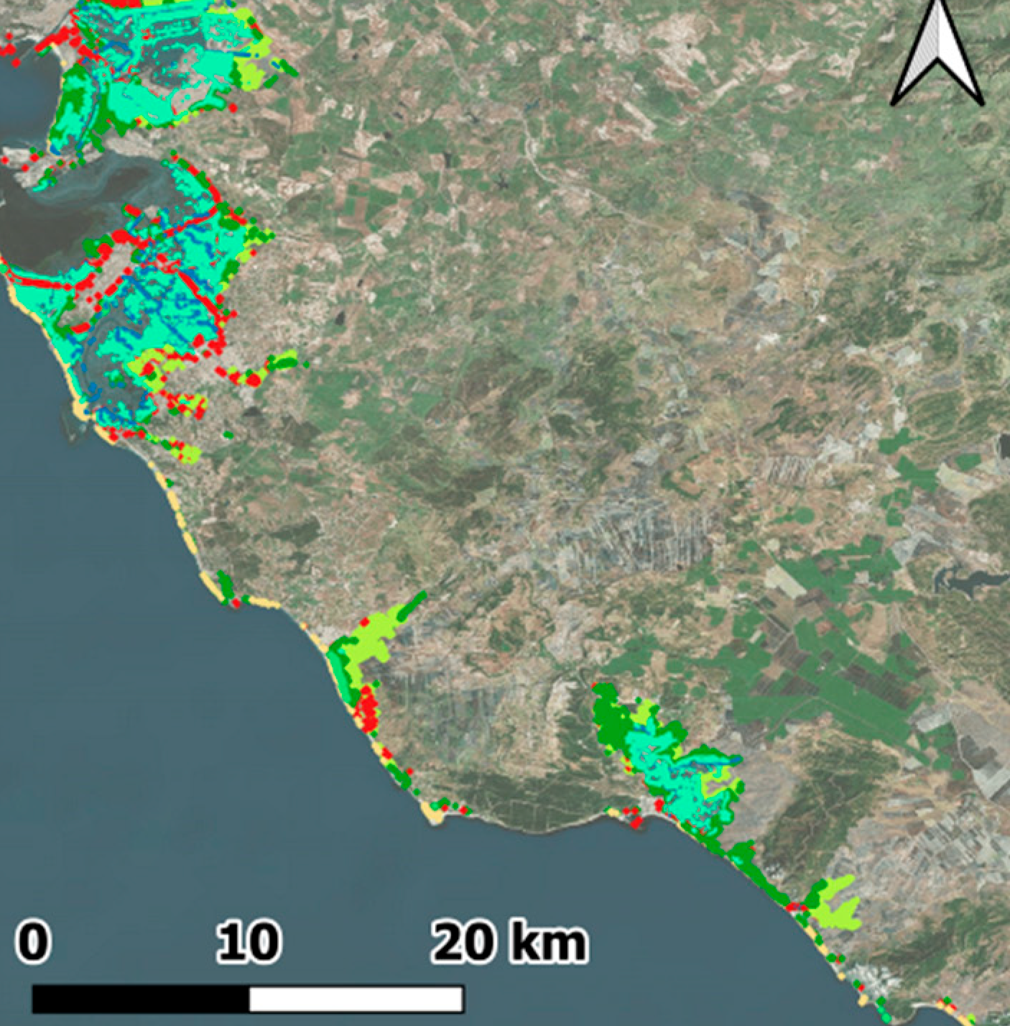
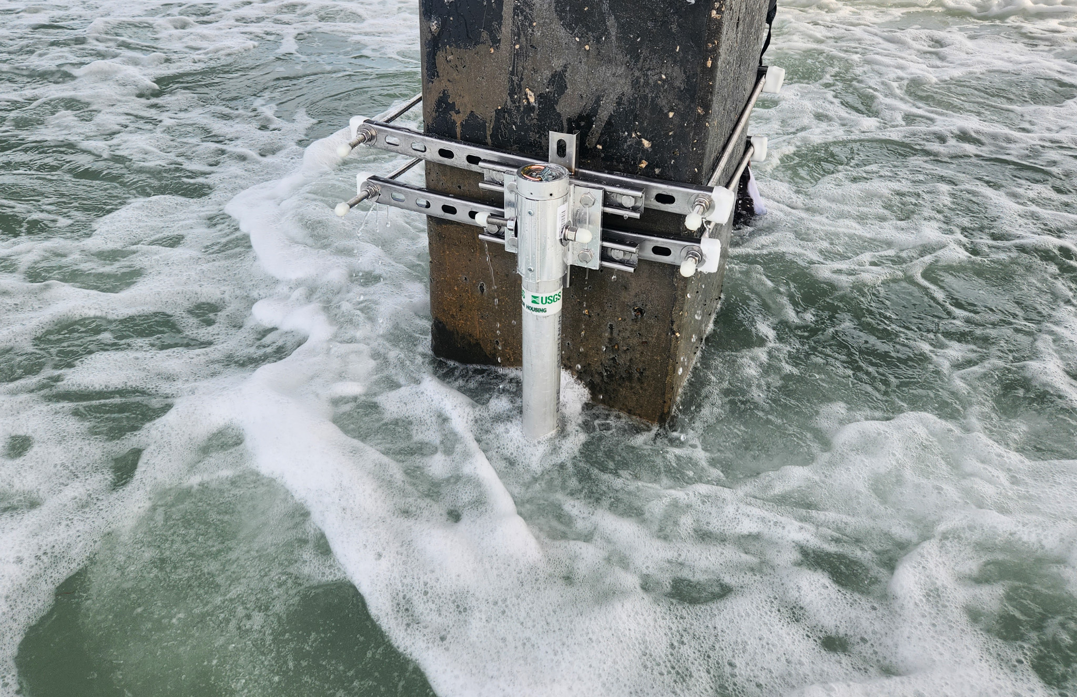
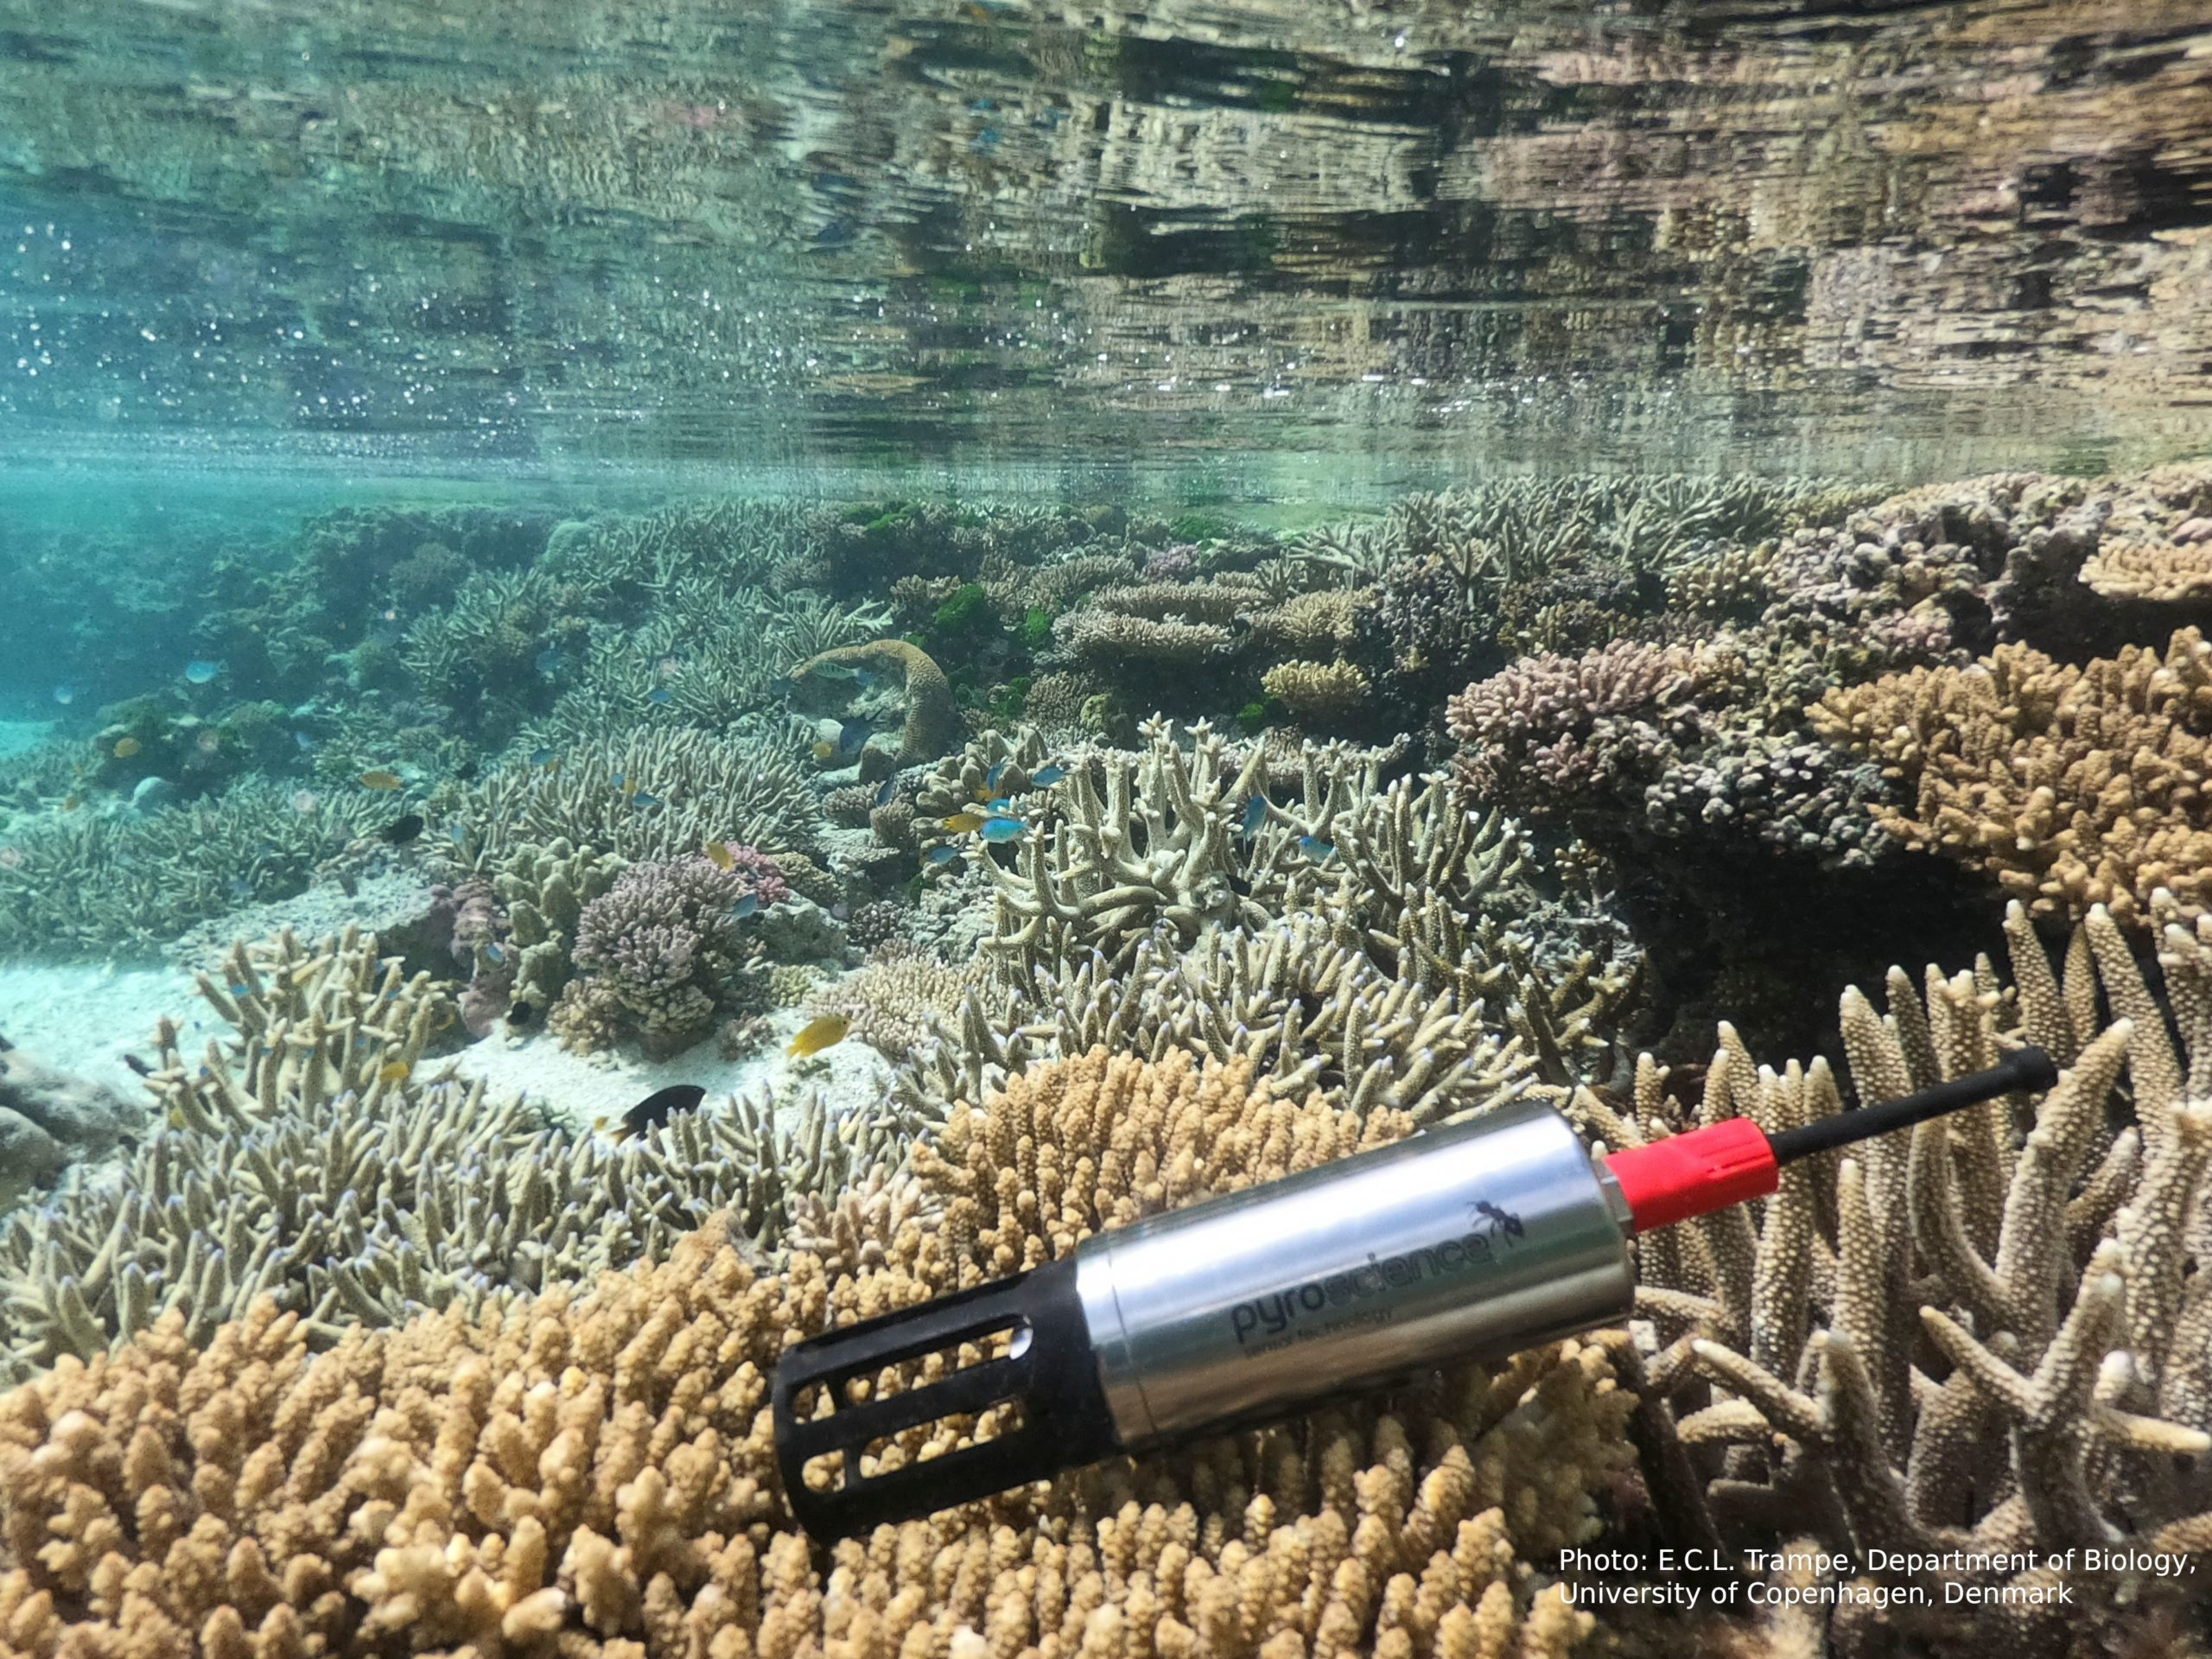
This Work is Motivated by Climate Change
The ocean plays the largest role in the world’s climate, and has been significantly impacted by climate change
Significant need to monitor the ocean, especially in coastal regions
We have been developing underwater backscatter, a new technology for distributed ultra-low-power underwater sensor networks
[SIGCOMM'19, SIGCOMM'20, OCEANS’20, Nature Communications’22, HotNets’22, HotMobile’22, SIGCOMM’23]
Food security + climate-friendly food
Climate monitoring
Sea-level + hurricane response
Notes:
Our generation’s existential threat is climate change.
What plays the largest role in the world’s climate?[click] The ocean. It plays the largestrole in the climate and it is the place most impacted by climate change.
Because of that, we need mechanisms to monitor the ocean, especially in coastal regions[click].
Why? Because most humans live near the shore.
[click]We need sensors that can monitor sea level rise and air-sea interactions.that’s important for disaster response because climate change is causing more severe weather events including hurricanes and flooding
Another area where underwater sensors can help is [click] seafood production. Climate change is impacting our food sources, [stress:] and agriculture is negatively impacting climate change. This is why the United Nations determined that aquaculture or seafood production is the most critical food source over the next 3 decades. And we need sensors to continuously monitor fish farms like the ones you see here near the shore.
[click]More generally, we need underwater sensors to monitor climate and climate change in the ocean such as CO2, pH and so on.
Recognizing these important applications, and realizing that existing undetrwater sensor networks are not ready to deliver on them, in our group [click], we have been developing underwater backscatter - which is a new technology for ulra low-power underwater sensor networks.
Let me tell you how it achieves that by comparing it to traditional underwater communication.

Slide 3
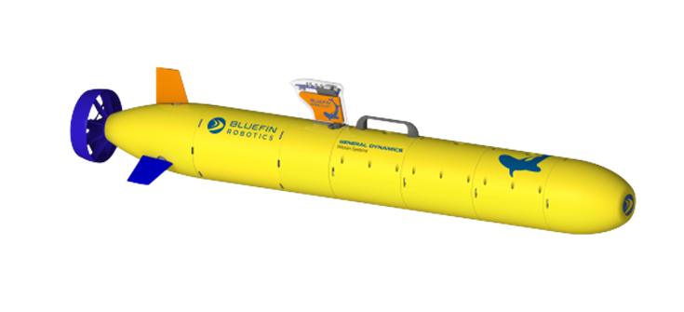
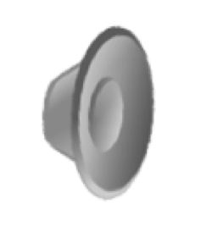
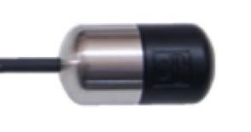

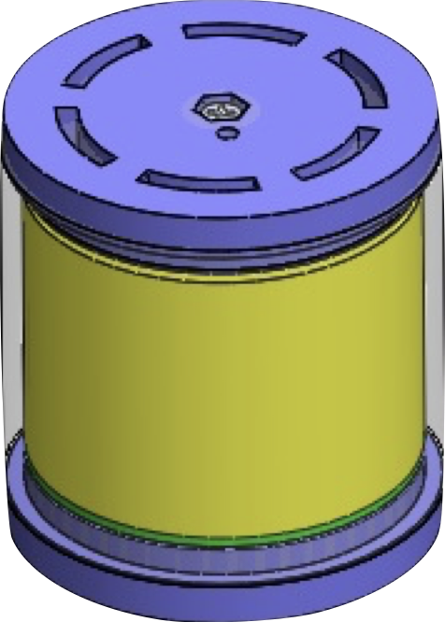

Traditional Acoustic Communication
Backscatter Communication
Acoustic waves
Generates its own acoustic signal
Consumes 10s of watts of power
Reflects an existing acoustic signal
Consumes a $μW$ few of power
Backscatter
Node
Notes:
For underwater communication, you can’t really use BT or WiFi because they don’t work underwater. Instead, we use sound to communicate. In traditional underwater acoustic communication, [click] you have a remote sensor attached to a transmitter, and a hydrophone or receiver is mounted on a passing by drone or ship. [click]
Now the sensor communicates its data to the receiver by generating its own acoustic signal which is a power-hungry process. [click] In contrast, in an underwater backscatter system, [click] the transmitter is mounted to the drone which has plenty of power. The transmitter sends a signal to the sensor which communicates data back to the receiver by reflecting the incoming signal instead of generating its own signal which makes it extremely low power. In summary, [click] traditional acoustic communication is power-hungry because the sensor generates its own signal and [click] backscatter communicates by reflecting existing acoustic signals therefore consuming few microwatts of power. This is exciting as we because now you can use this technology to enable low-power underwater sensor networks for ocean monitoring.[wait 3 sec]However, one question that remains unanswered and that we have been asking ourselves is [click],

Slide 4
How far can we communicate using underwater backscatter?
Notes:
How FAR can we communicate using underwater backscatter? Or put differently, What are the theoretical limits of underwater backscatter? The answer to this question is important because it would tell us whether we can use backscatter to enable applications similar to the ones I mentioned earlier.

Slide 5
End-to-End Link Budget Model
Transmitter
Channel
$$SNR=159.8+10\log\left(P_{e}\right)+G_{Tx}+10\log\left(\frac{λ^{2}}{π}\right)+2G_{node}+IML_{U}−2PL−NL$$
Signal-to-Noise Ratio
Backscatter Node
Notes:
To answer this question and understand the theoretical limits of underwater backscatter, we developed the FIRST analytical model that captures the performance of underwater backscatter as a function of different system parameters.[click] our model captures the end-to-end SNR or [click]signal-to-noise ratio of the backscattered signal as a function of [click]transmitter’s parameters, [click]backscatter node’s characteristics, and [click]propagation channel.

Slide 6
End-to-End Link Budget Model
First closed-form analytical model of underwater backscatter network
Validated through empirical and numerical evaluation with a median error of <0.76dB across frequencies
Shows that the backscatter range can be extended to multiple kilometers even in its current form
$$SNR=159.8+10\log\left(P_{e}\right)+G_{Tx}+10\log\left(\frac{λ^{2}}{π}\right)+2G_{node}+IML_{U}−2PL−NL$$
Notes:
And this equation here represents the [click] first closed-form analytical model of underwater backscatter which means that we can use this model to understand the limits and performance of an underwater backscatter system. [click] We verified this model through experiments and numerical simulation and achieved a median error of less than 0.76 dB across frequencies. [click] We then use this verified model to show that backscatter can achieve several kilometers of communication range even in its current form, which means that it can already deliver on important coastal monitoring applications.

Slide 7
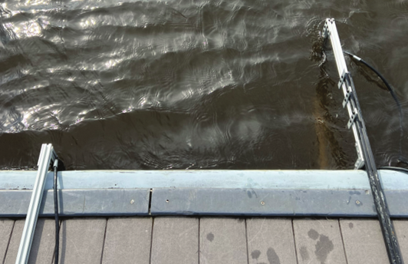
Theory vs Practice
$$SNR=159.8+10\log\left(P_{e}\right)+G_{Tx}+10\log\left(\frac{λ^{2}}{π}\right)+2G_{node}+IML_{U}−2PL−NL$$
Tx
Rx (hydrophone)
Node
1 m
Experimental Setup in the Charles River
Notes:
Now before I tell you how we derived this analytical model, I would like to show you the ability of this model to accurately capture the performance of a real-world underwater backscatter system. We set up an experiment in the Charles river in Boston and performed end-to-end underwater backscatter communication

Slide 8
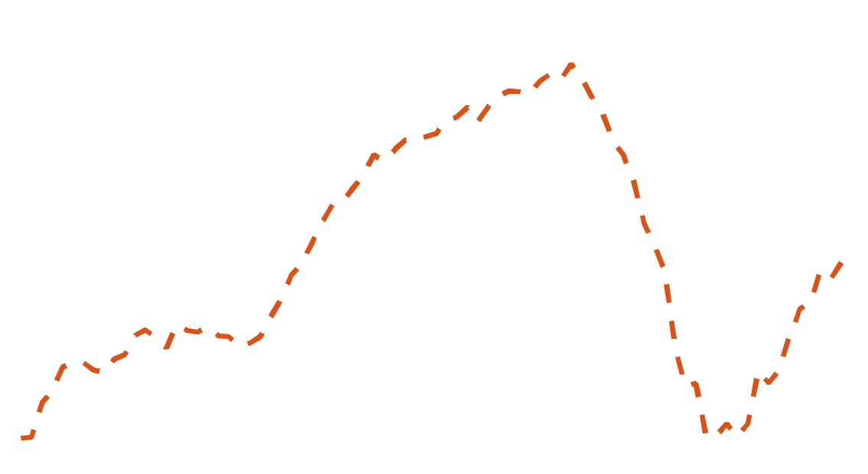
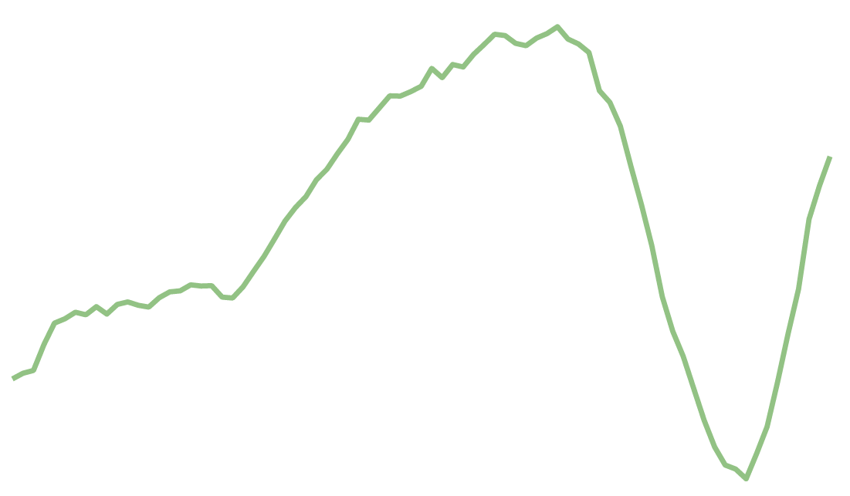


Theory vs Practice
Analytical (Theory)
$$SNR=159.8+10\log\left(P_{e}\right)+G_{Tx}+10\log\left(\frac{λ^{2}}{π}\right)+2G_{node}+IML_{U}−2PL−NL$$
Experimental Validation
Tx
Median deviation < 0.76 dB
Rx (hydrophone)
Node
1 m
Notes:
[click] We then plot the SNR of the received signal -shown on the y-axis - as a function of operation frequency - shown on the x-axis. [click] The orange curve shows the experimental value of SNR for this setup and [click] the green curve shows the SNR values predicted by the model for this experiment. Notice how the analytical model closely follows the experimental values and in fact, [click] median deviation across frequencies for these curves is less than 0.76 dB. [click]

Slide 9

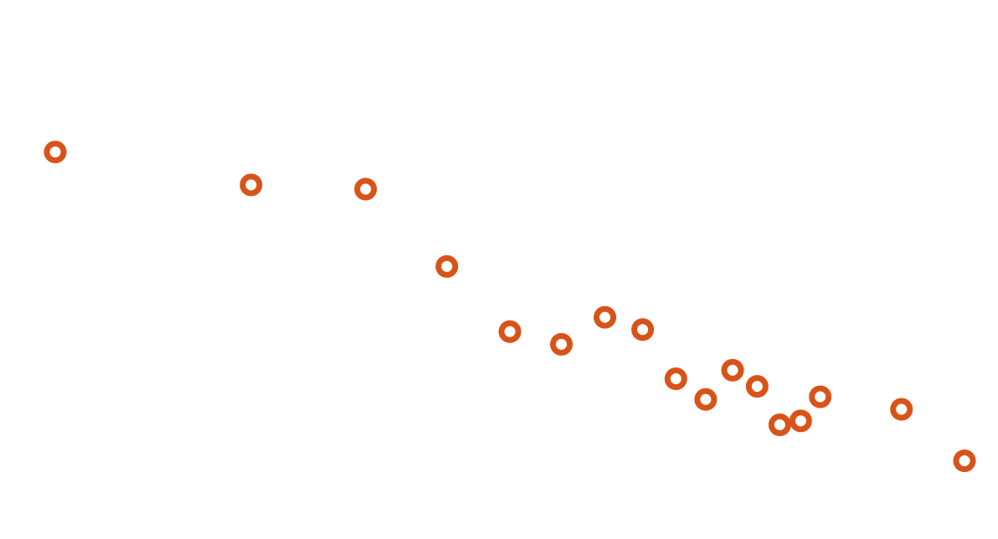
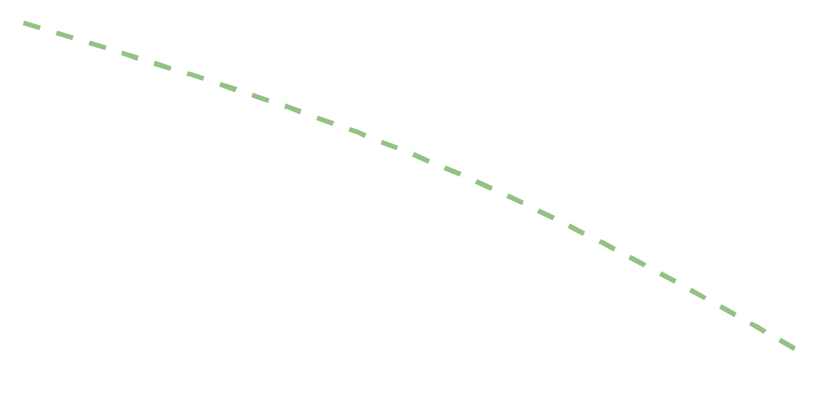
Theory vs Practice
Analytical (Theory)
$$SNR=159.8+10\log\left(P_{e}\right)+G_{Tx}+10\log\left(\frac{λ^{2}}{π}\right)+2G_{node}+IML_{U}−2PL−NL$$
Experimental Validation
Tx
Rx (hydrophone)
Node
1 m
Notes:
We also verified the model across distances. The graph on your screen plots the backscattered signal SNR on the y-axis and distance on the x-axis. [click] The orange dots on the plot show the experimental SNR and [click] green line shows the analytical SNR. As you can see, the model agrees really well with the experimental data.
These results are extremely powerful as they show that the model captures all the complexities of the underwater backscatter and we can reliably use this model to design practical backscatter systems. Now, of course, arriving at this model involves extensive derivation which I don’t have time to delve into but what I want us to do in the rest of this talk is to [click]

Slide 10
Let us focus on the key novel component of our
end-to-end link budget
Notes:
Focus on the key novel component of our analytical model and understand how we derived this component.

Slide 11



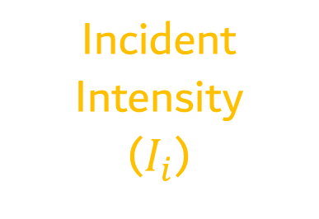
Traditional Acoustic Communication
Backscatter Communication
Rx
Rx
Tx
$$\frac{P_{refl}}{I_{i}}$$
${Δσ}_{s}$ =
Differential Scattering Cross Section
Incident
Intensity
($I_{i}$)
Channel
Reflected
Power
($P_{refl}$)
Channel
Tx
Notes:
let’s revisit the slide where we compared backscatter with the traditional acoustic systems. Now if you notice,[click] the transmitter in backscatter and in traditional systems is the same and has the same operation. Similarly, [click] the receiver is the same in both cases too and [click] the propagation medium or channel also has similar properties. The core difference between the two methods is the interaction of the [click]backscatter node with the acoustic waves and how it [click] communicates by reflecting a part of the incoming acoustic wave. And if we can quantify the relationship between the incident wave and reflected wave or formally speaking, [click] if we can mathematically express the ratio of reflected power to incident intensity, we can analytically describe the E2E performance of the backscatter system. [click] And we will refer to this ratio as the differential scattering cross-section of the backscatter node. Why do we call it differential? Because it is between the two reflective or scattering states of underwater backscatter. However, deriving the D-SCS is not straightforward because underwater backscatter involves the interaction of multiple physical components. Let me show you what are these components[click]

Slide 12


Differential Scattering Cross Section (${Δσ}_{s}$)
$$\frac{P_{refl}}{I_{i}}$$
${Δσ}_{s}$ =

Slide 13
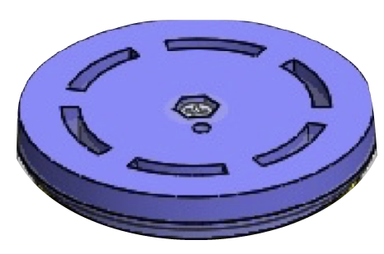
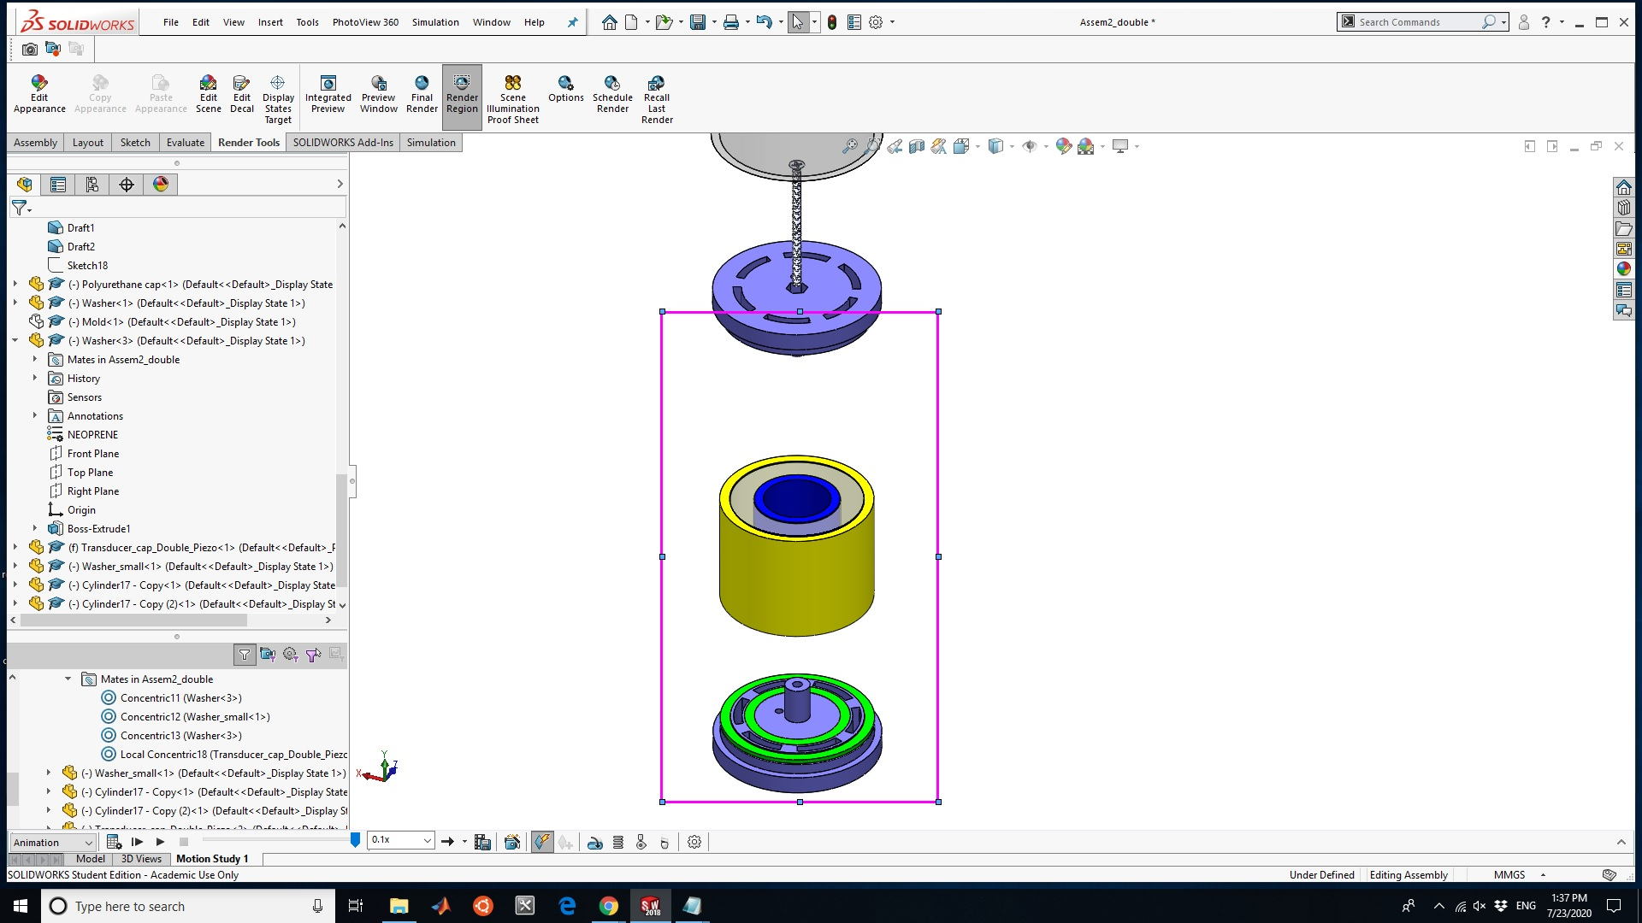
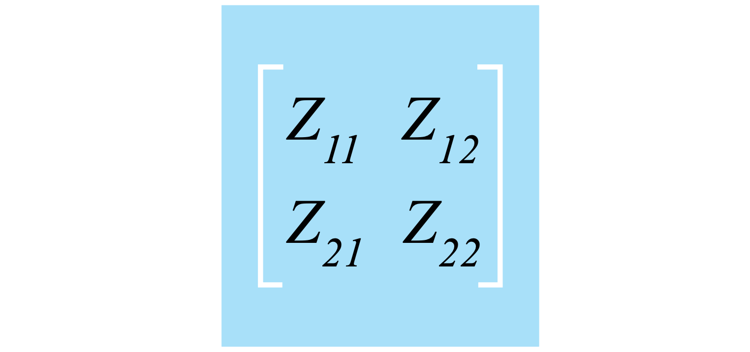

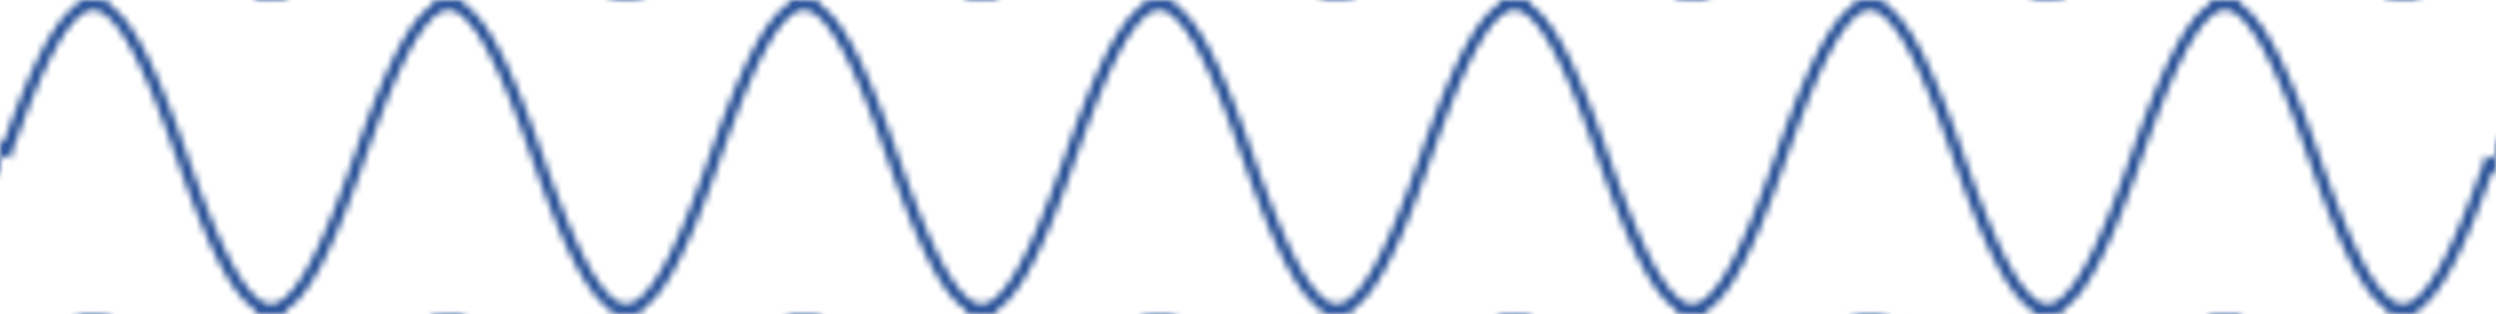














Differential Scattering Cross Section (${Δσ}_{s}$)
$$\frac{P_{refl}}{I_{i}}$$
${Δσ}_{s}$ =
$$I_{i}$$
$$P_{refl}$$
Electrical
$$R_{r}$$
$$Z_{e}$$
$$Z_{e}$$
$$F_{b}$$
$$Z_{o}$$
$$Z_{in}$$
$$V$$
Acoustic
Directivity
$\left|ΔΓ\right|=2\frac{R_{r}{\left|Z_{12}\right|}^{2}}{{R_{in}\left|Z_{22}+R_{r}\right|}^{2}} \frac{R_{in}\left|Z_{e2}−Z_{e1}\right|}{|Z_{in}+Z_{e1}||Z_{in}+Z_{e2}|}$
Differential
Reflection Coefficient
Piezoelectric
Wavelength
$${Δσ}_{s}=\frac{λ^{2}D_{f}{\left|ΔΓ\right|}^{2}}{4π}$$
$$η_{node}$$
Electrical impedance
mismatch
Notes:
First, there is an acoustic component that exists [click] because of an incoming acoustic wave that hits the backscatter node. [click] This incident wave causes the piezoelectric ceramic inside the node to vibrate which introduces a mechanical component in the system. Finally [click] the transducer is connected to an electrical circuit that enables sensing and communication. To derive an expression for DSCS, we not only need to capture all these components but we also need to consider the electromechanical coupling that translates the effect of one component to the other.
To account for all these components , our approach is to represent the backscatter transducer [click] by a simplified equivalent circuit. In this circuit,[click] the left side represents the acoustic component, the right port represents the [click] electrical component, and the two port impedance network in the middle captures the piezoelectric component which accounts for the mechanical vibration and electromechanical coupling.
We use this circuit to derive expressions for the incident intensity and reflected power as a function of circuit parameters and by leveraging underlying physics and mathematical manipulations, we arrive at the following expression of the DSCS. Where [click] lambda is the wavelength, [click]Df is the directivity of the transducer, and [click]delta Gamma is the differential reflection coefficient.
Those of you who are familiar with RFID’s radar cross-section would notice that this expression is remarkably similar to the RFID’s RCS. However, the major difference here is that the differential reflection coefficient [click] represents the electroacoustic reflection coefficient and can be expressed as a function of the circuit component. Where [click] the first term is nothing but the efficiency of the node and the second term [click] represents the impedance mismatch resulting b/w the electrical circuit and transducer’s impedance.
That said, what’s really nice, is that with this new model, because it is elegant and close to the RFID model, we can take the RFID literature from the past 2 decades and apply it to the problem of underwater backscatter.
Now that we have an expression for the D-SCS, let’s see how we can use it to derive a final expression for the E2E SNR.

Slide 14




End-to-End SNR
Tx
$$159.8+10\log\left(P_{e}\right)+G_{Tx}$$
Channel
$$2PL+NL$$
$$=\frac{λ^{2}D_{f}{\left|ΔΓ\right|}^{2}}{4π}$$
$$Δ σ_{s}$$
Notes:
let’s revisit the backscatter operation diagram I showed earlier. To complete the E2E SNR expression, we used a representation of the TX signal [click] from the underwater acoustics literature. We integerated it with a channel model from the underwater acoustic communication literature, and finally, integrated our expression for the scattering crossection of the backscatter node. Putting these expressions together,

Slide 15







End-to-End SNR
$$SNR=$$
$$159.8+10\log\left(P_{e}\right)+G_{Tx}$$
$$+ 10 log($$
$$Δ σ_{s}$$
$$)− ($$
$$2PL+NL$$
$$)$$
Backscatter Node Gain
Tx Gain
Pathloss
$$SNR=159.8+10\log\left(P_{e}\right)+G_{Tx}+10\log\left(\frac{λ^{2}}{π}\right)+2G_{node}+IML_{U}−2PL−NL$$
Input Electrical Power
Impedance Mismatch
Noise
Notes:
We arrive at our final analytical model of underwater backscatter where E2E SNR. Now if we expand this further with some mathematical manipulation, our E2E SNR becomes a function of the input electrical power, Tx gain, backscatter gain, impedance mismatch, path loss, and noise in the environment. Now that we have an analytical model to capture the performance of underwater backscatter, we come back to the question that we asked at the beginning of the presentation

Slide 16
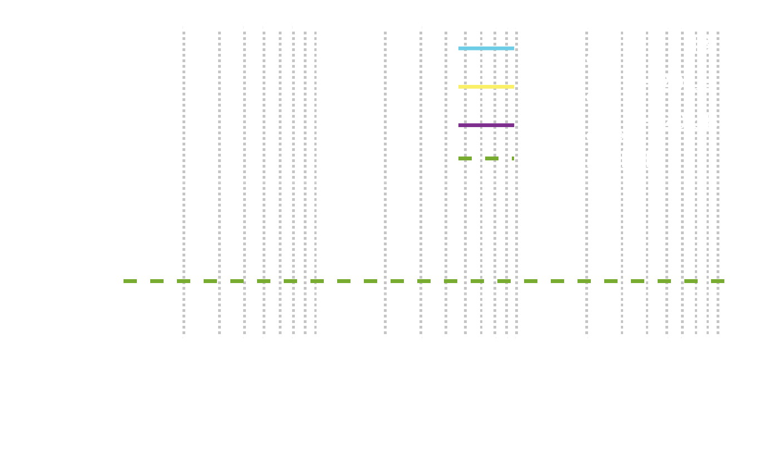
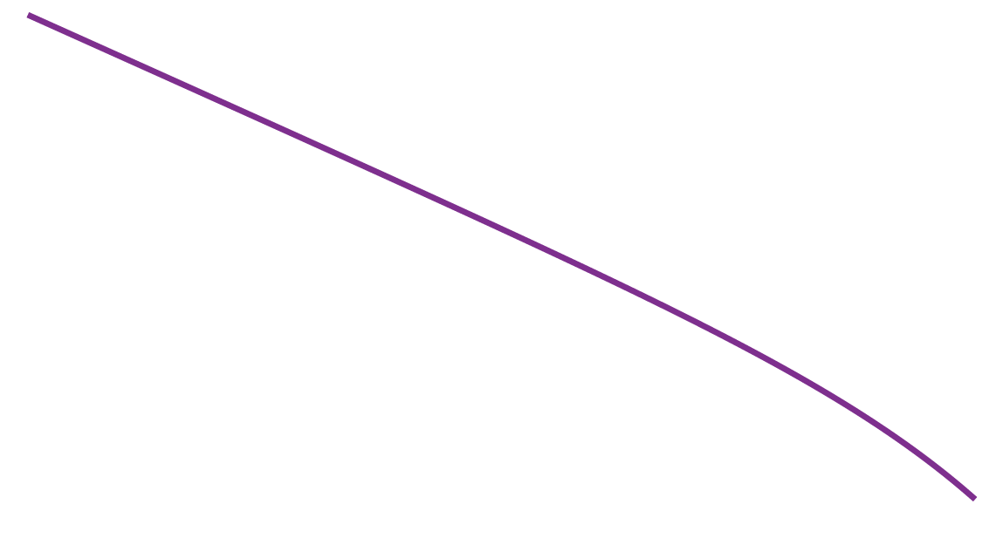


How far can we Communicate using Underwater Backscatter?
= 0 dB
Notes:
How far can we communicate using underwater backscatter? To answer this question, we use our model to [click] generate output SNR in dB as a function of distance. The graph here plots SNR on the y-axis and distance on the x-axis. The green dotted line represents the 6 dB decoding threshold. If we use spherical transducers - which have 0 dB of directivity - for transmitter and backscatter node, we can achieve a range of ~70meters If we increase the directivity value of the transducers to 20 dB by using commerical directive transducers, we can push the range beyond a kilometer. And if we use a directive commerical hydrophone with 20 dB directivity, the range extends to several kilometers, making backscatter a suitable candidate for enabling many real-world applications. In our most recent results in a SIGCOMM paper that came out last month, we’ve already demonstrated 300m of range, which is not very far from these distances, and the main difference is to use higher directivity transducers.

Slide 17
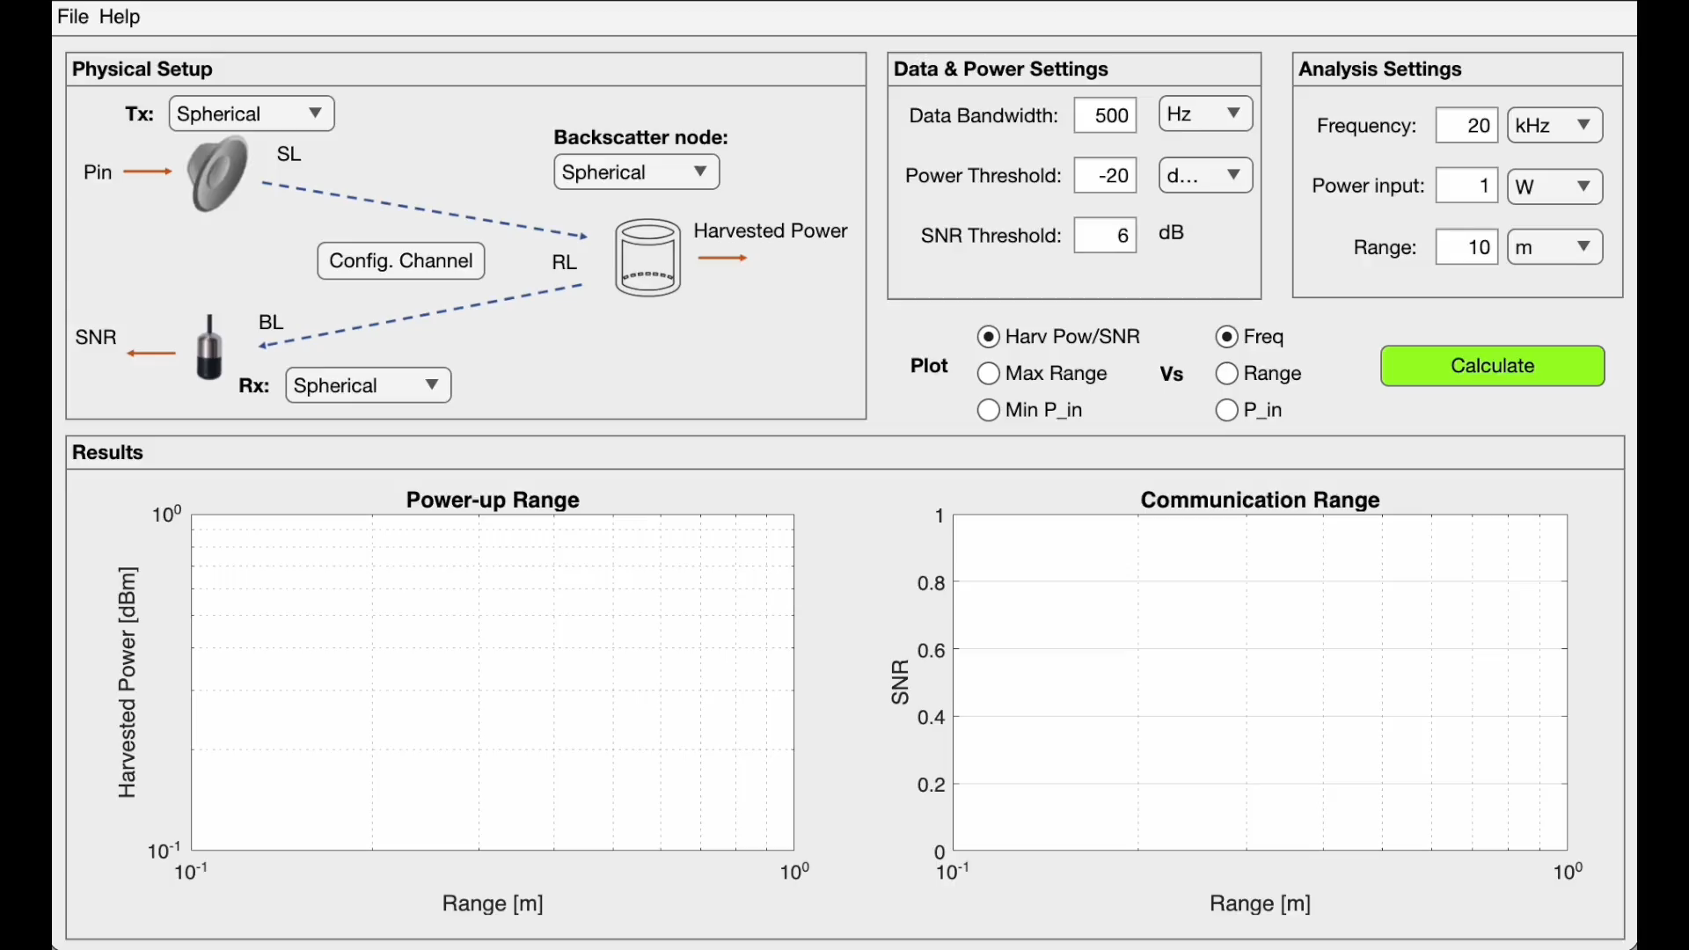
Link-Budget Tool
Notes:
To make our model accessible to the community, we have also developed an interactive open-source tool to help researchers and engineers in designing backscatter systems. The tool [click] allows the user to configure the transmitter, backscatter node, underwater channel, operation parameters, and analysis. Once you hit calculate, the tool spits out the downlink and uplink performance. The tool would allow a wider research community to understand and develop backscatter further

Slide 18
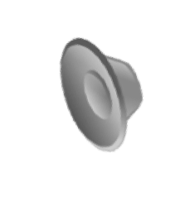

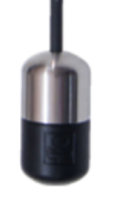
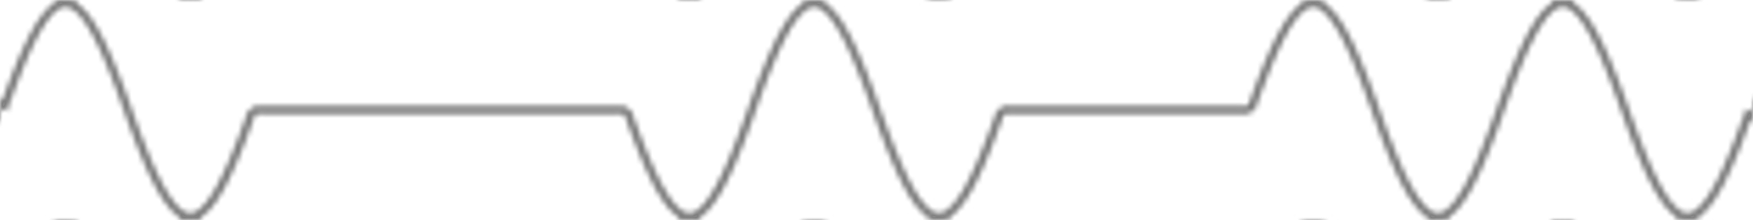


End-to-End Link Budget Model
First closed-form analytical model of underwater backscatter
Validated through empirical and numerical evaluation with a median error of <0.76dB across frequencies
Shows that the backscatter range can be extended to several kilometers
An interactive open-source tool to study backscatter systems: https://github.com/signalkinetics/linkbudget
Datasets (1,500+ experimental trials) & Open-Source Code [SIGCOMM’23]: https://github.com/signalkinetics/vab
01010101
$$Z_{e}$$
Notes:
In summary, [click] this work presents the first closed-form analytical model of underwater backscatter. [click] The model is verified through experimentation and numerical simulations with a median error of less than 0.76 dB across frequencies. [click] The model shows that the backscatter range can be extended to several kilometers and finally [click] we have also developed an open-source tool to study backscatter systems.e have also published some of our experimental datasets and code from our recent work on long range underwater backscatter communication with over 1,500 experimental trials at ranges up to 300 meters.
We hope that by theoretically analyzing and open-sourcing our experiments and code, more researchers will join us on our journey of building ultra-low-power underwater sensor networks and using them for key climate applications. Thank you, and I’m happy to take any questions.

