Slide 1




GPSMirror: Expanding Accurate GPS Positioning to Shadowed and Indoor Regions with Backscatter
Huixin Dong¹, Yirong Xie¹, Xianan Zhang¹, Wei Wang^{1*},
Xinyu Zhang² and Jianhua He³
¹School of Electronic Information
and Communication
²Electrical and Computer
Engineering
³School of Computer Science
and electrical Engineering

Slide 2
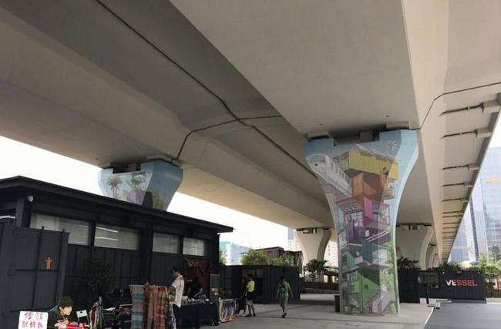


GPS services fail in shadowed region
Conventional GPS provides localization with high error (hundreds of meters^{[1]}) or even cannot localization^{[2]} in these shadowed regions.
Urban Canyon
Flyover Shadow
Gas/Dust Factory
[1] K.Chen and G.Tan. 2018. BikeGPS: Accurate Localization of Shared Bikes in Street Canyons via Low-Level GPS Cooperation. MobiSys ’18.
[2] S.Nirjon, J.Liu, G.DeJean, B.Priyantha, Y.Jin and T.Hart. 2014. COIN-GPS: indoor localization from direct GPS receiving. MobiSys’14.

Slide 3




GPS relays are hard to deploy
Receive antenna fixed in open area.
Block
The shadowed region.
Transmit Antenna
Long cable
Plug-in
power supply
Not Available
High Deployment Cost
Hard to Deploy
Cannot Deploy

Slide 4
Our Idea: Ultra-low-power backscattering
Backscatter Tag
Backscatter Tag
Backscatter Tag
Design a uW-level backscatter tag that provides comparable coverage to commercial relays.

Slide 5
New positioning opportunities of backscattering GPS
Real
distance
Uncertain delay
Common delay error
Delay match to the real distance
The relayed GPS signals cannot collaborate with non-relayed GPS signals since they contain different propagation delay.
The scattered and non-scattered GPS signals can collaborate to provide better positioning service.

Slide 6
Requirements on scattering the GPS signals
Power
uW-level power consumption for easy deployment.
Gain
Comparable coverage to commercial GPS relays.
Bandwidth
Flat gain over GPS L1 band.
Sensitivity
Sensitive to scatter weak GPS signals (-125dBm).

Slide 7
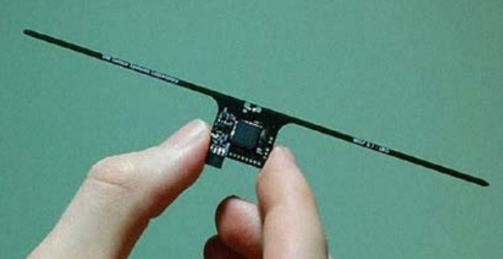

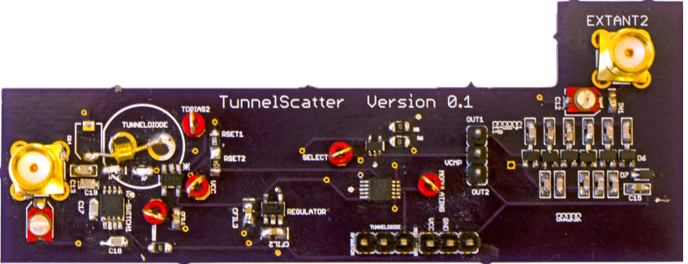
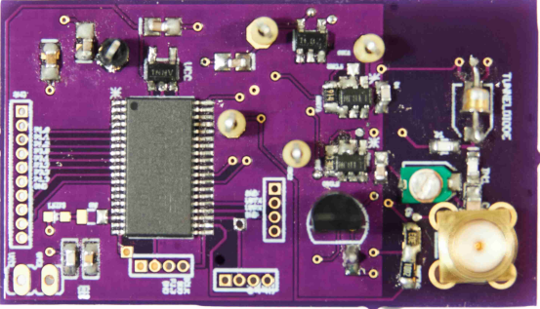
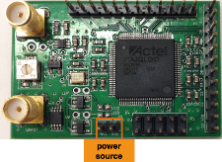
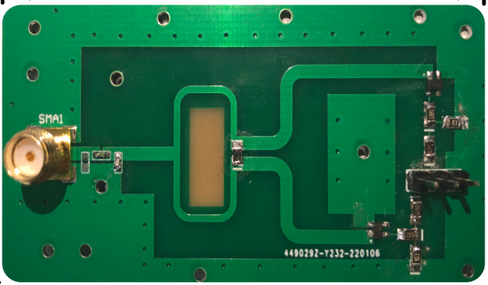


Existing backscatter devices
RF switch-based backscatters
Existing tunnel diode-based backscatters
WISP Platform
TIE’08
Ambient Backscatter
SIGCOMM’13
Can we design a backscatter system to meet all the requirements?
Tunnel Scatter MobiCom’19
Tunnel Emitter MobiCom’20
FS Backscatter
SIGCOMM 2016
RF-Transformer
MobiCom’22
Power
Gain
Power
Gain
Bandwidth
Sensitivity

Slide 8
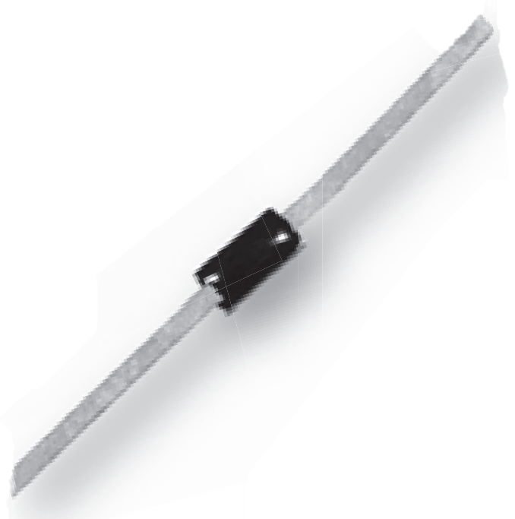












Challenge: Bandwidth
Design 1: Matching Parasitic Parameters.
Design 2: High-precision impedance control.
Tunable structure for precisely resonance control
Tunnel Diode
Equivalent Circuit
Circuit Board.
$$L_{p}$$
$$L_{2}$$
$$L_{p}$$
Parasitic Parameters
Unit: mm
$$±1\%$$
$$C_{p}$$
$$C_{2}$$
Tune
r
Aluminum
GND
$$C_{p}$$
r
Equal to a small adjustable capacitor
$$C_{j}$$
$$R_{2}$$
$$±10\%$$
Strip Line
$$C_{j}$$
Copper (0.035)
$$R_{NR}$$
Negative Resistance
Rogers RO4035B (0.508)
Resonator 1
Copper (0.035)
GND
Resonator 2
Aluminum

Slide 9
Challenge: Sensitivity
Tunnel diode amplifier
Reported threshold for injection-locked amplify of the SOTA tunnel diode-based backscatter:
Signal Reception
Signal In
DC Bias
-90 dBm ~ -100 dBm
Return Loss
Signal Out
Tunnel Emitter MobiCom’20
$$C_{pad}$$
Tunnel Diode
Current noise
Screw
GPS signals at the ground
~ -125 dBm
Our insight:
Minimizing the circuit loss, noise and maximize the signal reception.

Slide 10
Challenge: Sensitivity
Design 1:
Reduce the return loss caused by components solder.
Phase Control
Impedance change
No reflection
Capacitor
Solder
Amplitude
Control
Signal In
Signal out
Signal In
Signal Out
Return Loss
Lower the return loss by about 15 dB

Slide 11
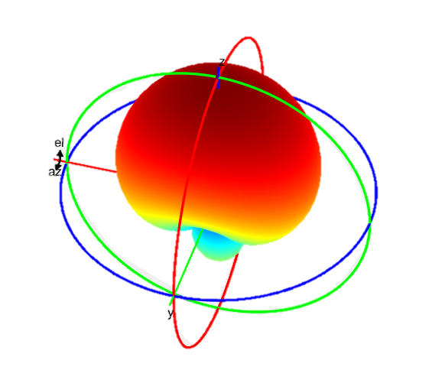
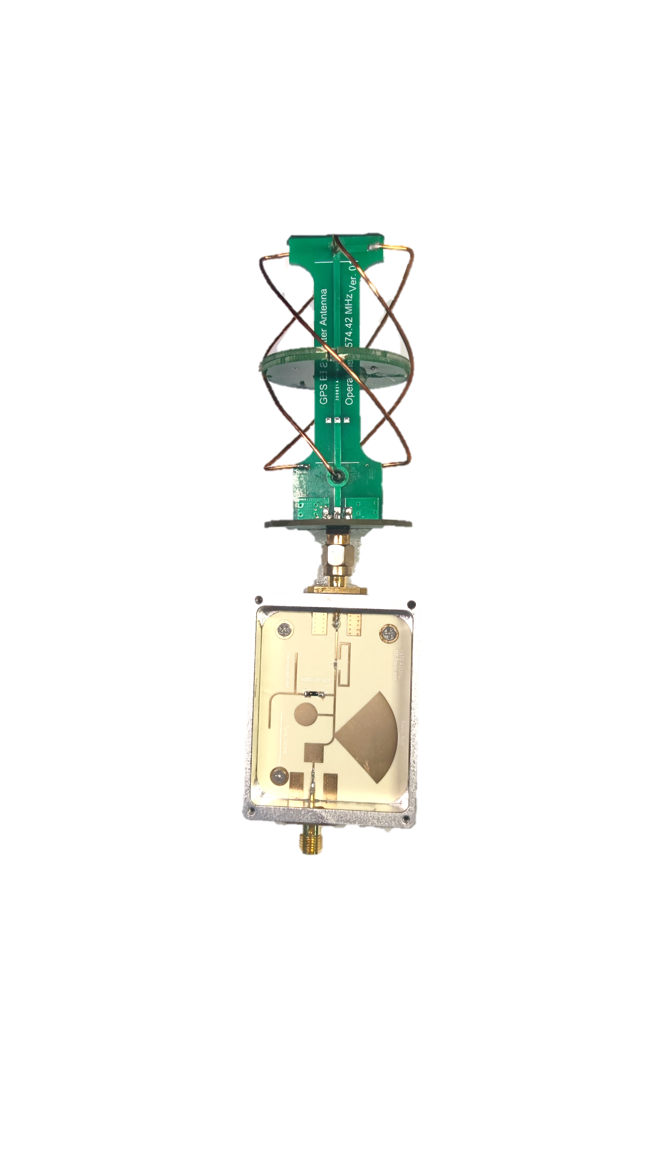
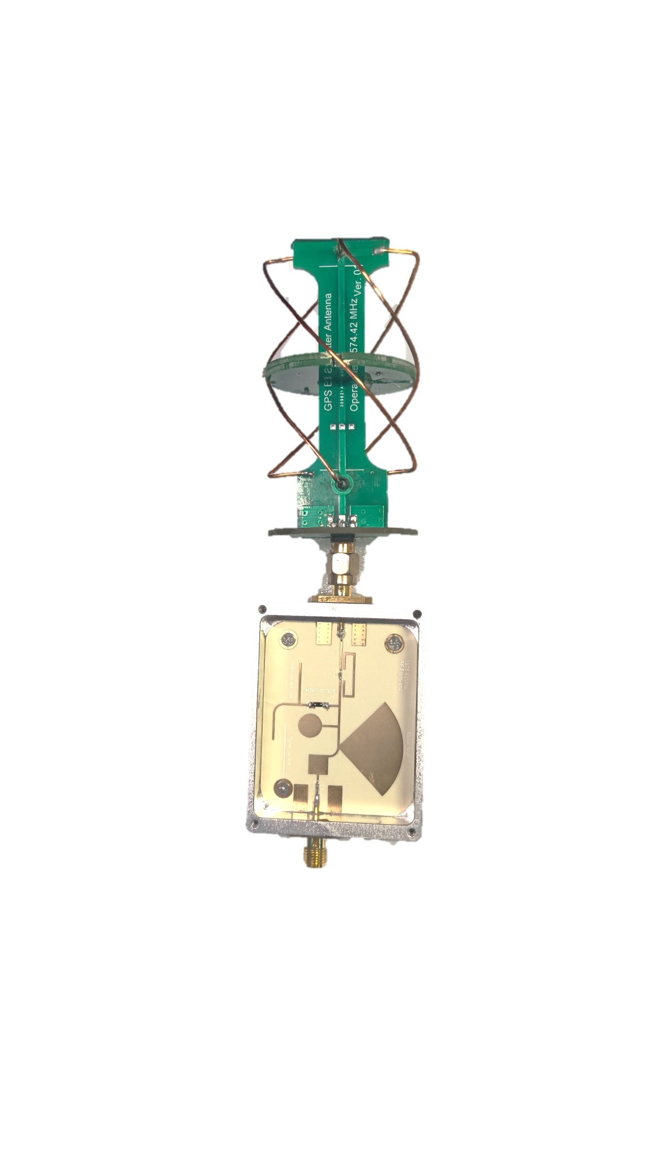
Challenge: Sensitivity
Design 2: Search the minimum noise operation point
Design 3: Customized radiation pattern for better reception
IV-Curve of selected diodes
Customize radiation pattern for better reception
Current (mA)
Minimum noise point
Helix
Antenna
Voltage (mV)

Slide 12
Localization under inadequate satellites
A piece of “Carrier to Noise Density Ratio (C/N₀ ) ” raw measurements of scattered and non-scattered GPS signals
X_{PRN-5}: PrM₁，AdrM₁
X_{PRN-5}’: PrM₁’，AdrM₁ ’
From
Virtual Satellites
X_{PRN-20}: PrM₂，AdrM₂
X_{PRN-20}’: PrM₂’，AdrM₂ ’
C/N₀ measurements of
non-scattered GPS signals
C/N₀ measurements of
scattered GPS signals
Separate distance raw measurements (PrM，AdrM) with the same index.
Duplex the measurements for GPS localization under inadequate satellites.

Slide 13

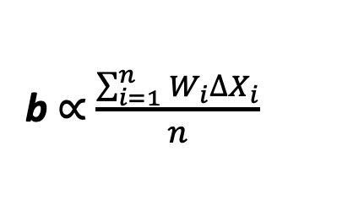
Differential positioning for accuracy improvement
Eliminate Common Error by differential
Modelling the vector b from a GPSMirror tag to smartphone
ΔX₁=X₁’-X₁
ΔX₂=X₂’-X₂
b $∝$ $\frac{\sum_{i=1}^{n}{{W_{i}∆X}_{i}}}{n}$
···
Common delay error
ΔX_{n}=X_{n}’-X_{n}
Differential positioning
$$\left[\begin{matrix}δb \\ c∆T\end{matrix}\right]=\left({\left(G^{T}WG\right)}^{−1}G^{T}\right)WS_{Φ}$$
Capable to eliminate the common delay error in distance measurements of GPS signals.

Slide 14
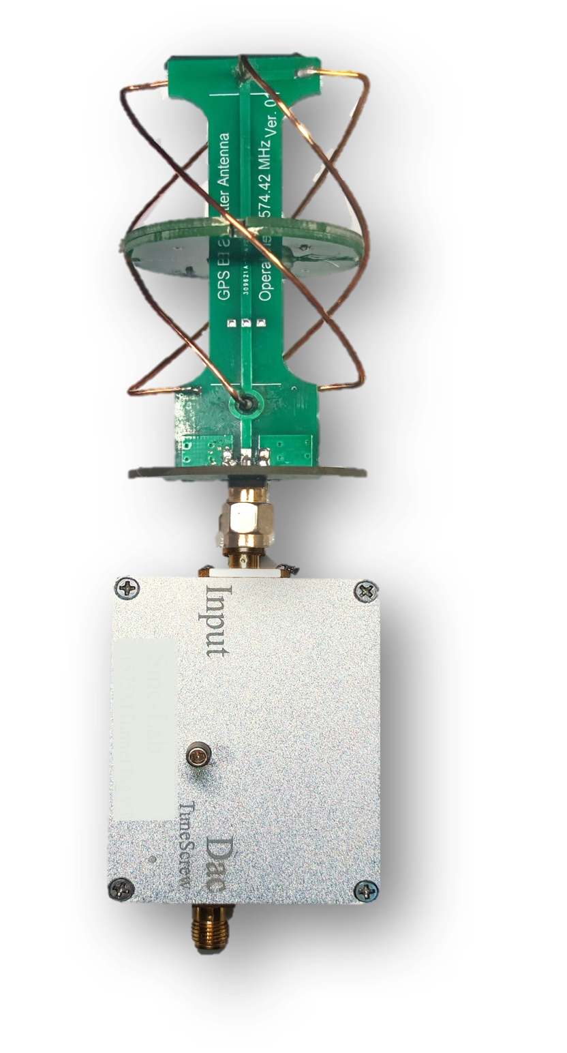
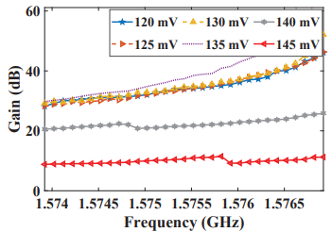
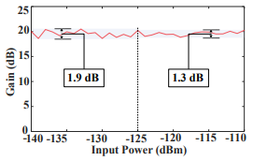
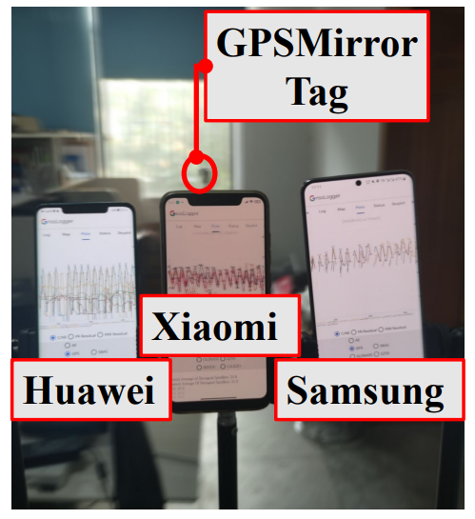
Implementation and hardware performance
～126uW power consumption
0-30dB adjustable gain.
GPSMirror Tag
-125dBm Sensitivity with variance less than 1.3dB.
Compatible with smartphones.

Slide 15
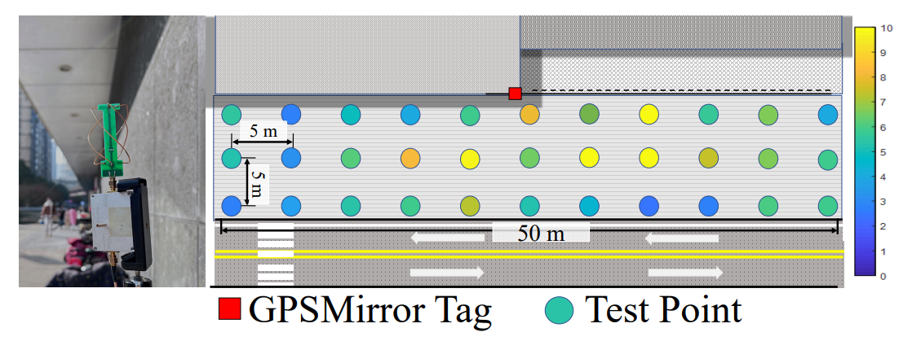
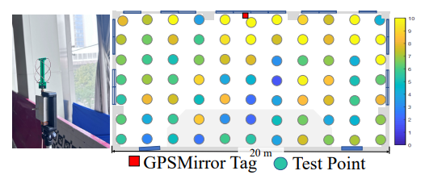
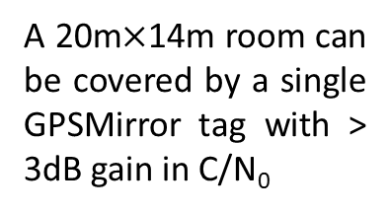
Coverage performance
Urban Canyon
27.7 m away from the tag with about 4 dB gain in C/N₀
Flat Room
A 20m$×$14m room can be covered by a single GPSMirror tag with > 3dB gain in C/N₀

Slide 16
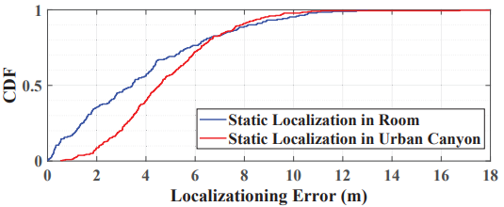
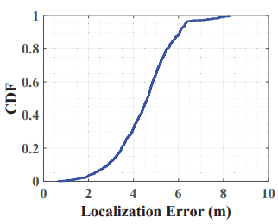
Localization accuracy
3.7 m
4.6 m
4.5 m
Static Localization Error
Dynamic Localization Error Indoor

Slide 17
Summary
The first backscatter system that scatters signals from orbiting satellites. The hardware design pushes the limit of backscatter that it can re-radiate weak GPS signals as low as -125 dBm with over 20 dB flat gain.
We propose novel GPS positioning algorithms based on GPSMirror tags to extend GPS positioning services in shadowed or indoor regions. It works seamlessly with off-the-shelf smartphones without any hardware or firmware modification.
We implement and evaluate the GPSMirror in real world environments using off-the-shelf smartphones from different manufacturers. Our experiments verify the feasibility and compatibility of GPSMirror .

Slide 18
Thanks!
Q&A

