Slide 1
APG: Audioplethysmography for Cardiac Monitoring in Hearables
Xiaoran "Van" Fan*, David Pearl*, Rich Howard^{ᗜ}, Longfei Shangguan^{ᗄ}, and Trausti Thormundsson*
*Google, ^{ᗜ} Rutgers University, ^{ᗄ} University of Pittsburgh

Slide 2
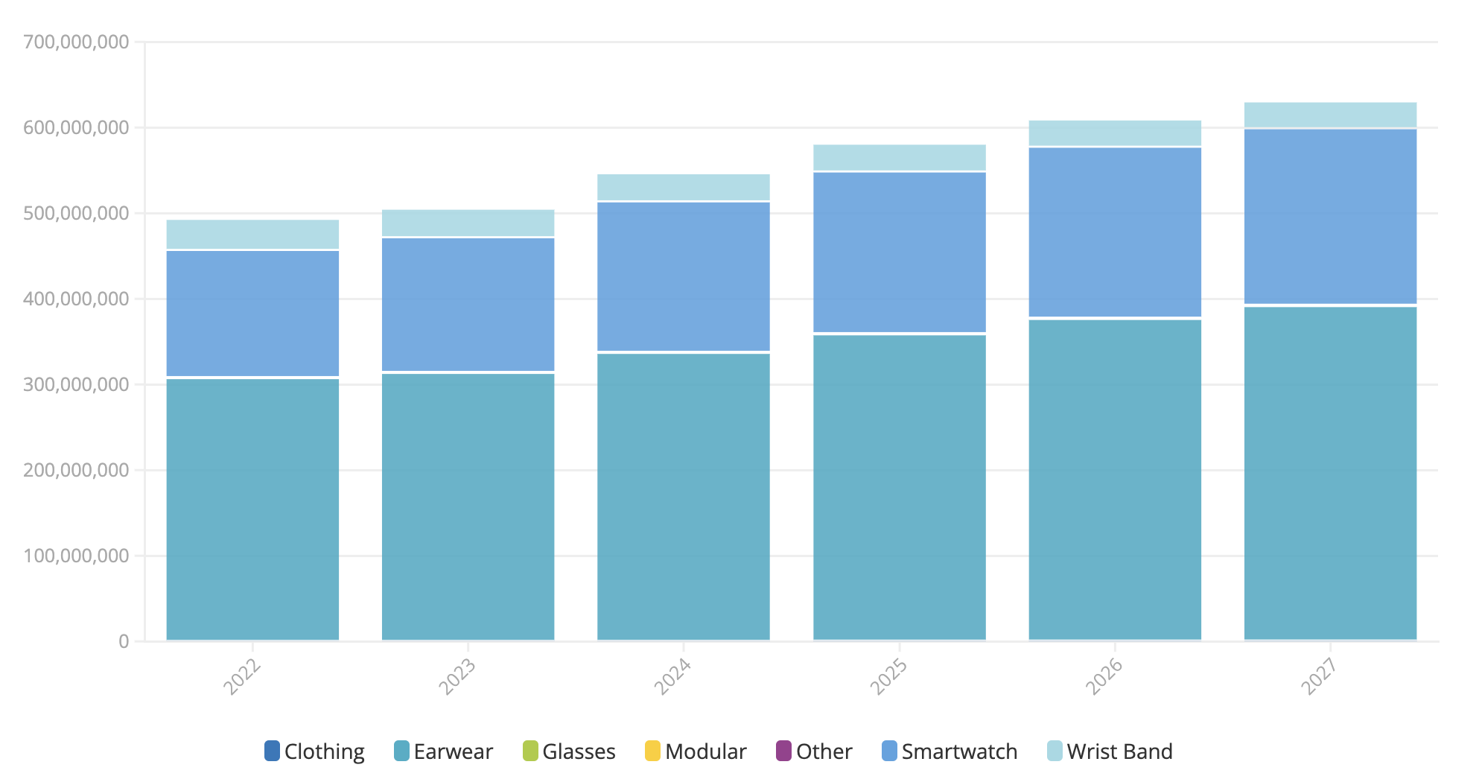
The Surge of Hearable Devices
Hearables are estimated to double the shipment volume than the sum of all other wearables in 2027
# of Hearable devices: over 300 millions
Notes:
Hearables are those embedded devices that can be placed in, on, or around our ears, such as earphones and earbuds. The past few years have witnessed a rapid growth of hearable devices.
[click]: This figure shows the hearable and wearable device shipment over time. We can see that the number of hearable shipment volume has already surpasses 30 millions last year;

Slide 3
The Surge of Hearable Devices
Hearables are estimated to double the shipment volume than the sum of all other wearables in 2027
# of all the other wearables: less than 200 millions
# of Hearable devices: over 300 millions
Notes:
In contrast, the sum of all other wearables such as glasses, smartwatch, and wristband is only around 20 millions. From this figure we also see gap between hearables and all other wearable devices continuously growing in the next few years.

Slide 4
The Surge of Hearable Devices
Hearables are estimated to double the shipment volume than the sum of all other wearables in 2027
# of all the other wearables: less than 200 millions
20 millions
# of Hearable devices: over 300 millions
40 millions
Notes:
And it is estimated that the hearables will double the shipment volume than the sum of all other wearables in 2027, and this gap continue to grow.

Slide 5
Hearable Health Is Still An Uncharted Territory
Manufactures like Apple, Samsung, and Google have nearly zero health features in their earbuds
Focus more on user experience, such as interactions, comfortableness, battery-life, etc.
Is it possible to bring health features such as heart rate monitoring to hearable devices?
We focus on Active Noise Cancellation (ANC) Earbuds
Notes:
While hearable market is huge, the health features such as heart rate and breath monitoring is still a relatively uncharted territory on hearable devices - manufacturers like Apple, Samsung, or Google have nearly zero health features in their earbuds.
[click]: so in this research project, we ask a simple question: is it possible to bring health features such as heart rate monitoring to hearable devices? In particular, we focused on active noise cancellation earbuds because ANC earbuds are becoming more and more popular among mobile users.

Slide 6
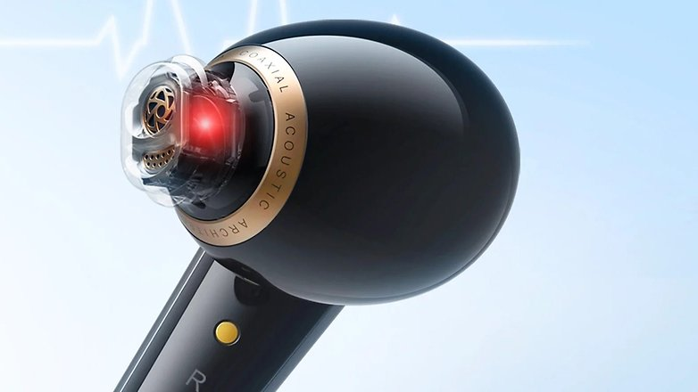
An Overview of Existing Hearable Health Solutions
Active sensing using PPG sensors
PPG sensor
Blood vessel
Soundcore Liberty 4 Earbuds are equipped with PPG sensors for heart rate tracking
Notes:
Before answering this question, let’s first take a look at existing hearable health solutions. Existing solutions can be broadly divided into two groups. The first group of works leverage PPG sensors to monitor heart rate, just like how wearables did. Basically, PPG shed a light to the blood vessel and detect the heartbeat by monitoring how the reflected signals change over time.

Slide 7
An Overview of Existing Hearable Health Solutions
Active sensing using PPG sensors
Drawback: high power consumption, sensitive to skin tones, complicate the hearable acoustic design
Drawback: high power consumption, sensitive to skin tones, complicate the hearable acoustic design
PPG sensor
Blood vessel
Soundcore Liberty 4 Earbuds are equipped with PPG sensors for heart rate tracking
Notes:
However, PPG solutions are facing a few fundamental limitations.
Firstly, PPG sensors consume too much power; if you have a smart watch, you may know the low-power mode on your smart watch will shut down the vital sign monitoring first.
Secondly, the onboard PPG sensor’s accuracy is susceptible to body motions. Users are usually required to remain still while the sensor takes a measurement. If the body moves, even slightly, the outcomes are known to become inaccurate. This can be problematic during sports and exercise,
Thirdly, PPG sensors are shown to be less accurate in people with dark skin [20]. This emerges from higher melanin content in dark-skinned individuals which absorb the laser light, lowering the measurement SNR.

Slide 8
An Overview of Existing Hearable Health Solutions
Passive sensing using in-ear microphone
Rationale: heartbeat vibrations propagate along the human body, arriving at the ear canal, which can be captured by an in-ear microphone
Representative works: [OESense, MobiSys’21], [hEARt, Percom’23], [EarAce, Ubicomp’23]
Notes:
The second group of works are using in-ear microphones to detect heartbeat signals. The rationale of this approach lies in the fact that heartbeat vibrations propagate along the human body, arriving at the ear canal, which can be captured by an in-ear microphone.
Our colleagues in academia have made significant contributions to this design space. Representative works include OESense, HEART, and EarACE.

Slide 9
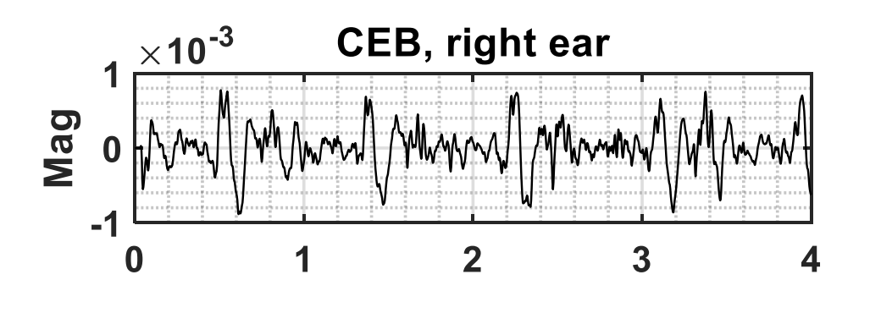
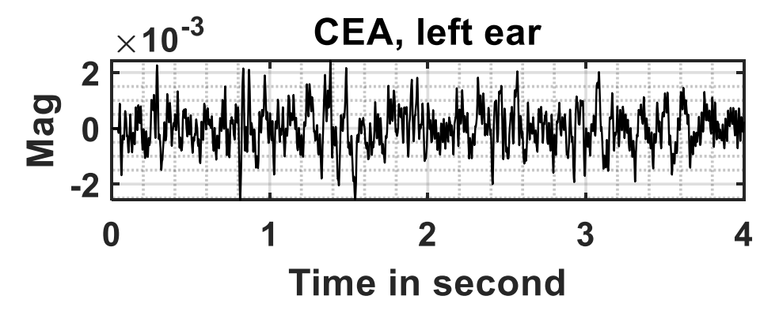
An Overview of Existing Hearable Health Solutions
Passive sensing using in-ear microphone
May not be a good solution to ANC earbuds:
Sensitive to earbud sealing conditions;
The high-pass filter bult in the earbud’s analog front-end would filter out low-frequency
With 50Hz high pass filter on the analog domain (most ANC earbuds)
With 50Hz high pass filter on the digital domain
heartbeat
Cannot detect heartbeat signals
Notes:
Given the fact that ANC earbud is already equipped with in-ear microphone, this passive sensing approach sounds like a plug-and-play solution. However, our in-depth analysis and field studies reveal that this approach may not be a good solution to ANC earbuds. There are primarily two reasons.
[click]: Firstly, we find that the performance of this passive sensing approach is very sensitive to earbud sealing conditions; a bad sealing condition due to human motions usually lead to a poor hear rate monitoring performance.
[click]: Secondly, ANC earphones are known to apply high pass filters to remove wind-noise on their in-ear microphone, usually at 50Hz. The heart rate thus could not survive in this earbud front-end.
[click]: The figure on the right hand-side shows the signal received at the ear canal; this earphone adopted a digital high-pass filter to remove wind-noise;
[click]: so we can still see a very clear heartbeat patterns from the microphone readings.
[click]: however, most existing ANC earphones or earbuds adopt an analog domain high-pass filter built in their analog front-end; including Google’s pixel earbud. As we can see from the figure shown in the right hand, the heartbeat signals are largely removed from microphone readings.

Slide 10
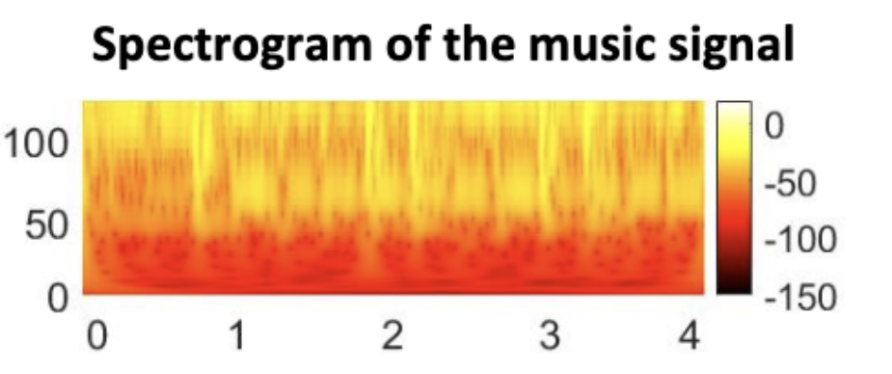
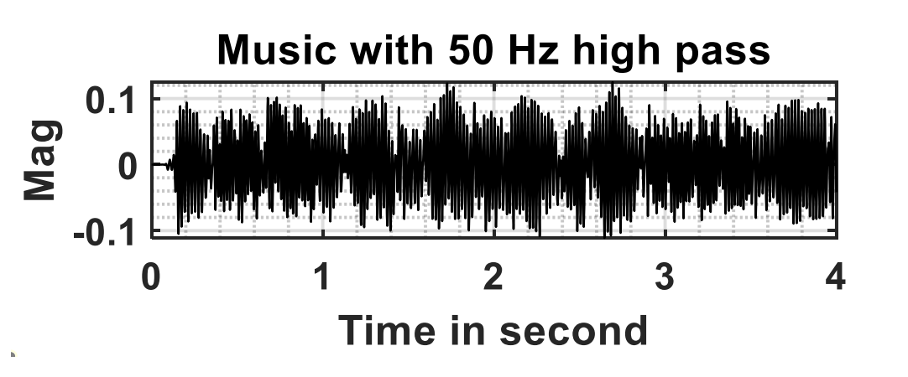
An Overview of Existing Hearable Health Solutions
Passive sensing using in-ear microphone
May not be a good solution to ANC earbuds:
Sensitive to earbud sealing conditions;
The high-pass filter bult in the earbud’s analog front-end would filter out low-frequency
Suffer from music interference, due to music harmonics
With 50Hz high pass filter on the digital domain
CEB earbud in the presence of music
Notes:
Last but not the least, this passive sensing approach still suffers from music interference. Due to the non-linear voice coil in the earphone’s speaker hardware, the vibration from the music playback produces non-linear harmonics at lower frequencies that are orders of magnitude stronger than heartbeat signals.
[click]: Recall that CEB earbud can detect a clear heartbeat cycles using its in-ear microphone when there is no music playing. As shown in the figure on the left hand side.
[click]: We then use the CEB earbud to collect heartbeat signals in the presence of music playback. The top plot on the right hand shows the music spectrum indeed has very low energy below 50Hz.
[click]: However, the bottom plot shows the [0, 50]Hz spectrum from the microphone recording, and we see significant energy that has drowned out the heart-rate.

Slide 11
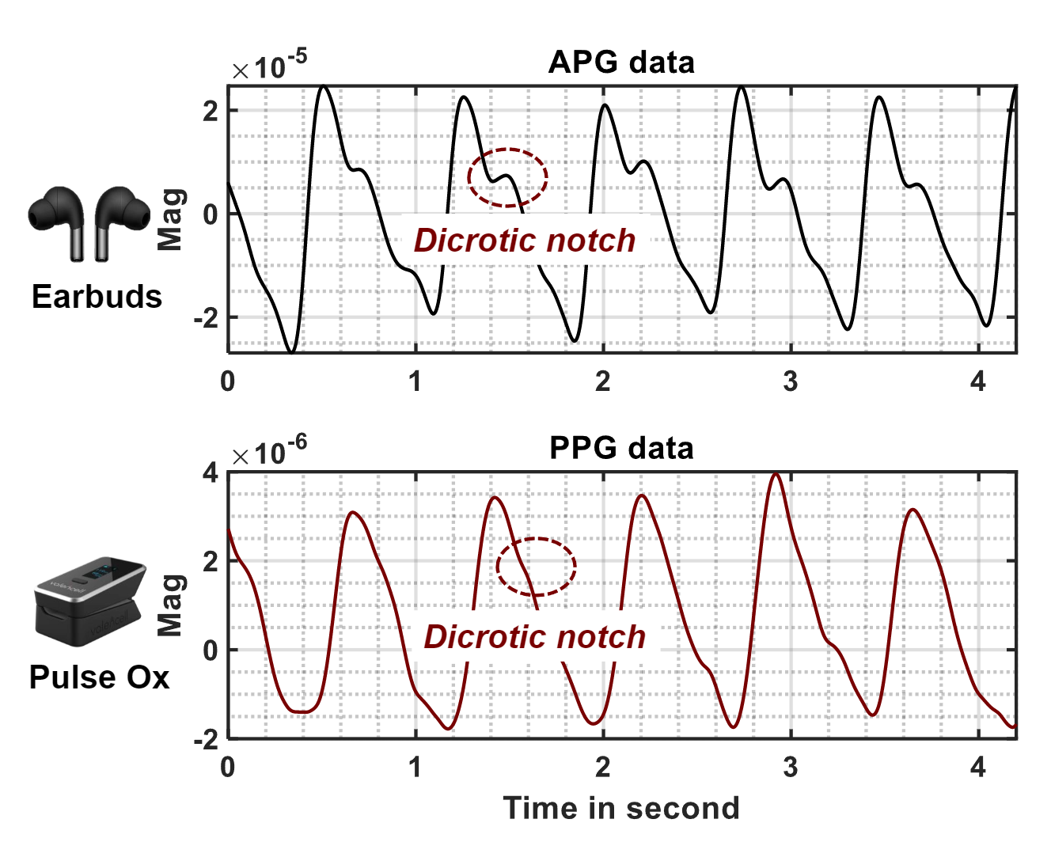
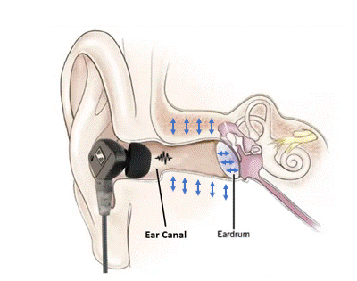
APG - A New Design Paradigm for Heart Rate Monitoring
Basic Principle:
Physiological observation: the deformation of blood vessels → the tissues encircling the ear canal undergo a minor constriction → a subtle compression of the ear canal cavity
Detect heart rate: send a low intensity ultrasound probing signal using an ANC headphone’s speakers and receives the echoes via the on-board feedback microphones.
Notes:
To address these issues, in this project we propose a new solution called APG, which is an active probing based heart rate monitoring approach, just like how SONAR system works.
APG is based on a basic physiological principle: when you put on your earbud, the earbud, the ear canal, and the ear drum will form a cavity. The deformation of blood vessels on the ear canal will essentially change the volume of this cavity.
[click]: So when we use the ANC earbud to send an acoustic probing signal, this alteration in volume within the ear canal inherently changes the propagation path of the probing signal. Since the deformation of blood vessels aligns with the rhythm of cardiac activities, we see an opportunity to extract heart rate information by monitoring the fluctuations in the echo signals.

Slide 12
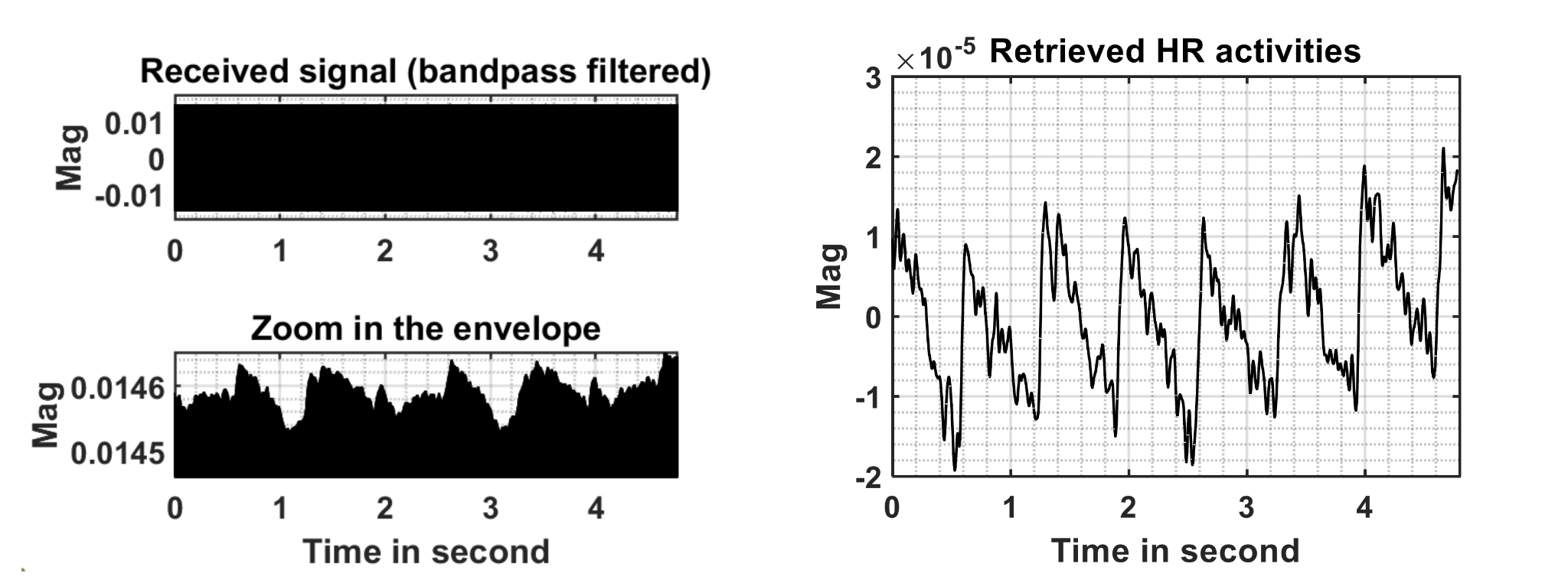
APG – How to Realize This Idea?
The alteration in volume within the ear canal due to heartbeat is subtle
The Raw ultrasound receptions (by feedback microphone)
Coherent
detection
Cannot detect heartbeat signals from the raw receptions
Notes:
To translate this idea into a practical system, we first apply coherent detection to the received signals, sort of down-converting it to base band. This operation also gives us some SNR gain to improve the detection accuracy of heartbeat signals.
As you can see from the figure,

Slide 13
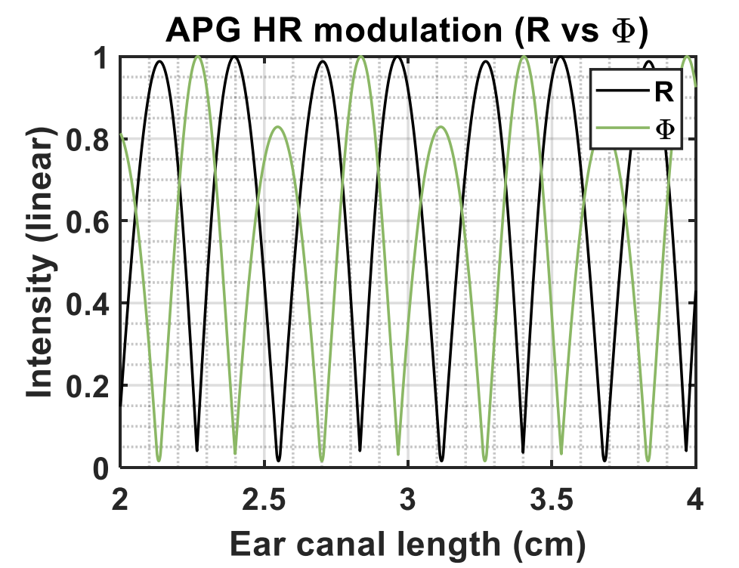
APG – How to Realize This Idea?
How to handle user diversity?
Amplitude
Phase
Phase variation/
amplitude variation
Phase variation (due to compression of the ear canal cavity) is not strong enough for heartbeat signal detection.
Notes:
The a follow-up question is how to handle user diversity? We know users differ drastically in their ear canal structure. And the same probing signal may not work for all users.
[click]: as you can see from this figure, for those specific ear canal length settings, the phase variation due to cardiac activities are almost non-detectable.

Slide 14
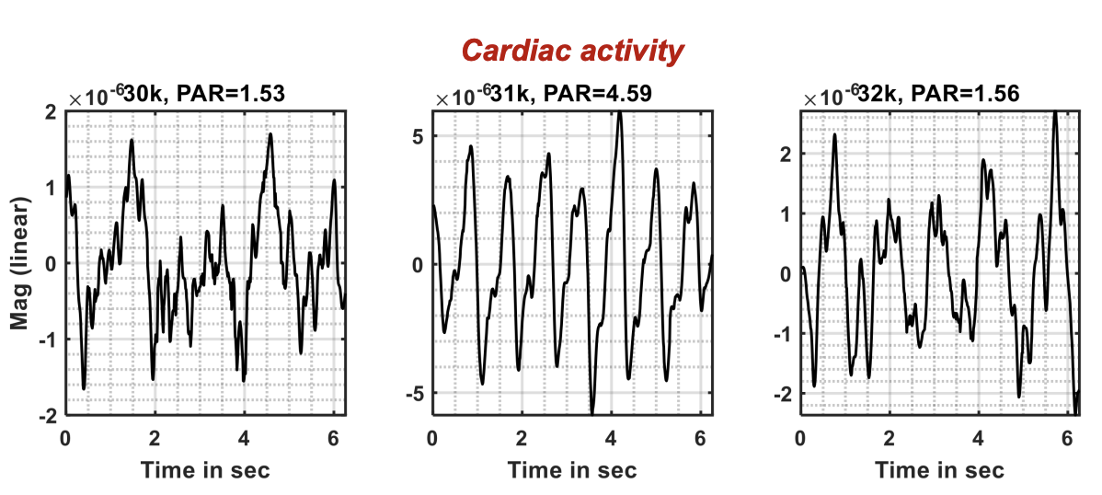
APG – How to Realize This Idea?
How to handle user diversity?
Solution: Sending multiple APG signals at different frequency bands concurrently, using peak-to-average ratio to measure the quality of the detected heartbeat signal
Low PAR
High PAR
Low PAR
Notes:
To address this challenge, we introduce a simple yet effective amendment to APG design, namely, multi-tone APG.
Multi-tone APG is based on a key observation that the intensity of phase modulation and magnitude modulation are hypersensitive to the frequency of APG probing signals。
This allows us to manipulate the frequency of probing signals to improve the success rate of cardiac activity detections.

Slide 15
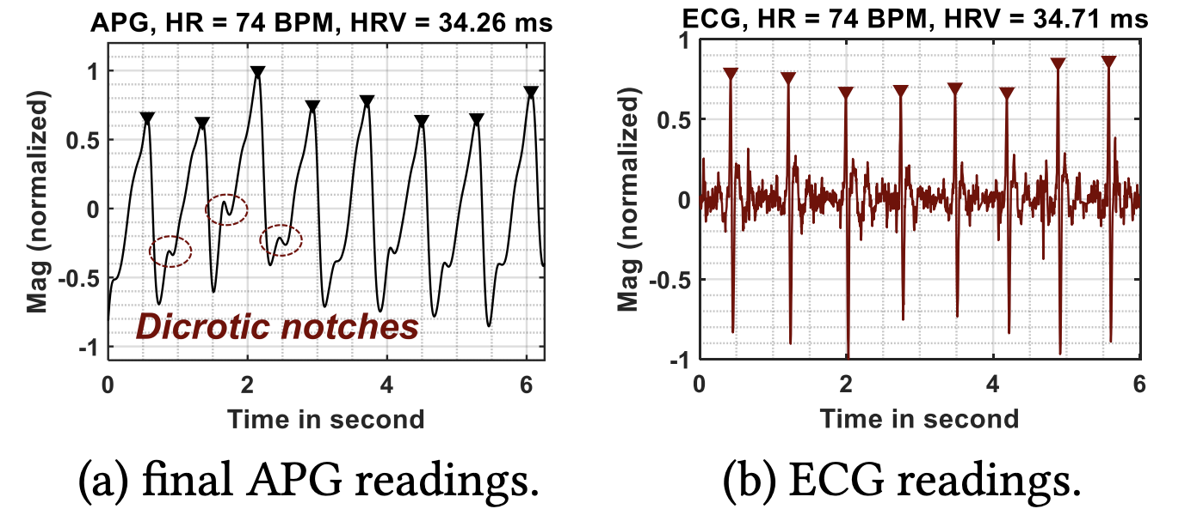
APG – How to Realize This Idea?
How to handle user diversity?
Solution: Sending multiple APG signals at different frequency bands concurrently, using peak-to-average ratio to measure the quality of the detected heartbeat signal
Once the optimal frequency is determined, we send APG signal on that specific frequency for a better signal quality

Slide 16

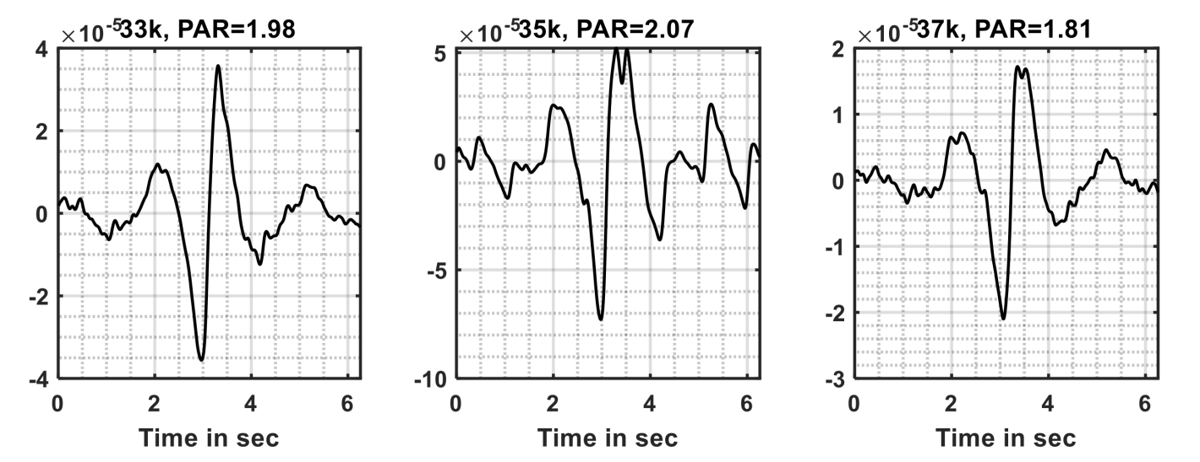
APG – How to Realize This Idea?
How to handle body motion artifacts?
Challenge: body motion also squeezes ear canal; they are hundreds of magnitude stronger than the heartbeat signals
APG receptions on three different frequency bands (after coherent detection)
Head motions dominate
Notes:
APG essentially measures the volumetric change in the ear canal. However, in practice, both head and body motions will squeeze the ear canals, altering their structures intermittently. Accordingly, these motion artifacts will be superimposed with the heartbeat signals, disturbing the cardiac signal detection. Since these body motion artifacts are orders of magnitude stronger than the cardiac activities, they will easily dominate the received signal, setting a strong barrier to the cardiac activity detection

Slide 17
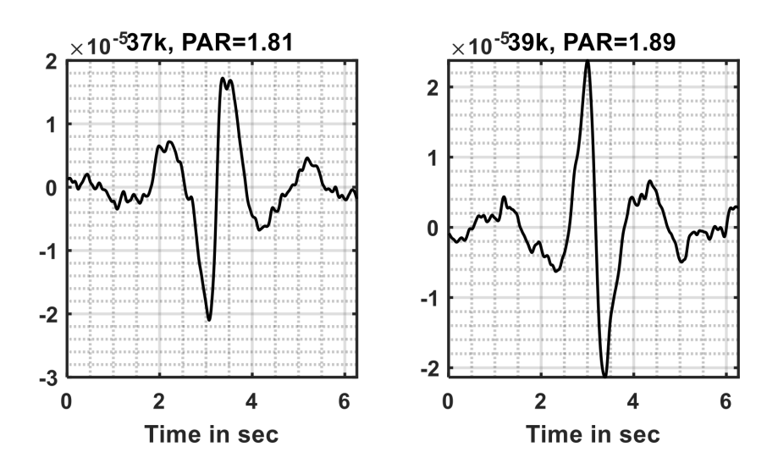
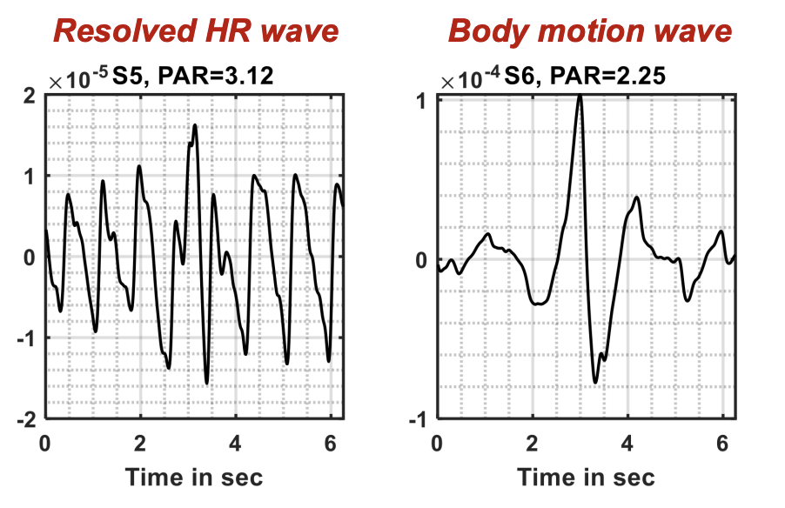
APG – How to Realize This Idea?
How to handle body motion artifacts?
Challenge: body motion also squeezes ear canal; they are hundreds of magnitude stronger than the heartbeat signals
Solution: model it as a blind source separation (BSS) problem
Opportunity: the frequency bands of probing signals are statistically decorrelated due to the channel frequency diversity
ICA
Notes:
We take advantage of the multi-frequency nature of APG probing signals to address this challenge. Specifically, the frequency bands of probing signals are statistically decorrelated due to the channel frequency diversity [49]. For instance, two separate frequency bands may capture totally different signal sources, as shown in Figure 8. Accordingly, the use of multi-frequency probing signals could significantly boost the number of independent observations and further make R𝑥 a determined covariance matrix.

Slide 18
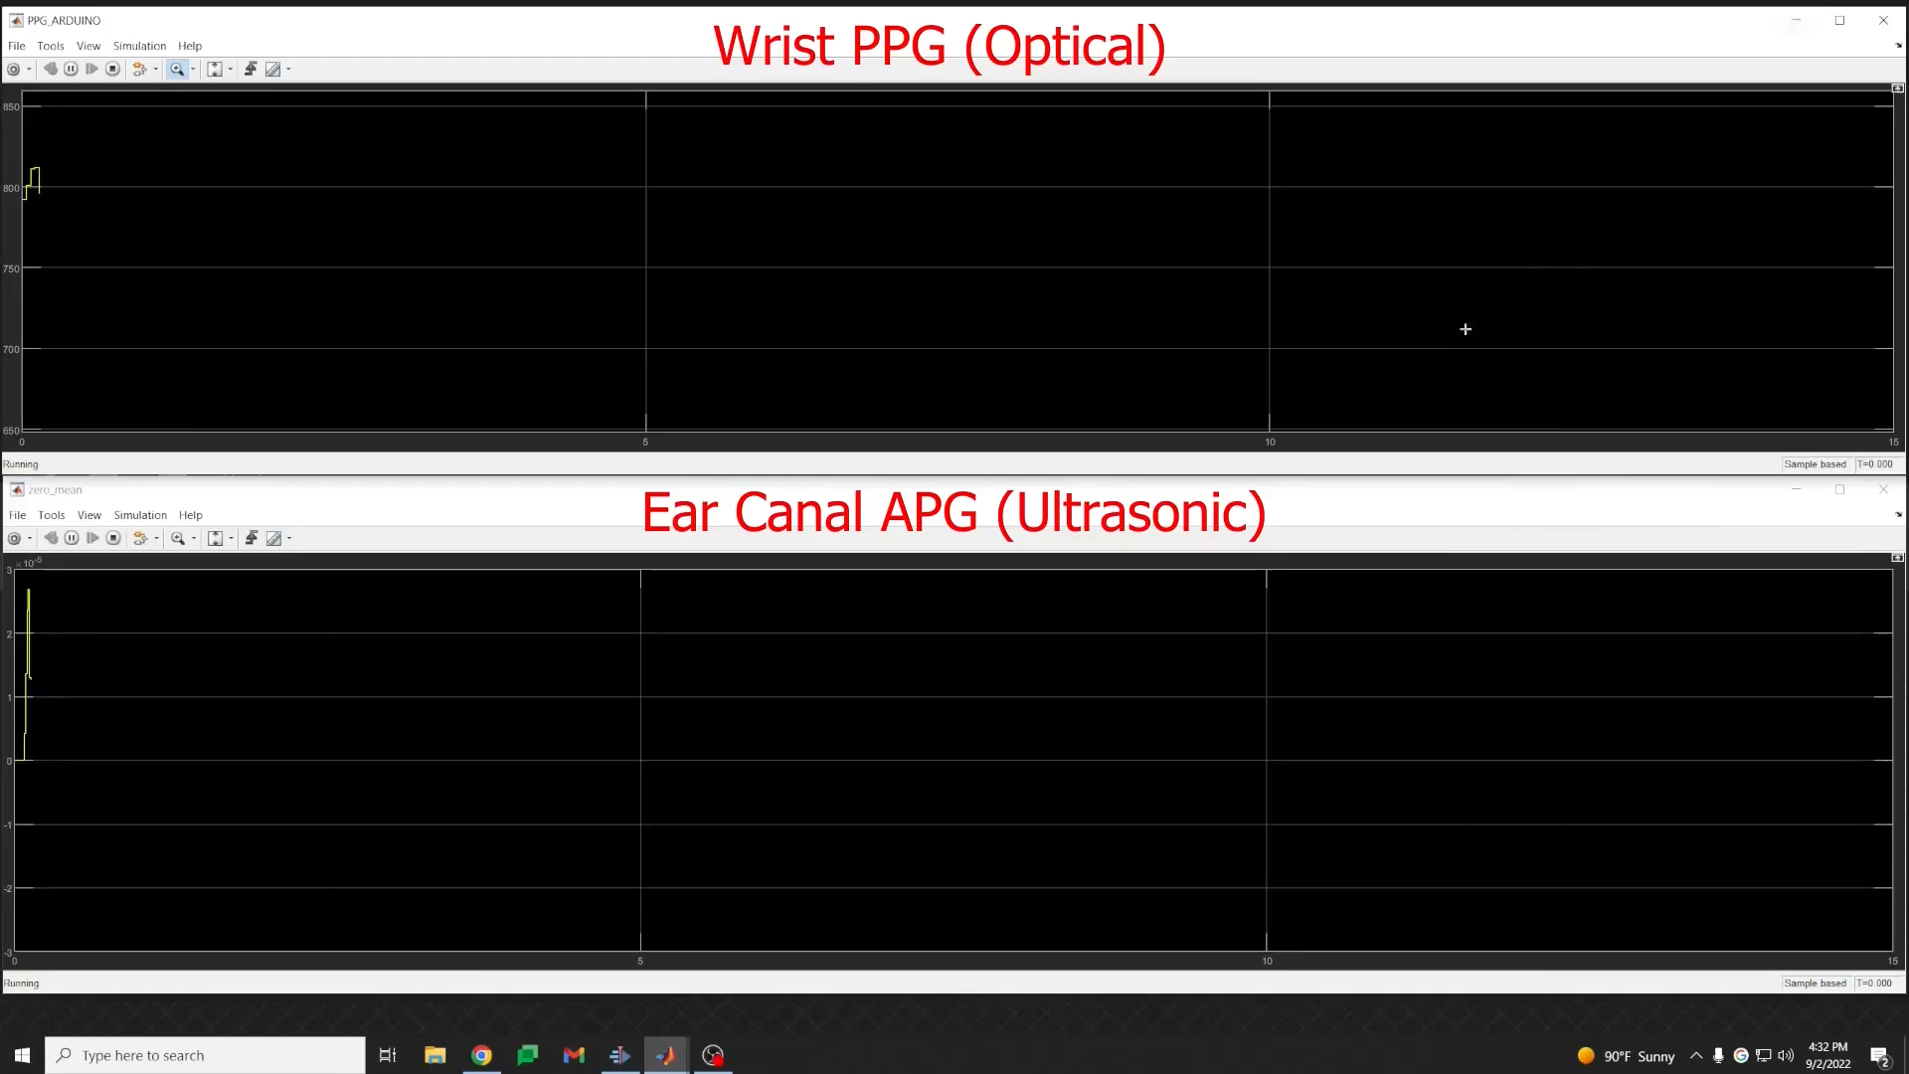

Slide 19
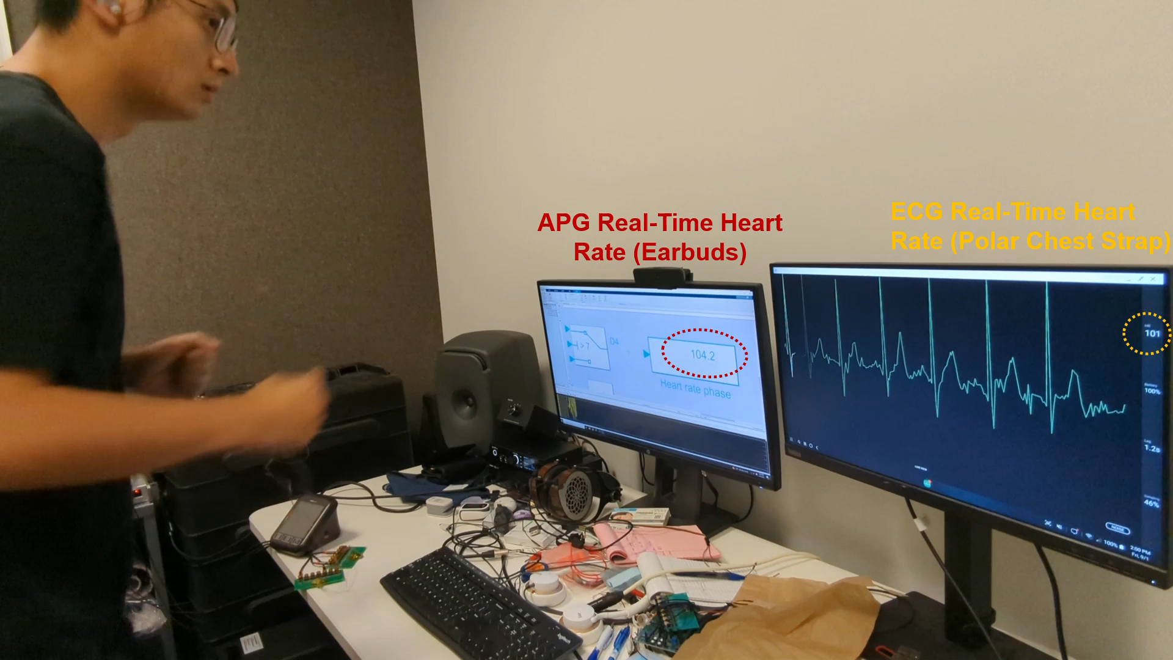

Slide 20
Summary
APG is a software solution that works with commodity ANC headphones, without requiring any hardware modifications;
APG achieves high heart rate monitoring performance in both stationary and mobile scenarios;
Ongoing efforts:
Tackling non-repetitive body motion artifacts;
Large-scale user studies to examine the system efficacy;
Notes:
We take advantage of the multi-frequency nature of APG probing signals to address this challenge. Specifically, the frequency bands of probing signals are statistically decorrelated due to the channel frequency diversity [49]. For instance, two separate frequency bands may capture totally different signal sources, as shown in Figure 8. Accordingly, the use of multi-frequency probing signals could significantly boost the number of independent observations and further make R𝑥 a determined covariance matrix.

