Slide 1





MUSE-Fi: Contactless MUti-person SEnsing Exploiting Near-field
Wi-Fi Channel Variation
Jingzhi Hu*, Tianyue Zheng*, Zhe Chen, Hongbo Wang, Jun Luo
Nanyang Technological University (Singapore) and Fudan University (China)
Presented by Yinghui He, Zhejiang University (China)

Slide 2
01 Background on Wi-Fi Sensing
02 Principle of Near-field Sensing
03 Insights into Multi-person Sensing
04 Shaping up MUSE-Fi
05 Experimental Results
CONTENTS

Slide 3
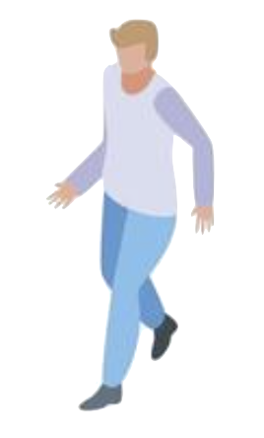
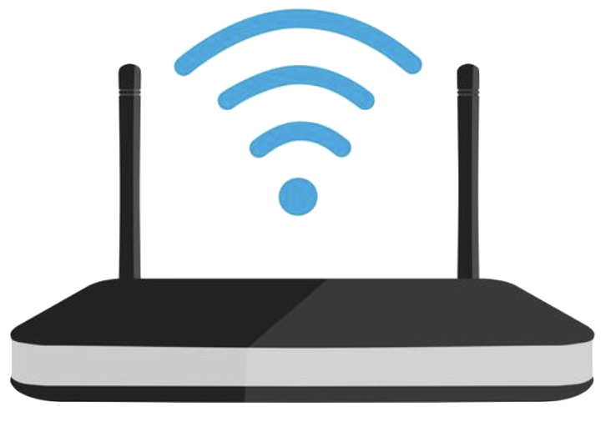
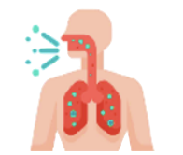


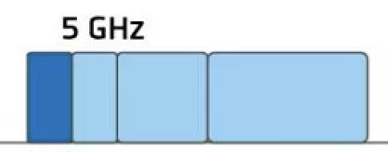
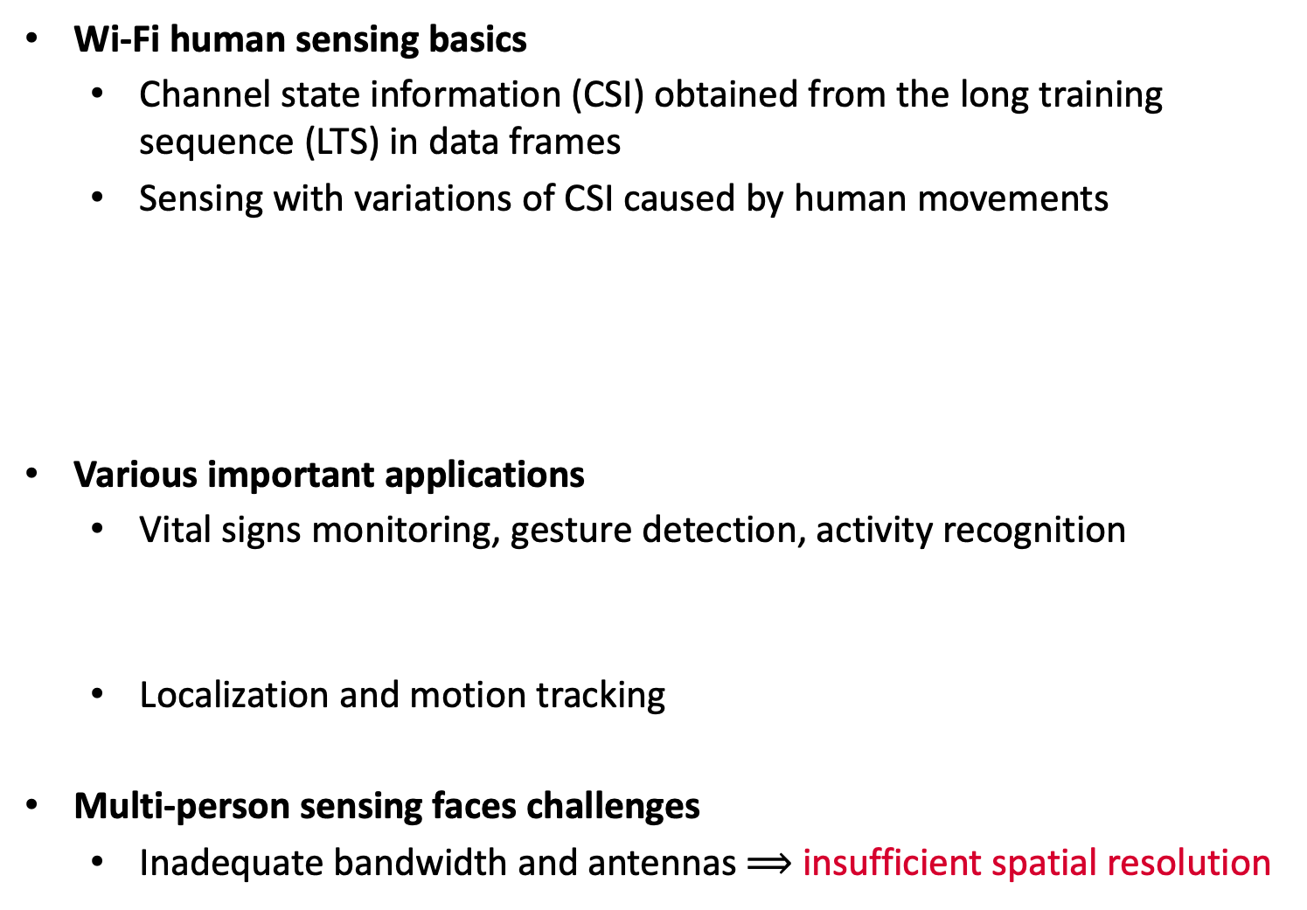
Wi-Fi human sensing basics
Channel state information (CSI) obtained from the long training sequence (LTS) in data frames
Sensing with variations of CSI caused by human movements
Various important applications
Vital signs monitoring, gesture detection, activity recognition
Localization and motion tracking
Multi-person sensing faces challenges
Inadequate bandwidth and antennas $⟹$ insufficient spatial resolution
Background on Wi-Fi Sensing
Basics
20~160MHz bandwidth

Slide 4
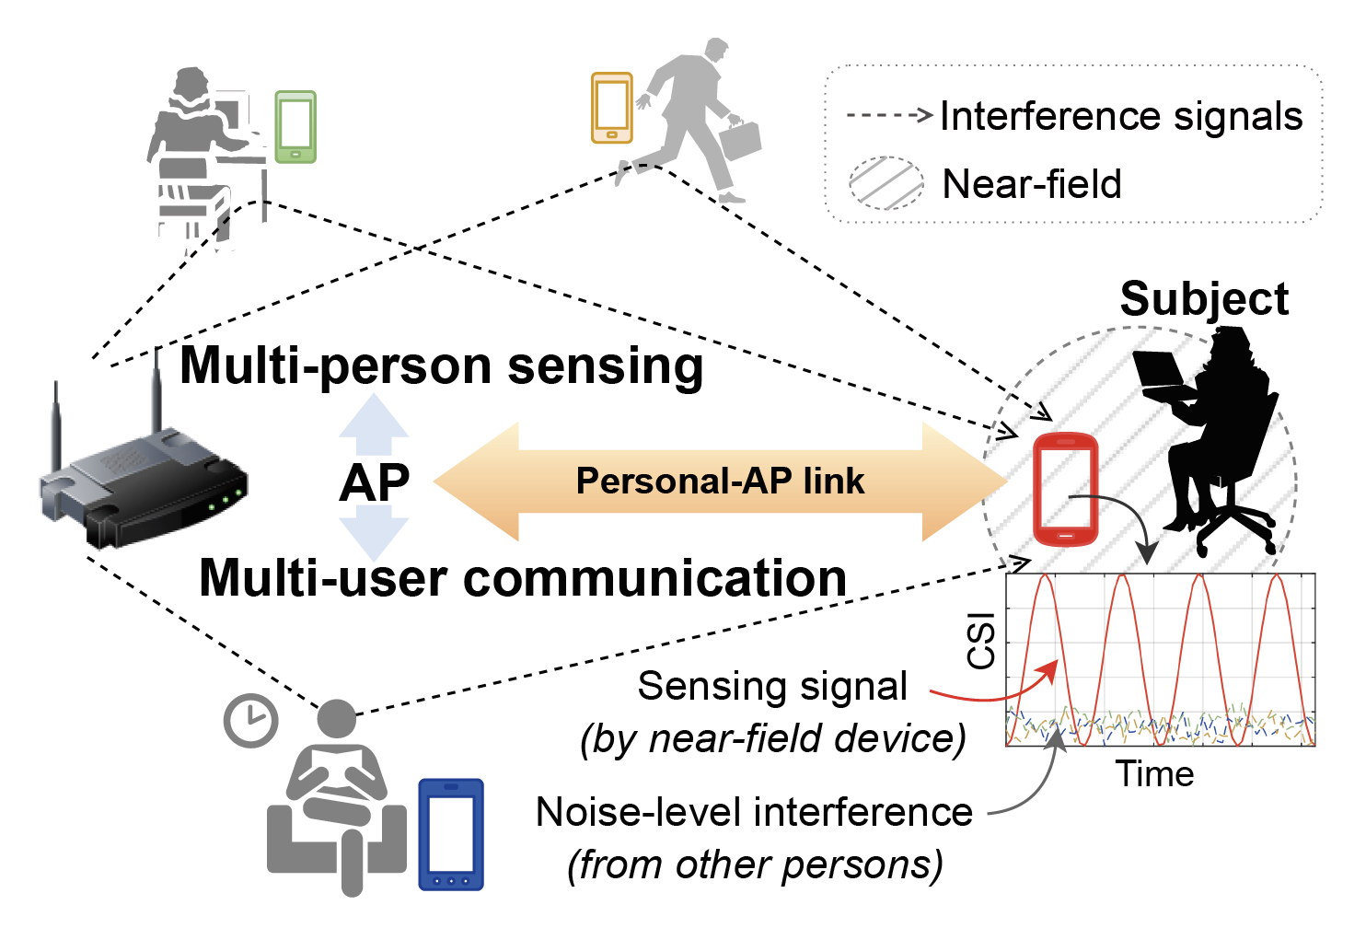
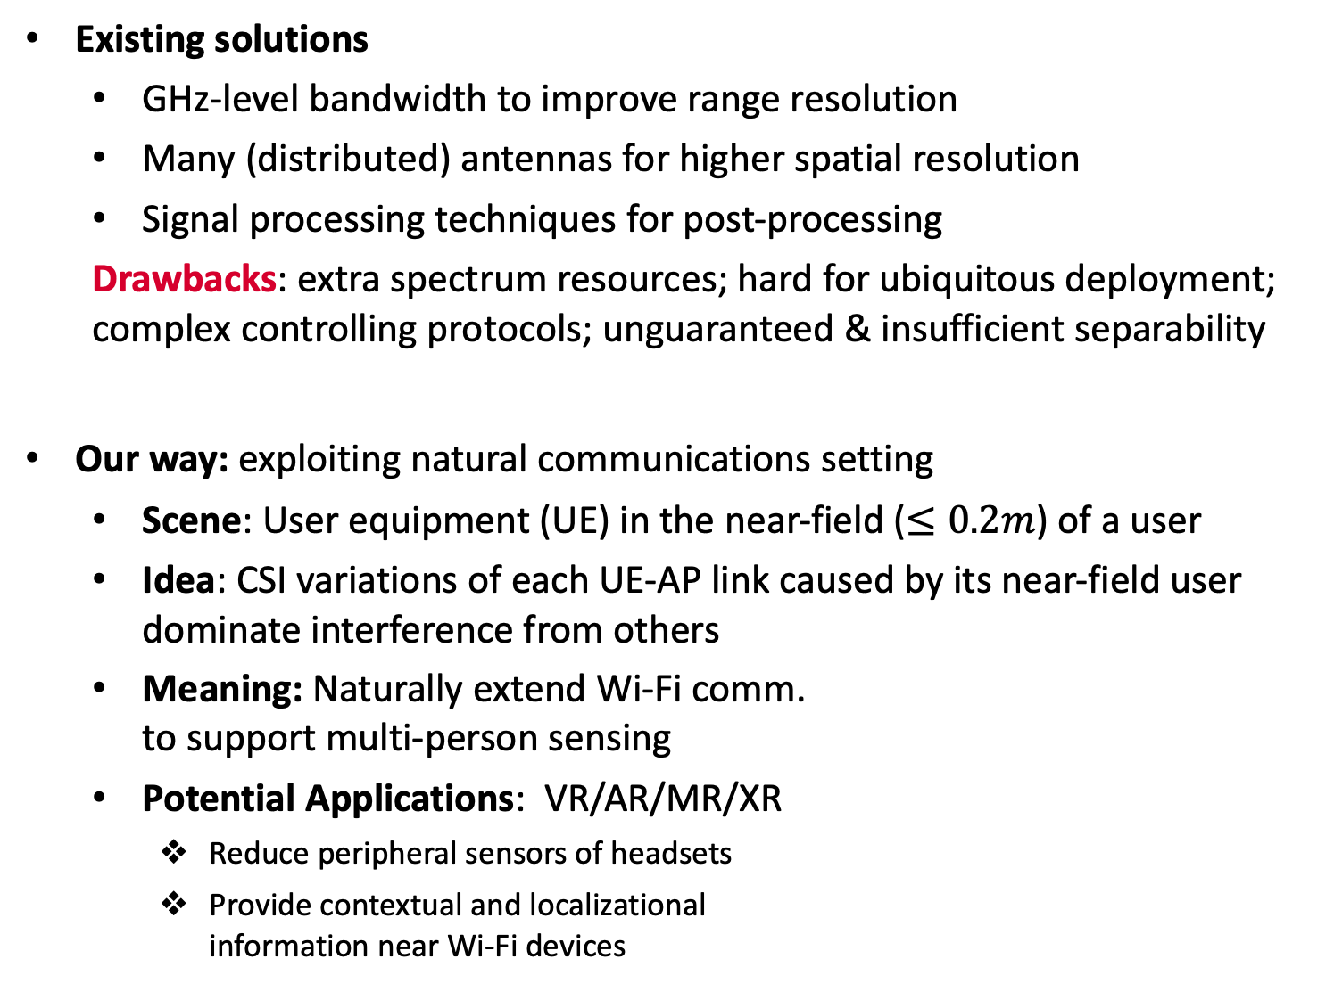
Existing solutions
GHz-level bandwidth to improve range resolution
Many (distributed) antennas for higher spatial resolution
Signal processing techniques for post-processing
Drawbacks: extra spectrum resources; hard for ubiquitous deployment; complex controlling protocols; unguaranteed & insufficient separability
Our way: exploiting natural communications setting
Scene: User equipment (UE) in the near-field ($≤0.2m$) of a user
Idea: CSI variations of each UE-AP link caused by its near-field user dominate interference from others
Meaning: Naturally extend Wi-Fi comm. to support multi-person sensing
Potential Applications: VR/AR/MR/XR
Reduce peripheral sensors of headsets
Provide contextual and localizational information near Wi-Fi devices
Background on Wi-Fi Sensing
Now and Then

Slide 5
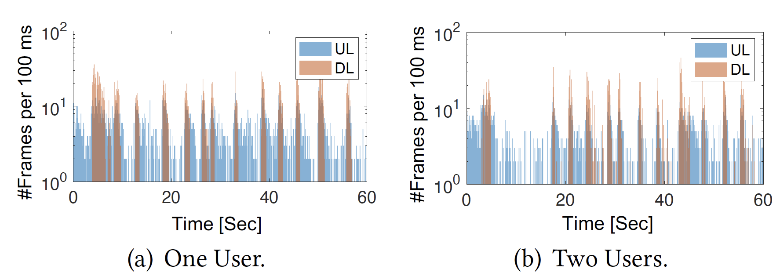
Challenges
Idea of near-field sensing lacks of theoretical analysis, experimental verification, and protocol integration
Realistic data traffic in Wi-Fi, especially in multi-UE scenarios, is of unsaturated, even low frequency, causing sparsity in CSI samples.
Solution: MUSE-Fi (MUlti-person SEnsing system leveraging Wi-Fi)
Theoretical characterization, prototyping, and experiment evaluations
Various WiFi-compatible sensing strategies
Recovery algorithm to tackle sparsity in CSI sampling rate
Background on Wi-Fi Sensing
Challenge and Solution
Frame arrival rates when one or two users stream 1080p videos

Slide 6
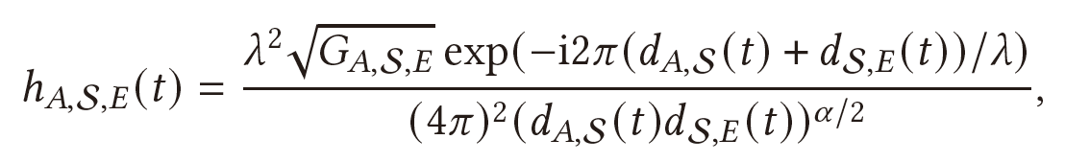
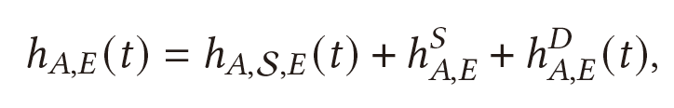
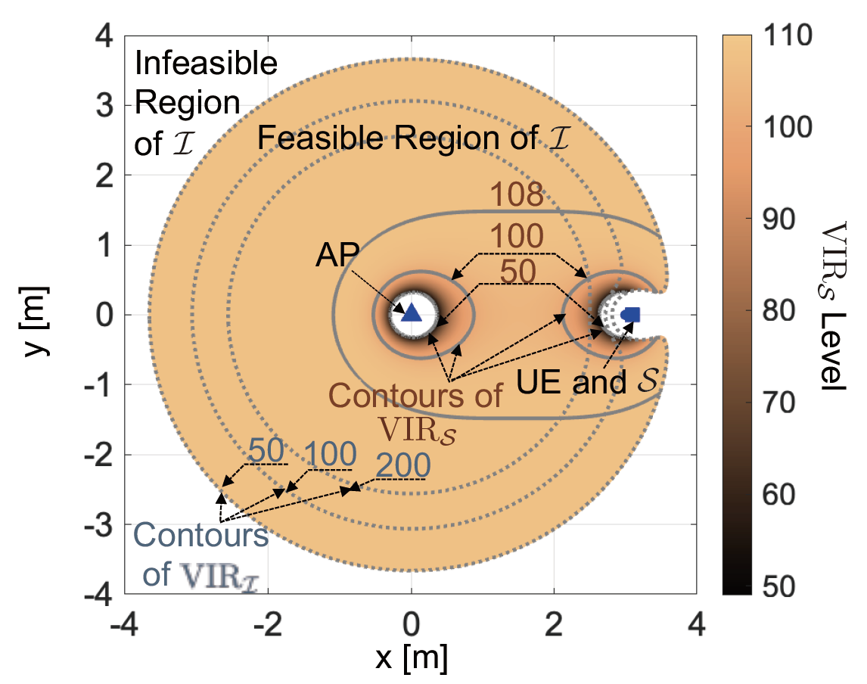
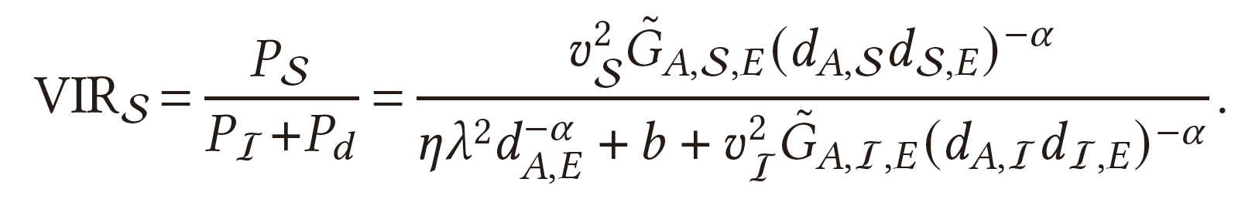



More on Wi-Fi sensing basics
Near-field domination effect (NFDE)
As CSI variations mater, ${\left|\frac{∂h_{A,S,E}\left(t\right)}{∂t}\right|}^{2}⟹$ Power of CSI variation $P_{S}∝v_{S}^{2}{\left(d_{A,S}d_{S,E}\right)}^{−α}$, $v_{S}$: intensity/speed of movement
As $d_{S,E}$ of near-field subject is much smaller than $d_{I,E}$ of interferers, $⟹$ variation power $P_{S}$ of subject dominates $P_{I}$ of interferer (near-field domination)
Channel between AP and UE = Reflection channel via subject S + static channel + env. dynamic channel
Principle of Near-field Sensing (NFS)
Path loss exponent
Distance S to UE
Distance AP to S
$γ_{th}$=50
Derivation of feasible regions for NFS
Metric: variation to interference ratio (VIR)
Illustration and observation:
${VIR}_{S}>γ_{th}$ constitutes Cassini ovals, physically guarantee boundaries for user separation
Subject and interferer can be very close (0.3-0.5m)
Envir. dynamic channel gain as an interference

Slide 7
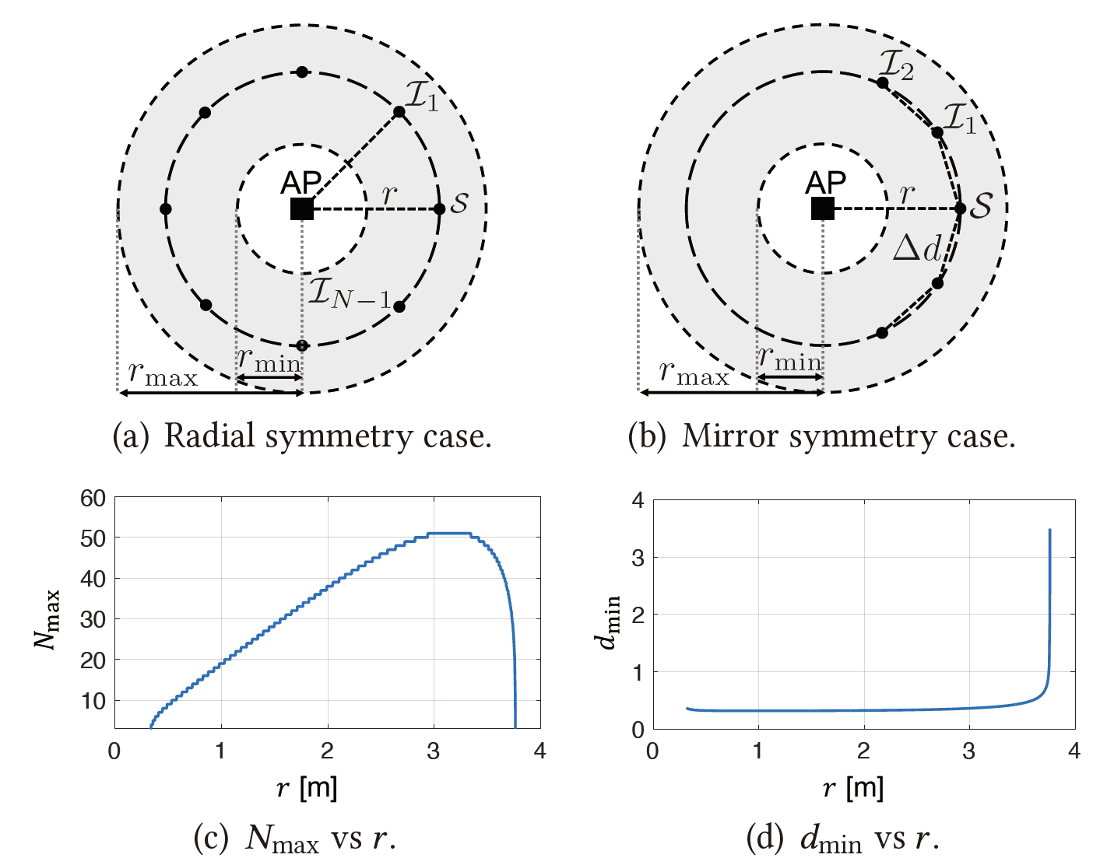
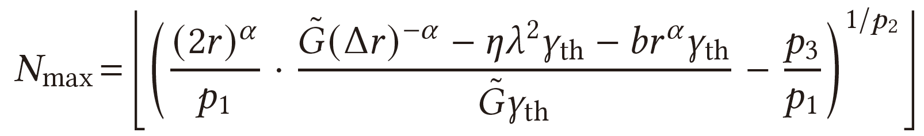
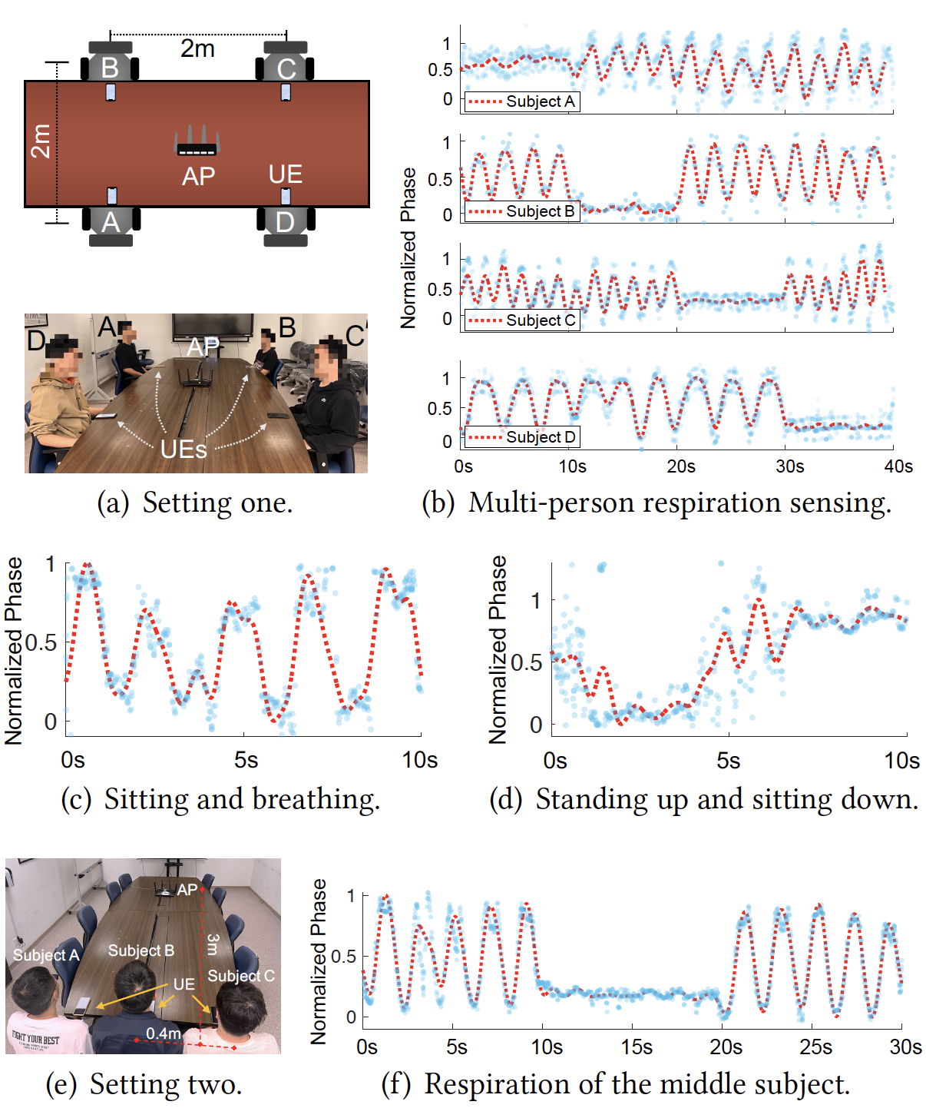
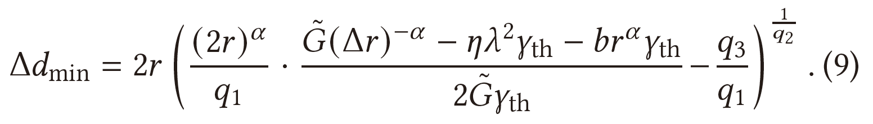






Ideal multi-person ($N>3$) scenes
Symmetry cases and normalized parameters
(a) Radial symmetry case for maximum $N$
(b) Mirror symmetry case for minimum $∆d$
Proof of concept experiments
Respirations of closely-sit persons (even by-shoulder) can be well separated
NFS works for different motion intensities: stronger signals do not mess up weaker ones
Insights of Multi-person Sensing (MPS)
$$N_{max}=51$$
$${∆d}_{min}=0.34$$
$N_{max}$ peaks at 51 around AP-UE distance $r≈$3m
$γ_{th}$=50
$∆d_{min}$ remains 0.34m for $r∈\left[0.32, 3.30\right]m$

Slide 8
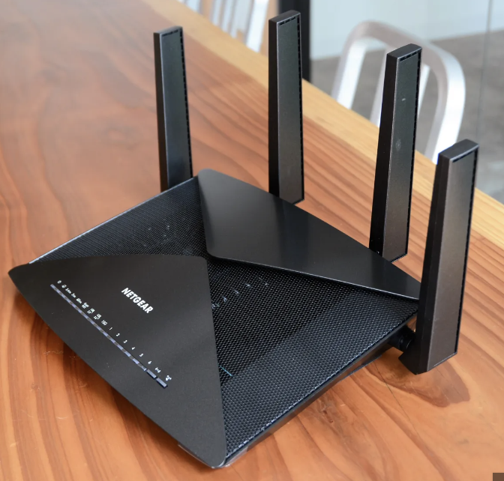
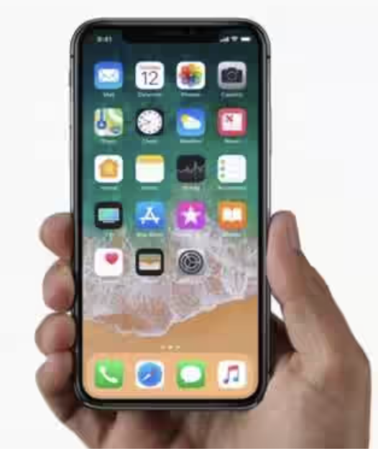
Hardware Components
A commodity AP and multiple UEs carried by individual users:
All devices follow prevalent Wi-Fi 5/6 standard
CSI can be obtained from the received frames
No additional antennas or bandwidth expansion
Strategies compatible with WiFi-ISAC (integrated sensing & communication)
Uplink (UL)-CSI: AP obtains CSI from UEs' UL traffic
Centralized sensing at AP, covering all users
Downlink (DL)-CSI: UEs obtain CSI from AP's DL traffic
Distributed sensing at UE, privacy preserving
UL-BFI: Beamforming feedback info (BFI) in UEs' UL traffic
As BFI is sent out in plain-text, sensing can be carried out at any Wi-Fi devices capable of hearing the traffic (WiKI-Eve in CCS’23)
Shaping up MUSE-Fi
Components, Strategies, Compatibility

Slide 9
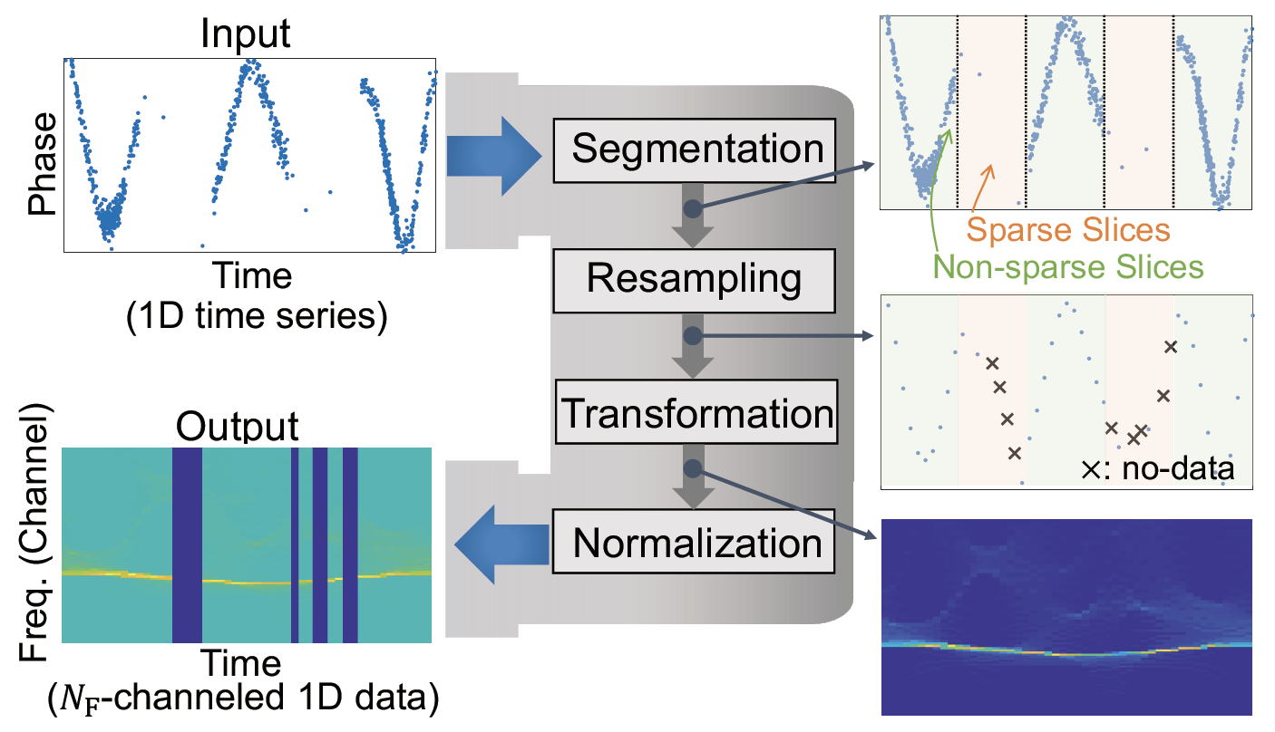
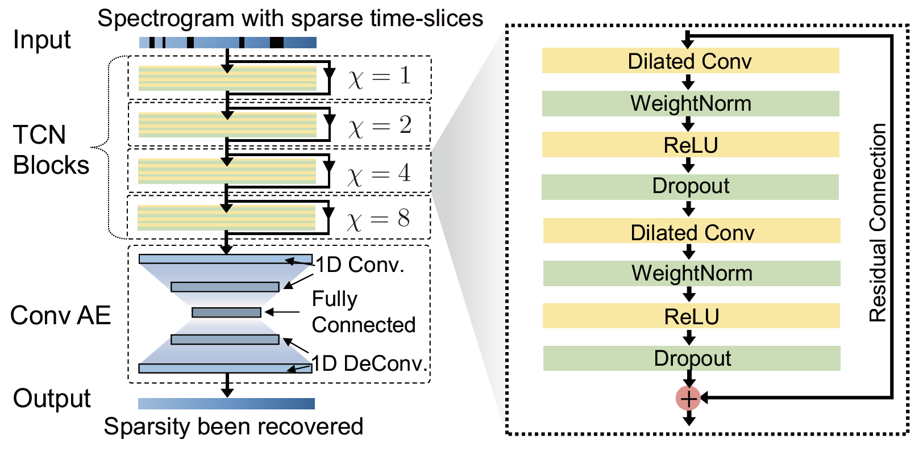
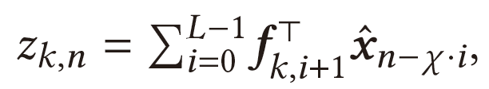

Goal: handle CSI sample sparsity in realistic data traffic
Data processing pipeline
Divide sparse and non-sparse time slices
Linearly resample/temporarily fill
Transform resampled CSI time series into spectrogram featuring freq. components
Normalize spectrogram and re-assign `no-data` labels to sparse slices
Sparse slice recovery with TCN-AE
Adopts temporal conv. network (TCN) due to its parameter efficiency
TCN is featured by dilated conv.
Self-supervised training
Use non-sparse slices as labeled training data for sparse slices
Shaping up MUSE-Fi
Sparse Recovery Algorithm (SRA)
output
kernel
input
$χ>1$: dilation factor

Slide 10
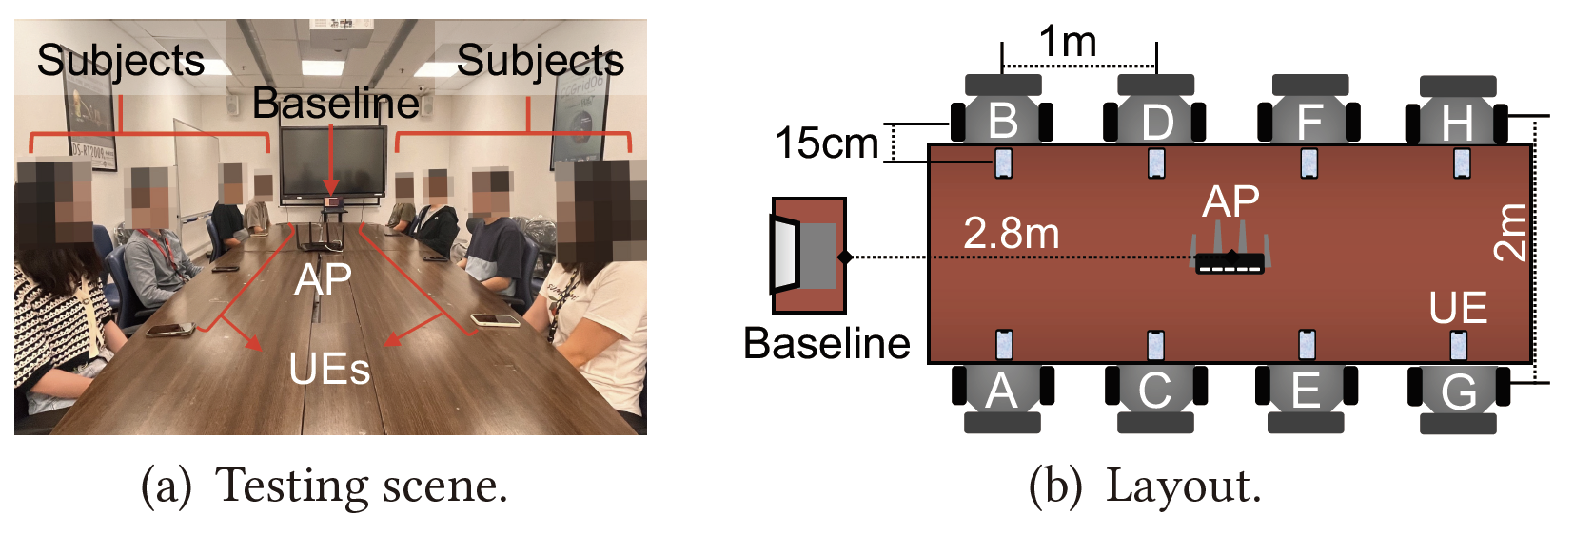
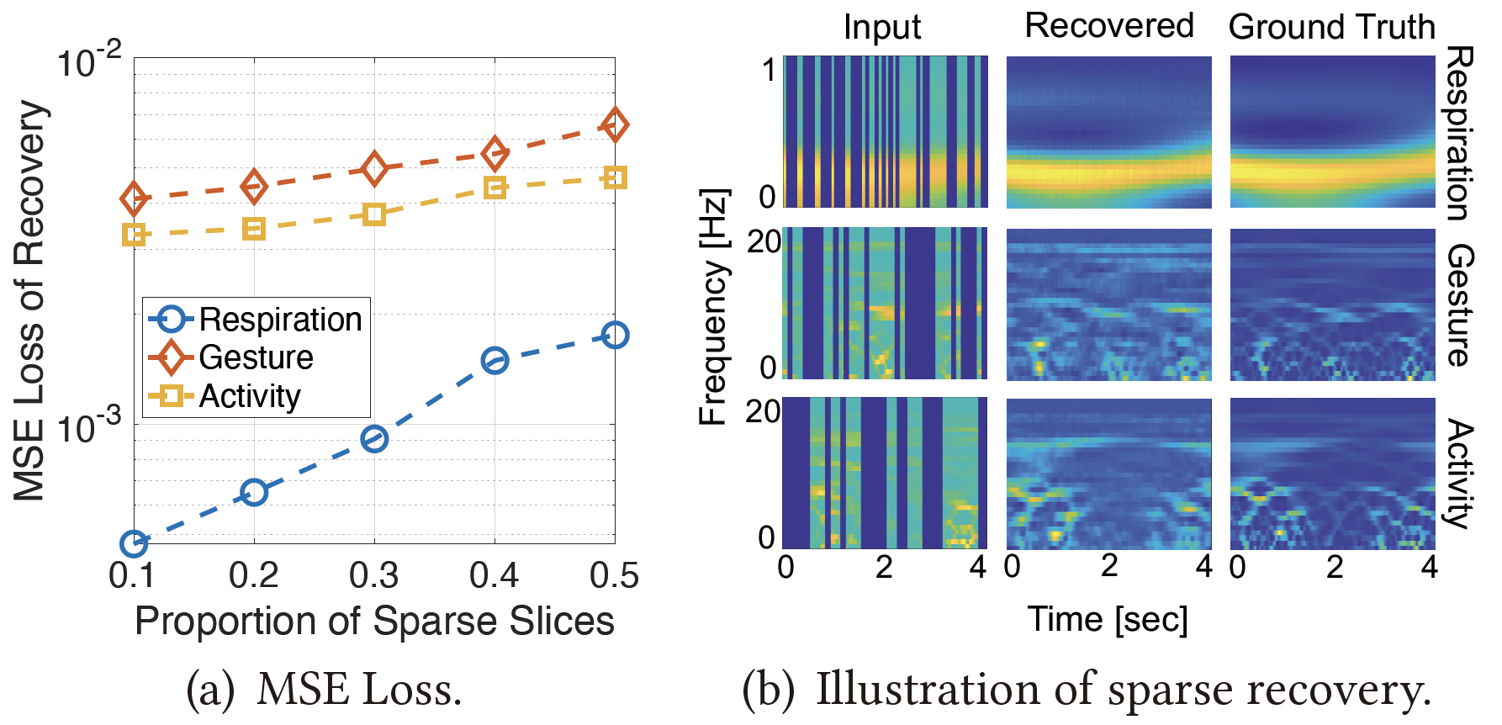
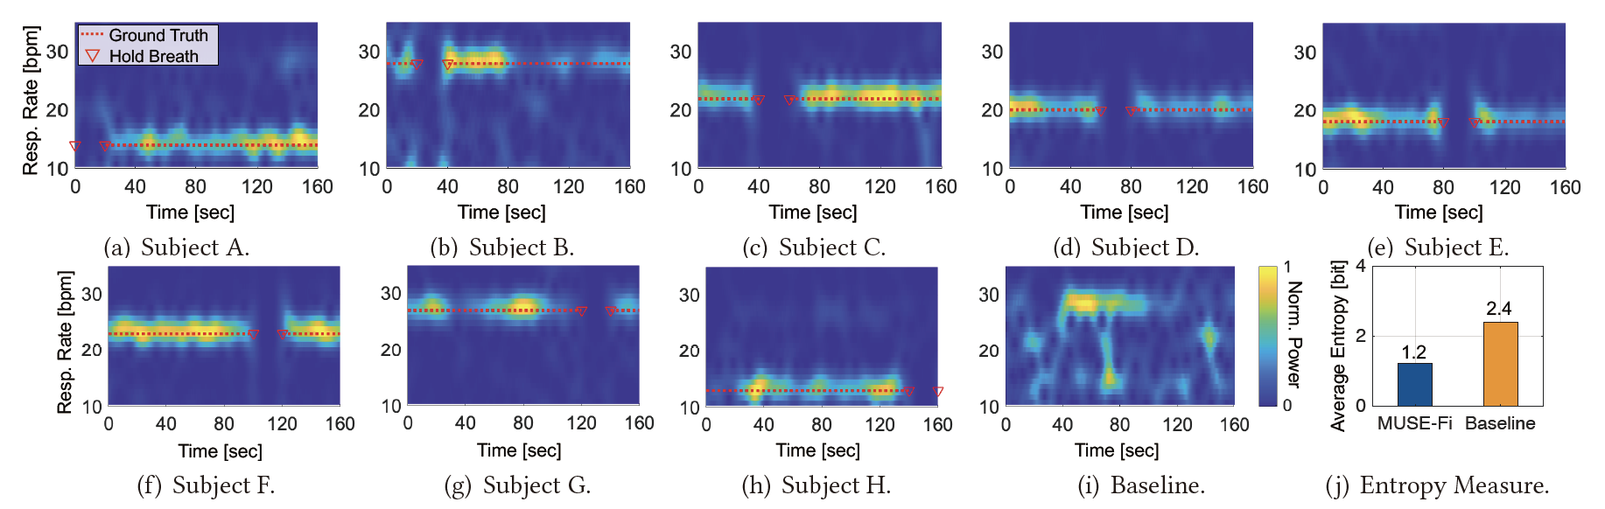
Implementation
AP: commercial Netgear router
UE: iPhone 13, iPhone X, OnePlus 10T, Acer TravelMate laptops
Retrieval of CSI: with the help of PicoScenes or Nexmon hardware
Retrieval of BFI: from Action No ACK frames captured by Wireshark software
Data traffic: e.g., video streaming
Evaluating SRA
Low MSE losses of the recovery in case of resp., gesture, and activity sensing (<10⁻²)
Respiration Monitoring
MUSE-Fi recovers a clear respiration signal
NFS halves the average spectral entropy
Experiment Results
Implementation and Evaluations
Baseline: non-near-field sensing setup for multi-person sensing

Slide 11
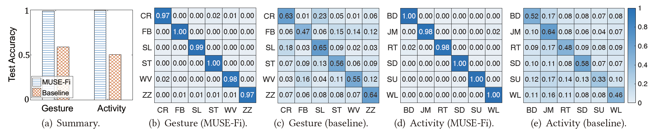
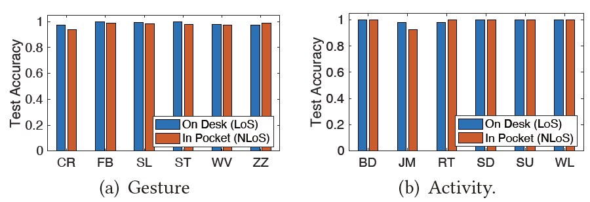
Gesture detection
Gestures: circle (CR), front-back (FB), slide (SL), star (ST), wave (WV), and zig-zag (ZZ)
Result: MUSE-Fi achieves about 98% accuracy for arbitrary subject thanks to near-field domination, while non-near-field baseline 57%
Activity recognition
Actions: bending (BD), jumping (JM), rotating (RT), sitting down (SD), standing up (SU), and walking (WL).
Result: MUSE-Fi 98% vs. non-near-field baseline 52%
Extended experiments
UE is kept in subject's pocket: NLoS with AP
Similar accuracy is achieved
Experiment Results
Evaluation Continued

Slide 12
Q & A

