Slide 1






Battery-free Wideband Spectrum Mapping Using Commodity RFID Tags
Mohamed Ibrahim
Atul Bansal
Kuang Yuan
Swarun Kumar
Peter Steenkiste
Notes:
Hello everyone! My name is Atul and I am here to present our paper “Battery-free Wideband Spectrum Mapping using Commodity RFID Tags”. This work was done at CMU with Mohamed, Kuang, Swarun and Peter.

Slide 2
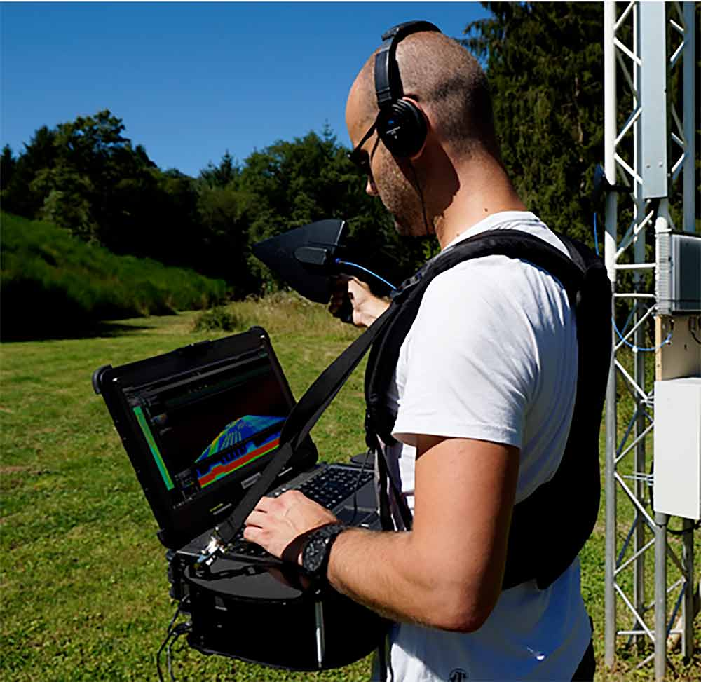

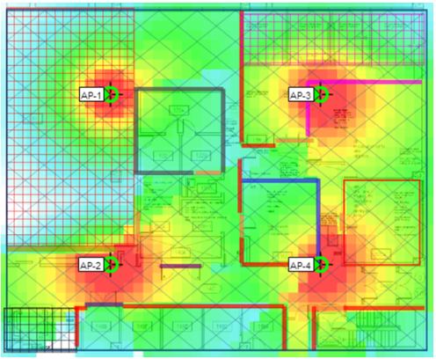
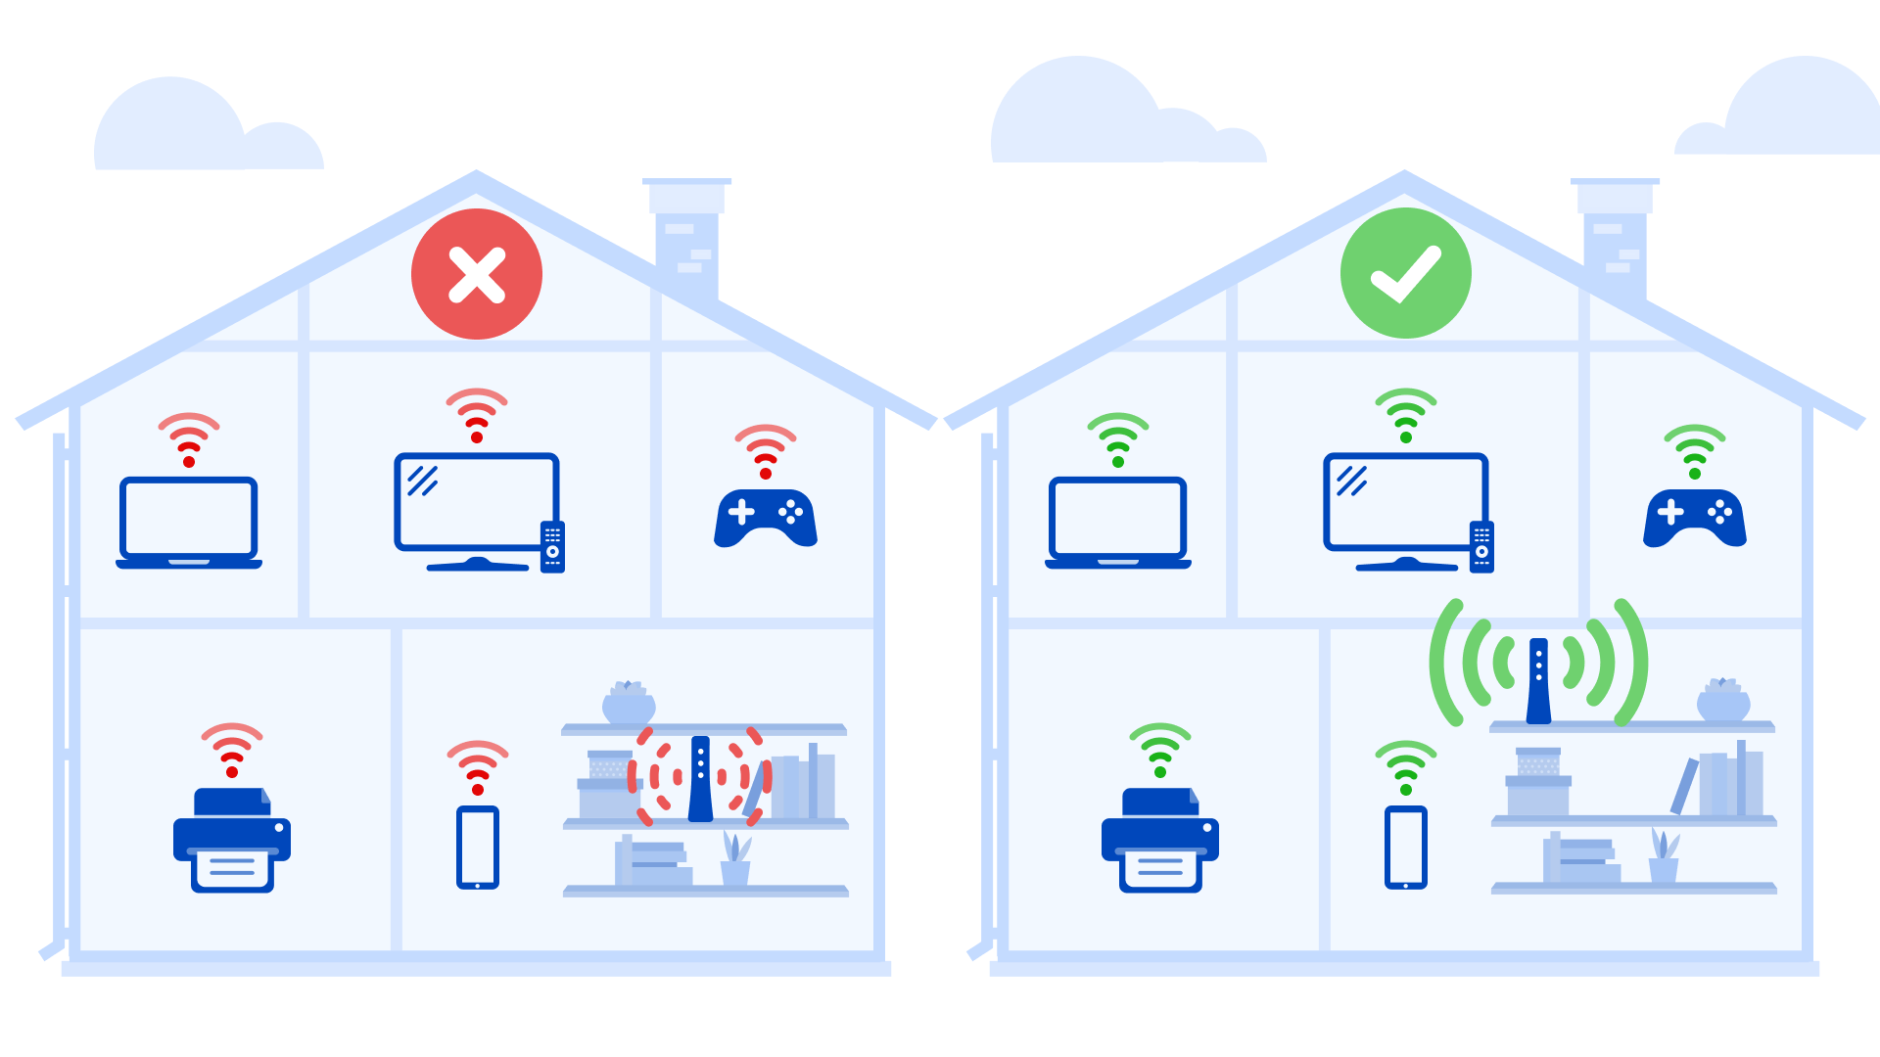
Spectrum Mapping
Interference Detection
Throughput Improvement
Network Placement
Notes:
Spectrum Mapping refers to signal power measurement at large bands of frequencies across a large area. This can enable lots of applications in the real world like RF Interference detection, Throughput Improvement and network placement.

Slide 3



Requirements
$$f$$
Wide Bandwidth
High spatial granularity
Low Cost
Notes:
Generally, a spectrum mapping system needs to be wideband, has a high spatial granularity of about cm level and low cost.

Slide 4
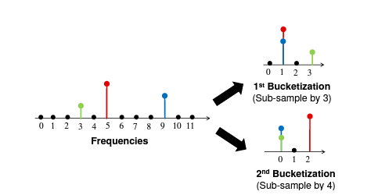
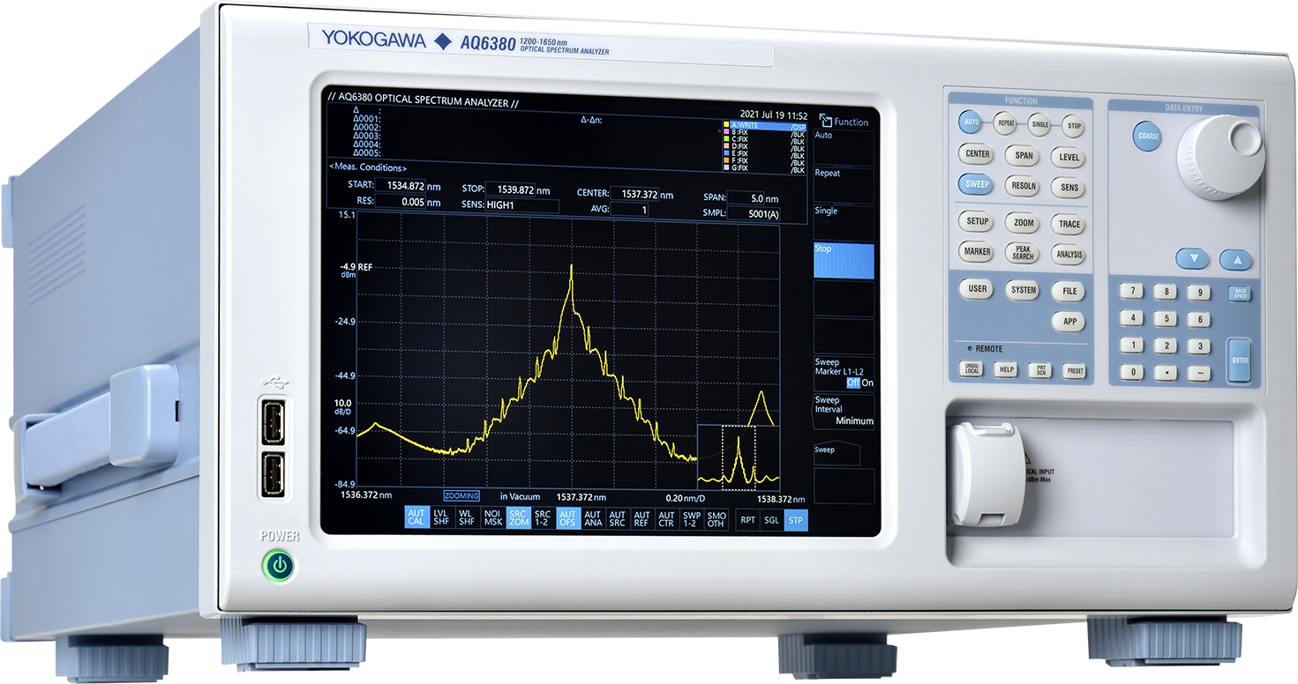
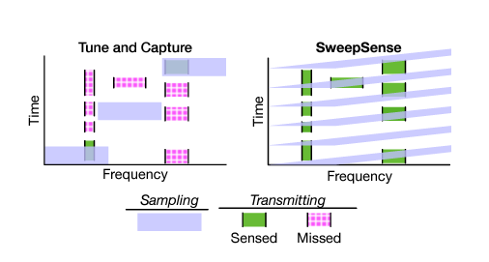
Related Work – Wideband Spectrum Sensing
High Cost => High Spatial granularity not possible!
Wideband Spectrum Analyzers
BigBand^{[1]}, SweepSense^{[2]}
[1] Hassanieh, Haitham, et al. "GHz-wide sensing and decoding using the sparse Fourier transform." IEEE INFOCOM 2014
[2] Guddeti, Yeswanth, et al. "SweepSense: Sensing 5 GHz in 5 Milliseconds with Low-cost Radios." 16th USENIX NSDI 2019.
Notes:
A lot of research has been done in this context and all of it can be broadly categorized into 2 types: 1) Enabling wideband spectrum sensing:- These systems mainly focus on different ways to improve the bandwidth of the sensed spectrum like using an expensive spectrum analyzer or developing algorithms to sweep across bands quickly. However, using a wideband receiver comes with huge cost and using multiple of them to perform granular spatial mapping would be expensive.

Slide 5
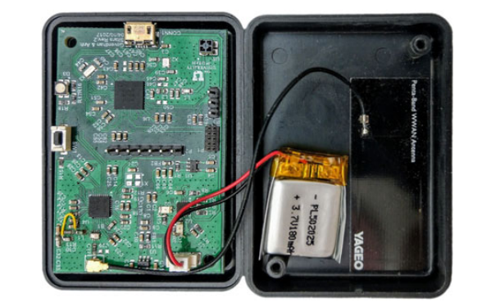
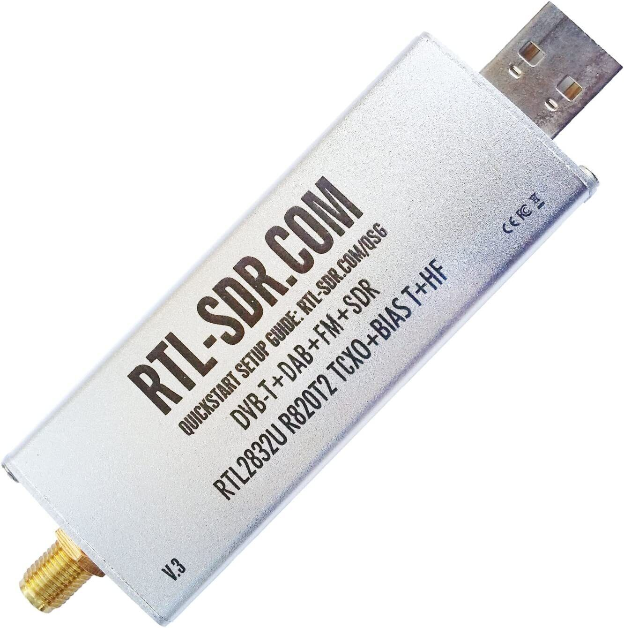
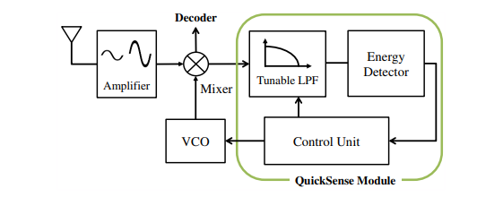
Related Work – Low-Cost Spectrum Sensing
Mostly narrowband/custom made sensors!
RTL-SDRs
Sitara^{[3]}, QuickSense^{[4]}, S^{3[5]}
[3] Smith, Phillip, et al. "Sitara: Spectrum measurement goes mobile through crowd-sourcing." IEEE MASS 2019
[4] Yoon, Sungro, et al. "QuickSense: Fast and energy-efficient channel sensing for dynamic spectrum access networks." IEEE INFOCOM 2013
[5] Guan, Junfeng, et al. "Efficient Wideband Spectrum Sensing Using MEMS Acoustic Resonators." 18th USENIX NSDI 2021.
Notes:
Other line of work either uses cheap spectrum sensors like RTL-SDRs or develops their own custom spectrum sensor such as QuickSense, Sitara, S3, which can be easily deployed in bulk to create a granular spatial map. However, their low cost comes with a “cost”, either they are narrowband or custom made sensors, which would take huge time to deploy.

Slide 6



RFIMap
Key Design Choice: Use RFIDs for Spectrum Sensing
Goal: Make Spectrum Mapping more scalable
$$f$$
Cheap
Battery-free
Easy Scalability
Wide Bandwidth
Performance: Median error of 3 dB across 2 GHz of bandwidth
Notes:
We present our system RFIMap, whose overall goal is to tackle all these problems and make spectrum mapping more scalable. To achieve that goal, we make a key design choice, that is use RFID’s for spectrum sensing. Why? Because RFIDs are cheap and battery-free which makes them one of the easiest technology to scale and deploy spatially. It also can scan wide bandwidth using just a single RFID reader and a wideband receiver. RFIMAp achieves a median error of 5 dB across 2 GHz of bandwidth – quite comparable to the state-of-the-art low-power spectrum sensing systems.

Slide 7






RFIMap - Overview
$$S_{2}(f)$$
$$S_{1}(f)$$
How to calculate $S_{i}\left(f\right)$ at every tag?
$$S_{3}(f)$$
$$S_{N}(f)$$
$$S(f, x, y)$$
Notes:
So, how does RFIMap work? Suppose we deploy lots of commercial and off-the-shelf RFID tags in a room where the spectrum map at a particular frequency ‘f’ is desired. If somehow, we can estimate the spectrum power estimate at each tag location, we can interpolate these measurements across the whole area to get a spectrum map at that frequency ‘f’.
But how does, RFIMap get spectrum power at each individual tag location for that frequency?

Slide 8
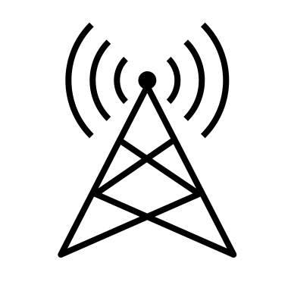
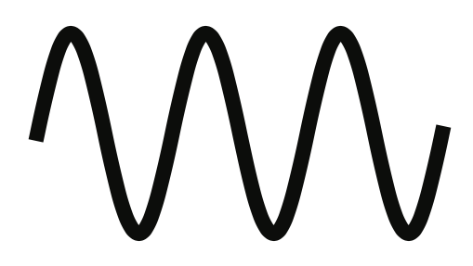
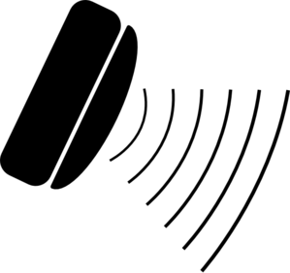

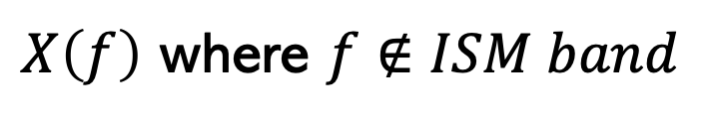
‘1’ (Reflect)
‘0’ (Absorb)
Ambient Source
T
2T
$X\left(f\right)$ where $f∉ISM band$
Tag
‘0’
‘1’
Reflected Signal
T
2T
$$X_{ref}(f)$$
Already been explored for localization and tracking in RFind^{[6]}, TurboTrack^{[7]}
RFID Reader
[6] Ma, Yunfei, et al. "Minding the billions: Ultra-wideband localization for deployed RFID tags." ACM MobiCom 2017
[7] Luo, Zhihong, et al. "3D Backscatter Localization for Fine-Grained Robotics." 16th USENIX NSDI 2019
Notes:
Before we understand this, we need to look at a key property of an RFID tag. Consider a single RFID reader-tag pair as shown here. The RFID reader powers the tag, which either absorbs (OFF) or reflects (ON) the reader signal according to the data it is supposed to send back to the reader. However, if we have another ambient transmitter transmitting at another frequency not in the ISM band, in the environment, the tag will also induce the same ON/OFF behavior at signals on this other frequency. Indeed, this effect has been exploited in the past to perform very accurate RFID localization.

Slide 9
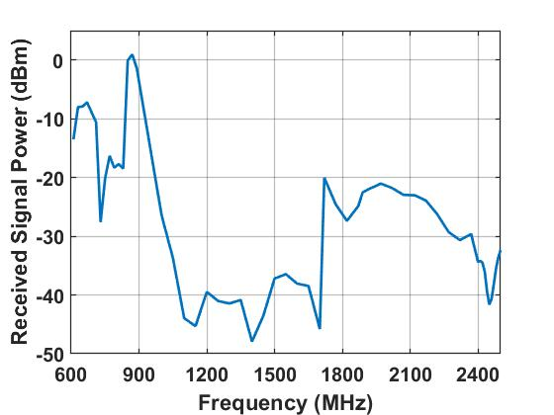
How good are reflections at other frequencies?
ISM Band
RFID Tags also reflect at harmonics of resonant frequency
Measure Frequency Response of Alien Squiggle RFID Tags
Harmonics
How do we use this to measure wideband spectrum?
Notes:
However, a natural question here to ask is - How good are these reflections at other frequencies? It has already been shown in the literature that RFID tag apart from being resonant at ISM band, also reflect at the harmonics of resonant frequency,. We confirm that by measuring the frequency response of commercial off-the-shelf Alien Squiggle RFID tags. We can observe that the RFID tags are resonant at ISM band as expected, but also reflect at the harmonics of the ISM band, albeit at a certain signal power loss. But, how do we use this phenomenon to measure wideband spectrum?

Slide 10

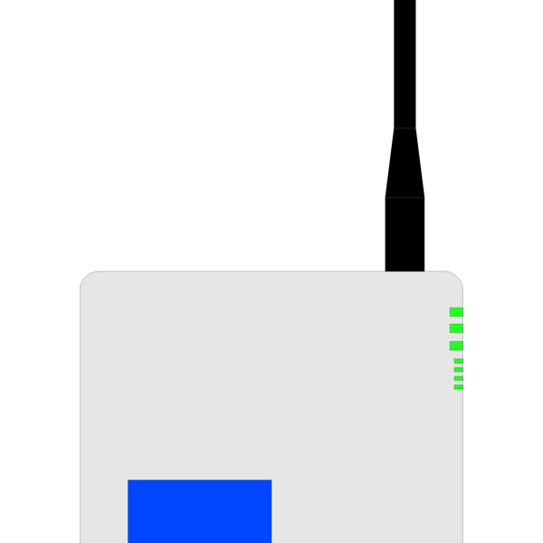





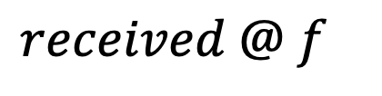


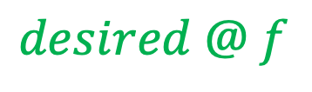

$h_{1}$
Tag
$$desired @ f$$
Source Signal
$$x @f∉ISM band$$
Quite challenging to do, since it requires extra transmission between the receiver and the tag at that frequency.
$h_{2}$
$$received =$$
$h_{2}$
$h_{1}$
$$x$$
$$received @ f$$
Extra term – Need to be eliminated
$desired$
Receiver
Notes:
Let us consider a single transmitter source transmitting at one of the frequencies ‘f’ apart from ISM band and now we want to measure its effect on the spectrum. Now, if the RFID tag could tell us the signal power measured at its location, we are done. But, it cant do that since it can only passively reflect the signals. Thus, we need a wideband receiver in the environment to receive the signals after being reflected by the tag. Now, the signal received by the receiver would be given by the combination of the source signal x, the channel between source and the tag, lets say it channel number 1 and the channel between tag and the receiver, lets say channel number 2. Now, the spectrum measurement at the tag which we want is given by this term, and this here is an extra term which needs to be estimated and eliminated to get the actual spectrum measurement. This is quite challenging to do, since measuring this channel requires another transmission at that frequency, which completely defeats the purpose of spectrum sensing.

Slide 11


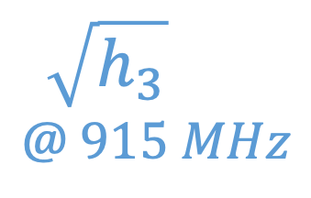

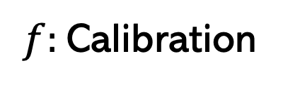
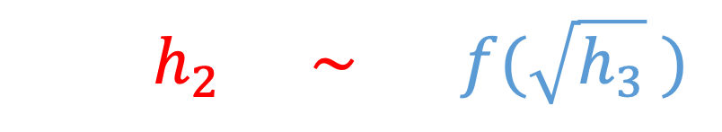
But we already have some transmission…
Tag
If the RFID Reader and Receiver are co-located
$h_{3}$
$h_{2}$
$${ h}_{2} \sim f(\sqrt{h_{3}} )$$
How do we estimate channel $h_{3}@ f$ ?
$f:$Calibration
Are we done?
NO!
Reader
$h_{2}$
$$@ f$$
$$\sqrt{h_{3}}$$
$$@ 915 MHz$$
Receiver
Notes:
But we already have some transmission going on in the system. The RFID reader which sends power signal to the tag to keep it powered on, also provides round-trip channel information. If we ensure that both the RFID reader and the wideband receiver are co-located, then both of these channels h2 and h3 are strongly correlated with one another. This means that if we have channel information about one channel h3 from the reader, we can estimate the channel h2 using a single-shot calibration process. So, are we done? No. There is a small caveat here – the above equation only holds true if both channels are at the same frequency. But in our scenario, the channel h2 in red is at the source transmitter frequency f, but the channel h3 in blue is operating at 915 MHz ISM band. So, how do we use this existing transmission to estimate the channel h3 at any other random frequency?

Slide 12



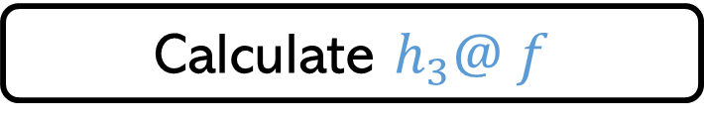
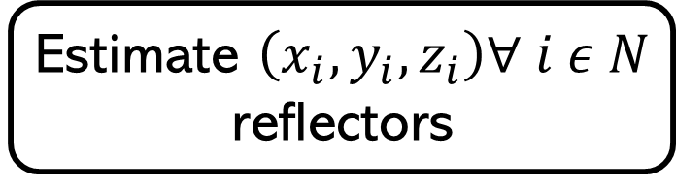
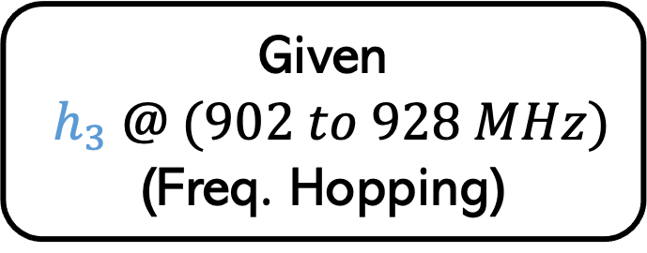
Use ray tracing models
Tag
Tag
Given
$h_{3} @ (902 to 928 MHz)$
(Freq. Hopping)
$$(x_{2},y_{2},z_{2})$$
M2
$$h_{3}$$
M1
Estimate $\left(x_{i},y_{i},z_{i}\right)∀ i ε N$ reflectors
$$(x_{1},y_{1},z_{1})$$
Calculate $h_{3}@ f$
Exact details are in the paper!
Reader
Reader
Notes:
We use Ray tracing models to generalize channel at any other frequency. For this scenario, assuming we have N reflector locations, the ray tracing model looks something like this. We get the channel h3 information at multiple ISM band frequencies because of the US RFID protocols. Using this model, we then estimate the location of reflectors in the environment. We can use these reflector locations to then estimate the channel h3 at any other frequency. To get to know about exact details, please read our paper.

Slide 13


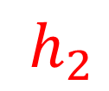

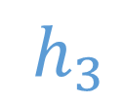


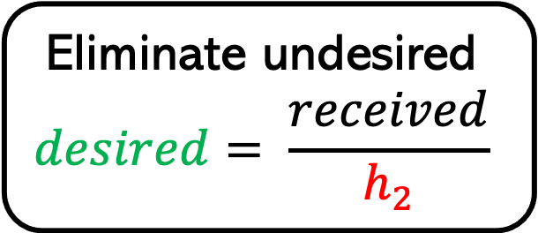
Putting it all together…
$$desired$$
Measure
$h_{3} @ ISM$
Calculated
$h_{3} @ f$
$h_{3}$
$h_{2}$
Estimate
$h_{2} @ f$
$$received= h_{2} .desired$$
Eliminate undesired
$$desired= \frac{received}{h_{2}}$$
Notes:
Now, putting it all together, we first measure the channels at multiple freq in ISM band, we calculate the channel h3 at frequency f using ray tracing models, then estimate the channel h2 at frequency f, and finally we eliminate this channel to get the desired spectrum measurement at the tag.

Slide 14
Other Challenges
Smart Interpolation to create spectrum map
Disambiguating small-sized reflectors using TV whitespaces
Scaling the system to multiple ambient sources
More details are in the paper!
Notes:
There are several other challenges as well which RFIMap solves such as smart interpolation of these spectrum measurements at all RFID tags to create a spectrum map, disambiguating small sized reflectors and scaling the system to multiple transmitters. To get more details, please read our paper.

Slide 15
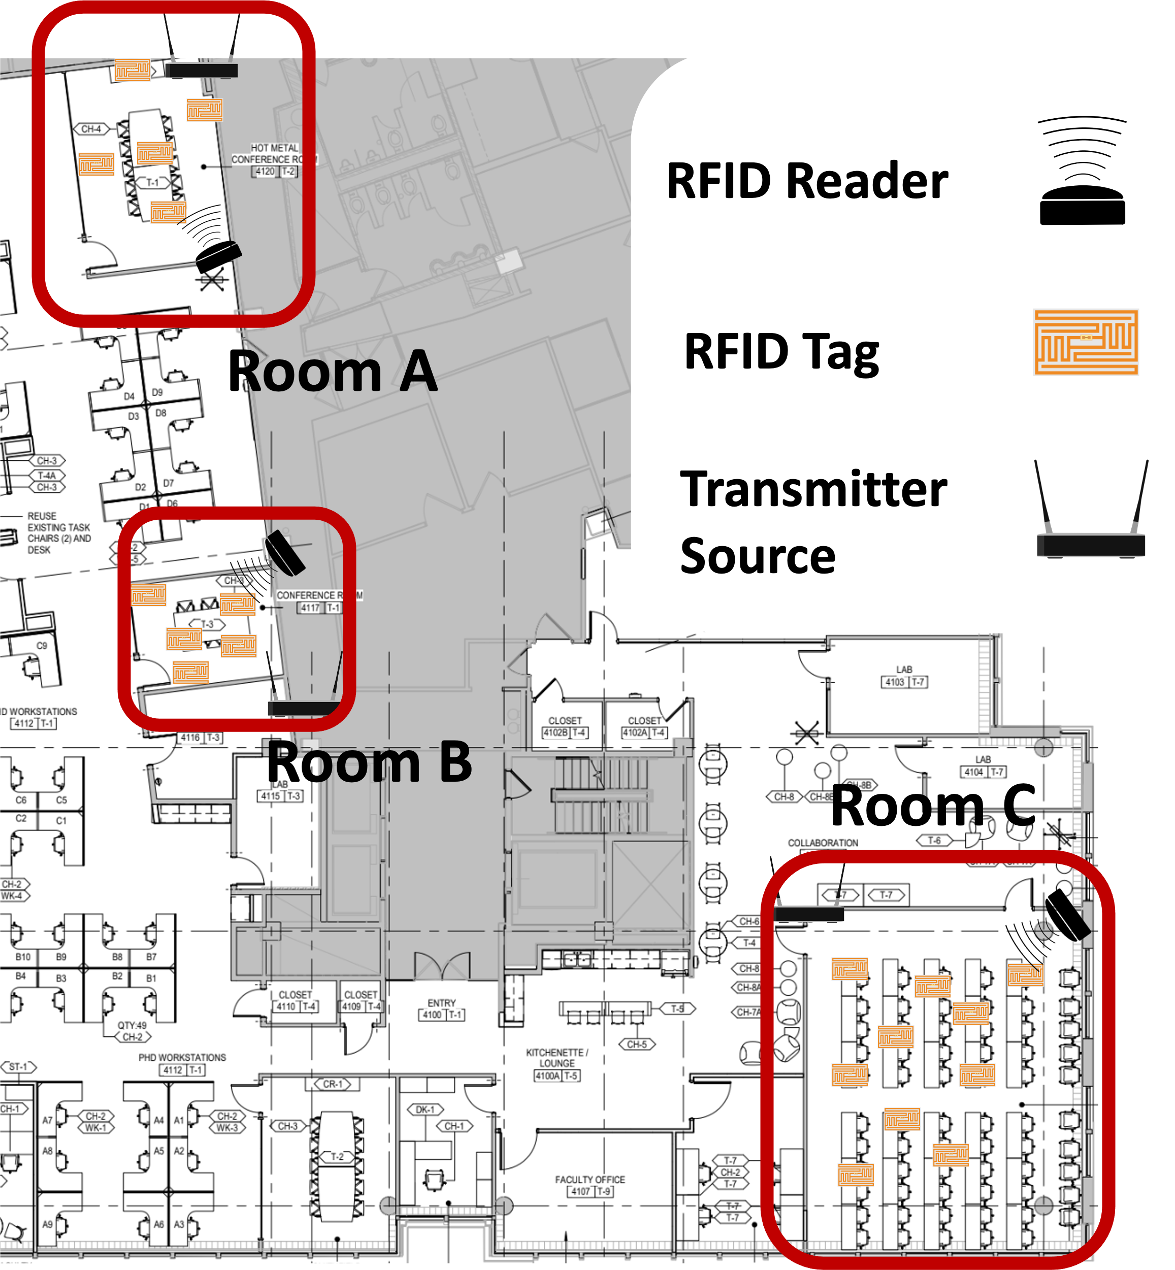
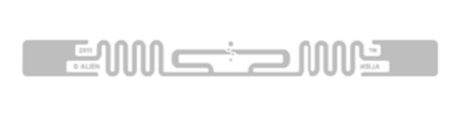
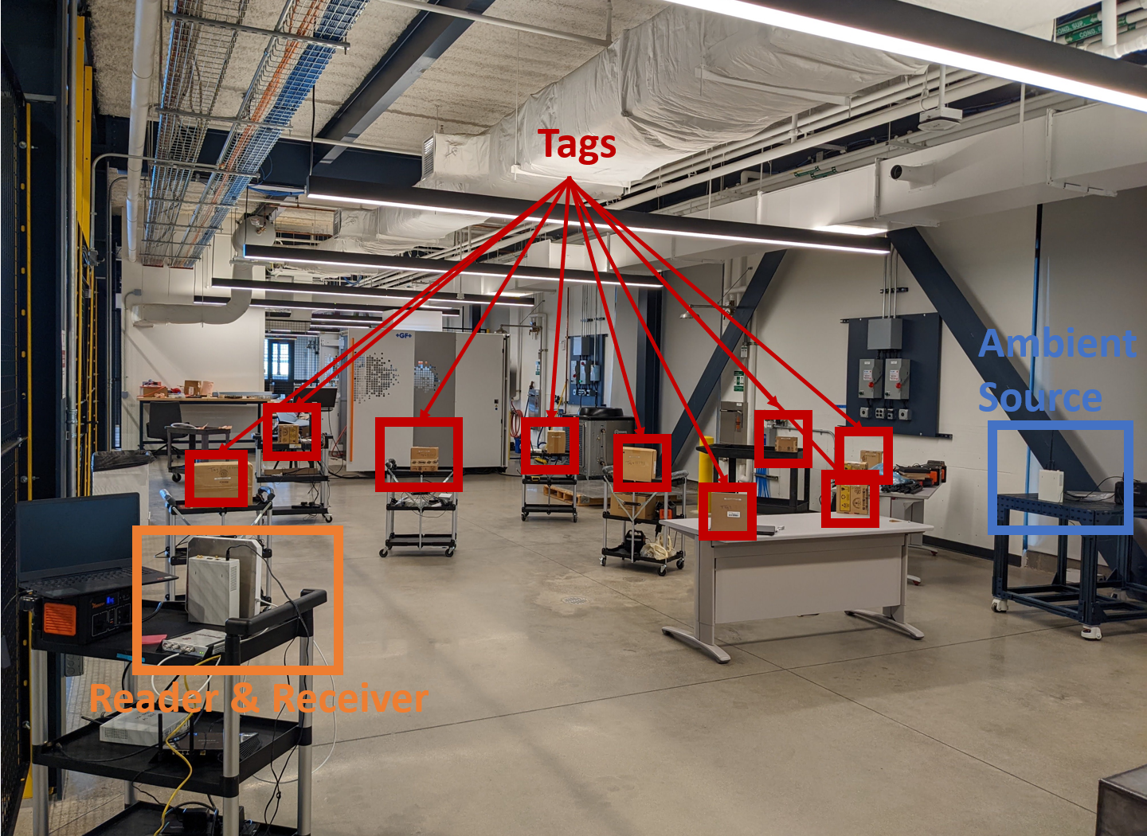
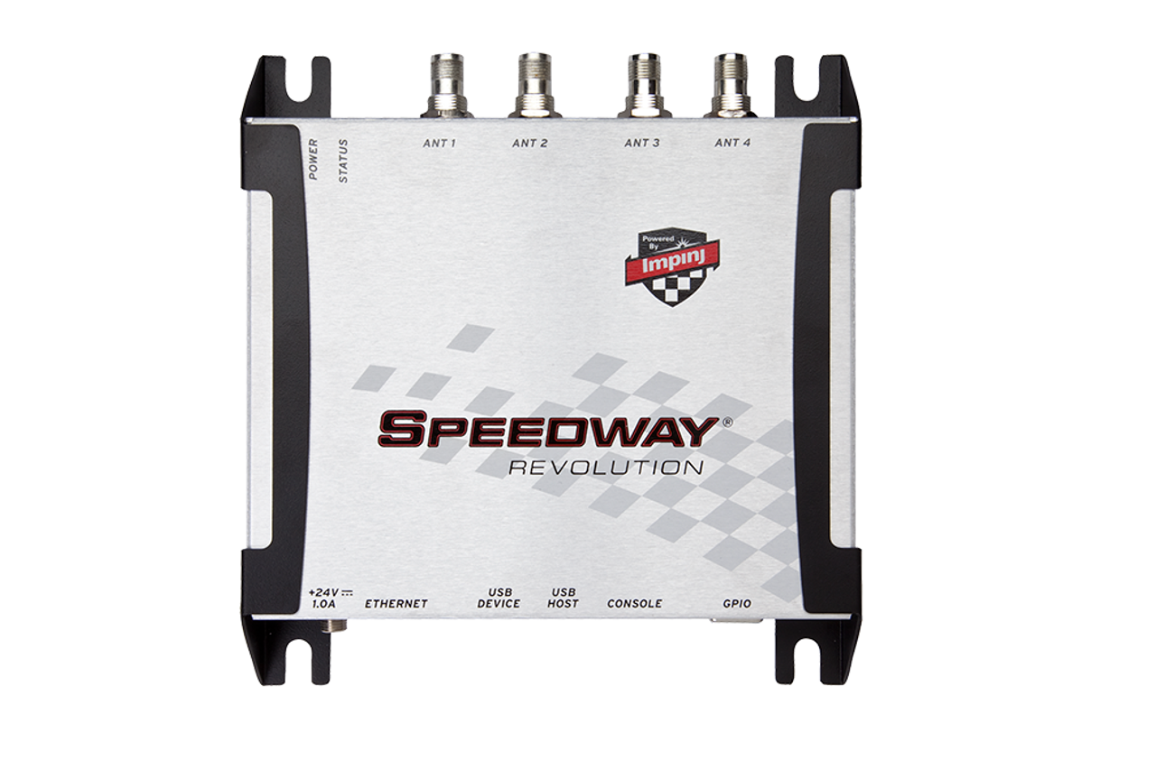
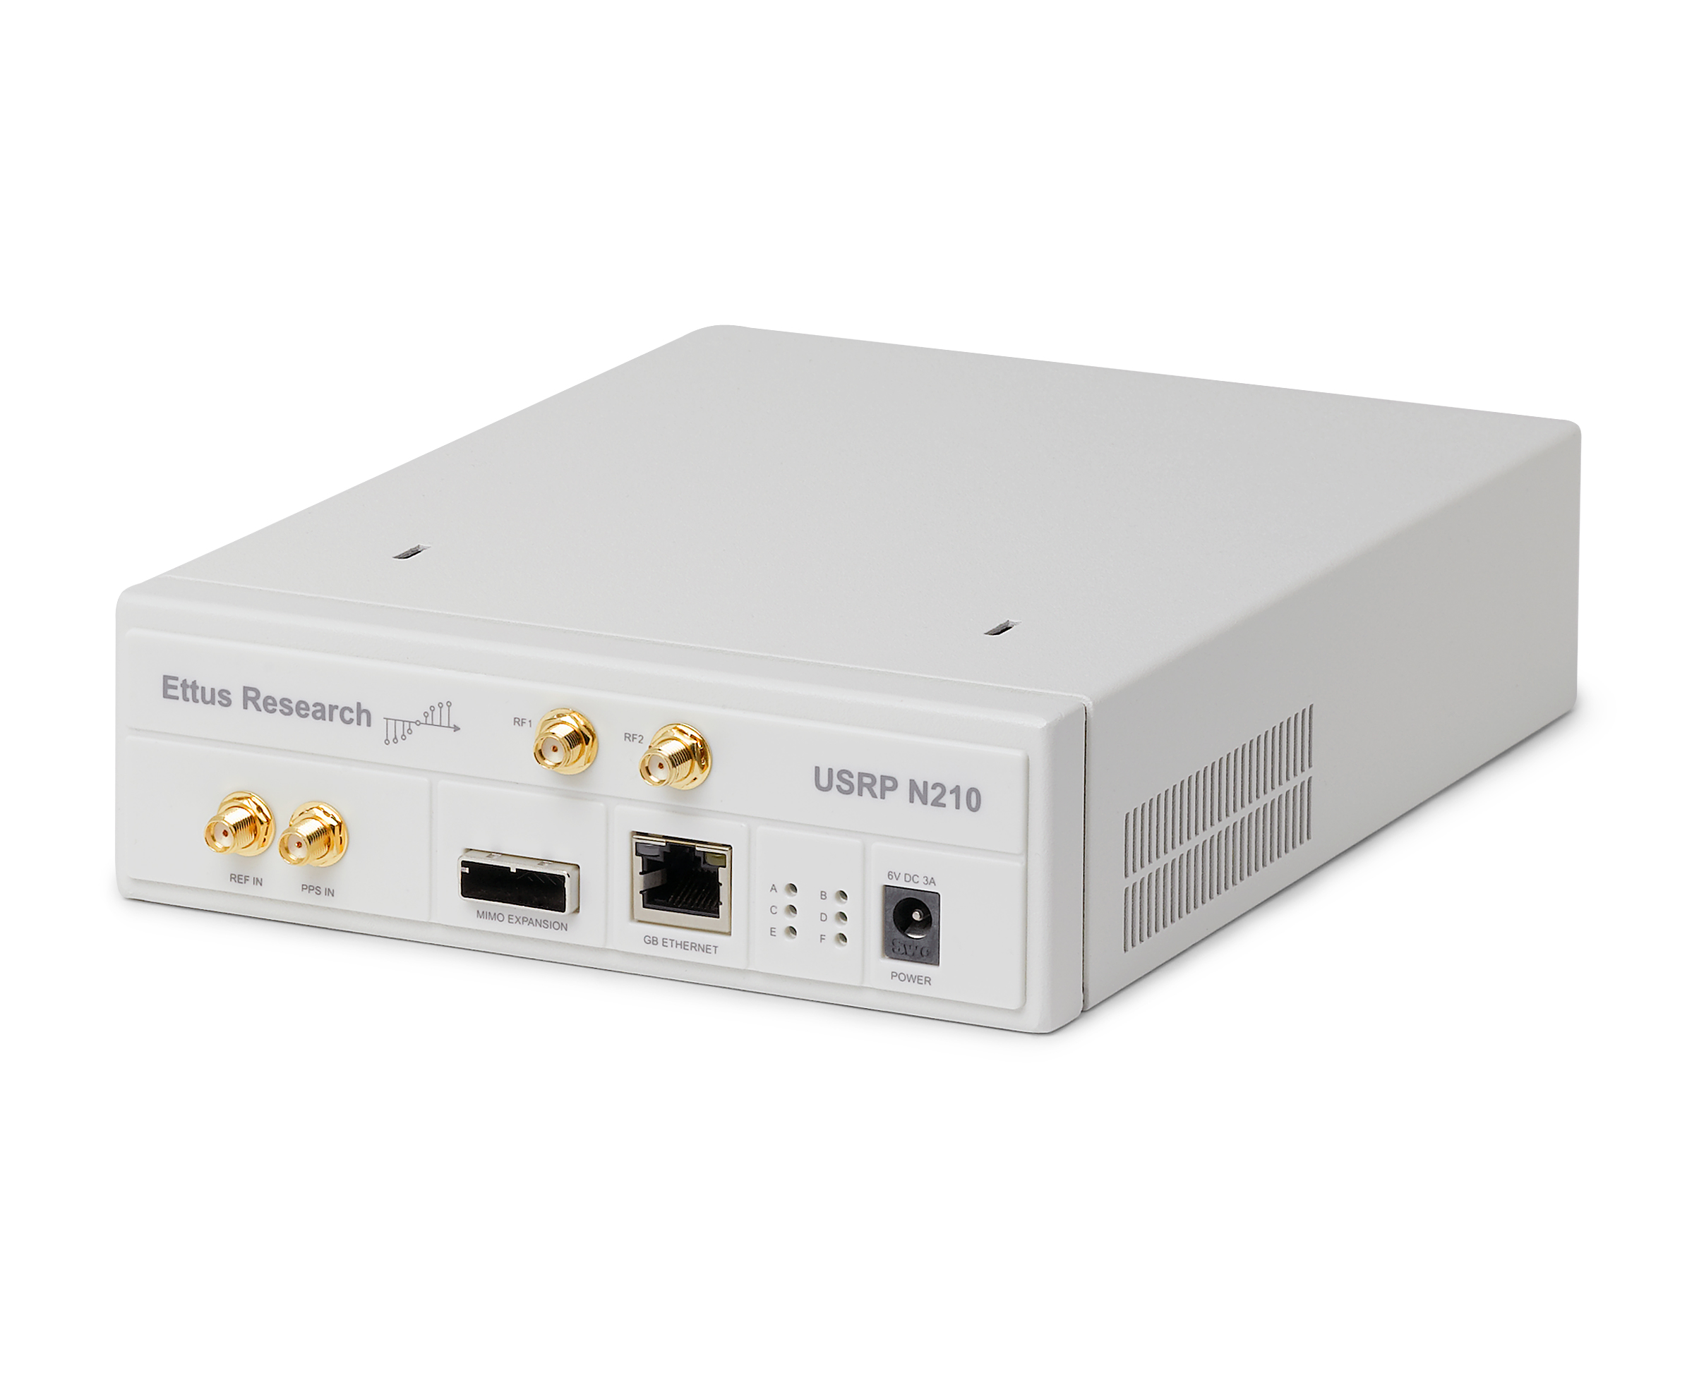
Implementation:
Alien ALN9640 Squiggle RFID Tags
Impinj RFID Reader
USRP N210’s to emulate wideband receiver using Frequency Hopping
Multiple Rooms in a Building
CMU Manufacturing Facility (Mill 19)
Notes:
To implement our system, we use off the shelf Alien Squiggle RFID tags, an off the shelf Impinj RFID reader and a single USRP N210s to emulate wideband receiver using Frequency Hopping. We implement RFIMap on two different testbeds including multiple conference rooms in a building and a manufacturing facility owned by CMU.

Slide 16
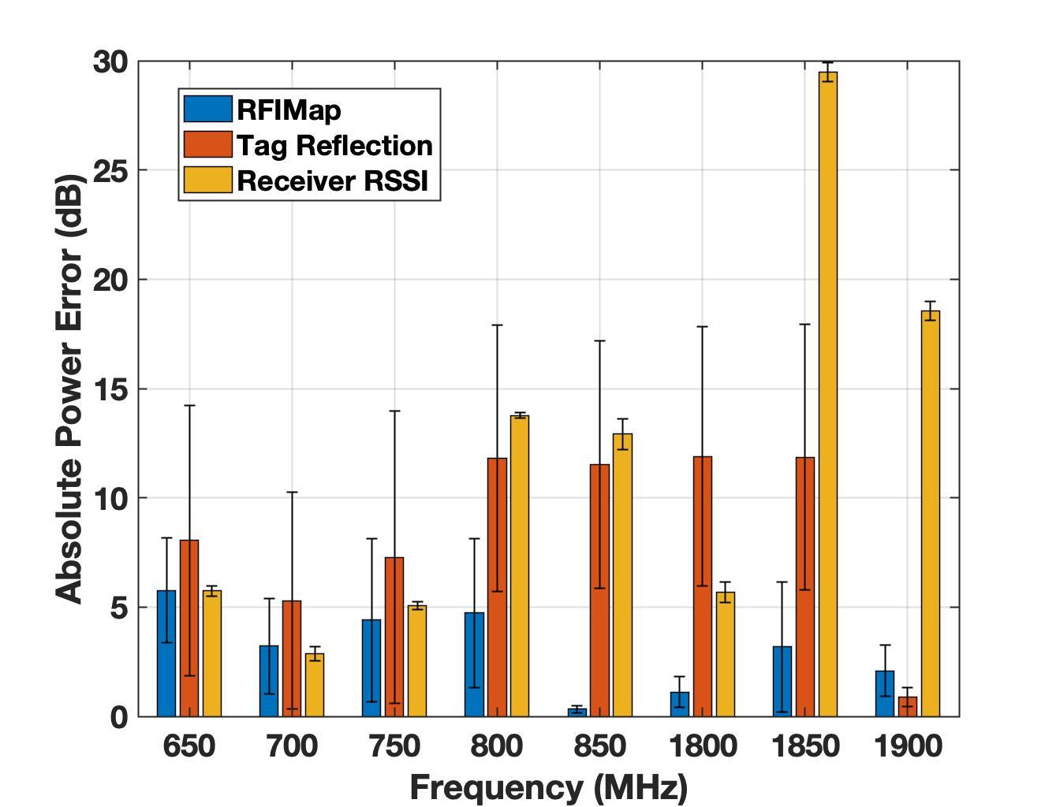
Results:
Baselines:
Tag reflection
Receiver RSSI
Median error of 3 dB across all frequencies from 650 MHz to 2 GHz
Notes:
Here are the RFIMap results. This plot represent the Absolute Power Error of spectrum measured using RFIMap across a wide band of frequencies from 650 MHz to 2 GHz. We compare RFIMap against 2 baseline – Tag Reflection baseline represents the absolute error with channel obtained at the receiver with no direct path channel correction and Receiver RSSI baseline represent the error obtained by using the direct signal power obtained at the receiver as the true spectrum measurement. We achieve a median error of 5 dB across all frequencies from 650 MHz to 2 GHz which is comparable to state-of-the art low-power spectrum sensing

Slide 17
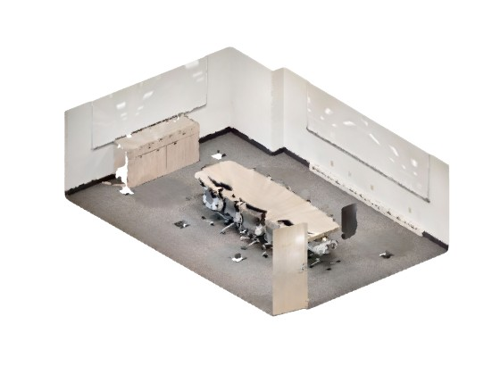
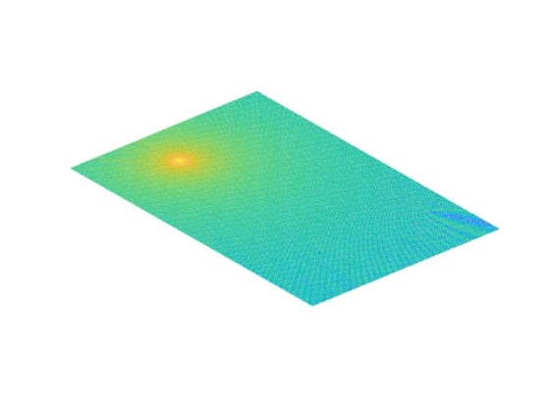
Results:
Maximum Spectrum Power
Transmitter Source Location
RFID Tags Location
Spectrum Map generated by RFIMap with maximum power close to the actual transmitter source location!!
Notes:
This is an example of how our spectrum map looks like as outputted from RFIMap. In this scenario, there is a single transmitter source represented by black dot and there 4 RFID tags placed across the room. We can see in the spectrum map that the high power components of the spectrum lie quite close to the actual transmitter location, validating the accuracy of our system.

Slide 18
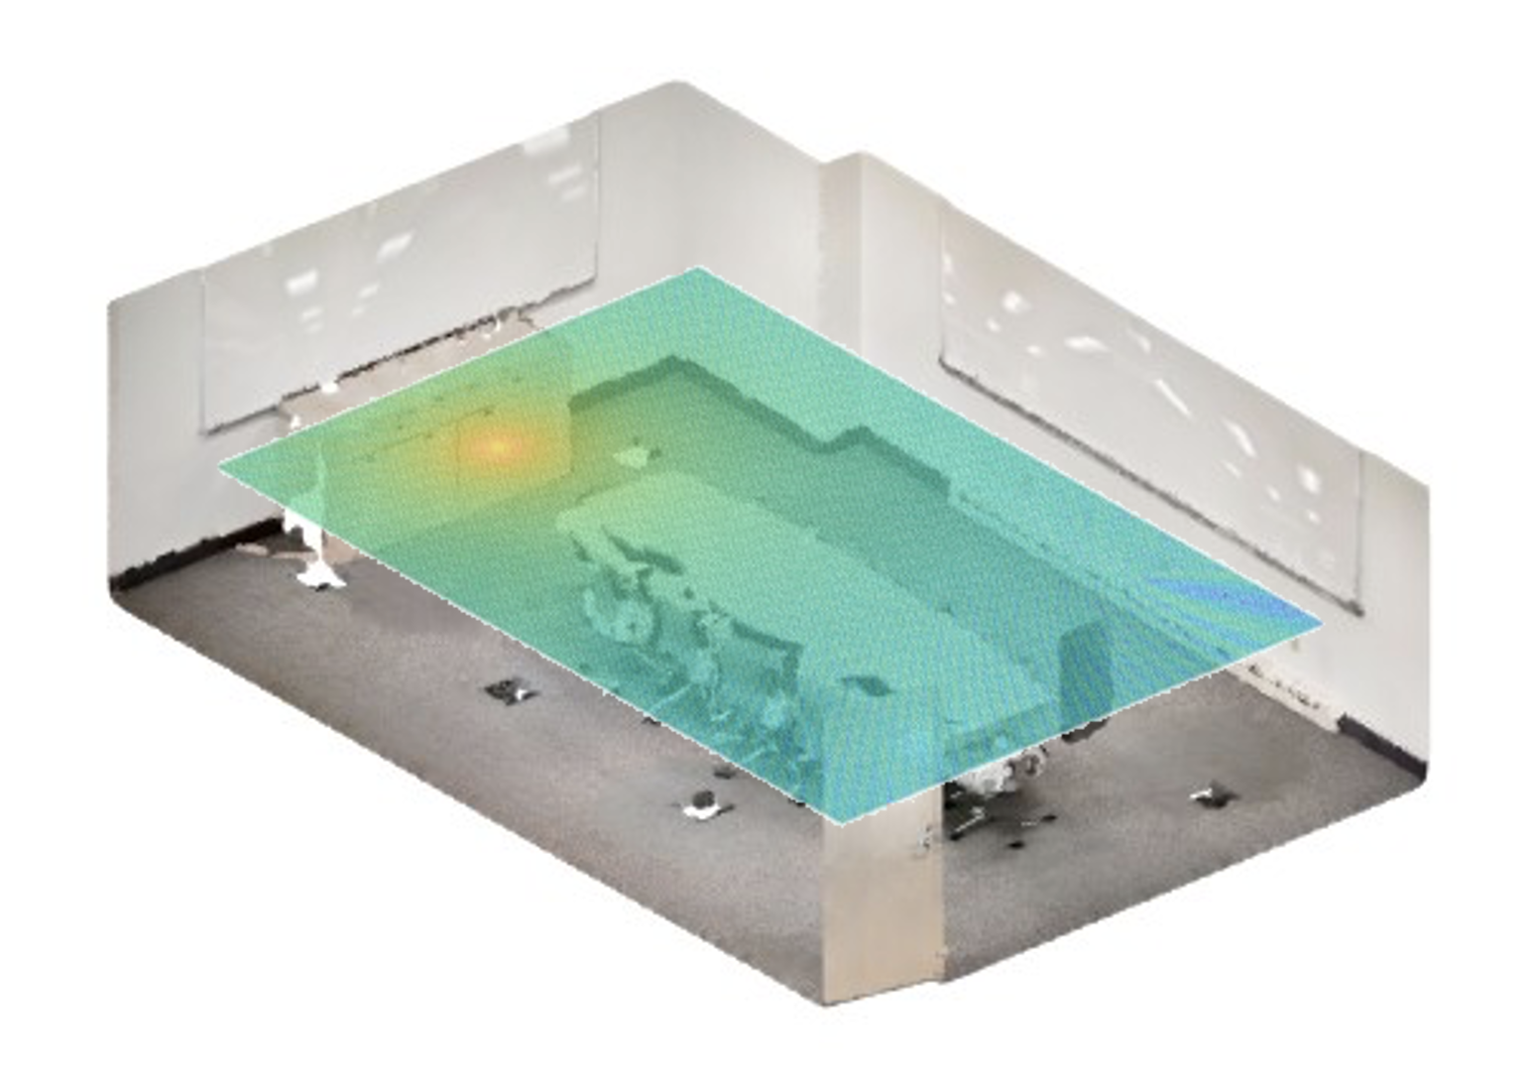
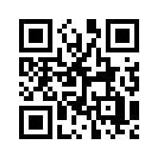
Conclusion
We present RFIMap – First wideband spectrum mapping system using off-the-shelf RFID tags
Uses RFID to estimate the spectrum power at tags indirectly and interpolates to create a spectrum map
Median Power Error of 3 dB across 2 GHz of bandwidth
Notes:
To conclude, we present RFIMap – which is the first wideband spectrum mapping system using off-the-shelf RFID tags. RFIMap creates a spectrum map by estimating the spectrum power at individual tags iindirectly and then interpolating. It achieves an absolute Power error of 5 dB across 2 GHz of bandwidth.

Slide 19
Some more points…
Tag Orientation Effects: Deploy multiple tags at different orientations
Wideband receiver: Can be extended to any spectrum analyzer
Sensing range: Limited by 15 m range of RFID.
Notes:
I want to add a few points regarding RFIMap before I conclude:- To deal with variations of tag reflections because of orientation, we deploy multiple tags at different orientations at the same location.
Even though, we use a single USRP to emulate a wideband receiver, RFIMap can be easily extended to any spectrum analyzer
And finally, RFIMap sensing range is limited by the range of RFID – which is about 15 m in the best case.

Slide 20
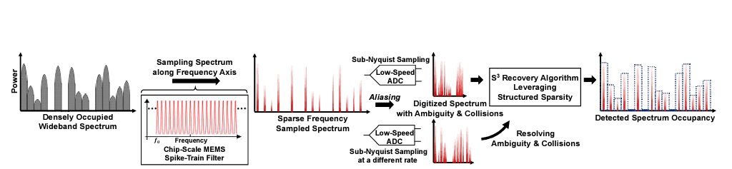
Related Work – S^{3[4]}
Custom made sensors and not easily deployed!
Low-Cost Wideband Spectrum Sensor using MEMS resonators
Notes:
There have been some recent works like S3, which have developed a low-cost wideband spectrum sensor, but these are custom made and are quite far away to be available in the market in near future.

Slide 21


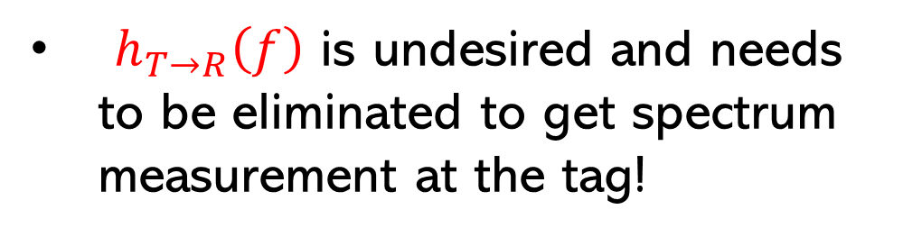



$$h_{s→T}\left(f\right)$$
Tag (T)
Ambient Source (S)
Received signal at R:
$$h_{T→R}\left(f\right)$$
$$y_{R}\left(f\right)= { x}_{s}(f)$$
$$h_{s→T}\left(f\right)$$
$$h_{T→R}\left(f\right)$$
Quite challenging to do, since it requires extra transmission between the receiver R and the tag T at that frequency.
Both $h_{s→T}\left(f\right)$ and $h_{T→R}\left(f\right)$ include the LOS and NLOS path!
$h_{T→R}\left(f\right)$ is undesired and needs to be eliminated to get spectrum measurement at the tag!
Wideband Receiver (R)
RFID Reader (H)
Notes:
Coming back to the reader-tag pair we have, if we have a wideband receiver, colocated with the reader, the receiver would receive the ambient source signal at a random frequency after being reflected by the tag. The signal obtained at the receiver can be written as a combination of this channel and this channel. Note that, both of these channels include both the Line of Sight and Non-Line of Sight paths. However, we only want this part of the signal to be measured and this part is totally undesired. Thus, we need to eliminate the effect of this direct channel between the tag and the receiver. This is quite challenging to do, since measuring this channel requires another transmission at that frequency, which completely defeats the purpose of spectrum sensing. Thus, we need to indirectly measure this channel and eliminate it. To do that we make 2 observations:-

Slide 22
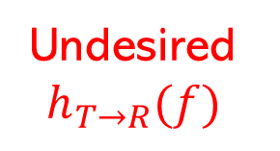

Observation 1:
$h_{T→R}$ and $h_{T→H}$ are strongly correlated $→h_{T→R} α h_{T→H}$
Tag (T)
Tag (T)
Undesired $h_{T→R}(f)$
$$h_{T→H}(f)$$
Wideband Receiver (R)
RFID Reader (H)
Co-Located!
Notes:
First, since our wideband Receiver and the RFID reader are at the exact same location => thus the undesired channel h_tag_to_receiver at any frequency is strongly correlated with channel h_tag_to_reader at the same frequency. Thus, given we have information about the channel between the tag to the reader, the channel between tag to the receiver can be calculated using a one-shot calibration process.

Slide 23


Observation 2:
$h_{T→H}\left(f\right)$ for multiple $fε \left[902 MHz, 928 MHz\right]$ is known due to Frequency Hopping
Tag (T)
RFID reader provides channel information already!
$$h_{T→H}\left(f\right)$$
RFID Reader (H)
Notes:
Our second observation is that our RFID reader already provides channel information only for the operating frequencies of RFID tags. In the US, RFID protocol requires it to continuously hop at multiple frequencies in the ISM band and thus, we already know channel information at multiple frequencies in the ISM band.

Slide 24

Combine both observations:
Observation 1: $h_{T→R}$ and $h_{T→H}$ are strongly correlated $→h_{T→R} α h_{T→H}$
Observation 2: $h_{T→H}\left(f\right)$ for multiple $fε \left[902 MHz, 928 MHz\right]$ is known due to Frequency Hopping
How to generalize to other frequencies?
Inference: $h_{T→R}(f)$ is known for multiple $fε \left[902 MHz, 928 MHz\right]$!
Notes:
Thus, if we combine both observations, we can infer that the channel from the tag to the receiver is know for multiple frequencies in the ISM band. But, how do we generalize this to other frequencies

Slide 25
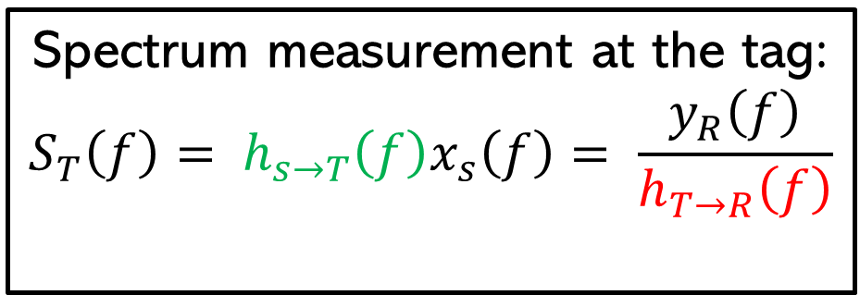



$$h_{s→T}\left(f\right)$$
Tag (T)
Ambient Source (S)
Received signal at R:
$$h_{T→R}\left(f\right)$$
$$y_{R}\left(f\right)= { x}_{s}(f)$$
$$h_{s→T}\left(f\right)$$
$$h_{T→R}\left(f\right)$$
Spectrum measurement at the tag:
$$S_{T}\left(f\right)= h_{s→T}\left(f\right)x_{s}\left(f\right)= \frac{y_{R}\left(f\right)}{h_{T→R}\left(f\right)}$$
Wideband Receiver (R)
Notes:
Now, coming to our original setup, given we have estimated channel from tag to the receiver, we can now estimate what would be the spectrum measurement at the tag location. We do that by dividing Received signal at the Receiver with the estimated channel.

