Slide 1

Fast, Fine-grained, and Robust Grouping of RFIDs
Meng Jin, Kexin Li, Xiaohua Tian, Xinbin Wang, Chenghu Zhou
Shanghai Jiao Tong University

Slide 2
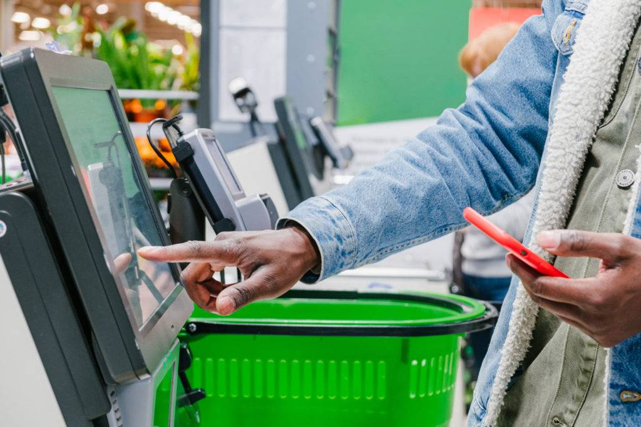
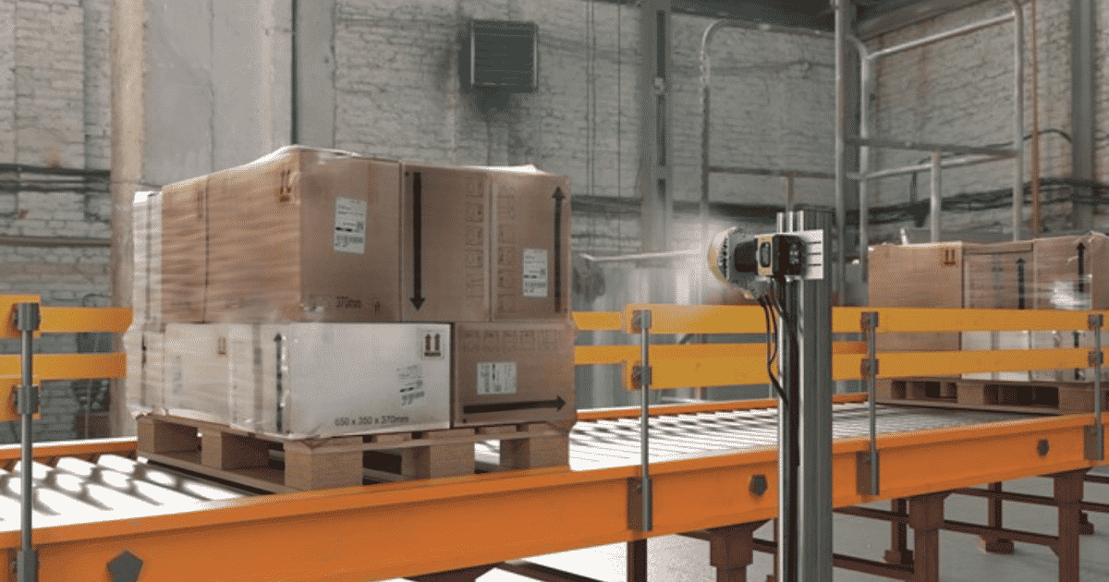
Background
Smart retail
Automated logistic
Efficient and accurate inventory tracking is important!
2

Slide 3
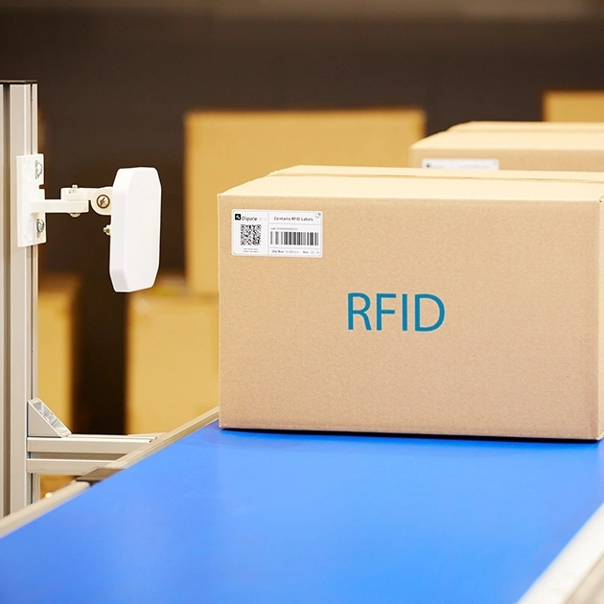
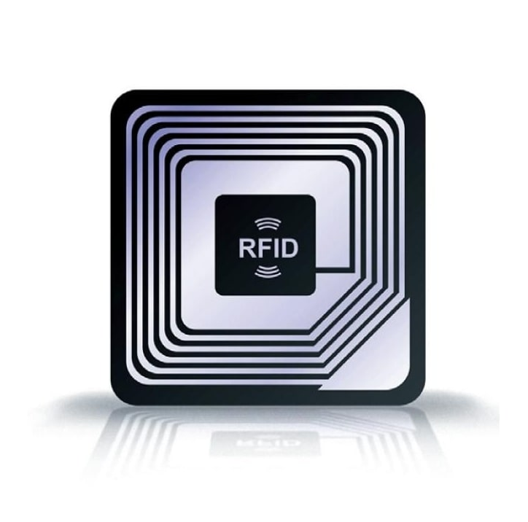
RFIDs
3

Slide 4
RFID Reader
4

Slide 5
RFID Reader
Box2
Box1
5
5

Slide 6
Is it possible to perform more fine-grained inventory tracking?

Slide 7
Multiple boxes pass simultaneously
RFID Reader
7

Slide 8
Multiple boxes pass simultaneously
Box A
Box B
RFID Reader
Box D
Tag 1 belongs to box A
Tag 2 belongs to box B
Tag 3 belongs to box A
Tag 4 belongs to box D
…
Box C
8

Slide 9
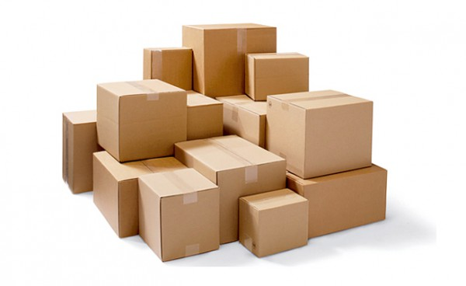
Localization based solution?
Reference Tag
RSSI and/or Phase
Localize tags with centimeter-level accuracy
Determine which box each tag belongs to
9

Slide 10

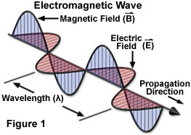
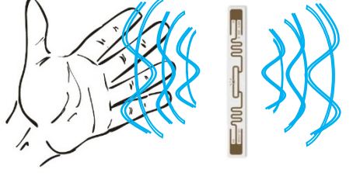
Localization based solution?
Unreliable in inventory scenarios
Coupling effect
NLoS and Multipath
Random geometric distribution
10

Slide 11
Localization based solution?
Other practical issues:
Long localization delay
Requiring multiple readers & antenna array
…

Slide 12
TaGroup
Fast, fine-grained, and robust RFID grouping

Slide 13
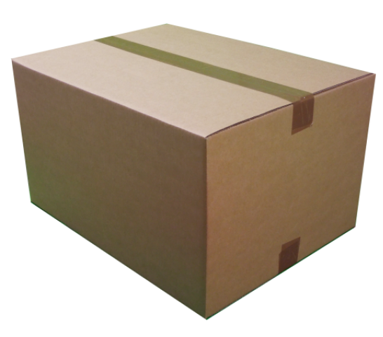
Localization based solution?
Tag-to-Reader Channel
Unreliable: Based only on the metrics of the tag-to-reader channel
Inefficient: Localize tags one by one
13

Slide 14
Localization based solution?
Tag-to-Reader Channel
Unreliable: Based only on the metrics of the tag-to-reader channel
Inefficient: Localize tags one by one
14

Slide 15
Localization based solution?
Tag-to-Reader Channel
Unreliable: Based only on the metrics of the tag-to-reader channel
Inefficient: Localize tags one by one
15

Slide 16
Localization based solution?
Tag-to-Reader Channel
Unreliable: Based only on the metrics of the tag-to-reader channel
Inefficient: Localize tags one by one
16

Slide 17
Localization based solution?
Tag-to-Reader Channel
Unreliable: Based only on the metrics of the tag-to-reader channel
Inefficient: Localize tags one by one
17

Slide 18
Localization based solution?
Tag-to-Reader Channel
Unreliable: Based only on the metrics of the tag-to-reader channel
Inefficient: Localize tags one by one
18

Slide 19
Localization based solution?
Tag-to-Reader Channel
Inaccurate channel measurements
19

Slide 20
Localization based solution?
Inaccurate channel measurements
Unreliable localization results
20

Slide 21
Proximity based solution
Transforming the localization problem to a proximity grouping problem
Inter-tag channel
Rely on the inter-tag channel instead of the tag-to-reader channel
Leverage multiple channels to localize one tag
21

Slide 22
Proximity based solution
Transforming the localization problem to a proximity grouping problem
Inter-tag channel
Rely on the inter-tag channel instead of the tag-to-reader channel
Leverage multiple channels to localize one tag
22

Slide 23
How to build a channel between tags?

Slide 24
Inter-tag reflection
Querying two tags simultaneously
24

Slide 25
Inter-tag reflection
Querying two tags simultaneously
25

Slide 26
Inter-tag reflection
Querying two tags simultaneously
26

Slide 27
Inter-tag reflection
Querying two tags simultaneously
27

Slide 28
Inter-tag reflection
Querying two tags simultaneously
28

Slide 29
Inter-tag reflection
Querying two tags simultaneously
Inter-tag channel
29

Slide 30
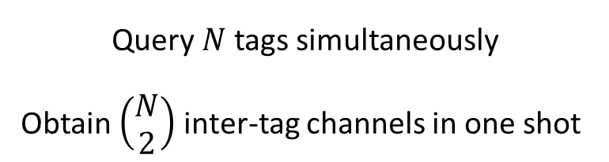
Inter-tag reflection
Querying two tags simultaneously
Query $N$ tags simultaneously
Obtain $\left(\begin{matrix}N \\ 2\end{matrix}\right)$ inter-tag channels in one shot
30

Slide 31
Inter-tag reflection
Query multiple tags simultaneously…
Efficient: Process tags in parallel and build multiple channels at each time slot
31

Slide 32
Inter-tag reflection
Query multiple tags simultaneously…
Efficient: Process tags in parallel and build multiple channels at each time slot
32

Slide 33
Inter-tag reflection
Query multiple tags simultaneously…
Efficient: Process tags in parallel and build multiple channels at each time slot
33

Slide 34
Inter-tag reflection
Query multiple tags simultaneously…
Efficient: Process tags in parallel and build multiple channels at each time slot
34

Slide 35
Inter-tag reflection
Query multiple tags simultaneously…
Efficient: Process tags in parallel and build multiple channels at each time slot
35

Slide 36
Inter-tag reflection
Group 2
Group 1
Group 4
Group 3
Obtain a proximity relation graph efficiently
36

Slide 37
Solving two practical challenges
37

Slide 38
Solving two practical challenges
How to isolate the inter-tag reflection from the superposed signal
38

Slide 39
Solving two practical challenges
How to isolate the inter-tag reflection from the superposed signal
How to distill parameters of the inter-tag channel form the inter-tag reflection which travels along indirect path.
More details can be found in our paper
39

Slide 40
Graph-based grouping

Slide 41
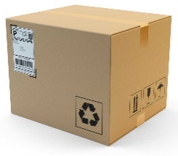
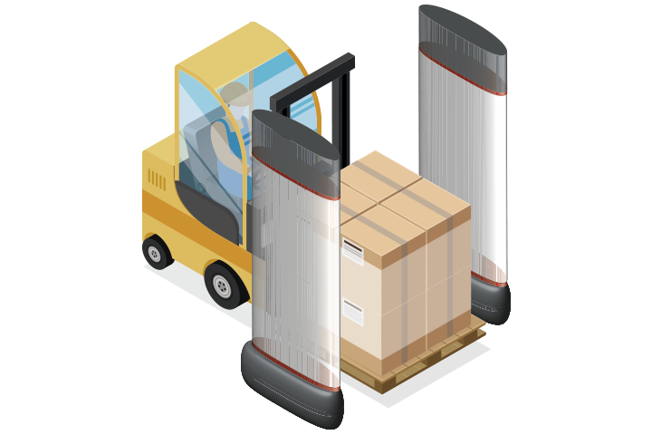
TaGroup
Reference tag
On-item Tags
……
Slots
1
2
3
4
5
6
7
8
9
10
11
12
13
14
15
16
17
18
19
20
41

Slide 42
TaGroup
Inter-tag Channel Extraction
PRG Graph Construction
1
2
1
Ref A
Ref B
1
3
-1
……
2
3
-1
Collision signal
RF-bonds
Slot 1
Slot 1+2
Slot 1+..+K
1
2
……
3
Slots
1
2
3
4
5
6
7
8
9
10
11
12
13
14
15
16
17
18
19
20
42

Slide 43
TaGroup
Inter-tag Channel Extraction
PRG Graph Construction
1
2
1
Ref A
Ref B
1
3
-1
……
2
3
-1
Collision signal
RF-bonds
Slot 1
Slot 1+2
Slot 1+..+K
Set A
Set B
1
4
2
5
……
3
6
Slots
1
2
3
4
5
6
7
8
9
10
11
12
13
14
15
16
17
18
19
20
43

Slide 44
Evaluation

Slide 45
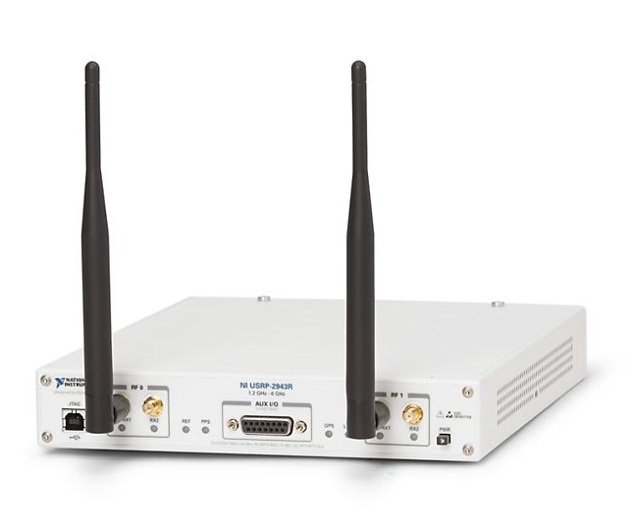
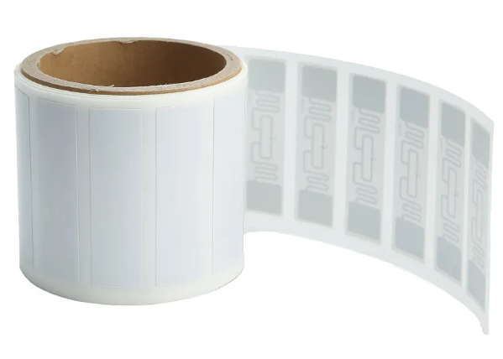
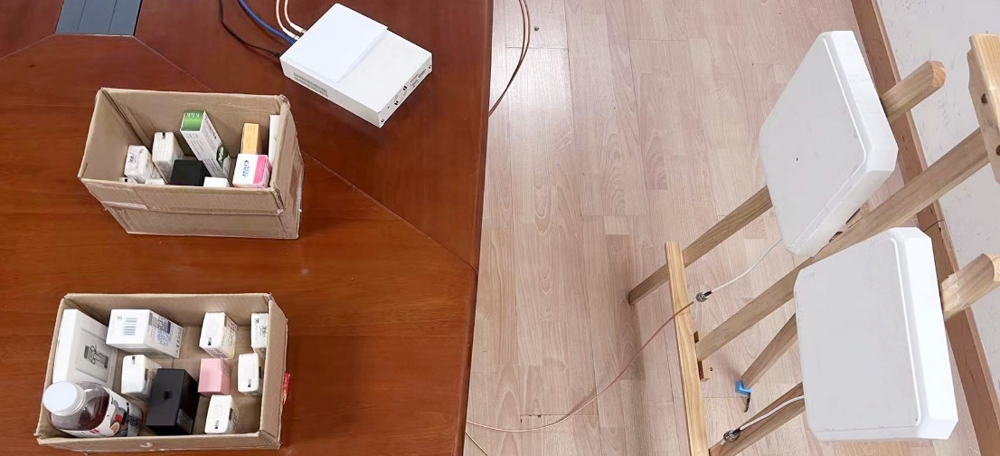
Implementation
Reader implementation: USRP N2920 equipped with WBX daughterboards
Tag side: Alien Squiggle RFIDs
2 groups
3 groups
4 groups
Container
Reader
Reference
Tagged items
RX & TX antennas
45

Slide 46
Comparison to State-of-the-Art
TaGroup: One antenna + two reference tags.
STPP: One moving antenna + two reference tags
60 tags; Three groups
46

Slide 47
Performance with more antennas
Tag Scale=60
Tag Scale=120
Numbers of references: 1
Numbers of references: 1
47

Slide 48
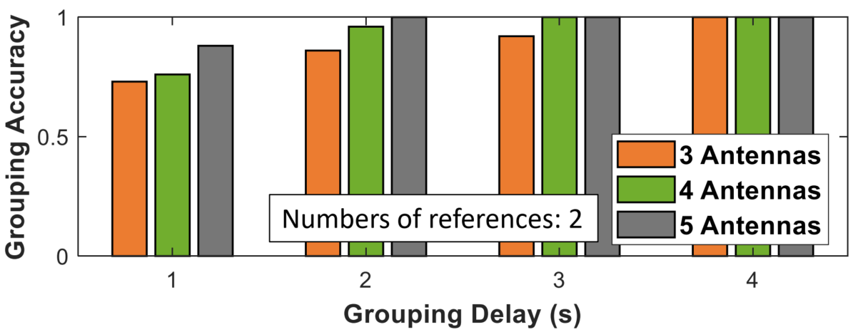
Grouping Speed
TaGroup can achieve a nearly 100% accuracy in grouping 120 tags into 4 closely located groups, at the cost of only 3 seconds.
48

Slide 49
Advantages
Robustness: leverages multiple channels to localize one tag.
Usability: achieves decent performance using one antenna.
Efficiency: supports parallel sensing.
49

Slide 50
Fast, Fine-grained, and Robust Grouping of RFIDs
Inter-tag Channel Extraction
PRG Graph Construction
1
2
1
Ref A
Ref B
1
3
-1
……
2
3
-1
Collision signal
RF-bonds
Slot 1
Slot 1+2
Slot 1+..+K
Set A
Set B

Slide 51
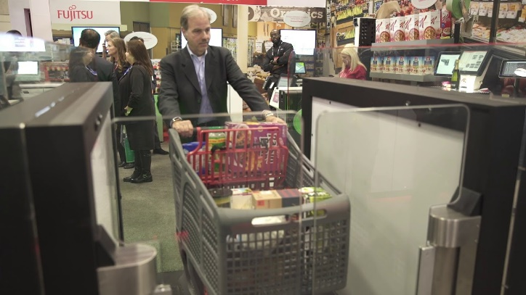
Fast, Fine-grained, and Robust Grouping of RFIDs
1
2
Self checkout
Slot 1+..+K
Inventory tracking
Building a channel between two COTS RFID tags
Transforming a localization problem to a graph-based grouping problem
Grouping tags efficiently and robustly with high accuracy
51

Slide 52
Thanks
Q&A

