Slide 1


Scrolls: Rolling Flexible Surfaces for Wideband Wireless
Ruichun Ma R. Ivan Zelaya Wenjun Hu

Slide 2



30 billion wireless devices expected by 2025! *
Standards and Frequencies
Cellular:
3~4GHz + mmWave -> 5G
1~2GHz -> LTE
Diversification of standards & frequencies
Wi-Fi:
2.4GHz + 5GHz -> 802.11n/ac/ax
6GHz -> 802.11ax/be
How to ensure coverage efficiently?
IoT:
2.4GHz -> BLE, ZigBee, Thread…
900MHz -> LoRa, Z-Wave, RFID…
* Data source: https://www.statista.com/statistics/1101442/iot-number-of-connected-devices-worldwide/
Notes:
Nowadays, we see more and more wireless devices deployed around us.
We also see more wireless networks running on different frequency bands.
For example, We have cellular, WiFi and other IoT networks, each operating on several different frequencies, and with potentially multiple versions of standards.
So we are facing a diversification of standards and frequencies, This poses new challenges for wireless networking.
The question we want to ask is How to ensure coverage for them all in a resource-efficient way?

Slide 3
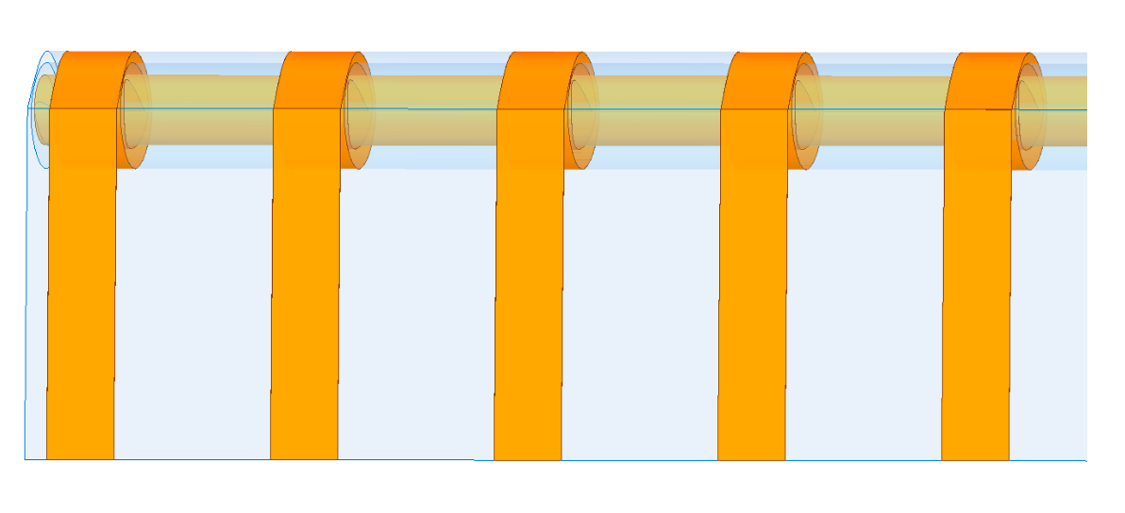
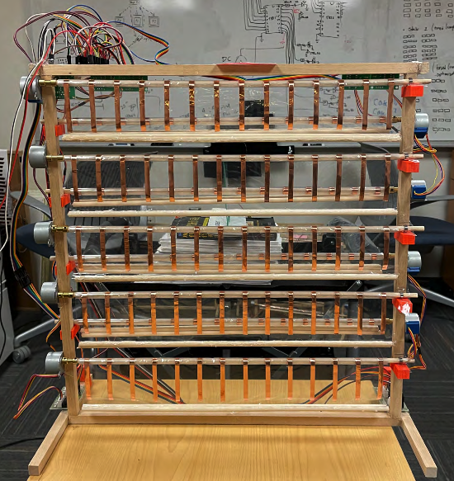
Our approach: Scrolls
Standard-agnostic, wideband frequency-tunable smart surface
Enhancing link quality with signal-level reflection control
Tunable, flexible surface elements to cover sub-6 GHz bands
Notes:
Our approach is to use Scrolls, a standard-agnostic and wideband frequency tunable smart surface.
We aim to enhance wireless link quality with signal-level reflection control of smart surface. By directing more energy towards the wireless endpoints, we can increase the received signal strength. Such operation is agnostic to the specific standard.
To achieve frequency-tunability, we use flexible surface elements to cover all the sub-6GHz frequency bands.
Here shows the basic hardware design and one of the prototypes we built.

Slide 4

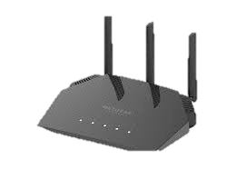
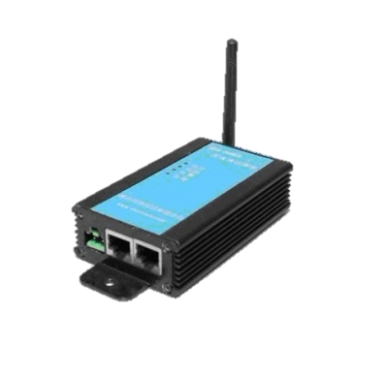



Existing approach
Wi-Fi Link
(2.4/5/6 GHz)
LoRa Link
(900 MHz)
Cellular Link
(1/2/3.7 GHz)
Cellular Link
(1/2/3.7 GHz)
Wi-Fi Link
(2.4/5/6 GHz)
LoRa Link
(900 MHz)
Densely deployed standard- and
frequency-specific infrastructure
To improve coverage…
Notes:
For existing approaches, when we want to increase coverage area or improve link quality,
We often need extra hardware for each frequency and each standard,
Like more wifi APs, more cellular base stations, and more IoT gateways.
So Existing solutions rely on densely deployed standard- and frequency-specific infrastructure.
This is not an efficient or scalable solution, since we deploy multiple sets of hardware despite the common goal of improving coverage.

Slide 5





Scrolls simplifies wideband coverage provisioning
Scrolls
Enhanced Links
Densely deployed standard- and
frequency-specific infrastructure
Simultaneous coverage enhancement
for diverse standards and frequencies
Notes:
By contrast, Scrolls simplifies wideband coverage provisioning.
It provides coverage enhancement for different standards and frequencies at the same time.
Then, We can have a single set of hardware that is shared by different networks!
This way, we can reduce infrastructure deployment cost and complexity.

Slide 6
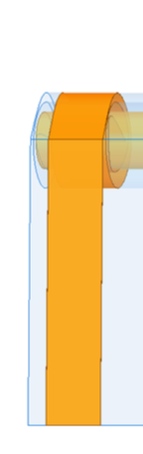
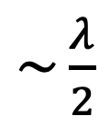
How to tune operating frequency?
Change the physical dimension of surface elements (antennas)
?
$\sim \frac{λ}{2}$
+
Length
-
Half-wave
dipole antenna
Metallic reflector
Scrolls element
Rolling a flexible copper strip!
Notes:
Next I will present the system design.
The first question is ....
How can we tune the operating frequency of smart surface
A straight-forward solution. Which is to change the physical dimension of an antenna
It is a simple solution and provides a very wide tunable frequency range compared to other methods.
Our design starts from a half-wave dipole antenna. Its length is around half of wavelength corresponding to the operating frequency.
To make the antenna reflect wireless signals, we can short circuit the antenna port.
Then we can simplify the design into a long metallic reflector. Its operating frequency is inversely proportional to the length.
The question then becomes how we can change the dimension of the reflector dynamically?
Our answer is rolling a flexible copper strip!
By rolling the strip , we can control its effective length, which is the exposed part of the strip, from top to bottom.
The rest part of the strip is rolled and will not interact with wireless signals.
So we use this flexible copper strip as our surface element.

Slide 7
Wideband frequency tunability
Length
Turned off with 1cm length
Continuously cover 6 GHz to 900MHz (1-16cm)
Notes:
To verify our design, we run simulations over a wideband from sub-1 to 6GHz.
Here shows the transmission power.
The lower it is, the higher the reflection we get
With 1cm, the copper strip is not reflecting any signal. We consider it as turned off.
With 2cm, it starts to reflect signals around 5GHz.
As the element gets longer, the operating frequency moves to lower part of spectrum.
With 6 cm, we can reflect signal for 2.4GHz.
And with 16cm, we can cover 900MHz.
So by controlling the length from 1-16cm, we can continuously cover the spectrum.

Slide 8
Surface assembly
Balancing control granularity and complexity
Length
Stepper Motor
Multiple elements onto one thin plastic sheet as one roll
-- Roll-wise control
Notes:
Given the element design,
we want to assemble many elements as a surface element array.
We also want to strike a balance between find-grained control and hardware complexity.
So we group multiple elements on one plastic substrate as one roll.
and use a stepper motor to control their lengths together.

Slide 9

Surface assembly
Assembling multiple rolls as composable panels
Scalable and flexible deployment
45cm
One panel:
Several rolls and a Wi-Fi micro-controller
Prototype of one panel ($40)
Notes:
Then,
We further assemble multiple rolls as composable panels,
Each including several rolls and a micro-controller.
Each panel can function independently, so we can deploy them in a distributed way and more panels can be deployed incrementally.
This can make our deployment more scalable and flexible.
Our panel prototype is around half meter by half meter and has very low hardware cost.

Slide 10

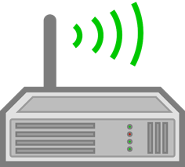

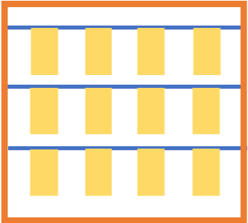
Hierarchical control architecture
Master controller
Can use existing infrastructure:
Wi-Fi APs + an edge server
Sub-controller
On walls, tables
or inside furniture
Panels
Notes:
Building on top of panels, we have a 3-tier control arch.
Panels receive commands to set roll lengths from its close-by sub-controller with Wi-Fi.
sub-controllers are connected to the master controller through Ethernet to forward commands.
The master controller is where the control algorithm runs.
All the controllers can simply be existing infra, such as ...
Then the only extra hardware we need is the low-cost panels , which can be deployed on walls ….

Slide 11



How to set roll lengths
Master controller
RSSI (received signal strength indicator)
minimal and accessible across devices
Receiver
Transmitter
Notes:
For the control algorithm, the question is how to decide the length for each roll.
Our algorithm needs guidance to do this so we require explicit feedback from the communication endpoints.
Since we aim to provide support for devices from different networks, including resource constrained devices, the feedback we need from the receivers should be minimal and easily accessible.
So we develop our algorithm based on the RSSI (received signal strength indicator).

Slide 12
How to set roll lengths
Master controller
Compute lengths
and send commands
Receiver
Transmitter
Notes:
Based on the feedback, the control algorithm will compute the length and send commands to panels.

Slide 13
How to set roll lengths
Group testing procedure:
Sample rolls to form a group.
Sweep over potential lengths together.
If no gain detected, turned off all rolls.
If gain detected, test each roll.
Receiver
Transmitter
Notes:
Specifically, We use a group testing procedure to do this.
First, We randomly sample multiple rolls to form a group. Then all rolls in the group sweeps over potential lengths together.
If no gain is detected, we turn off all rolls at once.
If for another group, gain is detected, we test each roll to find the roll and roll length that provides the gain.
We repeat this process until we set lengths for all the rolls.
Final result may look like this. Several rolls around the receiver are turned on to increase received signal strength and the rest
Turned off rolls can be used for other links.

Slide 14



Handling multiple links
No harm to any link
Targeting highest sum of SNR gain
Can use other policies
Receiver
Transmitter
Notes:
We also aim to support multiple links either on the same frequency or on different frequencies.
We extend our algorithm, with two principles,
First, We do not cause SNR drop for any link. If a roll length causes power drop, we don’t use that length.
Secondly, The algorithm should target the highest sum of gain from all devices. This means we consider power gain from all links as equal.
Other policies can be used to consider link priority. Such as Whether some link should get more enhancement for more important applications.

Slide 15
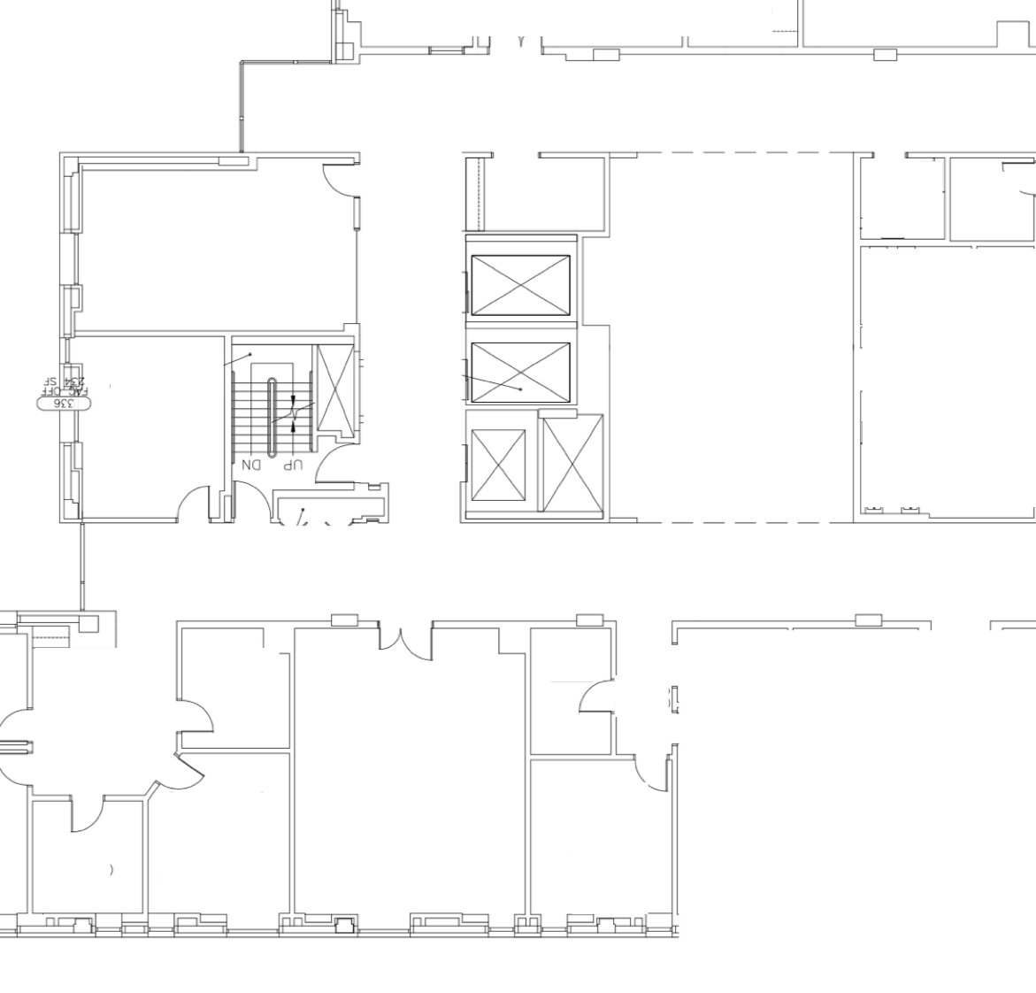
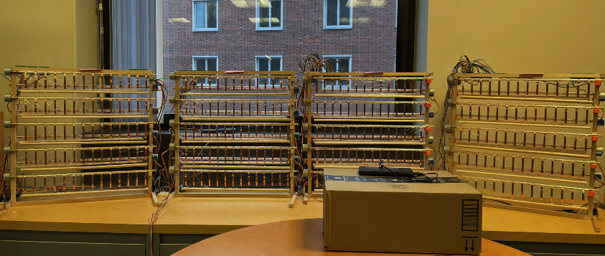

Evaluation setup
LoRa (915MHz)
Wi-Fi (2.4GHz)
5GHz & 3.7GHz
Panels and one endpoint
Endpoint(s)
Panels
4 m
Locations of the other endpoint
Notes:
Lastly, we evaluate scrolls in an office environment.
We deploy panel prototypes on a desk and put one wireless endpoint near by.
We move the other endpoint around to sample different wireless channel conditions over a large area. The locations used for experiments are marked in the Figure here.

Slide 16
Improving individual link SNR
Median gain : > 3 dB
Max gain : 14 dB
Received Signal Power Gain (dB)
Notes:
We experiment with wireless links on 4 different frequencies, ranging from 900MHz to over 5GHz.
Scrolls can provide a median of over 3dB receiver power gain, and up to 14dB power gain for all of them.
For wifi links as an example, this gain translates to around 50% throughput increase on average.

Slide 17
Multiple concurrent links
915MHz LoRa
2.4GHz Wi-Fi
3.7 GHz
5 GHz
Notes:
We also set up 4 concurrent links on different frequencies and with different standards,
to test the performance of Scrolls when enhancing multiple links simultaneously.

Slide 18
Every Link benefits from Scrolls!
Median gain : 4 dB
Max gain : 10 dB
Link Setup
Notes:
We test 5 diff link setups. moving the endpoints around.
As the results show, Scrolls provides high gain to all 4 links, a median of 4dB and up to 10dB.
Every link can benefit from our system.
Which one benefits more depends on individual channel conditions.

Slide 19
Conclusion
Problem:
Standard- and frequency-specific infrastructure is complex and costly
Solution:
Scrolls: standard-agnostic, wideband frequency-tunable smart surface
Results:
Coverage improvement for links on different frequencies concurrently
Notes:
To conclude,
The problem we want to solve is that Standard- and frequency-specific infrastructure is complex and costly.
We present scrolls, standard-agnostic and wideband frequency-tunable smart surface as a sharable infrastructure for different wireless networks.
Our evaluation results show that Scrolls can provide coverage improvement for links from different networks at the same time.
That’s all. Thank you for listening. I am happy to take questions.

