Slide 1


QfaR: Location-Guided Scanning of Visual Codes
from Long Distances
Sizhuo Ma Jian Wang Wenzheng Chen
Suman Banerjee Mohit Gupta Shree Nayar
Notes:
FarQR: Location-Guided Scanning of Visual Codes from Long Distances
Which is done under the mentoring of Shree Nayar and Jian Wang from Snap Research computational imaging team.

Slide 2
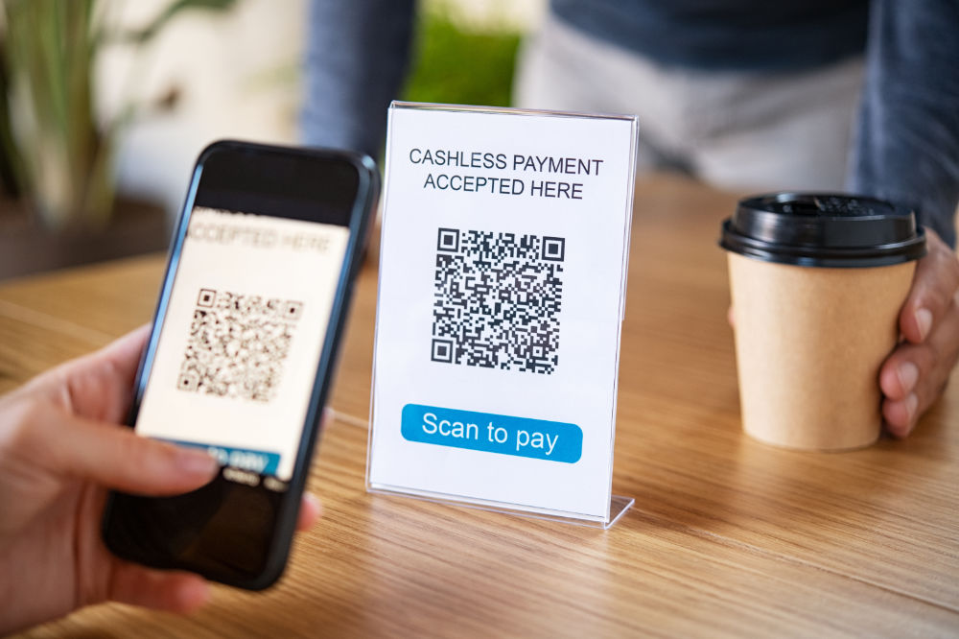
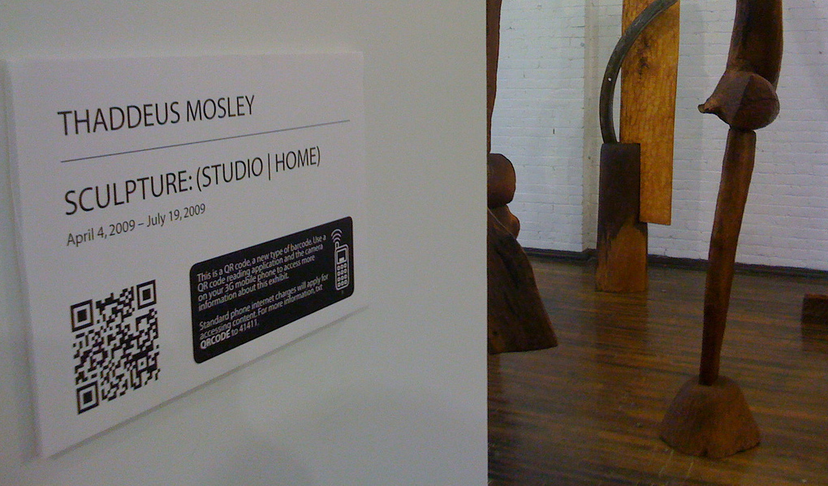
QR Code
Mobile Payment
Museum
Notes:
QR code offers a way of encoding information in structured visual patterns.
There is no need to emphasize how widely it has been used in our daily life, for example mobile payment and museum exhibitions. : D

Slide 3
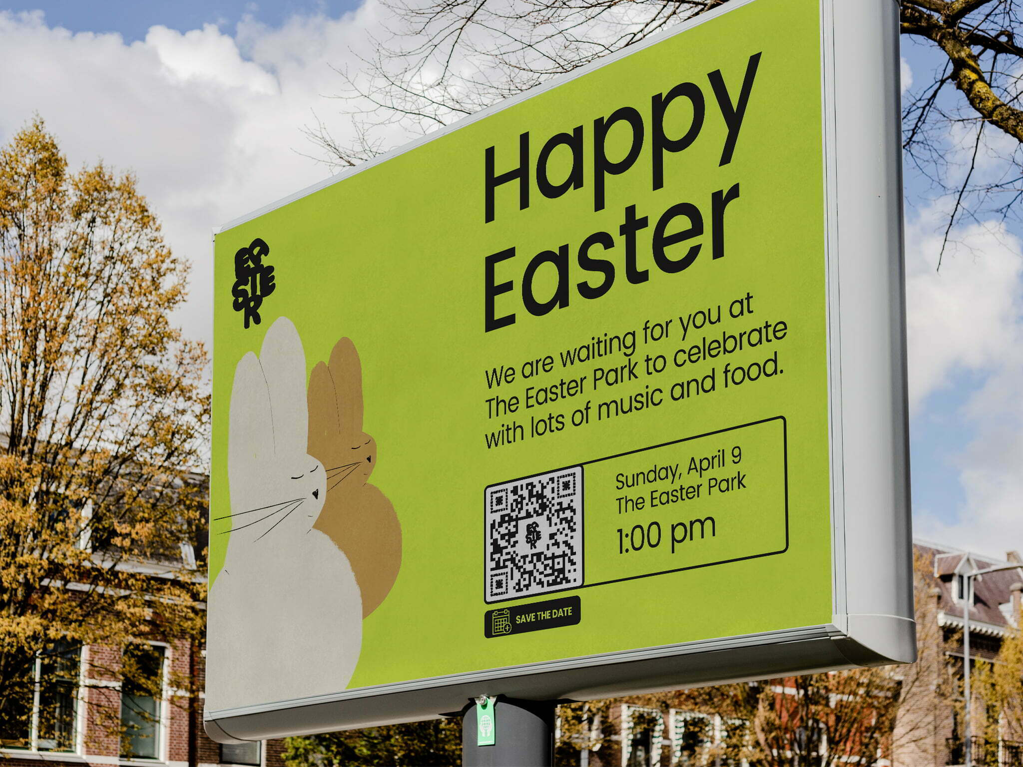
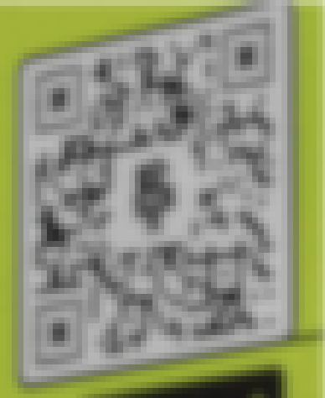

Challenge: Scanning at a Long Distance
Can we scan this code across the street?
$≈$1pixel/bit
Notes:
However, one known challenge for QR codes is to scan them at a long distance. For example, if there is a billboard on the other side of the street, the QR code on it may look very small on your camera app such that the size of each black or white square is comparable to a single pixel. This is a problem, as you can see in the image on the right. The image looks very pixelated. As a result, the camera app will fail to scan this QR code.

Slide 4
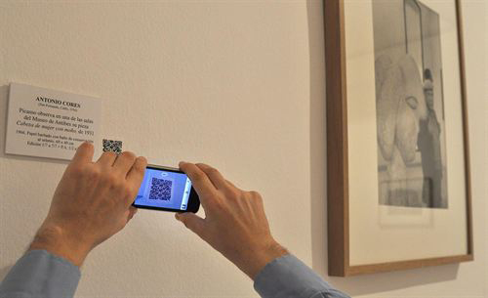
Challenge: Scanning at a “Long” Distance
How far away can we stand from this QR code?
Maximum scanning distance is proportional to code size!
Notes:
It is also important to notice that the definition of “long” depends on the physical size of the QR code. What really matters is how many pixels are there on the camera image. For a very small QR code like this, you may have to hold your phone very close to it.

Slide 5
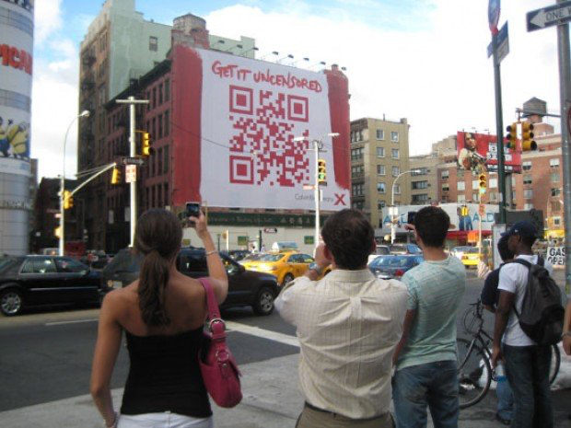
Solution: Bigger Codes?
Notes:
So how can we make sure our codes can be scanned at a long enough distance? One idea is to make the code as big as possible, which, as you can imagine, is not always the best idea.

Slide 6
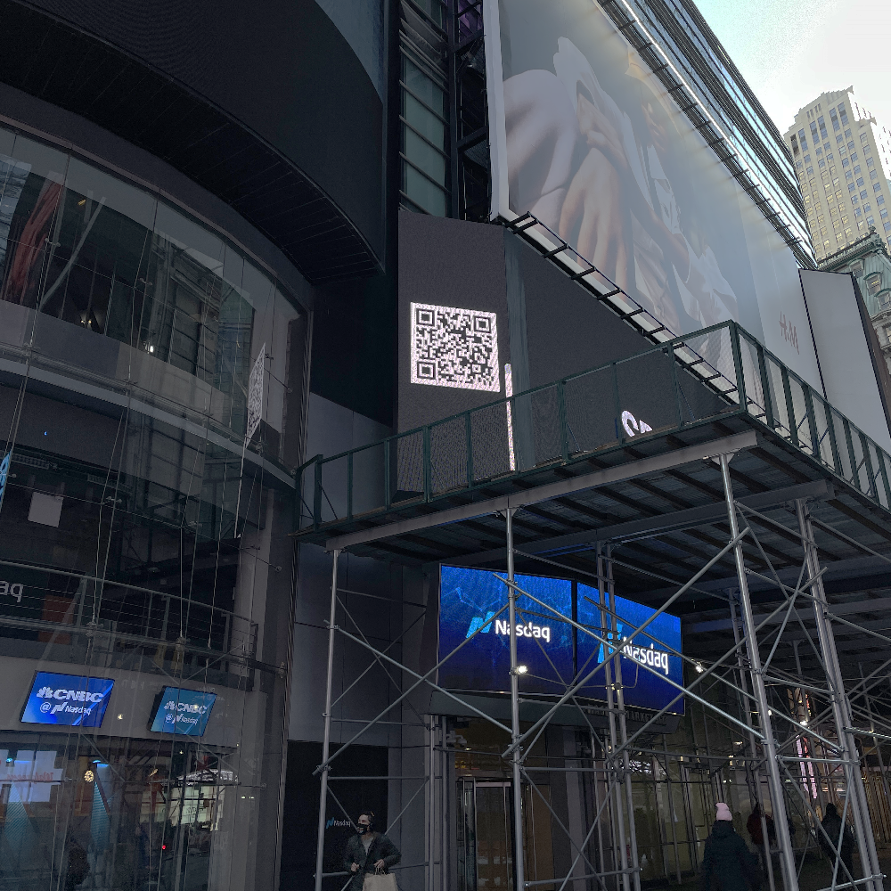
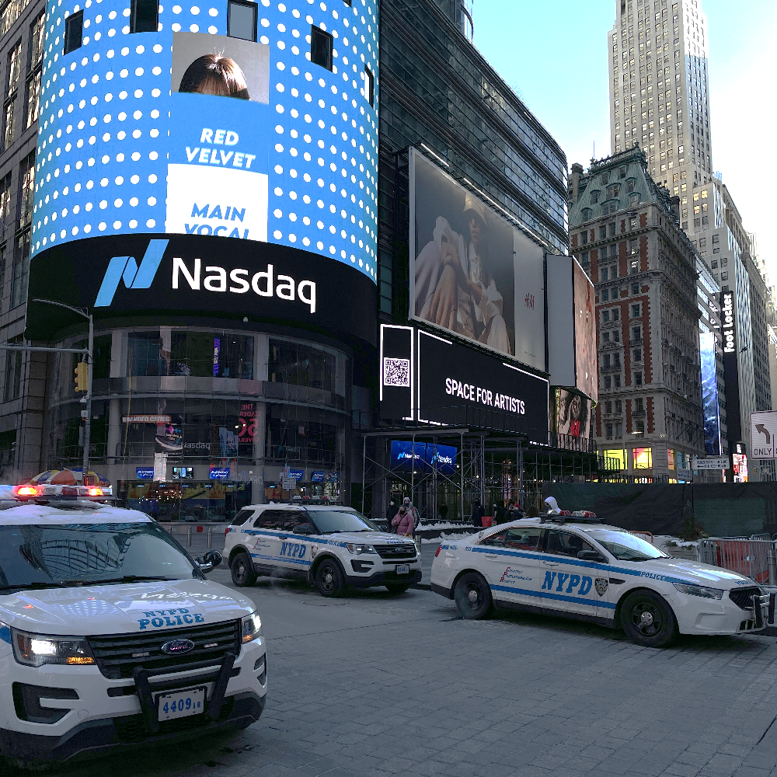
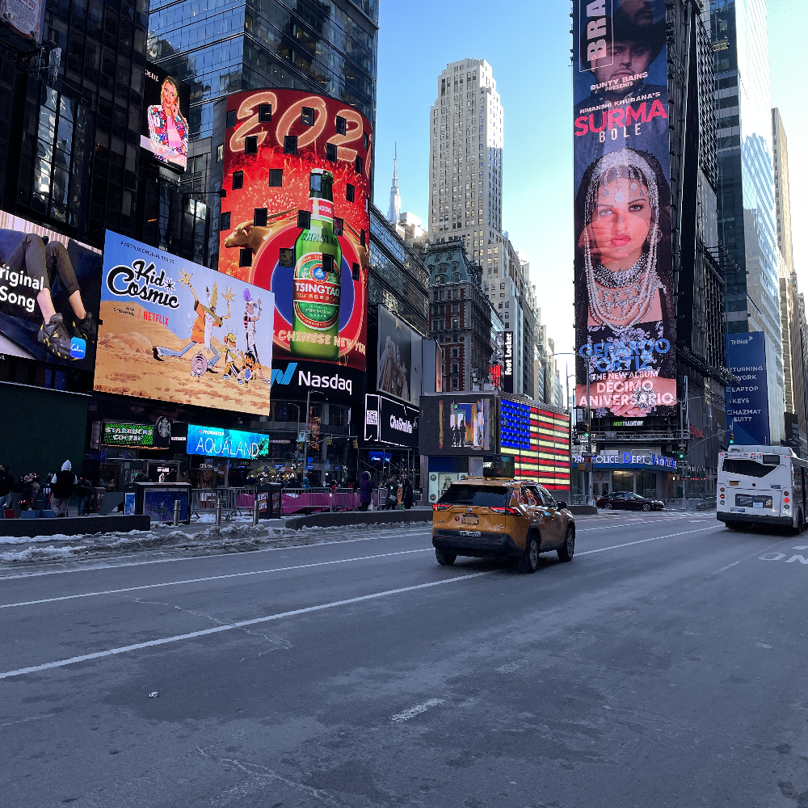
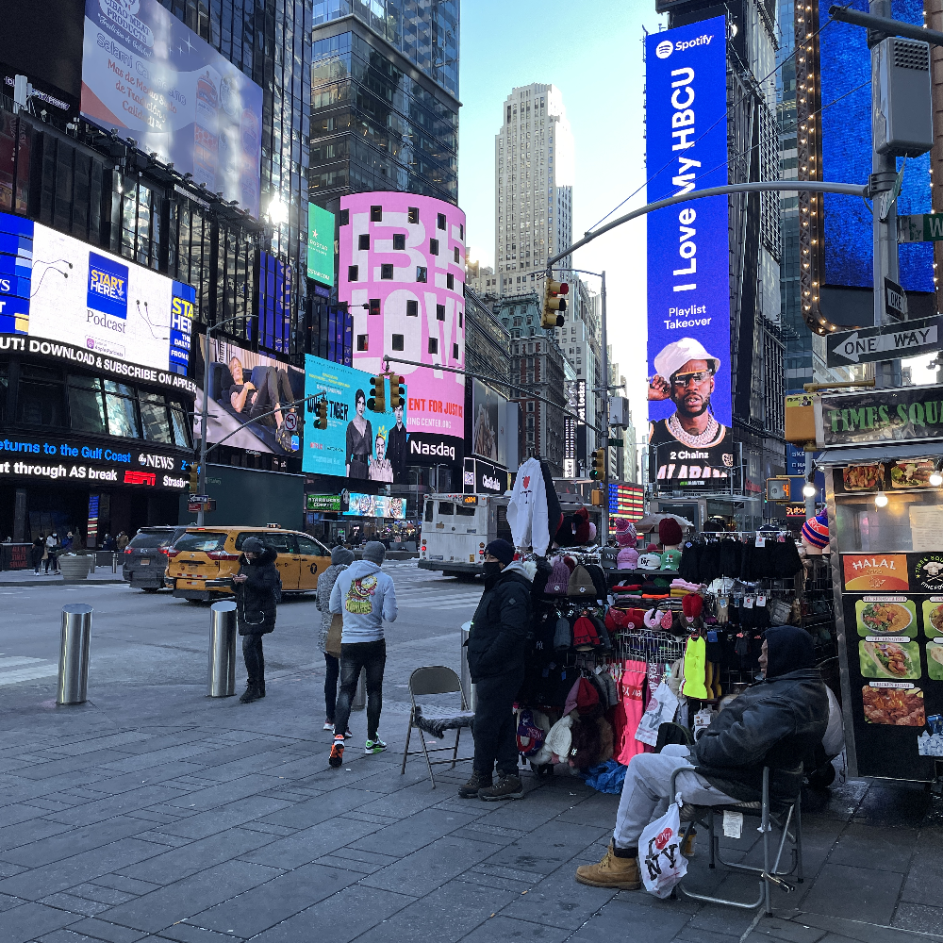
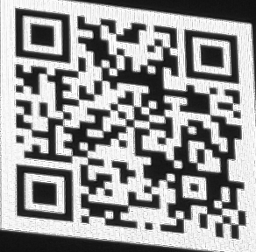
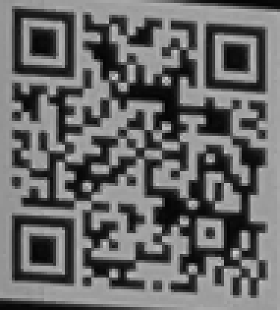
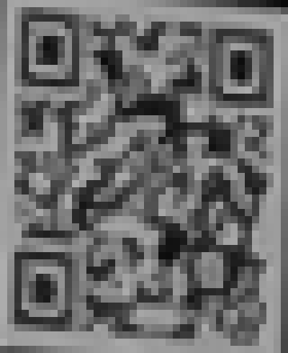
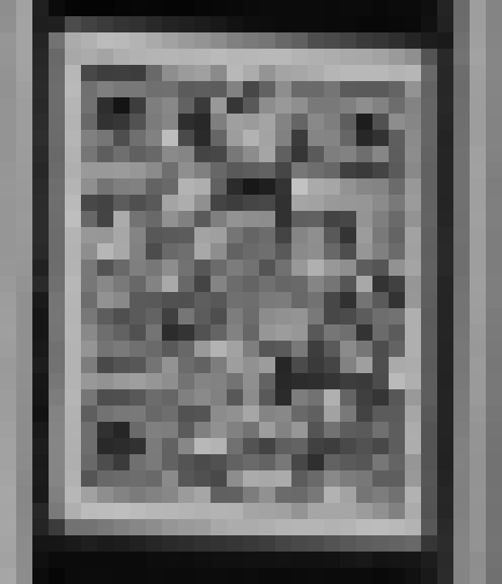
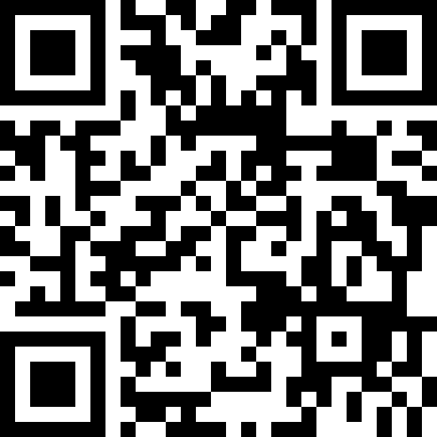

Our Solution: QfaR
7m
21m
53m
88m
Distance
4-5x
improvement
Image
Zoom-In
View
9.1x8.3 pixels/bit
3.0x3.3 pixels/bit
1.2x1.6 pixels/bit
0.7x1.0 pixels/bit
Scan
Result
Conventional
FarQR (Proposed)
Notes:
Our solution is a novel algorithm and system for scanning QR codes, called QfaR. Here are some images we captured at Times Square, where we tried to scan a code at different distances. Conventional QR code scanner only works at 20m, but QfaR works even at around 90m, even when each black or white bit is about 1 pixel big.
(click) QfaR offers a 4-5x improvement depending on the imaging conditions.

Slide 7

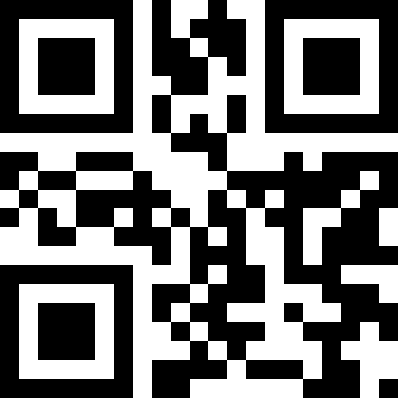
Observation
Use this one→
Do we really need to recover every single bit
to identify a unique code?
Notes:
Our main observation here is that a QR code is a binary code and contains more than 100 black/white bits, so there are 2^100 possible codes in total.
(click) But do we really need to recover every single bit if our goal is to just identify a unique code?

Slide 8

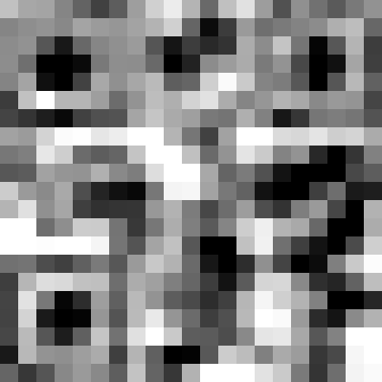
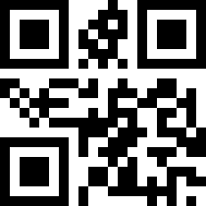
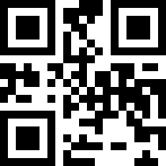
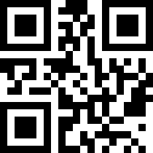
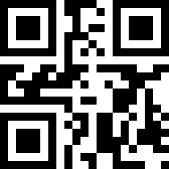
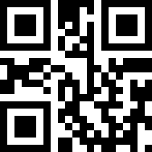
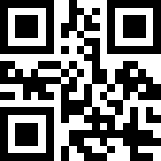
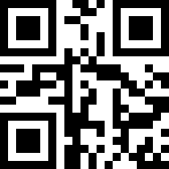
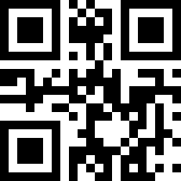
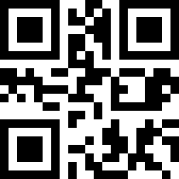
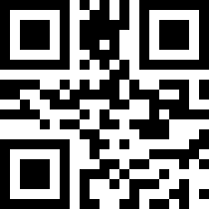
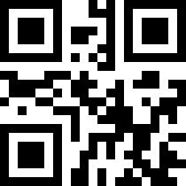
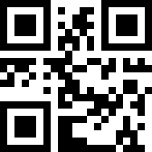
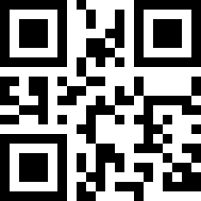
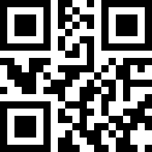
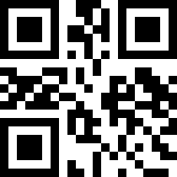
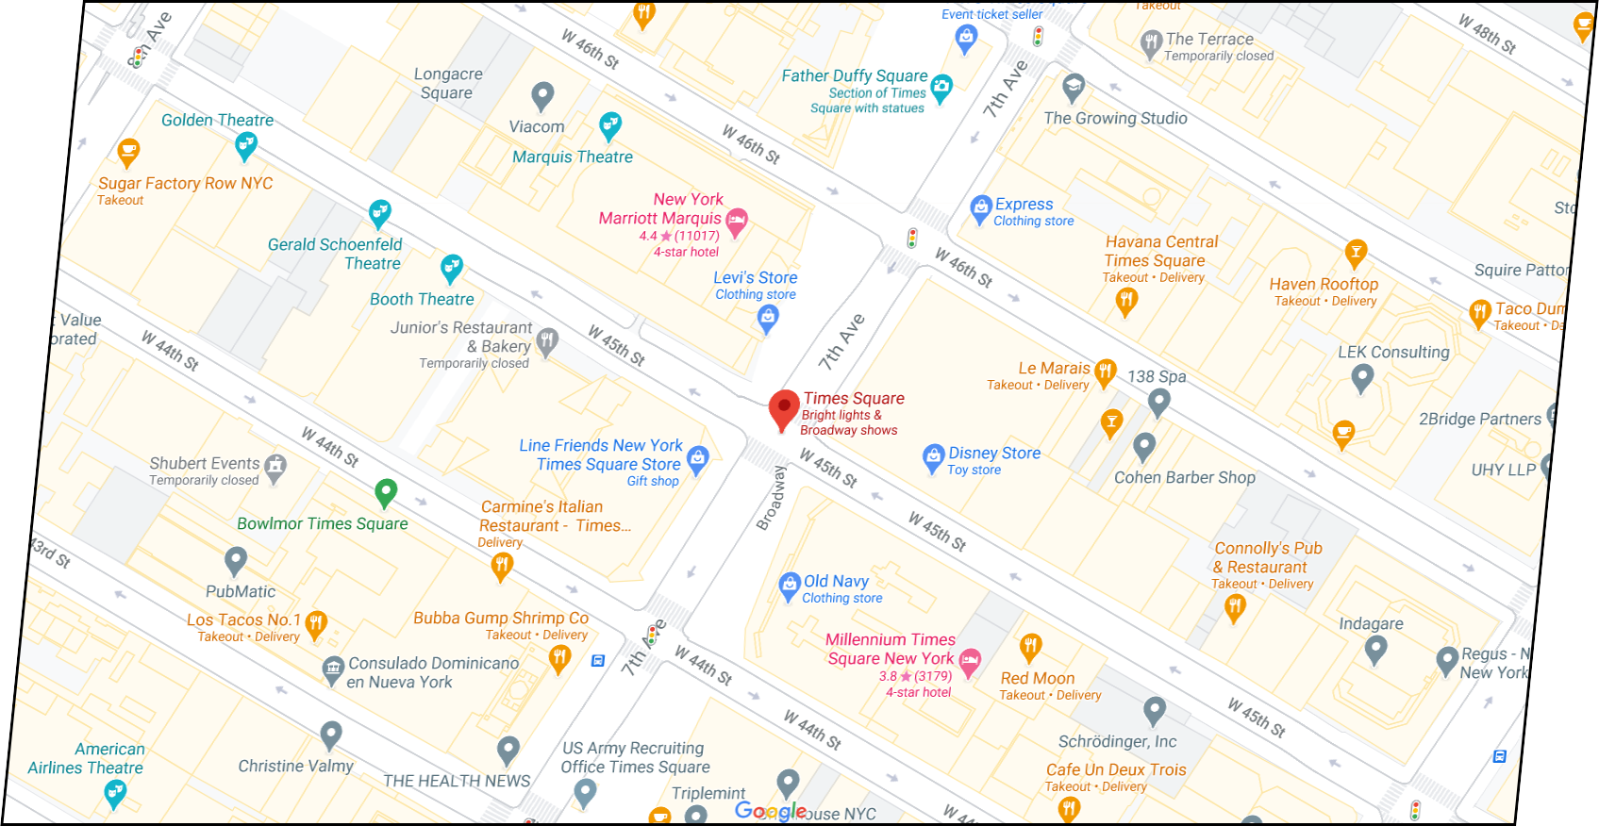
Observation
Entire Code Space
Low-Res User Image
Pruned List of Codes
Location-
Guided
Matching
10000 codes (within 500m)
Conventional
Decoding
(Proposed)
Decoding Fails
(Matched)
Vicinity
Notes:
Let’s assume you are at the Times square. You scan a code at a distance and get a low-resolution image.
(click) Conventional decoding tries very hard to find the correct code in the entire code space, which fails because there are too many possibilities.
(click) But we know that the code being scanned must be within the vicinity of the user, and there is always a limited number of codes in the vicinity. Let’s say the code must be within 500m of the user, and there are 10000 such codes.
(click) What we really need to do is find the most probable match among these 10000 codes.

Slide 9


Intensity-Based Matching
Notes:
Specifically, we compare our scanned code to all the candidate codes in the vicinity and return the one with shortest L2 distance, which is similar to template matching in computer vision. It is interesting that this very simple algorithm works very well in practice.

Slide 10
Why Intensity-Based Matching Works?
QR code is based on Reed–Solomon code: Minimum distance between codes >> 1
For a limited number of codes within vicinity,
p{∃ another code very similar} is low!
Notes:
Here are two insights. First, QR codes use Reed-Solomon error correction, which means that the minimum distance between two possible codes is greater than 1 bit.
(click) Second, because we only have a limited number of codes in the vicinity, it is very unlikely that there is a code that is very close to the correct code in terms of number of bits. Therefore, even for a highly degraded image, it is very unlikely to match it to a wrong code.

Slide 11
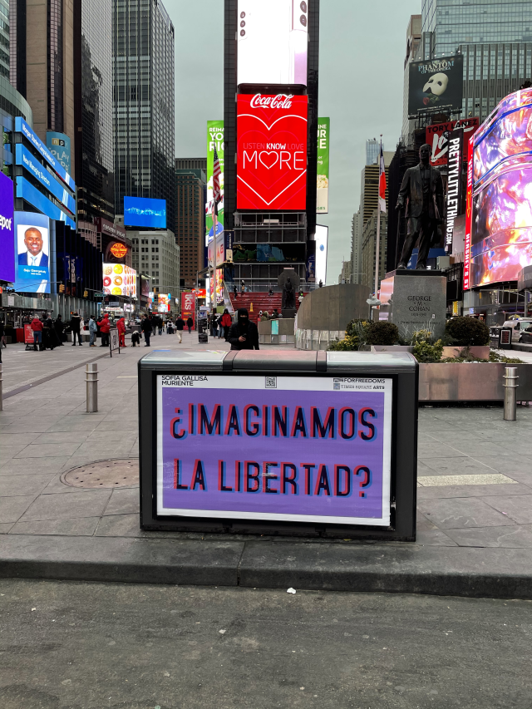
Method: Complete Pipeline
User Image & Location
Detect
& Rectify
Match
Detected Code
GPS loc.
40° N, 73° W
Vicinity
Server
Database
Access
Notes:
Alright. Now let’s take a look at the whole pipeline. After we capture an image, we detect where the code is and rectify the code to a square shape.
The GPS location of the user is sent to a server, which returns a list of all codes in vicinity. The rectified code is then matched against this list of candidate codes.

Slide 12
Missing Piece 1: Code Detection
User Image & Location
Detect
& Rectify
Match
Detected Code
GPS loc.
40° N, 73° W
Vicinity
Server
Database
Access
Notes:
We have two missing pieces in this pipeline. First how do we detect the code?

Slide 13
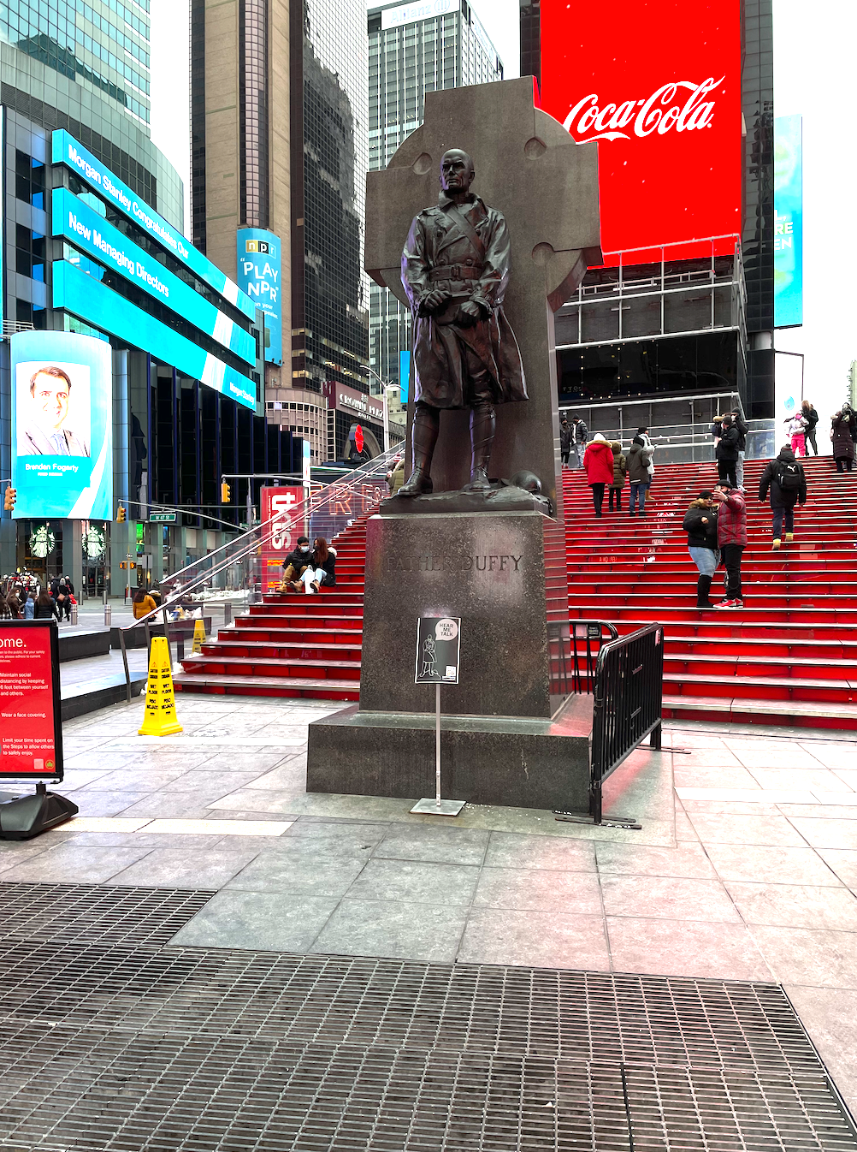
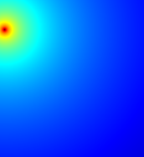
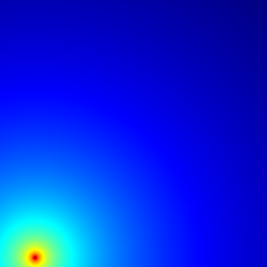
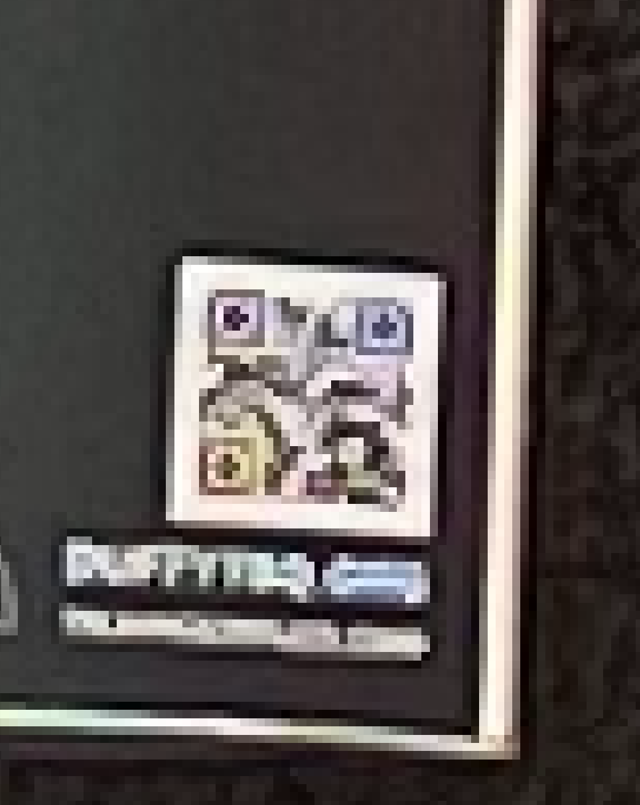
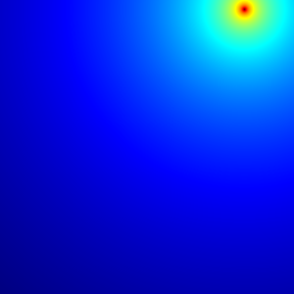
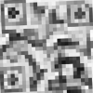
Detector & Aligner
User Image
Cropped Image
Key Point
Heatmaps
…
…
…
Conv
BN
ReLU
Data simulation with physics-based modeling
Three Key
Points
code 0.99
Rectify
Four Key
Points
Before
Alignment
After
Alignment
Detector
Based on YOLO
Aligner
Based on a Key Point Detection Network
Notes:
Our detector module is based on YOLO, a widely used object detection network, which gives a bounding box of the code.
(click) Then we have another aligner module, which is based on a keypoint detection network. It predicts the precise locations of the four corners
(click) and then apply a geometry transform to map the code from this tilted shape
(click) to a rectified square shape.
(click) Both models are trained with simulated images of QR codes, and we use a physics-based model of the imaging process so that it works well even for real images.

Slide 14
Missing Piece 2: Code Database
User Image & Location
Detect
& Rectify
Match
Detected Code
GPS loc.
40° N, 73° W
Vicinity
Server
Database
Access
Notes:
OK. The second missing piece is the code database. Especially, how do we get a database of nearby codes?

Slide 15

Code Localization
Crowdsourcing!
Approximate
GPS Location
Estimated Code Location
(Accuracy improves over time)
*Focusing on codes with fixed locations
Notes:
Fortunately, this can be done by crowdsourcing. Every time a user scans a code, the GPS location of the user can be used to update an estimate of the code location. Therefore, as more and more users scan the code, the accuracy of the code location keeps improving. Notice that so far, we have been focusing on codes with fixed locations, such as QR codes in restaurants, museums and so on.

Slide 16
Results
QfaR Detector +OpenCV
WeChat QR
QfaR (Proposed)
*Assuming 10000 candidate codes
Notes:
Now let’s look at the results. We compare QfaR with two baselines: one is a traditional QR code decoder available in OpenCV. Since their detector fails most of the time, we replace that with our detector. Another baseline is WeChat QR code, which also uses a neural network to detect the code, and then uses a super-resolution network to upscale the image. However, it is still based on conventional decoding. We first compare them on simulated data, at different distances. We can see that, because of the location-guided decoding, the performance of QfaR is significantly better than the baselines.

Slide 17
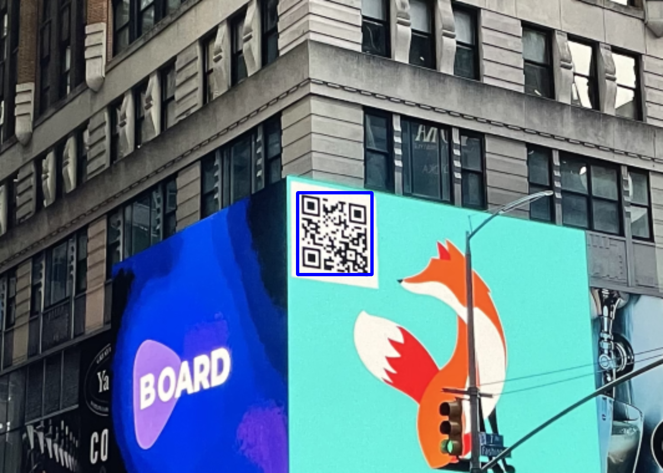
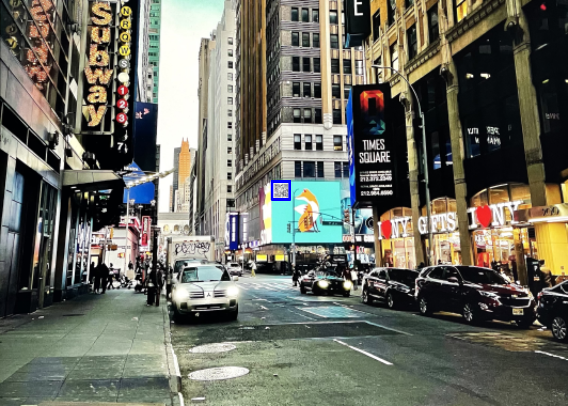
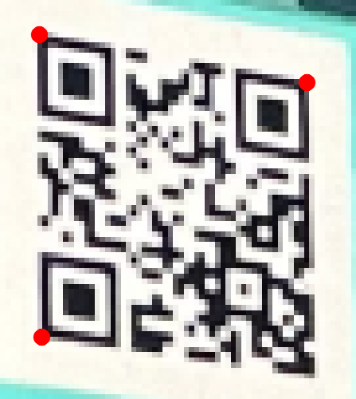
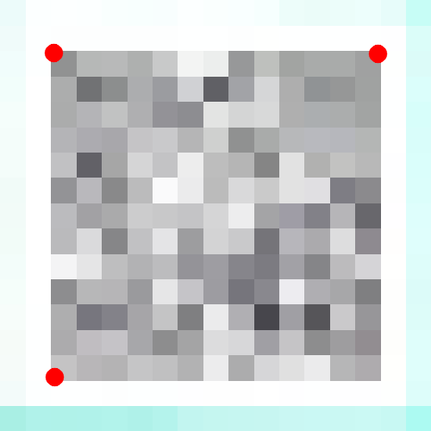
Robustness to Long Distances
Code
2.1x2.6 pixels/bit
0.5x0.5 pixels/bit
QfaR Detector +OpenCV
WeChat QR
QfaR (Proposed)
Notes:
Then let me go through some qualitative comparisons on real data. In this example, the conventional method stops working when the resolution of the code reaches about 2x2 pixels per bit, but QfaR continues working until it reaches 0.5x0.5 pixels / bit, which is a huge improvement.

Slide 18
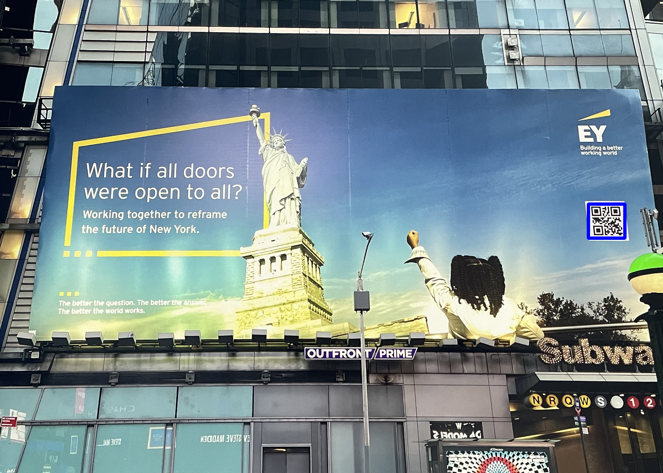
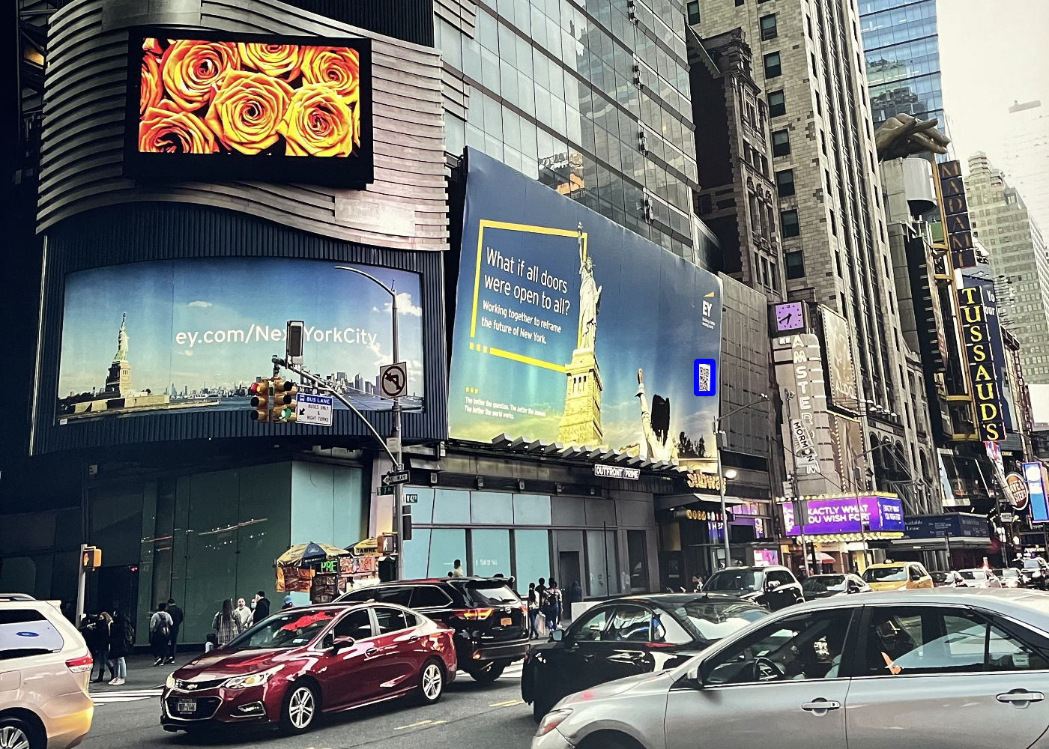
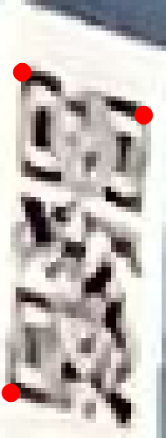
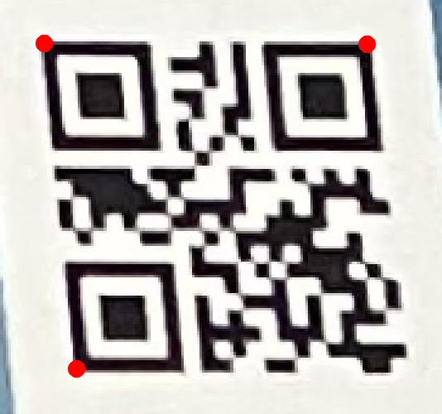
Robustness to Viewing Angles
Code
QfaR Detector +OpenCV
WeChat QR
QfaR (Proposed)
Notes:
In addition to distance, QfaR is also robust against other challenging code scanning scenarios such as viewing angles. Conventional scanner can only scan this code from the front. QfaR can be used to scan the code from a very large angle.

Slide 19
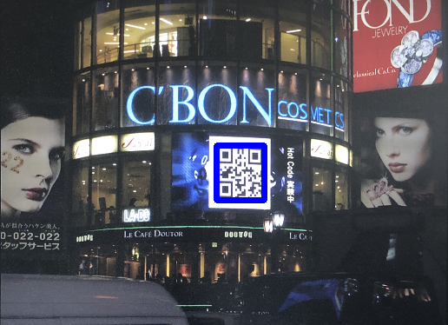
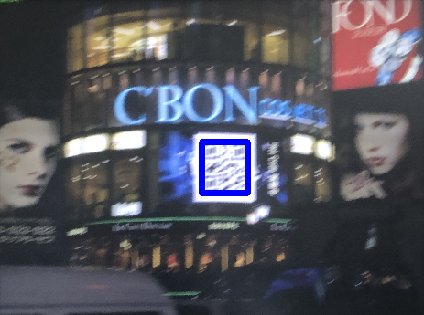


Robustness to Motion Blur
Code
QfaR Detector +OpenCV
WeChat QR
QfaR (Proposed)
Notes:
QfaR is also robust to motion blur caused by camera shake, which is difficult to completely avoid, especially in a dark environment.

Slide 20





Robustness to Poor Lighting
Code
Code
QfaR Detector +OpenCV
WeChat QR
QfaR (Proposed)
Notes:
And, QfaR is also robust to noise and artifacts due to poor lighting.

Slide 21



Serendipitous Scanning
Notes:
I’d like to end this talk with two additional applications. QfaR does not only just make scanning codes easier, but it also has the potential to enable what we call serendipitous scanning. When a user is taking a picture, even if they don’t have the intention to scan a code,

Slide 22


Serendipitous Scanning
“COFFEED - …”
https://qrco.de/bbyUK2
“TSQ MKT | …”
https://qrco.de/bbyUI7
“Times Square Arts …”
https://qrco.de/bblJ0l
Notes:
QfaR still have the power to identify the extremely small code in the image. In other words, these codes are scanned as a surprise to the user. This capability of serendipitous scanning may have a lot of potential applications including
(click) providing visual guide to nearby stores and restaurants,
(click) or using these codes as anchors for augmented reality elements to make the camera view looks more vivid and fun.

Slide 23


Context-Aware Scanning
Instead of location, the code space can also be pruned by other contextual information!
Logistics Industry
Friending
Notes:
In addition to location-based pruning, the same idea can also be used when the code space can be pruned using other context information. In logistics industry, the code space may be pruned down to the packages you are expected to receive today in your local region. For friending on a social media app, the code space may be pruned down to users who are actively waiting for friending requests. We think the proposed technique can be adapted to a wide range of code scanning applications, even beyond codes with fixed locations.

Slide 24

Summary
Method: Location-Guided Scanning
Extra Application:
Serendipitous Scanning
Extra Application:
Context-Aware Scanning
User Image & Location
Detect
& Rectify
Detected Code
Match
“COFFEED - …”
https://qrco.de/bbyUK2
40° N, 73° W
“TSQ MKT | …”
https://qrco.de/bbyUI7
“Times Square Arts …”
https://qrco.de/bblJ0l
Vicinity
Server
Database
Access
Check our website!
https://sizhuom.github.io/project-qfar/
Notes:
In summary, we propose location-guided long-distance qr code scanning. We also show two extra applications.
Thanks for your listening.
(click) Lastly, a small Ads.
We are…
Find us by google search… and talk to us (or talk to me)
---
This ends my talk,
and I’m happy to take questions.

Slide 25

How to Match Codes?
Original Code
Captured Code
Thresholded
Degraded
Lots of error bits
Outstanding visual features (black/white blobs) still get preserved!
Notes:
Let’s take a closer look at the decoding process. Conventional QR decoders do a binary thresholding on the captured image. But because the image is degraded, a large fraction of the bits is flipped from 0 to 1 or 1 to 0, meaning that it is impossible to decode it.
(click) However, if we look at the captured image itself, there are some outstanding visual features that are still preserved, such as blobs of black or white bits. This observation gives us confidence that, maybe we can just take this degraded image and compare with our list of 10000 candidate codes.

Slide 26
Two Sub-Problems
Find a very small code in the image (detect and align)
Recover the encoded message (decode)
Notes:
So to answer question, let’s think about the scanning process. The whole scanning process can be divided into two sub-problems. One is to find a very small code in the image, which we call detect and align. The other is to recover the encoded message from the detected code, which we call decode.

Slide 27



Visual Codes
1D
2D
Barcode
QR code
Data Matrix
Notes:
This project is about scanning visual codes, including barcode, qr code, snapcode and so on. They are widely used for encoding information such as website links and user IDs.

Slide 28


Observation
1 million codes
37% wrong bits
-> 90% success
Notes:
And actually it is not difficult to mathematically prove this. The take home message is that, even if there are 1 million codes in vicinity, and 37% of bits are wrong, we still have 90% probability to find the right code.

Slide 29
Why Can We Detect A Proportion of Bits?
Q: Does the number of correct bits degrade gracefully as the distance increases?
A: Yes! Some bits are more “reliable”
Notes:
The next question is, how do we know when we capture a code from a long distance, we can still detect a proportion of bits. In other words, does the number of correct bits degrade gracefully when we move farther away from code instead of suddenly dropping to zero.
(click) The answer is yes. Because some of bits are reliable than others. This is because there are usually a few blobs in the code which are bits of the same color. So even if other bits are mixed with neighboring bits, the bits at the center of these blobs will still be either black or white and can be reliably detected.

Slide 30





Method
Linearly map to the right range
Compensate for camera nonlinearity
Notes:
Then we do some simple image processing. The rectified code is first linearly mapped to the right intensity range from 0 to 1. And then we apply a gamma curve locally to compensate for the usually nonlinear camera response function. The corrected code is then used to match the candidate codes by template matching.

Slide 31
Results
Detector
Aligner
Decoder
Notes:
Now let’s

Slide 32
Robustness to Long Distances
Conventional
FarQR
Notes:
Now lets take a look at the results. We compare the conventional QR decoder in OpenCV with our FarQR in simulation. For FarQR we randomly generate 10,000 QR codes as our candidate codes in the vicinity. We can see that the curve for conventional method drops very quickly and suddenly, while for FarQR the performance degrades gracefully and performs much better than conventional one.

Slide 33
Can FarQR Replace Conventional QR?
Conventional QR Scanner | FarQR
Less robust | More robust
Require no database | Require database
Notes:
So far I have shown that FarQR is much more robust than conventional QR. Does this mean FarQR can replace conventional QR. The answer is no, because conventional QR still has the benefit that it does not require a database. Therefore, we believe FarQR should be used to complement conventional QR. Conventional QR should be preferred when scanning a code in good imaging conditions, which also bootstraps the crowdsourcing process. FarQR can then be used to scan codes in challenging scenarios.

