Slide 1
Breaking Mobile Notification-based Authentication with Concurrent Attack outside of Mobile Devices
Ahmed Tanvir Mahdad¹, Mohammed Jubur², and Nitesh Saxena¹
¹Texas A&M University, College Station, TX, USA
²Jazan University, Jazan, Saudi Arabia

Slide 2

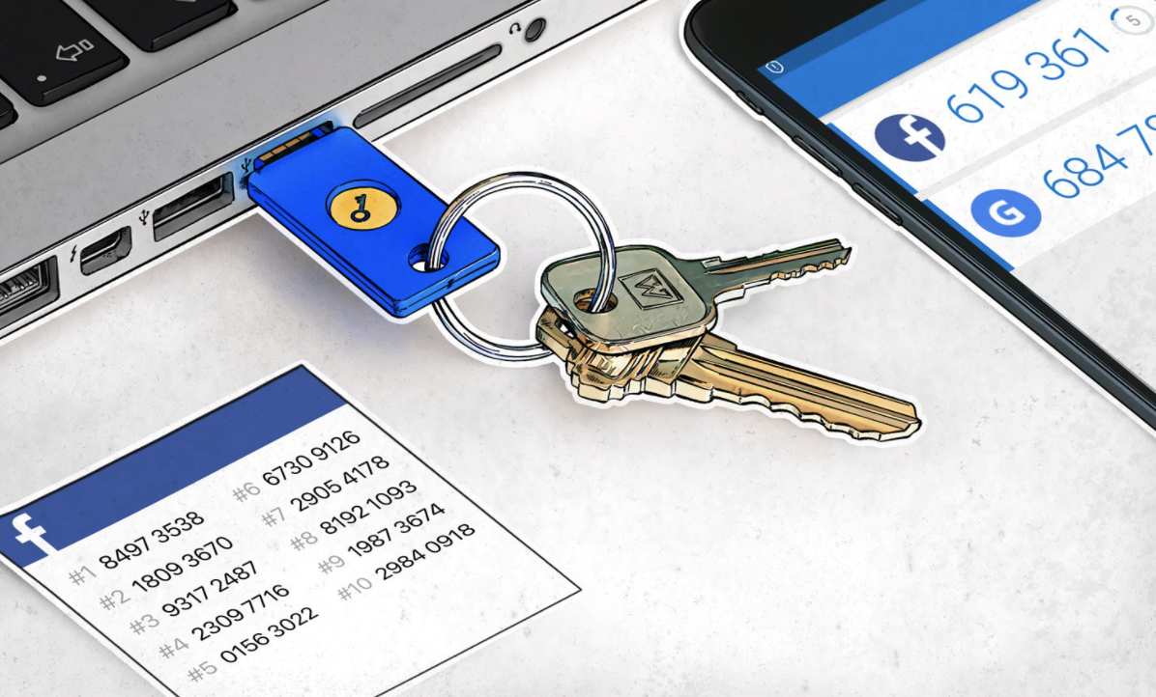
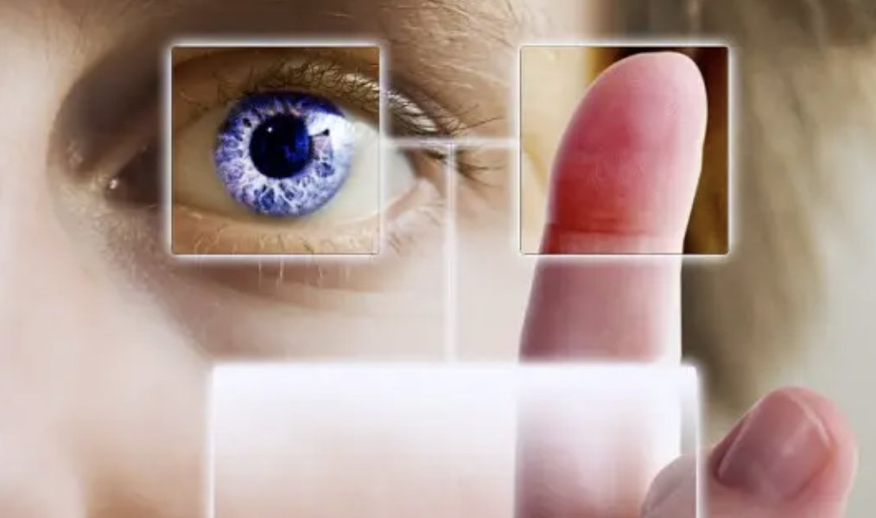
Factors of Authentication
Something the User
knows
Something the User
has
Something the User
is
Password, PIN
Examples: Smartphone, Smartwatch,
Security Key
Examples: Fingerprint, Iris, Voice
Multi Factor Authentication can be combination
of 3 authentication factors

Slide 3

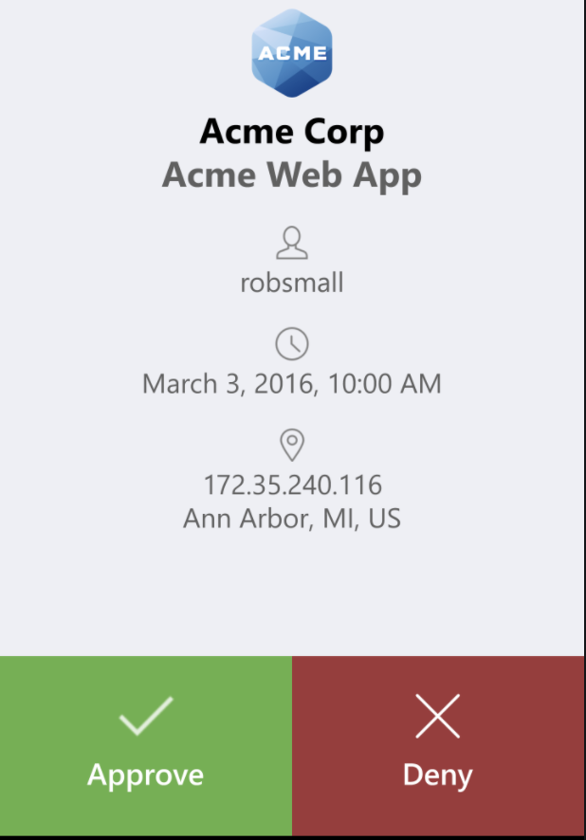
Multi-factor Authentication
Something the user knows
Password
Something the user has
Smartphone, Smartwatch, Security Key
Service sends user a notification on their smartphone / smartwatch
The user has to respond to notification by either approving/ denying
the authentication attempt.
The service communicates information to users regarding the
authentication attempt to help users make an informed decision.
Notification-based
Authentication
The service sometimes uses terminal verification in which the users
verify if the notification received for correct authentication session
using unique identifiers.

Slide 4
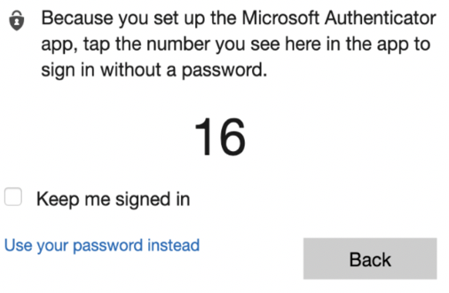
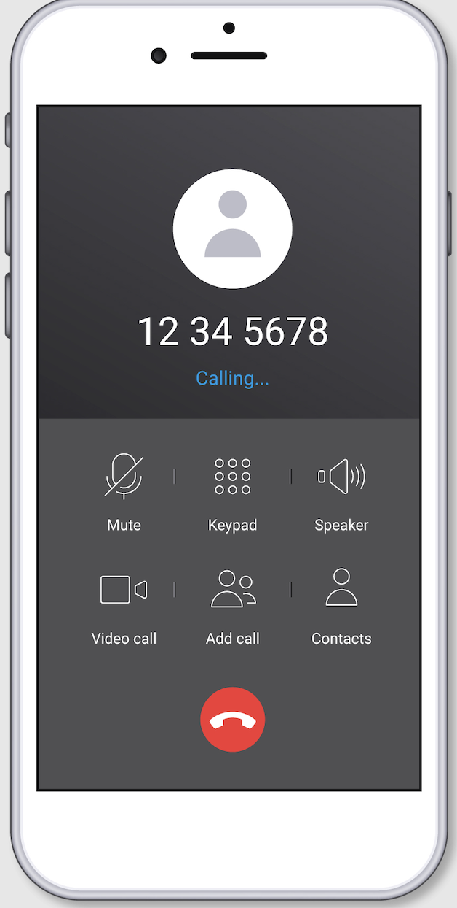
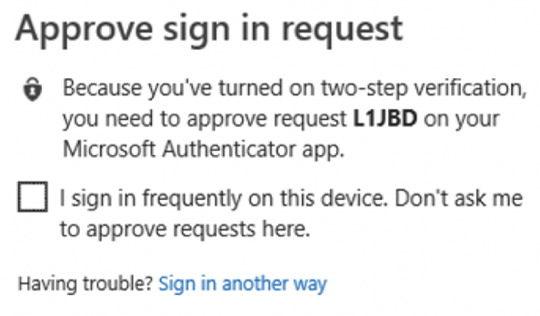
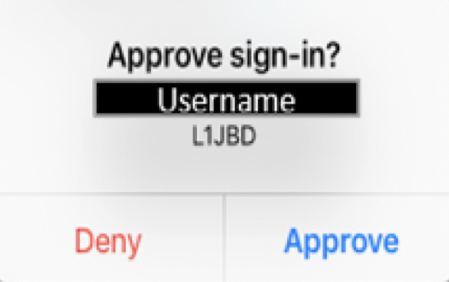
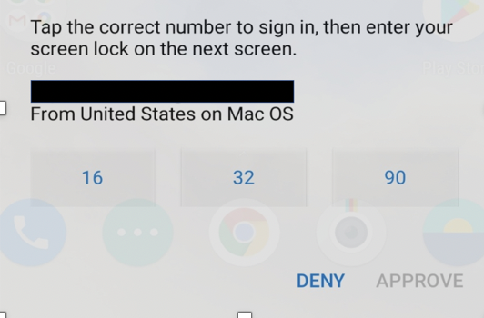
Notification-based Authentication
Confirm
Compare-and-confirm
Select-and-confirm
Phone Call
(unique identifier)
(unique identifier)
Is the information communicated in the notification
sufficient to make an informed authentication decision?

Slide 5
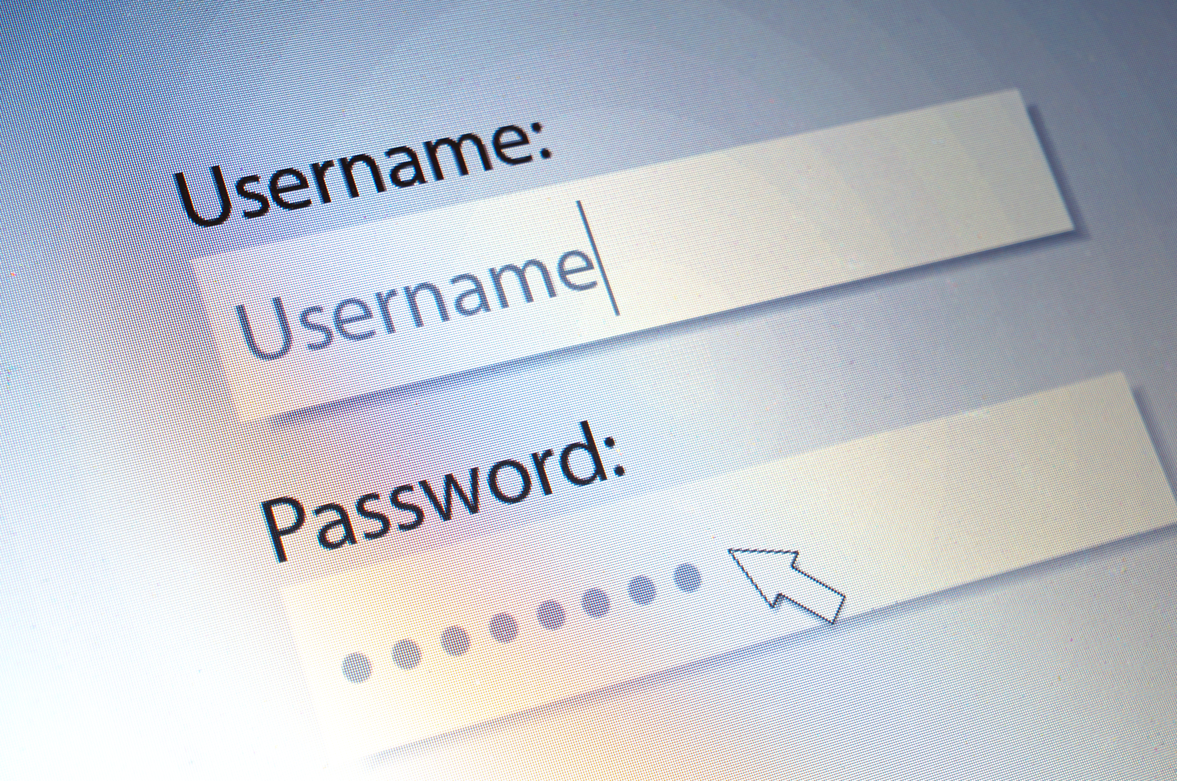
Malware on User Terminal
A malware on the user terminal, can easily compromise knowledge factor (e.g., username and password).
Notification-based 2FA on mobile device, such as smartphone, creates an extra security layer over password.
It is a common belief [Bonneau et al. ; IEEE S&P’2012] that, attackers need to compromise both User Terminal and 2FA device (i.e., Smartphone) to compromise 2FA systems.
Can the attackers compromise the notification-based 2FA without compromising smartphone itself?

Slide 6


Our Contributions
Analysis of information communicated on mobile devices by notification-based 2FA
We discovered that inadequate information in these notifications can lead to significant authentication vulnerabilities.
Design and implementation of concurrent login attack framework and a user study to evaluate the attack
We evaluated real-world 2FA systems using our developed attack framework and conducted a user study to assess the detectability of the attack.
Demonstrated real-world 2FA system vulnerability to the attack, with a high attack success rate in the user study.
We demonstrated that all notification-based 2FA systems we studied are vulnerable to our attack.
We observed a high attack success rate (82.2%) in our user study.

Slide 7

Outline
Background
Authentication Information and terminal verification
Attack Design
Threat Model and Attack Components.
Attack Workflow
Evaluation
Detectability
User Study
Summary of results
Limitation, Potential Mitigation and Future Works
Questions

Slide 8
Outline
Background
Authentication Information and terminal verification
Attack Design
Threat Model and Attack Components.
Attack Workflow
Evaluation
Detectability
User Study
Summary of results
Limitation, Potential Mitigation and Future Works
Questions

Slide 9




Authentication Information and Terminal Verification
Authentication Information
Terminal Verification
Username
Service Name
Logo
Generation Time
IP Address
Generation Device Information
Variants
Terminal Verification
Confirm
Compare-and-Confirm
Select-and-Confirm
Phone Call

Slide 10
Authentication Information
Service Providers (UI) | Service Name | Logo | Location | Time | IP | Username | Device name | Approve/ Deny | Terminal Verification
Duo(Notification body) | ✔️ | ✔️ | ✖️ | ✖️ | ✖️ | ✖️ | ✖️ | ✔️ | ✖️
Duo (App) | ✔️ | ✔️ | ✔️ | ✔️ | ✖️ | ✔️ | ✖️ | ✔️ | ✖️
Duo (Phone call) | ✖️ | ✖️ | ✖️ | ✔️ | ✖️ | ✖️ | ✖️ | ✔️ | ✖️
Google 2SV (Notification body) | N/A | ✔️ | ✖️ | ✖️ | ✖️ | ✔️ | ✖️ | ✖️ | ✖️
Google 2SV (Notification details) | N/A | ✔️ | ✔️ | ✔️ | ✖️ | ✔️ | ✔️ | ✔️ | ✖️
LastPass (Notification body) | ✖️ | ✖️ | ✖️ | ✖️ | ✖️ | ✖️ | ✖️ | ✔️ | ✖️
LastPass (App) | ✖️ | ✖️ | ✖️ | ✖️ | ✖️ | ✔️ | ✖️ | ✔️ | ✖️
LastPass (Phone Call) | ✖️ | ✖️ | ✖️ | ✔️ | ✖️ | ✖️ | ✖️ | ✔️ | ✖️
Microsoft (Notification- Confirm) | ✔️ | ✖️ | country | ✖️ | ✖️ | ✔️ | ✖️ | ✔️ | ✖️
Microsoft (Compare-and-confirm) | ✔️ | ✖️ | ✖️ | ✖️ | ✖️ | ✔️ | ✖️ | ✔️ | ✔️
Microsoft (Select-and-confirm) | ✔️ | ✖️ | country | ✖️ | ✖️ | ✖️ | ✔️ | ✖️ | ✔️
ID.me (Notification) | ✔️ | ✖️ | ✖️ | ✖️ | ✖️ | ✖️ | ✖️ | ✖️ | ✖️
ID.me (app) | ✔️ | ✔️ | ✔️ | ✔️ | ✔️ | ✔️ | ✔️ | ✔️ | ✖️

Slide 11
Outline
Background
Authentication Information and terminal verification
Attack Design
Threat Model and Attack Components.
Attack Workflow
Evaluation
Detectability
User Study
Summary of results
Limitation, Potential Mitigation and Future Works
Questions

Slide 12
Threat Model and Attack Components
Attack Components
Adversaries have ability to
The browser extension
Keylogger Program (KL)
Install malicious program in user terminal.
Convince users to install benign-looking browser extension.
Does not compromise browser itself.
Does not have ability to steal session cookies
Responsible for capturing username and password.
Can trigger for starting other attack components.
Background Browser Session (BBS)
The Malicious program
Adversaries
Can be triggered by KL
Can run from background
Creates a background automated session for attackers.
Does not require admin privilege
Does not compromise core OS functionality
Runs in user space
Can not compromise 2FA device (Smartphone or smartwatch).
Can not compromise authentication service.
Browser Extension (BE)
Responsible for blocking user’s request and redirect them to the attacker-controlled site.

Slide 13





General Attack Workflow
Terminal
Service
1. User Request
2. Block
1. User Request
3. Malicious Request
5. Authentication Success
4. Malicious Notification
5. User Approval
5. User Approval
User
Mobile Device

Slide 14
Cross-service Attack Workflow
Service 1
Terminal
1. User Request
1. User Request
2. Block
3. Malicious Request
5. Authentication Success
Service 2
5. User Approval
4. Malicious Notification
User
5. User Approval
Mobile Device

Slide 15
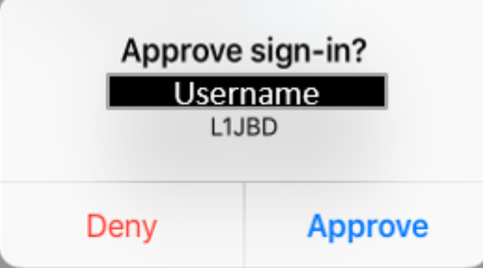
Attack workflow – Terminal Verification
L1JBD
16
Compare-and-confirm
Select-and-confirm

Slide 16
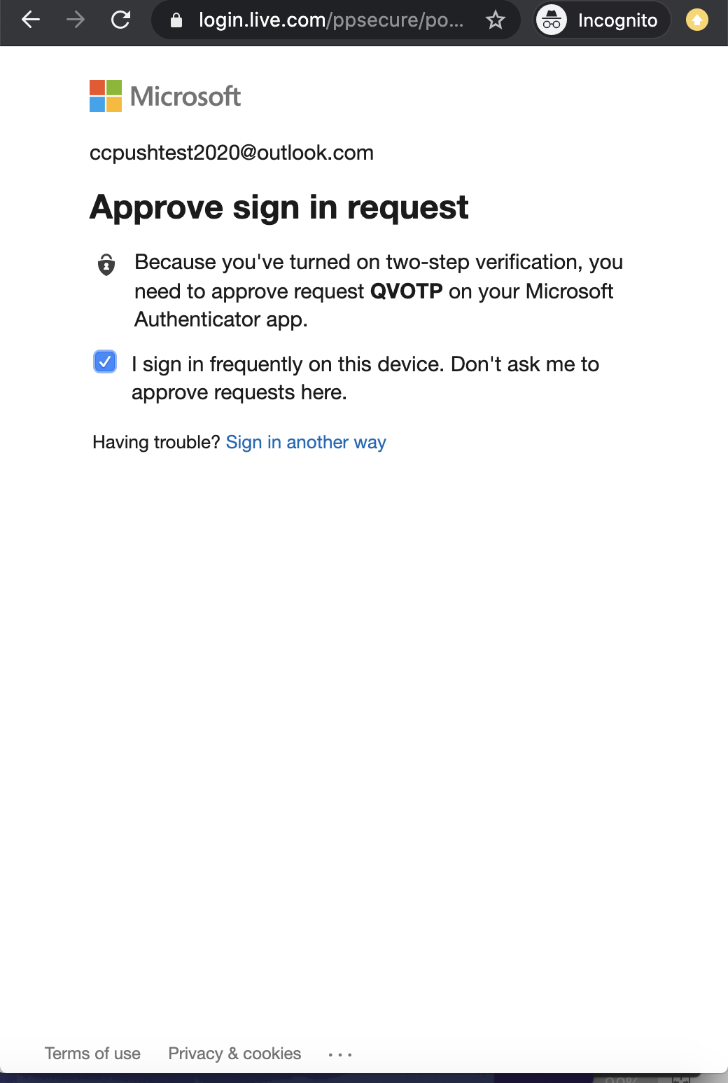
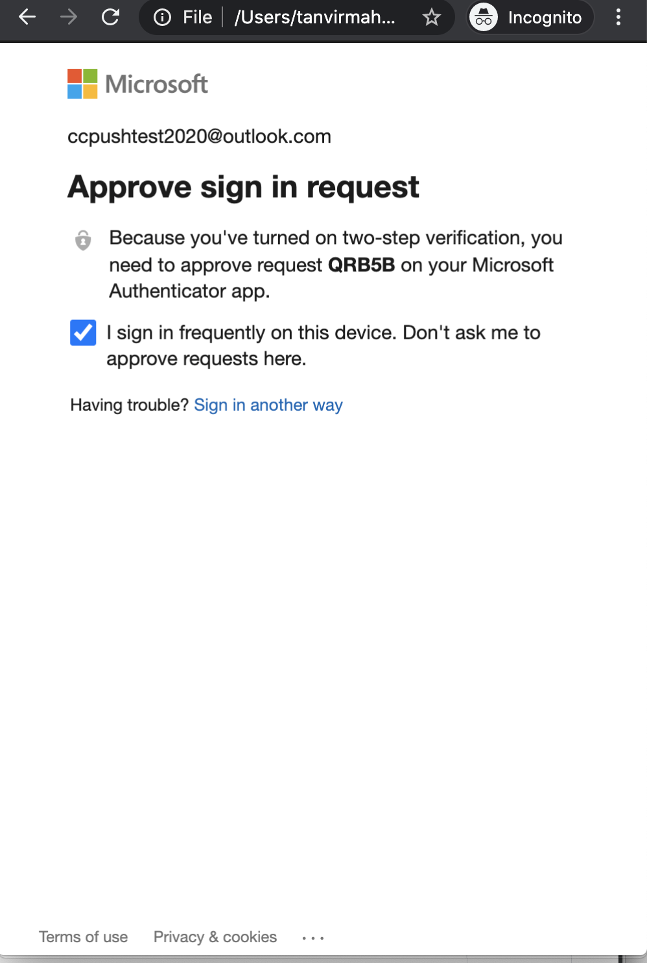
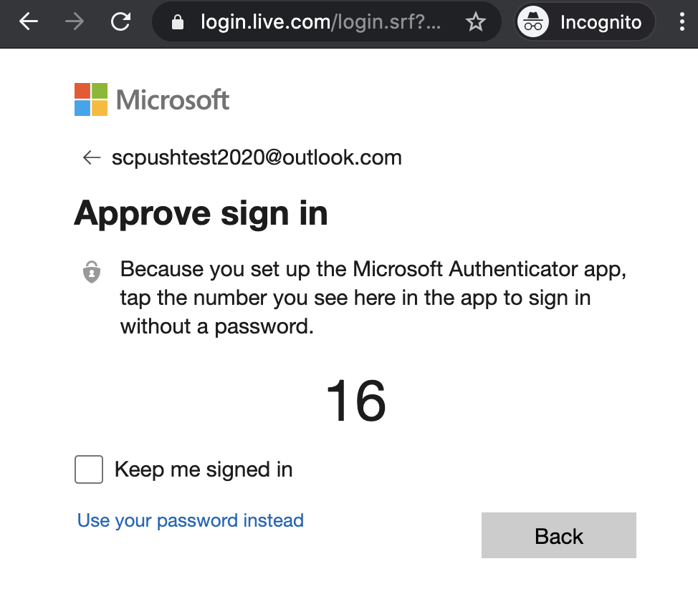
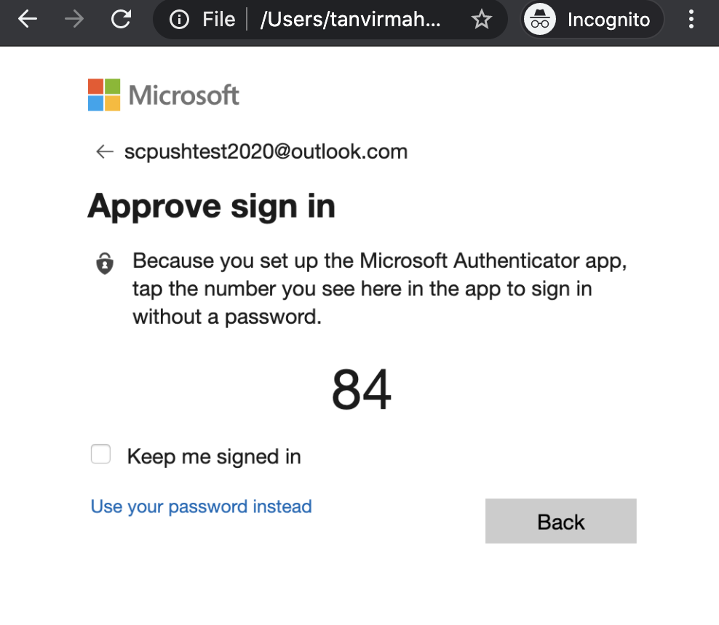
Attack Workflow – Terminal Verification
Benign page
Malicious page
Benign page
Malicious page
Compare-and-confirm
Select-and-confirm
The attacker can just block the user’s request and sends only attacker’s push notification on Confirm variant.
It can block user’s request and redirect the user to a page where an identical page with attacker’s unique identifier will be shown in Compare-and-confirm and Select-and-confirm variant

Slide 17
Outline
Background
Authentication Information and terminal verification
Attack Design
Threat Model and Attack Components.
Attack Workflow
Evaluation
Detectability
User Study
Summary of results
Limitation, Potential Mitigation and Future Works
Questions

Slide 18
Detectability
Anti-malware Programs
Same Service Attack
Only single notification
Name | Detected?
Windows Defender
Avast
MalwareBytes
Kaspersky Security
Sophos Home
Avira
AVG¹
VirusTotal²
Mcafee Total Protection
Service Name
Logo
Location
IP Address
Device name/ Operating System
The users have no way to detect the Same-service attack from notification.
Cross-service Attack
Can users notice the change in service and logo and detect the cross-service attack?
Service Name and logo will be different
1. After showing the warning the program is allowed to run.
2. Only 2 engines detected it, which turns out to be a false alarm

Slide 19
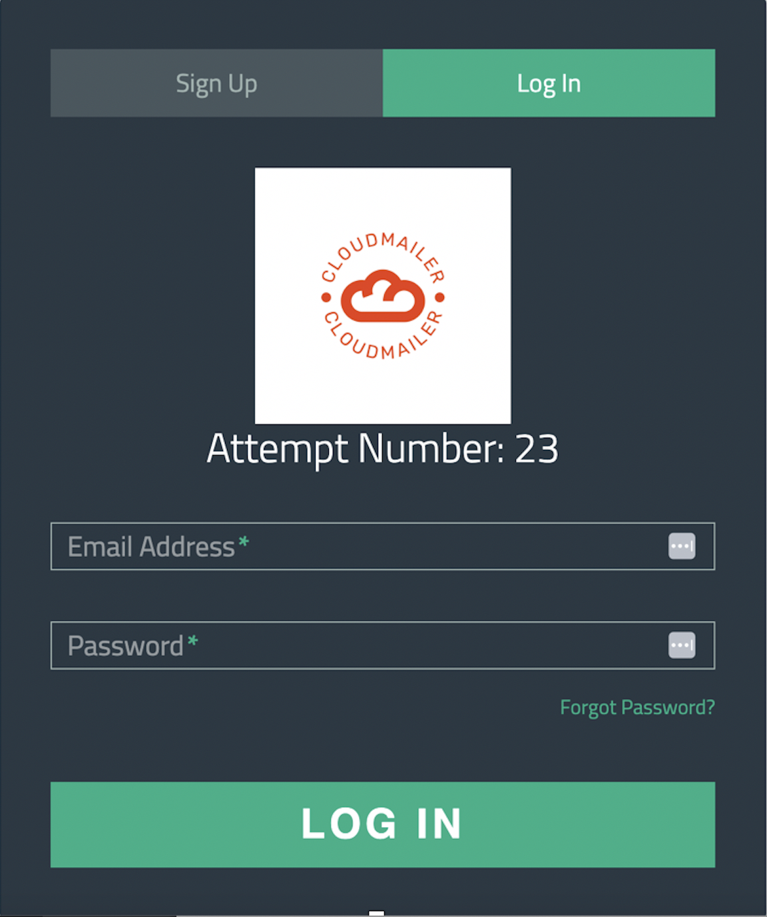
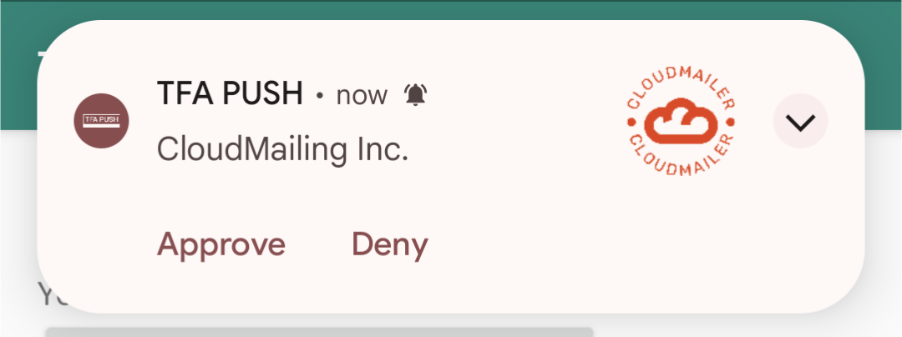
User Study - Design
Purpose:
Evaluate Detectability of Cross Service Attack
20 participants
600 requests (420 benign and 180 cross service)
Each participant encountered 30 requests (21 benign and 9 cross-service)
Cross service requests send to the participants in random order.
Orientation Phase
Pre-test Questionnaire
Familiarization Phase
Post-test Questionnaire
Data collection Phase

Slide 20
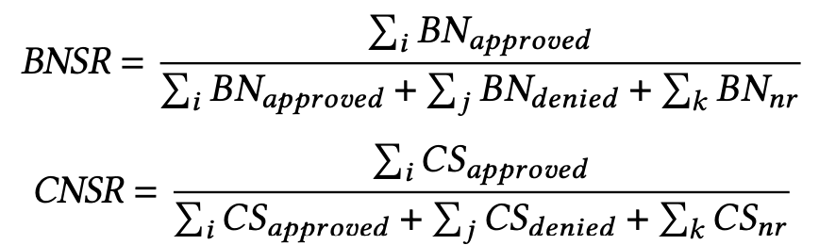
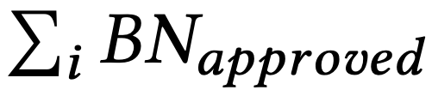
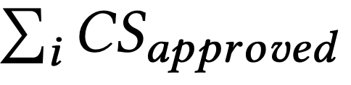


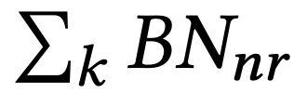
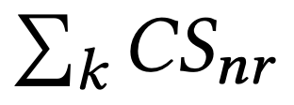
User Study - Results
Scenario | Variant | Response |  |  | BNSR | CNSR
 |  | Approve | Deny | NR
Benign | Confirm | 85.71% | 11.43% | 2.86% | 92.38%
 | Compare-and-Confirm | 95.71% | 1.43% | 2.86%
 | Select-and-confirm | 95.71% | 2.14% | 2.14%
Attack | Confirm | 56.61% | 40% | 3.33% |  | 82.22%
 | Compare-and-confirm | 91.67% | 6.67% | 1.67%
 | Select-and-confirm | 98.67% | 1.67% | 0.00%
We used BNSR (Benign Notification Success Rate) and CNSR (Cross-service Notification Success Rate) to evaluate the users response.
The equation of calculating BNSR and CNSR:
Total number of approved benign notification
Total number of approved cross-service notification
Total number of denied benign notification
Total number of denied cross-service notification
Total number of benign notification where participants did not response.
Total number of cross-service notification with no response.

Slide 21
Summary of results
Notification Variant | Attack Variant | Detectable in 2FA Device | Detectable in Terminal
Confirm | Same-service | No | Low
 | Cross-service | Moderate | Low
Compare-and-confirm | Same-service | No | Low
 | Cross-service | Very Low | Low
Select-and-Confirm | Same Service | No | Low
 | Cross-service | Very Low | Low
Phone Call | Same-service | No | Low
 | Cross-service | No | Low
User Study
56.67% attack Success Rate
91.67% attack Success Rate
98.67% attack Success Rate
No Service name is communicated during phone Call

Slide 22
Outline
Background
Authentication Information and terminal verification
Attack Design
Threat Model and Attack Components.
Attack Workflow
Evaluation
Detectability
User Study
Summary of results
Limitation, Potential Mitigation and Future Works
Questions

Slide 23
Limitation, Potential Mitigation, and Future Work
Limitation
The use of custom apps during the study, which is different from real-world apps, could potentially affect participant behavior and responses.
The study required participants to authenticate 30 times, potentially leading to habitual bias.
Mitigation
For phone-call 2FA, service providers should communicate service information with users.
Service providers should show request location, IP, device name in the notification where "approve" and "deny" button is present.
Users should carefully examine all intermediate page URL and deploy phishing site detector tool.
Service providers should make logo larger and noticeable in the notification body.
Future Work
The researchers have the opportunity to develop a similar attack for additional OS/browser combinations.
They can create a more secure notification-based authentication system that prevents such attacks while prioritizing usability.

Slide 24

Questions?

