Slide 1
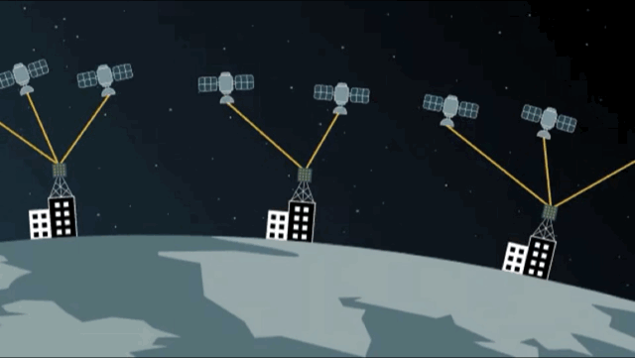
PMSat: Optimizing Passive Metasurface for Low Earth Orbit Satellite Communication
Hao Pan¹, Lili Qiu^{1&2}, Bei Ouyang¹,
Shicheng Zheng¹, Yongzhao Zhang^{1&3}, Yi-Chao Chen^{1&3}, Guangtao Xue³
¹Microsoft Research Asia, ²UT Austin, ³Shanghai Jiao Tong University
Notes:
Hi all, my name is Hao Pan, and I am a researcher at Microsoft Research Asia (Shanghai Lab). I am honored to represent all other authors to present our work: PMSat: Optimizing Passive Metasurface for Low Earth Orbit Satellite Communication.

Slide 2
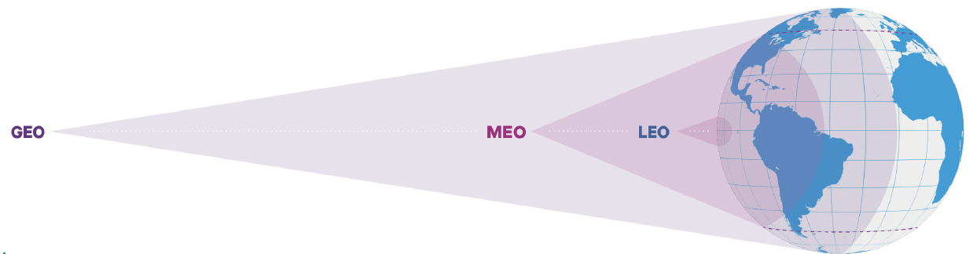
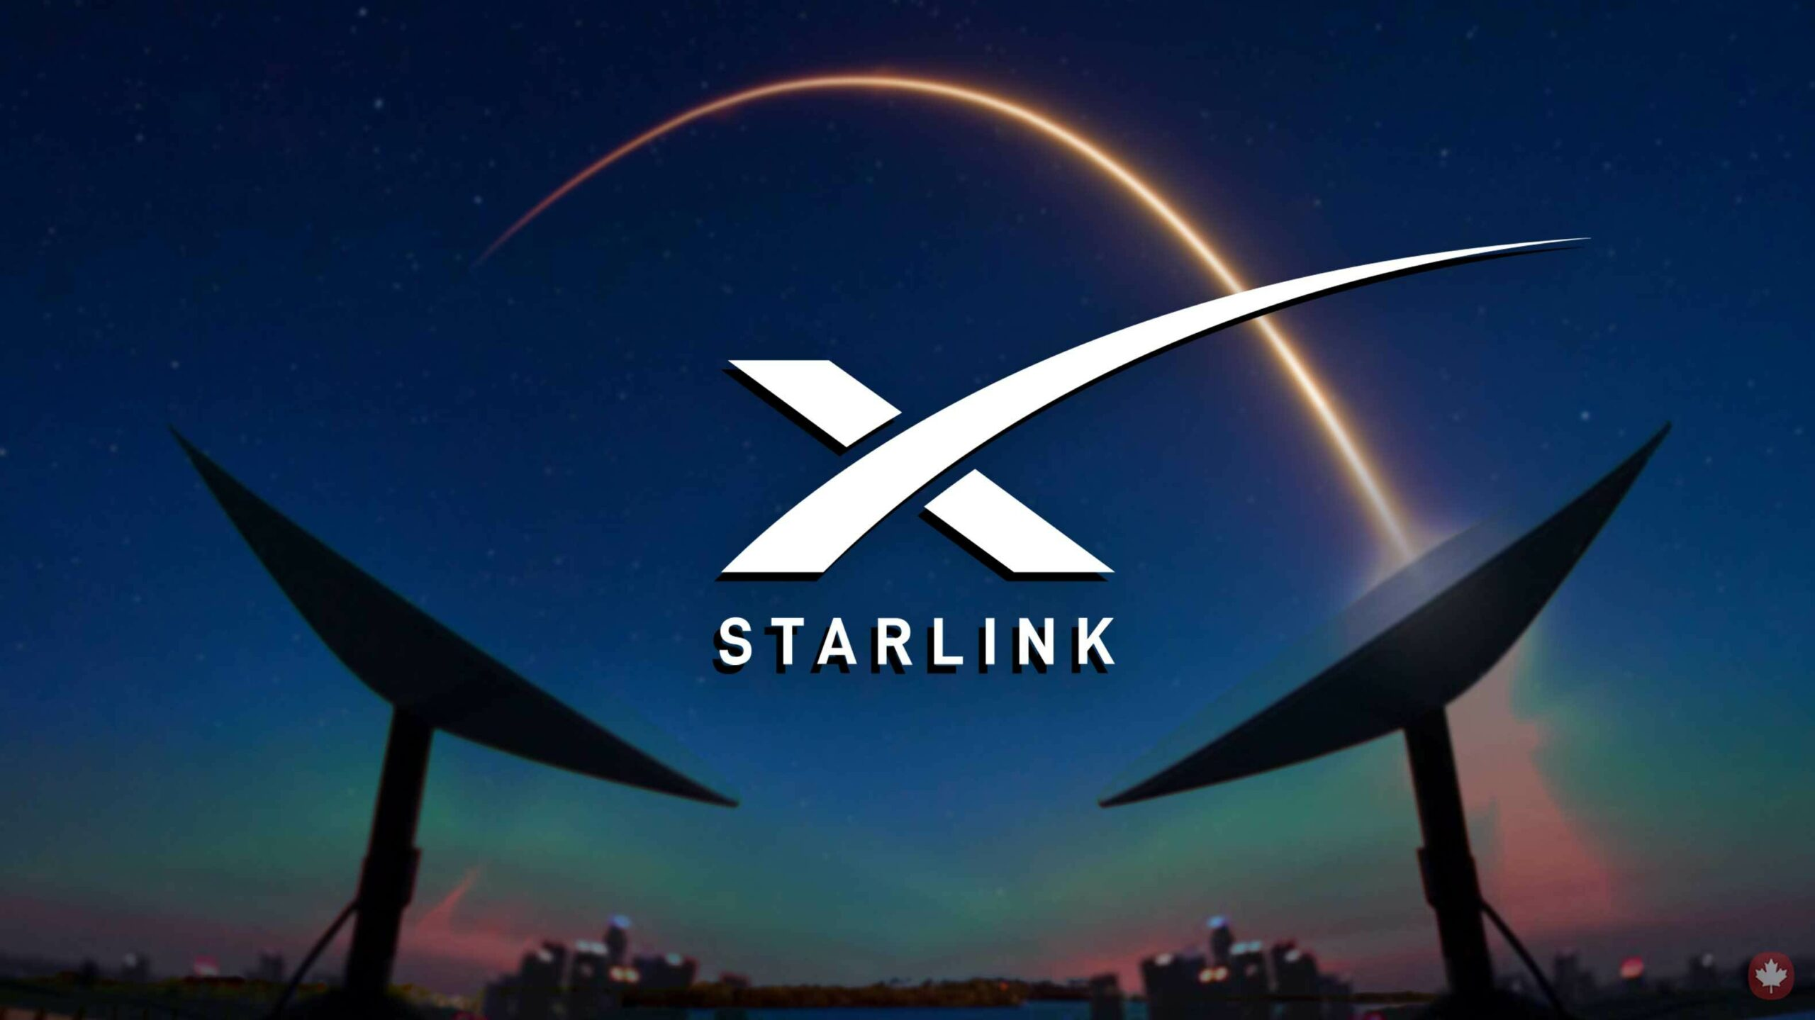


Expanding Internet Access through and Space
36,000~
40,000km
5,000~
20,000km
500~
1,000km
SpaceX StarLink
Amazon Kuiper
Airbus OneWeb
Notes:
Satellite communication is a very important technology in the next generation communication. Among them, LEO network is a type of satellite network that many companies are focusing on, such as SpaceX, Amazon, and Airbus. In this network, satellites are in low Earth orbit, at about 500-1000 kilometers from the Earth's surface.

Slide 3
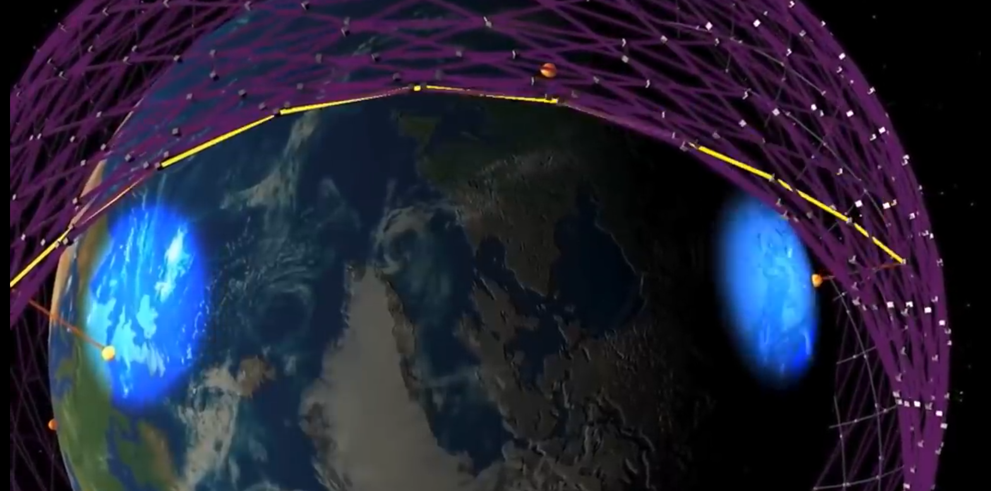
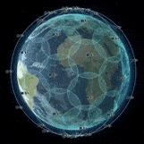
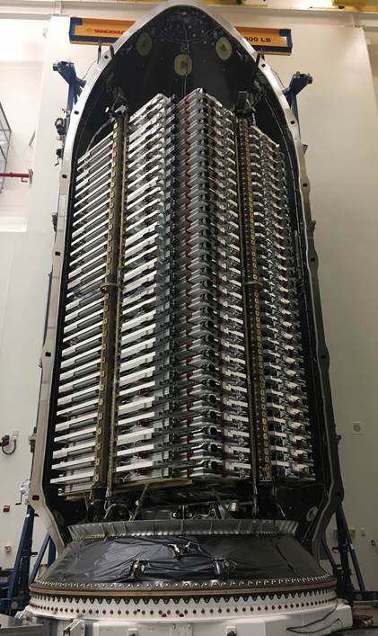
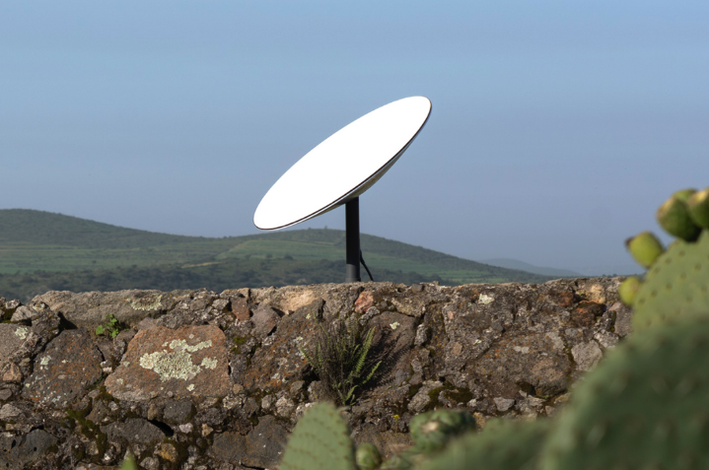
Advantages of LEO Satellite Communication
1. High Speed and Low latency
3.Global Coverage
Low cost of launching nano LEO satellites
e.g., Ku/Ka bands
2. Easy to set up
SpaceX: 4408 LEO satellites
OneWeb: 428 satellites
Kuiper: 3236 satellites (plan)
Launch around 60 LEO satellites one time
For each, cost $2000
Notes:
LEO satellite networks have several advantages: First, it has high speed and low latency. Next, LEO satellites ground station is easy to set up due to the small size. In addition, the cost of launching LEO satellites is becoming increasingly lower, by deploying thousands of LEO satellites, it can achieve global coverage.

Slide 4
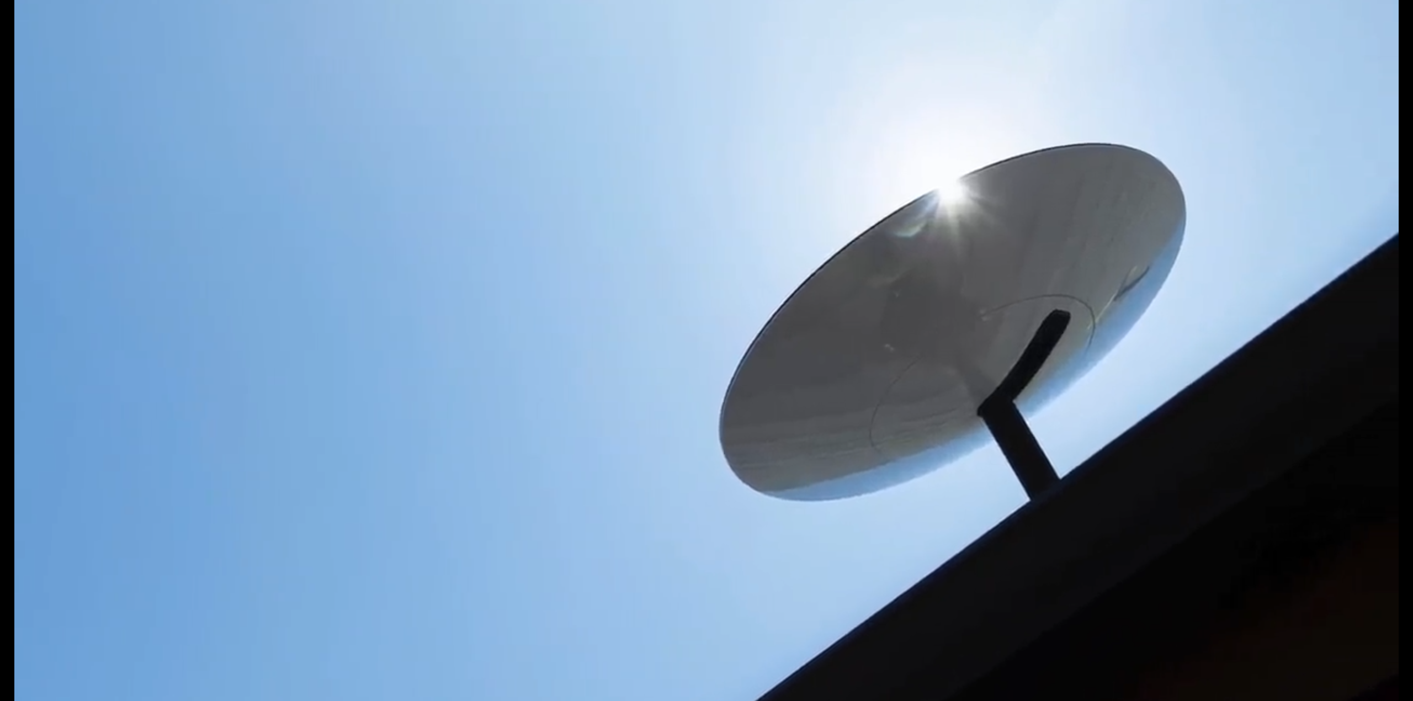
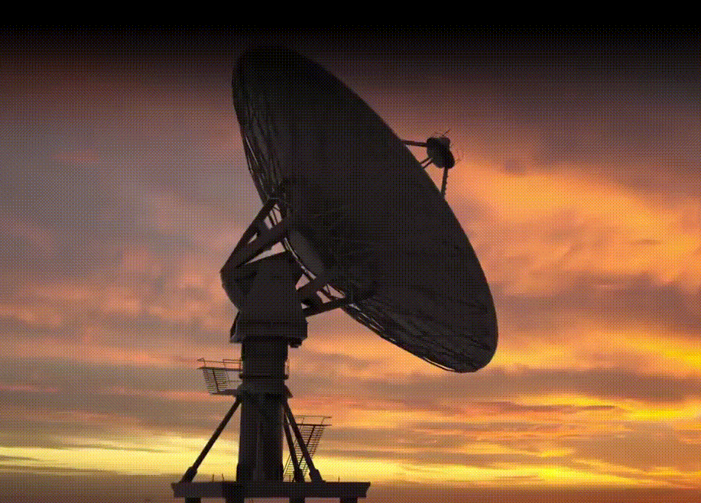

Limitations of LEO satellite communication
Requirement of ground receiver terminal:
mmWave experiences severe attenuation, requiring high SNR for high throughput
Fast-moving satellites require real-time tracking
Tracking Structure
Bulky
Complex mechanical structure (unstable)
Power-consuming
Challenges:
How to build a low-cost, space-saving, and high- performance ground station for LEO satellite communication?
Dish Antenna
Equipment fee of ground antenna terminals: $599~2500 (for StarLink) ^{[1]}
[1] https://www.satelliteinternet.com/providers/starlink/
Notes:
However, LEO satellite networks have strict requirements for the ground station transceiver. The LEO ground station needs to handle with millimeter wave severe attenuation, to provide high SNR to support high throughput. And it should also track the fast-moving LEO satellites.
The common technology is to use massive phased array to realize beam forming and beam steering towards moving satellites. However, massive phased shifters make the cost of ground station too expensive. [CLICK] So, the biggest challenge is: How to build a low-cost, space-saving, and high-performance ground station for LEO satellite communication?

Slide 5
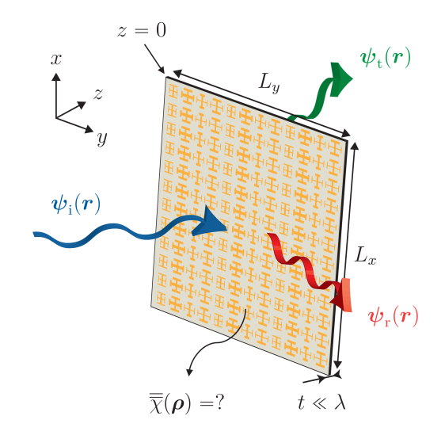

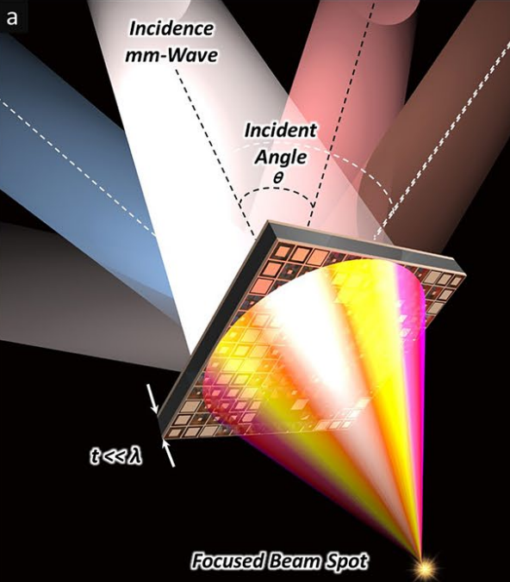


EM metasurface provides a new solution!
Passive (no power needed)
2D structure (negligible thickness)
Cheap (Martial cost of metasurface < $20/m²)
An example of EM metasurface
for signal strength enhancement
Notes:
Electromagnetic metasurfaces provide a new solution. EM metasurfaces are materials that can control incident EM waves. They can function as a passive device, requiring no energy. They have a 2D structure and are also inexpensive.
Taking a passive and transmissive metasurface as an example, by reasonably designing its structure, we can use it to focus incident EM waves and improve signal strength.

Slide 6
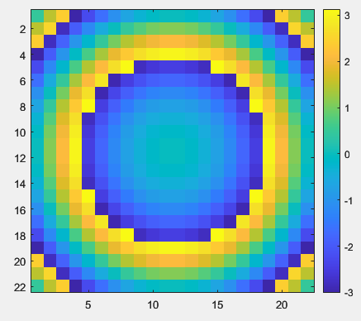
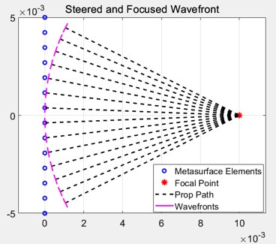
Case study: Focusing passive metasurface
Phase delay introduced by each unit can achieve the focusing effect.
Focusing metasurface:
improve RSS
Metasurface’s
phase profile
Notes:
To obtain a focusing metasurface, we need to design the metasurface’s phase profile, like a circular phase profile.
[CLICK] We explain from one dimension phase compensation why this phase map can achieve focusing. The blue dots represent each metasurface unit, and each unit cell introduces a specific phase delay, and they can finally control the wavefront of the incident EM waves and make them superimposed positively at the specific focusing point.

Slide 7

Metasurface equals to an antenna array
Equivalent passive antenna array
Metasurface
…
Each metasurface unit
can be equated to
a passive subwavelength antenna
…
…
…
…
…
…
…
…
…
…
…
…
…
Notes:
Similar with phased array technique, we can treat each unit cell in the metasurface as a passive mini antenna, and these unit cells have the ability of introducing phase delay in 2pi range.
By arranging these unit cells reasonably, we can obtain the specific wavefront control function.

Slide 8
Overview: How to design passive metasurface for LEO？
Q1: How to enable dynamic adaptation using passive metasurface?
Q2: How to design phase profile of the metasurface?
Q3: How to design the metasurface unit cell for LEO scenarios?
Notes:
OK, next we will describe how to design a passive metasurface for LEO scenarios. We propose three points that are needed to be solve.
First, how to enable dynamic adaptation using passive metasurface.
Second, how to design the phase map of the metasurface?
And, the third is how to design the metasurface unit cell for LEO scenarios.
We will answer the three question one by one.

Slide 9


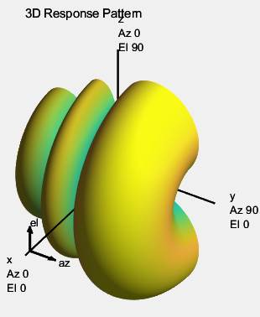
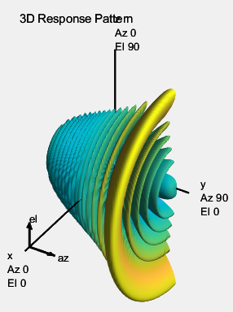
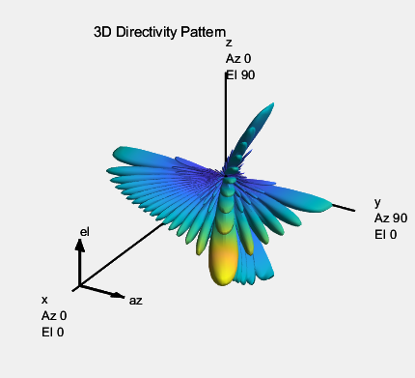


Our idea: A Passive Metasurface + A Small Phased Array
Passive Metasurface:
1. has weak wavefront shaping capability due to the small scale
2. has programmable capability with digital phased shifters
1. is cheap and has massive elements
2. has a powerful capability of wavefront shaping
3. cannot be reconfigurable once fabrication
Small Phased Array:
Metasurface Small Phased Array
Powerful beam forming Programmable beam steering
1x4 line PA
1x22 line PA
22x22 line PA
An example of EM metasurface
for FOCUSING
Antenna
Array
phase
shifter
phase
shifter
phase
shifter
…
$$w_{d}$$
Code word
RF Chain
Notes:
For the first question, our solution is to combine passive metasurfaces with small phased array systems.
Although passive metasurfaces are very cost-effective and have a large number of units, providing powerful wavefront control capabilities. Their drawback is also obvious, they lack programmability, meaning that once they are fabricated, their wavefront control function cannot be changed.
[CLICK] Phased array systems have programmability. When the number of phase shifters is small, that may cause phased array has the weak beamforming capabilities, but, we only need they are featured with programmable.
[CLICK] Therefore, by combining metasurfaces with small phased array systems, we can integrate their powerful beamforming and programmable beam steering to achieve a low-cost LEO satellite ground station transceiver.

Slide 10
Overview: How to design passive metasurface for LEO？
Q1: How to enable dynamic adaptation using passive metasurface?
Q2: How to design phase profile of the metasurface?
Q3: How to design the metasurface unit cell for LEO scenarios?
Notes:
Next, we describe how to determine the metasurface’s phase profile for beam forming and steering.

Slide 11

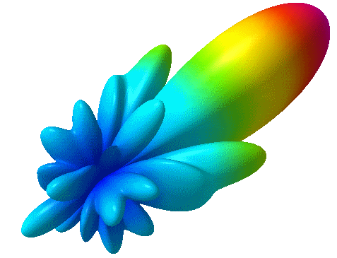
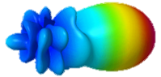
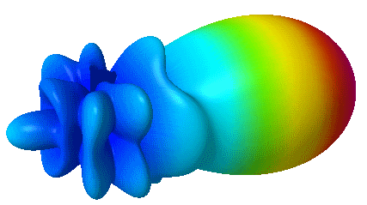




Our idea: A Passive Metasurface + A Small Phased Array
Powerful wavefront
shaping
Programmable capability
Code word
$$M$$
$$R_{d}$$
$$w_{d}$$
wavefront
Transmitter
Active Beam
Receiver
Beam
phase shifter
Baseband Module
RF
Chain
Splitter/
Combiner
phase shifter
Steering angle
$$d$$
…
phase shifter
Phased Antenna
Array
Metasurface
Notes:
Our target is to find the optimal code word for a small phased array and the optimal phase profile for a passive metasurface. By jointly designing and optimizing the phased array and metasurface, we try to achieve both efficient beamforming and steering capabilities to communicate with LEO satellites.

Slide 12


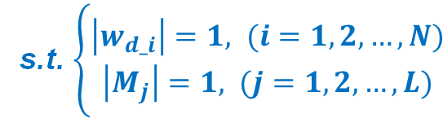








Uplink Optimization Model
$$H$$
$$M$$
Code word: $w_{d}$
$$w_{d}$$
$$R_{d}$$
phase shifter
Receiver
Beam
Splitter
phase shifter
For a specific steering direction, $d$.
Our objective is to:
…
$$\max_{M, w_{d}} F{{(w}_{d} H M R_{d})}$$
phase shifter
s.t. $\left\{\begin{aligned}\left|w_{d_i}\right|=1, (i=1, 2,…,N) \\ \left|M_{j}\right|=1, (j=1, 2, …,L)\end{aligned}\right.$
Phased Antenna
Array
Channel
(coupling PA
and metasurface)
Metasurface
For specific steering direction set, $D$.
Our objective is to:
$$\max_{M, W_{D}} F{{(W}_{D} H M R_{D})}$$
Notes:
For the uplink, we assume that the phased array only has phase shifters and no power amplifiers, it is a common configuration.
[CLICK] We build the wireless channel between each antenna in the phased array and each unit of the metasurface.
[CLICK] The optimization objective is to ensure that for every steering angle, the transmitted signal can be received by the satellite receiver with the maximum signal energy. By formulating this optimization problem and using a gradient descent solver, we can find the optimal phased array’s code word and the uplink metasurface’s phase map.

Slide 13
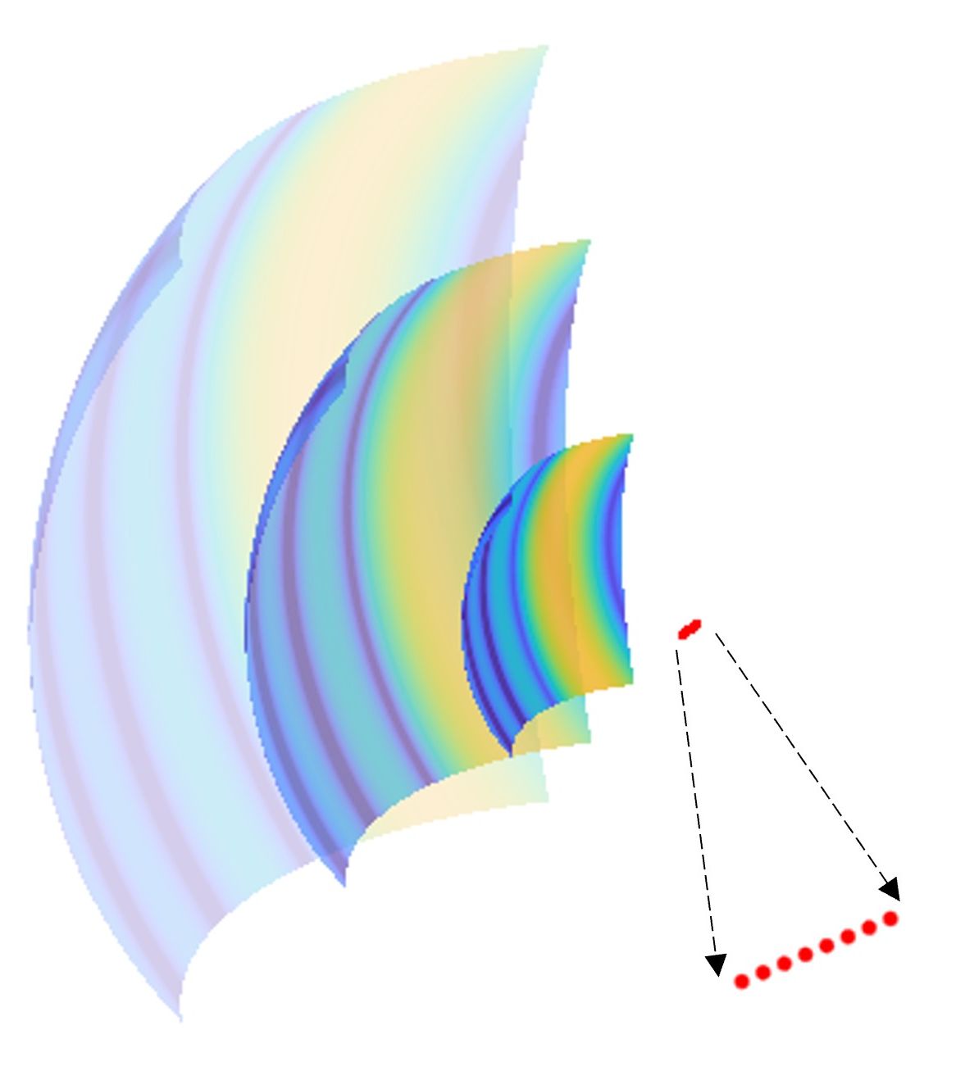
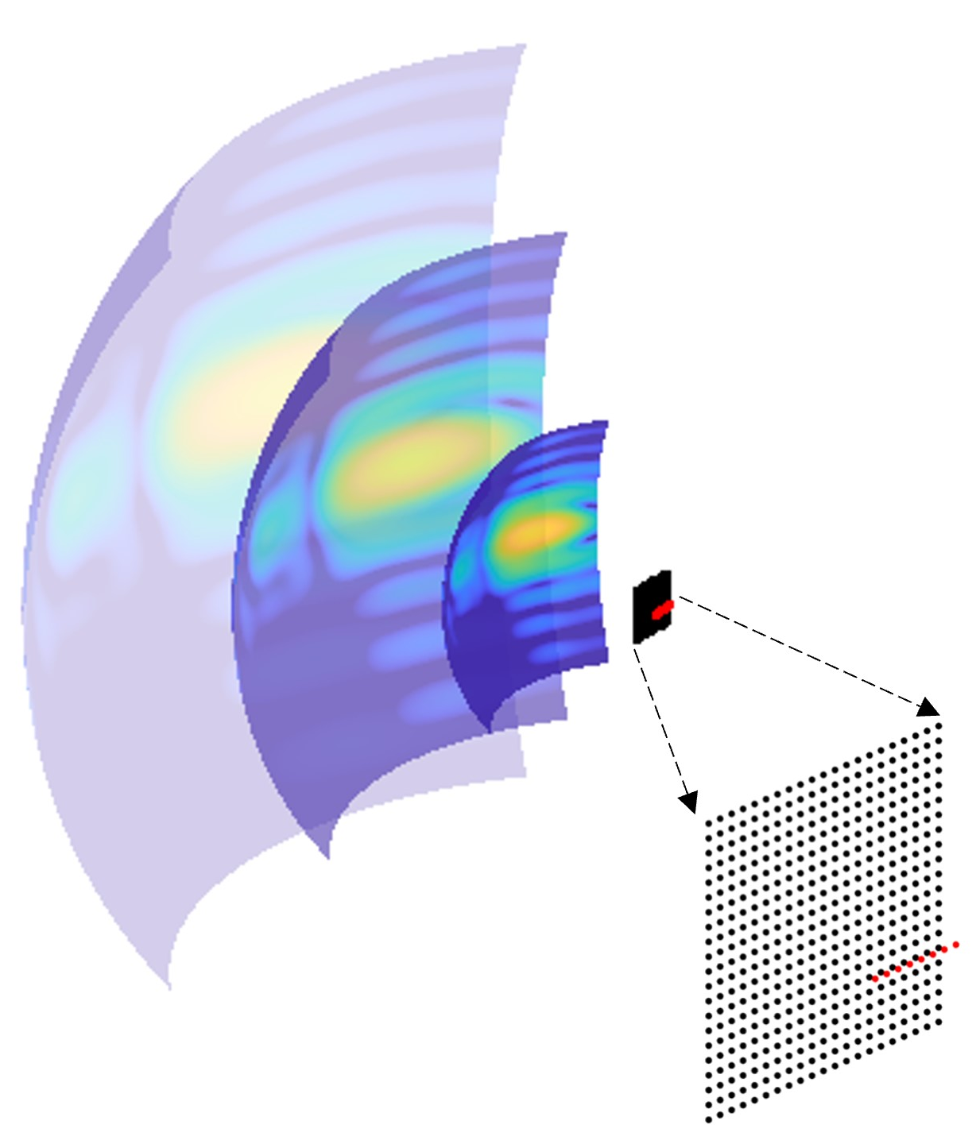
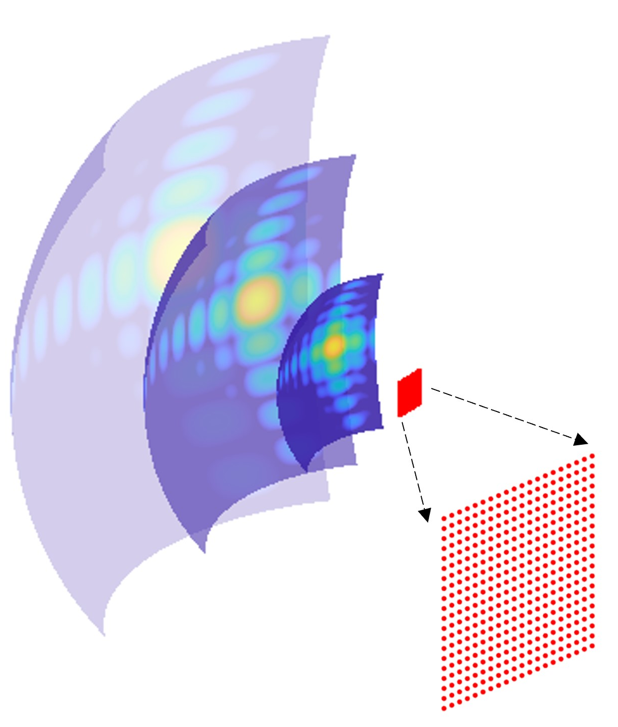
Uplink Performance: 1x8 PA + 21x21 HMS vs. PA
EM wave propagation in 3D space
Steering direction: azimuth = 20°, elevation = 0°
7.91 dB gain
1.47 dB gain
≫
≈
1x8 line phased array
1x8 line phased array +
22x22 metasurface
close to
22x22 rectangular
phased array
Notes:
We visualized the EM wave energy distribution during the 3D propagation. The red dots mean the antennas, and the black dots mean the metasurface cells.
If there is only a 1x8 phased array antenna, the beam has directivity only in azimuth dimension.
When we add the optimized metasurface and combine it with the phased array with a new code word, we observe that the beam has good directivity and focusing in both dimensions. Compared to the phased array alone, our system has a 7.91 dB gain.
[CLICK] We also compared it with a large phased array antenna of the same size as the metasurface. Its performance has only 1.47 dB gain to our system, and the beamforming performance is almost the same.

Slide 14
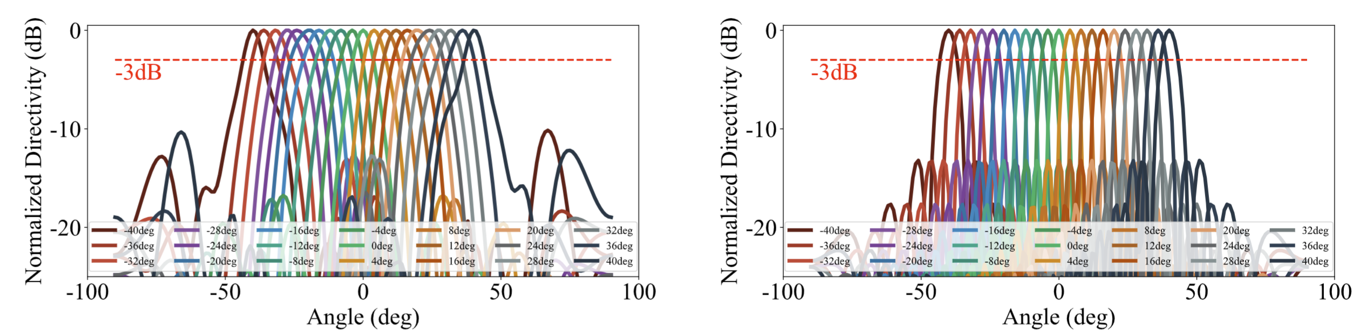
Uplink Performance: 1x8 PA + 21x21 HMS vs. PA
Beam patterns
Steering direction: azimuth: from -40° to 40 °, elevation = 0°
1x8 line phased array +
22x22 metasurface
close to
22x22 rectangular
phased array
Notes:
We also demonstrated the system’s beam pattern when different phased array’s code words. This proves that our optimized metasurface have good beamforming capabilities, as well as great beam steering by switching phased array code words.

Slide 15
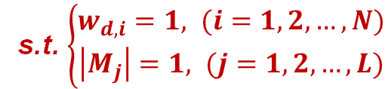







Downlink Optimization Model
$$H$$
$$M$$
$$w_{d}$$
$$T_{d}$$
Transmitter
Beam
Combiner
For a specific incident direction, $d$.
Our objective is to:
…
$$\max_{M, w_{d}} G{{(T}_{d} M H w_{d})}$$
s.t. $\left\{\begin{aligned}w_{d, i}=1, (i=1, 2,…,N) \\ \left|M_{j}\right|=1, (j=1, 2, …,L)\end{aligned}\right.$
Multiple
antennas
Channel
(coupling PA
and metasurface)
Metasurface
For specific steering direction set, $D$.
Our objective is to:
$$\max_{M, W_{D}} G{{(T}_{D} M H W_{D})}$$
Notes:
For the downlink, we directly superimpose the signals collected by multiple antennas without adding phase shifters in the downlink frequency band, as this would generate additional costs.
The optimization objective we build for the downlink is to ensure that for every incident angle, the signal transmitted by the satellite will be received by our system with the maximum signal energy. In this way, we can find the optimal phase map for the metasurface.

Slide 16


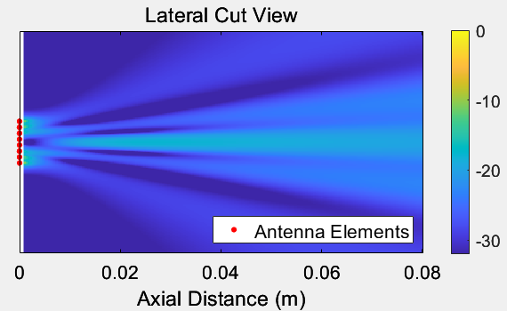
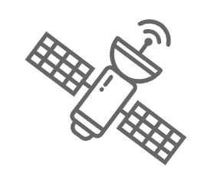
Downlink Performance: 1x8 PA + 22x22 HMS vs. 1x8 PA
EM wave focusing in lateral cut view
Incident
EM waves
Incident
EM waves
multi antennas
…
…
1x8 line phased array +
22x22 metasurface
11.76dB gain
1x8 line phased array
Notes:
Taking an example, after adding our optimized downlink metasurface, the total signal energy received by multiple antennas has 11.76 dB gain than 1x8 phased array antenna alone.
[CLICK] Our metasurface can also focusing the EM waves with other incident angles, and it shows the effectiveness of our method in downlink.

Slide 17
Overview: How to design passive metasurface for LEO？
Q1: How to enable dynamic adaptation using passive metasurface?
Q2: How to design phase profile of the metasurface?
Q3: How to design the metasurface unit cell for LEO scenarios?
Notes:
The last question is, how to design the metasurface unit cell for LEO scenarios, so that we can fabricate the metasurface with the above phase profiles in both uplink and downlink.

Slide 18
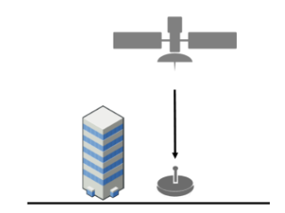




Microscopic design: Meta-atom for LEO scenarios
Requirements for TRANSMISSVE meta-atom design in LEO scenarios:
High transmission rate, e.g., >90%
360° phase shift range for powerful wavefront control
3. Wide incident angels, [-40°, 40°]
4. Dual-band support and wide frequency bands
Downlink:
17.7-20.2GHz
e.g., Amazon Kuiper
$$θ=−40°$$
$$θ=40°$$
Uplink:
27.5-30GHz
Notes:
There are four main requirements to design an EM transmissive metasurface unit cell for use in LEO scenarios.
First, the designed metasurface unit cell need to satisfy high transmission rates to reduce the energy loss.
The second requirement is the unit cell should have a 2pi phase modulation range. This is the necessary items for effective wavefront control.
In addition, we need to enable unit cell to support a wide range of incident angles, as the reasonable communication angles for LEO satellites range from -40 degrees to 40 degrees.
The forth requirement is dual band support. This is because current LEO networks use two frequency bands to support uplink and downlink communication to prevent interference.

Slide 19

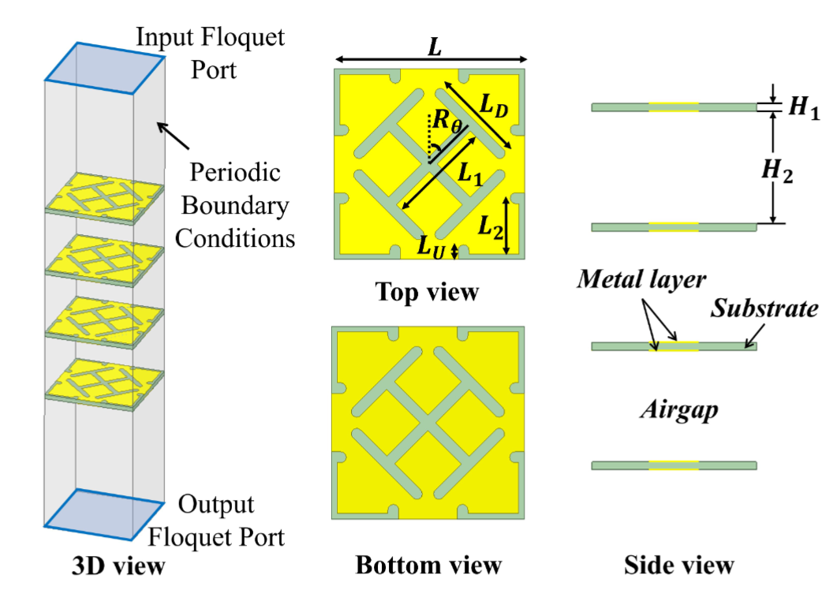
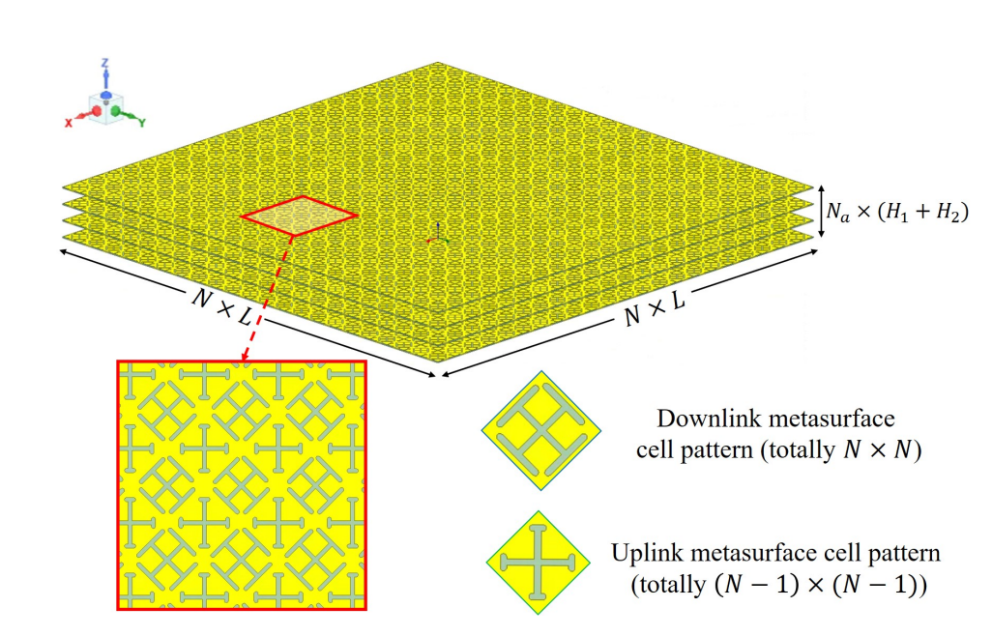
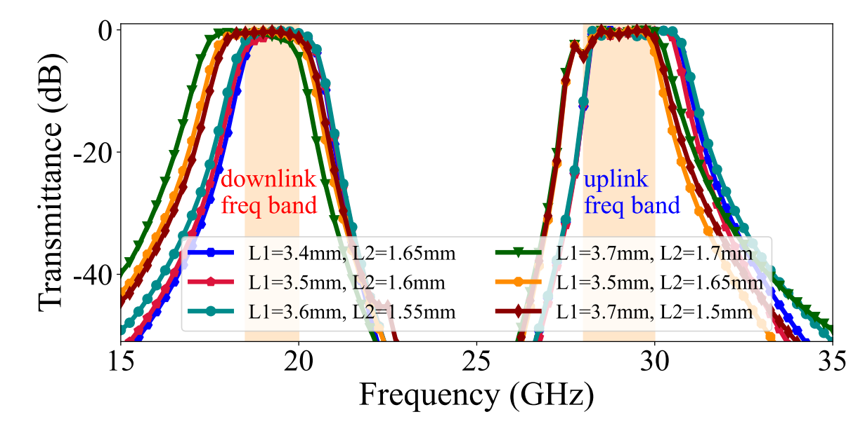

Metasurface design: Meta-atom structure
Meta-atom structure design
Overview of our proposed metasurface
High transmission rates across wide frequency bands for uplink and downlink
Metal-substrate-metal sandwich design
Two patterns are interlaced for dual bands
4-layers design for high transmission rate and 2π
phase shift range
Notes:
To this end, we propose a multi-layer metatasurface unit cell design that can support operation in LEO scenarios. We can use different parameters, such as L1 and L2 to introduce different phase delay in the downlink and uplink. For the details of meta-atom design, please refer to our paper.
[CLICK] By assembling unit cells into a large metasurface, we can see the sub-patterns contained in the metasurface. The large cross patterns are for the function of downlink, and the smaller cross patterns are for the uplink.
[CLICK] We simulate the frequency response of our proposed metasurface, the results show that high transmission rates across wide frequency band for both uplink and downlink.

Slide 20


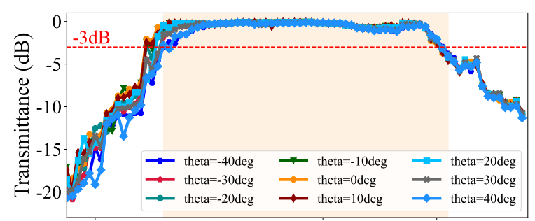

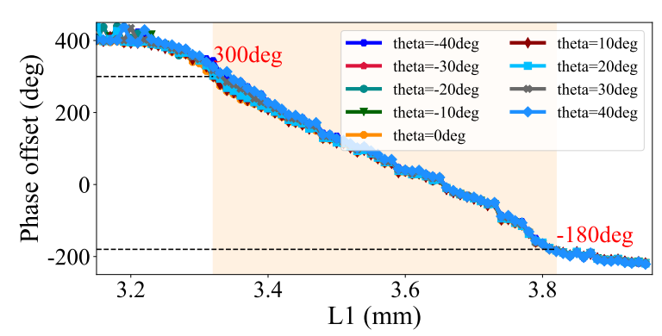

Meta-atom: dual-band, high |S21| & 360° ∠(S21), wide-angle
20GHz
L1 =
3.4mm
Δ θ =
300deg
Downlink Meta-atom Performance
L1 =
3.8mm
Δ θ =
-180deg
Notes:
Let's discuss the phase modulation capability of the meta-atoms. For the downlink frequency, such as 20 GHz, when we change the parameter L1, the phase delay corresponding to the meta-atom changes from 300 degrees to -180 degrees to cover 2pi phase modulation range. And we can ensure the unit with the minimized transmission attenuation.

Slide 21
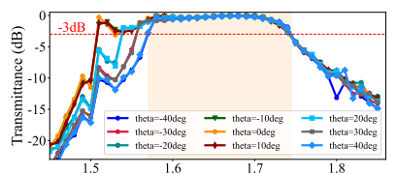
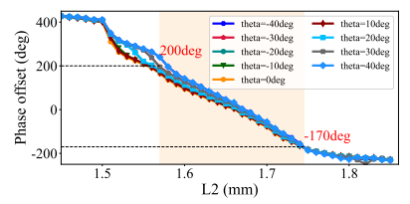
Meta-atom: dual-band, high |S21| & 360° ∠(S21), wide-angle
30GHz
Uplink Meta-atom Performance
L2 =
1.5mm
Δ θ =
310deg
L2 =
1.7mm
Δ θ =
-170deg
Notes:
For the uplink frequency, when we change the parameter L2, the phase delay corresponding to the meta-atom changes from 310 degrees to -170 degrees to cover 2pi phase modulation range.

Slide 22
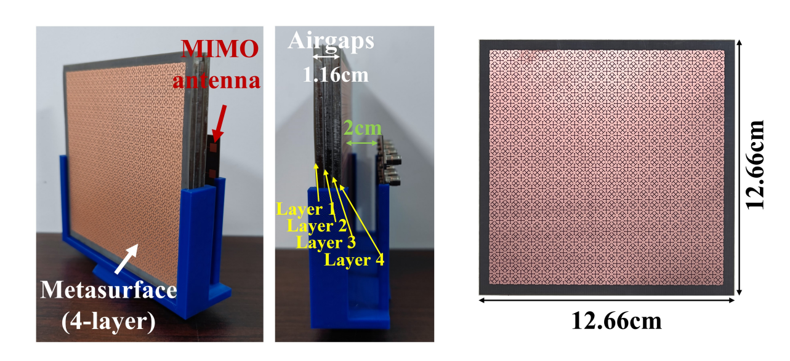
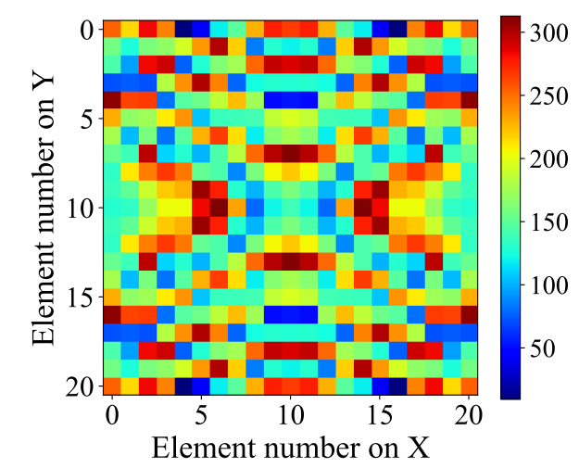
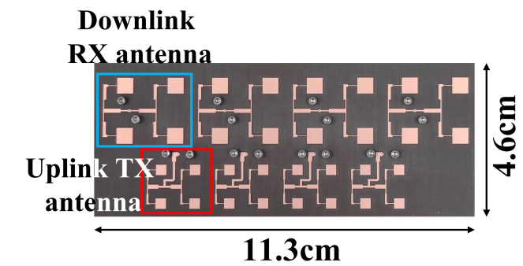
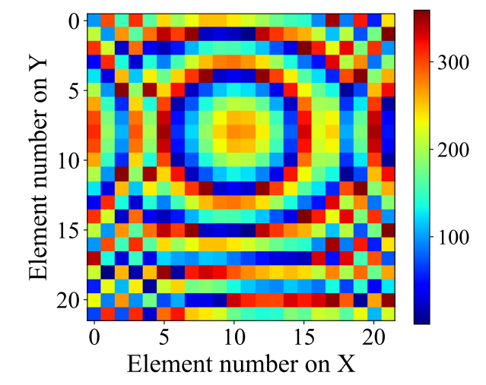
Prototype of Our System
21x21 uplink metasurface
Metasurface + phased array
22x22 downlink metasurface
1x4 downlink antenna array
1x4 uplink phased array
Notes:
The optimized metasurface phase profiles for both uplink and downlink are shown in the right part of the figure, which is set up with a 1x4 phased array.
[CLICK] We have fabricated a physical prototype based on these phase maps, with a metasurface that supports both uplink and downlink, and an antenna PCB board that includes uplink antennas and downlink antennas.

Slide 23
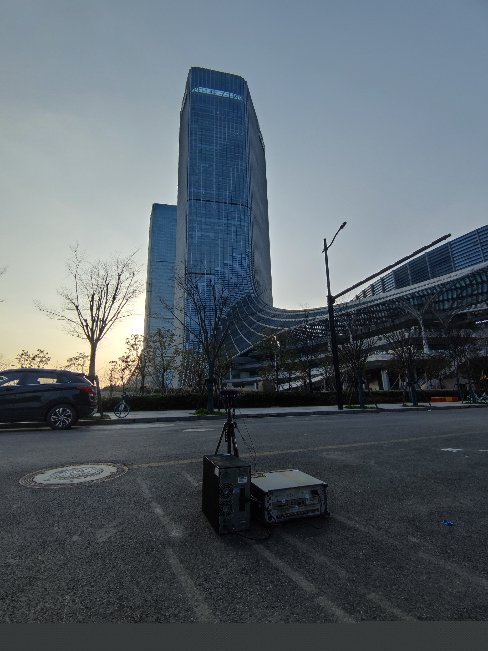
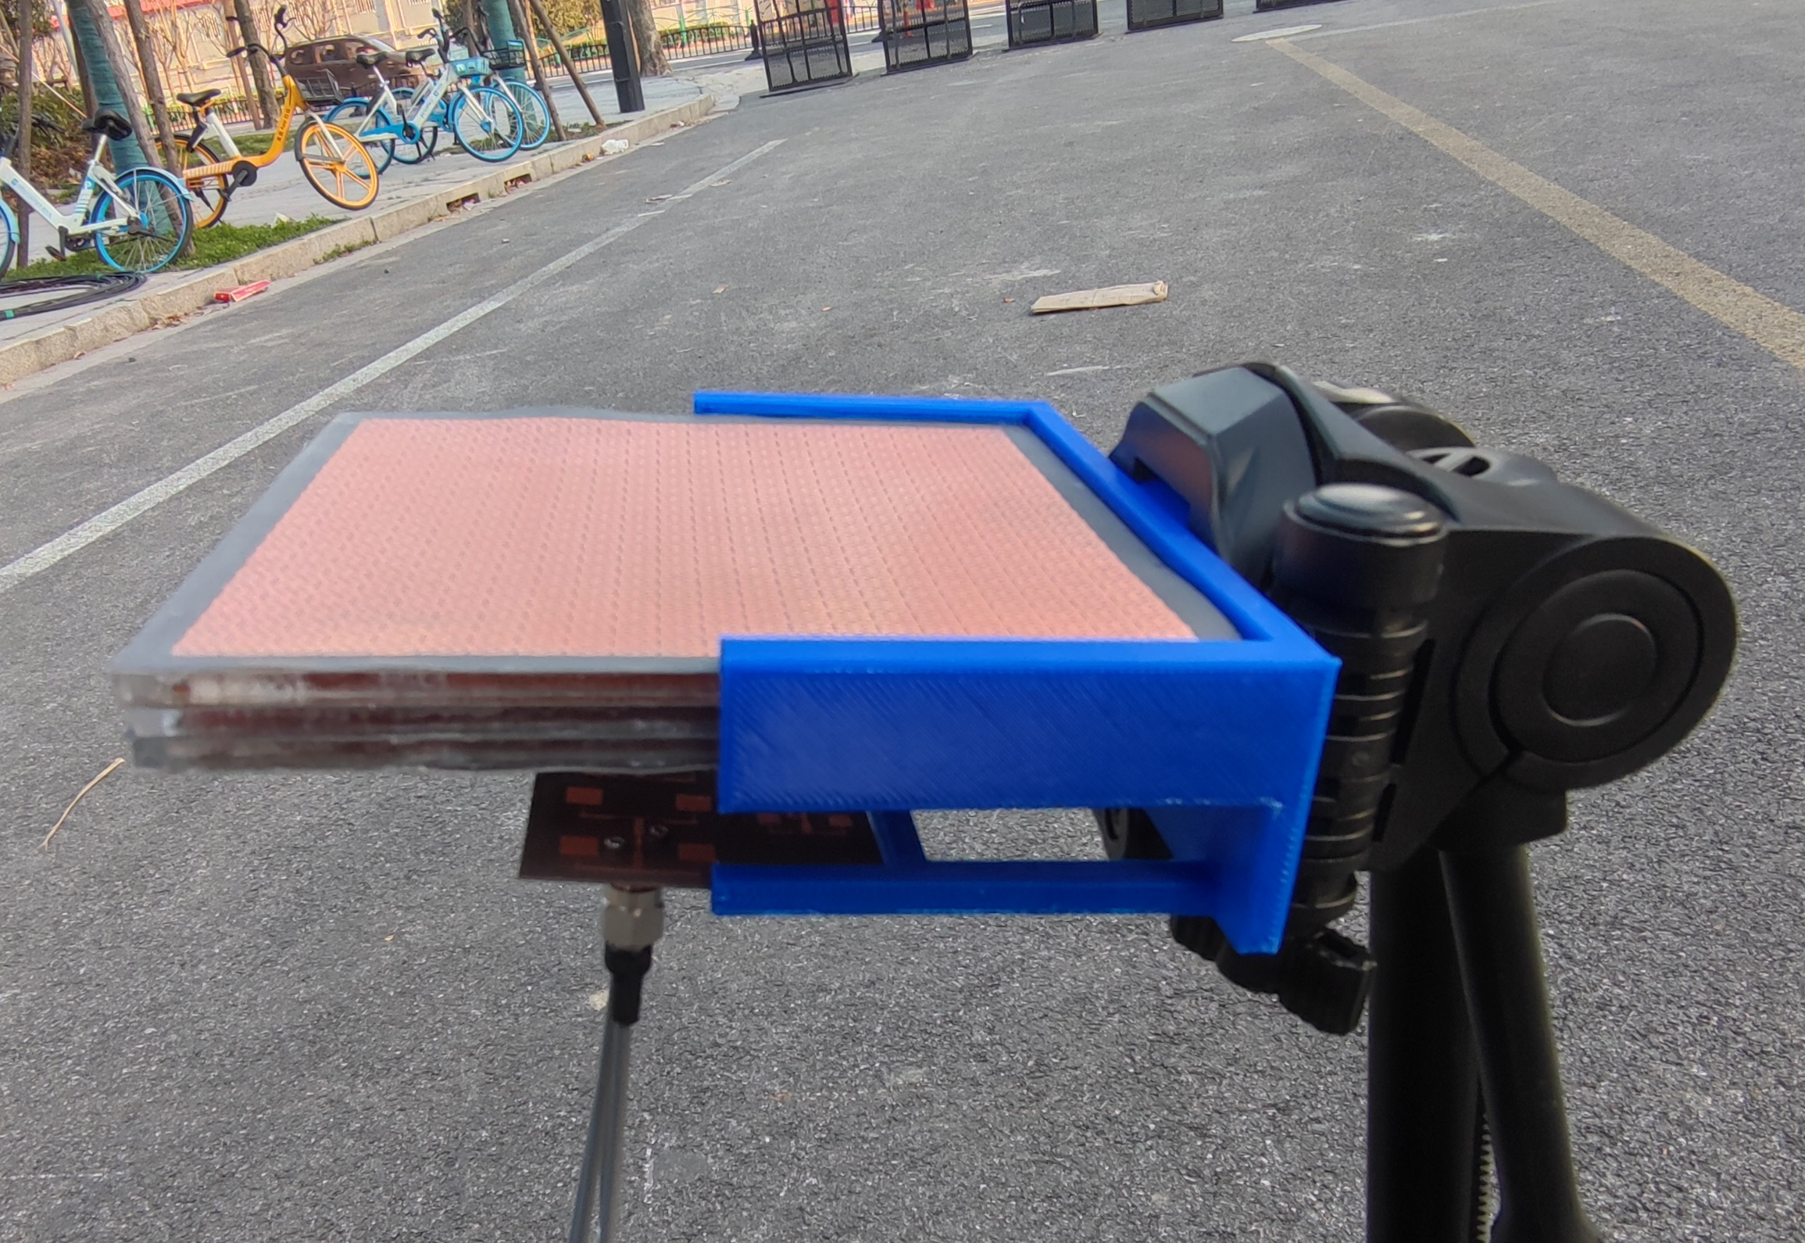
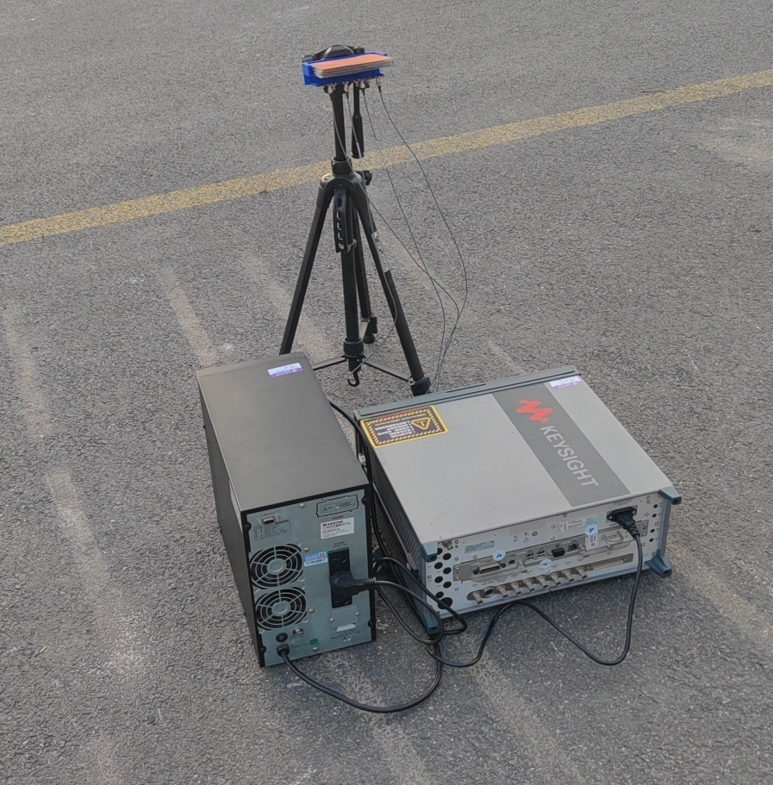
Real-world Experiment Setup
Our
transmitter
190
meters
Uplink Gain:
8.32dB
Downlink Gain：16.57dB
Our proposed LEO ground station
Notes:
We deploy a transmitter antenna on a high-rise building, and MSRA shanghai lab is in the 43rd floor of this building, it has very beautiful view, and welcome to have a visit to MSRA shanghai. We set up our LEO ground station design on the ground to test the performance in real-world scenarios. The results show that our metasurface can provide average 8.32 dB gain to the phased array antennas in the uplink, and 16.57 dB gain in the downlink. For more detailed experimental results, please refer to our paper.

Slide 24


Performance of our prototyped system
Phased
Antenna Array
Uplink performance comparison:
1x4 phased array + 21x21 metasurface 8.32dB
= 14x14 phased array for steering
$$M$$
$$w_{d}$$
phase shifter
Splitter/
Combiner
phase shifter
Downlink performance comparison:
1x4 multiple antennas + 22x22 metasurface 16.57dB
= 17x17 phased array for focusing
phase shifter
phase shifter
4 digital phased shifter:
cost: ~9 × 4 = 36 dollars
1 × 4 phased array:
cost: ~10 dollars
289 digital phased shifter:
Cost: ~9 × 289 = 2601 dollars
17 × 17 phased array:
Cost: ~200 dollars
Metasurface
cost: ~30 dollars
Total cost: ~76 dollars
Total cost: ~2800 dollars
Notes:
We also compare the costs of our system and a massive phased array with the same performance.
We estimated the total costs of the two systems based on the prices of phase shifters and antennas. Our system costs 76 dollars, but it can achieve almost the same performance of a 17 x 17 phased array which costs 2800 dollars, saving around 40 times.

Slide 25
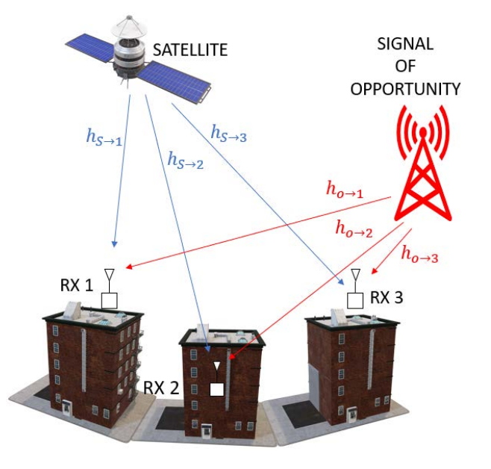
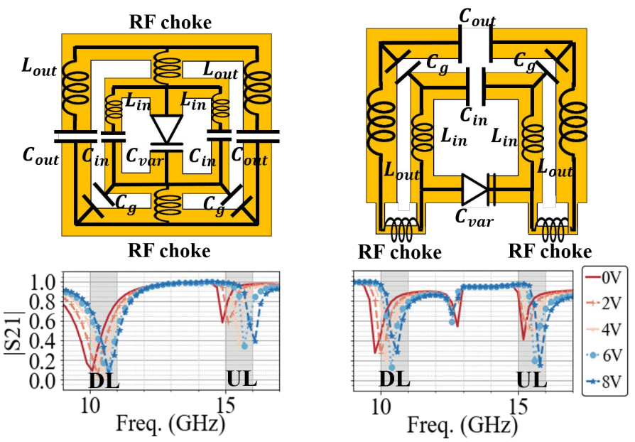
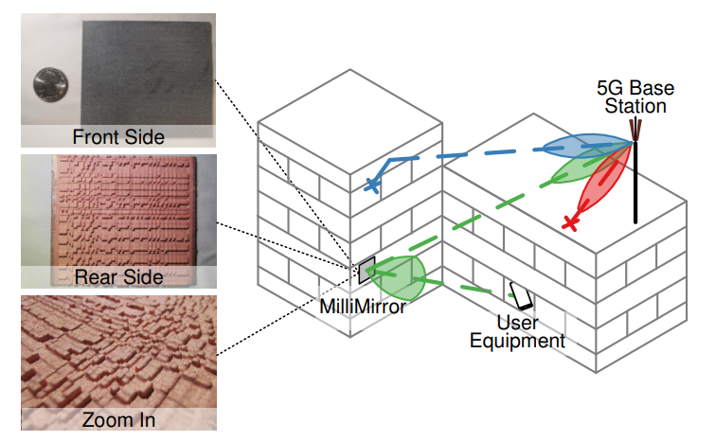
Related work
LEO ground station design
Active metasurface
Passive metasurface
[Mobicom’21]
A Community-Driven Approach to Democratize Access to Satellite Ground Stations
[HotNets’22]
Towards dual-band reconfigurable metasurfaces for satellite networking
[MobiCom’22]
MilliMirror: 3D Printed Reflecting Surface for Millimeter-Wave Coverage Expansion
Our work: (1) joint design of passive metasurface and a small phased array
(2) novel metasurface unit cell design for LEO
Notes:
There are some related work in our community on the design of low-cost LEO ground receivers, and there are also some related work on the design and application of active and passive metasurfaces.
Different from these related works, our work mainly focus on (1) joint design of passive metasurface and a small phased array, and (2) novel metasurface unit cell design for LEO

Slide 26
Conclusion
We combine the passive metasurface and small phased array to achieve a low-cost high-performance LEO ground station.
We joint optimize the metasurface’s phase profile and phased array’s code words in both uplink and downlink
We design a metasurface unit cell structure for LEO scenarios to satisfy high transmission rate, 2π phase range, dual bands, and wide incident angles
Notes:
In conclusion, first, we combine the passive metasurface and small phased array to achieve a low-cost high-performance LEO ground station.
Next, we joint optimize the metasurface’s phase profile and phased array’s code words in both uplink and downlink.
And last, We design a metasurface unit cell structure to satisfy LEO scenarios.
The above is our work. Thanks for your attention!

Slide 27
Thanks for listening!

