Slide 1

UniScatter: a Metamaterial Backscatter Tag for Wideband Joint Communication and Radar Sensing
Kun Qian, Lulu Yao, Kai Zheng, Xinyu Zhang, Tse Nga Ng
Presenter: John Nolan
University of California San Diego

Slide 2
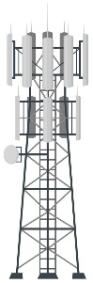

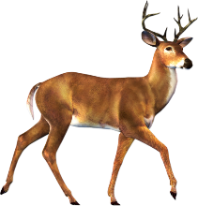
Joint Communication and Sensing (JCAS)
JCAS brings new opportunities for future wireless communication and sensing.
High spectrum efficiency due to shared spectrum
Cost saving due to shared hardware
Comm Link
Target Echo
The feasibility of JCAS is due to the similar signal processing flows of sensing and communication.

Slide 3
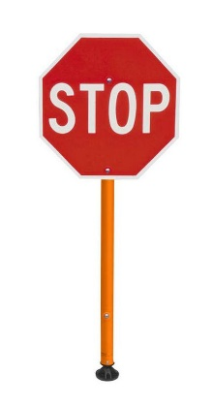
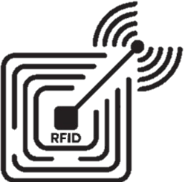
Enabling JCAS for Passive Internet of Things
For the Internet of Things, some passive objects need to be simultaneously localized and communicated with.
Comm Link
Target Echo
The JCAS for passive IoT can be achieved with backscatter technologies.

Slide 4

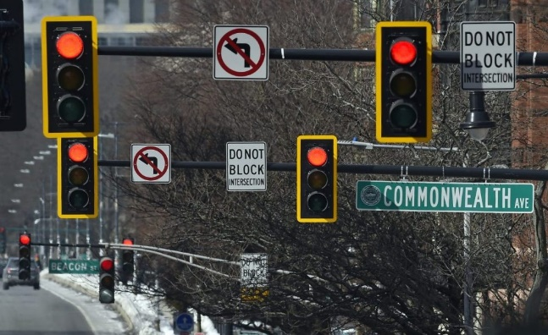
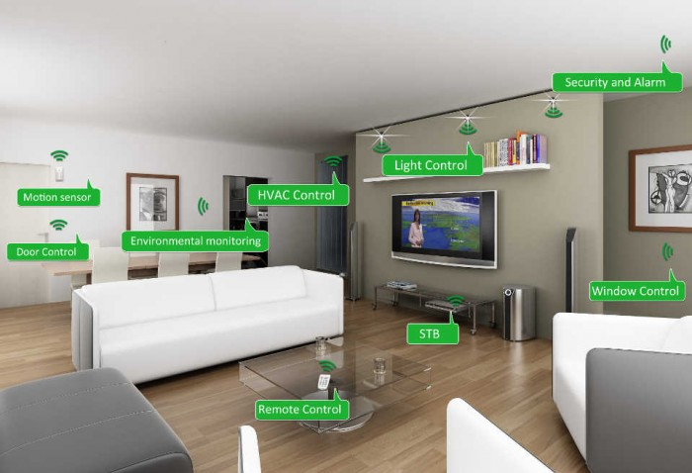

Applications of Passive IoT with JCAS
Warehouse management
Intelligent transportation infrastructure
Whole-home HOI
Advertising

Slide 5
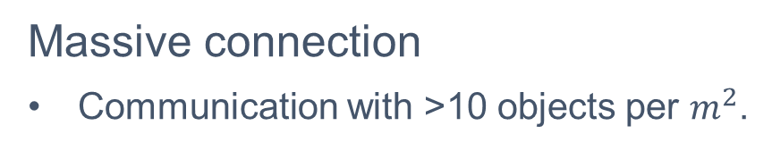
Emerging Challenges for Passive IoT
Massive connection
Communication with >10 objects per $m^{2}$.
High-resolution sensing
Localization with sub-meter accuracy
Warehouse management
Intelligent transportation infrastructure

Slide 6

From Microwave Band to Mmwave Band
Key solution to solve both challenges: wider bandwidth
Communication: wider bandwidth → larger capacity → More connections
Sensing: wider bandwidth → Higher resolution
$$Total Capacity=Bandwidth×\log_{2}\left(1+SNR\right)$$
$$Range Resolution=\frac{Speed of Light}{Bandwidth}$$
Designing backscatter tags working at mmWave band
Microwave bandwidth is usually at MHz level (e.g., 100MHz@2.4GHz).
MmWave bandwidth usually achieves GHz-level (e.g., 14GHz@60GHz).

Slide 7
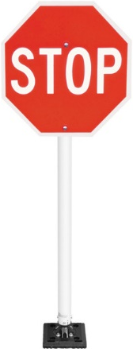
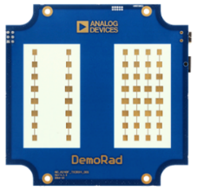
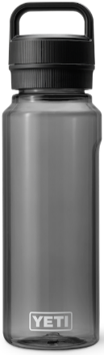
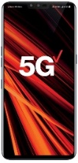
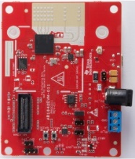
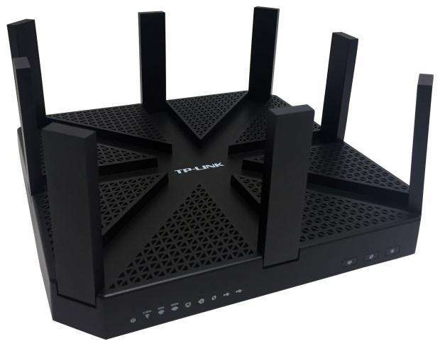
Design Challenges of MmWave Backscatter
Challenge #1: heterogeneous readers in the ultrawide mmWave band
MmWave tags need to work through ultrawide bandwidth.
24 GHz Radar
5G@28 GHz
79 GHz Radar
WiGig@60 GHz

Slide 8
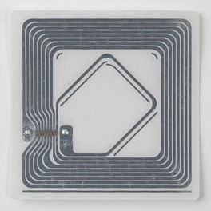
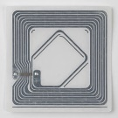
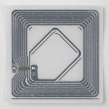


Design Challenges of MmWave Backscatter
Challenge #2: power loss due to smaller tag size
MmWave tags must have scalable sizes.
Frequency
900 MHz
24 GHz
28 GHz
60 GHz
79 GHz
Range
12 m
2.3 m
2.2 m
1.5 m
1.3 m

Slide 9
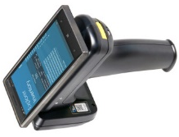
MmWave Backscatter Tag Structure
Retroreflector for maximum power efficiency
7
7
Reader
Tag
Diffusion
Specular reflection
Retroreflection
Modulator for seamless data modulation
Requirements
Scalable size
Ultrawide bandwidth
0110010…
Modulator

Slide 10
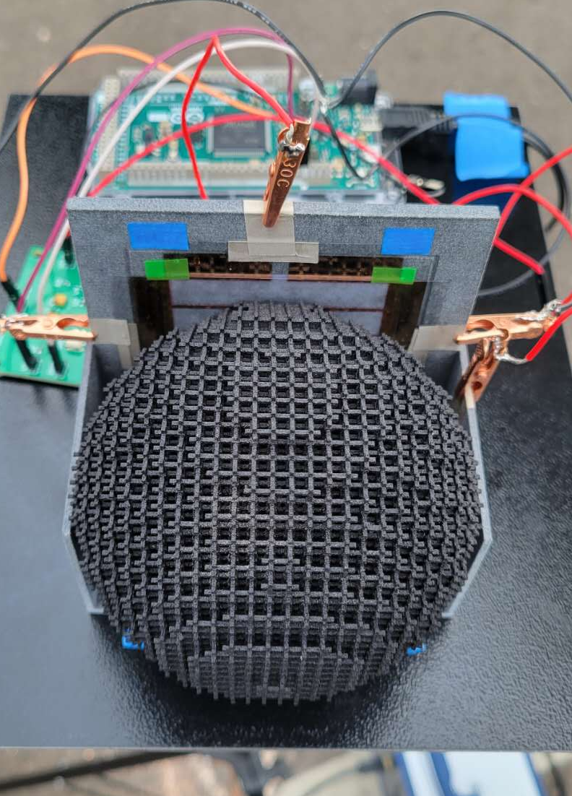
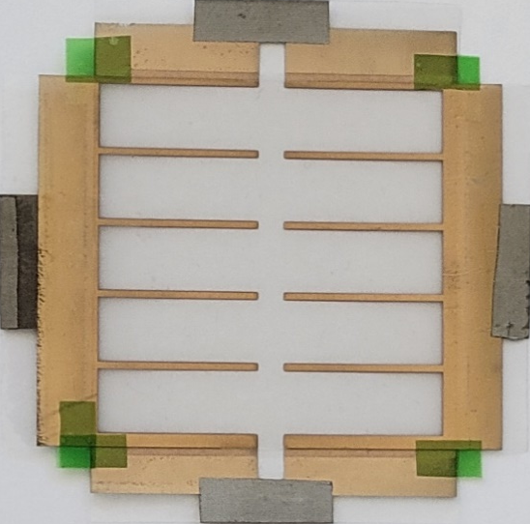
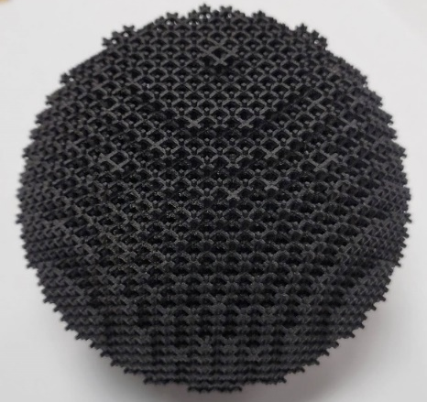
Our Solution
Designing ultrawide-band and scalable tags using metamaterials
Graphene modulator
3D printed retroreflector
UniScatter

Slide 11
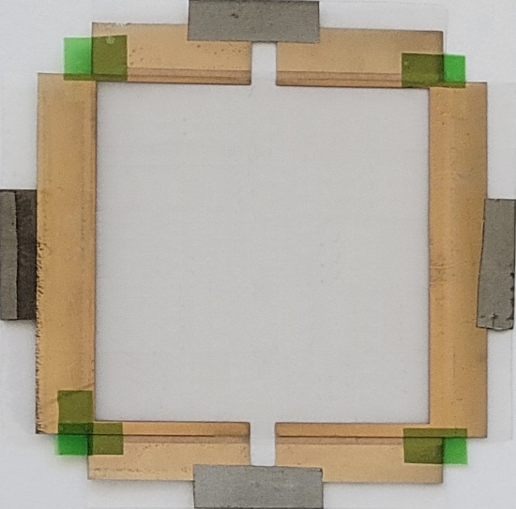
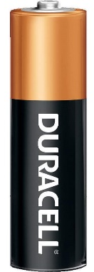
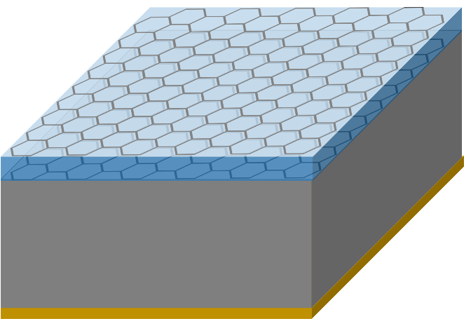

UniScatter Design
Modulator design
Graphene with ultra-wideband tunable reflection power.
Metal coating patterns increase scalability without sacrificing tuning rate.
Power level #1
Metal coating
Electrode
Power level #2
+
Graphene
Electrolyte
Graphene
Gap
Support
Ground
-
Electrode
Modulator structure
$5×5 cm^{2}$ modulator
Tuning rate >100 Hz
Tuning rate <10 Hz

Slide 12
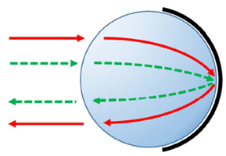
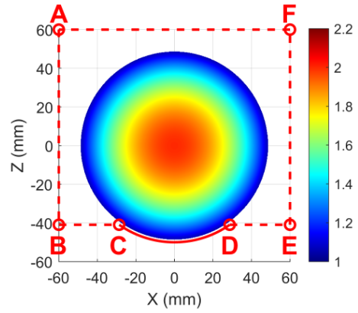
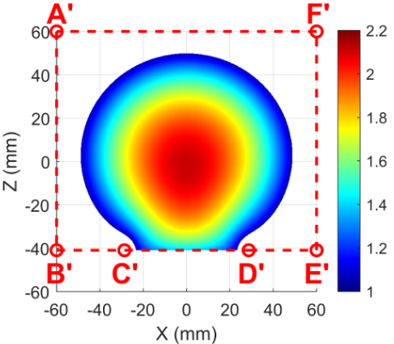
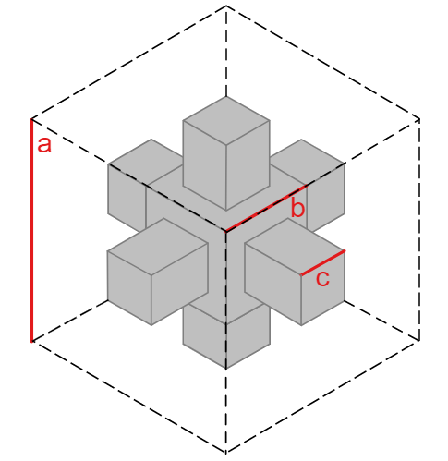
UniScatter Design
Retroreflector design
Luneburg lens has both ultrawide bandwidth and scalable size.
Sub problems #1: aligning the spherical lens with the flat modulator
Computational optics reshapes the lens while retaining the retroreflectivity.
Sub problems #2: fabricating the lens with non-uniform material properties
Discretizing the lens into small cubes
Controlling the filling ratio of uniform material in each cube
Tunable part
Rod

Slide 13
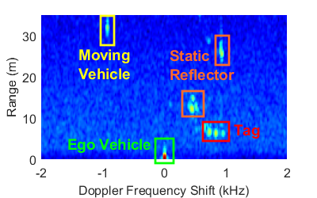
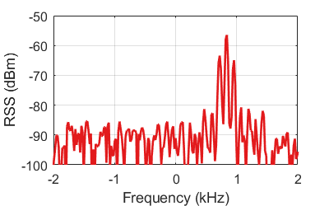
Tag Detection and Decoding
We adopt frequency shift keying to encode tag bits.
Tag coding can be reliably detected in the Doppler frequency spectrum.
Tag bits can be successively decoded while the co-located object is being tracked.
Coding Peaks
Radar profile
Doppler spectrum
Workflow

Slide 14
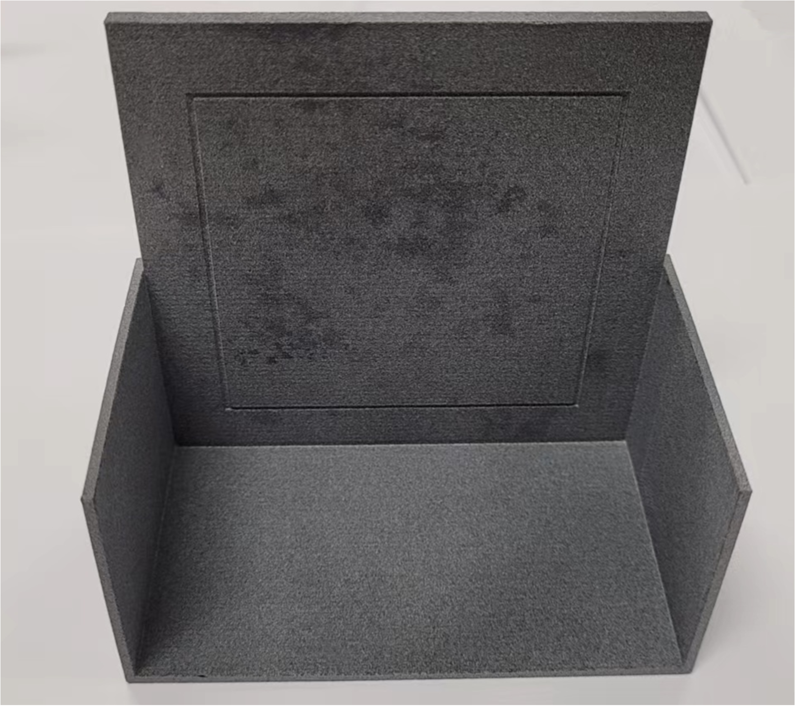
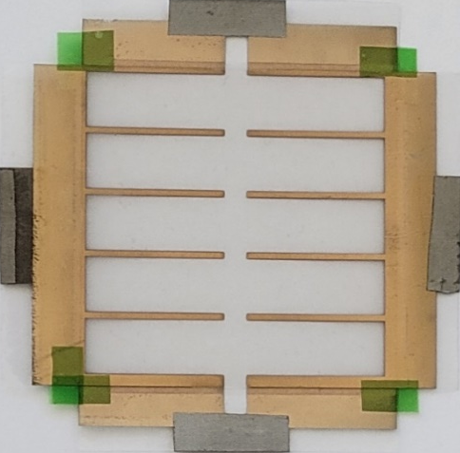
Implementation
Charging
5 cm
Discharging
Power management circuit
3D printed support
1 cm
5 cm
9.4 cm
Graphene modulator
3D printed retroreflector

Slide 15
Field Experiments: Intelligent Transportation Infrastructure
Transportation infrastructure responds to radars on vehicles by reflecting radar signals.
Road signs, traffic lights, etc.
Radar
Tag
Power
management
Modulation
Controller

Slide 16
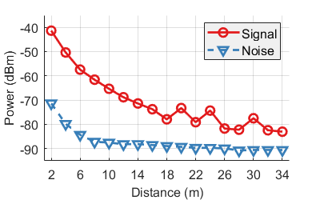
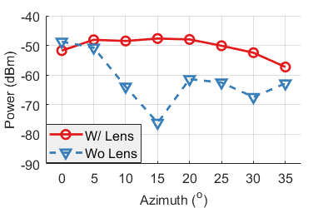
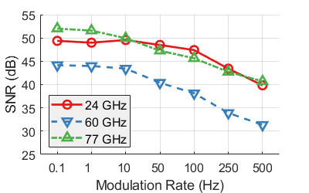

Evaluation of Tag Coverage
UniScatter achieves a wide coverage in both space and frequency.
Distance $>30 m$
Azimuth/Elevation $>{70}^{∘}$
Bandwidth $>57 GHz$
Tag-Radar Distance
Tag-Radar angle
Radar frequency

Slide 17
Conclusion
We have designed UniScatter, a metamaterial-based tag for mmWave joint sensing and communication.
A novel modulator + retroreflector tag architecture for the mmWave band
Ultrawide-band and scalable modulator and retroreflector design
We have fabricated and validated UniScatter.
Novel fabrication processes for high-frequency RF components
Wide coverage across both space and frequency

Slide 18
Thank you!
Any Questions?

