Slide 1


Precise Localization & Communication In Body
Bill Tao, Emerson Sie, Jayanth Shenoy, Deepak Vasisht
Notes:
Hi, I am here today to talk about doing precise localization of and communication with in-body medical devices. This is a collaboration work with Emerson, Jayanth and Deepak.

Slide 2
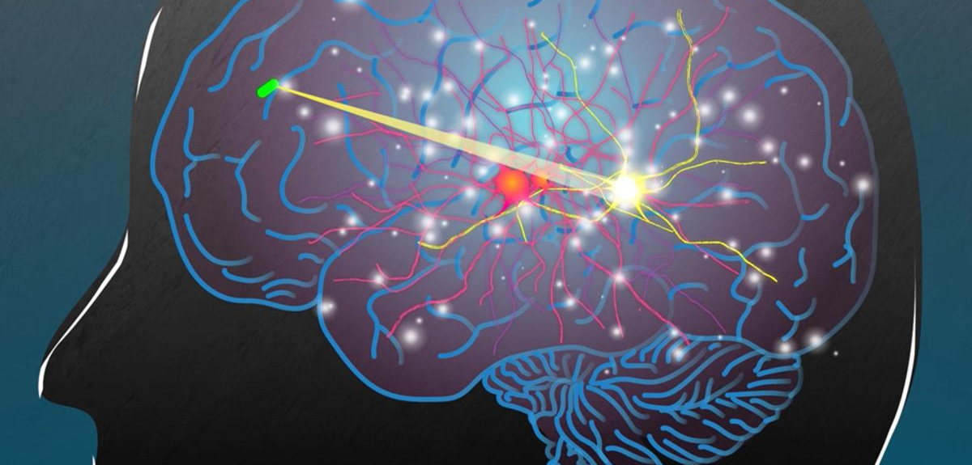
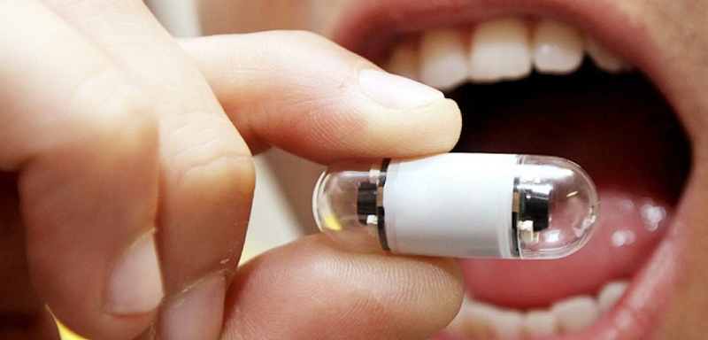
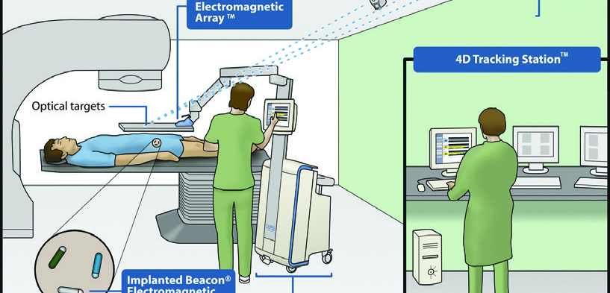
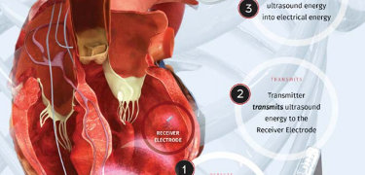
Need: Communication and Localization
Notes:
In-body wireless devices have a wide variety of applications today. They are used to sense signals inside human brain, detect diseases inside human digestion canal, marking target location for oncology radiotherapy, and even in wireless pacemakers. All these applications carry a need for a robust communication and localization system for these devices.

Slide 3
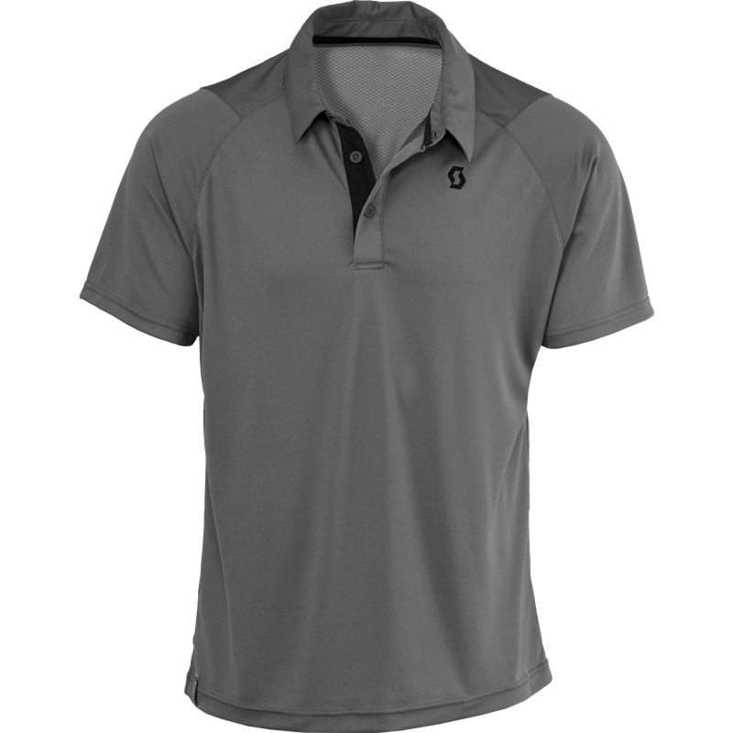

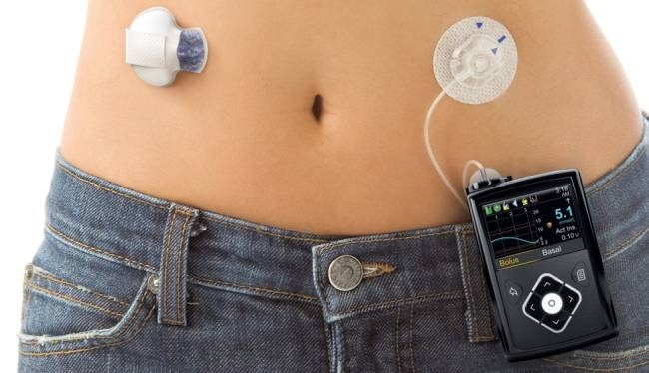
Future: Continuous Intelligent Medicine
Notes:
Currently these wireless medical systems work only in highly constrained lab environment. In the future, we envision that the in-body devices will be developed to be more versatile to provide continuous health monitoring functions, and to be embedded in everyday objects such as the shirt you put on, the bed you sleep on and the other mininature medical devices you wear.

Slide 4
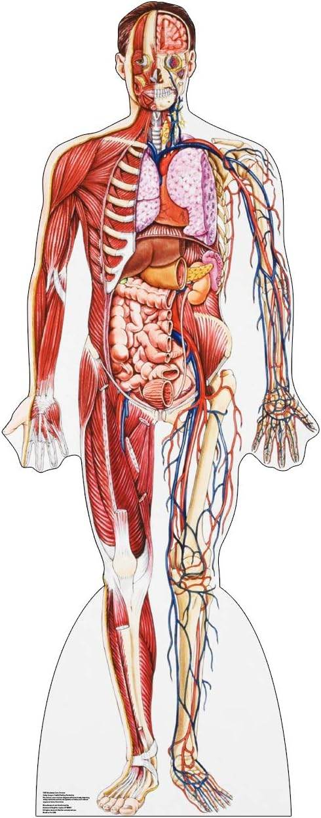
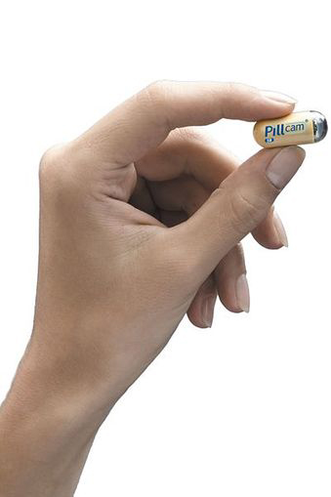

Designing such systems is challenging…
Human body is complex
Need mm-scale accuracy
Need High Quality Communication
Notes:
But, these applications are facing multiple challenges today. First, the human body is complicated and interfere with the wireless signal in a complicated way. Second, the accuracy requirements for localization is high, for example, in the case of marking target for radiotherapy of prostate cancer where the entire prostate is but a few cms in size. We need mm-level accuracy here. Third, these small in-body devices are very limited in size and generally have tight energy requirements too.

Slide 5
InnerCompass
Uses magnetic signal and analytical models to generalize across human body types
Achieves mm-scale localization using MIMO-inspired multiplexing
Design zero-impedance coil for low power long range backscatter
Notes:
Today, we present our system Innercompass, which solves these challenges and makes a significant advance to the future of smart medical devices that we envision.

Slide 6

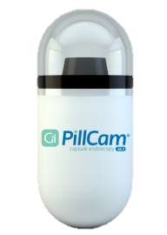
Localization in Complex Human Body
Idea: Use magnetic communication
Notes:
Let's see how InnerCompass achieves high accuracy localization. Human bodies are complicated, consisting of multiple types of tissues with convoluted boundaries. Also, each type of tissue like bone or mussle has different electromagnetic properties. There has been some previous work trying to model EM waves inside human body, for example, here’s a multi layer model that makes no sense. None of these models satisfy the accuracy requirements. As a result, people have shifted to this new way of doing localization: using low-frequency magnetic signals.

Slide 7


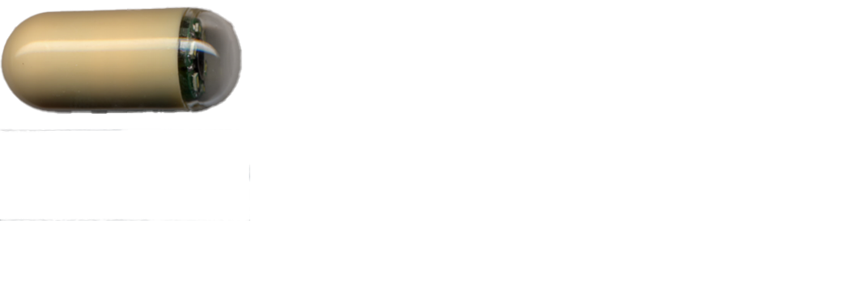
Idea: Use Magnetic Communication
Transparent in human body
Operate in near-field → do not have phase
RSSI-based models require fingerprinting
Notes:
The advantage of magnetic signal is that it is transparent in human body and is clean. However, it operates in near field and does not have phase information, only RSSIs. Traditional RSSI localization uses fingerprinting, which works as follows: we generally have multiple external readers communicating with the in-body device. we first collect RSSI data on a grid when the human body is not present and use the data to train a neural network/lookup table. Then in prediction time we can use the trained model as if the human does not exist.

Slide 8


Idea: Use analytical model
Problem: Fingerprinting does not generalize
Notes:
However, here’s a problem: we human have different size and body shapes. E.g. if I give you my belt, you probably need to adjust it before wearing. Even if human bodies are transparent to magnetic field here, as we can see, the relative locations of the sensors does not stay the same, and you have to train a different model for every possible body shape to do localization, making this fingerprinting impossible to generalize. Instead, we make the observation that since human bodies are transparent and does not affect signal, why don’t we just calculate what the signal strength is using analytical model? It turns out that this calculated model is good enough as we will show, and the good thing is that it needs absolutely no training data, and is automatically generalizable to all body shapes.

Slide 9

Analytical Model for Magnetic Coupling
I
$$M$$
Notes:
Here’s how we build the analytical model: we started by looking at how magnetic coupling works. When I have a coil, and I give it a current, it generates a magnetic field. Now, when I put a second coil next to it, some part of the magnetic field goes through the second coil, and thus the signal in one coil can stimulate signal in the other coil. We know from Faraday’s law that the stimulated signal is proportional to how much magnetic field goes through the green coil here, and it can be denoted by the mutual inductance value M.

Slide 10

Analytical Model for Magnetic Coupling
I
$$M$$
Notes:
When the coil moves, we can see that the amount of magnetic field going through the green coil changes, and so does the mutual inductance.

Slide 11
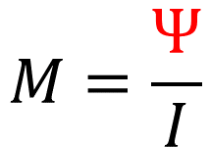


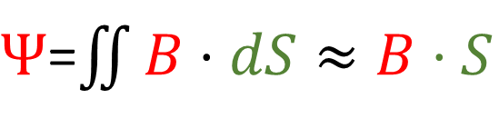
Analytical Model for Magnetic Coupling
$$M=\frac{Ψ}{I}$$
I
$$M∝\oint{\frac{dl×r}{r^{3}}}$$
$Ψ$=$\iint{B⋅dS≈B⋅S}$
$$B=\frac{μ_{0}}{4π}\int{\frac{Idl×r}{r^{3}}}$$
Notes:
If we look at the physical relations behind the mutual inductance and the magnetic field, we can come up with a rather simple way of calculating this mutual inductance.

Slide 12




Modeling Magnetic Signal Strength
$$M_{1}$$
$$M_{2}$$
RSSI$∝M_{1}M_{2}$
$$M∝\oint{\frac{dl×r}{r^{3}}}$$
Tx
In Body
Rx
Notes:
Now let’s put this into the real world. We are working with generally backscatterring systems, which has a transmission coil, and we have here an in-body device coil. The transmitter coil transmits a signal that goes on the in-body coil through mutual inductance. The in-body device then reflects the signal onto a receiver coil through another mutual inductance. We can see from the process that the RSSI is essentially the product of the two mutual inductances. Combining this with the way to calculate mutual inductance, we have now a complete way to calculate the RSSI.

Slide 13
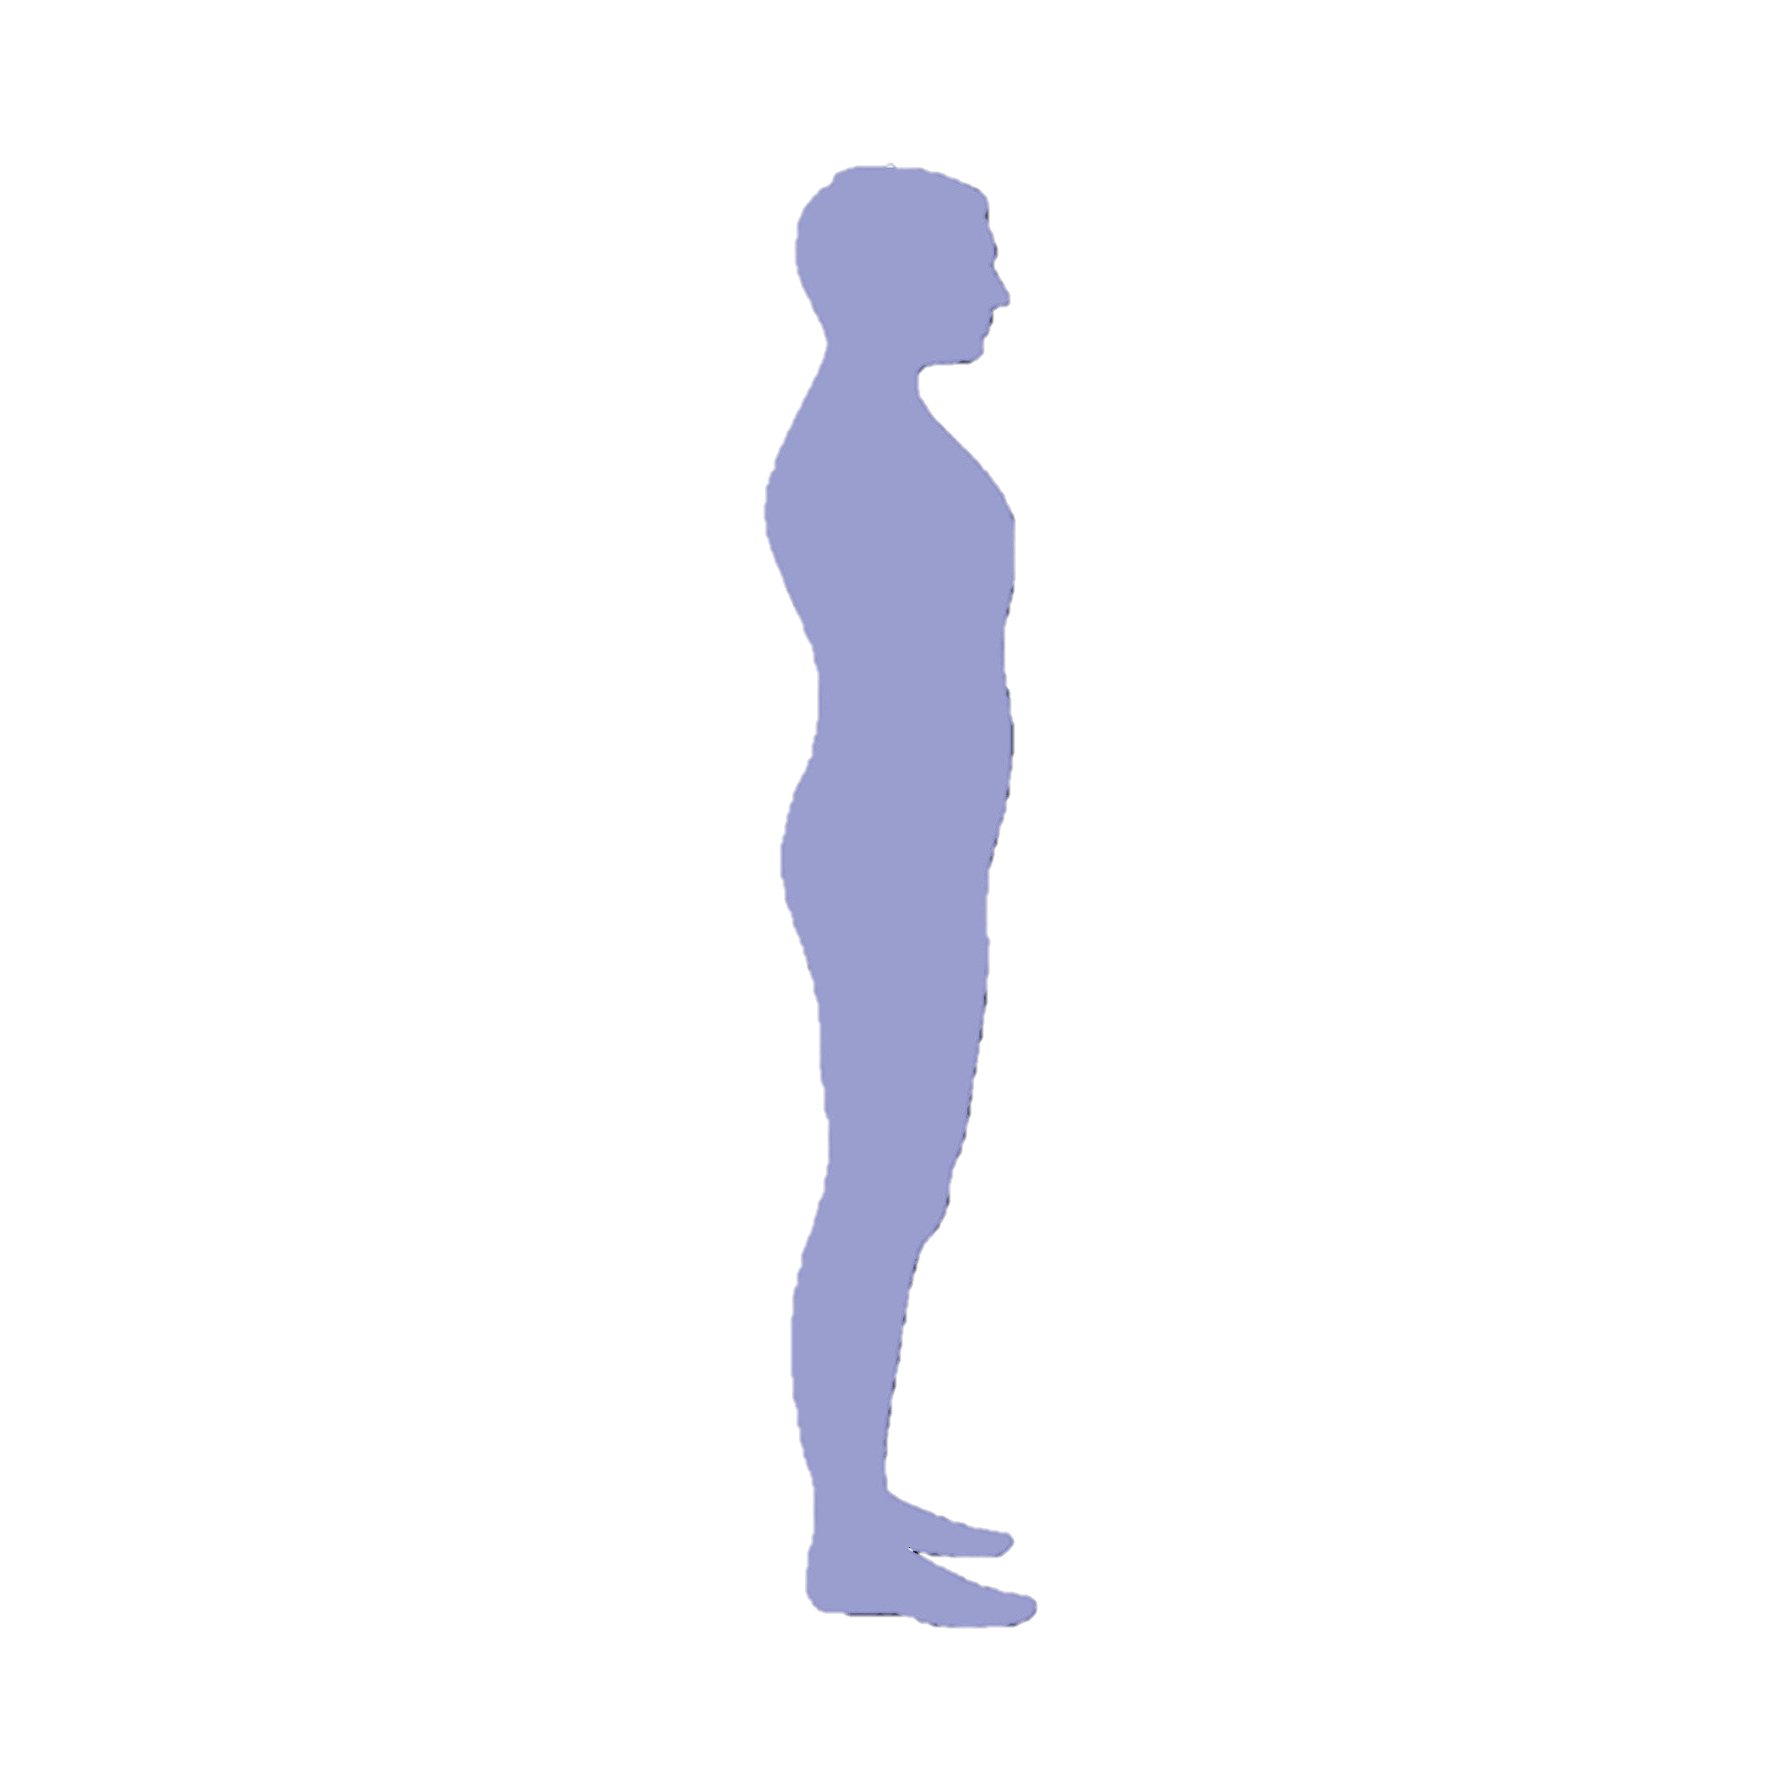


Long Range Magnetic Communication
4cm
25cm
This Photo by Unknown Author is licensed under CC BY-NC
Notes:
The next challenge we are facing here is the range problem. Traditional near-field magnetic communication systems, like your apple pay, only works when you hold your phone all the way up to the reader. In fact, it cannot work longer than 4cm. This is due to that these in-body devices are very power limited and usually uses backscaterring communication. In human body, we sometimes have to penetrate a distance of as long as 25cm. How do we bridge the gap here?

Slide 14




Long Range Magnetic Communication
Higher Current
=
Stronger Signal
$$Z=50Ω$$
$$Z=0Ω$$
This Photo by Unknown Author is licensed under CC BY-SA
This Photo by Unknown Author is licensed under CC BY-SA
Notes:
We do so by looking at the circuit design of the transmitter coil. Traditional coils are connected in a parallel scheme to enforce impedance matching of 50Ohm. We observe that impedance matching is important for RF applications but not necessary for low frequency applications. Indeed, a high impedance can also limit the peak current through the coil and thus the RSSI. We chose the alternative design of this series sceme here that can drive the impedance down to 0 to achieve a much higher current and a much stronger signal.

Slide 15
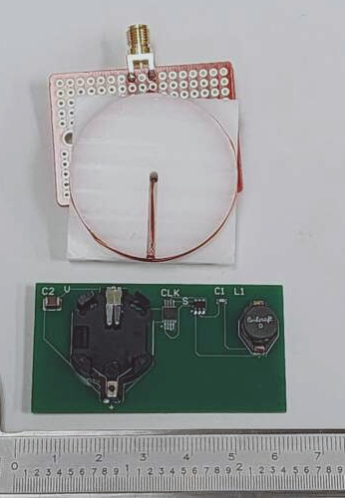
Evaluation: Prototype
Tx/Rx coil
Tag coil
Tag PCB
Notes:
We evaluated InnedCompass by building a prototype of the in-body device and external reader. This PCB here contains the circuit of the in-body device, and it has a coil having a diameter of 8mm, similar to the size of a capsule.

Slide 16
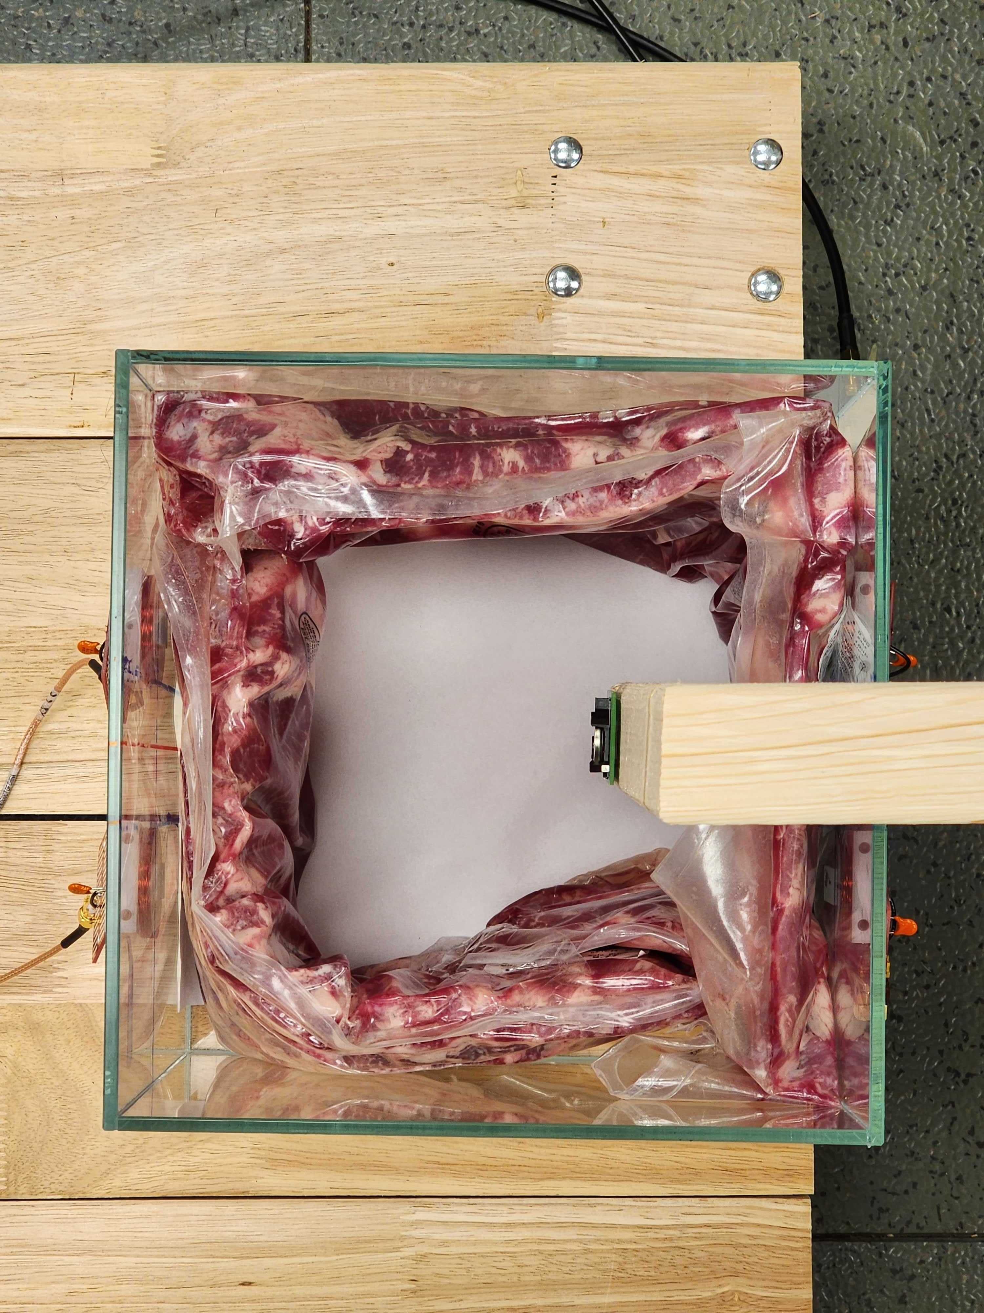
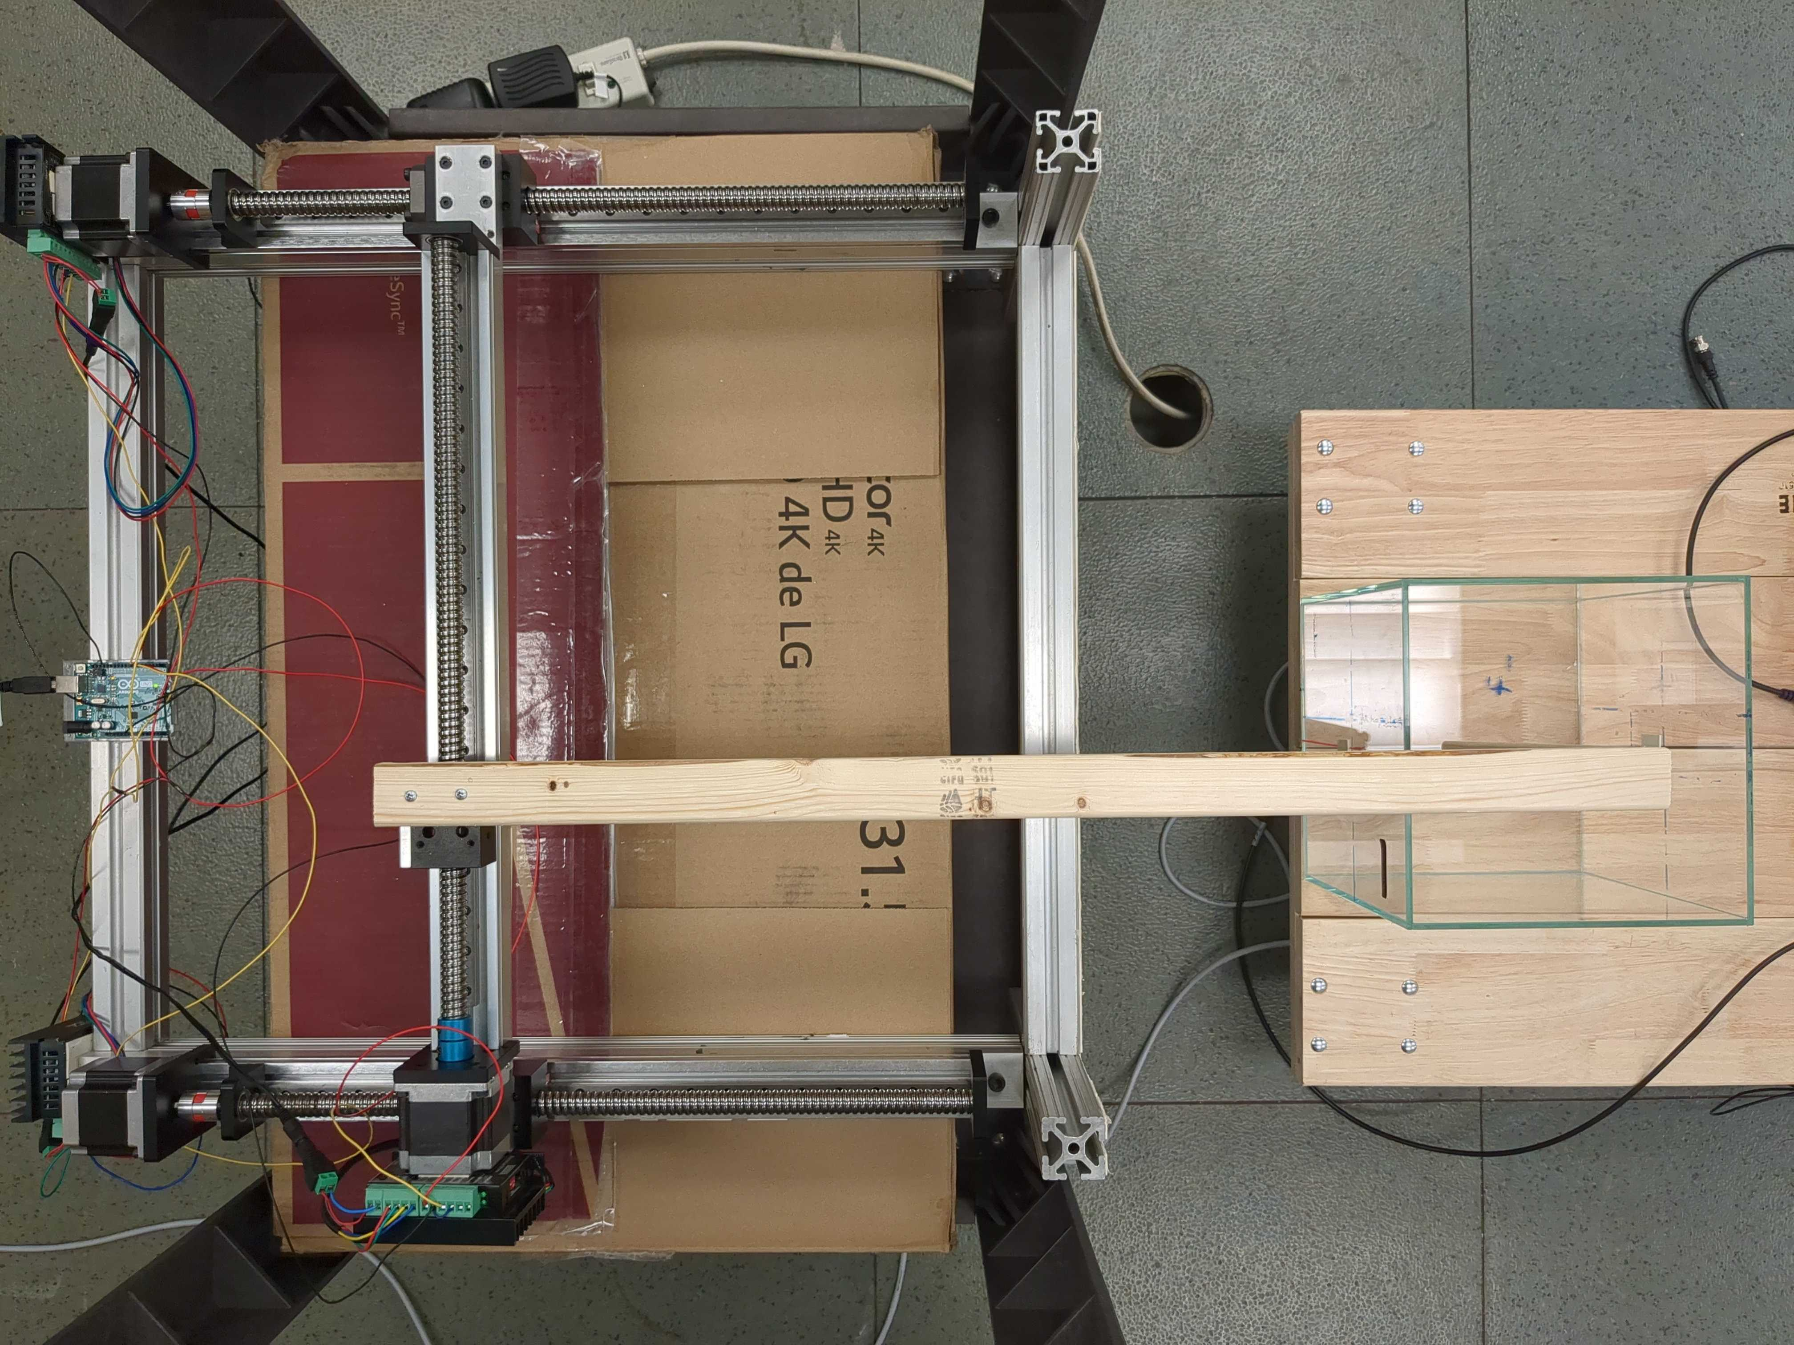
Evaluation: Testbed
Tx Coils
Rx Coils
Test Field
Tag
Notes:
We tested InnerCompass by building a testbed consisting of a linear stage and an aquarium. In evaluation, we used pork ribs to represent human body, because pork rib is one of the most complicated part, consisting of bone, mussle, fat and blood, the types of tissues usually found in human body. We attach the tag to the moving end of the linear stage, and attach the Tx and Rx coils to the aquarium, and tested the prototype at different points inside this test field.

Slide 17
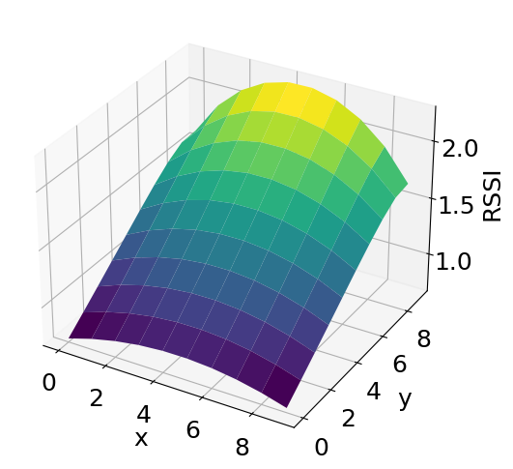
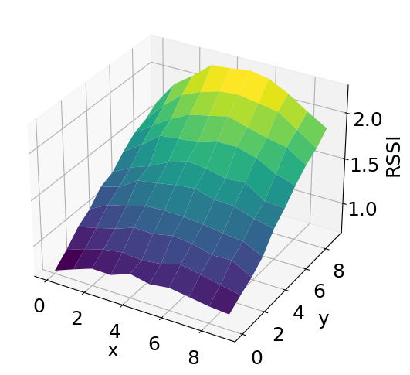
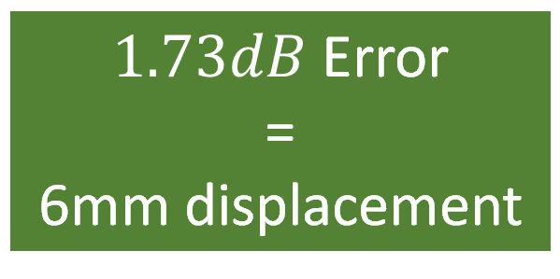
Model Accuracy
Model Predicted
Measured
$1.73dB$ Error
=
6mm displacement
Notes:
We first look at how accurate our analytical model is. Here you can see our model’s predicted RSSI over the test field. X,Y here are coordinates in the test field, and Z values are RSSIs. On the right we have measured signal strength under the same condition. Not only do they look visually similar, but actually it has only 1.73dB mean error, which translates to a 6mm displacement according to the slope of these surfaces.

Slide 18
Localization
5.3mm median error
Capsule is 1cmx2cm
Notes:
We then look at the end-to-end localization accuracy. Here we have a plot of the CDF of the localization errors on the test field grid. As we see here, the median localization error is just 5.3mm. Compared to a typical capsule size of up to 1cm by 2cm, this localization error will satisfy the accuracy requirements for in-body devices.

Slide 19
Generalizability
LUP do not generalize
Notes:
Then, we take a look at how well InnerCompass is able to generalize. On the left we have the localization error cdf and on the right side, we present the experiment, where we perturbed the relative positions of the coils to simulate different body shape. Here we compared InnedCompass against a lookup table trained on the original collected data. We ca see here that while InnerCompass can achieve similar localization error, LUP’s performance drops significantly with different body shape.

Slide 20
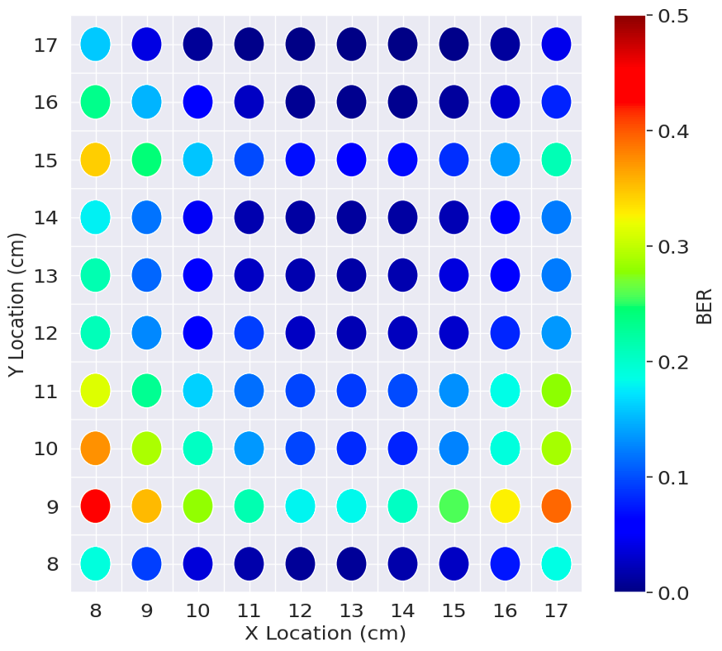
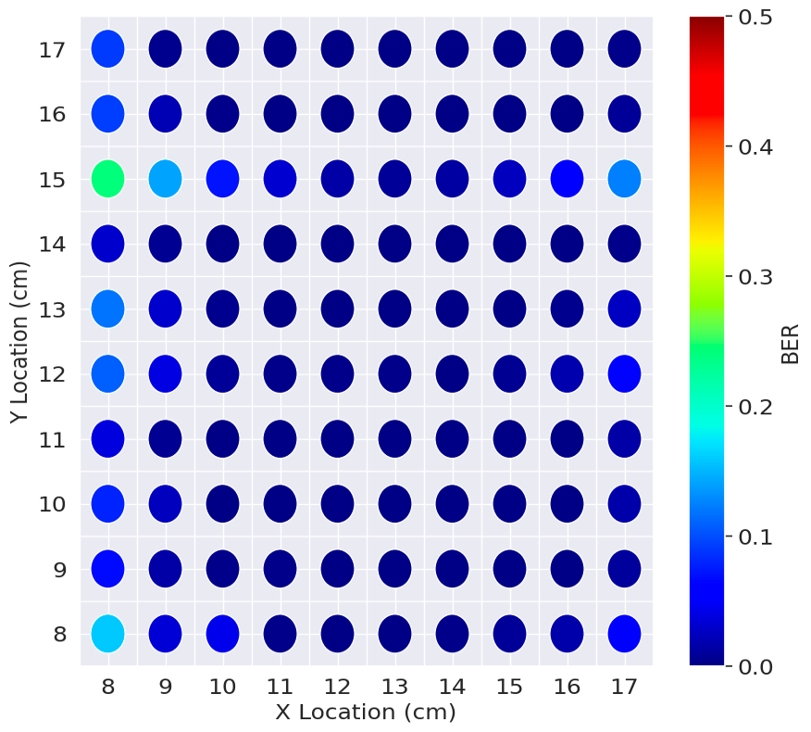
Communication
10X Lower BER
Notes:
Last, we verify our effort of increasing the communication range by comparing the two coil circuits in the terms of BER. We can see that the new design has 10X less BER than the traditional design, and it will have longer communication range therefore.

Slide 21
Conclusion
I
Human body is complex
Need mm-scale accuracy
Need ultra-low power
Notes:
In conclusion, achieving a flexible communication and localization system for in-body devices has multiple challenges including dealing with human body, improving accuracy and reducing power. We designed InnerCompass that uses an analytical model, an alternative coil circuit and a MIMO-inspired design to solve these challenges. We verified that our analytical model is highly accurate, and InnerCompass is able to achieve high accuracy and generalizable localization.

