Slide 1


XCopy: Boosting Weak Links for Reliable LoRa Communication
ACM MobiCom 2023, Oct 2–6, Madrid, Spain
Xianjin XIA¹, Qianwu CHEN¹, Ningning HOU¹, Yuanqing ZHENG¹, Mo LI²
¹The Hong Kong Polytechnic University, Hong Kong
²Nanyang Technological University, Singapore
Oct 2, 2023
Notes:
[Greeting]
It’s a great pleasure to present our latest study.
This is a joint work with researchers from the HK PolyU and NTU.

Slide 2

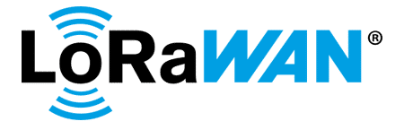

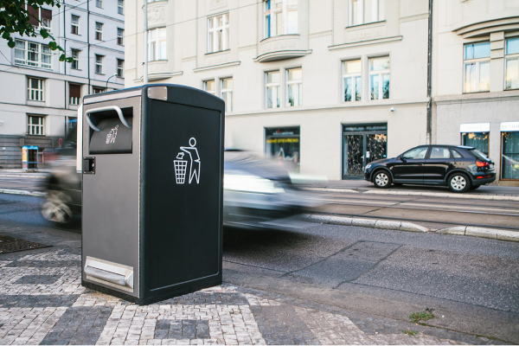

Low Power Wide Area Network
(Long Range)
Wide coverage
High capacity
Long battery life
Low cost
Smart Logistics
Smart Agriculture
Smart City
(waste management)
Notes:
LPWAN has emerged as a new tech. to connect IoTs.
[As compared to existing IoT tech.,] LPWAN has advantages of both long-range and low-power.
LoRa is a representative LPWAN tech. and the word LoRa comes from the first two letters of Long Range.
It has good features like xxxx.
We can deploy a single GW to serve thousands of IoT devices in a large area.
It is mostly suitable for applications like xxxx.

Slide 3
Is LoRa really long-range?
>10,000 m
when Line-of-Sight (LoS) path exists.
What if signal blockages happen?
Notes:
As a key advantage of LoRa, it is advertised to reliably communicate over 10 km.
But this is achieved when LoS path exists between the Tx and Rx.
Then, what if xxx?

Slide 4


Is LoRa really long-range?
600 m
Disconnected, or
weak links
800 m
Notes:
We performed an experiment to study LoRa performance in an urban environment.
We put a LoRa gateway at the top of this building, and move a few LoRa nodes around on this map.
We measure the received signal strength at different grids.
This right figure displays the coverage of the gateway.
We see that the longest range is less than 1 km in our settings.
If a node is placed at this or this locations, the link connection from the node to the GW will be very weak, or sometimes even get disconnected.
And our study aims to improve communication reliability for these nodes.

Slide 5

Reliability mechanism of LoRaWAN
Packet retransmission
…
Succeed
when a better link condition is encountered!
Notes:
Before presenting our strategies, let us first look at how the standard LoRaWAN protocol deal with weak links.
The answer is retransmission.
That is, if a packet cannot be reliably received, the transmitter will resend the packet, until the packet is received successfully.
This mechanism works if a retransmitted packet encounters a good channel condition.
This can happen when a link varies with time between good and bad channel conditions.

Slide 6
Reliability mechanism of LoRaWAN
If a link stays poor consistently…
…
Packet loss
Max. # of retransmissions
Connection failure
Notes:
But, what if xxx?
This can happen in practical networks with severe signal blockages.
Obviously, LoRaWAN cannot achieve reliable communications in this case.
Because every retransmitted packet experiences poor channel conditions.
When the number of retx. reaches the maximum num., the packet will be dropped.
And the links will get disconnected if the channel stays poor consistently.
Then, in this case,
is it possible to improve reliability for these links that consistently suffer poor channel conditions?

Slide 7
Opportunity in the PHY
LoRa radio: Higher sensitivity on packet detection than decoding
Notes:
The answer is yes.
We leverage a physical layer observation that LoRa radio has higher sensitivity on xxxx.
For instance, this figure displays the min SNRs of LoRa packets that can be successfully decoded by a radio.

Slide 8
Opportunity in the PHY
LoRa radio: Higher sensitivity on packet detection than decoding
SNR_{detect} < SNR_{decode}
Notes:
We also measure the min SNRs of packets that can be detected by a radio.
We can observe an SNR gap between detect and decode. The gap can be 3~5 dB in our measurements.
The results indicate that, for some packets,
although they cannot be decoded correctly,
their signals can still be reliably received and detected by a radio.

Slide 9
PHY retransmission
Received symbols
Symbol combination
…
Noise floor
Notes:
For the retransmissions over weak links, our insight is that
although the received signals are not strong enough for packet decoding, these retransmitted signals can be detected and received.
More importantly, each copy of these signals carries partial info about the encoded symbol.
If we can add up these weak signals, it is likely to increase the signal strength of symbols.
As shown in this figure, the symbol power is likely to grow above the noise floor when sufficient signal copies are added together.

Slide 10
PHY retransmission
Received symbols
Symbol combination
Performance gains
(∆SNR > 5 dB)
Signal strength
SNR_{decode}
…
SNR_{detect}
Noise floor
A packet is getting decoded once being detected!
Notes:
Ideally, we can expect that xxx.
It essentially pulls down the SNR threshold of LoRa packets reception from this blue line to the red line.
If the SNR of a packet falls in this region, it cannot be received by standard LoRaWAN, but can be successfully received by our method.

Slide 11



Combining across retransmissions
Destructive combination
Heterogeneity in
CFOs
STOs
Channels
…
…
Constructive combination
Frequency and phase differences
Notes:
However, when we add two signals for signal combination, it does not always produce SNR gains.
For instance, if the two signals are out-of-phase, the combined signal strength may be even lower.
We can get SNR gains when the two signals are in-phase, as displayed in the bottom.
And this is what we want.
However, as retransmissions take place at different times, they may experience different channels and suffer from different frequency and phase offsets.
[As a result, the received signals usually differ in frequency and phase.]
We need to remove the freq and phase differences among retransmitted signals to make sure their combination can produce constructive SNR gains.

Slide 12
Combining across retransmissions
Signal strength
Noise floor
Time
#1
…
#2
#3
1. Align signal timing
2. Mitigate frequency and phase difference
3. Combine for higher SNR
Notes:
Before going into the method details, let’s first look at the high-level workflows of how to achieve constructive combination across retx.
We focus on the receiver side.
A receiver receives multiple copies of retransmitted signal.
Suppose all signals are very weak and hidden below the noise floor.
What XCopy does is to firstly identify these signals,
then align their signal timing and remove their frequency and phase differences,
and lastly combine the aligned signals for SNR gains.

Slide 13
Combining across retransmissions
Signal strength
Noise floor
Challenge #1: ultra-low SNRs
Time
How to correctly align signal timing, frequency and phase under low SNRs?
#1
…
#2
#3
1. Align signal timing
2. Mitigate frequency and phase difference
3. Combine for higher SNR
Notes:
The first challenge we faced is the ultra-low SNRs of received packets.
It is challenging to detect a weak packet, and even more challenging to align the weak signals in time, freq. and phase.

Slide 14


Combining across retransmissions
Signal strength
Noise floor
Time
#1
#2
#3
1. Align signal timing
2. Mitigate frequency and phase difference
3. Combine for higher SNR
Notes:
The second challenge comes from the fact that the packet transmissions of different nodes can be interleaved.
For instance, these blue packets are the retransmissions of this node.
The red packets are from other nodes.
The red packets can be received in between the retransmissions of blue packet.
In this case, only the signals of blue packet should be combined. The red signals should not be used.

Slide 15
Combining across retransmissions
Signal strength
Noise floor
Challenge #2: interleaved (re)transmissions
Time
How to correctly identify retransmissions of the same packet under ultra-low SNRs?
#1
#2
#3
1. Align signal timing
2. Mitigate frequency and phase difference
3. Combine for higher SNR
Notes:
However, in case of ultra-low SNRs, we do not have the chance to decode a packet.
How could we tell whether two signals are from the same packet or not?

Slide 16
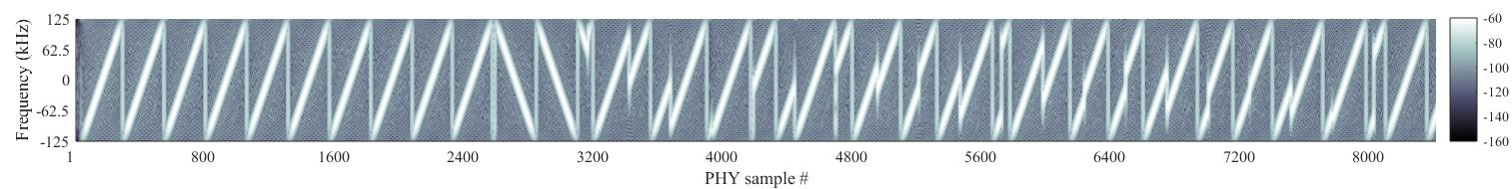
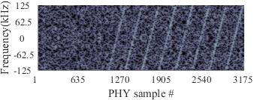
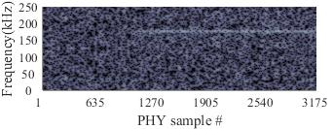
Detect weak packets
Preamble
Sync.
SFD
Payload
Detect with longer windows!
1x chirp len
4x chirp len
dechirp
Signal strength
Signal strength
Notes:
Let’s first look at how to detect weak packets.
This is a LoRa packet in good SNRs. It consists of xxxx.
Normally, a receiver detects LoRa preamble to detect a packet.
However, when the SNR is low, a received preamble would be like this.
The chirp signals are overwhelmed by noises.
How can we detect this weak LoRa preamble?
What we do is to first apply a dechirp operation to the signals, which will transform the chirp signal into a single freq wave.
As LoRa preamble is composed of identical chirps, so what we get here is a long single-frequency wave.
If we can detect identical frequency across consecutive windows, we can assure a packet is present.
A standard LoRa receiver uses a window of one chirp length to detect LoRa preamble.
If the SNR is low, the preamble chirp is hidden below the noise floor. A std receiver will not detect any preamble.
Since a LoRa preamble is long and has identical frequency across windows,
why don’t we use a longer detection window?
For instance, if we enlarge the detection window, more signal power will be aggregated and become higher than the noise floor.
Then we can reliably detect weak packets from this results.

Slide 17
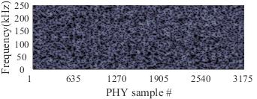

Select & Align signals
Conjugate multiplication:
$$y_{1}\left(t\right)×y_{2}^{∗}(t)$$
Preamble
SFD
Payload
Preamble
SFD
Payload
Signal strength
Signal strength
Notes:
Alignment of retransmitted signals
Misalignment of retransmitted signals
Signals from different packets

Slide 18
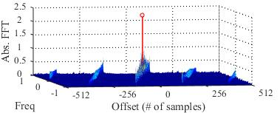


Synchronize frequency and phase
Conjugate multiplication:
$$y_{1}\left(t\right)×y_{2}^{∗}(t)$$
Signal strength
$$y_{1}\left(t\right)×y_{2}^{∗}(t)$$
Combat low SNRs
Identify retransmissions
Align signal timing
Align frequency and phase
$${=(h}_{1}h_{2}^{∗})∙e^{−j2π∆ft}∙e^{j∆φ}$$
Frequency difference
Phase difference
Notes:
Moving window to detect and align retransmitted signals.
Estimate frequency difference and phase difference.
Use conjugate multiplication to do everything.

Slide 19
Mitigate symbol heterogeneity
Problem (unique to LoRa signals):
Heterogeneous SNR gains across symbols
Why it happens?
Heterogeneous sampling timing intervals for different transmissions
Heterogeneous frequency and phase differences across symbols
Notes:
Describe the problem.
Explain why it happens.

Slide 20
Mitigate symbol heterogeneity
Problem (unique to LoRa signals):
Heterogeneous SNR gains across symbols
Why it happens?
Heterogeneous sampling timing intervals for different transmissions
Heterogeneous frequency and phase differences across symbols
Notes:
Large timing interval leads to large heterogeneity.

Slide 21
Mitigate symbol heterogeneity
Problem (unique to LoRa signals):
Heterogeneous SNR gains across symbols
Why it happens?
Heterogeneous sampling timing intervals for different transmissions
Heterogeneous frequency and phase differences across symbols
Solution
Use higher sampling rate
Align high sampling-rate signals
Notes:
Small timing interval produces consistent gains.
Our solution.

Slide 22
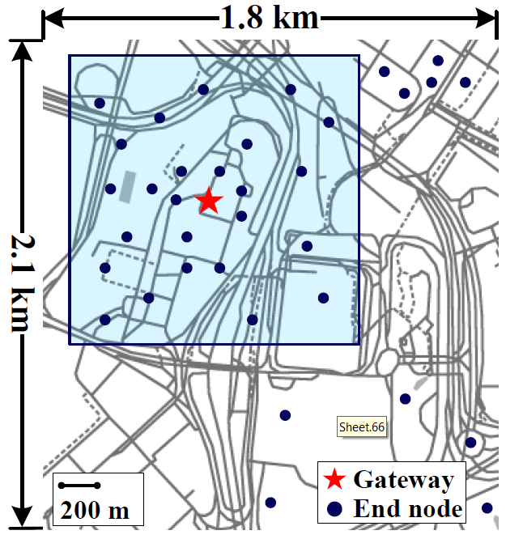
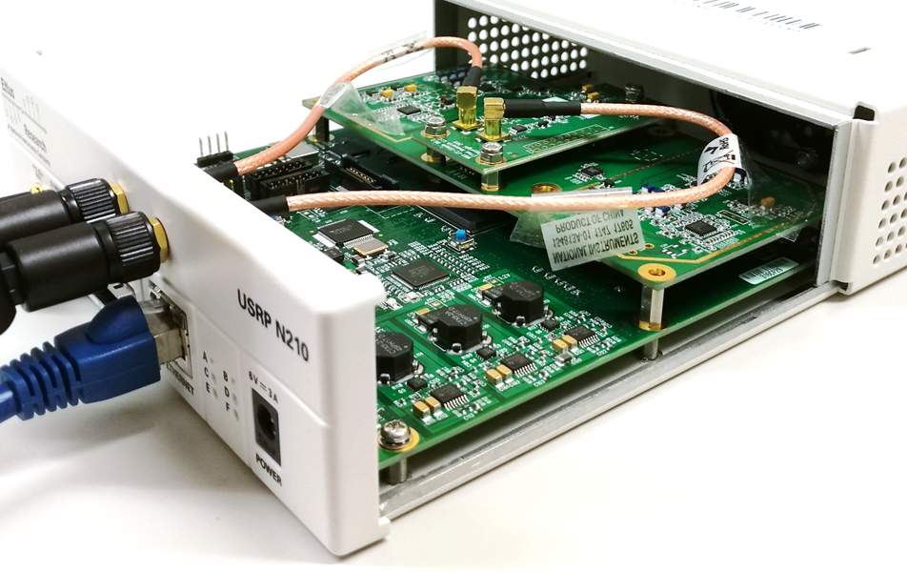
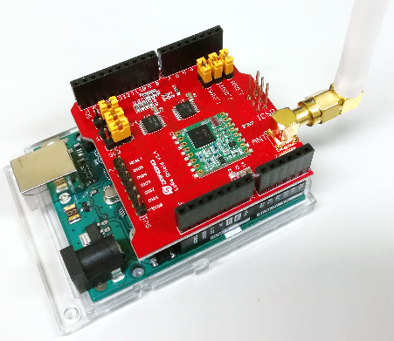
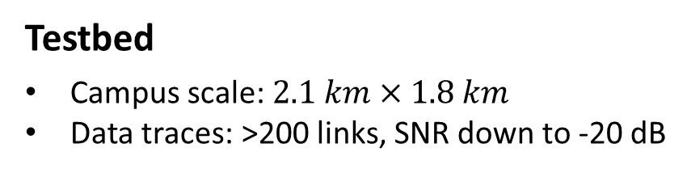
Evaluation
Implementation
Software implementation at gateways
SDR gateway: USRP N210, RTL-SDR dongles
COTS LoRa nodes: Semtech SX1276
Testbed
Campus scale: $2.1 km×1.8 km$
Data traces: >200 links, SNR down to -20 dB
Benchmark
LoRaWAN: standard protocol
Charm: combining across multi-gateways
MALoRa: combining across multi-antennas
SDR based Gateway
LoRa nodes
Notes:
We implemented a prototype on a SDR platform, and performed comprehensive experiments to evaluate XCopy.
Compared with two SOTA strategies.

Slide 23
Retransmission gains

Slide 24
Comparison with State-of-The-Art

Slide 25
Weak link performance

Slide 26

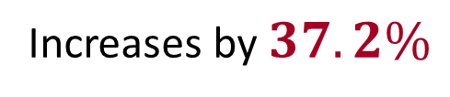
Coverage improvement
LoRaWAN (SF12)
XCopy (# Retx. = 8)
XCopy (# Retx. = 16)
Increases by $37.2\%$
$$43.4\%$$

Slide 27
Conclusion
Introduce PHY retransmission as a new paradigm for SNR enhancement of weak LoRa connections by constructively combining retransmitted signals
Techniques for LoRa packet detection, signal calibration and synchronization under ultra-low SNRs
SDR based implementation with comprehensive testbed evaluations, up to 10dB SNR improvement over state-of-the-art
Notes:
To summarize, xxxx

Slide 28
Thank you!
Q&A

