Slide 1



Practically Adopting Human Activity Recognition MobiCom 2023
Huatao Xu, Pengfei Zhou, Rui Tan, Mo Li
Nanyang Technological University, University of Pittsburgh,
Hong Kong University of Science and Technology

Slide 2
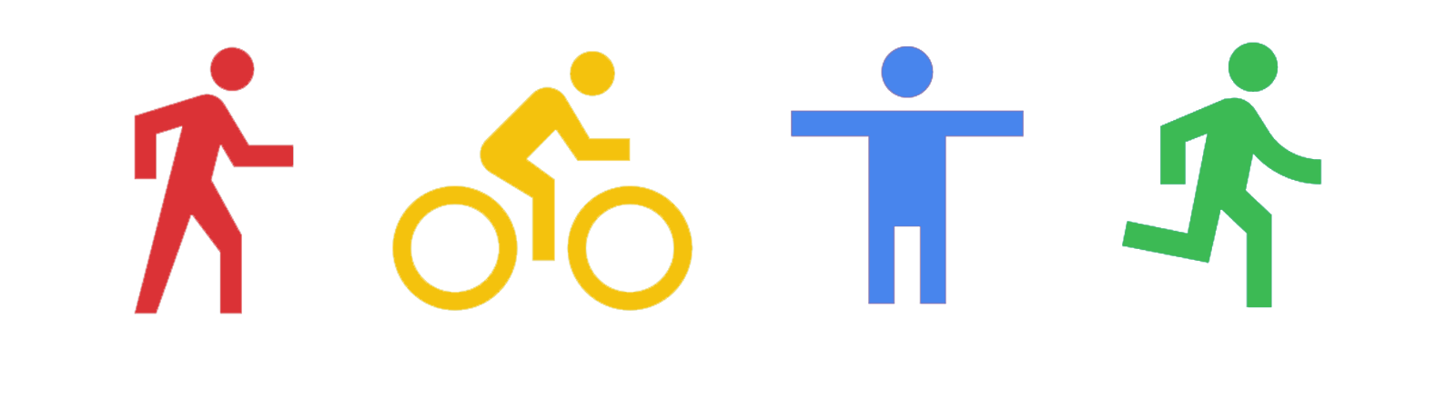

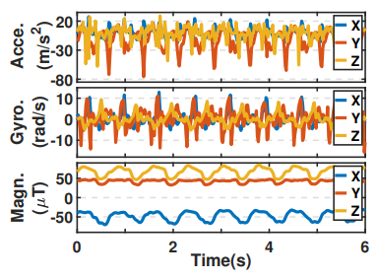
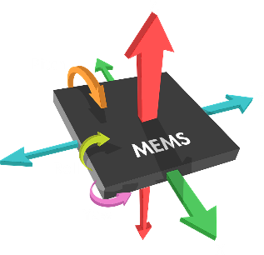
Human Activity Recognition
Inference
[1] Xu, Huatao, et al. "Limu-bert: Unleashing the potential of unlabeled data for imu sensing applications." Sensys 2021.

Slide 3
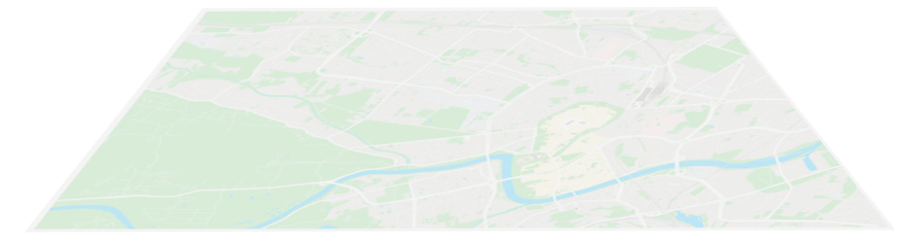









Human Activity Recognition
Practical adoption at scale.
Labeled Data
Unlabeled
Data

Slide 4
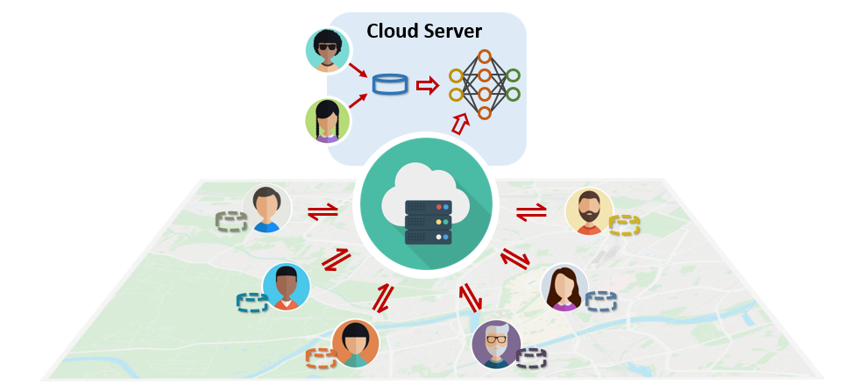
Human Activity Recognition
A universal Human Activity Recognition (HAR) scenario.
Source
Users
Limited and biased
Labeled Data
Target
Users
Massive and heterogeneous
Unlabeled Data

Slide 5
Human Activity Recognition
A universal Human Activity Recognition (HAR) scenario.
Source
Users
Adaptation
Target
Users

Slide 6

Prior Works
1. Supervised learning models.
Source
Users
Limited and biased
Labeled Data
Overfitted models
Target
Users
Massive and heterogeneous
Unlabeled Data

Slide 7
Prior Works
2. Foundation models,
e.g., LIMU-BERT.
Source
Users
Limited and biased
Labeled Data
Overfitted classifiers
Target
Users
Massive and heterogeneous
Unlabeled Data

Slide 8
Prior Works
3. Unsupervised domain
adaptation models.
Source
Users
Limited and biased
Labeled Data
Poor performance
Target
Users
Massive and heterogeneous
Unlabeled Data
There is still a gap in designing general HAR models!

Slide 9
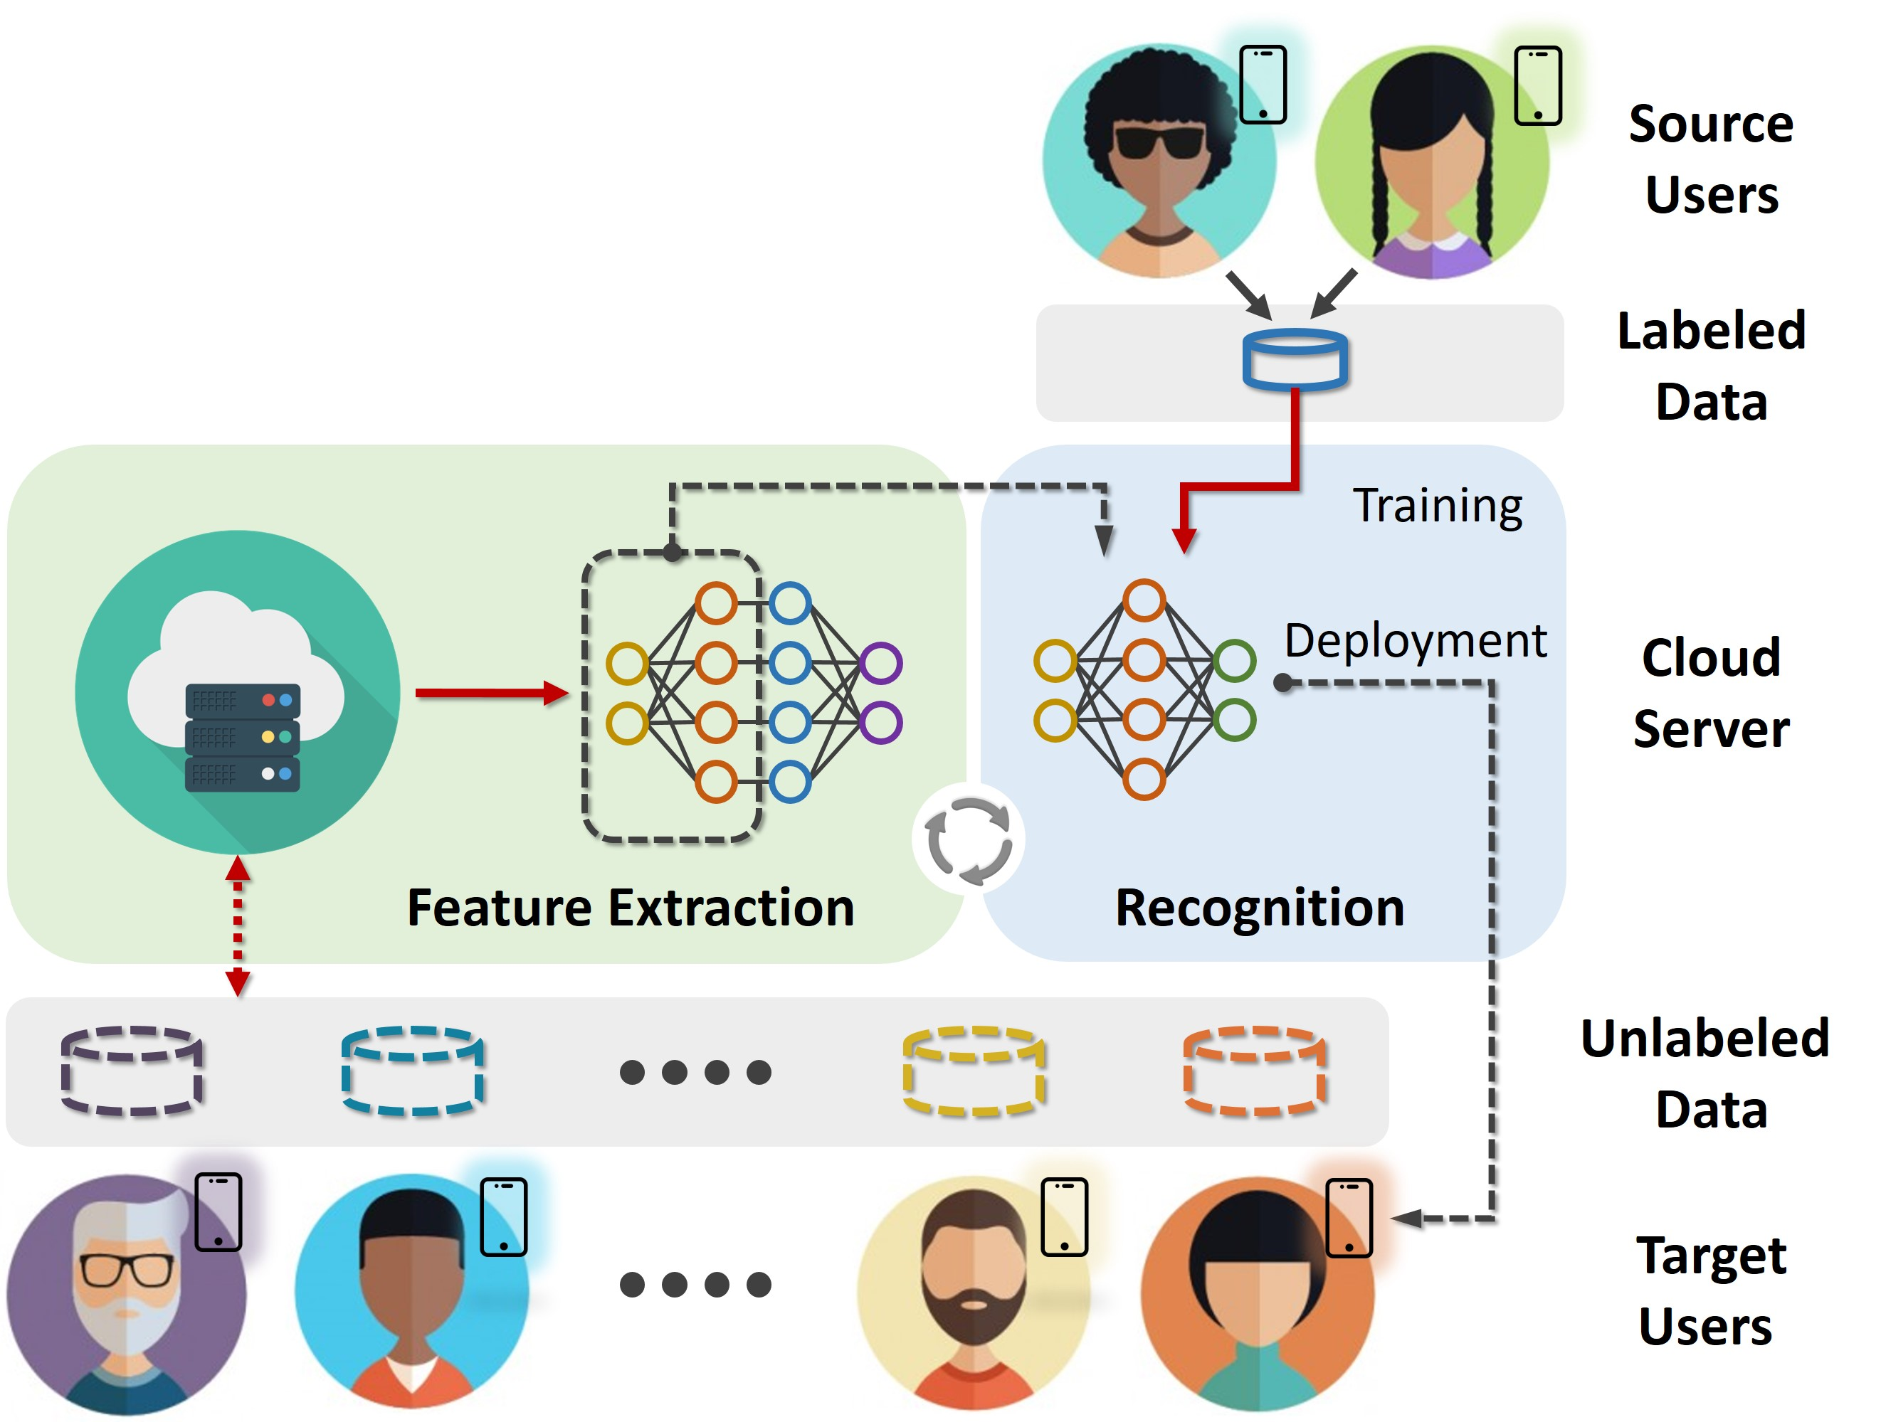

Key Challenge
How to combat data heterogeneity and extract generalizable features for activity recognition?
Solution1: Exploiting all available data with a two-stage framework.
Notes:
The two-stage framework alone is not good enough

Slide 10
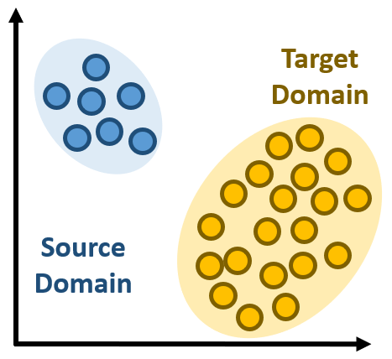
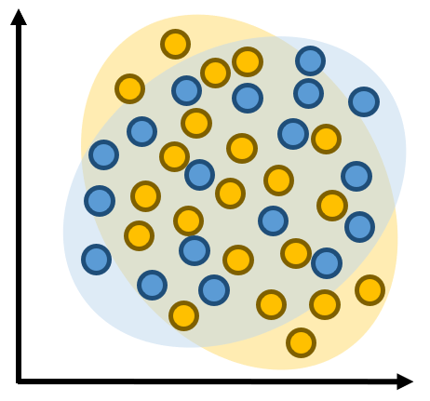
Key Challenge
How to combat data heterogeneity and extract generalizable features for activity recognition?
Solution2: Data augmentations with support of underlying physics.
Physics-based
Data Augmentation

Slide 11
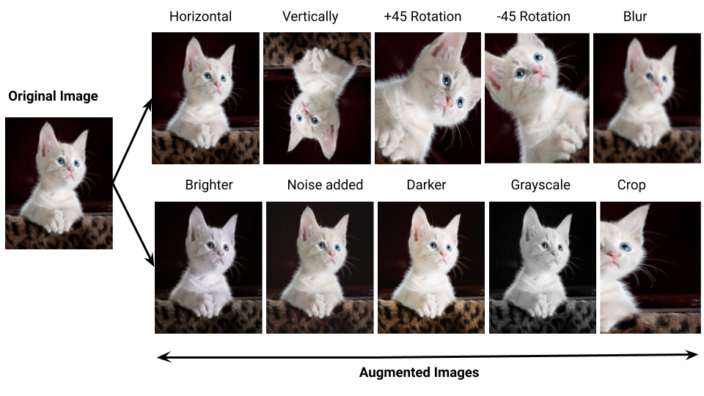

Data Augmentation
Data augmentation is a technique that enriches the dataset by creating modified copies of existing data.
[1] https://medium.com/@tagxdata/data-augmentation-for-computer-vision-9c9ed474291e.

Slide 12
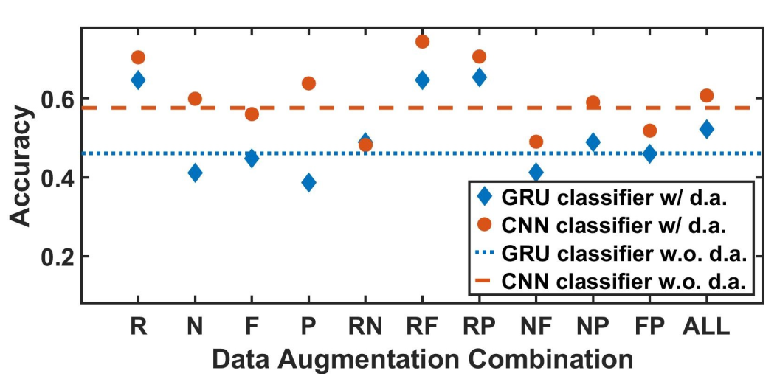
Data Augmentation
Applying existing data augmentations to activity recognition.
It is non-trivial to adopt data augmentation for activity recognition.

Slide 13
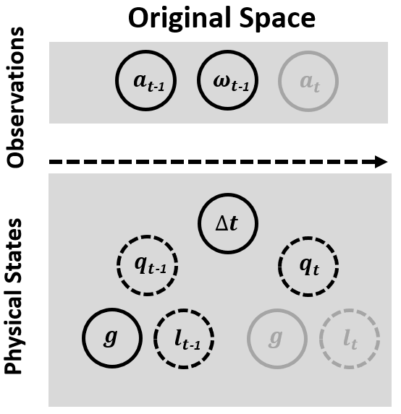
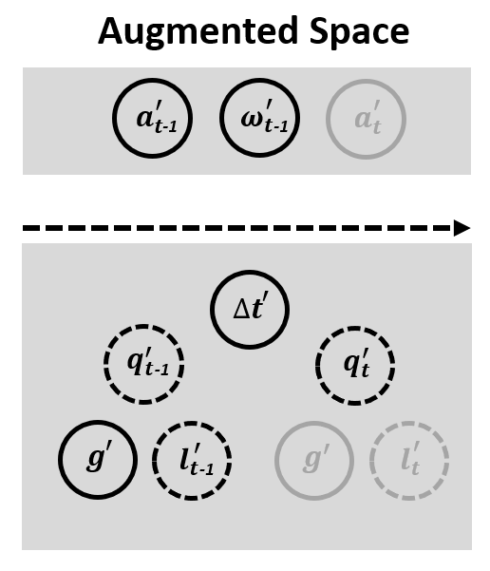


Data Augmentation
Why do most data augmentations fail to improve HAR performance?
Acc.
Gyr.
Acc.
Gyr.
How have underlying physical states changed?

Slide 14

Data Augmentation
Why do most data augmentations fail to improve HAR performance?
Unrealistic
Observations!
Acc.
Gyr.
Acc.
Gyr.
No Valid States

Slide 15

Physics-Informed Data Augmentation
Data augmentation should have a corresponding transition in physical states!
Realistic
Observations!
Acc.
Gyr.
Acc.
Gyr.

Slide 16
Physics-Informed Data Augmentation
Data augmentation should have a corresponding transition in physical states!
Acc.
Gyr.
Acc.
Gyr.
Physical
Embedding

Slide 17
Data
Augmentation
Has a physical embedding
Yes
No
Has deterministic
observations
Flaky Data
Augmentation
e.g., flipping
Yes
No
Complete Data
Augmentation
Approximate Data
Augmentation
Physics-Informed
Data Augmentation
e.g., local rotation
e.g., linear upsampling
Notes:
If you are interested in how to derive physical embedding for a data augmentation, check our paper for more details.

Slide 18
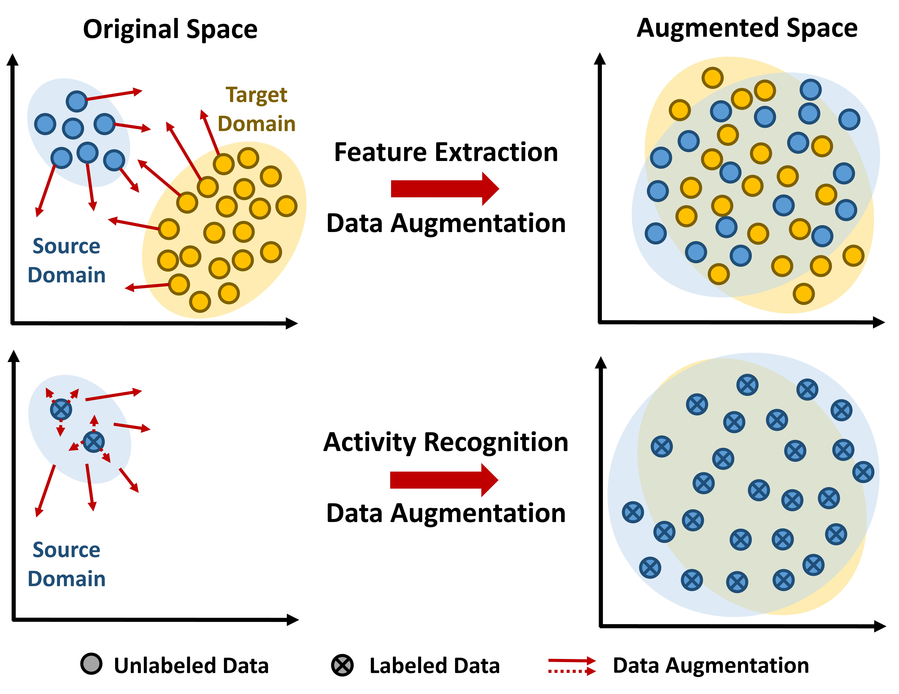
Data Augmentation Adoption
Integrating physics-informed data augmentations into the framework.
Complete data augmentation ✓
Approximate data augmentation ✗
Flaky data augmentation ✗
Complete data augmentation ✓
Approximate data augmentation ✓
Flaky data augmentation ✗

Slide 19

Our Solution
UniHAR: an universal human activity recognition framework.
Data-decentralized
scenario
Data-centralized
scenario
1
2
raw data
raw data
UniHAR + Federated learning
UniHAR + Domain adaptation

Slide 20
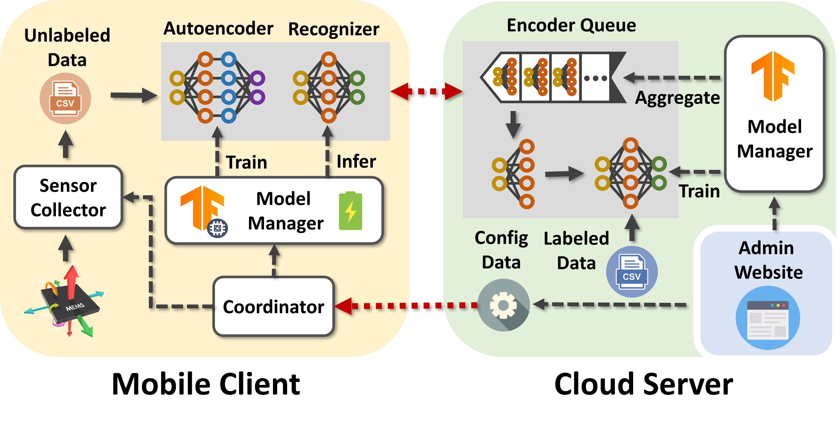
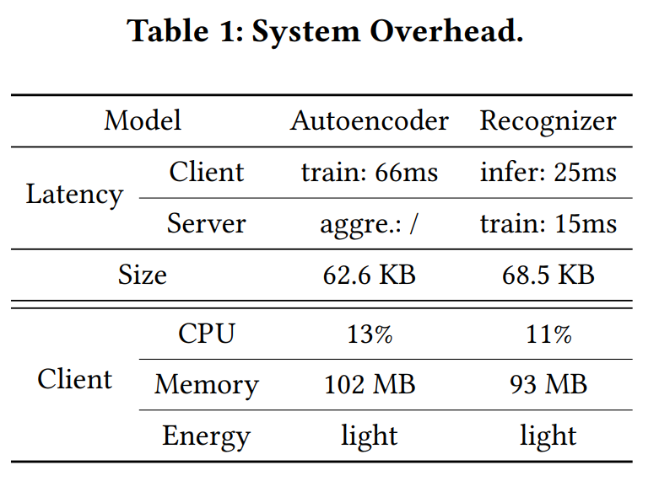
Implementation and System Evaluation
UniHAR is fully prototyped in mobile platform.

Slide 21
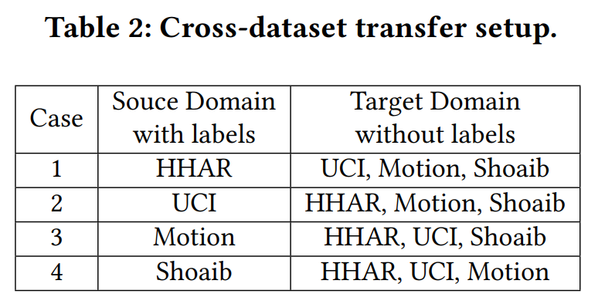
Comparative Evaluation
Open datasets: HHAR, UCI, Motion, and Shoaib.
Baseline models:
Data-decentralized scenario: MM’15-DCNN, IMWUT’19-TPN, and SenSys’21-LIMU-BERT.
Data-centralized scenario: PerCom’18-HDCNN, SECON’20-XHAR, and IMWUT’21-FM.
Cross-dataset experiments:
Merge the data with the same activity labels from four datasets.
Transfer models from one dataset to other three datasets without any labeled data.

Slide 22
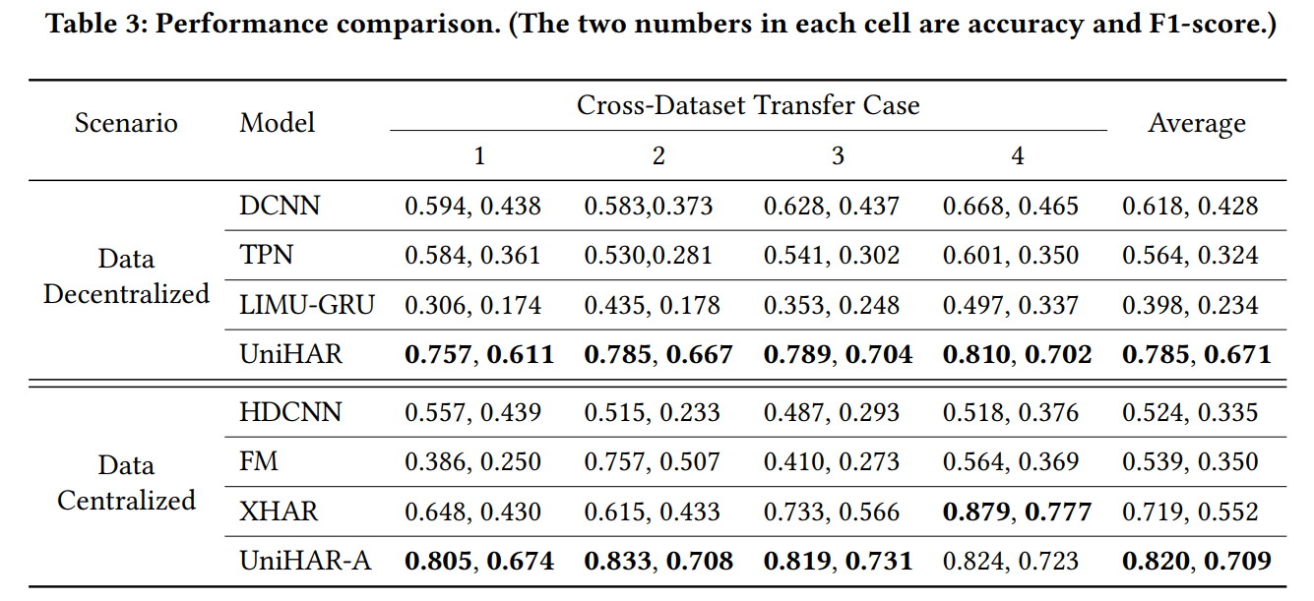
Comparative Evaluation
Overall performance.

Slide 23
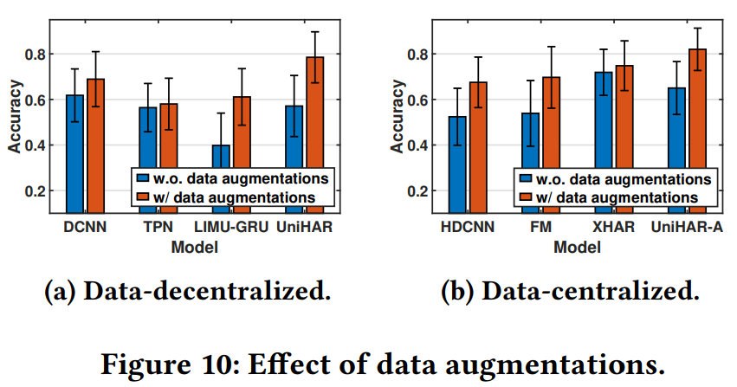
Comparative Evaluation
Effectiveness of physics-informed data augmentation.

Slide 24
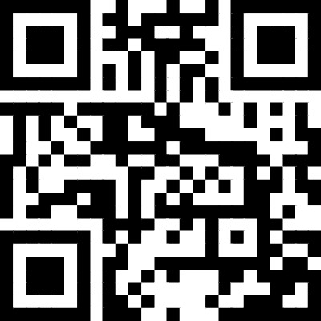
Conclusion
We consider a practical and challenging HAR scenario at scale.
We present a thorough analysis of IMU data augmentation methodology and characterize physics-informed data augmentations.
We integrates different data augmentation methods into a learning framework to address data heterogeneity.
We prototype UniHAR on the standard mobile platform and evaluate its generalization with practical settings across different datasets.
Scan to visit UniHAR

Slide 25
Thank you!
Q&A

Slide 26
Backup Slides

Slide 27
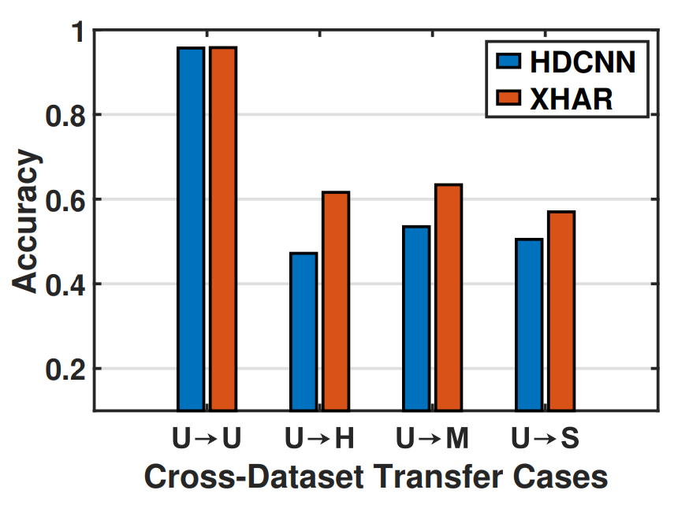
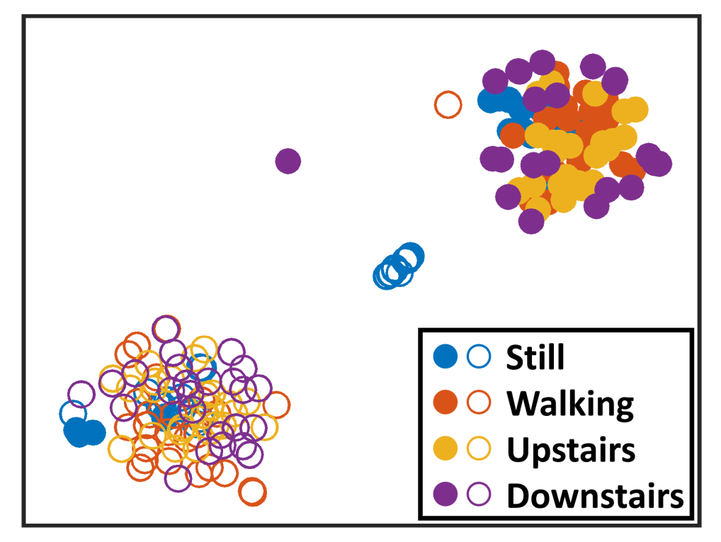
Prior Works
Preliminary experiments for unsupervised domain adaptation methods.
Dataset 1
Data Visualization
Dataset 2

Slide 28
Prior Works
Preliminary experiments for unsupervised domain adaptation methods.
Data Visualization
There is still a gap in designing general HAR models!

Slide 29
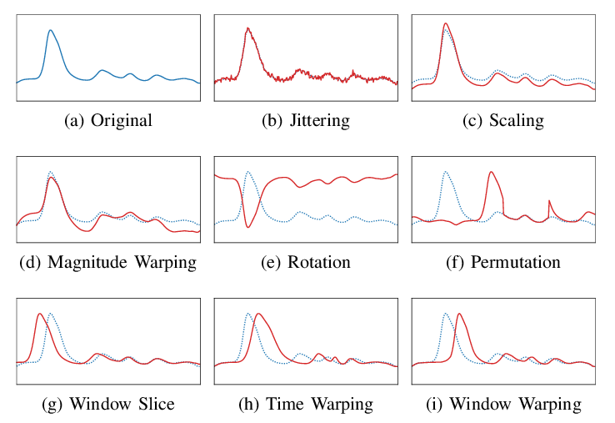
Data Augmentation
Data augmentation is technique that enriches the dataset by creating modified copies of existing data.
[1] Iwana, Brian Kenji, and Seiichi Uchida. "Time series data augmentation for neural networks by time warping with a discriminative teacher." ICPR2021.

Slide 30
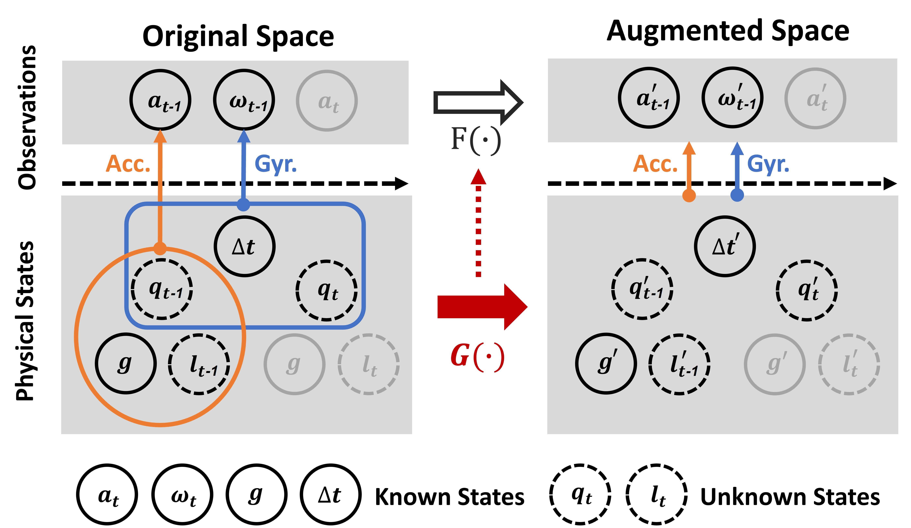
Physics-Informed Data Augmentation
Data augmentation model and physical embedding.
G(·) is a physical embedding of F(·)
if observations of the transformed physical states equal the augmented observations of F(·).

Slide 31
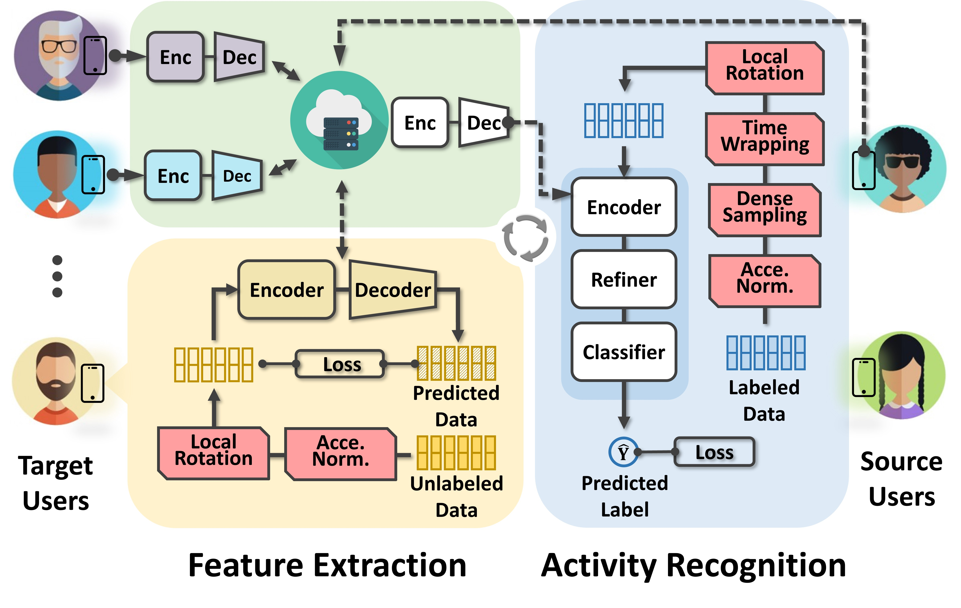
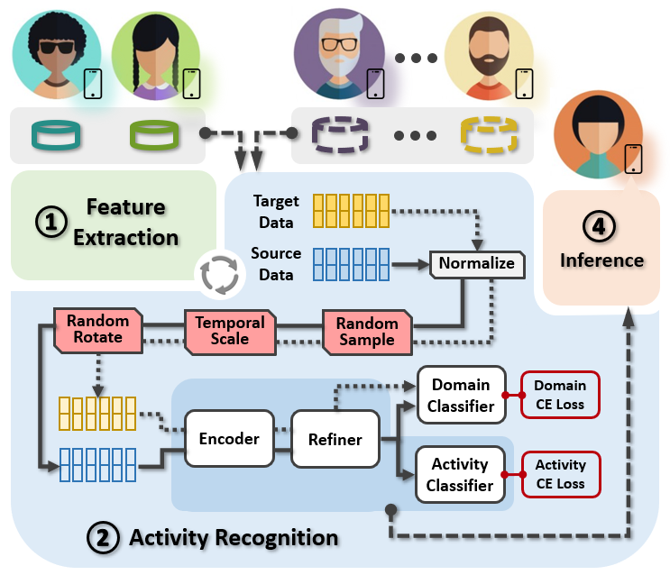
UniHAR
Data-decentralized scenario
(no raw data transmission)
Data-centralized scenario
(raw data transmission is allowed)

Slide 32
UniHAR Design
Data-decentralized scenario (no raw data transmission)
Feature extraction: self-supervised + federated learning with augmented unlabeled data.
Activity recognition : supervised learning with augmented labeled data.

Slide 33
UniHAR Design
Data-centralized scenario (raw data transmission is allowed)
Activity recognition : supervised learning with augmented labeled data + adversarial training with user labels.

Slide 34
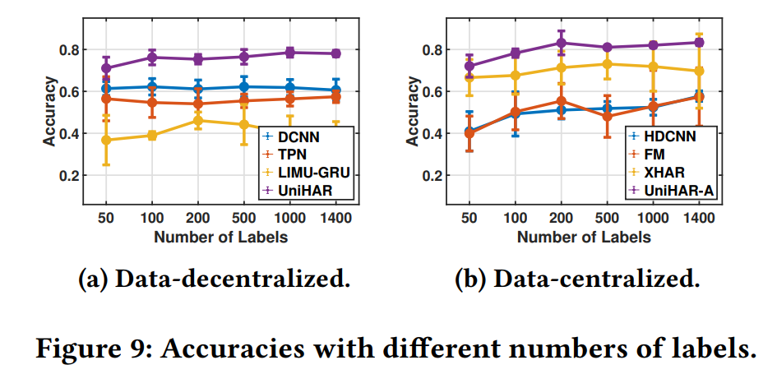
Comparative Evaluation
Varying number of labels.

Slide 35
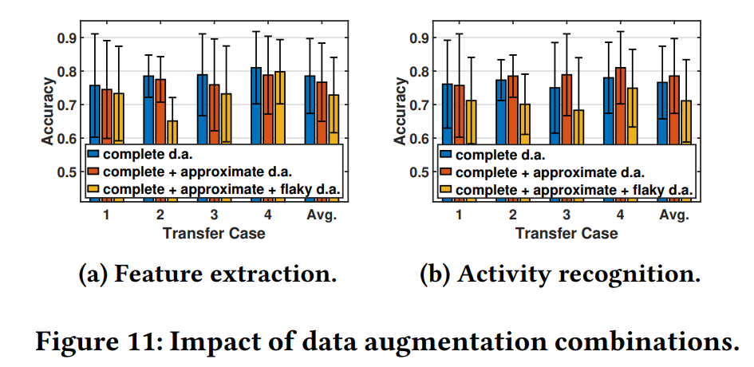
Comparative Evaluation
Varying data augmentation adoption strategies.

