Slide 1



Ne(RF)²: Neural Radio-Frequency Radiance Fields
Xiaopeng Zhao, Zhenlin An, Qingrui Pan, Lei Yang
The Hong Kong Polytechnic University

Slide 2
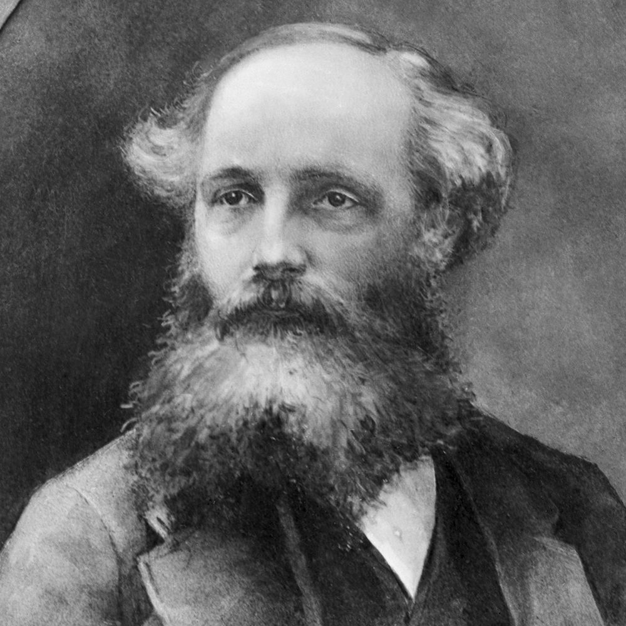
Precisely modeling the propagation of RF signals remains a long-standing problem
Complicated interactions between the RF signal and the obstacles

Slide 3
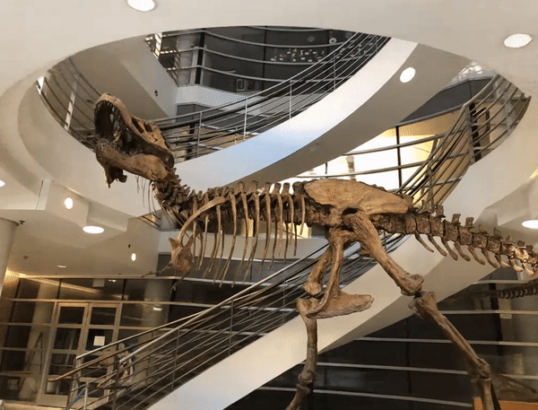

Optical NeRF:
Synthesize images from arbitrary view directions
B.Mildenhall etc., “NeRF: Representing Scenes as Neural Radiance Fields for View Synthesis,” in ECCV 2020.

Slide 4
Task Comparability
Pixel Array $⇒$ RF Ant. Array & Images $⇒$Spatial Spectra
Optical Pixel Array
RF Antenna Array
VS
The task similarity inspired our NeRF²

Slide 5
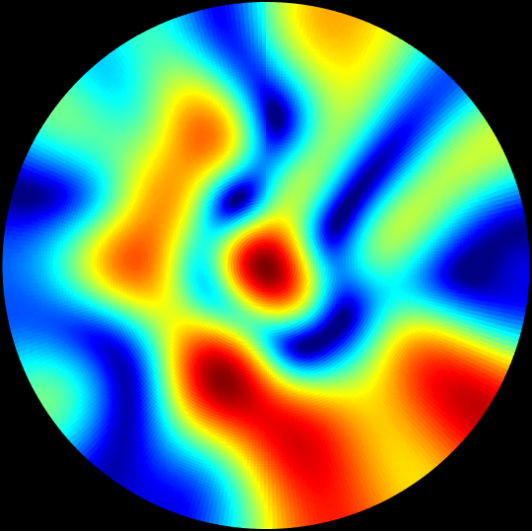
Problem: How to predict the received RF signals when TX/RX is located at an arbitrary position?
Predict received signal
when TX is here
RX
NeRF² represents a scene as a neural radiance field, which is trained by a small number of signal measurements

Slide 6
Background: Spatial Spectrum as Optical Image
Spatial spectrum shows the power of RF signals originating from all directions
Task: synthesize the spatial spectrum given the position of a TX/RX

Slide 7
Demo Video
https://xpengzhao.github.io/NeRF2/

Slide 8

NeRF² Design
The scene is discretized into 3D voxels
A direction is a path across a line of voxels
RX
A direction
$$ω$$
Discretize the scene into a finite number of 3D voxels

Slide 9
NeRF² Design
Voxels on a directional path become new radiation sources:
Emitting signals to RX along that direction
Diffraction
Reflection
Attenuation
Radiance
Direct Incident
RX
The Huygens–Fresnel principle suggests that a voxel can be considered as a new radiance source

Slide 10

NeRF² Design
MLP
Radiance
Attenuation
（P_{voxel,} $ω$, P_{TX}）
RX
Details refer to our paper
Similar to NeRF, two MLPs are trained to model the physical and radiative characteristics of each voxel

Slide 11
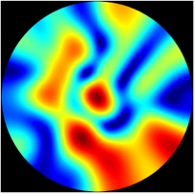
NeRF² Design
The result of ray tracing is an accumulation of radiations of voxels on the direction
Predict the received signal at the direction
Integral along the direction
RX
Taking ray tracing to know the RF signal from this direction

Slide 12
NeRF² Design
Predict the received signal at all directions
Integral along all directions
RX
A spatial spectrum is a result of ray tracing across all potential directions

Slide 13
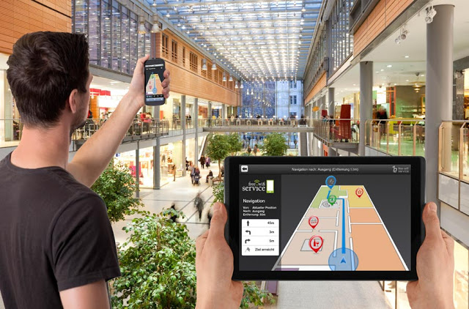
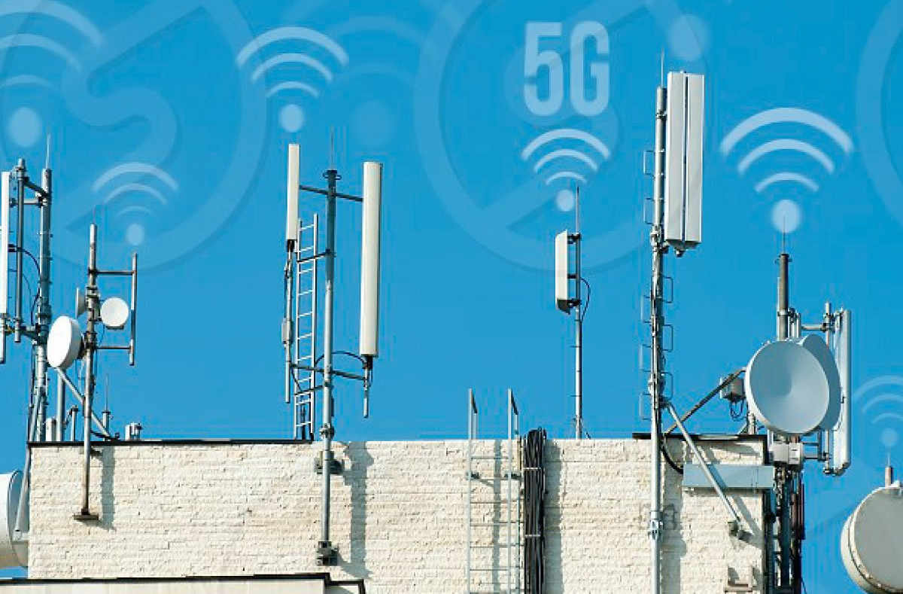
What is NeRF² used for?
Indoor Localization
5G FDD MIMO

Slide 14
Case 1: Augmented Localization by NeRF²
Deep learning-based AoA estimation algorithm requires a large number of samples
Synthesizing samples at arbitrary locations by NeRF²

Slide 15
NeRF² can synthesize more training samples
collect 1000 training samples
Use 1000 samples to train NeRF²
Use NeRF² to generate extra 9000 samples
Train a DNN localization model with (1000 + 9000) samples
The quality of the synthetic dataset generated by NeRF² is as good as the true dataset

Slide 16
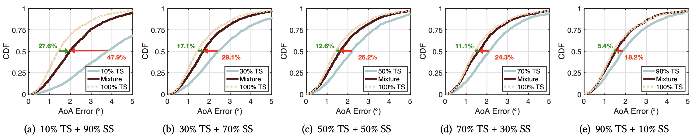
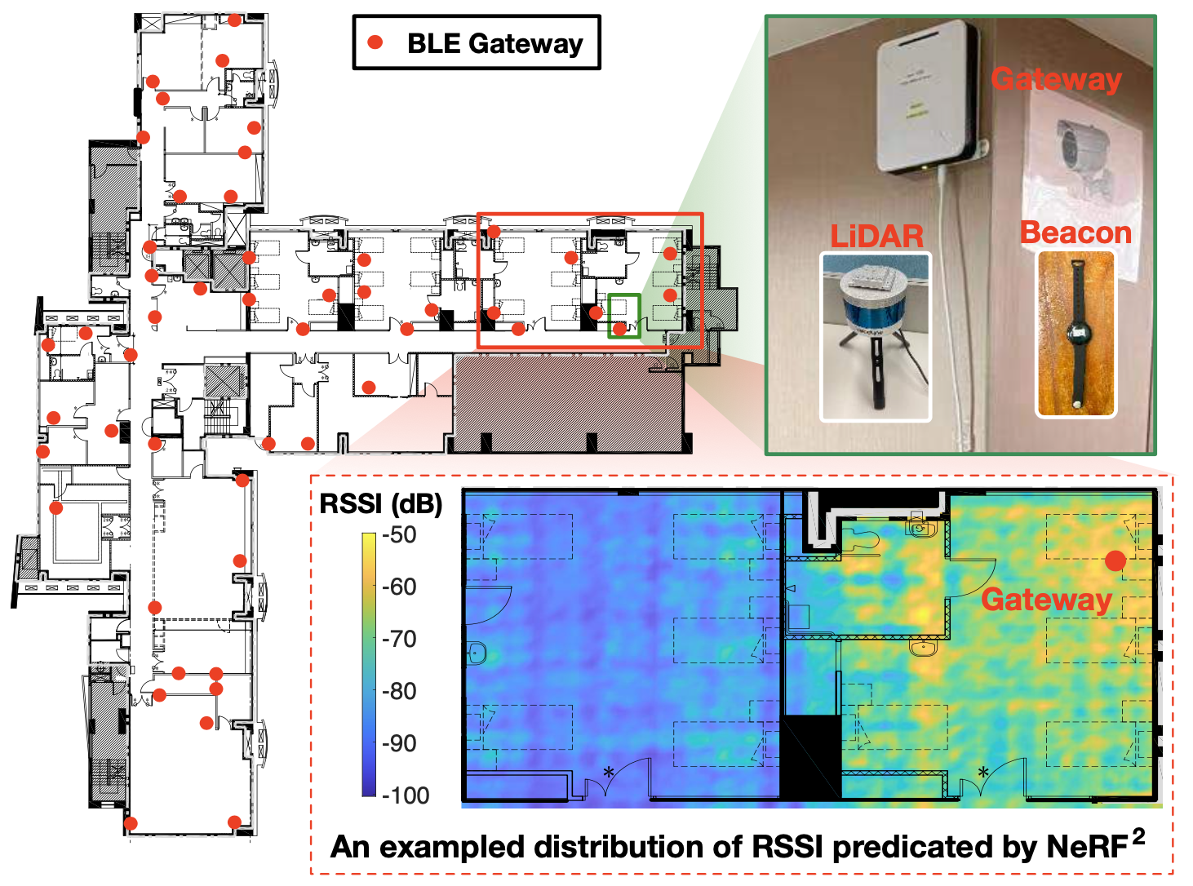
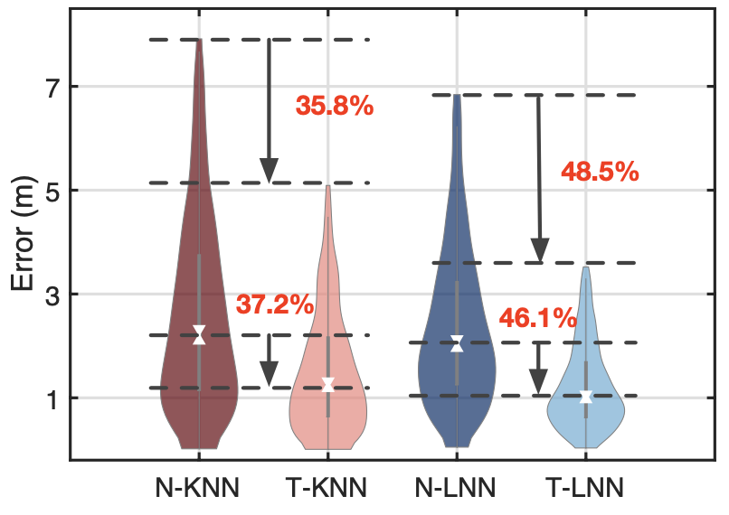
NeRF² can synthesize more training samples
Notes:
10‘

Slide 17
Case 2: Channel Estimation/Prediction
1. Report presence
2. Pilot tone
Uplink Channel in frequency 1
Downlink Channel in frequency 2
3. Send back the CSI
5G FDD base stations employ two different frequencies for the uplink and downlink
How to estimate the downlink channel using the uplink parameters?

Slide 18

Use NeRF² to help FDD channel prediction
MLP
Radiance
Attenuation
（P_{voxel,} $ω$, Uplink CSl ）
RX
Using the uplink as a location indictor (location) to predict the downlink beamforming parameters

Slide 19
Use NeRF² to help FDD channel prediction
2
NeRF² is 5.97 dB better SNR than the STOA work

Slide 20

Conclusion
We translate the neural radiance field to the RF domain.
We propose the NeRF²-enabled turbo-learning.
We conduct real-life field studies in terms of RFID, BLE, and 5G systems.
Our code is available here!
Notes:
12‘

