Slide 1
Robust Real-time Multi-vehicle Collaboration on Asynchronous Sensors
Qingzhao Zhang†*, Xumiao Zhang†*, Ruiyang Zhu†*,
Fan Bai‡, Mohammad Naserian‡, Z. Morley Mao†
(*equal contributions) †University of Michigan ‡General Motors
Oct. 3, 2023

Slide 2
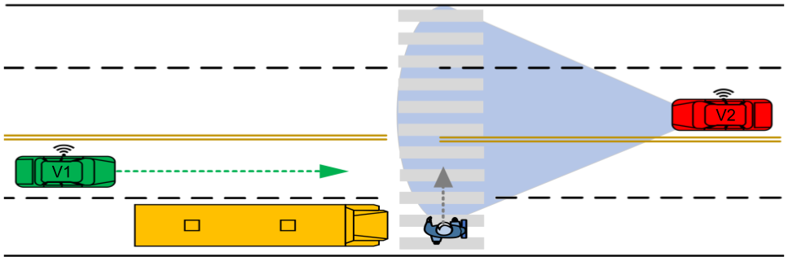
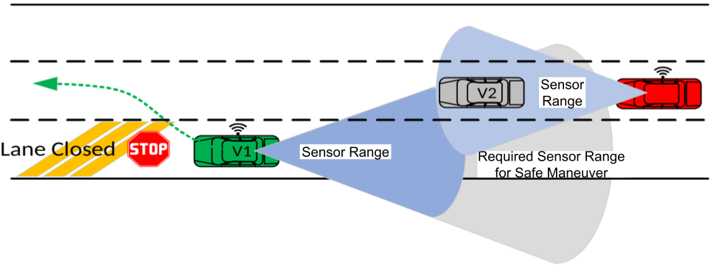
Why cooperative perception?
Limited sensing on occluded or far-away objects
Occluded pedestrian
Far-away obstacles
Notes:
Connected and autonomous vehicles, are equipped with sensors to form a preception about their surrondings. The quality of the perception is critical for vehicle safety.
Naturally, sensors have effective range that is limited (for example a Lidar effective range is around 80-100 meters).
Also, Potentislly sensors’ field of view can be occulded by obstacles.
See the scenario on the top immage: the green vehicle fails to detect the pedestrian on the crosswalk because of the occlusion.
In the second scenario, the green CAV fails to observe a fast moving vehicle approaching from the rear because it is too far away. However, we can see there is another red CAV who can observe the critical objects and thus can potentially help the green CAV.
This brings out the proposal of cooperative perception. Various cooperative perception systems have been proposed recently and they demonstrated the significant benefits on perception coverage and accuracy.
However, existing cooperative perception schemes suffer from inaccuracies.

Slide 3
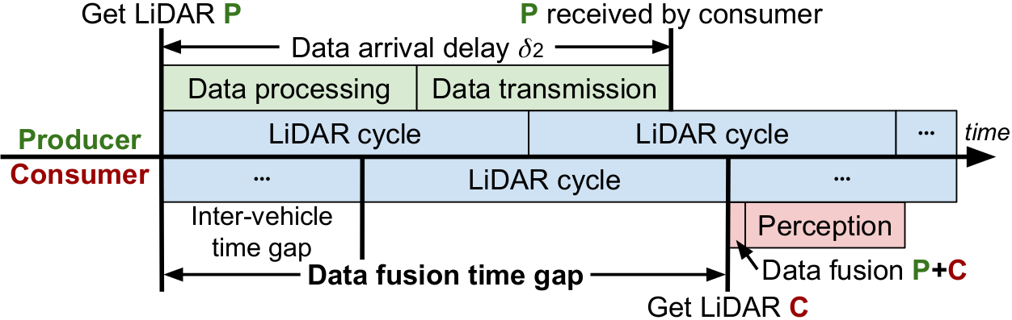
Motivation 1: synchronization problem
In multi-vehicle collaboration, the LiDAR images to be merged is not captured on the same timestamp.
Consumer is the vehicle receiving LiDAR data;
provider is the vehicle providing LiDAR data.
Notes:
The first challenge is the synchronization of LiDAR images. There is a timestamp gap between LiDAR images from different veicles that can be significat because of the LiDAR frequency and transmission delay. This problem has not explicitly discussed and addressed in previous works.
The producer vehicle is sending a LiDAR image to the consumer vehicle, and the consumer will merge the received image with its local image for perception. LiDAR sensor has a scan cycle and produces images periodically, let say every 100 ms. The producer’s LiDAR and the consumer’s LiDAR are not producing images on the same timeline, which is the inter-vehicle time gap.
On the other hand, the producer’s image has time delay due to data processing and transmission before it can be received by the consumer, which is the data arrival delay. To understand how asynchronous the LiDAR images can be, we need to evaluate the data fusion time gap, which is the timestamp difference between the producer’s LiDAR image and the consumer’s LiDAR image.
(Potential question. This is nothing to do with clock synchronization protocols, and we assume good clocks.)

Slide 4
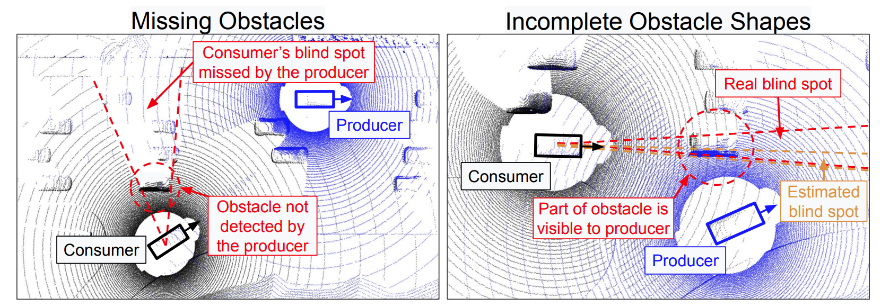
Motivation 2: inaccurate blind spot estimation
Existing systems trend to share sensor data about blind spots only.
However, inaccurate blind spot estimation compromise the sharing efficiency
e.g., AutoCast^{[1]} estimate blind spots based on observed objects and naive ray casting.
[1] Qiu, Hang, et al. "AutoCast: scalable infrastructure-less cooperative perception for distributed collaborative driving." Proceedings of the 20th Annual International Conference on Mobile Systems, Applications and Services. 2022.
Notes:
There is a limitted bandwidth in Vehicle communication. It makes sense to share only the areas of the lidar image that are needed by the consumer (only blind spots). AutoCast (previous related work), for example, requires producers to estimate blind spots of consumers based on the relative locations of the consumer and known obstacles. However, such estimation could be inaccurate.
In the figure, we show two scenarios where producer can fail to accuratly estimate the blind spot areas.
(on the left) Obstacle causing the blind spots is not detected by the producer so the producer misses important sensor data to share. In the scenario on the right, the size (width) of the obstacle causing the blind spot is not known to the producer that can lead to errors in blind spot estimation.
We are going to make the data sharing occlusion-aware more accurate and smart.

Slide 5
Overview
Q: Synchronization problem?
A: Prediction
Leverage prediction algorithms to synchronize LiDAR point clouds.
Q: Accurate blind spot estimation?
A: On-demand data sharing
Let consumers proactively request data they need.
Notes:
Our proposed system aims to resolve the two problems mentioned.
For the synchronization problem, we leverage prediction algorithms to synchronize LiDAR point clouds to the same timestamp, mitigating the misalignment.
For the blind spot estimation challenge, we propose on-demand data sharing protocol, where consumers proactively request data that they need.
It sounds straightforward but these two features are not easy to implement in a real-time system because they require a lot of data dependencies and burdens the data transmission.
Our key contribution is the system design which achieves real-time execution of data synchronization and intelligent data sharing, with only minor extra latencies.

Slide 6
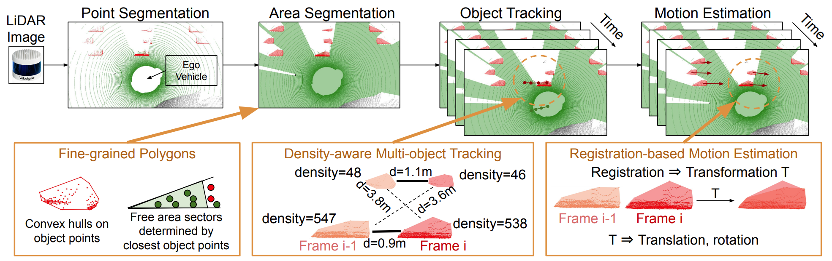
For all CAVs, share occupancy maps
The map labels occupied, free, and occluded areas
Notes:
We require all participating CAVs to share an “occupancy map” ideally in each LiDAR cycle. This is a 2D map that basically labels occupied, free, and occluded areas along with motion information of occupied areas.
We design a pipeline of data processing: ground detection and clustering. We first segment the 2D space into the three categories, then multi-object tracking links the same occupied area across continuous frames, and finally point cloud registration and motion model assigns each moving occupied area a motion vector (including linear and angular velocity).
This occupancy map plays an important role in both prediction and blind spot estimation.

Slide 7
For consumers, prepare data requests
Make a plan of data sharing for the next LiDAR cycle
i.e., which producer share which area
Producers’ occupancy maps
Occupancy map prediction
Synced occupancy maps
Data scheduling
Data requests for next frame
Local occupancy map
Occupancy map prediction
Occlusion-aware
Notes:
The consumer collects latest occupancy maps from itself and all available producers perodically and synchronize them to the next LiDAR cycle time. The consumer plans for the future and it is the key design to make the system real-time. Otherwise, if the consumer requests data for its current use, the latency of communication and data processing will make the data far out-dated.
After the synchronization, the consumer makes a schedule of data sharing, i.e., which producer should share data on which area. This data scheduling relies on the occupancy maps to know which area is visible to the producers and which area is invisible to the consumer. Finally, the consumer sends data requests to producers accordingly.

Slide 8
For producers, share requested data
Share the latest point cloud on the requested areas, and synchronize the point clouds to the requested timestamp.
List of areas and a timestamp
Data request
Point cloud prediction
Synced LiDAR point cloud
LiDAR point cloud
Notes:
The producer on the other hand makes responses to the data requests. Each data request contains a set of areas and a timestamp when the consumer is going to use the data. On receiving the request, the producer needs to synchronize its latest LiDAR point cloud to the requested timestamp via point cloud prediction and sends the data to corresponding consumer by the deadline. The consumer can then merge its requested sensor data and perform its perception.

Slide 9
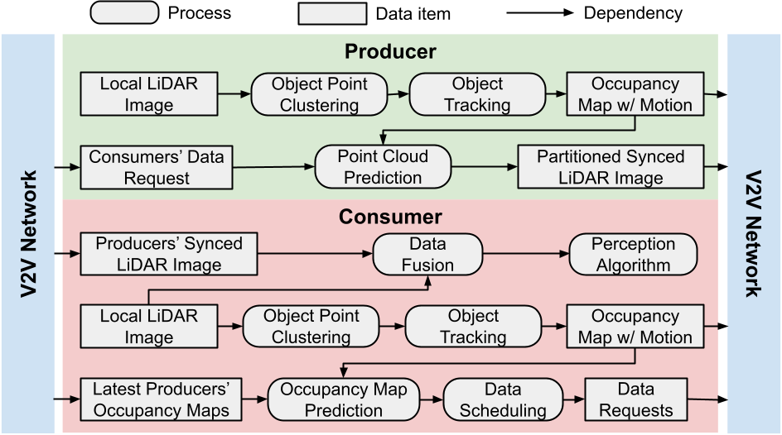
Execute all processes in parallel
Compared with single-CAV perception, the only delay is from data fusion.
Notes:
So far we talked about occupancy map sharing, consumers’ data requests, and producers data responses. These processes are executed simultaneously and whitin a LiDAR cycle. The paralel pipeline does not add extra latency on the perception. Whenever the consumer needs the perception, it simply merges all latest sensor data requested in the last LiDAR cycle.
The only extra minor delay is the merging operation.

Slide 10
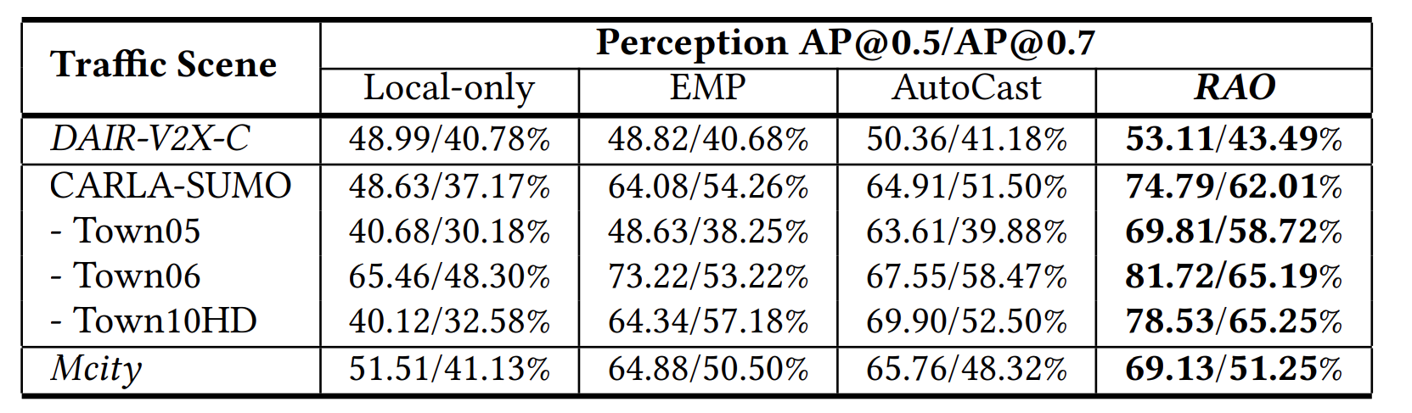
RAO Perception Benefits and performance
RAO achieves the best perception accuracy compared with EMP^{[1]} and AutoCast^{[2]}.
We used various simulated and real-world datasets,
We used PointPillars as the perception model.
[1] Zhang, Xumiao, et al. "Emp: Edge-assisted multi-vehicle perception." Proceedings of the 27th Annual International Conference on Mobile Computing and Networking. 2021.
[2] Qiu, Hang, et al. "AutoCast: scalable infrastructure-less cooperative perception for distributed collaborative driving." Proceedings of the 20th Annual International Conference on Mobile Systems, Applications and Services. 2022.
Notes:
We evaluated RAO using various datasets, including the simulated data from Carla and SUMO simulators, the real-world dataset DAIR-V2X-C, and our new dataset collected from MCity testbed located at the University of Michigan. We compared RAO with two previous work EMP and AutoCast.
To make the comparison fair, we use the same perception model PointPillars in all tests. RAO outperforms EMP and AutoCast in terms of the average precision of perception, which is a common metric for perception accuracy.

Slide 11
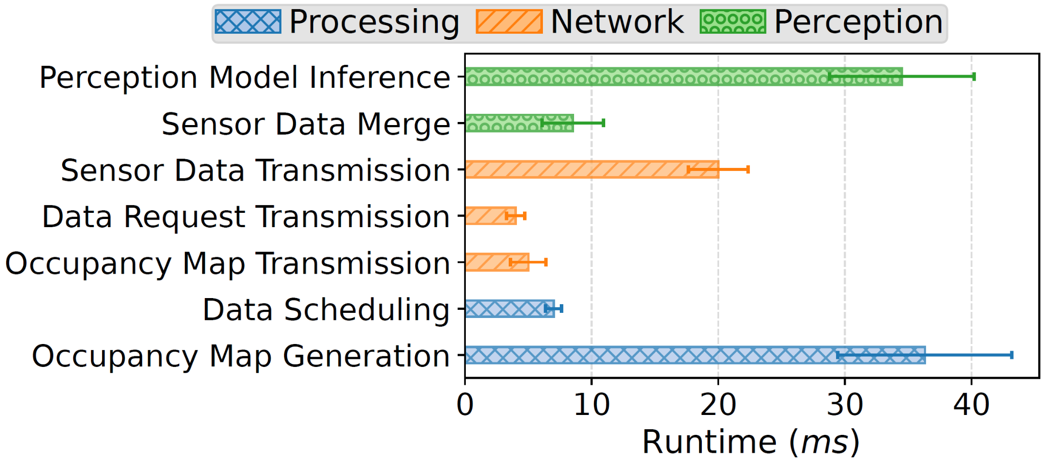
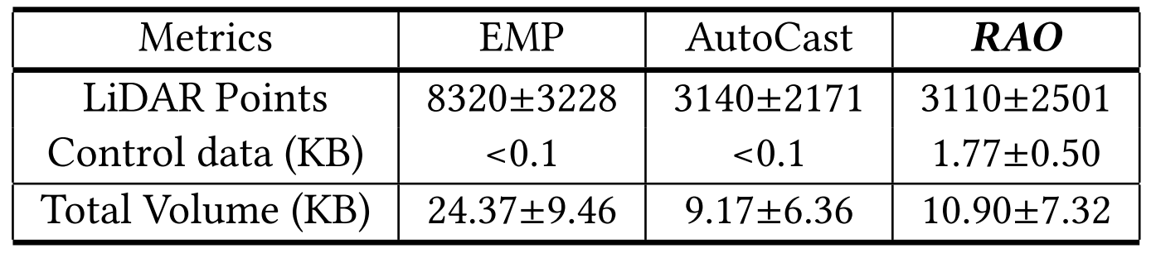
System Overhead - Latency & Data Volume
The total avg latency of all the modules is 80.82 ms (14.40 ms variance)
RAO can process LiDAR at regular full frame rate of 10 FPS
RAO incurs similar data overhead compared to the STOA approach
Notes:
Also we measured the overhead of RAO. We proved that RAO can be fitted in 10 FPS LiDAR cycles. The data transmission overhead is acceptable for current vehicular networks, and is not larger compared to previous work. We optimize the data structure of occupancy maps and make it as small as 0.1 KB.

Slide 12
Summary
Thank You!
RAO is a real-time occlusion-aware cooperative perception system running on asynchronous sensors.
RAO tackles two problems in existing cooperative perception.
Use prediction methods to mitigate sensor asynchronization.
Use on-demand data sharing to optimize data scheduling.
Notes:
RAO is a real-time occlusion-aware cooperative perception system running on asynchronous sensors.
RAO tackles two problems in existing cooperative perception.
Use prediction methods to mitigate sensor asynchronization.
Use on-demand data sharing to optimize data scheduling.

